Slide 1
CasperJS Introduction
Agenda :
Background to CasperJS and its purpose .
Demo of CasperJS
Introduce Sherlock
Demo of Sherlock

Slide 2
CasperJS Introduction
What Is CasperJS ?
CasperJS is a navigation scripting & testing utility for PhantomJS and SlimerJS (still experimental). It eases the process of defining a full navigation scenario and provides useful high-level functions and methods for doing common tasks such as:
      defining & ordering navigation steps
      filling forms
      clicking links
      capturing screenshots of a page (or an area)
      making assertions on remote DOM

Slide 3
CasperJS Introduction
What Is CasperJS ? – Continued
    logging & events
    downloading resources, even binary ones
    catching errors and react accordingly
    writing functional test suites, exporting results as JUnit XML (xUnit)

Slide 4
CasperJS Introduction
How CasperJS Works :
As Stated earlier CasperJS runs on top of either PhantomJS or SlimerJS
PhantomJS
    PhantomJS is a scripted, headless browser used for automating web page interaction. PhantomJS provides a JavaScript API enabling automated navigation, screenshots, user behavior and assertions making it a common tool used to run browser-based unit tests in a headless system like a continuous integration environment. PhantomJS is based on WebKit making it a similar browsing environment to Safari and Google Chrome (before Chrome's fork of WebKit evolved into Blink). It is open-source software released under the BSD License.

Slide 5
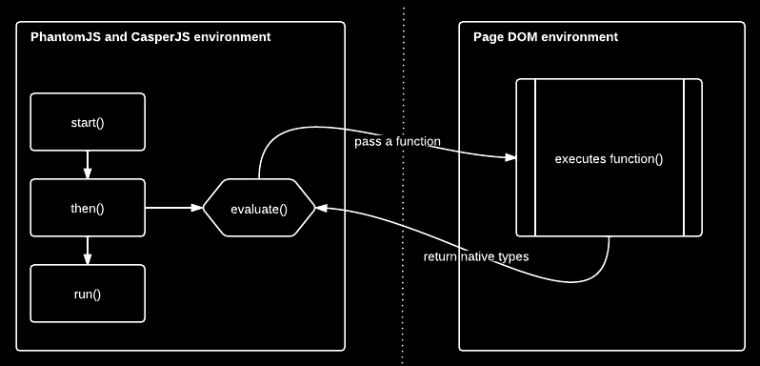
CasperJS Introduction
How CasperJS Works :
As Stated earlier CasperJS runs on top of either PhantomJS or SlimerJ
PhantomJS

Slide 6
CasperJS Introduction
How CasperJS Works -continued:
SlimerJS
    SlimerJS is a scriptable browser, aiming to keep the same API as PhantomJS, but built on top of Gecko (i.e. Firefox) instead of on top of WebKit.
    Although officially not fully headless yet there are two ways of doing so that I am aware of.
        XVFB (X virtual framebuffer)
        Xvfb is a display server implementing the X11 display server protocol. In contrast to other display servers, Xvfb performs all graphical operations in virtual memory without showing any screen output.

Slide 7
CasperJS Introduction
How CasperJS Works -continued:
SlimerJS -continued
    The second way is:
        Mozilla Firefox-Nightly (build firefox-55.0a1)
        From this build onward gecko will be capable of been ran fully headless thus so can SlimerJS without the need of Xvfb.
The main reason for using CasperJS instead of PhantomJS or SlimerJS natively is the CasperJS API is much easier to use and provides additional features such as the mouse module also if you run CasperJS with SlimerJS you have access to both SlimerJS and PhantomJS API.

Slide 8
CasperJS Introduction
Installation advice & practical demo
Link to HEAnet Gitlab CasperJS install page:

Slide 9

SherlockWebsite Monitor
Agenda :
Background to Sherlock and its purpose .
Demo of Sherlock

Slide 10
SherlockWebsite Monitor
Background to Sherlock and its purpose:
HEAnet clients have multiple online resources which are accessed by users via their institutional credentials and funded by the HEA.
The login for this is either or IP via Edugate (HEAnet's federated access service).
Example http://dl.acm.org/

Slide 11
SherlockWebsite Monitor
Background to Sherlock and its purpose:
Clients pay premium prices for these services.
Clients rely on the publisher for login rates and performance data.
at present, clients do not monitor this data against the SLA.
Students are often left to report issues as they arise.

Slide 12
SherlockWebsite Monitor
Technical architecture

Slide 13
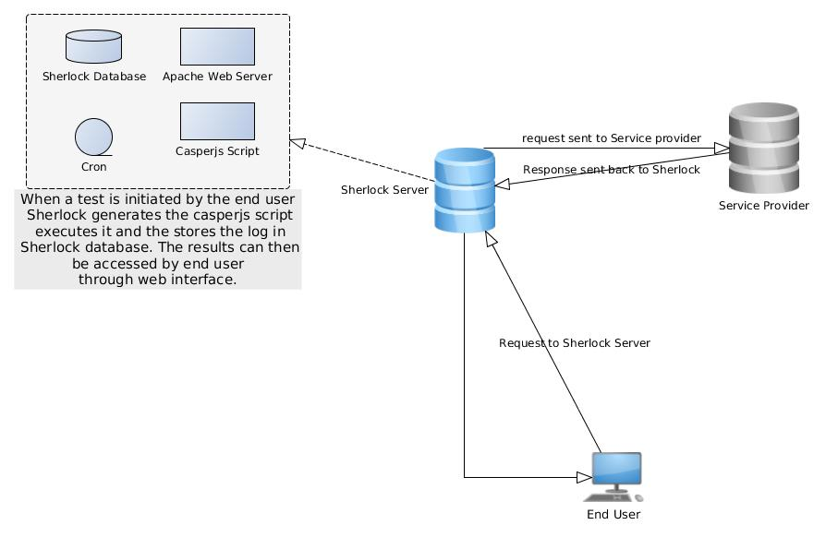
SherlockWebsite Monitor

Slide 14
SherlockWebsite Monitor
Sherlock is intended to provide performance and uptime checks of Edugate protected resources.

Slide 15
SherlockWebsite Monitor
Sherlock Demo

