Slide 1

SQL 4
Hunter Bartlett
ISIN 325 Database Security
Dr. Greg Gogolin

Slide 2
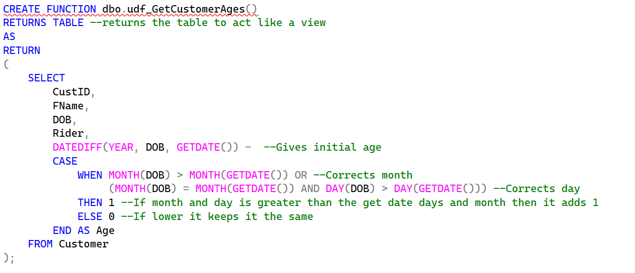
Create a Function to Get Ages Based on DOB

Slide 3
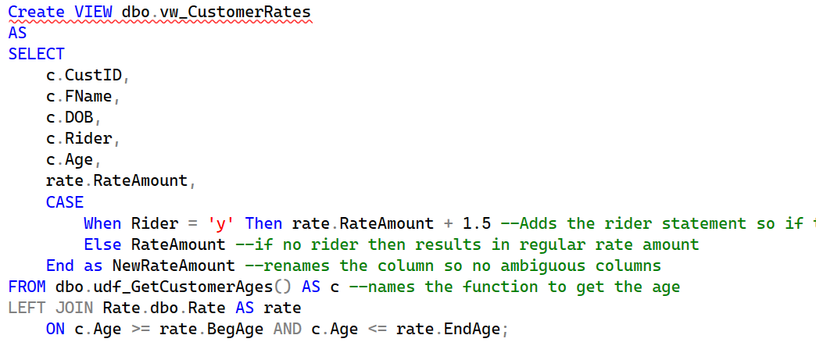
Create View to get Rate Amount from Rate Table While Including Rider

Slide 4
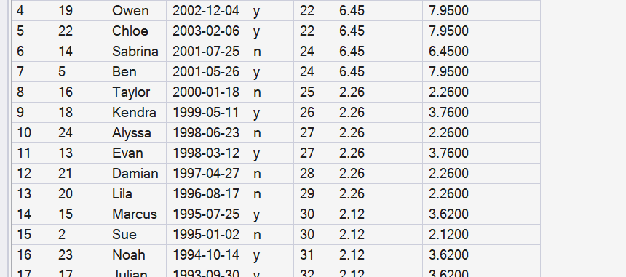
Completed Table of Rates With New Rate With Riders

