Slide 1

SQL 3
Hunter Bartlett
ISIN 325 Database Security
Dr. Gogolin

Slide 2
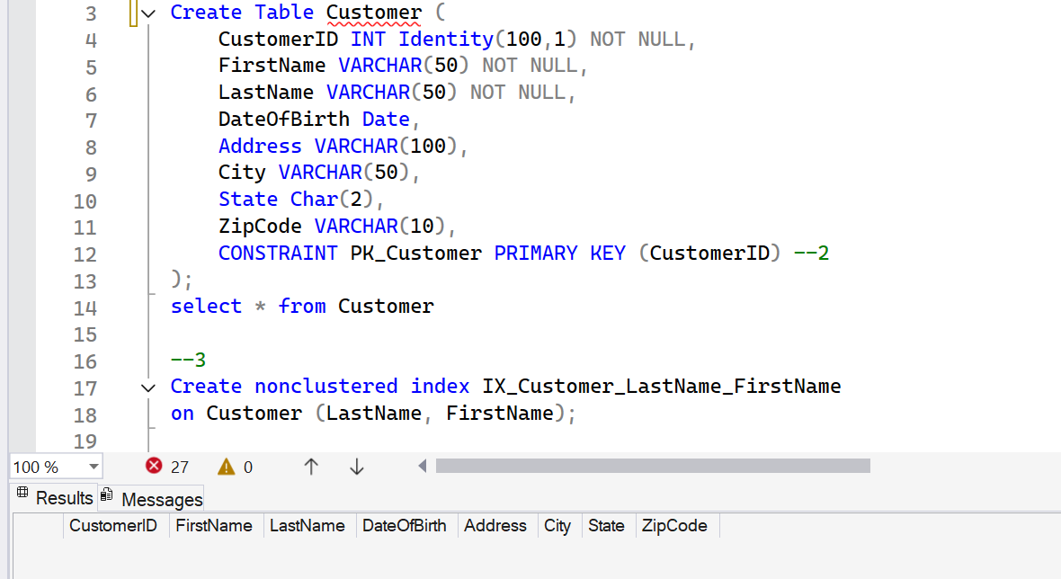
1) SQL to create a Customer table using appropriate data types that has the following columns: CustomerID, First Name, Last Name, Date of Birth, Address, City, State, Zip Code. CustomerID must be defined as an identity field that starts with 100.
2) SQL to define the primary key in the CustomerID column. (SQL must not be generated)

Slide 3
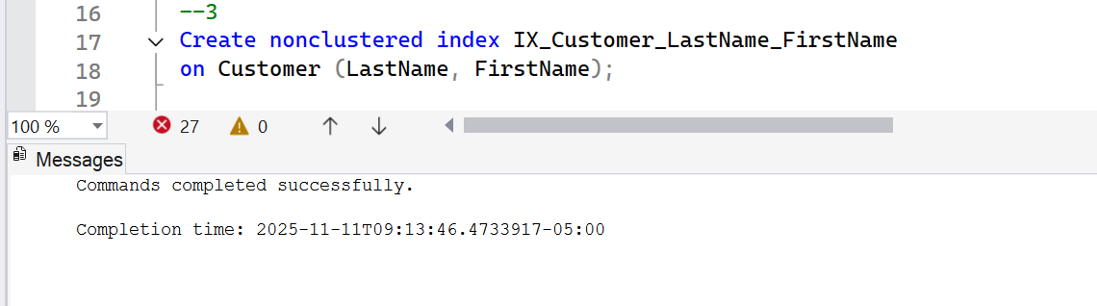
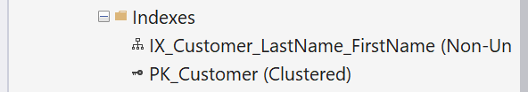
3) SQL to define an index using the primary key and a second index using Last Name and First Name.

Slide 4
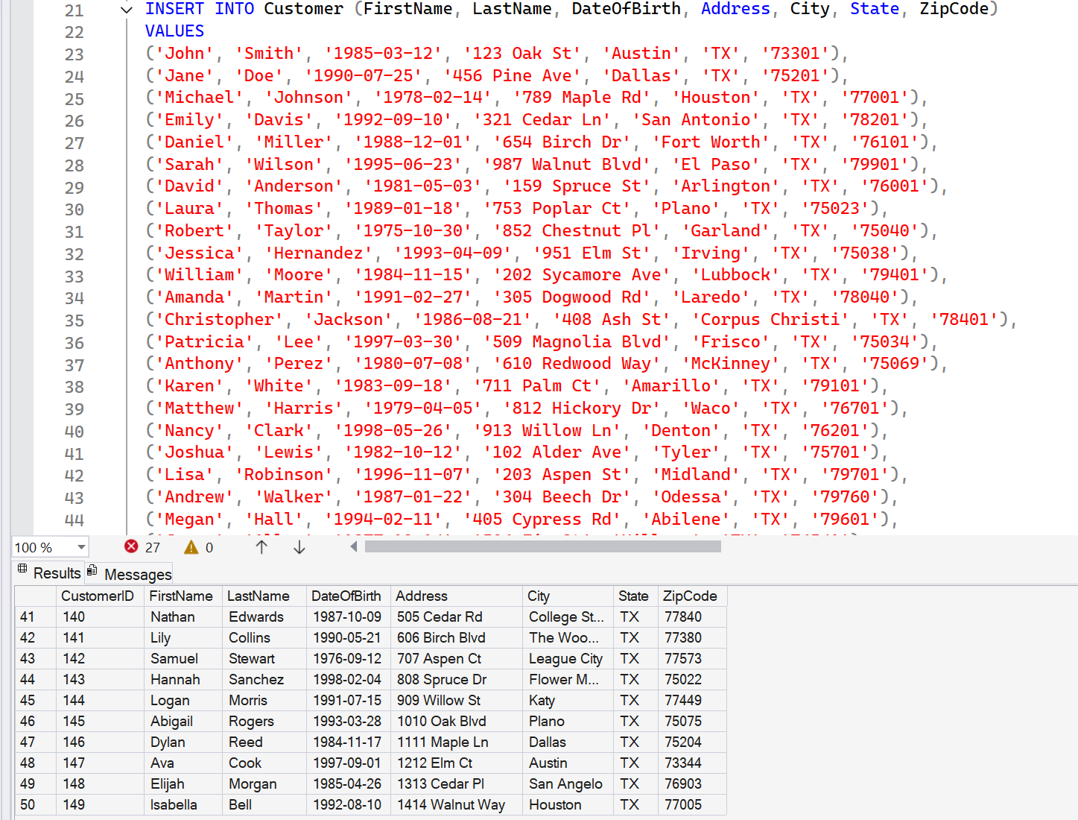
4) SQL to insert fifty rows of unique data into the Customer table.

Slide 5
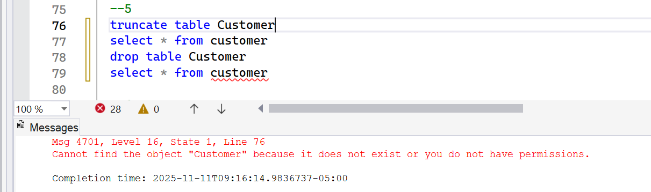
5) SQL to truncate and drop the Customer table

Slide 6
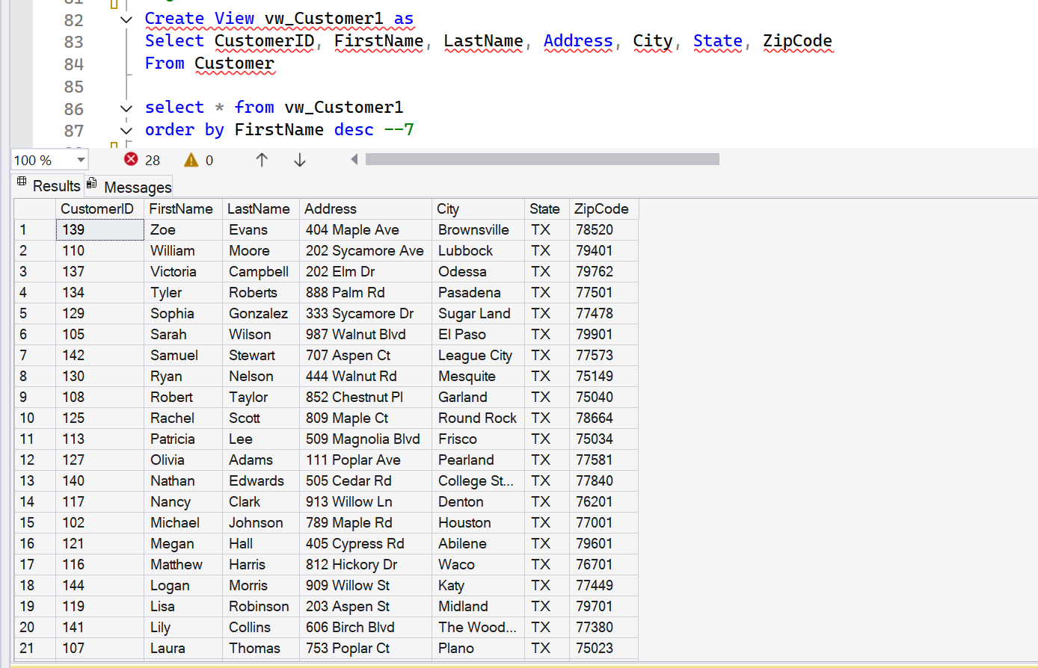
6) SQL to create a view of the Customer table using all of the columns in the table except Date of Birth.
7) SQL that uses the view to display all Customers in the Customer table sorted by First Name in descending order.

Slide 7
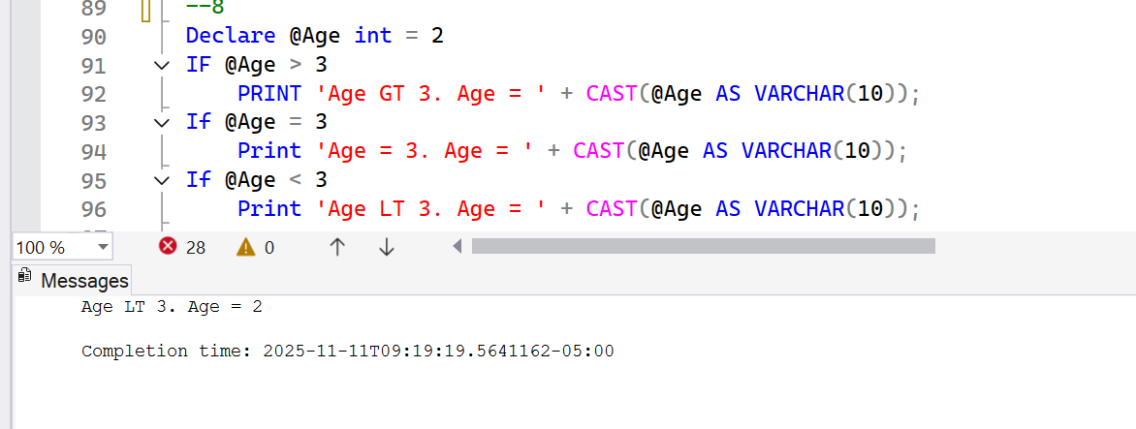
8) One sql routine with at least 3 If statements and confirmation that they work.

Slide 8
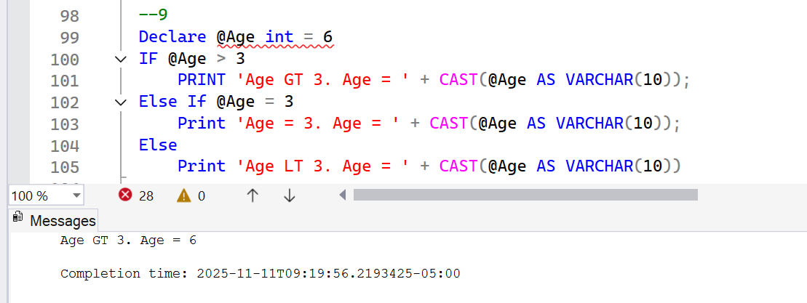
9) One sql routine with If, Else-If and confirmation that they work

Slide 9
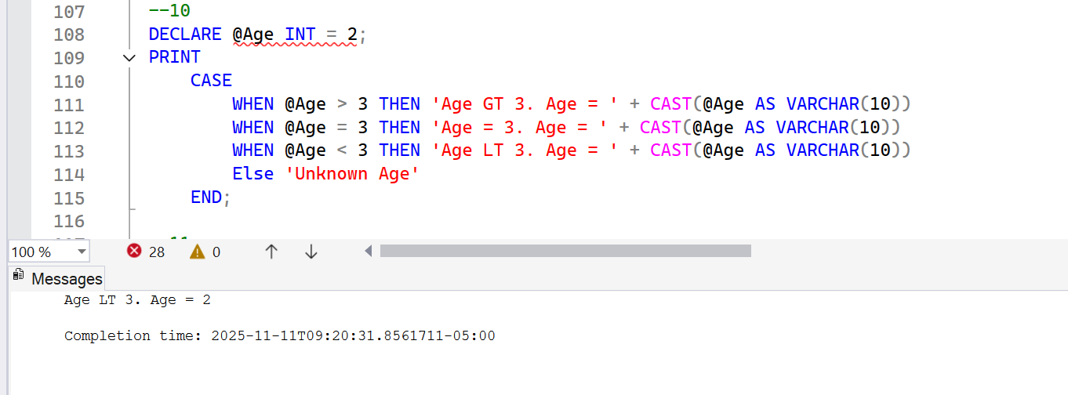
10) One Case statement with at least 3 When options and confirmation that they work.

Slide 10
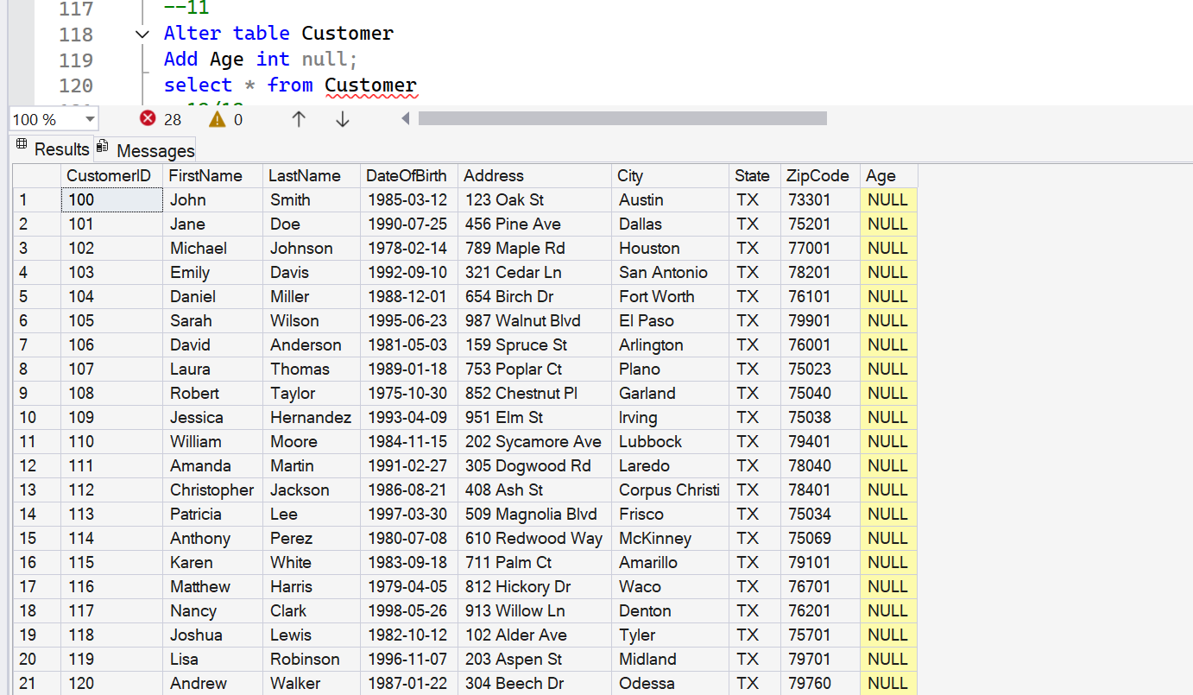
11) Alter table sql to add an integer column to an existing table that allows nulls.

Slide 11
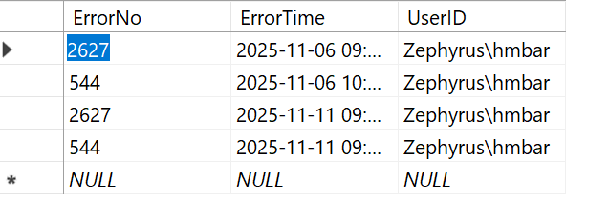
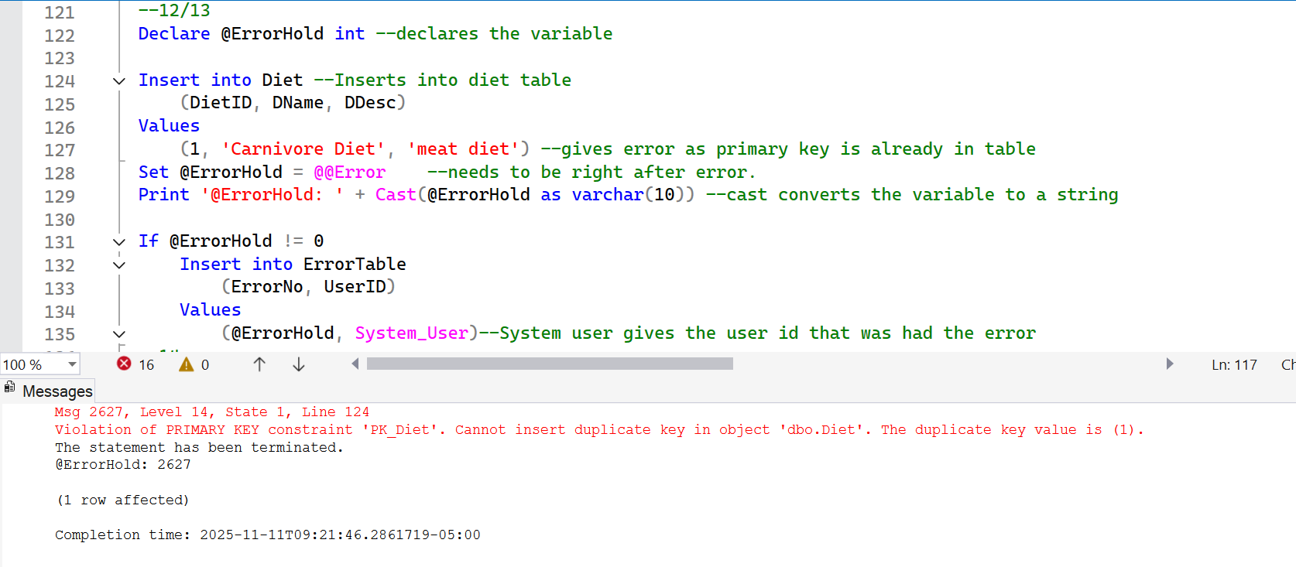
12) SQL update routine with error checking and error logging. Confirmation statement that generates logged error.
13) SQL statement that defines and uses variables.

Slide 12
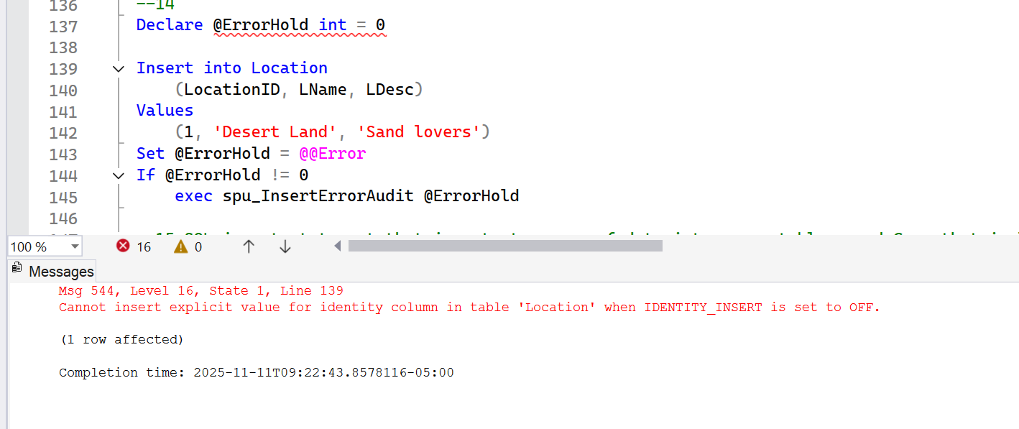
14) Store procedure that accepts a variable and has error checking and logging as part of the execute stored procedure statement.

Slide 13
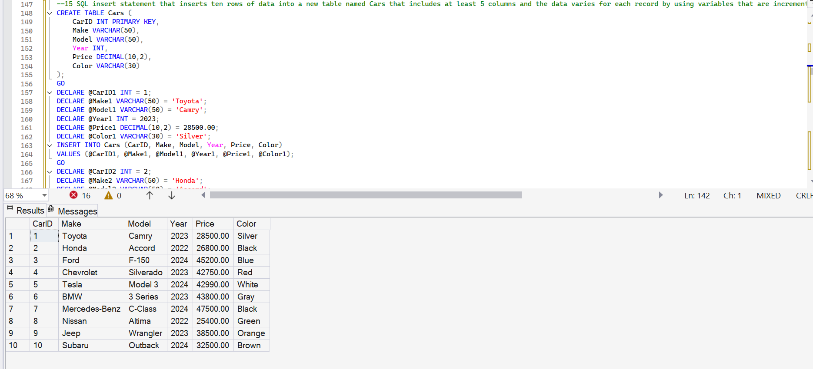
15) SQL insert statement that inserts ten rows of data into a new table named Cars that includes at least 5 columns and the data varies for each record by using variables that are incremented and/or changed within the routine for each record.

Slide 14
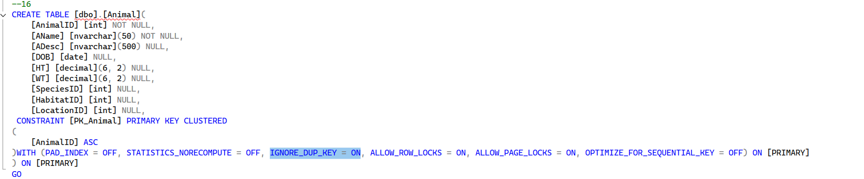
16) Create a table named HikingLocations that has the appropriate structure to remove duplicates when loading the table. Demonstrate that it works. Include sql that defines the structure to remove duplicates in your submission. (this is the same as any other table create except you set the ignore_dup_key option to on).

Slide 15
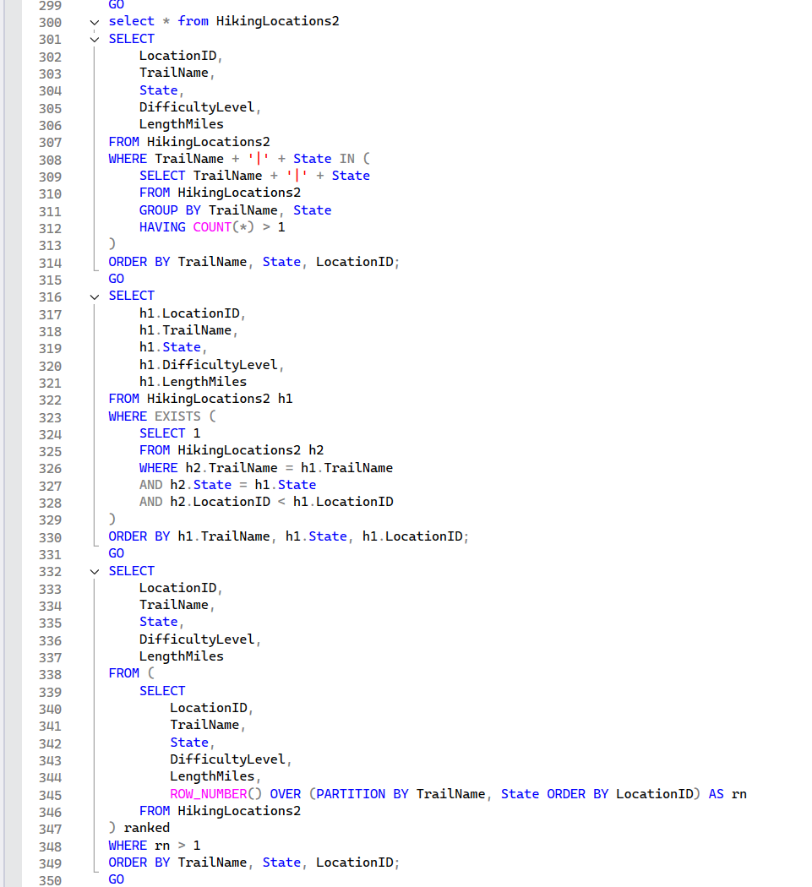
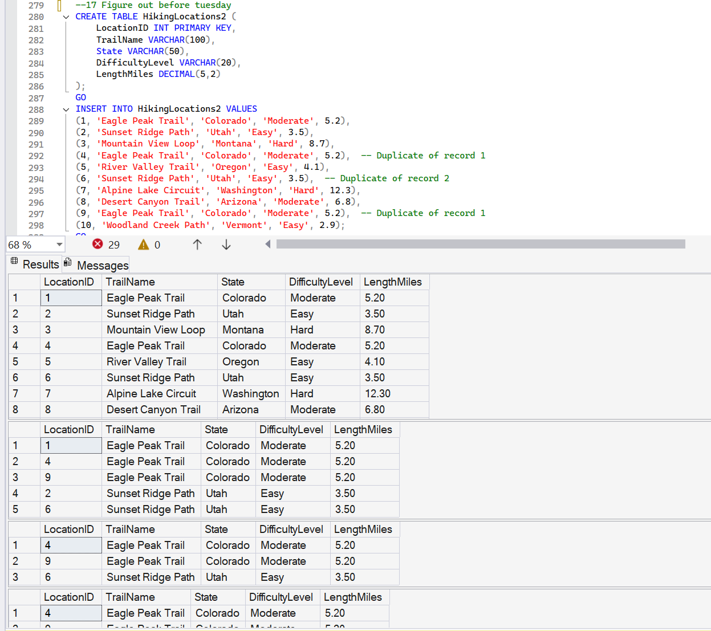
17) Define a table named HikingLocations2 that has 10 records and 3 of the records are duplicates. Create an SQL routine that identifies the duplicate records by key value. Create a second SQL routine that displays only the duplicate records.

Slide 16
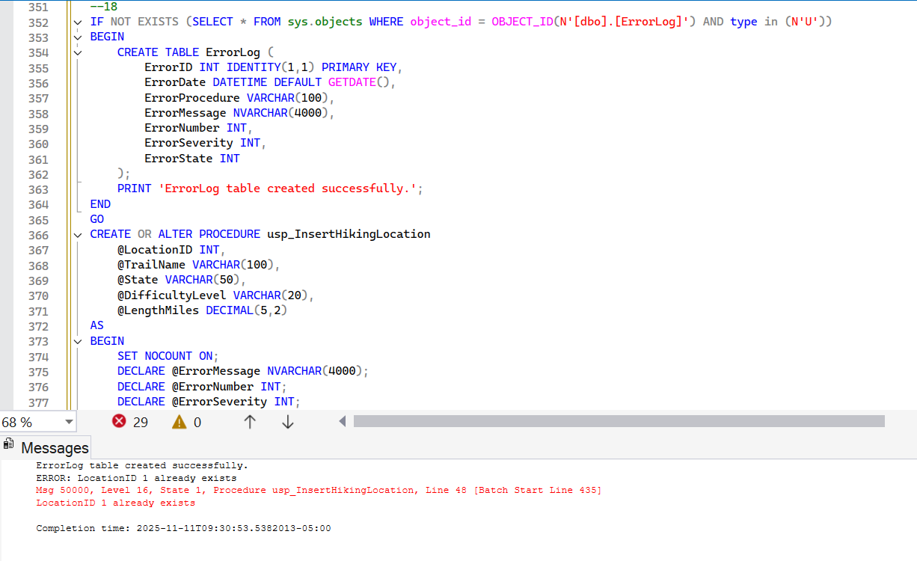
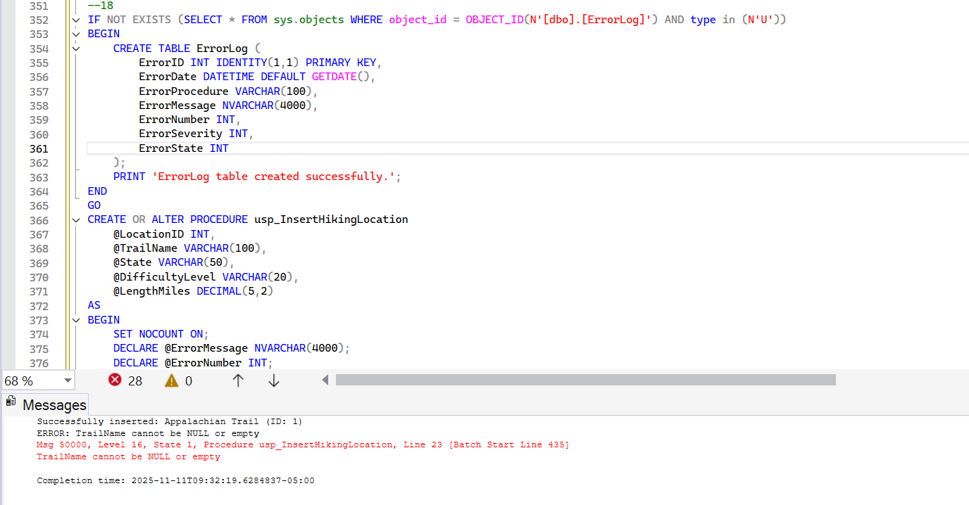
18) Create an insert routine for HikingLocations2 that uses variables and performs error checking and error logging.

