Slide 1

DB Standards
Hunter Bartlett
Dr. Gogolin
ISIN 325

Slide 2

Project Overview
In this assignment we were tasked with creating a data dictionary.
We were also tasked to create a set of standards for the organization to allow for uniform databases.
To be included in the standards were security, the platform considerations, naming, selection, and design/referential integrity standards.

Slide 3
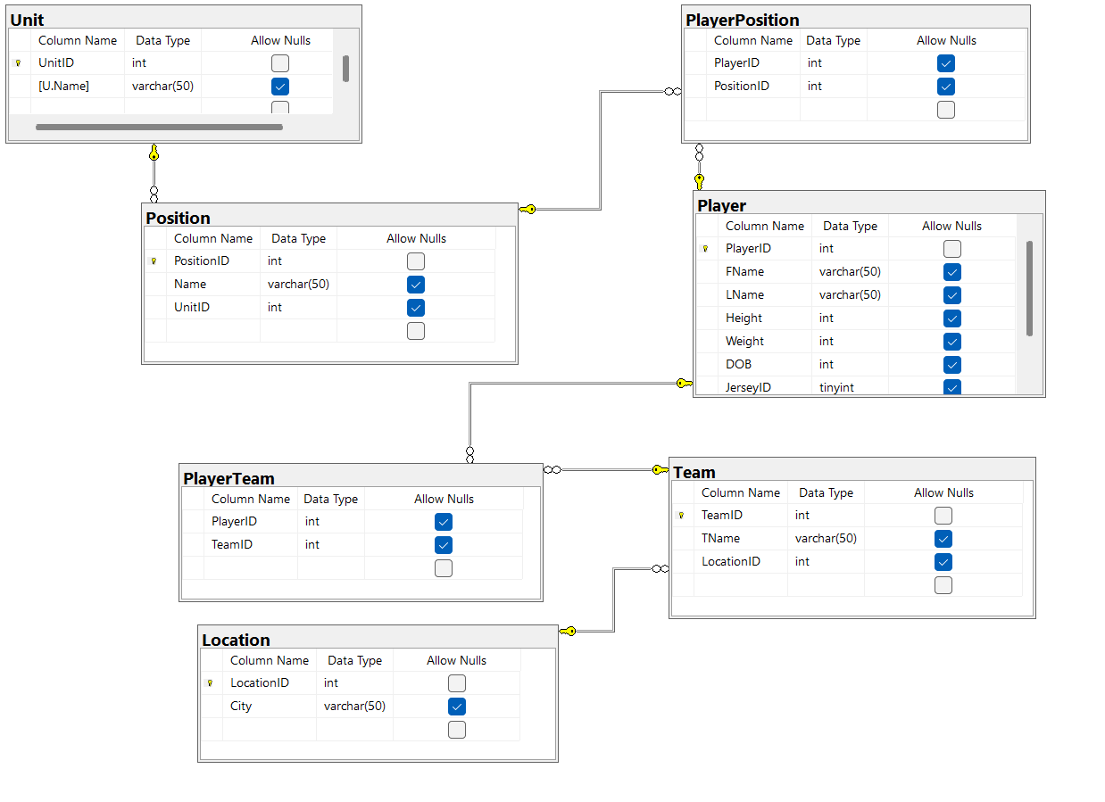
Database Design Diagram
Displays the different types of tables that were included. This also shows the naming scheme that will be used for each column and table.

Slide 4
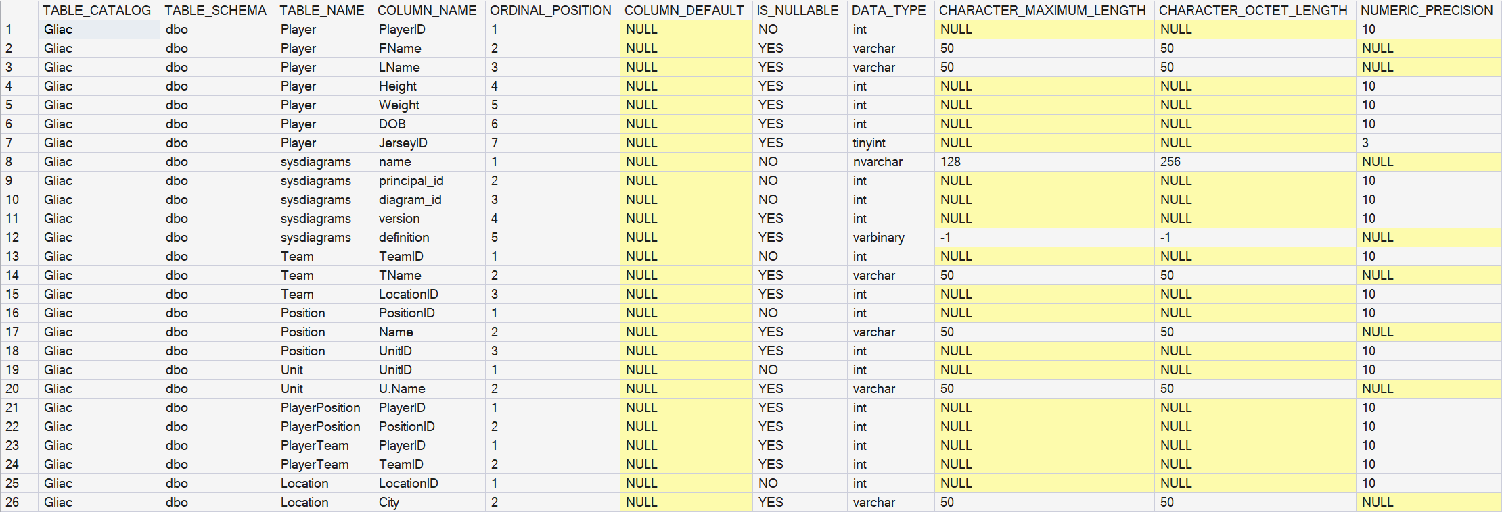
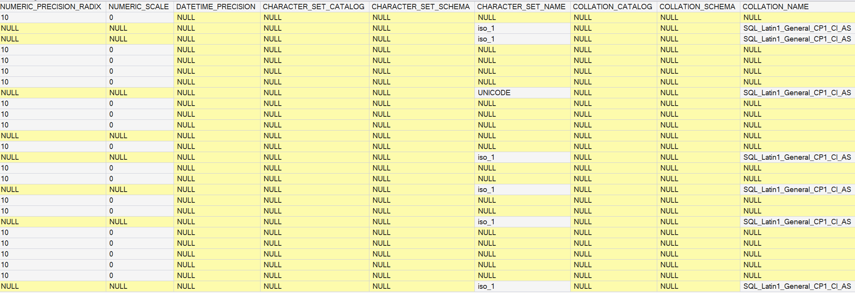
Data Dictionary
Data dictionary includes the type of data that was used to name, and define each data type.

Slide 5
Standards Diagram
  Naming standard includes using Camel Case, maximum of 20 characters for naming schemes.
  Abbreviations can be used, for example a team name can be said as FSU, GVSU, NMU.
  No spaces between characters
  No underscores in naming
  Use of windows login and not SQLServer Logins

Slide 6
Standards Diagram
Database will be in SQL Server with windows authentication and proper password protection.
Backups will be done according to the backup standards..

Slide 7
Summary of Assignment
My experience from this assignment gave me the ability to be able to see where the database needs consistency especially with database naming. This allows data types to be inserted easily. This also allowed me to learn data dictionary and how that is done.

