Slide 1
Book Club
We are not experts, so challenging each other is good but be professional of course.
Try and connect to our own work.
Try to point out general ideas.
Going forward, should we do problems? What chapters should we do?

Slide 2
Ideal MHD Ch. 1
Nathan Bartlett

Slide 3
Ch.1 Introduction

Slide 4
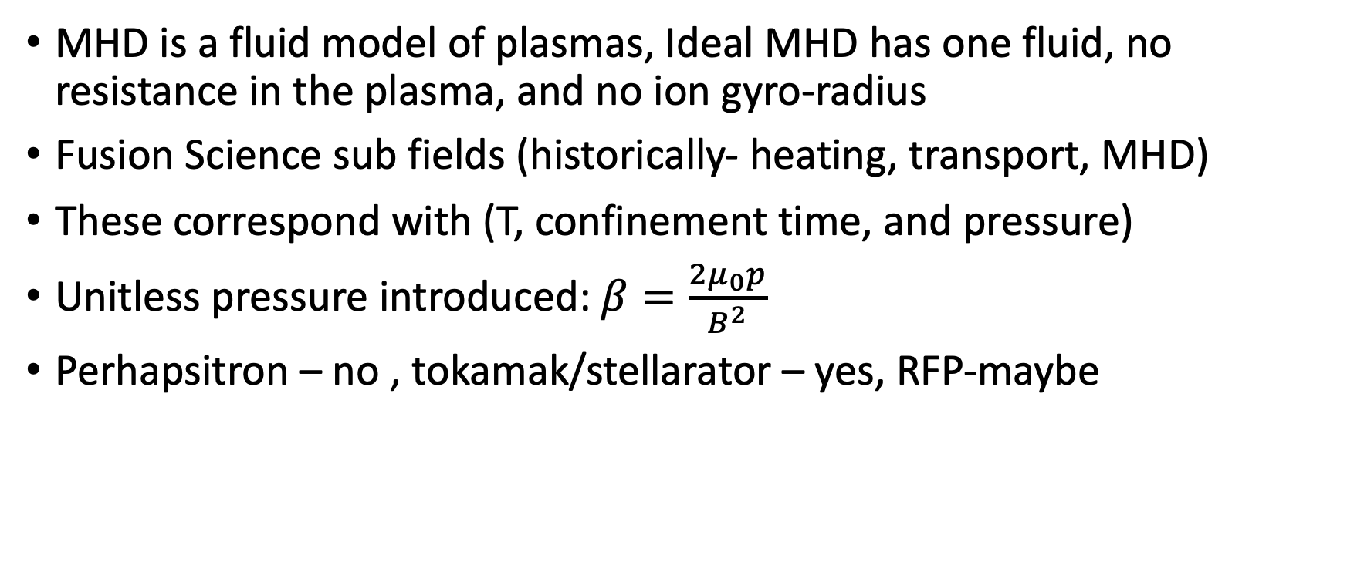
1.1 The Role of MHD in Fusion Energy
MHD is a fluid model of plasmas, Ideal MHD has one fluid, no resistance in the plasma, and no ion gyro-radius
Fusion Science sub fields (historically- heating, transport, MHD)
These correspond with (T, confinement time, and pressure)
Unitless pressure introduced: $β=\frac{2μ_{0}p}{B^{2}}$
Perhapsitron – no , tokamak/stellarator – yes, RFP-maybe

Slide 5
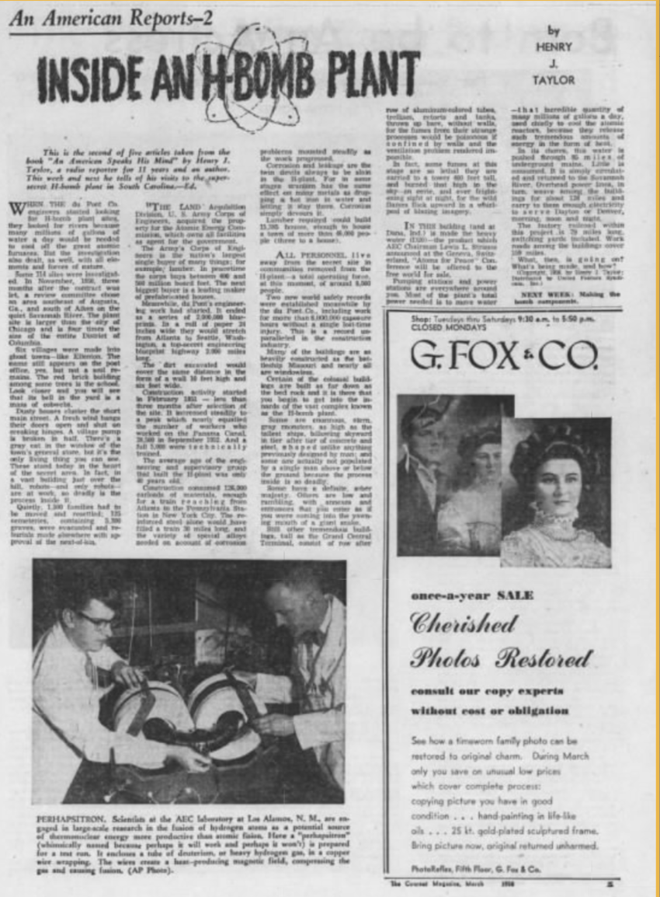

Slide 6
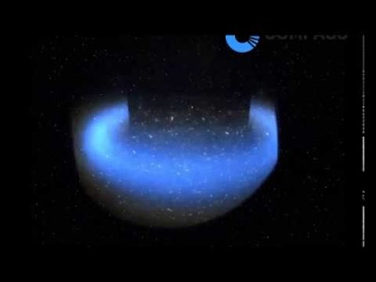
Tokamak

Slide 7
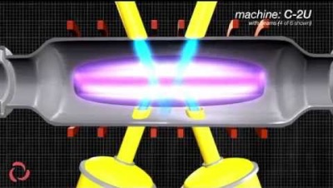
FRC

Slide 8

1.2 Units
$T →k_{B}T$

