Slide 1
Ideal MHD Ch. 3
Nathan Bartlett

Slide 2
Ch. 3 General Properties of Ideal MHD

Slide 3
3.1 Introduction
Chapter will introduce conservation laws
There are three boundary conditions (wall, vac-wall, coils/no wall)
Ideal MHD conserves mass, momentum, and energy both globally and locally
The chapter also discusses the “frozen-in flux”

Slide 4
3.2 Boundary Conditions
The Ideal MHD equations need boundary conditions

Slide 5
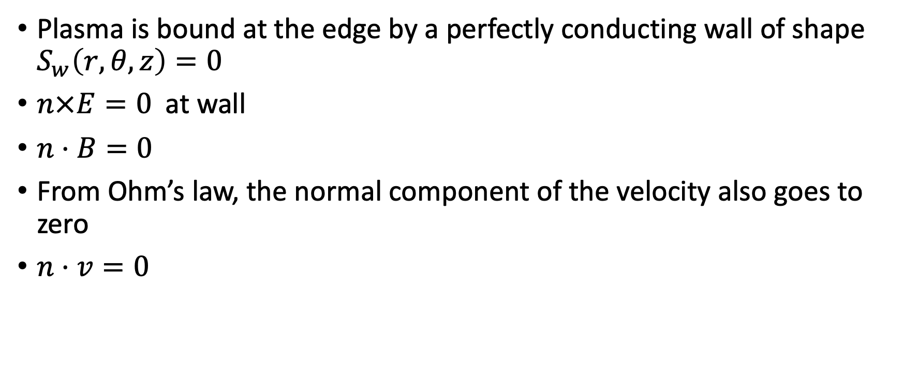
3.2.1 The Perfectly Conducting Wall
Plasma is bound at the edge by a perfectly conducting wall of shape $S_{w}\left(r,θ,z\right)=0$
$n×E=0$at wall
$n⋅B=0$
From Ohm’s law, the normal component of the velocity also goes to zero
$n⋅v=0$

Slide 6
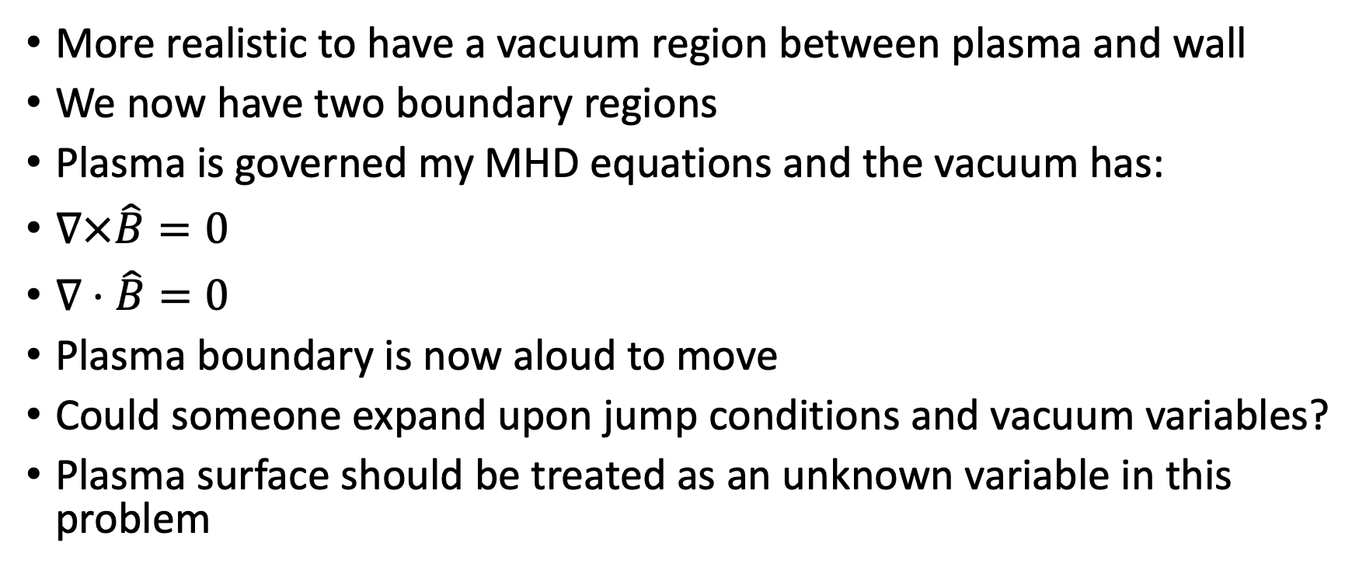
3.2.2 Insulating Vacuum Region
More realistic to have a vacuum region between plasma and wall
We now have two boundary regions
Plasma is governed my MHD equations and the vacuum has:
$∇×\hat{B}=0$
$∇⋅\hat{B}=0$
Plasma boundary is now aloud to move
Could someone expand upon jump conditions and vacuum variables?
Plasma surface should be treated as an unknown variable in this problem

Slide 7
3.2.3 Plasma Surrounded by External Coils
No wall now, B field is combination of coils and plasma
We have conditions at infinity, B-field dies there.
Numerical calculation required for experimental comparison

Slide 8
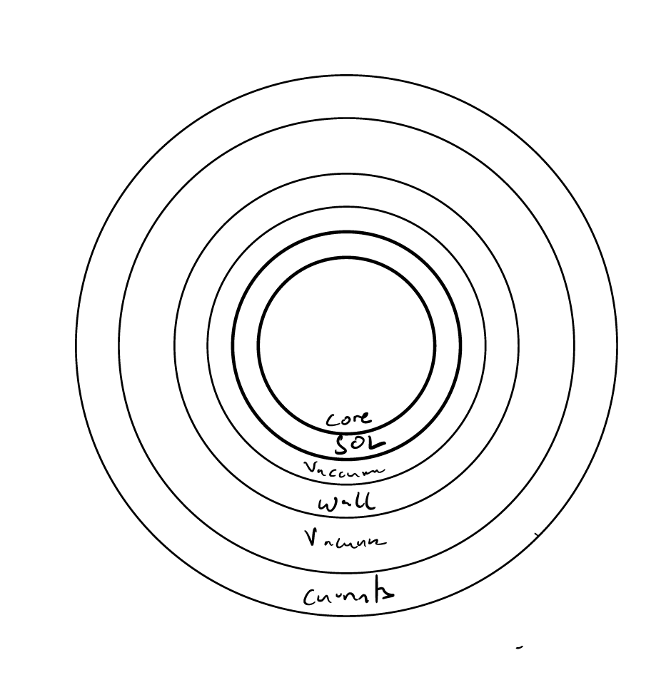
Discussion on Further Boundary Condition Considerations

Slide 9
3.3 Local Conservation Relations
The kinetic maxwell relation is conservative, but is Ideal MHD after so many assumptions?
Mass – yes
Momentum - yes – perp/parr pressure is interesting
Energy - yes

Slide 10
3.4 Global Conservation Laws
Global conservation is achieved by integrating local conservation over the entirety of a volume and incorporating the correct boundary conditions

Slide 11
3.4.1 Insulating Vacuum Region
From the center to the wall,

Slide 12
3.4.2 Insulating Vacuum Region
Need to now include magnetic field energy in the vacuum.

Slide 13
3.4.3 Plasma Surrounded by External Coils
Now total energy is equal to power pass through currents.
Contemplation on superconducting materials – kind of crazy.

Slide 14
3.5 Conservation of Flux: the “Frozen-in Field Line” Concept
The magnetic flux of an arbitrary surface inside of the plasma remains constant
A necessary result of zero resistance
Resistivity leads to magnetic reconnection but on slightly longer time scales

Slide 15
3.6 Summary
Mass, momentum, and energy is conserved locally and globally in the Ideal MHD model.

