Slide 1


Nathan Bartlett
Stellarator Optimization Summer School 2020

Slide 2
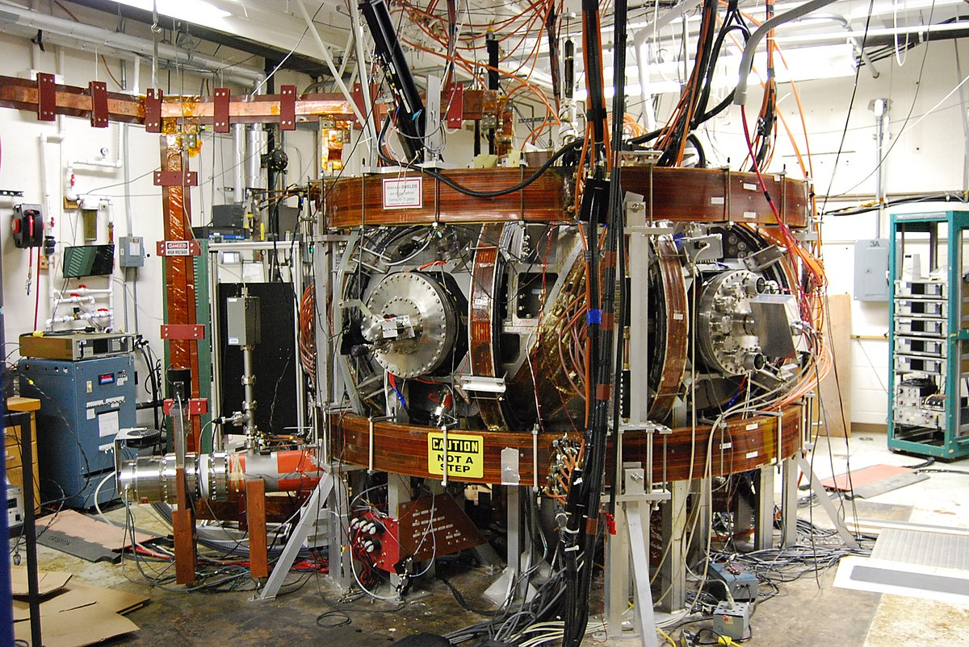
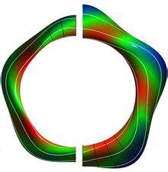
About Me
Bachelors at the University of Illinois at Urbana-Champaign in engineering physics
New graduate student at Auburn University
Interested in MHD stability of current carrying stellarators as well as divertor physics.
[1] https://en.wikipedia.org/wiki/Compact_Toroidal_Hybrid

