Slide 1
Ideal MHD Ch. 5
Nathan Bartlett

Slide 2
Ch. 5 Equilibrium: One-Dimensional Configurations

Slide 3
5.1 Introduction
We Want…
B field that confines plasma
Stable
High Beta

Slide 4


5.2 The $Θ$-pinch
All J in $θ$, all B in Z
$∇⋅B=0$
$∇×B=μ_{0}J$
$J ×B=∇P$
Stable, simple, but end losses

Slide 5

5.3 The Z-pinch
All current in Z, all B in $θ$
Simple, but kink unstable
Introduces the reader to a simple curvature effect

Slide 6
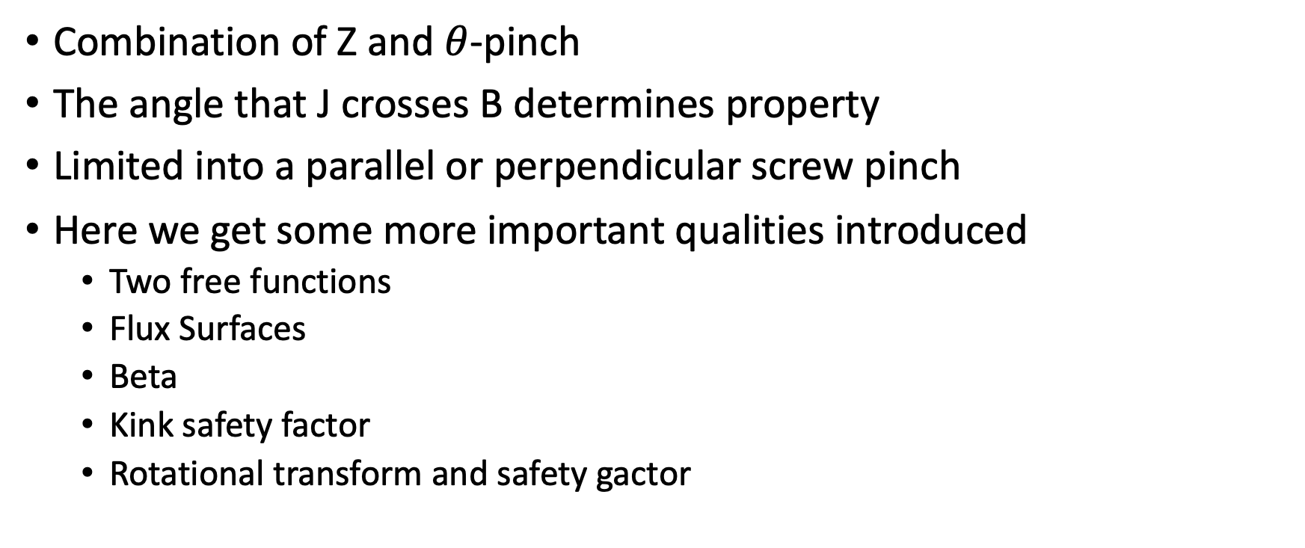
5.4 The General Screw Pinch
Combination of Z and $θ$-pinch
The angle that J crosses B determines property
Limited into a parallel or perpendicular screw pinch
Here we get some more important qualities introduced
Two free functions
Flux Surfaces
Beta
Kink safety factor
Rotational transform and safety gactor

Slide 7
5.5 Inherently 1-D Fusion Configurations
RFP (kind of a tokamak, but different relative magnitudes of fields and a different experimental procedure)
Low beta Tokamak
Circular cross section
Ohmic-heated
Curvature effects are simply perturbative only

Slide 8

5.6 Summary
$Θ$-pinch
Z-pinch
Screw Pinch
RFP
Low-Beta Tokamak

