Slide 1
Ideal MHD Ch. 6
Nathan Bartlett

Slide 2
Ch. 6 Equilibrium: Two-Dimensional Configurations

Slide 3
6.1 Introduction
Our goal now is to balance both radial pressure forces as well as balance against curvature effects.
Grad-Shafranov will help us describe:
Field Reveres Configuration
Tokamak
Levitated-Dypole
RFP
Spheromaks

Slide 4
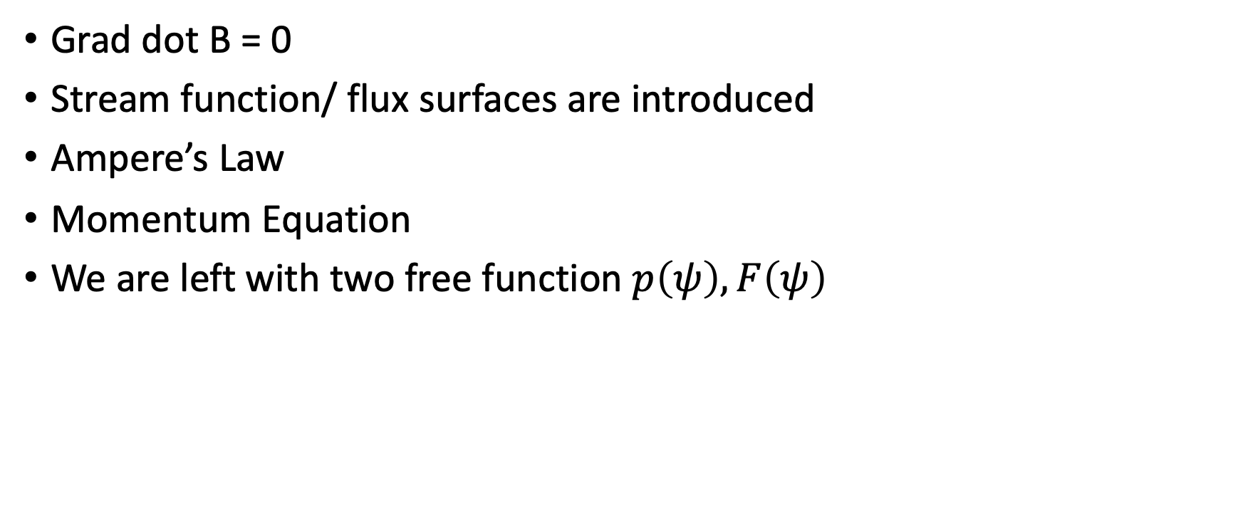
6.2 Derivation of the Grad-Shafranov Equation
Grad dot B = 0
Stream function/ flux surfaces are introduced
Ampere’s Law
Momentum Equation
We are left with two free function $p\left(ψ\right),F\left(ψ\right)$

Slide 5
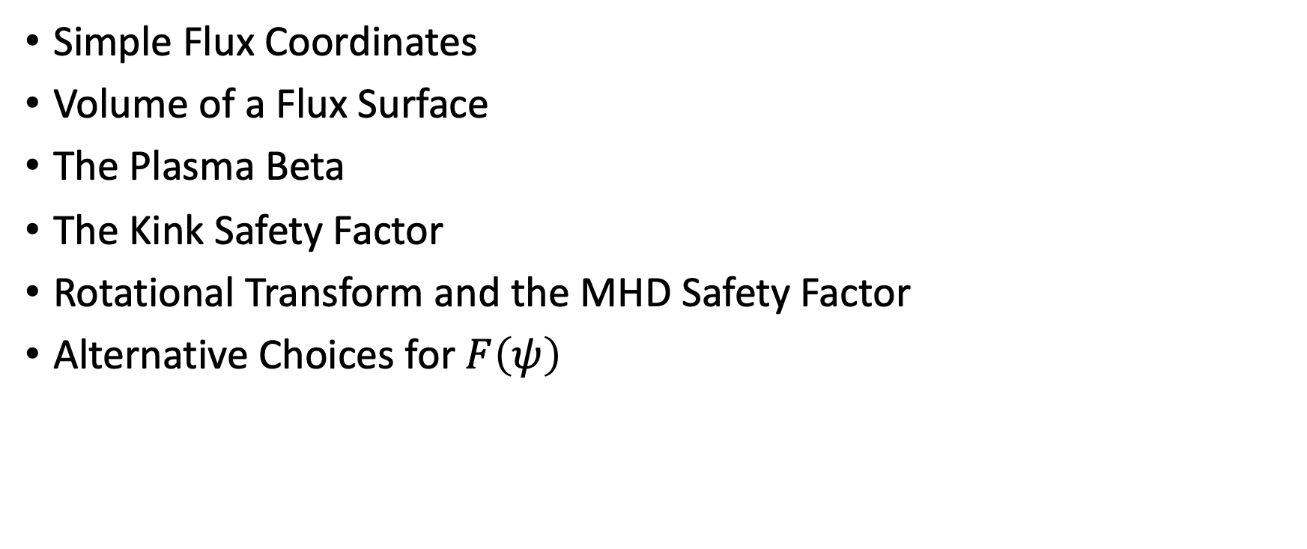
6.3 Plasma Parameters and Figures of Merit
Simple Flux Coordinates
Volume of a Flux Surface
The Plasma Beta
The Kink Safety Factor
Rotational Transform and the MHD Safety Factor
Alternative Choices for $F\left(ψ\right)$

Slide 6
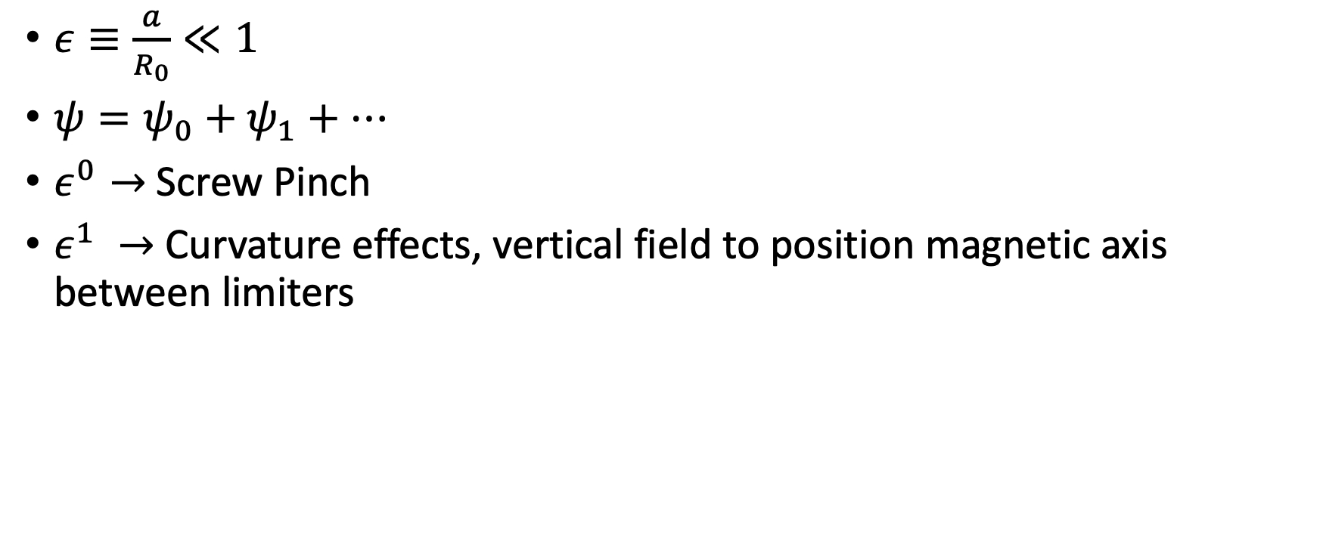
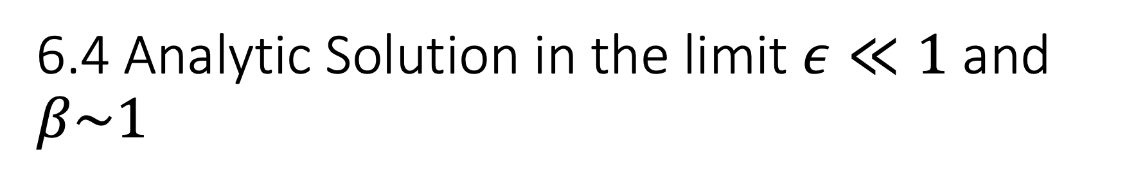
6.4 Analytic Solution in the limit $ε≪1$ and $β\sim 1$
$ε≡\frac{a}{R_{0}}≪1$
$ψ=ψ_{0}+ψ_{1}+…$
$ε^{0}→$Screw Pinch
$ε^{1} →$Curvature effects, vertical field to position magnetic axis between limiters

Slide 7
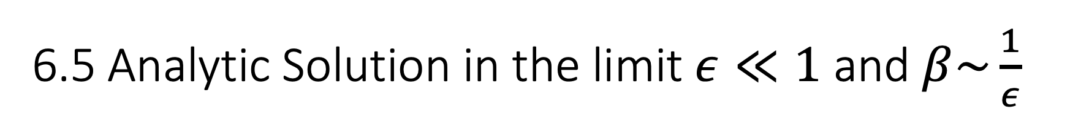
6.5 Analytic Solution in the limit $ε≪1$ and $β\sim \frac{1}{ε}$
We need to pick good free functions and do lots of math.
Use circular cross sections
Quickly get into numerical territory

