Slide 1
Ideal MHD Ch. 6
Nathan Bartlett

Slide 2
Ch. 6 Equilibrium: Two-Dimensional Configurations

Slide 3
6.1 Introduction
Our goal now is to balance both radial pressure forces as well as balance against curvature effects.
Grad-Shafranov will help us describe:
Field Reveres Configuration
Tokamak/ spherical tokamak
Levitated-Dypole
RFP
Spheromaks

Slide 4
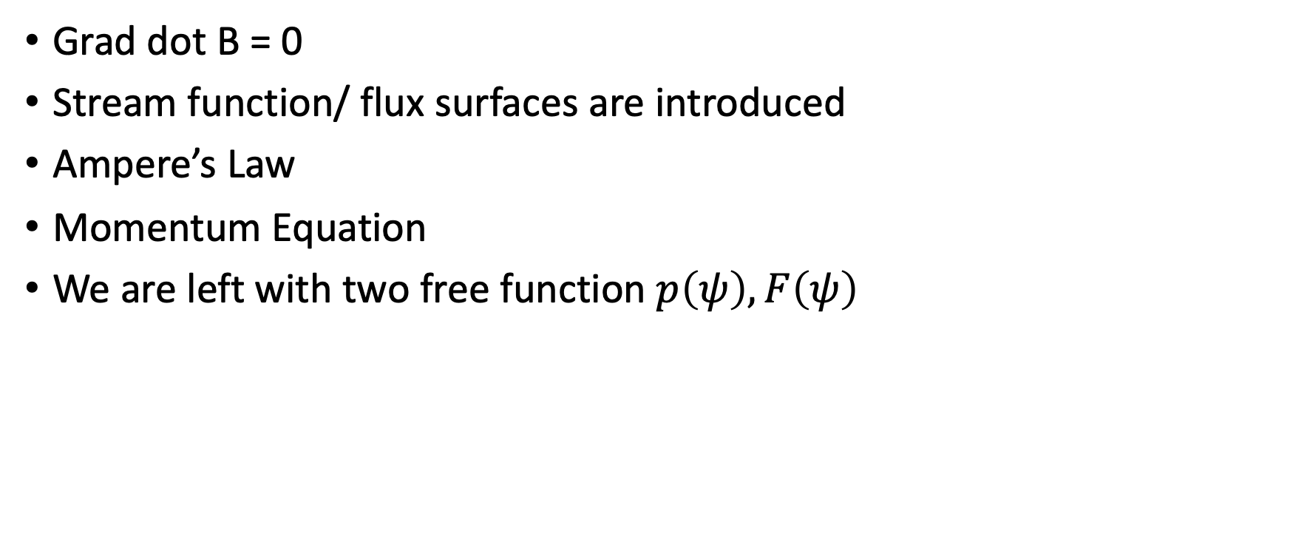
6.2 Derivation of the Grad-Shafranov Equation
Grad dot B = 0
Stream function/ flux surfaces are introduced
Ampere’s Law
Momentum Equation
We are left with two free function $p\left(ψ\right),F\left(ψ\right)$

Slide 5
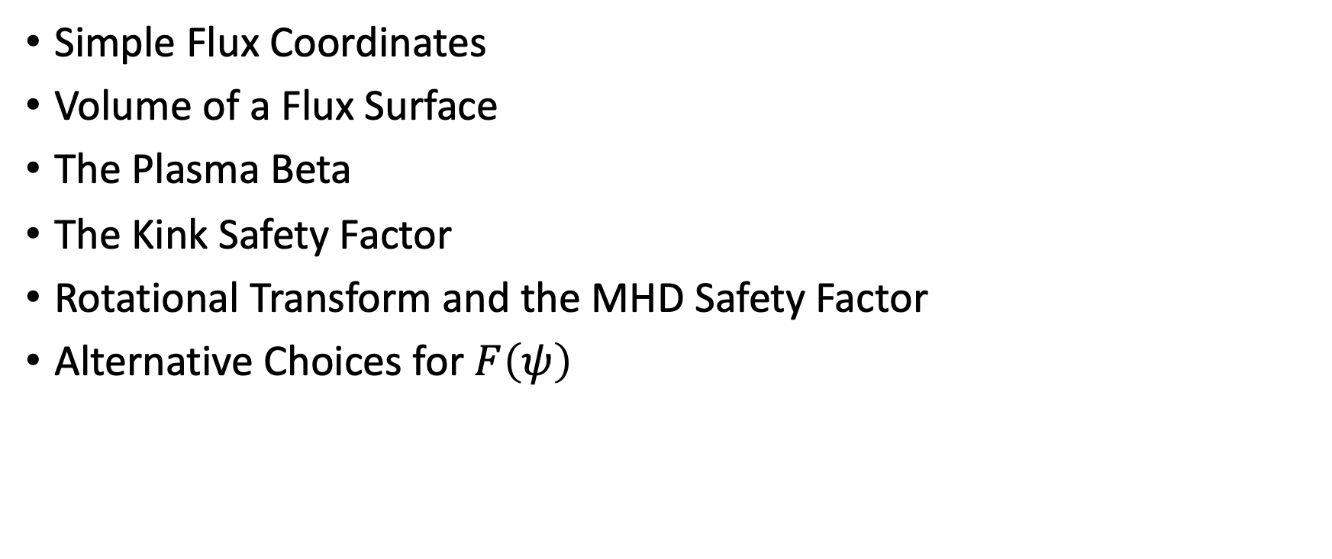
6.3 Plasma Parameters and Figures of Merit
Simple Flux Coordinates
Volume of a Flux Surface
The Plasma Beta
The Kink Safety Factor
Rotational Transform and the MHD Safety Factor
Alternative Choices for $F\left(ψ\right)$

Slide 6
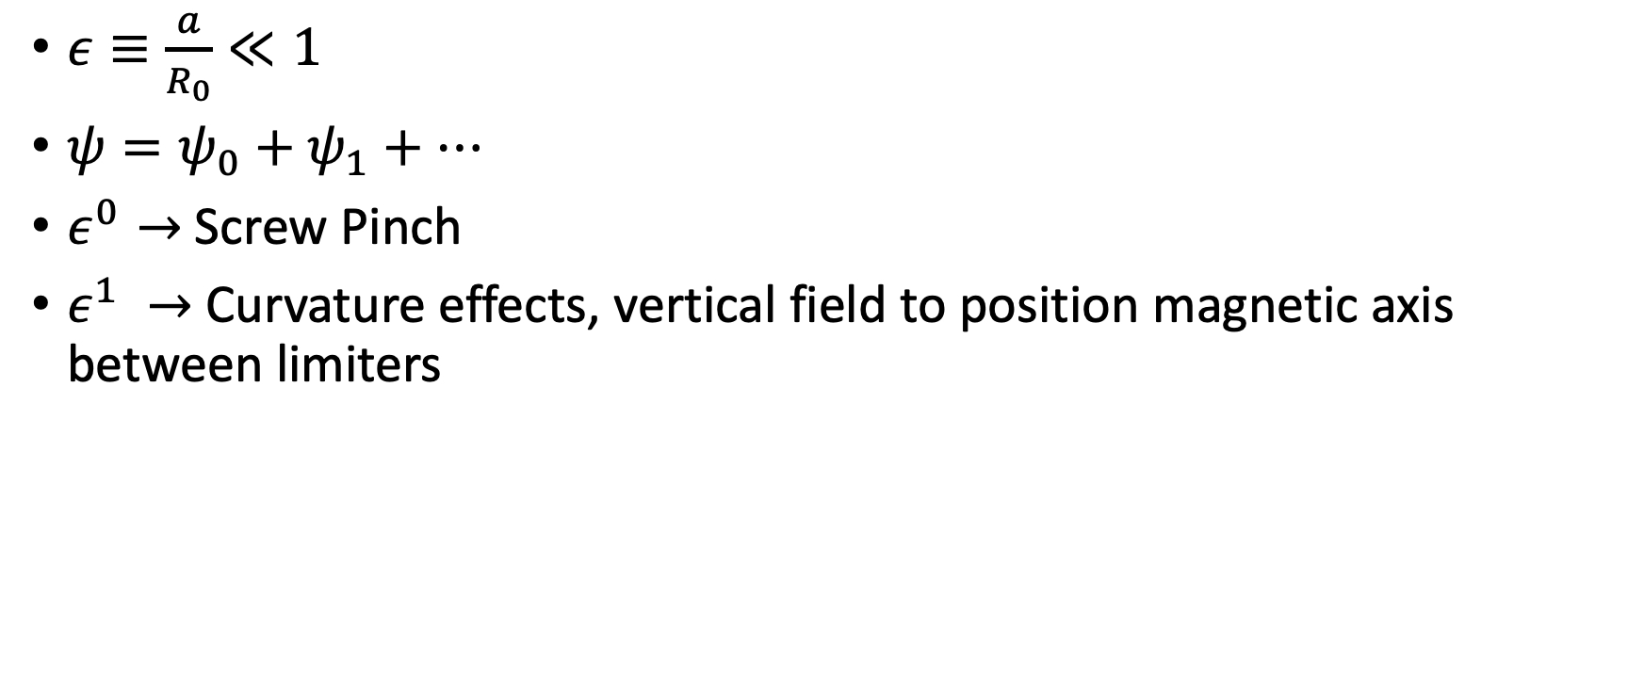
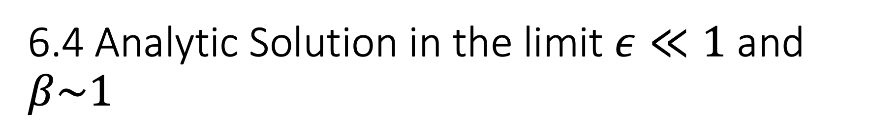
6.4 Analytic Solution in the limit $ε≪1$ and $β\sim 1$
$ε≡\frac{a}{R_{0}}≪1$
$ψ=ψ_{0}+ψ_{1}+…$
$ε^{0}→$Screw Pinch
$ε^{1} →$Curvature effects, vertical field to position magnetic axis between limiters

Slide 7
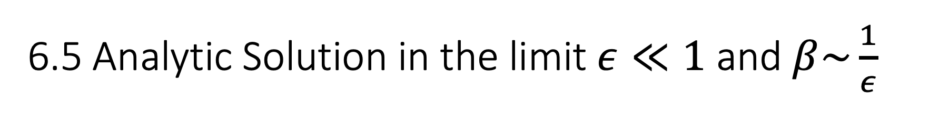
6.5 Analytic Solution in the limit $ε≪1$ and $β\sim \frac{1}{ε}$
We need to pick good free functions and do lots of math.
Use circular cross sections
Quickly get into numerical territory

Slide 8
6.6 Exact Solutions to the Grad-Shafranov Equation
Real tokamaks, and especially spherical tokamaks, do not satisfy the Taylor expansion criteria
Numerical solutions exist to compare to experiments, but we lose the scaling properties
Therefore, we want to solve exactly, analytically

Slide 9
6.6.1 Mathematical Formulation
We use constant-first-derivative functions for our free functions (Solov’ev profiles)
The steps are roughly summarized as
Choose a good set of basis function
Pick the right number of terms to constitute a finite sum
Pick the right set of matching constraints

Slide 10
6.6.2 Examples: TFTR and JET
The shifted magnetic axis location is achieved

Slide 11

6.6.3 Example: The Spherical Tokamak (ST)
Spherical tokamaks are desirable because beta scales with the aspect ratio
Better as a volumetric neutron source
MAST is discussed

Slide 12
6.6.4 The Equilibrium Beta Limit
Does a good job… I skimmed

Slide 13
6.6.5 Up-Down Asymmetric Solution
Single null divertor
Add new boundary description basically
X-point for example

Slide 14
6.6.6 Example: ITER
ITER discussed

Slide 15
6.6.7 Example: NSTX

Slide 16
6.6.8 Summary

Slide 17

6.7 The Helical Grad-Shafranov Equation (The Strait Stellarator)
We stick to 2D, so the stellarator becomes long and strait
$Ψ\left(R,φ,Z\right)→Ψ\left(R,Z\right) or Ψ\left(R,φ,Z\right)→Ψ\left(R,lθ+hz\right)$
$α= \left(lθ+hz\right)$

Slide 18
6.8 Summary
The many different 2D-symmetric fusion devices are quickly gone over again.

