Slide 1
Ideal MHD Ch. 7
Nathan Bartlett

Slide 2
Ch. 7 Equilibrium: Three-Dimensional Configurations

Slide 3
7.1 Introduction
We Want…
We are limited in our ability to drive the toroidal current
Central solenoid
NBI
???
This motivated a 3-D equilibrium
Inherently steady state
No current induced disruptions
Vacuum field is more independent from the plasma in a sense
But not really (Auburn/PPPL)
Disadvantages:
Harder to Engineer
Bad transport

Slide 4
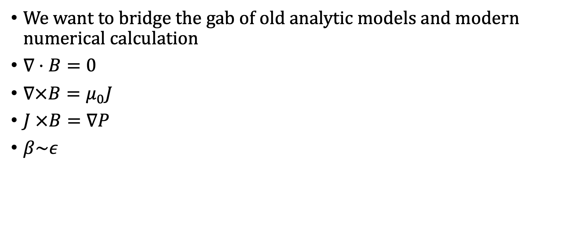
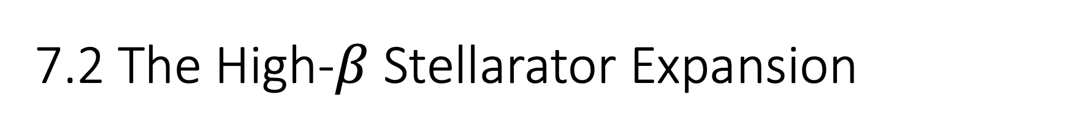
7.2 The High-$β$ Stellarator Expansion
We want to bridge the gab of old analytic models and modern numerical calculation
$∇⋅B=0$
$∇×B=μ_{0}J$
$J ×B=∇P$
$β\sim ε$

Slide 5
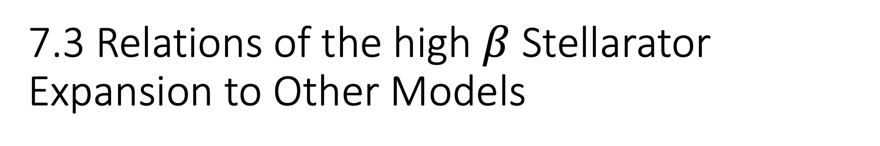
7.3 Relations of the high $β$ Stellarator Expansion to Other Models
Cam Reduce into the high beta tokamak and the stait stellarator at the correct limits.

Slide 6
7.4 The Green-Johnson Limit
This is the early model ~1961 noted in the intro of the chapter
See Appendix E

Slide 7
7.5 Vacuum Flux Surfaces
We can achieve analytic standalone harmonic solutions l=1, l= 2, etc.
When we need to combine though, we must go numerical.

Slide 8

7.6 Effects of Finite Beta
$Toroidal shift calculation$
Pressure gradient driven current
Change in vertical field is now needed to shift plasma inwards

Slide 9
7.7 Neoclassical Transport in Stellarators
Review of collisional transports is given
Banana Orbits lead to high collision frequency and step size
Helical modulation of field leads to lots of trapped particle orbits compared to tokamaks
There are different philosophies driving stellarator optimization
Isodynamic- Design against net current
Symmetric – Design for flow shear and reduce micro-turbulence
Quasi-axisymetric
Boozer Coordinates introduced

Slide 10
7.8 Modern Stellarators
LHD
W7-X
Future
Permanent Magnets?
CFQS

Slide 11
7.9 Overall Stellarators

