Slide 1

Software Engineering Processes for the CASL Innovation Hub
Roscoe A. Bartlett, Ph.D.
bartlettra@ornl.gov
http://web.ornl.gov/~8vt/ Computational Engineering and Energy Sciences Group, Oak Ridge National Laboratory
Center for Computing Research Seminar
Sandia National Laboratories
October 26, 2015

Slide 2
Overview of CASL

Slide 3
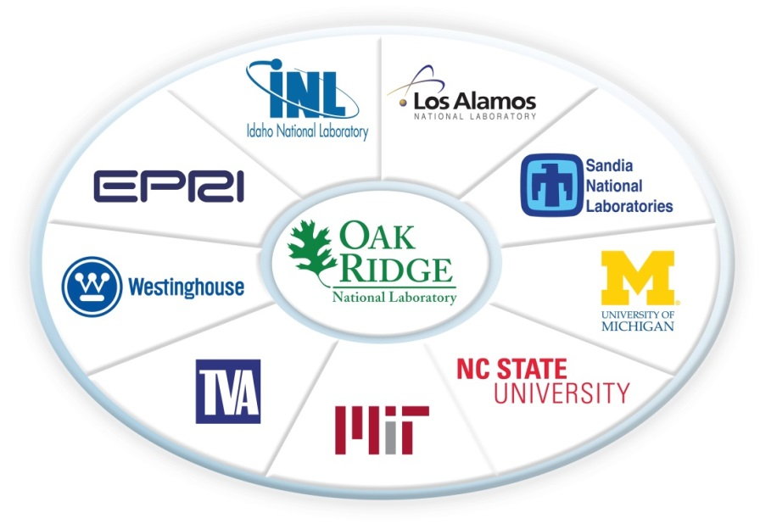
Overview of CASL
CASL: Consortium for the Advanced Simulation of Lightwater reactors
DOE Innovation Hub including DOE labs, universities, and industry partners
Goals:
Advance modeling and simulation of light-water nuclear reactors
Produce a set of simulation tools to model light-water nuclear reactor cores to provide to the nuclear industry: VERA: Virtual Environment for Reactor Applications.
Phase 1: July 2010 – June 2015
Phase 2: July 2015 – June 2020
Organization and management:
ORNL is the hub of the Hub
Milestone-driven (6 month plan-of-records (PoRs))
Focus areas: Physics Integration (PHI), Thermal Hydraulic Methods (THM), Radiation Transport Methods (RTM), Advanced Modeling Applications (AMA), Fuel Materials & Chemistry (FMC), Validation & Modeling Applications (VMA), Technology Development & Outreach (TDO)

Slide 4
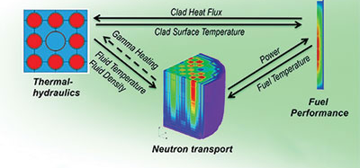
CASL VERA Core Simulator
Focus: Modeling of the Reactor Core for Nuclear Light-water Reactors

Slide 5
Overview of CASL VERA Development

Slide 6
CASL VERA Development Overview
VERA Development is complicated in almost every way ☹
VERA Currently Composed of:
19 different git repositories on casl-dev.ornl.gov (clones of other repos) most with a different access list (NDAs, Export Control, IP, etc.)
Integrating development efforts from many teams from 9+ institutions
CMake build system using TriBITS CMake Framework:
Over 2700 CMakeLists.txt files!
VERA Software Development Process:
Official definition of VERA is ‘master’ branch of git repos under gitolite control at git@casl-dev.ornl.gov:<repo-name>.
Primary development platform: CASL Fissile/Spy Machines
VERA integration maintained by continuous and nightly testing:
Pre-push CI testing: checkin-test-vera.sh, cloned VERA git repos, on Fissile machine.
Post-push CI testing: CTest/CDash, all VERA git repos, shared libs.
Nightly testing: MPI and Serial builds, Debug and Release builds, …
100% passing builds and tests!
VERA snapshots and releases are taken off of ‘master’ branches on casl-dev git repos.

Slide 7
Dependencies Between Selected VERA Repositories
Trilinos (SNL)
TeuchosWrappersExt
(Multi Inst.)
DatraTransferKit
(ORNL)
VERAInExt
(Multi Inst.)
MOOSEExt
SCALE (ORNL)
MOOSE / Bison (INL)
MAMBA (LANL)
Exnihilo (ORNL)
COBRA-TF
(PennState)
MPACT (U.Mich.)
PSSDriversExt
(Multi Inst.)
Primary/originating institution shown in Blue
Most codes being contributed by multiple institutions as well
All direct dependencies not shown
Dependencies between repos are though TriBITS package dependencies
Local VERA git clones of all these repos kept compatible
DakotaExt
VUQDemos
(SNL)
Dakota (SNL)

Slide 8
TriBITS Structural Units
and
VERA Software Organization

Slide 9
What is TriBITS?
Framework for large, distributed multi-repository CMake projects
Reduce boiler-plate CMake code and enforce consistency across large distributed projects
Subproject dependencies and namespacing architecture (packages)
Automatic package dependency handling (directed acyclic graph)
Additional functionality missing in raw CMake
Change default CMake behavior when necessary
Additional tools for agile software development processes (e.g. Continuous Integration (CI))
History of TriBITS:
2007: Initially developed as a CMake package architecture for Trilinos
2011: Generalized and extended for CASL VERA
2014: Source code hosted on GitHub

Slide 10
TriBITS Structural Units
TriBITS Project:
Complete CMake “Project”
Overall projects settings
TriBITS Repository:
Collection of Packages and TPLs
Unit of distribution and integration
Typically a version control (git) repository
TriBITS Package:
Encapsulated collection of related software & tests
Unit of testing, namespacing, documentation, and reuse
Lists dependencies on SE Packages & TPLs
TriBITS Subpackage:
Optional partitioning of package software & tests
Primarily for dependency management (SE principles)
TriBITS TPLs (Third Party Libraries):
Specification of external dependencies (libs)
Required or optional dependency
Single definition across all packages
Can use native CMake Find<Package>.cmake modules
See: https://tribits.org/doc/TribitsDevelopersGuide.html
Packages
+ Subpackages
=
Software Engineering (SE) Packages

Slide 11
TriBITS and VC Repos for CASL VERA
Trilinos (SNL)
TeuchosWrappersExt
(Multi Inst.)
DatraTransferKit
(ORNL)
VERAInExt
(Multi Inst.)
MOOSEExt
SCALE (ORNL)
MOOSE / Bison (INL)
MAMBA (LANL)
Exnihilo (ORNL)
COBRA-TF
(PennState)
MPACT (U.Mich.)
PSSDriversExt
(Multi Inst.)
Outer boxes are all TriBITS and VC repos (all native git or snapshotted to git)
Inner boxes (e.g. Exnihilo, MOOSE, Dakota) are VC repos but not TriBITS repos
DakotaExt
VUQDemos
(SNL)
Dakota (SNL)

Slide 12
VERA/cmake/ExtraRepositoriesList.cmake
TRIBITS_PROJECT_DEFINE_EXTRA_REPOSITORIES(
TriBITS "" GIT git@casl-dev:TriBITS "" ${TriBITS_REPO_TYPE}
Trilinos "" GIT git@casl-dev:Trilinos "" Continuous
TeuchosWrappersExt "" GIT git@casl-dev:TeuchosWrappersExt "" Continuous
MAMBA "" GIT git@casl-dev:MAMBA "" Continuous
COBRA-TF "" GIT git@casl-dev:COBRA-TF "" Continuous
VERAInExt "" GIT git@casl-dev:VERAInExt "" Continuous
VERAData "" GIT git@casl-dev:VERAData NOPACKAGES ${VERADATA_CAT}
DataTransferKit "" GIT git@casl-dev:DataTransferKit "" Continuous
MOOSEExt "" GIT git@casl-dev:MOOSEExt "" Continuous
MOOSE MOOSEExt/MOOSE GIT
git@casl-dev:MOOSE NOPACKAGES Continuous
SCALE "" GIT git@casl-dev:SCALE "" Continuous
Exnihilo SCALE/Exnihilo GIT
git@casl-dev:Exnihilo NOPACKAGES Continuous
MPACT "" GIT git@casl-dev:MPACT "" Continuous
LIMEExt "" GIT git@casl-dev:LIMEExt "" Nightly
PSSDriversExt "" GIT git@casl-dev:PSSDriversExt "" Continuous
DakotaExt "" GIT git@casl-dev:DakotaExt "" Continuous
Dakota DakotaExt/Dakota GIT git@casl-dev:Dakota NOPACKAGES Continuous
VUQDemos "" GIT git@casl-dev:VUQDemos "" Nightly
)
Official version of VERA in on master branch used for CI & Nightly testing
Partial set of repos can be cloned (protected by different groups)
Non-git repos are converted into git repos: Dakota (svn), SCALE (hg), MOOSE (git submodules)

Slide 13
VERA Meta-Project, Repositories, Packages & Subpackages
VERA
VERAInExt
MPACT
Trilinos
VERAIn
MPACT_libs
Teuchos
…
…
MPACT_Drivers
Core
Comm
SCALE/Exnihilo
…
ParameterList
…
Nemesis
Shift
Insilico
COBRA-TF
Epetra
NOX
…
Neutronics
…
COBRA_TF
…
VERA meta-project: Git repository and TriBITS meta-project (contains no packages)
TriBITS repos:: Trilinos, VERAInExt, COBRA-TF, MPACT, SCALE …
TriBITS packages: Teuchos, Epetra, VERAIn, Insilico, COBRA_TF, MPACT_Drivers, …
TriBITS subpackages: TeuchosCore, InsilicoNeutronics …
TriBITS SE packages: TeuchosCore , Teuchos, VERAIn, Insilico, InsilicNeutronics, …

Slide 14
Current Adoption and Usage of TriBITS in CASL
Repositories of independent projects using TriBITS primary build/test system:
Trilinos: SNL
SCALE: ORNL
Requires GCC 4.6.1+ and Intel 13.1+
Mixed Fortran, C, C++
Linux builds
Windows builds
Exnihilo: ORNL
Mostly C++ with some Fortran 90/77, Python, etc.
Contains Denovo, Shift, Insilico
MPACT: Univ. of Mich.
Requires GCC 4.6.1+ and Intel 13.1+
Mostly Fortran
Windows builds
COBRA-TF: Penn. State Univ.
Mostly Fortran 77 and 90
Native TriBITS repos providing packages: TeuchosWrappersExt, VERAInExt, DataTransferKit
VERA Repositories/packages not using TriBITS as native build system but have secondary native TriBITS support: MAMBA
VERA Repositories not providing a TriBITS build: MOOSE, DAKOTA

Slide 15
Flexibility in TriBITS Projects and Repositories
MPACT
Trilinos
Trilinos
VERAInExt
MPACT
Trilinos
COBRA-TF
SCALE
SCALE (Exnihilo)
Trilinos
SCALE
COBRA-TF
Exnihilo
COBRA-TF
VERAInExt
The same TriBITS repositories can be arranged into multiple TriBITS CMake projects!

Slide 16
Multi-Repository Support and Handling

Slide 17
Managing Compatible Repos and Repo Versions
pull
and/or
push
pull
and/or
push
Project Internal Repos
pull
push
External
Repo1
Project Copy
Repo1
PkgA
PkgB
Repo1 Devs
Repo1 Integrator
PkgA
PkgB
pull
push
External
Repo2
pull
and/or
push
pull
and/or
push
Project Copy
Repo2
PkgC
PkgD
Repo2 Devs
PkgC
PkgD
Issues that need to be addressed:
Flexibility for development inside and outside of particular project.
Managing changes between different repos versions and projects.
Full tracking of changes and updates.
Reproducibility of prior versions.
Repos may be missing with optional package dependencies.
Making non-backward compatible changes across many repos.
How to manage compatible repos versions?
Repo2 Integrator
pull
and/or
push
Project Native
Repo3
PkgE
PkgF
Project Devs
pull
Project Releaser

Slide 18
Managing Multiple Compatible Git Repo Versions?
Snapshot all repos into one big repo (e.g. SIERRA/Trilinos style)?
Advantages:
One set of SHA1s, easy to do git bisect
One repo to pull and build final version
Can pull in non-git repos (e.g. Hg, svn)
Disadvantages:
Harder to coordinate changes back and forth to native repos
Does not allow for partitioning based on access control
Use git modules?
Advantages:
Built-in git support and documentation
Individual repos stay independent (let git do its job).
Tracks compatible versions of repos, allows basic git bisect
Disadvantages:
Extra commands to pull component repos
Updating repos versions is complex for non-git savvy developers
Does not support co-development well at all
Treat set of repos as one big repo (e.g. SIERRA code, test & doc) (gitdist)
Advantage: Simple single-repo workflow
Disadvantage: Must track compatible versions as add-on (e.g. <Project>RepoVersion.txt files)
CASL VERA => Uses gitdist for most git repos, uses snapshotting for non-native or more complex git repos.

Slide 19
gitdist: Treat collection of git repos as one
gitdist: Simple stand-alone Python tool for distributing git commands across multiple git repos.
Usage: gitdist [gitdist options] <raw-git-command> [git options]
.gitdist.default file committed to base git repo:
Trilinos
SCALE
SCALE/Exnihilo
…
Example:
$ gitdist status
*** Base Git Repo: VERA
On branch master
…
*** Git Repo: Trilinos
On branch master
…
*** Git Repo: SCALE
# On branch master
…
*** Git Repo: SCALE/Exnihilo
# On branch master
…
Same workflow as single git repo:
$ gitdist checkout master
$ gitdist pull
<create commits to repos>
$ gitdist status
$ gitdist push
No complexities of git submodules
Keeps full history of separate repos for easy merging, etc. (unlike snapshots)
Special commands for many repos:
Show compat status table:
$ gitdist-status
Show only changed repos:
$ gitdist-mod-status
$ gitdist-mod local-stat

Slide 20
gitdist: Show summary status table
$ gidist-status # alias ‘gitdist dist-repo-status’
------------------------------------------------------------------
| ID | Repo Dir | Branch | Tracking Branch | C | M | ? |
|----|--------------------|--------|-----------------|---|---|---|
| 0 | VERA (Base) | master | origin/master | 2 | 1 | |
| 1 | TriBITS | master | origin/master | | | |
| 2 | Trilinos | master | origin/master | | | |
| 3 | TeuchosWrappersExt | master | origin/master | | | 2 |
| 4 | MAMBA | master | origin/master | | | |
| 5 | COBRA-TF | master | origin/master | | | |
| 6 | VERAInExt | master | origin/master | | | 3 |
| 7 | DataTransferKit | master | origin/master | | | |
| 8 | MOOSEExt | master | origin/master | | | |
| 9 | MOOSEExt/MOOSE | master | origin/master | | | |
| 10 | SCALE | master | origin/master | | | |
| 11 | SCALE/Exnihilo | master | origin/master | | | |
| 12 | MPACT | master | origin/master | 2 | | |
| 13 | LIMEExt | master | origin/master | | | |
| 14 | hydrath | master | origin/master | | | |
| 15 | PSSDriversExt | master | origin/master | | 4 | |
| 16 | DakotaExt | master | origin/master | | | |
| 17 | DakotaExt/Dakota | master | origin/master | | | |
| 18 | VUQDemos | master | origin/master | | | |
------------------------------------------------------------------

Slide 21
gitdist: Show summary status table, modified only
$ gidist-mod-status # alias ‘gitdist dist-repo-status --dist-mod-only’
------------------------------------------------------------------
| ID | Repo Dir | Branch | Tracking Branch | C | M | ? |
|----|--------------------|--------|-----------------|---|---|---|
| 0 | VERA (Base) | master | origin/master | 2 | 1 | |
| 3 | TeuchosWrappersExt | master | origin/master | | | 2 |
| 6 | VERAInExt | master | origin/master | | | 3 |
| 12 | MPACT | master | origin/master | 2 | | |
| 15 | PSSDriversExt | master | origin/master | | 4 | |
------------------------------------------------------------------
Compress out repos with no changes
Manage changes on many repos at once even when there are 100s of repos!

Slide 22
gitdist: Run commands only on modified repos
$ gitdist-mod log --oneline --name-status HEAD ^@{u}
*** Base Git Repo: VERA
0ed6639 Minor comment update
M cmake/ctest/drivers/fissile4/load_dev_env_gcc-4.8.3.sh
*** Git Repo: TriBITS
db7152a Add better gitdist-mod-status command
M test/python_utils/gitdist_UnitTests.py
M tribits/devtools_install/load_dev_env.csh.in
M tribits/devtools_install/load_dev_env.sh.in
M tribits/python_utils/gitdist
See detailed changes only in changed repos
Manage changes on many repos at once even when there are 100s of repos!

Slide 23
TriBITS: clone_extra_repos.py
$ ./clone_extra_repos.py
…
-----------------------------------------------------------------------------------------------------
| ID | Repo Name | Repo Dir | VC | Repo URL | Category |
|----|--------------------|--------------------|-----|---------------------------------|------------|
| 1 | TriBITS | TriBITS | GIT | git@casl-dev:TriBITS | Continuous |
| 2 | Trilinos | Trilinos | GIT | git@casl-dev:Trilinos | Continuous |
| 3 | TeuchosWrappersExt | TeuchosWrappersExt | GIT | git@casl-dev:TeuchosWrappersExt | Continuous |
| 4 | MAMBA | MAMBA | GIT | git@casl-dev:MAMBA | Continuous |
| 5 | COBRA-TF | COBRA-TF | GIT | git@casl-dev:COBRA-TF | Continuous |
| 6 | VERAInExt | VERAInExt | GIT | git@casl-dev:VERAInExt | Continuous |
| 7 | DataTransferKit | DataTransferKit | GIT | git@casl-dev:DataTransferKit | Continuous |
| 8 | MOOSEExt | MOOSEExt | GIT | git@casl-dev:MOOSEExt | Continuous |
| 9 | MOOSE | MOOSEExt/MOOSE | GIT | git@casl-dev:MOOSE | Continuous |
| 10 | SCALE | SCALE | GIT | git@casl-dev:SCALE | Continuous |
| 11 | Exnihilo | SCALE/Exnihilo | GIT | git@casl-dev:Exnihilo | Continuous |
| 12 | MPACT | MPACT | GIT | git@casl-dev:MPACT | Continuous |
| 13 | LIMEExt | LIMEExt | GIT | git@casl-dev:LIMEExt | Continuous |
| 14 | hydrath | hydrath | GIT | git@casl-dev:hydrath | Nightly |
| 15 | PSSDriversExt | PSSDriversExt | GIT | git@casl-dev:PSSDriversExt | Continuous |
| 16 | DakotaExt | DakotaExt | GIT | git@casl-dev:DakotaExt | Continuous |
| 17 | Dakota | DakotaExt/Dakota | GIT | git@casl-dev:Dakota | Continuous |
| 18 | VUQDemos | VUQDemos | GIT | git@casl-dev:VUQDemos | Nightly |
-----------------------------------------------------------------------------------------------------
…
Running: git clone git@casl-dev:TriBITS TriBITS
Running: git clone git@casl-dev:Trilinos Trilinos
…
Reads from ExtraRepositoriesList.cmake
Only clones the repos that the user/developer has access to clone!

Slide 24
TriBITS: Keeping track of compatible sets of repos
How to keep track of compatible sets of repos?
=> TriBITS support for <Project>RepoVersion.txt file:
*** Base Git Repo: SomeBaseRepo
e102e27 [Mon Sep 23 11:34:59 2013 -0400] <author1@someurl.com>
First summary message
*** Git Repo: ExtraRepo1
b894b9c [Fri Aug 30 09:55:07 2013 -0400] <author2@someurl.com>
Second summary message
*** Git Repo: ExtraRepo2
97cf1ac [Thu Dec 1 23:34:06 2011 -0500] <author3@someurl.com>
Third summary message
...
Setting -D<PROJECT>_GENERATE_REPO_VERSION_FILE=ON results in <Project>RepoVersion.txt getting:
generated in the build base directory,
echoed in the configure output (therefore archived to CDash),
installed in the base install directory,
included in the source tarball (‘make package_source’),
installed in the base install directory from the untarred source.
Use with gitdist to access compatible versions:
$ gitdist --dist-repo-file=<Project>RepoVersion.<somedate>.txt [other options]

Slide 25
Using VERARepoVersion.txt for Dev Distributions
Known “good” versions of the Project code are recorded as VERARepoVersion.txt files (e.g. archived on CDash, committed directly to base repo, etc.).
Example: If a given Nightly build of Project passed on all platforms then we can give the associated VERARepoVersion.txt file as the “version” for a client to use.
Send client file VERARepoVersion.<newdate>.txt for “good” version to install.
Client gets updated version:
$ cd VERA/
$ gitdist fetch
$ gitdist --dist-version-file=~/VERARepoVersion.<newdate>.txt \
checkout _VERSION_
Client can see changes since a previous installs of <Project>:
$ gitdist fetch
$ gitdist \
--dist-version-file=~/VERARepoVersion.<newdate>.txt \
--dist-version-file2=${INSTALL_BASE}/<olddate>/VERARepoVersion.txt \
log-short --name-status _VERSION_ ^_VERSION2_
NOTE: <Project>RepoVersion.txt could be committed to the base repo (at well-defined points) to allow using git bisect to search for introduction of defects and other changes!

Slide 26
Pre-Push CI Testing and Pushing of Multiple Repos
$ cat checkin-test-vera.sh
#!/bin/bash -e
…
$VERA_BASE_DIR/VERA/checkin-test.py \
--src-dir=$VERA_BASE_DIR_ABS/VERA \
--extra-repos-file=project \
--extra-repos-type=Continuous \
--ignore-missing-extra-repos \
--default-builds=MPI_RELEASE_DEBUG_SHARED \
-j16 \
--ctest-timeout=400 \
$EXTRA_ARGS
Very thin bash script wrapper checkin-test-vera.sh for TriBITS checkin-test.py
Automatically picks up cloned repos listed in ExtraRepositoriesList.cmake
Safe pushes requires all affected repos to be cloned and available

Slide 27
Dealing with Missing Repos giving Missing Packages
What if Repo2 is missing? Can we still configure and build the remaining packages in Repo3?
# Repo3/PkgE/cmake/Dependencies.cmake
LIB_REQUIRED_PACKAGES PkgA
LIB_OPTIONAL_PACKAGES PkgC
…
TRIBITS_ALLOW_MISSING_EXTERNAL_PACKAGES(PkgC)
# Repo3/PkgF/cmake/Dependencies.cmake
LIB_REQUIRED_PACKAGES PkgD
LIB_OPTIONAL_PACKAGES PkgC
…
TRIBITS_ALLOW_MISSING_EXTERNAL_PACKAGES(PkgC PkgD)
Now when configuring the Project with Repo2 missing TriBITS automatically adjusts:
NOTE: PkgC is being ignored since its directory is missing and PkgC_ALLOW_MISSING_EXTERNAL_PACKAGE = TRUE!
…
NOTE: Setting <PROJECT>_ENABLE_PkgF=OFF because PkgD is a required missing package!
Repo1
PkgA
PkgB
Repo2
PkgC
PkgD
Repo3
PkgE
PkgF

Slide 28
Primary Meta-Project Packages (PMPP)
Some packages are “primary” to the project and are under development by the project. Other packages are just there to satisfy downstream dependencies.
Example: VERA
SET(Trilinos_NO_PRIMARY_META_PROJECT_PACKAGES TRUE)
SET(SCALE_NO_PRIMARY_META_PROJECT_PACKAGES TRUE)
SET(SCALE_NO_PRIMARY_META_PROJECT_PACKAGES_EXCEPT Insilico)
SET(LIMEExt_NO_PRIMARY_META_PROJECT_PACKAGES TRUE)
-DVERA_ENABLE_ALL_PACKAGES=ON: Only explicitly enable the PMPPs for VERA and not packages in Trilinos, SCALE (except Insilico), LIME, etc.
-DVERA_ENABLE_ALL_TESTS=ON: Only enable tests for PMPPs that are explicitly enabled and not others that might be enabled in Trilinos, SCALE, etc.
Used in:
Automated CTest/CDash testing (only process PMPPs)
Pre-push CI testing with checkin-test.py (tests for only PMPPs)
Creating source tarball distributions (excludes packages not enabled)

Slide 29
Incorporating Externally Configured/Built Software
Motivation: For some software, it may not be practical or maintainable to create a (secondary) native TriBITS build for a piece of software.
Goal:
Use another configure/build tool for external software.
Put in CMake/TriBITS hooks to incorporate into TriBITS build with other packages.
Easy case: No upstream TriBITS packages => Repo1
Medium case: No downstream TriBITS packages => Repo3
Hard case: Both upstream and downstream TriBITS packages => Repo2
Example: INL MOOSE developers not willing to support a native TriBITS build of libmesh and MOOSE/Bison for CASL VERA. Libmesh depends on DataTransferKit and therefore Trilinos ☹
Tpetra <= DataTransferKit <= libmesh <= MOOSE <= Tiamat
Technical challenges in TriBITS:
Generate export makefile for upstream Trilinos packages
Create CMake rules to produce libs/executables
Add dependencies for changes to upstream code
Add dependencies for modified external project files
Repo1
PkgA
PkgB
Repo2
PkgC
PkgD
Repo3
PkgE
PkgF

Slide 30
Testing

Slide 31
TriBITS Standard Testing Layers
Nightly Testing
Secondary Tested (ST)
CATEGORIES [BASIC CONTINUOUS NIGHTLY]
(more platforms, more TPLs)
Post-Push CI Testing
Secondary Tested (ST)
CATEGORIES [BASIC CONTINUOUS]
(post-push CTest/CDash, Linux/GCC)
Correctness Testing
Pre-Push CI Testing
Primary Tested (PT)
CATEGORIES [BASIC]
(pre-push checkin-test.py)
Coverage Testing
Memory (Valgrind) Testing

Slide 32
Pre-Push CI Testing: checkin-test.py
$ checkin-test.py --do-all –push
Integrates with latest version in remote git repositories
Figures out modified packages
Modified file: 'packages/teuchos/CMakeLists.txt'
=> Enabling 'Teuchos'!
Enables all forward/downstream packages & tests
Configures, builds, and runs tests
Does the push (if all builds/tests pass)
Sends notification emails
Fully customizable (enabled packages, build cases, etc.)
Documentation: checkin-test.py --help

Slide 33
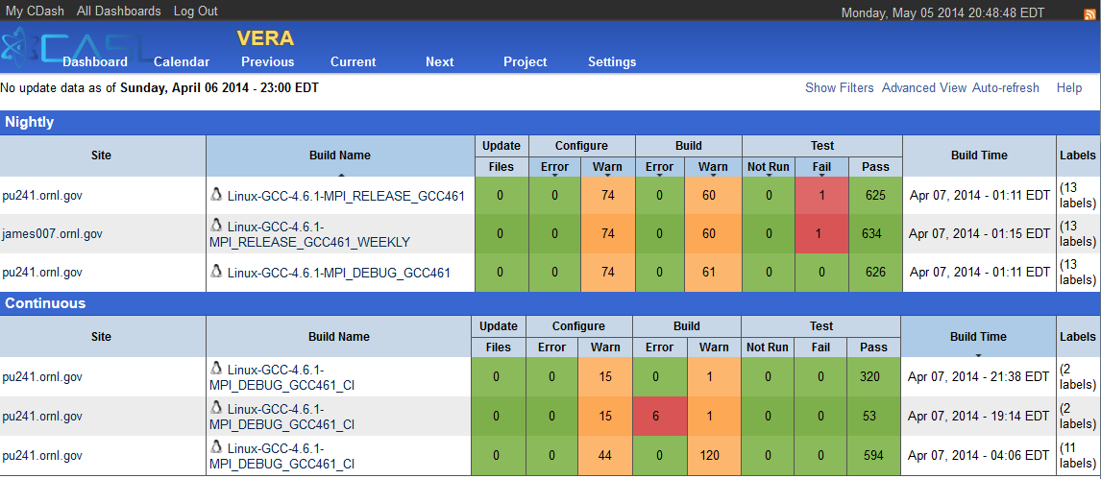
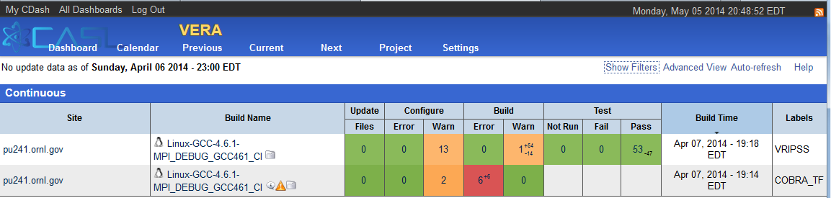
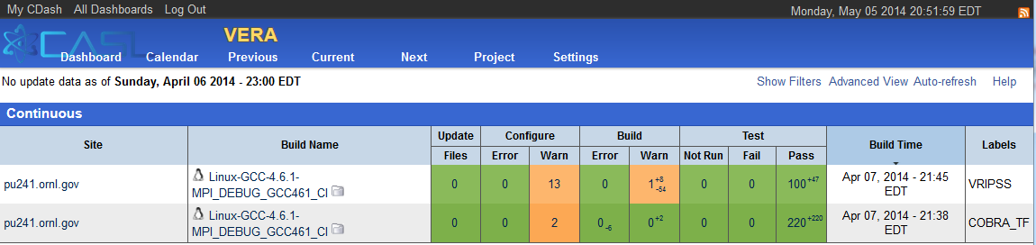
Post-Push Testing: TRIBITS_CTEST_DRIVER()
VERA CDash Dashboard for 4/6/2014
Collapsed summaries for each build case
Nightly, CI, Experimental build cases
VERA CDash CI Iterations
Individual packages built in sequence
Targeted emails for failed package build & tests
Failed packages disabled in downstream packages
=> Don’t propagate failures!

Slide 34
Multi-Repository Integration Models and Processes

Slide 35
Integrating Repos into Project: External and Internal
pull
and/or
push
pull
and/or
push
Project Internal Repos
pull
push
External
Repo1
Project Copy
Repo1
PkgA
PkgB
PkgA
PkgB
Repo1 Devs
Repo1 Integrator
pull
push
External
Repo2
pull
and/or
push
pull
and/or
push
Project Copy
Repo2
PkgC
PkgD
PkgC
PkgD
Repo2 Devs
Repo2 Integrator
Project must contain consistent clones of all the repos in the master branches of each!
Processes enforce that code pulled from the master branch of the project’s interval repo’s is working code!
Core developers for Repo1 and Repo2 may be in different organizations/regions.
pull
and/or
push
Project Native
Repo3
PkgE
PkgF
Project Devs
pull
Project Releaser

Slide 36
Multi-Repository Integration Models
Range of development and sync models (external dev to internal dev):
External repo is manually synced into project/master as needed.
External repo is synced automatically using sync server into project/master using the checkin-test.py script.
Both external and internal repos pushed to by different development groups with sync servers running one way or both ways.
Internally managed repo is synced to an external repo on some schedule to make available to other developers and users and changes from external repo may or may not be synced back into internal repo.
Internally managed repo
A given repo may shift between different integration models at different periods of time (e.g. Trilinos, COBRA-TF)
Integration of different repos should be done independently if possible (e.g. errors in MPACT should not stop pushes of SCALE/Exnihilo and visa versa).
Non-backward compatible changes to upstream repos require coordinated development and combined pushing to project/master

Slide 37
External Repo is manually synced
Project Internal Repos
pull
push
External
Repo2
Project Copy
Repo1
pull
Repo2 Devs
PkgC
PkgD
push
PkgA
PkgB
Repo2 Integrator
A person (Repo2 Integrator) as needed:
Clones all repos from “Project Copy”
Merges in changes from “External Repo2” (fast forward)
Tests against all down-stream packages and pushes with checkin-test.py to “Project Copy Repo2”
Notes:
No-one else pushes changes to “Project Copy Repo2”
Good when changes are not urgent for Project or when “External Repo2” is unstable
Project Copy
Repo2
PkgC
PkgD
pull
Project Native
Repo3
PkgE
PkgF
Project Devs
VERA Repos: DataTransferKit, MAMBA, MOOSE

Slide 38
External repo is synced automatically using sync server
Project Internal Repos
pull
push
External
Repo2
Project Copy
Repo1
pull
Repo2 Devs
PkgC
PkgD
push
PkgA
PkgB
Cron job
Repo2 Integrator
A cron job running a script (Repo2 Integrator) on a hourly/daily/weekly basis:
Clones all repos from “Project Copy”
Merges in changes from “External Repo2” (fast forward)
Tests against all down-stream packages and pushes with checkin-test.py to “Project Copy Repo2”
Notes:
No-one else pushes changes to “Project Copy Repo2”.
Good when changes are important or urgent to Project and “External Repo2” is fairly stable.
Project Copy
Repo2
PkgC
PkgD
pull
Project Nagtive
Repo3
PkgE
PkgF
Project Devs
VERA Repos: SCALE/Exnihilo, MPACT

Slide 39
Both external and internal repos pushed to
Project Internal Repos
pull
push
push
External
Repo2
Project Copy
Repo1
[Cron job?] Repo2 Integrator
to External
pull
Repo2 Devs
PkgC
PkgD
PkgA
PkgB
pull
Sync servers (or people when manual) push changes both ways.
Different sets of developers make changes and push to different Repo2 repos.
Notes:
Good when subsets of developers can not push to each other’s repos
Good when changes are important or urgent to Project.
Good when changes tend to be independent made to Internal and External repos.
Most complex and danger of merge conflicts that someone has to resolve!
Project Copy
Repo2
[Cron job?] Repo2 Integrator
to Internal
push
PkgC
PkgD
pull
push
Project Nagtive
Repo3
PkgE
PkgF
Project Devs
VERA Repos: TriBITS, Trilinos

Slide 40
Internally managed repo is synced to an external repo
Project Internal Repos
pull
External
Repo2
Project Copy
Repo1
push
External Repo2 User
PkgC
PkgD
pull
PkgA
PkgB
[Cron job?]
Repo2 Integrator
A cron job running a script (Repo2 Integrator) on a hourly/daily/weekly basis (or a person when not run as a cron job) :
Clones “External Repo2”
Merges in changes from “Project Copy Repo2” (fast forward)
Tests against just Repo2 tests with checkin-test.py and push to “External Repo2”
Notes:
No-one else pushes changes to “External Repo2”
Good when you just want to make changes available to external users on a continuous basis.
Project Copy
Repo2
PkgC
PkgD
pull
push
Project Nagtive
Repo3
PkgE
PkgF
Project Devs
VERA Repos: COBRA-TF, TeuchosWrappersExt, VERAInExt

Slide 41
Internally managed repo
Project Internal Repos
Project Copy
Repo1
PkgA
PkgB
Simple single-repo development model
Notes:
Good when you don’t need to coordinate with developers outside of Project
Project Copy
Repo2
PkgC
PkgD
pull
push
Project Nagtive
Repo3
PkgE
PkgF
Project Devs
VERA Repos: MOOSEExt, PSSDriversExt , DakotaExt, VUQDemos

Slide 42
Lean/Agile Project Management

Slide 43
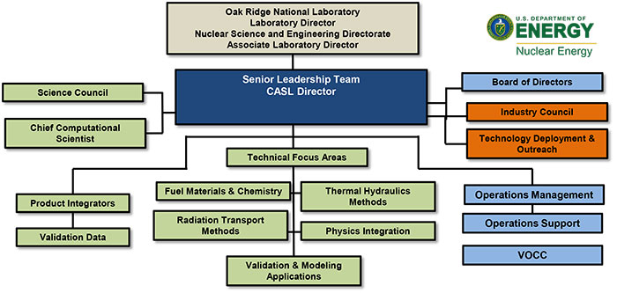
Organization of CASL
http://www.casl.gov/organization.shtml

Slide 44
The Iron Triangle
Time (schedule)
Effort (people)
Scope (functionality)
Given fixed Scope, Time is only weakly improved by adding more Effort!
=> “Mythical Man Month”, Fred Brooks, 1975
For any non-trivial software project it is impossible to fix all three (Time, Effort and Scope)
Agile methods fix Time (fixed iterations, fixed releases) and Effort (fixed time size) and vary Scope (functionality) based on iterative feedback

Slide 45
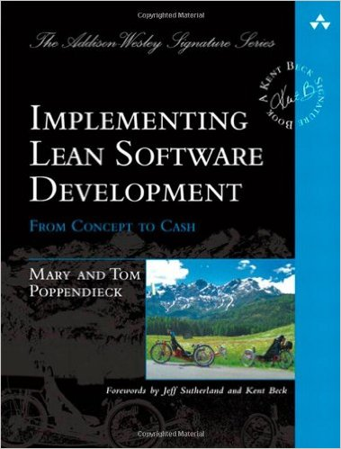
Overview of Lean Methods (7 Principles of Lean)
Motivation for Lean Software Methods:
Lean Manufacturing (e.g. Toyota Production System)
Seven Principles of Lean:
Eliminate Waste
Build Quality In
Create Knowledge
Defer Commitment
Deliver Fast
Respect People
Optimize the Whole
Poppendieck, Mary and Tom. Implementing Lean Software Development. Addison Wesley, 2007

Slide 46
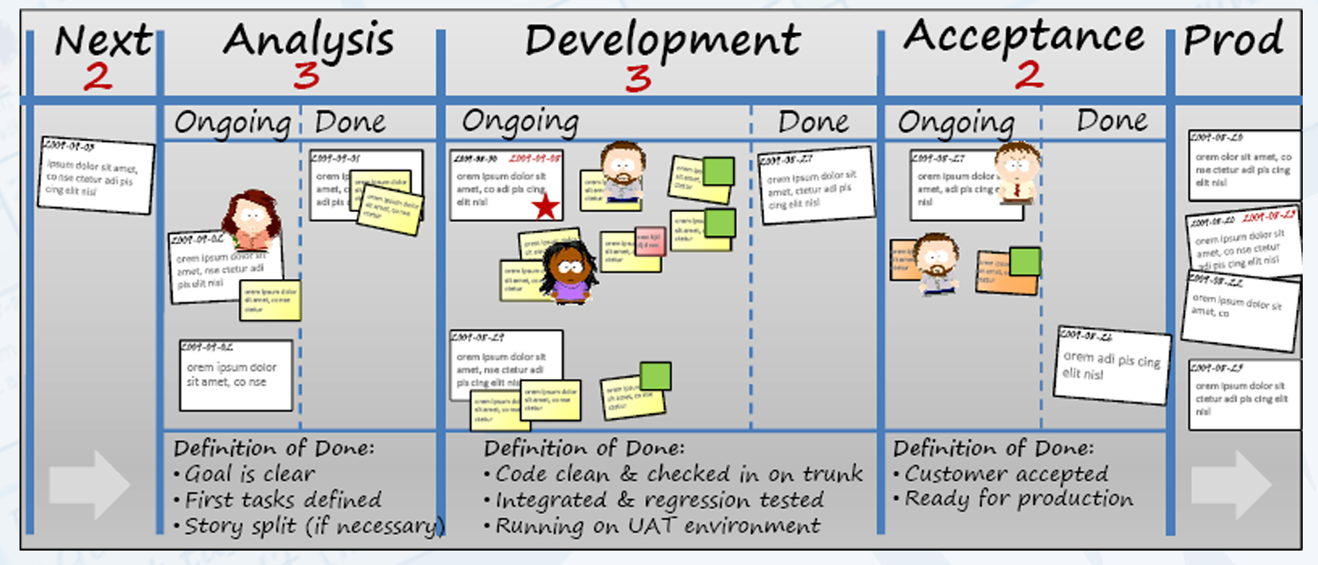
Overview of Kanban
Kanban prescribes:
Just-in-time pull scheduling
Visualize workflow
Limit work in progress
Focusing on minimizing “cycle time”

Slide 47
CASL PHI Kanban Process
Requirements flow from CASL Milestone process (6-month plans of record)
CASL milestones have some agile flexibility:
L3 milestones can be moved back, re-scoped, even canceled based on an agile feedback.
DOE-reportable milestones can’t be moved (since DOE is not agile), but scope can be adjusted based on agile feedback
PHysics Integration (PHI) focus area Kanban Process:
Customized Trac site using Trac tickets for Epics, Stories & Tasks
Projects and Product Owners:
Infrastructure: Build/test infrastructure, repository development workflow and integration strategies, deployment infrastructure
Product Owner: Roscoe Bartlett (ORNL)
Coupled Methods and Development: Physics and mathematical coupling methods and related development
Product Owner: Roger Pawlowski (SNL)
VERA-CS: Physics development, benchmark problem development and testing
Product Owner: Scott Palmtag (Independent)
Weekly Standup Meetings, one for each PHI Project
Review/Retrospective/Planning (RRP) Meetings:
Approximately every 2 to 3 months (flexible)

Slide 48
Summary

Slide 49
CASL VERA Development Challenges
Large legacy codes under active development being constantly updated
=> Memory leaks, memory access errors, etc.
Long configure and build times, unnecessary rebuilds after configure, etc.
Non-native configure/build of MOOSE not using TriBITS CMake
Stack of required TPLs:
MPI, LAPACK/BLAS, Boost, Zlib, PETSC, HDF5, QT, SILO
Different problems with different TPLs on different platforms
QT (required by SCALE) almost always hard to build and install
Testing:
Insufficient unit and verification testing in legacy codes
Many full system acceptance tests that exist require 1000s of processors and hours to run. (currently not automated).
Insufficient staff for infrastructure, testing, deployments, support etc.

Slide 50
Summary
CASL VERA:
CASL almost continuously integrates development efforts from several independent teams and institutions to provide stream of stable versions of versions of VERA software.
By controlling the build, integration, test and distribution Infrastructure one can:
Automate and enforce many SE best practices which helps to …
Avoid mistakes even with low developer training
Improve development productivity (by avoiding broken code)
Improve collaboration between groups (because changes are integrated almost continuously)
TriBITS:
CASL VERA development has pushed multi-repo support in TriBITS
TriBITS offers a lot of flexibility in assembling TriBITS Repositories and Packages into different TriBITS (complete CMake) projects.
Major remaining issues yet to be resolved in TriBITS:
Combining concepts of packages and TPLs for large meta-projects
Finish support for wrapping externally configured/build software as TriBITS packages.
High-level and tutorial documentation
But once these are done => TriBITS will be a good candidate for a universal meta-build and installation system for a very large amount of CSE software!

Slide 51
THE END
Contact: bartlettra@ornl.gov
Sponsors:
CASL: Consortium for the Advanced Simulation of Lightwater reactors

