Slide 1
Design Patterns for Git Workflows
Trilinos Spring Developers Meeting
May 13, 2015
Roscoe A. Bartlett
Oak Ridge National Lab
Computational Eng. & Energy Sciences
Computer Science and Mathematics Div

Slide 2
Background on Git Workflows
2005: Git development begins (Linus Torvalds, for Linux Kernel)
2010: “Gitflow” is presented (Vincent Driessen)
Uses ‘develop’ and ‘master’ branches with short-lived “feature”, “release” and “hotfix” branches
Most well known and popular git workflow (by far)
Every workflow since compares itself to gitlfow (and criticizes gitflow in the process)
After Gitflow:
“Github Flow”: Advocated by Github
Simple feature branches with pull requests
“Simple Git Workflow is Simple”: Advocated by Atlassian
Simple feature branches with rebasing on top of ‘master’ and --no-ff merges to ‘master’
“Gitlab Flow”: Advocated by Gitlab team
“Git.git Worklow” (i.e. “gitworkflows(7))”: Official git man page “gitworkflows(7)”
All feature branches with ‘next’ and ‘pu’ temp testing branches, graduate to ‘master’.
Use by the developers for git itself (i.e. git.git)
Used by Linux Kernel developers
See “Overview and Analysis of Version Control and Development Strategies with Git used by CSE Projects”

Slide 3
Overview of Existing Defined Workflows

Slide 4
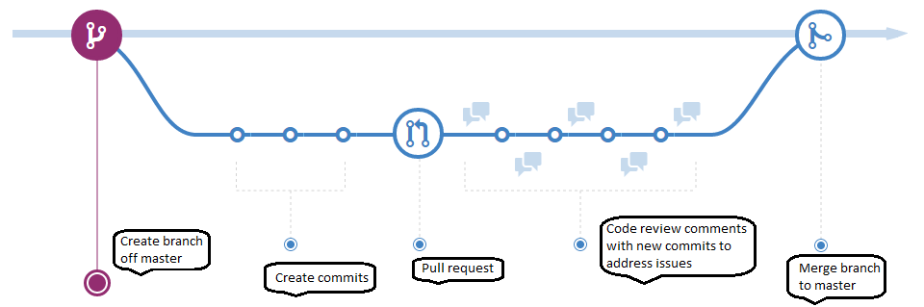
Github Flow
Permanent branches: ‘master’
Primary focus of testing: Each individual feature branch
Notes:
No release branches! (can’t support multiple releases)

Slide 5
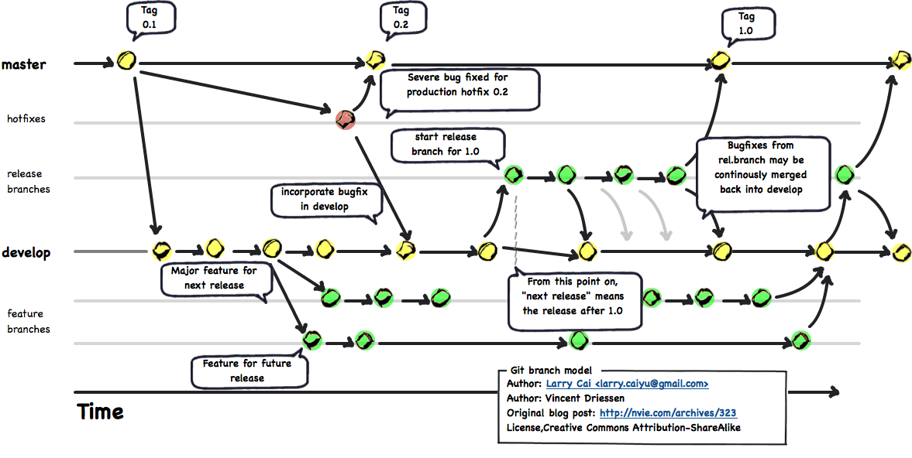
Gitflow
Permanent branches: ‘develop’ and ‘master’
Short-lived branches: “feature”, “release”, and “hotfix”
Primary focus of testing: ‘develop’ branch (but still need testing on ‘master’ if ‘hotfixes’ exist)
Special git command systems has been created to drive workflow! (Criticized as too complex)

Slide 6
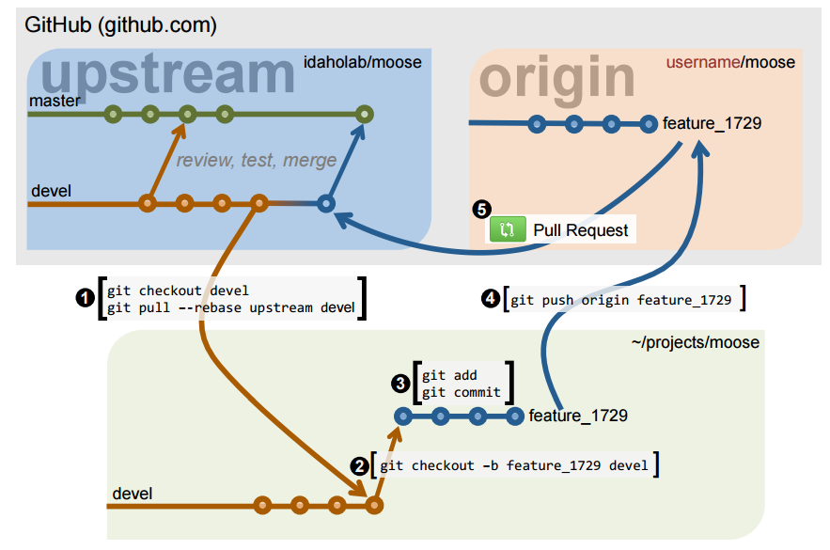
MOOSE Workflow (Gitflow + Github Flow)

Slide 7
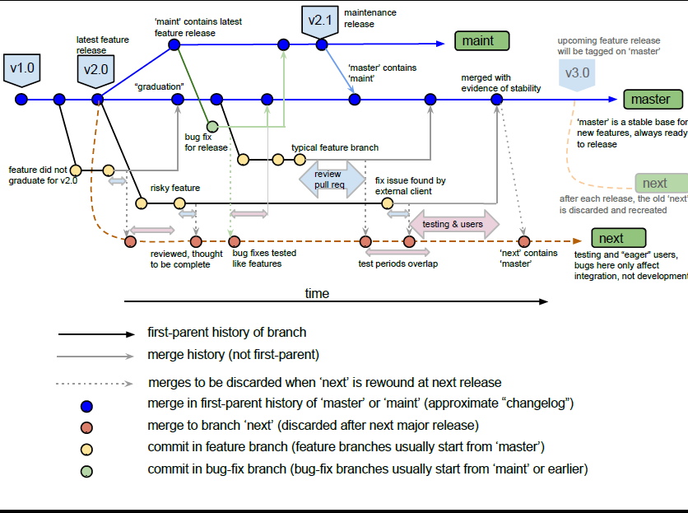
Git.git Workflow “gitworkflows(7)” (PETSc)
See:
Gitworfkows(7) man page
Gitworkflows(7) presentation

Slide 8
Design Patterns for Git Workflows

Slide 9
Incrementally Expanding Git Workflow (Intro)
Instead of defining complete workflows to choose from
=> Define git workflow “building blocks” and construct the workflow that is need!
Workflow Construction Steps:
Consider the properties and challenges for a given project
Construct simplest git workflow using building blocks to meet current needs
Add new features to workflow as situation changes and more challenges emerge
Workflow building blocks
Begin: The simple centralized CI workflow
Addition of a ‘develop’ branch
Addition of topic branches
Addition of a subteam branch
Addition of release branches
Addition of feature branches
Addition of throw-away integration test branch(es)
End: The Git.git Workflow (e.g “gitworkflows(7)”)
Consistent with “gitworkflows(7)” https://www.kernel.org/pub/software/scm/git/docs/gitworkflows.html
These can be added to a git workflow in almost any order!

Slide 10
Issues to Consider to Select Git Workflow
Number of developers
Distribution of general software knowledge and skills of the developers
Distribution of git-specific knowledge and skills of the developers
Amount of (or lack of) communication and coordination between the developers
Nature of the customers and need for releases of the software
Sensitivity of the software (e.g. security vulnerabilities?)
Rate of development and change in the software
Importance (and urgency) of performing code reviews
Portability requirements and portability challenges of the software
Heterogeneity of the development and testing environments

Slide 11
Testing Issues/Support for Git Workflows
Test Suites:
CI Build: This is a Continuous Integration (CI) [2, 3] build of the code on a single platform and single configuration and the running of a (relatively) fast test suite. The CI Build should be constructed so that it protects the major features of the code that are needed by the other developers to continue their development work. The CI Build would be performed before any branch is updated that impacts other developers. This is the pre-push regression test suite described in [1].
Nightly Builds: This is a collection of builds on different platforms with different compilers and running a more comprehensive (i.e. expensive) test suite. This is the nightly regression test suite described in [1].
Testing assumptions:
Additive test assumption of branches: If ‘m + a’ PASSES and ‘m + b’ PASSES, then ‘m + a + b’ also PASSES
Subtractive test assumption of branches: If ‘m + a + b’ PASSES then ‘m + a’ or ‘m + b’ also PASSES.
[1] “How to Add and Improve Testing in Your CSE Software Project”, IDEAS Project, 2015.
[2] “Continuous Integration”, Wikipedia, http://en.wikipedia.org/wiki/Continuous_integration
[3] Fowler, Martin. “Continuous Integration”, http://martinfowler.com/articles/continuousIntegration.html

Slide 12
Begin: Simple Centralized CI Workflow
master
A1
B1
A2
A3
B2
C
D
Dev 1
Dev 2
Features implemented in commits intermingled on ‘master’ branch
Feature “A”: Commits “A1”, “A2”, “A3”
Feature “B”: Commits “B1”, “B2”
Feature “C”: Commit “C”
Pros and Cons (w.r.t. other more sophisticated workflows):
Pro: Simplest workflow with fewest git commands, no distributed VC concepts (i.e. SVN-like)
Pro: Requires least knowledge of git
Pro: Minimizes merge conflicts (frequent pushes to and pulls from ‘master’)
Con: Difficult to perform pre-merge code reviews
Con: Difficult to collaborate with other developers with partial changes (can’t push broken code to ‘master’ to share with others)
Con: Difficult to back out bad feature sets
Con: Difficult to maintain 100% passing tests for all Nightly Builds
Example project: New research project
Small number of closely collaborating developers
No real users (e.g. no need to support releases)

Slide 13
Addition of a ‘develop’ branch
master
(Rare) Bug fix on ‘master’
Close Users
M1
M2
M3
M4
M5
‘develop’ always contains ‘master’
bug-fix-promotion
develop
Bug fixes to allow merge to ‘master’
A1
A2
B1
B2
C
D
Passes nightlies
Fails nightlies
Fails nightlies
Passes nightlies
Passes nightlies
Introduce a ‘develop’ branch:
Developers directly push to ‘develop’ branch using CI Build (i.e. simple centralized CI workflow)
Only merge from ‘develop’ into ‘master’ when all Nightly Builds pass (perhaps with minor bug fixes)
Temp ‘bug-fix-promotion’ branch can be used to stabilize and fix bugs before update of ‘master’
Close users pull from more stable ‘master’ branch (‘master’ is default branch when cloning a git repo!)
Most testing focused on ‘develop’ branch. (Little to no testing needed on ‘master’)
Pros and Cons (w.r.t. single branch workflow):
Pro: Developers still only perform simple centralized CI workflow (only on ‘develop’ not ‘master’)
Pro: More stable ‘master’ branch seen by users
Pro: Allows some time for review of commits on ‘develop’ before merge to ‘master’
Con: Requires knowing how to use multiple branches and merges
Con: Extra effort to perform merges from ‘develop’ to ‘master’ (or could use cron job to do merges)
Example project: Established research project with close users
Small number of closely collaborating developers
Few close customers that can’t handled the instability of the main dev branch
Devs

Slide 14

Addition of topic branches
develop
Or ‘master’ branch if not using a ‘develop’ branch
C
D
1st topic branch for feature A
direct commit
2nd topic branch for feature A
A1
A2
A3
Branch for compete feature B
B1
B2
Introduce usage of temporary short-lived topic branches:
Developers (optionally) implement features in one or more topic branches and merge to ‘develop’. E.g.:
Feature “A”: 1st topic branch (commits “A1”, “A2”), 2nd topic branch (commit “A3”)
Feature “B”: Single topic branch (commits “B1”, “B2”)
Topic branches pass CI Build merged into ‘develop’ about once/day or 4-6 hours of work (rule of thumb)
Direct pushes to ‘develop’ are okay for single commit changes that are not shared/reviewed.
NOTE: Usage of topic branches does not degrade CI at all! Does not lead to more merge conflicts!
NOTE: Not typically long-lived “feature branches” that are hard to merge back!
Pros and Cons (w.r.t. single branch workflow):
Pro: Allow changes to be easily backed out if something goes wrong
Pro: Allow switching between different topic branches quickly
Pro: Allow easy sharing for quick collaboration with other devs before merging to ‘develop’
Pro: Allow quick code reviews (pull-requests) on the topic branch before merging to ‘develop’.
Con: Requires knowing how to use multiple branches and merges with git
Example project: Established research project with multiple developers
Medium number of number of developers who closely collaborate and review code

Slide 15
Addition of a subteam branch
Subteam developers collaborate directly on ‘st-dev’ branch using just the simple centralized CI workflow.
Code reviews can take place on ’st-dev’ branch and issues addressed with new commits before merge to ‘develop’.
Use separate repo where this branch is the default branch after clone.
st-dev
Subteam
Dev 1
Subteam
Dev 2
Merge commits can be backed out if problems are found after merge.
Merge updates from ‘develop’ to/from ‘st-dev’ when needed and/or desired.
Only Subteam Integrator needs to deal with multiple branches, merge commits, etc.
Subteam
Integrator
develop
Dev 1
Dev 2
Works well when:
Changes by subteam commits don’t typically conflict with commits on main ‘develop’ branch.
Criteria for pushing to ‘st-dev’ branch may be different than for pushing to ‘develop’ branch.
Pros and Cons (w.r.t. topic branch workflow):
Pro: Most subteam developers only need to know and use the Simple Centralized CI Workflow
Con: Can create messier git history (e.g. can’t ‘git rebase -i’ to clean up ‘st-dev’ before merge to ‘develop’)
NOTE: Some topic branches can still be used by subteam developers in certain cases
Used for CASL Trilinos co-development (~ 2013-2015), CASL TriBTS (~2013-now), ROL (currently)

Slide 16
Addition of release branches
v2.2.5
release-2.2
v2.2.4
v2.3.0-rc.1
v2.3.0
v2.3.1
Bug fix that affects v2.2 and forward branches
release-2.3
Merge forward
i.e. many commits
later
release-2.3-start
v2.3.0-rc.0
‘master’ contains all release branches
External
Users
v2.3.0-dev
Update for release
v2.4.0-dev
master
Introduce long-lived release branches:
Follows “Semantic Versioning” standard recommended by Github (http://semver.org):
Release tag: vX.Y.Z (X = major, Y = minor, Z = patch), Release candidate: vX.Y.0-rcZ
Apply bug fix to oldest release branch that needs the fix then merge forward (“gitworkflows(7)”)
Cherry-picks from upstream to downstream also allowed (but not preferred)
NOTE: Since ‘master’ contains all release branches, then just testing ‘master’ provides some release testing.
Pros and Cons (w.r.t. single ‘master’ branch which provides a single stream of releases):
Pro: Allow support for multiple releases
Pro: Allows customers to depend on well-defined named versions of the software
Con: More labor and more testing needed to maintain old releases
Example project: Established project with many customers requiring stable named releases
See: “gitworkflows(7)” https://www.kernel.org/pub/software/scm/git/docs/gitworkflows.html
Devs

Slide 17
Addition of release branches (\w ‘develop’)
v2.2.5
release-2.2
v2.2.4
v2.3.0-rc.1
v2.3.0
v2.3.1
release-2.3
Bug fix that affects v2.2 and forward branches
External
Users
Merge forward
release-2.3-start
v2.3.0-rc.0
Release branch merged to ‘develop’, not ‘master’
Other release candidates later …
Close Users
v2.3.0-dev
Update for release
master
i.e. many commits later
v2.4.0-dev
develop
Passes nightlies
Passes nightlies
Passes nightlies
Fails nightlies
Passes nightlies
Devs
Modifications to release workflow when using a ‘develop’ branch:
Most recent release branch is merged to ‘develop’ (instead of ‘master’)
The ‘develop’ (instead of ‘master’) branch is tagged for the next release with ‘vX.Y.0-dev’

Slide 18
Addition of feature branches
Big Bang Integration!
develop
Or ‘master’ branch if not using a ‘develop’ branch
Merge of medium-lived “A” branch goes smoothly
Merge of long- lived “B” branch has many conflicts and other problems
A1
A2
A15
A2 and B2 conflict!
feature-a
feature-b
B1
B2
B55
Introduce long-lived feature branches:
Features completed in separate (long-lived) branches before single merge into ‘develop’.
Pros and Cons (w.r.t. short-lived topic branches):
Pro: Allow time for detailed code reviews before the changes are merged into ‘develop’.
Pro: Accommodate less experienced developers who can’t be trusted to directly push to ‘develop’.
Pro: Accommodate changes from external developers who can’t directly push to the ‘develop’.
Pro: Handle risky changes that may never make it into ‘master’
Pro: Keep very clean git history for each feature, merge commits become “changelog”.
Con: Risk of major merge (or semantic) conflicts (i.e. BIG BANG INTEGRATION, e.g. merge of “B”)
Con: Not consistent with Agile best practice of CI (see “Feature Branch” by Martin Fowler).
Con: Discourages Agile best practice of continuous refactoring (refactoring makes merges difficult)
Con: Requires more testing resources to test each feature branch individually
Example project: Established project with many external contributors and/or junior developers

Slide 19
Addition of throwaway integration test branch(es)
“Graduation” of medium-lived ‘feature-a’ branch goes smoothly
develop
Or ‘master’ branch if not using a ‘develop’ branch
Has same merge conflicts!
feature-a
Graduation of long- lived ‘feature-b’ has fewer conflicts but still has conflicts with already merged in
‘feature-a’.
temp-a-b
feature-b
A1
A2
A15
A2 and B2 have conflicts
AB1
ABn
Temp branch to resolve conflicts
Rebuild ‘next’ from ‘develop’ after next release or more frequently.
B1
B2
B55
All feature branches merged into ‘next’
‘next’ always contains ‘develop’
Address merge conflicts
next
Run Nightly Builds against ‘next’
Or rebase ‘feature-b’ on ‘develop’ then merge to ‘next’ without conflicts.
Introduce throwaway integration test branch(es):
Feature branches (FBs) passing CI Build merged into throwaway ‘next’ branch.
Nightly Builds run on ‘next’ branch every night.
When ready, FB “graduates” and merges into ‘develop’. (i.e. Subtractive test assumption of branches!)
Use throwaway conflict resolution branches (e.g. ‘temp-a-b’) to resolve conflicts between feature branches
Pros and Cons (w.r.t. stand-alone feature branches):
Pro: Incompatibles between feature branches are tested early and often
Pro: Multiple feature branches can be tested together, instead of individually, saving test computing resources
Con: Bad code in a single FB breaks all Nightly Builds run on ‘next’ branch (and no other FB gets tested).
Con: Hard to determine which FB is breaking a ‘next’ Nightly Build
Con: Have to resolve same conflicts twice! (i.e. merge “feature-b” to ‘next’ and ‘develop’) => use git rerere?
Con: More complex and labor intensive workflow!

Slide 20
End: The Git.git Workflow “gitworkflows(7)”
The Git.git Workflow may be a good choice for projects when any of the following are true:
Developers are git experts
Code is of high consequence and responsible for basic security (e.g. git itself)
Many changes being suggested in feature branches may never go into the final version
Desire for a very clean git history
Close users expect to pull working versions of the code from ‘master’ at any point in time
Testing on any single platform (or small number of platforms) does not give sufficient confidence that there will not be major problems on other platforms.
Developers use a heterogeneous set of development environments (e.g. Linux, PC, Mac, and various vendors and versions of compilers) and the code has portability issues.
Going from “addition of throw-away integration test branches” to Git.git Flow
Discard the ‘develop’ branch
Feature branches created from and merged to ‘master’
Full Git.git Flow also uses throw-away ‘pu’ branch!
Current release branch is called ‘maint’, not ‘release’
Old maintained release branches called ‘maint-X.Y.Z’.
In summary, Git.git Flow would be a good starting choice for any project where all of the members of the development team were very good with git and the portability is challenging. However, it comes at the cost of a more complex and labor-intensive development workflow.

Slide 21
Summary
Instead of defining complete workflows to choose from
=> Define workflow “building blocks” and construct the workflow that you need!
Workflow Construction Steps:
Consider the properties and challenges for a given project
Construct simplest git workflow using building blocks to meet current needs
Add new features to workflow as situation changes and more challenges emerge
Workflow building blocks
Begin: The simple centralized CI workflow
Addition of a ‘develop’ branch
Addition of subteam branches
Addition of topic branches
Addition of release branches
Addition of feature branches
Addition of throw-away integration test branch(es)
End: Git.git Flow (e.g “gitworkflows(7)”)
Next steps:
Git training (see Git Tutorial and Reference Info)
These can be added to a git workflow in almost any order!

