Slide 1
Tribal Build, Integrate, and Test System
TriBITS
Roscoe A. Bartlett, Ph.D.
bartlettra@ornl.gov
http://web.ornl.gov/~8vt/ Computational Engineering and Energy Sciences Group, Oak Ridge National Laboratory
SIAM Computational Science & Engineering Conference
Salt Lake City, Utah
March 14, 2015

Slide 2
Background and Motivation
The Challenge => Develop and Deploy Complex Software
Multiple software repositories and distributed development teams
Multiple compiled programming languages (C, C++, Fortran) and mixed-language programs
Multiple development and deployment platforms (Linux, Windows, Super-Computers, etc.)
Stringent software quality requirements
Solution Approach
=> TriBITS custom CMake build & test framework

Slide 3
Overview of CASL VERA Development

Slide 4

Overview of CASL
CASL: Consortium for the Advanced Simulation of Lightwater reactors
DOE Innovation Hub including DOE labs, universities, and industry partners
Goals:
Advance modeling and simulation of lightwater nuclear reactors
Produce a set of simulation tools to model lightwater nuclear reactor cores to provide to the nuclear industry: VERA: Virtual Environment for Reactor Applications.
Phase 1: July 2010 – June 2015
Phase 2: July 2015 – June 2020 Approved by DOE and Congress!
Organization and management:
ORNL is the hub of the Hub
Milestone driven (6 month plan-of-records (PoRs))
Focus areas: Physics Integration (PHI), Thermal Hydraulic Methods (THM), Radiation Transport Methods (RTM), Advanced Modeling Applications (AMA), Materials Performance and Optimization (MPO), Validation and Uncertainty Quantification (VUQ)

Slide 5
CASL VERA Development Overview
VERA Development is complicated in almost every way ☹
VERA Currently Composed of:
18 different git repositories on casl-dev.ornl.gov (clones of other repos) most with a different access list (NDAs, Export Control, IP, etc.)
CMake build system using TriBITS Framework:
Over 2700 CMakeLists.txt files!
VERA Software Development Process:
Official definition of VERA is ‘master’ branch of git repos under gitolite control at git@casl-dev.ornl.gov:<repo-name>.
Primary development platform: CASL Fissile/Spy Machines
VERA integration maintained by continuous and nightly testing:
Pre-push CI testing: checkin-test-vera.sh, cloned VERA git repos, on Fissile machine.
Post-push CI testing: CTest/CDash, all VERA git repos, shared libs.
Nightly CI testing: Debug and Release builds.
100% passing builds and tests!
VERA snapshots and releases are taken off of ‘master’ branches on casl-dev git repos.

Slide 6
Dependencies Between Selected VERA Repositories
Trilinos
hydrath
TeuchosWrappersExt
DatraTransferKit
MOOSE
VERAInExt
SCALE
Exnihilo
MOOSEExt
COBRA-TF
MPACT
PSSDriversExt
LIMEExt
VUQDemos
DakotaExt
Dakota

Slide 7
Why CMake?
Why TriBITS?

Slide 8
Why CMake?
Open-source tools maintained and used by a large community and supported by a profession software development company (Kitware).
CMake:
Simplified build system, easier maintenance
Improved mechanism for extending capabilities (CMake language)
Support for all major C, C++, and Fortran compilers.
Automatic full dependency tracking (headers, src, mod, obj, libs, exec)
Good Fortran support (parallel builds with modules with src => mod => object tracking, C/Fortran interoperability, etc.)
Shared libraries on all platforms and compilers (support for RPATH)
Faster configure times (e.g. > 10x faster than autotools)
Native support for MS Windows (e.g. Visual Studio projects)
Portable support for cross-compiling
CTest:
Parallel running and scheduling of tests and test time-outs
Memory testing (Valgrind)
Line coverage testing (GCC LCOV)
Better integration between the test system and the build system

Slide 9
Why TriBITS?
Framework for large, distributed multi-repository CMake projects
Reduce boiler-plate CMake code and enforce consistency across large distributed projects
Subproject dependencies and namespacing architecture (packages)
Automatic package dependency handling (directed acyclic graph)
Additional functionality missing in raw CMake
Change default CMake behavior when necessary
Additional tools for agile software development processes (e.g. Continuous Integration (CI))
History of TriBITS:
2007: Initially developed as a CMake package architecture for Trilinos
2011: Generalized and extended for CASL VERA
2014: Source code hosted on GitHub

Slide 10
Raw CMake vs. TriBITS

Slide 11
Example Raw CMakeLists.txt File
# Build and install library
set(HEADERS hello_world_lib.hpp)
set(SOURCES hello_world_lib.cpp)
add_library(hello_world_lib ${SOURCES})
install(TARGETS hello_world_lib DESTINATION lib)
install(FILES ${HEADERS} DESTINATION include)
# Build and install user executable
add_executable(hello_world hello_world_main.cpp)
target_link_libraries(hello_world hello_world_lib)
install(TARGETS hello_world DESTINATION bin)
# Test the executable
add_test(hello_world ${CMAKE_CURRENT_BINARY_DIR}/hello_world)
set_tests_properties(hello_world PROPERTIES PASS_REGULAR_EXPRESSION "Hello World")
# Build and run some unit tests
add_executable(unit_tests hello_world_unit_tests.cpp)
target_link_libraries(unit_tests hello_world_lib)
add_test(unit_test ${CMAKE_CURRENT_BINARY_DIR}/unit_tests)
set_tests_properties(unit_test PROPERTIES PASS_REGULAR_EXPRESSION "All unit tests passed")
Executable and test names must be globally unique!

Slide 12
Example TriBITS Package CMakeList.txt File
tribits_package(HelloWorld)
TRIBITS_add_library(hello_world_lib HEADERS hello_world_lib.hpp SOURCES hello_world_lib.cpp)
TRIBITS_add_executable(hello_world NOEXEPREFIX SOURCES hello_world_main.cpp INSTALLABLE)
TRIBITS_add_test(hello_world NOEXEPREFIX PASS_REGULAR_EXPRESSION "Hello World")
tribits_add_executable_and_test(unit_tests SOURCES hello_world_unit_tests.cpp
PASS_REGULAR_EXPRESSION "All unit tests passed")
tribits_package_postprocess()
Less duplication and boiler-plate code
Fewer commands
Build command wrappers:
Install by default (most common)
Optionally Install libraries and headers or just executables?
Optional global prefixing of libraries
And more …
CTest command wrappers:
Automatic namespacing of tests and test executables
Classification of tests (BASIC, CONTINUOUS, NIGHTLY, …)
Uniform handling of timeouts (and scaling of timeouts)
And more …
Maintain consistency and add/change behavior across different independent repositories and packages and 1Ks of CMakeLists.txt files!.

Slide 13
TriBITS Structural Units
and
Meta-Projects

Slide 14
TriBITS Structural Units
TriBITS Project:
Complete CMake “Project”
Overall projects settings
TriBITS Repository:
Collection of Packages and TPLs
Unit of distribution and integration
Typically a version control (git) repository
TriBITS Package:
Encapsulated collection of related software & tests
Unit of testing, namespacing, documentation, and reuse
Lists dependencies on SE Packages & TPLs
TriBITS Subpackage:
Optional partitioning of package software & tests
Primarily for dependency management (SE principles)
TriBITS TPLs (Third Party Libraries):
Specification of external dependencies (libs)
Required or optional dependency
Single definition across all packages
Can use native CMake Find<Package>.cmake modules
Packages
+ Subpackages
=
Software Engineering (SE) Packages

Slide 15
Example: VERA Meta-Project, Repositories, Packages & Subpackages
VERA
VERAInExt
MPACT
Trilinos
VERAIn
MPACT_libs
Teuchos
…
…
Core
Comm
MPACT_Drivers
SCALE/Exnihilo
ParameterList
…
Nemesis
Shift
Insilico
COBRA-TF
Epetra
NOX
…
Neutronics
…
COBRA_TF
…
VERA: Git repository and TriBITS meta-project (contains no packages)
TriBITS and Git repos:: Trilinos, VERAInExt, COBRA-TF, MPACT, SCALE, Exnihilo …
TriBITS packages: Teuchos, Epetra, VERAIn, Insilico, COBRA_TF, MPACT_Drivers, …
TriBITS subpackages: TeuchosCore, InsilicoNeutronics …
TriBITS SE packages: Teuchos, TeuchosCore, VERAIn, Insilico, InsilicNeutronics, …

Slide 16
Flexibility in TriBITS Projects and Repositories
MPACT
Trilinos
Trilinos
VERAInExt
MPACT
Trilinos
COBRA-TF
SCALE
SCALE (Exnihilo)
Trilinos
SCALE
COBRA-TF
Exnihilo
COBRA-TF
VERAInExt
The same TriBITS repositories can be arranged into multiple TriBITS projects.

Slide 17
Automated Package Dependency Handling

Slide 18
Package Dependency Structure (Example: Trilinos)
Thyra
RTOp
Triutils
EpetraExt
Teuchos
Epetra
Required Dependence
Optional Dependence

Slide 19
Package Dependencies.cmake Files
Teuchos
Epetra
tribits_package_define_dependencies(
LIB_REQUIRED_TPLS BLAS LAPACK
LIB_OPTIONAL_TPLS Boost )
tribits_package_define_dependencies(
LIB_REQUIRED_TPLS BLAS LAPACK )
RTOp
Triutils
tribits_package_define_dependencies(
LIB_REQUIRED_PACKAGES Teuchos )
tribits_package_define_dependencies(
LIB_REQUIRED_PACKAGES Epetra )
EpetraExt
Thyra
tribits_package_define_dependencies(
LIB_REQUIRED_PACKAGES Epetra Teuchos
LIB_OPTIONAL_PACKAGES Triutils )
tribits_package_define_dependencies(
LIB_REQUIRED_PACKAGES RTOp Teuchos
LIB_OPTIONAL_PACKAGES EpetraExt Epera )

Slide 20
CI Testing: Change Epetra
$ ./do-configure \
-D Trilinos_ENABLE_Epetra=ON \
-D Trilinos_ENABLE_ALL_FORWARD_DEP_PACKAGES=ON \
-D Trilinos_ENABLE_TESTS=ON
Thyra
Libs & Tests
RTOp
Triutils
EpetraExt
Lib Only
Teuchos
Epetra

Slide 21
CI Testing: Change RTOp
$ ./do-configure \
-D Trilinos_ENABLE_RTOp=ON \
-D Trilinos_ENABLE_ALL_FORWARD_DEP_PACKAGES=ON \
-D Trilinos_ENABLE_TESTS=ON
Thyra
Libs & Tests
RTOp
Triutils
EpetraExt
Lib Only
Teuchos
Epetra

Slide 22
Multi-Repository Support

Slide 23
Managing Compatible Repos and Repo Versions
pull
and/or
push
pull
and/or
push
Project Internal Repos
pull
push
External
Repo1
Project Copy
Repo1
PkgA
PkgB
Repo1 Devs
Repo1 Integrator
PkgA
PkgB
pull
push
External
Repo2
pull
and/or
push
pull
and/or
push
Project Copy
Repo2
PkgC
PkgD
Repo2 Devs
PkgC
PkgD
Issues that need to be addressed:
Flexibility for development inside and outside of particular project.
Managing changes between different repos versions and projects.
Full tracking of changes and updates.
Reproducibility of prior versions.
Repos may be missing with optional package dependencies.
Making non-backward compatible changes across many repos.
How to manage compatible repos versions?
Repo2 Integrator
pull
and/or
push
Project Native
Repo3
PkgE
PkgF
Project Devs
pull
Project Releaser

Slide 24
VERA/cmake/ExtraRepositoriesList.cmake
tribits_project_define_extra_repositories(
TriBITS "" GIT git@casl-dev:TriBITS "" Continuous
Trilinos "" GIT git@casl-dev:Trilinos "" Continuous
TeuchosWrappersExt "" GIT git@casl-dev:TeuchosWrappersExt "" Continuous
MAMBA "" GIT git@casl-dev:MAMBA "" Continuous
COBRA-TF "" GIT git@casl-dev:COBRA-TF "" Continuous
VERAInExt "" GIT git@casl-dev:VERAInExt "" Continuous
DataTransferKit "" GIT git@casl-dev:DataTransferKit "" Continuous
MOOSEExt "" GIT git@casl-dev:MOOSEExt "" Continuous
MOOSE MOOSEExt/MOOSE GIT
git@casl-dev:MOOSE NOPACKAGES Continuous
SCALE "" GIT git@casl-dev:SCALE "" Continuous
Exnihilo SCALE/Exnihilo GIT
git@casl-dev:Exnihilo NOPACKAGES Continuous
MPACT "" GIT git@casl-dev:MPACT "" Continuous
LIMEExt "" GIT git@casl-dev:LIMEExt "" Continuous
hydrath "" GIT git@casl-dev:hydrath "" Nightly
PSSDriversExt "" GIT git@casl-dev:PSSDriversExt "" Continuous
DakotaExt "" GIT git@casl-dev:DakotaExt "" Continuous
Dakota DakotaExt/Dakota GIT git@casl-dev:Dakota NOPACKAGES Continuous
VUQDemos "" GIT git@casl-dev:VUQDemos "" Nightly
)
Official version of VERA in on master branch used for CI & Nightly testing
Partial set of repos can be cloned (protected by different groups)
Non-git repos are converted into git repos: Dakota, SCALE, MOOSE

Slide 25
clone_extra_repos.py
$ ./clone_extra_repos.py
…
-----------------------------------------------------------------------------------------------------
| ID | Repo Name | Repo Dir | VC | Repo URL | Category |
|----|--------------------|--------------------|-----|---------------------------------|------------|
| 1 | TriBITS | TriBITS | GIT | git@casl-dev:TriBITS | Continuous |
| 2 | Trilinos | Trilinos | GIT | git@casl-dev:Trilinos | Continuous |
| 3 | TeuchosWrappersExt | TeuchosWrappersExt | GIT | git@casl-dev:TeuchosWrappersExt | Continuous |
| 4 | MAMBA | MAMBA | GIT | git@casl-dev:MAMBA | Continuous |
| 5 | COBRA-TF | COBRA-TF | GIT | git@casl-dev:COBRA-TF | Continuous |
| 6 | VERAInExt | VERAInExt | GIT | git@casl-dev:VERAInExt | Continuous |
| 7 | DataTransferKit | DataTransferKit | GIT | git@casl-dev:DataTransferKit | Continuous |
| 8 | MOOSEExt | MOOSEExt | GIT | git@casl-dev:MOOSEExt | Continuous |
| 9 | MOOSE | MOOSEExt/MOOSE | GIT | git@casl-dev:MOOSE | Continuous |
| 10 | SCALE | SCALE | GIT | git@casl-dev:SCALE | Continuous |
| 11 | Exnihilo | SCALE/Exnihilo | GIT | git@casl-dev:Exnihilo | Continuous |
| 12 | MPACT | MPACT | GIT | git@casl-dev:MPACT | Continuous |
| 13 | LIMEExt | LIMEExt | GIT | git@casl-dev:LIMEExt | Continuous |
| 14 | hydrath | hydrath | GIT | git@casl-dev:hydrath | Nightly |
| 15 | PSSDriversExt | PSSDriversExt | GIT | git@casl-dev:PSSDriversExt | Continuous |
| 16 | DakotaExt | DakotaExt | GIT | git@casl-dev:DakotaExt | Continuous |
| 17 | Dakota | DakotaExt/Dakota | GIT | git@casl-dev:Dakota | Continuous |
| 18 | VUQDemos | VUQDemos | GIT | git@casl-dev:VUQDemos | Nightly |
-----------------------------------------------------------------------------------------------------
…
Running: git clone git@casl-dev:TriBITS TriBITS
Running: git clone git@casl-dev:Trilinos Trilinos
…
Only clones the repos that the user/developer has access to clone!

Slide 26
gitdist
$ gidist-status
------------------------------------------------------------------
| ID | Repo Dir | Branch | Tracking Branch | C | M | ? |
|----|--------------------|--------|-----------------|---|---|---|
| 0 | VERA (Base) | master | origin/master | 2 | 1 | |
| 1 | TriBITS | master | origin/master | | | |
| 2 | Trilinos | master | origin/master | | | |
| 3 | TeuchosWrappersExt | master | origin/master | | | 2 |
| 4 | MAMBA | master | origin/master | | | |
| 5 | COBRA-TF | master | origin/master | | | |
| 6 | VERAInExt | master | origin/master | | | 3 |
| 7 | DataTransferKit | master | origin/master | | | |
| 8 | MOOSEExt | master | origin/master | | | |
| 9 | MOOSEExt/MOOSE | master | origin/master | | | |
| 10 | SCALE | master | origin/master | | | |
| 11 | SCALE/Exnihilo | master | origin/master | | | |
| 12 | MPACT | master | origin/master | 2 | | |
| 13 | LIMEExt | master | origin/master | | | |
| 14 | hydrath | master | origin/master | | | |
| 15 | PSSDriversExt | master | origin/master | | 4 | |
| 16 | DakotaExt | master | origin/master | | | |
| 17 | DakotaExt/Dakota | master | origin/master | | | |
| 18 | VUQDemos | master | origin/master | | | |
------------------------------------------------------------------
(tip: to see a legend, pass in --dist-legend.)

Slide 27
Testing Support

Slide 28
TriBITS Standard Testing Layers
Nightly Testing
Secondary Tested (ST)
CATEGORIES [BASIC CONTINUOUS NIGHTLY]
(more platforms, more TPLs)
Post-Push CI Testing
Secondary Tested (ST)
CATEGORIES [BASIC CONTINUOUS]
(post-push CTest/CDash, Linux/GCC)
Correctness Testing
Pre-Push CI Testing
Primary Tested (PT)
CATEGORIES [BASIC]
(pre-push checkin-test.py)
Coverage Testing
Memory (Valgrind) Testing

Slide 29
Pre-Push CI Testing: checkin-test.py
$ checkin-test.py --do-all –push
Integrates with latest version in remote git repositories
Figures out modified packages
Modified file: 'packages/teuchos/CMakeLists.txt'
=> Enabling 'Teuchos'!
Enables all forward/downstream packages & tests
Configures, builds, and runs tests
Does the push (if all builds/tests pass)
Sends notification emails
Fully customizable (enabled packages, build cases, etc.)
Documentation: checkin-test.py --help

Slide 30
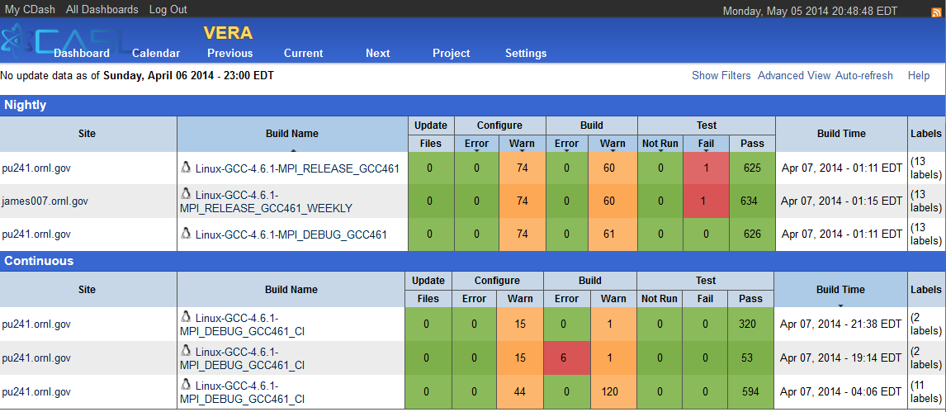
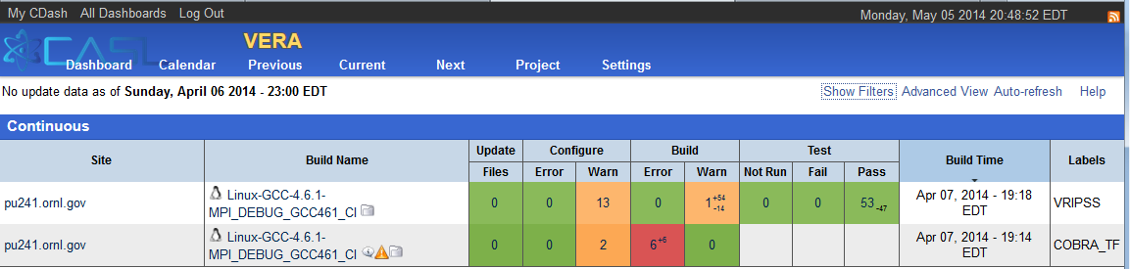
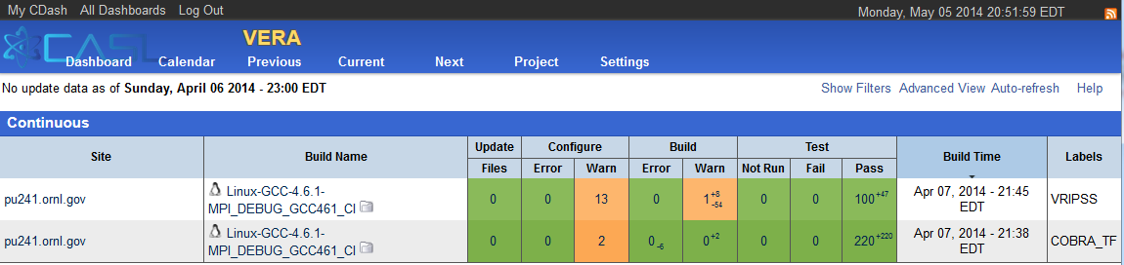
Post-Push Testing: TRIBITS_CTEST_DRIVER()
VERA CDash Dashboard for 4/6/2014
Collapsed summaries for each build case
Nightly, CI, Experimental build cases
VERA CDash CI Iterations
Individual packages built in sequence
Targeted emails for failed package build & tests
Failed packages disabled in downstream packages
=> Don’t propagate failures!

Slide 31
TriBITS Miscellaneous Facts and Future Work
TriBITS System Partitioning and Dependencies:
TriBITS Core: Basic configure, build, test, install, and creating distributions
=> Only requires raw CMake 2.8.11+
=> 10K lines of CMake code (1M of disk space)
TriBITS CI Support (checkin-test.py, clone_extra_repos.py,…)
=> Requires Git (1.7.0.4+) and Python 2.4
See TriBITS Developers Guide for more details (http://tribits.org )
Usage of TriBITS:
Trilinos (SNL, originating project)
ORNL: SCALE, Exnihilo, DataTransferKit
Non-ORNL: MPACT (Univ. of Misc.), COBRA-TF (Penn. State)
CASL-Related: VERA
TriBITS Development & Distribution:
3-clause BSD-like license, Copyright SNL
Main source hosted on GitHub (https://github.com/TriBITSPub/TriBITS )
Documentation hosted on http://tribits.org
Near-term Future Work:
More flexibility on pre-building packages and linking in as TPLs
Define a standard installation of TriBITS
Put out a TriBITS release
Finish overview document and tutorials
More error checking to catch user mistakes

Slide 32
THE END
Contact: bartlettra@ornl.gov
Sponsors:
CASL: Consortium for the Advanced Simulation of Lightwater reactors

