Slide 1
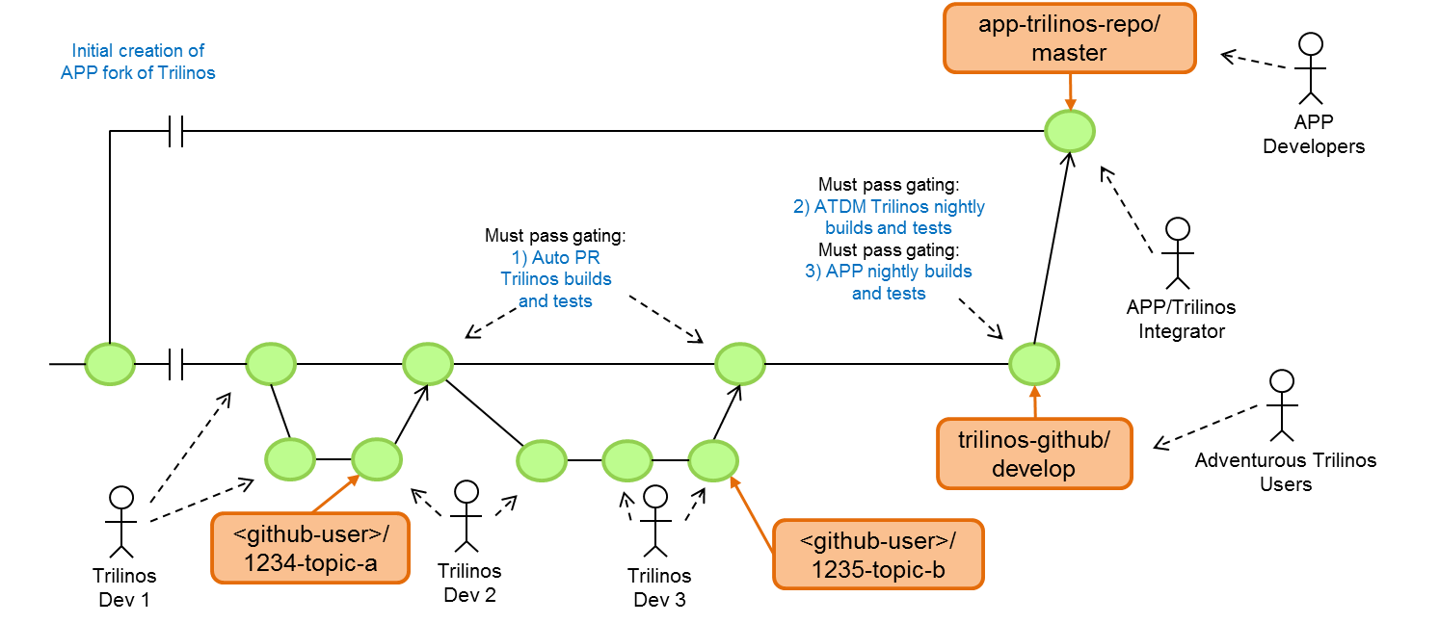
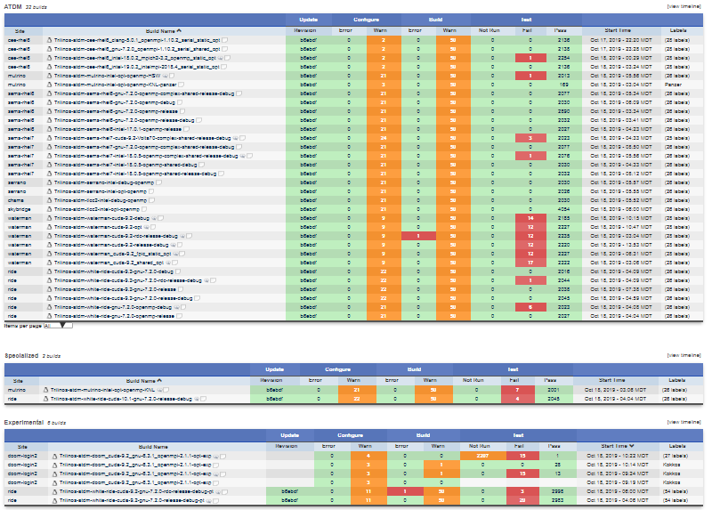
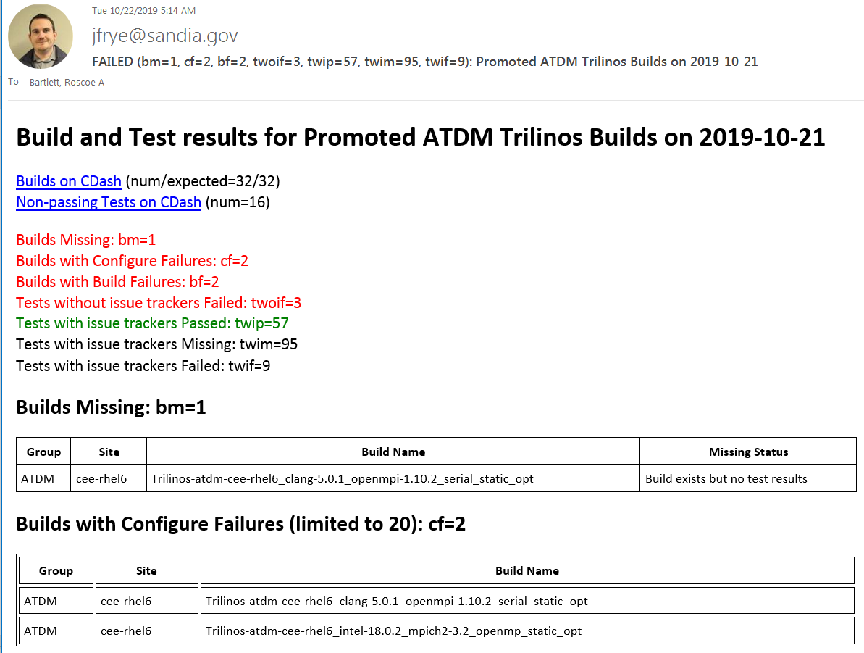
Staying on top of a lot of CDash builds/tests: cdash_analyze_and_report.py
Trilinos Developers Meeting
October 23, 2019
Roscoe A. Bartlett, Joseph R. Frye
Sandia National Laboratories
SAND2019-13824 C

Slide 2
ATDM Trilinos Nightly Builds and Tests (CDash)

Slide 3
Challenges staying on top of a lot of builds/tests on CDash
Existing test failures hide the emergence of new failing tests
Random configure and build failures due to system issues:
Disk and network I/O issues
Machine overloading
Compiler license server problems (e.g. Intel license server).
Random test failures due to system issues:
Disk and network I/O issues
MPI stat-up problems
Non-deterministic (rare) bugs in bleeding-edge system software (e.g. OpenMPI+CUDA CPU/GPU data management).
(Randomly) failing tests due to defects in project code:
Defects in features not used by important customers
Defects in functional software used by important customers
Missing build and test results on CDash dashboard:
Machine overloading (e.g. queues are full)
Machines go down for maintenance in middle of build/testing.
Communication problems with CDash server to upload results.
Can’t judge health of a Project from just the amount of red or green on CDash dashboard!

Slide 4
Options for monitoring results on CDash
Go look at CDash every day
Pro: It is there to look at ☺
Con: Have to remember to look every day
Con: Hard to see history of test failures
Con: Hard to see history of failures (first time?, regularly or randomly failing?)
Have CDash send out emails for each build each day
Pro: Already implemented in CDash
Con: Spammed a lot of emails if there are failures across many builds
Con: Hard to see if same tests are failing in multiple builds
Con: Can’t tell of failures have already been triaged or are new failures
Generate single summary email: cdash_analyze_and_report.py
Pro: Single email no matter how many failures occur
Pro: Reports builds with any missing results
Pro: Show test history
Pro: Show new failures not already reported
Pro: Detect randomly failing tests
Pro: Show patterns of failures across multiple builds
Con: ???

Slide 5
cdash_analyze_and_report.py: Example Email: ATDM

Slide 6
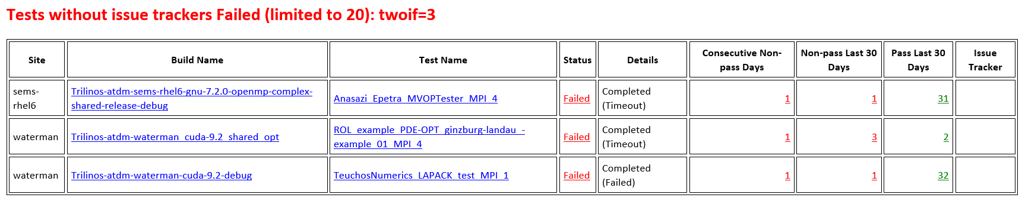
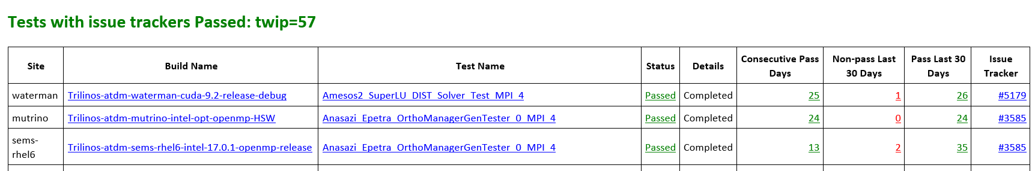
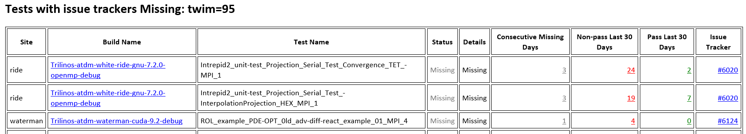
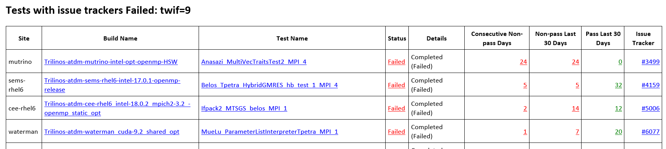
cdash_analyze_and_report.py: Example Email: ATDM

Slide 7
cdash_analyze_and_report.py: Example Driver Script: ATDM
TrilinosATDMStatus/trilinos_atdm_builds_status.sh
${TRIBITS_DIR}/ci_support/cdash_analyze_and_report.py \
--cdash-project-name="Trilinos" \
--build-set-name="Promoted ATDM Trilinos Builds" \
--cdash-site-url="https://testing-dev.sandia.gov/cdash" \
--cdash-builds-filters="<index-php-filters>" \
--cdash-nonpassed-tests-filters="<query-tests-php-filters>" \
--expected-builds-file=\
promotedAtdmTrilinosExpectedBuilds.csv \
--tests-with-issue-trackers-file=\
promotedAtdmTrilinosTestsWithIssueTrackers.csv \
--limit-table-rows=20 \
<other non-essential arguments> \
"$@"
Run the script
$ git clone git@gitlab-ex.sandia.gov:atdm/TrilinosATDMStatus.git
$ cd TrilinosATDMStatus/
$ git clone git@github.com:TriBITSPub/TriBITS.git
$ cd ../..
$ module load sems-env ; module load sems-python/2.7.9
$ ./TrilinosATDMStatus/trilinos_atdm_builds_status.sh \
--date=2019-10-21 --send-email-to=<your-email-address>

Slide 8
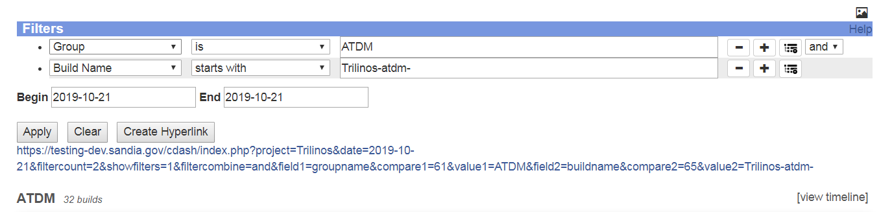
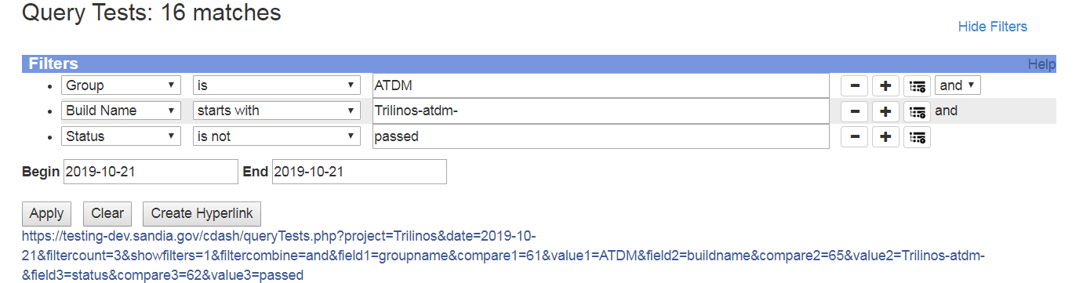
cdash_analyze_and_report.py: Getting the CDash Filters
cdash/index.php: <index-php-filters>
cdash/queryTests.php: <query-tests-php-filters>

Slide 9
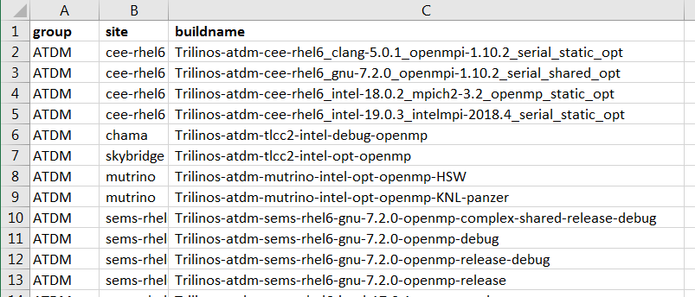
cdash_analyze_and_report.py: Expected Builds CSV file
--expected-builds-file=\
promotedAtdmTrilinosExpectedBuilds.csv \

Slide 10
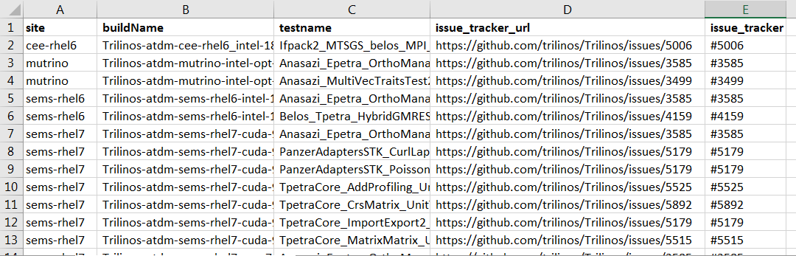
cdash_analyze_and_report.py: Tests with Issue Trackers CSV File
--tests-with-issue-trackers-file=\
promotedAtdmTrilinosTestsWithIssueTrackers.csv \

Slide 11
cdash_analyze_and_report.py: Setup and usage tips
Test history queries are expensive, so don’t run tool in real-time
Set up cron job to run after the end of the testing day but not during business hours (e.g. 2 AM)
Use argument --write-failing-tests-without-issue-trackers-to-file=<file>.csv to have tool write out the list of failing tests to add the list of tests with issue trackers CSV file.
Use examples in the repo: https://gitlab-ex.sandia.gov/atdm/TrilinosATDMStatus
Other possible usages:
Trilinos Framework team: Monitor “Clean” and “Nightly” builds
ROL Team: Monitor “ROL” builds
MueLu Team: Monitor “MueLu” builds

Slide 12
cdash_analyze_and_report.py: Near-term ToDos
Configure and Build Errors:
Add number of configure, build, and test failures in each build (with links)
Add history of configure/build errors over last X days (with links)
Test Failures:
Add randomly_failing field with values:
0: Fails every day
1: Randomly fails regularly
2: Randomly fails rarely (don’t list in ‘twip’ table if passing)
Add expected_fail_regex field
E.g.: “Caught signal 11 .Segmentation fault: address not mapped to object at address”
Allow for wild-card (regex) matches for sites, builds, and/or tests:
E.g.: buildname: “.*cuda.*”
E.g.: testname: “MueLu_ParameterList.*”
Add allow_to_fail field with values:
0: Not allowed to fail
Listed in “Tests with issue trackers Failed: twif=???”
1: Allowed to fail
Listed in “Tests with issue trackers allowed to fail Failed: twiatff=???”

Slide 13
THE END

