Slide 1
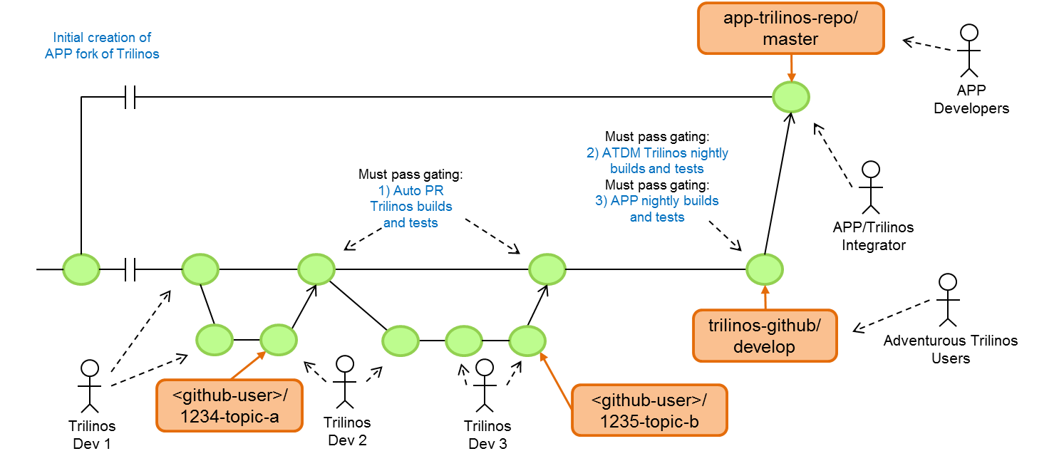
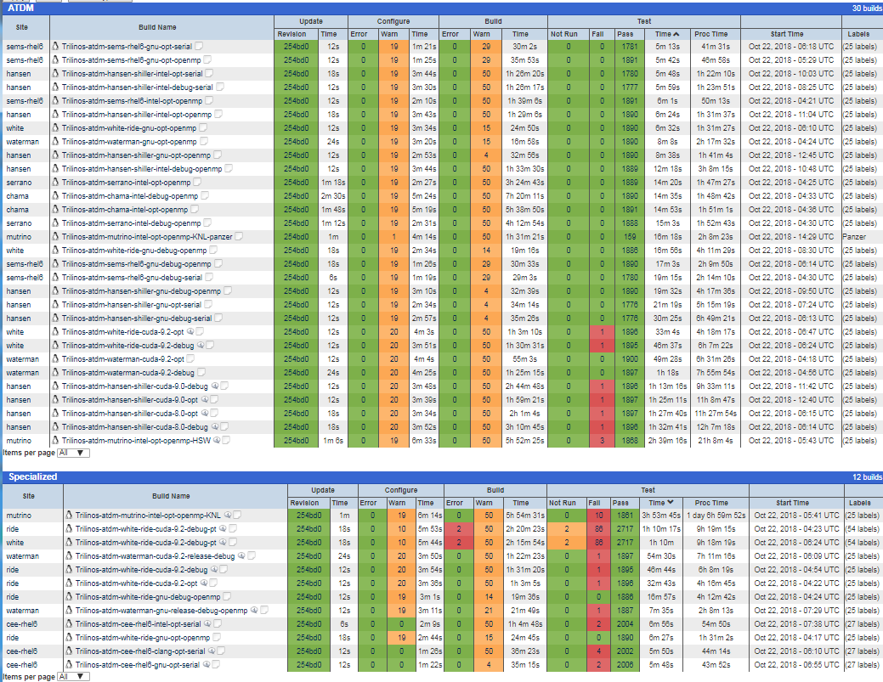
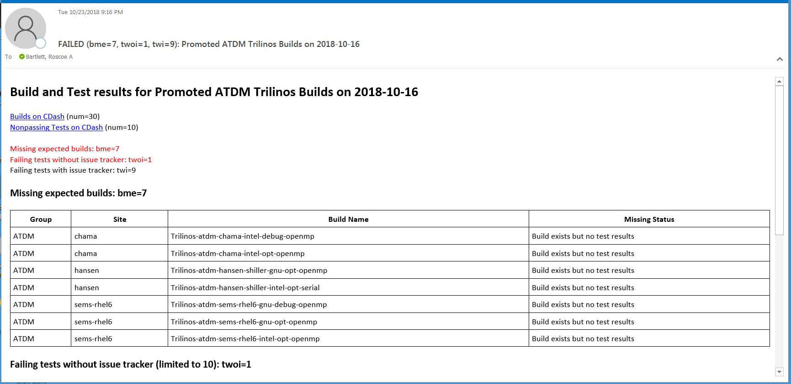
ATDM Trilinos Testing and Integration
Trilinos Developers Meeting
October 25, 2018
Roscoe A. Bartlett, Joseph R. Frye
Sandia National Laboratories
SAND2018-12416 PE

Slide 2
Overview of ATDM Trilinos Testing and APP Integration

Slide 3
Trilinos Development and APP-Integration Parts
Trilinos / APP Git Workflows:
How git repositories and branches are set up, how merges occur, what git commands are run, etc.
Different git workflows are used for Trilinos developers, APP developers, and APP/Trilinos co-developers
Gating test suites can/should be run before each “merge” in the workflow
Testing gates for workflows:
Gating tests can be run manually or automated, daily or “every-so-often”, etc.
Important test suites:
1) Auto PR Trilinos builds and tests : Owned by the Trilinos Framework team
2) ATDM Trilinos nightly builds and tests: Jointly owned by ATDM DevOps and APP teams
3) APP nightly builds and tests: Owned by APP teams
Triaging and fixing failed builds and tests:
Notification of new failures
Triage failures
Address failures
Manage & Follow-up

Slide 4
Trilinos Development and APP-Integration Workflows
app-trilinos-repo/
master
Initial creation of APP fork of Trilinos
APP
Developers
Must pass gating:
2) ATDM Trilinos nightly builds and tests
Must pass gating:
3) APP nightly builds and tests
Must pass gating:
1) Auto PR Trilinos builds and tests
APP/Trilinos
Integrator
trilinos-github/
develop
Adventurous Trilinos Users
<github-user>/
1234-topic-a
<github-user>/
1235-topic-b
Trilinos
Dev 1
Trilinos
Dev 2
Trilinos
Dev 3
Legend for Git Workflow Diagrams
This is the goal, but the APPs are updating without checking that the native Trilinos test suite actually passes on the ATDM platforms!
direct commit on <main-branch>
link to ancestor commit
(explicit) merge commit
<main-branch>
commits on branch
branch
references
link to merge ancestor
Unspecified git graph/history
<topic-branch>
Person creating commit
Time

Slide 5
Trilinos Development and APP-Integration Parts
Trilinos / APP Git Workflows:
Trilinos Pull Request (PR) testing & merging to ‘develop’ [Done]
SPARC / Trilinos subteam workflow (manual testing by Micah H.) [Done]
EMPIRE / Trilinos git.git workflow (EMPIRE-owned Jenkins pipeline for testing) [Done]
Testing gates for workflows:
1) Auto PR Trilinos builds and tests :
Current: MPI GCC 4.8.4, GCC 4.9.3, Intel 17
Future: CUDA (see Trilinos GitHub #2646)
2) ATDM Trilinos nightly builds and tests:
ATDM Trilinos builds for EMPIRE … EMPIRE switchover in-progress/complete?
ATDM Trilinos builds for SPARC … ‘cee-rhel6’ gnu, intel, and clang complete
3) APP nightly builds and tests
EMPIRE-PIC and EMPIRE-Fluid build and test suite: A few builds posting to Jenkins only
SPARC build and test suite: Submits to Sierra CDash site
Triaging and fixing failed builds and tests:
Notification of new failures: Python email tool pulling data for ATDM Trilinos builds off CDash site.
Triage failures: Filter out non-code failures then create Trilinos GitHub Issues
Joe Frye creates initial GitHub Issues, Product Areas Leads follow up from there
Address failures :
New builds: a) fix, b) allow to fail, c) temporally disabling non-critical tests
Existing builds: a) fix, b) allow to fail, c) temporally disable, or d) reverting PR from ‘develop’
Manage & Follow-up: Someone must observe and ensure failures are addressed (???Who???)

Slide 6
2) ATDM Trilinos Nightly Builds and Tests (CDash)
All cleaned-up builds promoted to “ATDM” CDash group and maintained (30 as of 10/22/2018).
Every Trilinos developer can see details on build and test failures.
Easy to query about behavior of tests over multiple days, multiple builds, etc.
Easy for Trilinos developers to reproduce failing builds and tests on any ATDM platform.
Pull down results using CDash API for automated workflows.
Python tool pulling data off CDash and daily summary email.

Slide 7
Where to Catch Trilinos Defects on ATDM Systems?
Trilinos package native test suite running in ATDM platform
Best place to catch a Trilinos defect!
Trilinos developers can triage and fix a defect before APP/Trilinos Integrators need to dig in to triage APP failures caused by these defects.
APP (EMPIRE, SPARC) native test site running on ATDM platform
Less than best place to catch a Trilinos defect.
Requires APP/Trilinos Integrator and APP Developers to triage problems and communicate back to Trilinos developers.
APP developer or user when running APP code
The worst place to catch a Trilinos defect!
APP Customer has to report problems back to APP Developers who have to triage the failure and then report back to Trilinos developers.
Example:
SEACAS update https://github.com/trilinos/Trilinos/issues/2650
Broke Trilinos/SEACAS CUDA test suite.
Did NOT break the EMPIRE test suite.
Broke usage of EMPIRE!
If update of Trilinos was gated by 100% passing SEACAS tests, then EMPIRE developers may have never seen these defects!

Slide 8
Injecting Failures
vs.
Fixing Failures

Slide 9
Injecting New Failures and Fixing Failures: A Race!
Mean-time to fail: Average time (in days) for when a new failure shows up in ‘develop’ branch in one or more promoted ATDM Trilinos builds.
Mean-time to fix: Average time (in days) to discover, triage and fix a failure on the Trilinos ‘develop’ branch in the promoted ATDM Trilinos builds.
The core problem: If “mean-time to fail” is less than “mean-time to fix”, then the ATDM Trilinos builds on ‘develop’ on average will ALWAYS be broken (and therefore block updates of Trilinos to the APP customers)!
Mean-time to fix
<
Mean-time to fail
# Failures
Time (days)
100% clean allowing Trilinos APP updates
Mean-time to fix
>
Mean-time to fail
# Failures
Promoted “ATDM” Trilinos builds have been continuously broken for 3+ months since 7/15/2018!
Almost never clean unless freeze and bug fix sprint!
Freezing the ‘develop’ branch to fix failures is never going to happen!

Slide 10
Options for ATDM Trilinos APP Updates
Option-1: Make ATDM Trilinos builds clean on ‘develop’ periodically
Option-2: Create ‘atdm-release’ branches and clean up there

Slide 11
Option-1: Get clean ATDM Trilinos Builds on ‘develop’
app-trilinos-repo/
master
Passes gating:
2) ATDM Trilinos nightly builds and tests
3) APP nightly builds and tests
Badly Breaks:
2) ATDM Trilinos Nightly Builds and Tests
Passes gating:
2) ATDM Trilinos nightly builds and tests
3) APP nightly builds and tests
trilinos-github/
develop
# Failures
Time (days)

Slide 12
Option-2: Trilinos ‘atdm-release’ branches: Workflow
app-trilinos-repo/
master
Merge ‘atd-relase’ to ‘app-trilinos-repo/master’
Must run ATDM Trilinos builds on ’atdm-release’ branch also!
Must create bug-fix branch off of ‘atdm-release’ NOT ‘develop’
Fixes failures on ‘atdm-release’ and ‘develop’
atdm-release
Fixes ATDM Trilinos and APP test suites!
atdm-release
Create a new ‘atdm-release’ branch
Create a new ‘atdm-release’ branch
Bug-fix topic branch
Must create 2 PRs per bug-fix branch!
Adds new ATDM Trilinos and APP failures on ‘develop’?
trilinos-github/
develop
‘develop’ has many ATDM Trilinos and APP failures!
Adds new ATDM Trilinos and APP failures on ‘develop’?
NOTE: Note this is really just an adaptation of the gitworkflows(7) release ‘maint’ branch!

Slide 13
Option-2: Trilinos ‘atdm-release’ branches: Failures
Create new ‘atdm-release’ branch
Merge ‘atdm-release’ to ‘app-trilinos-repo/master’
Create new ‘atdm-release’ branch
Merge ‘atdm-release’ to ‘app-trilinos-repo/master’
‘atdm-rerlease’ branch
# Failures
‘develop’ branch
# Failures
Time (days)

Slide 14
Options for ATDM Trilinos APP Updates: Summary
Option-1: Make ATDM Trilinos builds clean on ‘develop’ periodically
Assumes: “Mean-time to fix” is less than the “mean-time to fail” on ‘develop’ branch.
Pro: Requires just one set of builds on the ATDM platforms.
Pro: Simpler workflow for Trilinos developers merge bug fixes to ‘develop’ branch.
Pro: Provides quicker APP updates of Trilinos.
Pro: Allows APPs like EMPIRE to co-develop Trilinos and update Trilinos ‘develop’ and get updates to the APP fairly regularly.
Con: Requires fast reaction time to detect and triage new failures and then either a) fix, b) disable, or c) revert breaking PRs so that the “mean-time to fix” is less than “mean-time to fail”.
Option-2: Create ‘atdm-release’ branches and clean up there
Assumes: “Mean-time to fix” is less than the “mean-time to failure” (not true right)
Pro: More leisurely reaction time to fix defects since no race with “mean-time to fail”.
Pro: Guaranteed periodic Trilinos updates with 100% clean ATDM Trilinos builds.
Con: Requires double the number of builds; one on ‘develop’, one on ‘atdm-release’
Con: More complex workflow for Trilinos developers to commit fixes to ‘atdm-release’ and then merge back to “develop” in two Trilinos PRs per bug-fix branch!
Con: More complex workflow for APP Trilinos co-developers involving branches, cherry-picks (e.g. EMPIRE git-git-like workflow and SPARC cherry-picking workflow).

Slide 15
General Software Engineering Principles for Defects

Slide 16
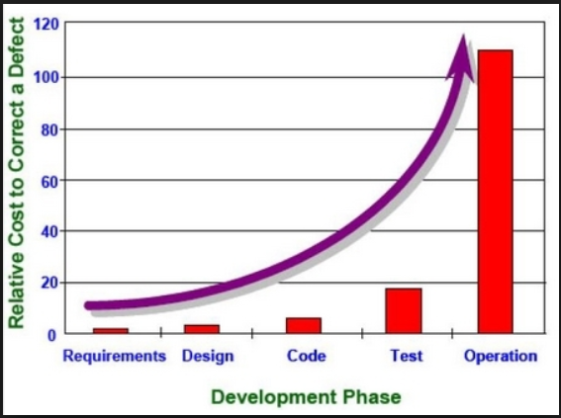
General SE Principles for Defects
Cost of a defect goes up (significantly) the longer it takes to detect and correct a defect.
Lean/Agile SE Practices for dealing with defects:
Strong automated testing (have tests help new detect defects)
Continuous testing (reduce the time to detect new defects caught by tests)
Continuous integration (reduce time to detect conflict defects)
STOP THE LINE when a new defect gets into the main development branch
Fixing defects in previously working software is higher priority than developing new features!

Slide 17
Reducing Time to Detect, Triage, and Address Trilinos Failures

Slide 18
Reduce Time to Detect, Triage, and Fix Defects
Reduce time to detect and triage new Trilinos defects
Run nightly ATDM Trilinos builds against ‘develop’ and run APP native tests against Trilinos ‘develop’ [Much progress but more to do]
Filter out non-code failures and create new ATDM Trilinos GitHub Issues with dedicated person(s) to do top-level triage. [In Progress, Joe Frye]
Python tool to keep track of new failures not already covered by Trilinos GitHub issues [In Progress]
Add categories according to severity (e.g. “critical”, “blocker”, “nonblocker”) [ToDo]
Reduce time to fix defects
Make it easy for Trilinos developers to reproduce failures for ATDM Trilinos builds [Done]
Send regular reminders to Trilinos Product Area Leads and assigned Trilinos developers about un-resolved ATDM Trilinos GitHub issues. [ToDo]

Slide 19

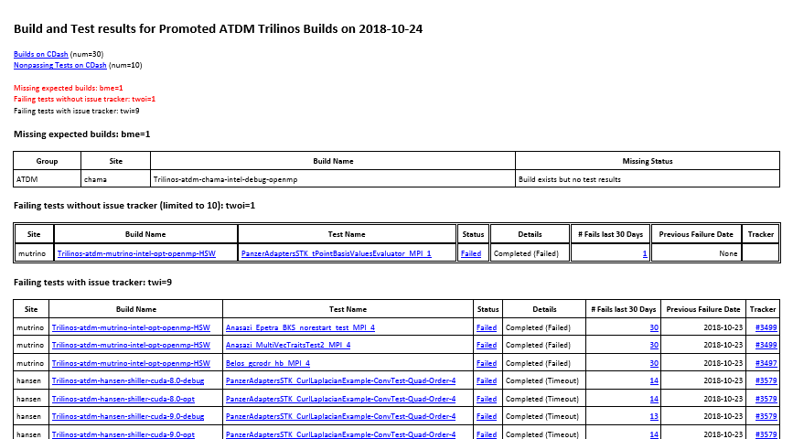
Detecting New Failures/Missing Results: CDash Email
Missing test results!
Failing test without issue tracker!
Failures in red require action!

Slide 20
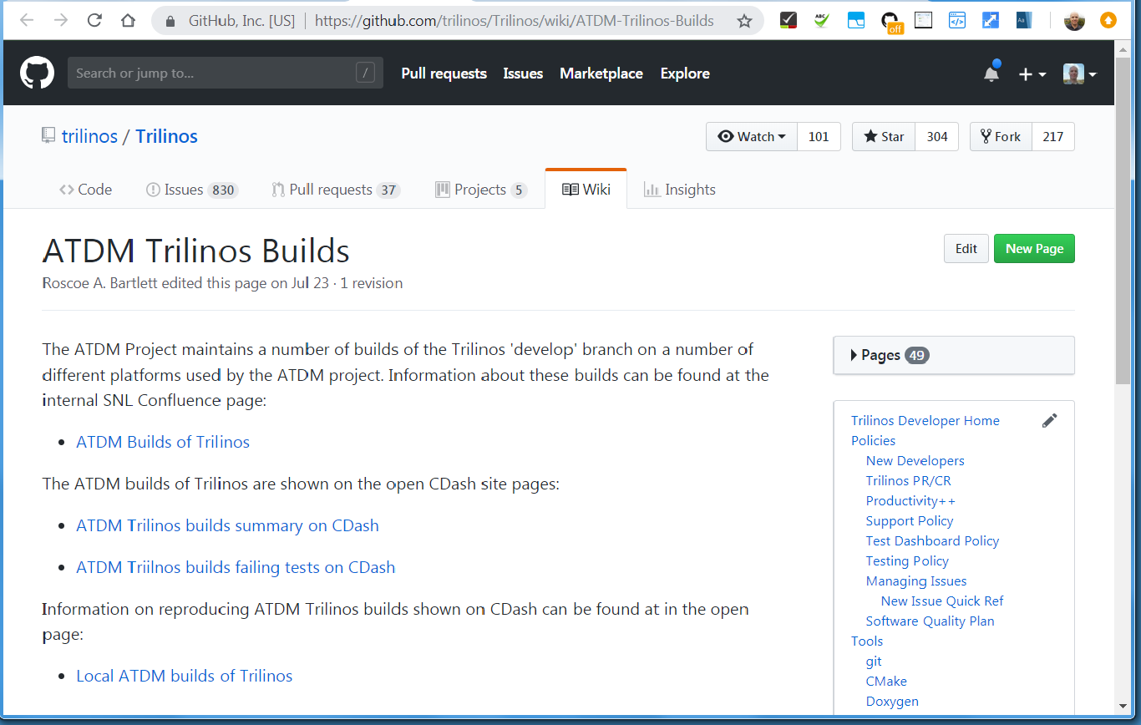
Reproducing ATDM Trilinos Builds: Trilinos Wiki

Slide 21
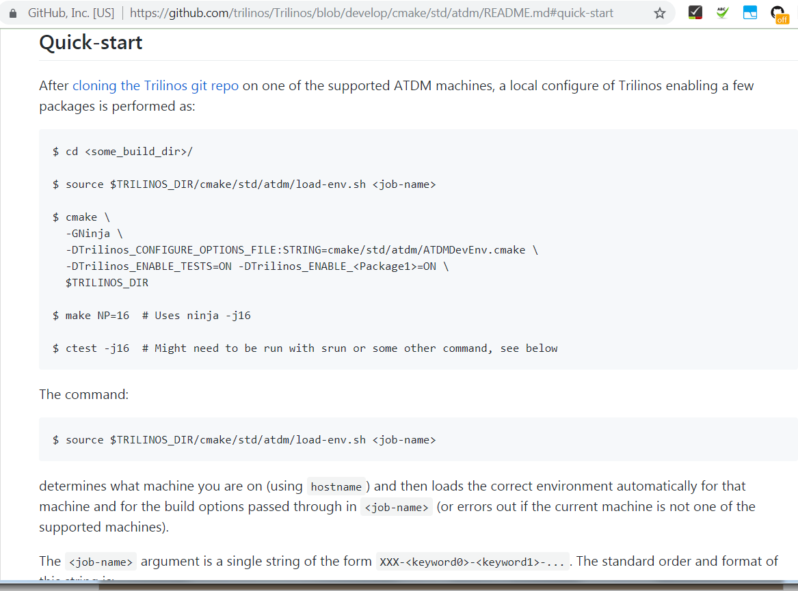
Reproducing ATDM Trilinos Builds: README.md

Slide 22
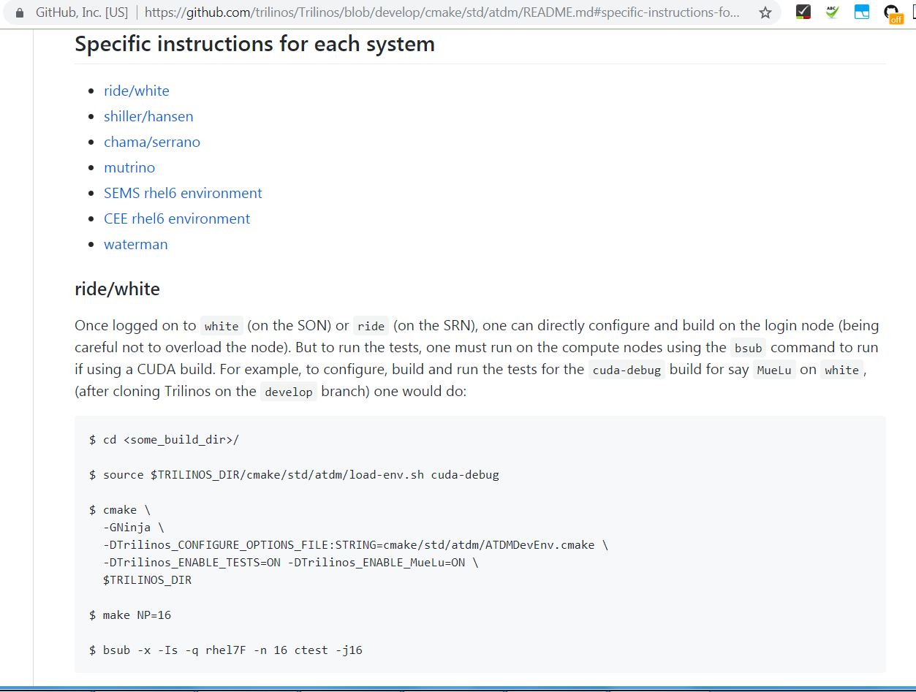
Reproducing ATDM Trilinos Builds: Systems Info

Slide 23
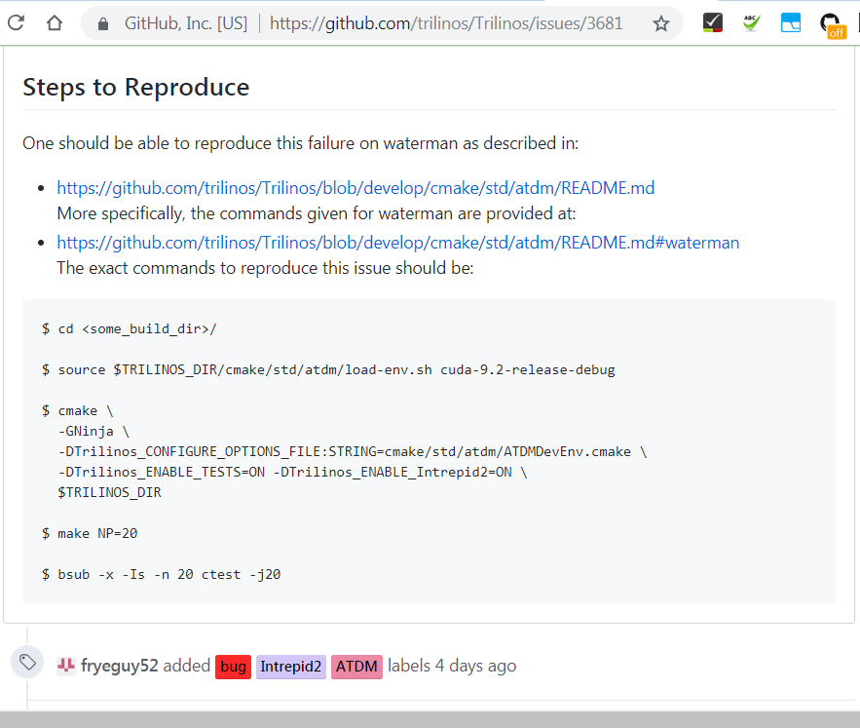
Reproducing ATDM Trilinos Builds: GitHub Issue

Slide 24
Addressing Trilinos Failures

Slide 25
How to Address Trilinos Failures?
Keeping already cleaned-up promoted builds clean
Fix the failures => Best option!
Mark failing tests as “expected may fail” and not trigger global failure in Python tool:
Only for non-blocking issues
Allows us to watch test run but not block updates of Trilinos to APPs
Best for cases where someone is working (or soon is going to work) to fix non-blocking failures.
(Temporarily) disable failing tests:
Only for non-blocking issues
Best for cases where no-one is going to work on fixing the failures anytime soon.
Revert the commit(s) (or PR merge) causing the failure:
=> Perhaps best option for critical or blocking failures that can’t be fixed soon!
Initial failures from setting up new platforms
Fix the failures
(Temporarily) disable failing tests (non-blocking issues only)
Mark failing tests as “expected may fail” and not trigger global failure in Python tool (non-blocking issues only)
NOTE: Reverting commits is NOT an option for cleaning up failures that occur when setting up new builds on new platforms or envs on existing platforms.

Slide 26
Following up on ATDM Trilinos GitHub Issues

Slide 27
Problems with Trilinos GitHub Issue Management
Problems not working issues:
Ignoring new ATDM Trilinos GitHub Issues (e.g. no replies for weeks)
Not following up on Issues after some initial investigation
Problems closing issues:
Closing Issues before getting confirmation on CDash (sometimes issue is *not* addressed)
Not closing issues after issue has been addressed (clutter up list of active issues)
Proposed Solution => Send out weekly email listing
Send out emails to Trilinos Product Area Leads for open ATDM Issues in their area
Send out emails to assignees of open ATDM Trilinos issues?

Slide 28
Trilinos GitHub Issue Reminder Emails
(7) ATDM Trilinos Linear Solvers Product Area GitHub Issues on 2018-10-24
#Issue | ATDM Priority | Created | Last Updated | # Comments
Summary
Next Action Status
#3499 | Blocker | 2018-09-25 | 2018-10-03 | 5
Anasazi tests failing in ATDM build on mutrino
Likely broken by PR #3481 merged to ‘develop’ on 9/21/2018 …
#3686 | Blocker | 2018-10-16 | 2018-10-16 | 0
Teko_ModALPreconditioner_MPI_1 Failing in ATDM cee-rhel6-clang-opt-serial build
???
…
Python tool that pulls data off GitHub (query labels ‘ATDM’, ‘TPA: Linear Solvers’, …)
To Who? Send only to Trilinos Product Area Leads? Send email also to Issue assignees?
Frequency? Once a week? Twice a week?

Slide 29
Wrapping Up

Slide 30
Observations and Open Questions
SNL ATDM is test-bed for components approach for exascale HPC software!
Two approaches being compared:
Full buy-in to using and co-developing components: EMPIRE
Avoid deep dependencies or co-development of components: SPARC
The role of Trilinos in ATDM will either be viewed as:
A) Successful:
=> Encouraging the usage of components approaches
=> Leading to more future funding for Trilinos?
B) Unsuccessful:
=> Discouraging the usage of components approaches
=> Leading to less future funding for Trilinos?
Questions:
At the end of ATDM, which approach will be viewed more successful?
What will that say about Trilinos?
What will this say about the future of components in CSE/HPC exascale?
If we can’t succeed with components with Trilinos in ATDM at SNL, how we expect this to work in the larger ECP project across labs, universities, etc.?
Let’s stabilize Trilinos for ATDM APPs and remove that as an excuse!

Slide 31
Trilinos Development and APP-Integration Parts
Trilinos / APP Git Workflows:
Trilinos Pull Request (PR) testing & merging to ‘develop’ [Done]
SPARC / Trilinos subteam workflow (manual testing by Micah H.) [Done]
EMPIRE / Trilinos git.git workflow (EMPIRE-owned Jenkins pipeline for testing) [Done]
Testing gates for workflows:
1) Auto PR Trilinos builds and tests :
Current: MPI GCC 4.8.4, GCC 4.9.3, Intel 17
Future: CUDA (see Trilinos GitHub #2646)
2) ATDM Trilinos nightly builds and tests:
ATDM Trilinos builds for EMPIRE … EMPIRE switchover in-progress/complete?
ATDM Trilinos builds for SPARC … ‘cee-rhel6’ gnu, intel, and clang complete
3) APP nightly builds and tests
EMPIRE-PIC and EMPIRE-Fluid build and test suite: A few builds posting to Jenkins only
SPARC build and test suite: Submits to Sierra CDash site
Triaging and fixing failed builds and tests:
Notification of new failures: Python email tool pulling data for ATDM Trilinos builds off CDash site.
Triage failures: Filter out non-code failures then create Trilinos GitHub Issues
Joe Frye creates initial GitHub Issues, Product Areas Leads follow up from there
Address failures :
New builds: a) fix, b) allow to fail, c) temporally disabling non-critical tests
Existing builds: a) fix, b) allow to fail, c) temporally disable, or d) reverting PR from ‘develop’
Manage & Follow-up: Someone must observe and ensure failures are addressed (???Who???)

Slide 32
THE END

