Slide 1

Git Workflow Building Blocks for Improved VERA Development, Integration, and Deployments
Roscoe A. Bartlett
Physics Integration Infrastructure Team Lead
IDEAS Methodologies Team
Oak Ridge National Lab
Computational Eng. & Energy Sciences
Computer Science and Mathematics Div

Slide 2
Dependencies Between Selected VERA Repositories
Trilinos
hydrath
TeuchosWrappersExt
DatraTransferKit
MOOSE
VERAInExt
SCALE
Exnihilo
MOOSEExt
COBRA-TF
MPACT
PSSDriversExt
LIMEExt
VUQDemos
DakotaExt
Dakota

Slide 3
Single-Repository and Multi-Repository Development and Integration
VERA
pull
and/or
push
pull
and/or
push
Project Internal Repos
pull
push
External Repo1 (e.g. MPACT)
Project Copy
Repo1
PkgA
PkgB
Repo1 Devs
Repo1 Integrator
PkgA
PkgB
pull
push
External Repo2 (e.g. SCALE)
pull
and/or
push
pull
and/or
push
Project Copy
Repo2
PkgC
PkgD
Repo2 Devs
PkgC
PkgD
Workflows:
Workflows for developing external repos (e.g. MPACT and SCALE/Exnihilo)
Workflows for developing directly against set of project repos (e.g. VERA repos)
Workflows for integrating external repos into project repos (i.e. sync processes)
Repo2 Integrator
pull
and/or
push
Project Native
Repo3
PkgE
PkgF
Project Devs
pull
Project Releaser

Slide 4
Background on Git Workflows
2005: Git development begins (Linus Torvalds, for Linux Kernel)
2010: “Gitflow” is presented (Vincent Driessen)
Uses ‘develop’ and ‘master’ branches with short-lived “feature”, “release” and “hotfix” branches
Most well known and popular git workflow (by far)
Every workflow since compares itself to gitlfow (and criticizes gitflow in the process)
After Gitflow:
“Github Flow”: Advocated by Github
Simple feature branches with pull requests
“Simple Git Workflow is Simple”: Advocated by Atlassian
Simple feature branches with rebasing on top of ‘master’ and --no-ff merges to ‘master’
“Gitlab Flow”: Advocated by Gitlab team
“Git.git Worklow” (i.e. “gitworkflows(7))”: Official git man page “gitworkflows(7)”
All feature branches with ‘next’ and ‘pu’ temp testing branches, graduate to ‘master’.
Used by the developers for git itself (i.e. git.git)
Used by Linux Kernel developers

Slide 5
Overview of Existing Defined Workflows

Slide 6
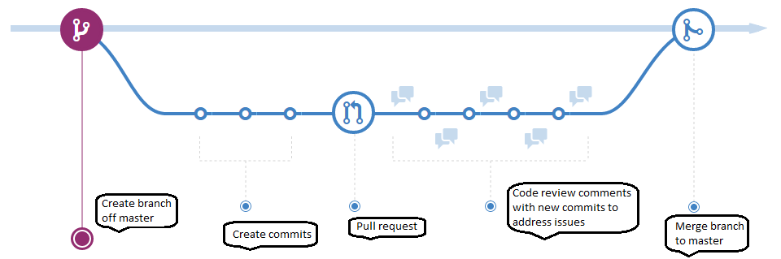
Github Flow
Permanent branches: ‘master’
Primary focus of testing: Each individual feature branch
Notes:
No release branches! (can’t support multiple releases)

Slide 7
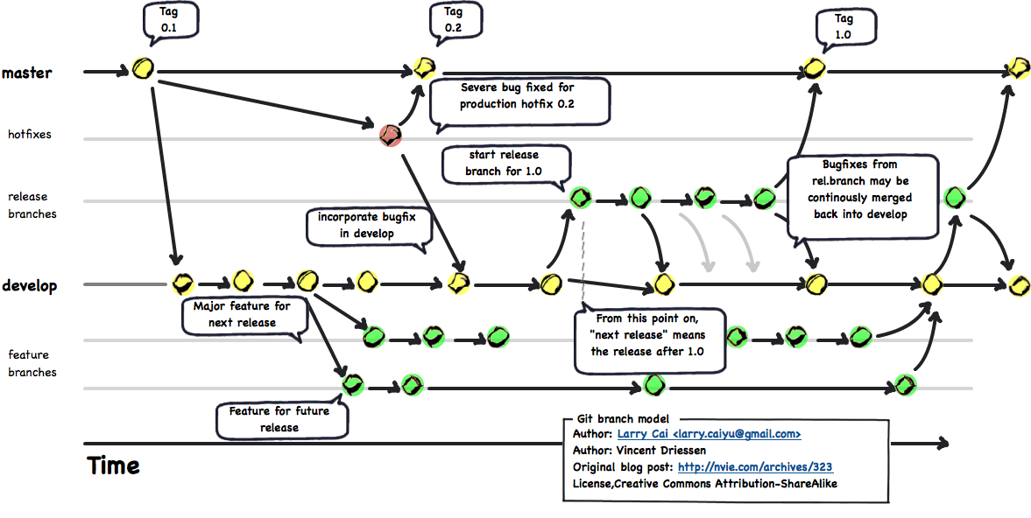
Gitflow
Permanent branches: ‘develop’ and ‘master’
Short-lived branches: “feature”, “release”, and “hotfix”
Primary focus of testing: ‘develop’ branch (but still need testing on ‘master’ if ‘hotfixes’ exist)
Special git command systems has been created to drive workflow! (Criticized as too complex)

Slide 8
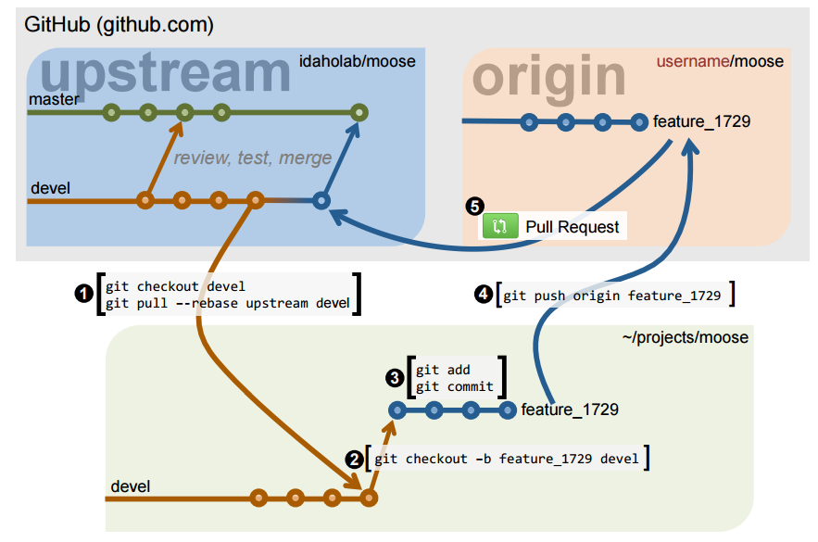
MOOSE Workflow (Gitflow + Github Flow)

Slide 9
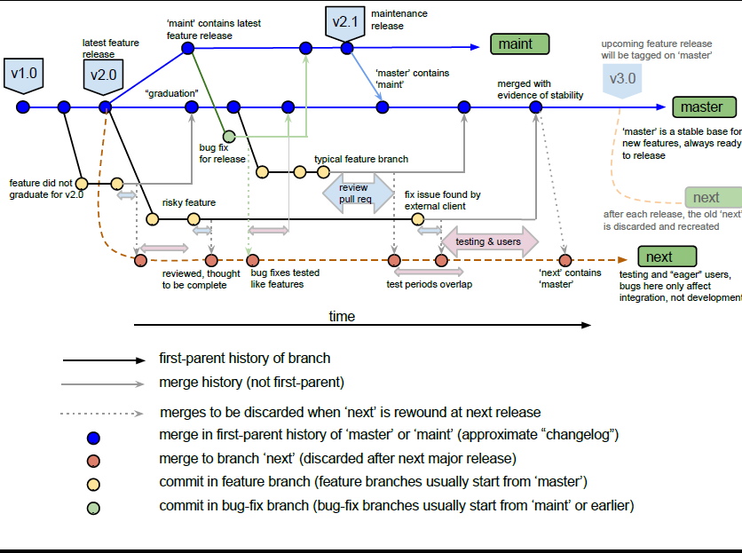
Git.git Workflow “gitworkflows(7)” (PETSc)
See:
Gitworfkows(7) man page
Gitworkflows(7) presentation

Slide 10
An Incrementally Expanding Git Workflow for CSE Projects

Slide 11
Incrementally Expanding Git Workflow (Intro)
Instead of defining complete workflows to choose from
=> Define git workflow “building blocks” (i.e. design patterns) and construct the workflow that is need!
Workflow Construction Steps:
Consider the properties and challenges for a given project
Construct simplest git workflow using building blocks to meet current needs
Add new features to workflow as situation changes and more challenges emerge
Workflow building blocks
Begin: The simple centralized CI workflow
Addition of a ‘develop’ branch
Addition of topic branches
Addition of release branches
Addition of feature branches
Addition of throwaway integration test branch(es)
End: The Git.git Workflow (e.g “gitworkflows(7)”)
Consistent with “gitworkflows(7)” https://www.kernel.org/pub/software/scm/git/docs/gitworkflows.html
Git Tutorial and reference information:
https://ideas-productivity.org/resources/howtos/git-tutorial-and-reference-collection/
These can be added to a git workflow in almost any order!

Slide 12
Issues to Consider to Select Git Workflow
Number of developers
Distribution of general software knowledge and skills of the developers
Distribution of git-specific knowledge and skills of the developers
Amount of (or lack of) communication and coordination between the developers
Nature of the customers and need for releases of the software
Sensitivity of the software (e.g. security vulnerabilities?)
Rate of development and change in the software
Importance (and urgency) of performing code reviews
Portability requirements and portability challenges of the software
Heterogeneity of the development and testing environments
Budget of computing resources available for testing
Quality and expense of the test suites

Slide 13
Testing Issues/Support for Git Workflows
Test Suites:
CI Build: This is a Continuous Integration (CI) [2, 3] build of the code on a single platform and single configuration and the running of a (relatively) fast test suite. The CI Build should be constructed so that it protects the major features of the code that are needed by the other developers to continue their development work. The CI Build would be performed before any branch is updated that impacts other developers. This is the pre-push regression test suite described in [1].
Nightly Builds: This is a collection of builds on different platforms with different compilers and running a more comprehensive (i.e. expensive) test suite. This is the nightly regression test suite described in [1].
Testing assumptions:
Additive test assumption of branches: If ‘m + a’ PASSES and ‘m + b’ PASSES, then ‘m + a + b’ also PASSES
Subtractive test assumption of branches: If ‘m + a + b’ PASSES then ‘m + a’ or ‘m + b’ also PASSES.
[1] “How to Add and Improve Testing in Your CSE Software Project”, IDEAS Project, 2015.
[2] “Continuous Integration”, Wikipedia, http://en.wikipedia.org/wiki/Continuous_integration
[3] Fowler, Martin. “Continuous Integration”, http://martinfowler.com/articles/continuousIntegration.html

Slide 14
Begin: Simple Centralized CI Workflow
master
A1
B1
A2
A3
B2
C
D
Dev 1
Dev 2
Features implemented in commits intermingled on ‘master’ branch
Feature “A”: Commits “A1”, “A2”, “A3”
Feature “B”: Commits “B1”, “B2”
Feature “C”: Commit “C”
Pros and Cons (w.r.t. other more sophisticated workflows):
Pro: Simplest workflow with fewest git commands, no distributed VC concepts (i.e. SVN-like)
Pro: Requires least knowledge of git
Pro: Minimizes merge conflicts (frequent pushes to and pulls from ‘master’)
Con: Difficult to perform pre-merge code reviews
Con: Difficult to collaborate with other developers with partial changes (can’t push broken code to ‘master’ to share with others)
Con: Difficult to back out bad feature sets
Con: Difficult to maintain 100% passing tests for all Nightly Builds
Example project: New research project
Small number of closely collaborating developers
No real users (e.g. no need to support releases)

Slide 15
TriBITS Standard Testing Layers
Nightly Testing
Secondary Tested (ST)
CATEGORIES [BASIC CONTINUOUS NIGHTLY]
(more platforms, more TPLs)
Post-Push CI Testing
Secondary Tested (ST)
CATEGORIES [BASIC CONTINUOUS]
(post-push CTest/CDash, Linux/GCC)
Correctness Testing
Pre-Push CI Testing
Primary Tested (PT)
CATEGORIES [BASIC]
(pre-push checkin-test.py)
Coverage Testing
Memory (Valgrind) Testing

Slide 16
Addition of a ‘develop’ branch
master
(Rare) Bug fix on ‘master’
Users
M1
M2
M3
M4
M5
‘develop’ always contains ‘master’
Minor bug fix to allow merge to ‘master’
develop
A1
A2
B1
B2
C
D
Passes nightlies
Fails nightlies
Fails nightlies
Passes nightlies
Passes nightlies
Introduce a ‘develop’ branch:
Developers directly push to ‘develop’ branch using CI Build (i.e. simple centralized CI workflow)
Only merge from ‘develop’ into ‘master’ when all Nightly Builds pass (perhaps with minor bug fixes)
Close users pull from more stable ‘master’ branch (‘master’ is default branch when cloning a git repo!)
Most testing focused on ‘develop’ branch. (Little to no testing needed on ‘master’)
Pros and Cons (w.r.t. single branch workflow):
Pro: Developers still only perform simple centralized CI workflow (only on ‘develop’ not ‘master’)
Pro: More stable ‘master’ branch seen by users
Con: Allows little to no time for review of commits on ‘develop’ before merge to ‘master’
Con: Requires knowing how to use multiple branches and merges
Con: Extra effort to perform merges from ‘develop’ to ‘master’ (or could use cron job to do merges)
Example project: Established research project with close users
Small number of closely collaborating developers
Few close customers that can’t handled the instability of the main dev branch
Devs

Slide 17

Addition of topic branches
develop
Or ‘master’ branch if not using a ‘develop’ branch
C
D
1st topic branch for feature A
direct commit
2nd topic branch for feature A
A1
A2
A3
Branch for small compete feature B
B1
B2
Introduce usage of temporary short-lived topic branches:
Developers (optionally) implement features in one or more topic branches and merge to ‘develop’. E.g.:
Feature “A”: 1st topic branch (commits “A1”, “A2”), 2nd topic branch (commit “A3”)
Feature “B”: Single topic branch (commits “B1”, “B2”)
Topic branches pass CI Build merged into ‘develop’ about once/day or 4-6 hours of work (rule of thumb)
Direct pushes to ‘develop’ are okay for single commit changes that are not shared/reviewed.
NOTE: Usage of short topic branches does not degrade CI at all! Does not lead to more merge conflicts!
NOTE: NOT long-lived “feature branches”!
Pros and Cons (w.r.t. single branch workflow):
Pro: Allow changes to be easily backed out if something goes wrong
Pro: Allow switching between different topic branches quickly
Pro: Allow easy sharing for quick collaboration with other devs before merging to ‘develop’
Pro: Allow quick code reviews (pull-requests) on the topic branch before merging to ‘develop’.
Con: Requires knowing how to use multiple branches and merges with git
Example project: Established research project with multiple developers
Medium number of number of developers who closely collaborate and review code

Slide 18
Addition of release branches
v2.2.5
release-2.2
v2.2.4
v2.3.0-rc.1
v2.3.0
v2.3.1
Bug fix that affects v2.2 and forward branches
release-2.3
Merge forward
release-2.3-start
v2.3.0-rc.0
‘master’ contains all release branches
v2.3.0-dev
Update for release
v2.4.0-dev
master
Introduce long-lived release branches:
Follows “Semantic Versioning” standard recommended by Github (http://semver.org):
Release tag: vX.Y.Z (X = major, Y = minor, Z = patch), Release candidate: vX.Y.0-rcZ
Apply bug fix to oldest release branch that needs the fix then merge forward (“gitworkflows(7)”)
Cherry-picks from upstream to downstream also allowed (but not preferred)
NOTE: Since ‘master’ contains all release branches, then just testing ‘master’ provides some release testing.
Pros and Cons (w.r.t. single ‘master’ branch which provides a single stream of releases):
Pro: Allow support for multiple releases
Pro: Allows customers to depend on well-defined named versions of the software
Con: More labor and more testing needed to maintain old releases
Example project: Established project with many customers requiring stable named releases
See: “gitworkflows(7)” https://www.kernel.org/pub/software/scm/git/docs/gitworkflows.html

Slide 19
Addition of feature branches
Big Bang Integration!
develop
Or ‘master’ branch if not using a ‘develop’ branch
Merge of medium-lived “A” branch goes smoothly
Merge of long- lived “B” branch has many conflicts and other problems
A1
A2
A15
feature-a
feature-b
B1
B2
B55
Introduce long-lived feature branches:
Features completed in separate (long-lived) branches before single merge into ‘develop’.
Pros and Cons (w.r.t. short-lived topic branches):
Pro: Allow time for detailed code reviews before the changes are merged into ‘develop’.
Pro: Accommodate less experienced developers who can’t be trusted to directly push to ‘develop’.
Pro: Accommodate changes from external developers who can’t directly push to the ‘develop’.
Pro: Handle risky changes that may never make it into ‘master’
Pro: Keep very clean git history for each feature, merge commits become “changelog”.
Con: Risk of major merge (or semantic) conflicts (i.e. BIG BANG INTEGRATION, e.g. merge of “B”)
Con: Not consistent with Agile best practice of CI (see “Feature Branch” by Martin Fowler).
Con: Discourages Agile best practice of continuous refactoring (refactoring makes merges difficult)
Con: Requires more testing resources to test each feature branch individually
Example project: Established project with many external contributors and/or junior developers

Slide 20
Addition of throwaway integration test branch(es)
develop
Or ‘master’ branch if not using a ‘develop’ branch
Has same merge conflicts!
“Graduation” of medium-lived “A” branch goes smoothly
Graduation of long- lived “B” branch has fewer conflicts
feature-b
A1
A2
Merge refactoring from “A” into “B” to make compatible
A15
feature-a
Rebuild ‘next’ from ‘develop’ after next release!
B1
B2
B3
B55
All feature branches merged into ‘next’
‘next’ always contains ‘develop’
next
Run Nightly Builds against ‘next’
Has merge conflicts!
Introduce throw-away integration test branch(es):
Feature branches (FBs) passing CI Build merged into throwaway ‘next’ branch.
Nightly Builds run on ‘next’ branch every night.
When ready, FB “graduates” and merges into ‘develop’. (i.e. Subtractive test assumption of branches!)
Use promiscuous integration between feature branches to resolve conflicts (e.g. merge “A2” into “B” branch)
Pros and Cons (w.r.t. stand-alone feature branches):
Pro: Incompatibles between feature branches are tested early and often
Pro: Multiple feature branches are tested together, instead of individually, saving test computing resources
Con: Bad code in a single FB breaks all Nightly Builds run on ‘next’ branch (and no other FB gets tested).
Con: Hard to determine which FB is breaking a ‘next’ Nightly Build
Con: Have to resolve same conflicts twice! (i.e. merge “B” to ‘next’ and ‘develop’) => use git rerere?
Con: More complex and labor intensive workflow!

Slide 21
End: The Git.git Workflow “gitworkflows(7)”
The Git.git Workflow may be a good choice for projects when any of the following are true:
Developers are git experts
Code is of high consequence and responsible for basic security (e.g. git itself)
Many changes being suggested in feature branches may never go into the final version
Desire for a very clean git history
Users expect to pull working versions of the code from ‘master’ at any point in time
Testing on any single platform (or small number of platforms) does not give sufficient confidence that there will not be major problems on other platforms.
Developers use a heterogeneous set of development environments (e.g. Linux, PC, Mac, and various vendors and versions of compilers) and the code has portability issues
Going from “addition of throw-away integration test branches” to Git.git Flow
Discard the ‘develop’ branch
Feature branches created from and merged to ‘master’
Full Git.git workflow also uses throw-away ‘pu’ branch!
Current release branch is called ‘maint’, not ‘release’
Old maintained release branches called ‘maint-X.Y.Z’.
In summary, Git.git Flow would be a good starting choice for any project where all of the members of the development team were very good with git and the portability demands are challenging. However, it comes at the cost of a more complex and labor-intensive development workflow.

Slide 22
Summary
Instead of defining complete workflows to choose from
=> Define workflow “building blocks” and construct the workflow that you need!
Workflow Construction Steps:
Consider the properties and challenges for a given project
Construct simplest git workflow using building blocks to meet current needs
Add new features to workflow as situation changes and more challenges emerge
Workflow building blocks
Begin: The simple centralized CI workflow
Addition of a ‘develop’ branch
Addition of topic branches
Addition of release branches
Addition of feature branches
Addition of throw-away integration test branch(es)
End: Git.git Flow (e.g “gitworkflows(7)”)
Next steps:
Git training (see Git Tutorial and Reference Info)
Review, refine and publish supporting document “Design Patterns for Incrementally Expanding Git Workflows for Research-Based Projects”
Apply and improve workflows
These can be added to a git workflow in almost any order!

Slide 23
A Proposed Git Workflow for VERA
Overview:
Introduce a ‘develop’ branch that developers directly pull from and push to and integration scripts sync to
The ‘master’ branch is only updated from ‘develop’ after Nightly and Weekly builds pass!
Introduce a ‘nightly’ branch that is updated from ‘develop’ so all Nighty builds test against consistent version
Cron job automatically does merge from ‘nightly’/’develop’ to ‘master’ based on CDash query (Kitware)
Close customers pull from (a much more stable) ‘master’ branch
For average VERA developer/integrator:
Directly pull from and push to ‘develop’ branch with same a single-repo, single-branch workflow
(Optional) Use topic branches for most development work
Pros and Cons (w.r.t. current simple centralized CI workflow):
Pro: Users and close collaborators will see a much more stable ‘master’ branch
Pro: Less paranoid sync processes for integrating repos
Con: Requires learning a little more about git to deal with ‘develop’ branch

