Slide 1


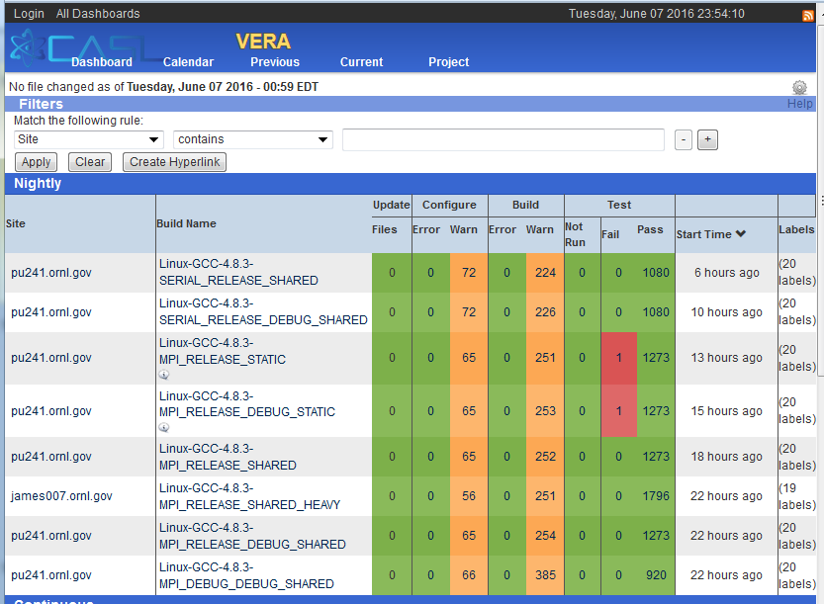
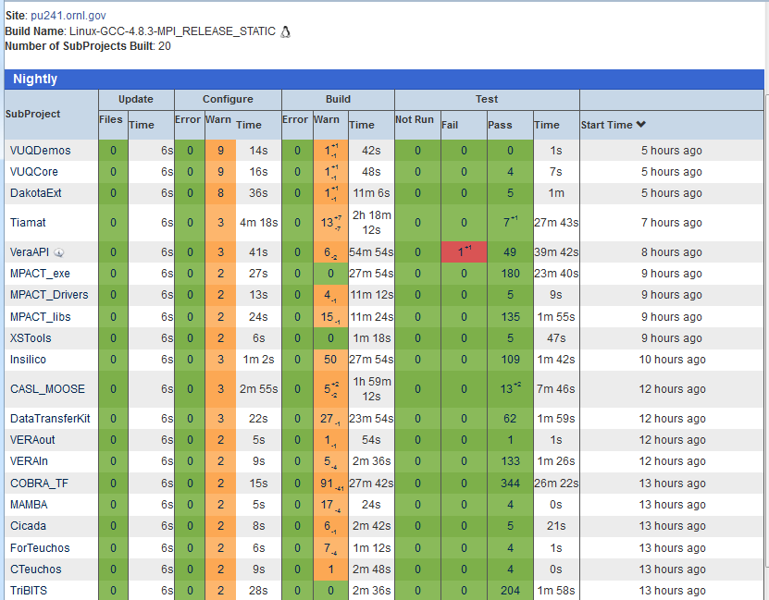
Application of TriBITS to Larger Componentized Scientific and Engineering Software Projects
Sandia National Laboratories
Roscoe A. Bartlett
Sandia National Laboratories, New Mexico, 87185
Challenges
Raw CMake vs. TriBITS
Multiple software repositories and distributed development teams
Multiple programming languages (C, C++, Fortran)
Multiple development and deployment platforms
Development, builds, testing, and/or deployments of different subsets of the software
Co-development of multiple software packages
Raw CMakeLists.txt
TriBITS CMakeLists.txt
# Build and install library
set(HEADERS hello_world_lib.hpp)
set(SOURCES hello_world_lib.cpp)
add_library(hello_world_lib ${SOURCES})
install(TARGETS hello_world_lib
DESTINATION lib)
install(FILES ${HEADERS} DESTINATION include)
# Build and install user executable
add_executable(hello_world
hello_world_main.cpp)
target_link_libraries(hello_world
hello_world_lib)
install(TARGETS hello_world DESTINATION bin)
# Test the executable
add_test(test
${CMAKE_CURRENT_BINARY_DIR}/hello_world)
set_test_properites(test PROPERTIES
PASS_REGULAR_EXPRESSION "Hello World")
# Build and run some unit tests
add_executable(unit_tests
hello_world_unit_tests.cpp)
target_link_libraries(unit_tests
hello_world_lib)
add_test(unit_test
${CMAKE_CURRENT_BINARY_DIR}/unit_tests)
set_test_properites(unit_test PROPERTIES
PASS_REGULAR_EXPRESSION
"All unit tests passed")
tribits_add_library(hello_world_lib
HEADERS hello_world_lib.hpp
SOURCES hello_world_lib.cpp)
tribits_add_executable(hello_world NOEXEPREFIX
SOURCES hello_world_main.cpp INSTALLABLE)
tribits_add_test(hello_world NOEXEPREFIX
PASS_REGULAR_EXPRESSION "Hello World")
tribits_add_executable_and_test(unit_tests
SOURCES hello_world_unit_tests.cpp
PASS_REGULAR_EXPRESSION
"All unit tests passed")
Approach
Less duplication and boiler-plate
Fewer commands
Fewer lines of CMake code
Installs by default (most common)
Library linking automatically handled
Automatic namespacing of test & test executable names. (All target and test names must be globally unique!)
Enforced uniform behavior across all CMakeListst.txt files
Tribal Build, Integration, and Test System (TriBITS) using CMake
Framework for large, distributed multi-repository CMake projects
Flexible package-based dependency and namespacing architecture
Automatic package dependency handling using dependency DAG
Reduced boiler-plate CMake code and enforce consistency across large distributed projects
Package-based Architecture
<project>/
|- ProjectName.cmake
|- CMakeList.txt
|- PackagesList.cmake
|
|
|
|
|
|- packages/
| |- <package_a>/
| | |- […]
| |- <package_b>/
| | |- cmake/
| | | \- Dependencies.cmake
| | |
| | |
| | |
| | |- CMakeLists.txt
| | |
| | |
| | |
| | |
| | |
| | |- src/
| | | \- CMakeLists.txt
| | |
| | |
| | |
| | |
| | |
| | |- test/
| | | \- CMakeLists.txt
| |
| |
| |
| |
| |
| |- […]
Example: Trilinos & CASL
set(PROJECT_NAME <ProjectName>)
tribits_repository_define_packages(
<PackageA> packages/<package_a> PT
<PackageB> packages/<package_b> PT
[…] )
VERA
Trilinos
VERAInExt
MPACT
Teuchos
VERAIn
…
MPACT_libs
Same TriBITS repos can be rearranged into multiple CMake projects!
Core
Comm
…
MPACT_exe
ParameterList
SCALE/Exnihilo
…
…
Nemesis
Shift
Epetra
NOX
Insilico
COBRA-TF
Trilinos
COBRA-TF
tribits_package_define_dependencies(
LIB_REQUIRED_PACKAGES <PackageA> )
…
Neutronics
…
COBRA_TF
Trilinos
COBRA_TF
…
tribits_package(<PackageB>)
add_subdirectory(src)
tribits_add_test_directories(test)
tribits_package_postprocess()
VERA meta-project (1): Git repository and TriBITS meta-project
TriBITS repos (17):: Trilinos, VERAInExt, COBRA-TF, MPACT, SCALE …
TriBITS packages (93 enabled out of 213 total): Teuchos, Epetra, VERAIn, Insilico, COBRA_TF, MPACT_exe, …
TriBITS subpackages: TeuchosCore, InsilicoNeutronics, …
TriBITS SE packages (229 enabled out of 496 total): TeuchosCore , Teuchos, VERAIn, Insilico, InsilicNeutronics, …
SCALE
TriBITS Project and TriBITS Repository
Trilinos
VERAInExt
include_directories(${CMAKE_CURRENT_SOURCE_DIR})
tribits_add_library(<package_b>
SORUCES <src0>.cpp <src1>.cpp […]
HEADERS <header0>.hpp <header1>.hpp […] )
SCALE
TriBITS Package
Exnihilo
Package-based CDash board
tribits_add_executable_and_test(unit_tests
SOURCES unit_tests.cpp
PASS_REGULAR_EXPRESSION
"All unit tests passed")
Package Dependencies
$ cmkae \
-D Trilinos_ENABLE_RTOp=ON \
-D Trilinos_ENABLE_ALL_FORWARD_DEP_PACKAGES=ON \
-D Trilinos_ENABLE_TESTS:BOOL=ON \
../Trilinos
Example: CI Testing
Tests built and run for affected downstream packages only.
Only libraries are enabled for upstream packages.
Huge cost savings for most intermediate packages in dependency graph!
Thyra
Usage and Availability
RTOp
Triutils
EpetraExt
Used By: Trilinos (SNL), Drekar (SNL), MPACT (U.Mich./ORNL), COBRA-TF (PennState/ORNL), SCALE/Exnihilo (ORNL), DataTransferKit (ORNL), …
Availability: GitHub, 3-clause BSD license
See: https://tribits.org, https://github.com/tribitspub/tribits
We acknowledge the contributions of Brent Pershbacker (SNL), Nico Schlomer (T.U. Berlin) and others who have helped to develop and extend TriBITS.
Teuchos
Epetra
Legend:
Libs & Tests
Libs Only
SAND2017-2405 C

