Slide 1


Daily Integration and Testing of the Development Versions of Applications and Trilinos
A stronger foundation for enhanced collaboration in application and algorithm research and development
SAND2007-7236C
Roscoe A. Bartlett
Department of Optimization & Uncertainty Estimation
Sandia National Laboratories
Software Engineering Seminar Series, October 30th, 2007
Sandia is a multiprogram laboratory operated by Sandia Corporation, a Lockheed Martin Company,
for the United States Department of Energy under contract DE-AC04-94AL85000.

Slide 2
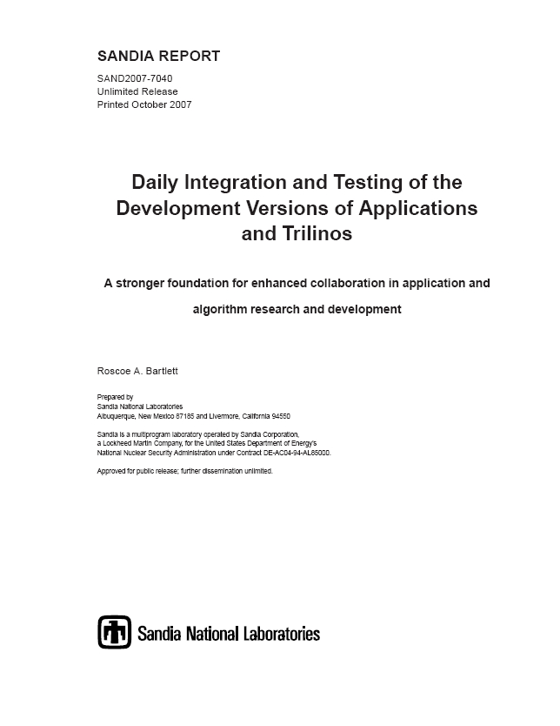
APP + Trilinos Dev SAND Report
http://software.sandia.gov/SESS/common/AppPlusTrilinosDev.pdf

Slide 3
Outline
Background
Proposed APP + Trilinos Dev Daily Integration and Testing
Advantages and Disadvantages of APP + Trilinos Dev Daily Integration
Recommended Practices to Support APP + Trilinos Dev Daily Integration
Experience from the Vertical Integration Milestone (Charon + Trilinos Dev)
Wrap Up and Next Steps

Slide 4
Outline
Background
Proposed APP + Trilinos Dev Daily Integration and Testing
Advantages and Disadvantages of APP + Trilinos Dev Daily Integration
Recommended Practices to Support APP + Trilinos Dev Daily Integration
Experience from the Vertical Integration Milestone (Charon + Trilinos Dev)
Wrap Up and Next Steps

Slide 5
Overview of Current APP + Trilinos Interactions
Many active research collaborations have existed and continue to exist between applications (APPs) and Trilinos where APP + Trilinos Dev is developed throughout year and drives algorithm and APP development
Currently, Trilinos has a major release once a year (typically in September, at the end of each Fiscal Year)
  Some minor releases go out from time to time (e.g. Trilinos 7.1.x for ML)
  Several minor minor releases (bug fixes) go out frequently (e.g. 7.0.9)
Potential issues
  Porting of some Trilinos packages to some customer platforms is only done right before a major release => Portability problems
  May be very difficult to update the APP for new Trilinos release (e.g. porting problems, failing and diffing tests, etc.)
  As much as year or more between introduction of new Trilinos capability and impact on end customer (through an APP release)
  Post delivery maintenance after the introduction of a new capability

Slide 6
Obstacles to Algorithms Impacting Applications
Technical Challenges
  Features needed by algorithm from APP are difficult to implement
    e.g. Accurate parameter derivatives, in-core response functions
  Algorithm is unproven on APP problem area
  Inability of algorithm to scale to APP sizes (# DOFs and # processes)
  Algorithm too complex to easily implement by APP developers
    => Have algorithm experts implement the algorithms =>Trilinos!
  Others …
Difficulty of collaboration between algorithm and APP developers
  Difficult to access shared platforms
  Difficult to build Dev versions algorithm and APP codes together
    Software configuration management problems
    Development versions of APP and algorithm codes incompatible
  => Even smallest overhead can kill a collaboration

Slide 7
Obstacles to Algorithms Impacting Applications
Examples of missed opportunities in FY07
  Aria + Rythmos
    Pat Notz (1514) had some funding to put Rythmos into Aria
    There where some issue in the ModelEvaluator software
    Could not easily access Dev version of Trilinos to address issues!
  Alegra + Thyra/Stratimikos
    Tom Brunner (1641) wanted to experiment with Thyra/Stratimikos to build some physics-based preconditioners
      PLUG: Thyra talk 3:30 PM Tuesday 11/6 at Trilinos User Group (TUG) Meeting in CSRI/90!
        http://trilinos.sandia.gov/events/trilinos_user_group_2007
    Using released version of Trilinos and must port to Purple => Porting problems
    Could not easily access Dev version of Trilinos to address issues!

Slide 8
Future of APP + Trilinos Interactions?
Many applications are reluctant to take on direct Trilinos dependences
  Example: APP will not allow use of Teuchos::RCP at application level
Trilinos capability set is expanding:
  Automatic differentiation (Sacado)
    A fundamental type of dependency!
  PDE discretization support (Intrepid)
  Mesh support (phdMesh)
  Finite element assembly (FEI)
  …
Will applications take on these new dependences in a significant way?
  Can algorithm development in Trilinos lead to “Transformational” changes in APPs when treaded as a Third Party Library (TPL)?
My assertion: For applications to take on more serious Trilinos dependences they must have more direct interaction with and control of these services!

Slide 9

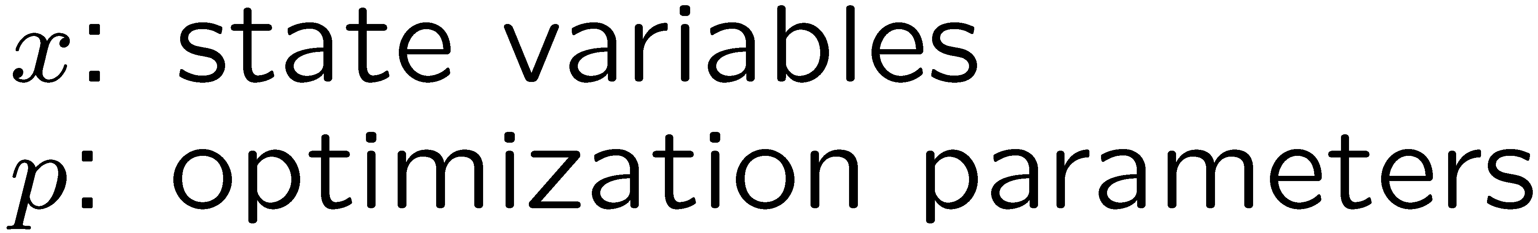
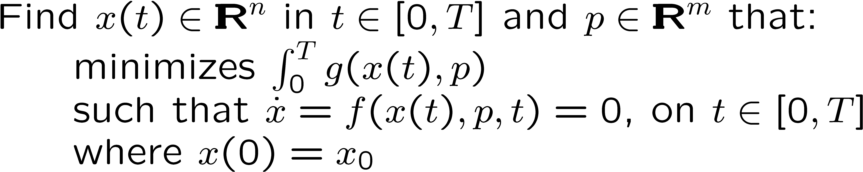
ASC FY07 Level-2 Vertical Integration Milestone (Targets)
Steady-State Simlaton-Constrained Optimization:
Transient Simulation-Constrained Optimization:
Nonlinear Optimizer
MOOCHO, Aristos
Iterative Linear Solver
AztecOO, Amesos, Belos
( Stratimikos)
Transient Solver
Rythmos, CVODES, IDAS
Nonlinear Solver
NOX, LOCA
Targeted Demonstration Problems:
Steady-state and transient model calibration against experimental data (part of QASPR project) modeled with Charon using parameter estimation optimization using Rythmos, MOOCHO, …
Preconditioners
Ifpack, ML, Meros
Operators and Vectors
Epetra, Tpetra
Application
Charon
Goal: Demonstrate fully vertical integration from linear algebra all the way through to optimization
Approach: Create standard interfaces and implementations to break N-to-N coupling using Thyra

Slide 10
ASC FY07 Level-2 Vertical Integration Milestone (Achieved)
Goal: Vertically integrate newly developed advanced numerical solver algorithms in Trilinos to build new predictive capabilities
  Impact: Achieved vertical integration of more than 10 Trilinos algorithm packages from parallel linear algebra data structures to transient sensitivities and simulation-constrained optimization!
Goal: Demonstrate new vertically integrated solver algorithms on relevant production applications
  Impact: Solved steady-state parameter estimation problems and transient sensitivities on QASPR-related semiconductor devices => New capabilities!
Goal: Deliver new vertically integrated solvers to ASC customers
  Impact: Release of new packages in Trilinos 8.0!
Added Goal: Explore enhanced models of collaboration between production application developers and algorithm researchers.
  Impact: Closer collaboration between application and algorithm developers yielding better solvers and better applications

Slide 11
Charon + Trilinos Dev Daily Integration &Testing
Motivation for nightly building and testing of Charon + Trilinos Dev
  Avoid backslides in Vertical Integration Milestone capabilities
    Before nightly testing, backslides of capability happened!
  Proof of Milestone capabilities
  Preservation of milestone problems

Slide 12
Agile Software Development Methods
Manifesto for Agile Software Development
We are uncovering better ways of developing
software by doing it and helping others do it.
Through this work we have come to value:
Individuals and interactions over processes and tools
Working software over comprehensive documentation
Customer collaboration over contract negotiation
Responding to change over following a plan
That is, while there is value in the items on
the right, we value the items on the left more.
Kent Beck (XP)
Mike Beedle
Arie van Bennekum
Alistair Cockburn (Crystal Clear)
Ward Cunningham
Martin Fowler (UML, Refactoring)
James Grenning
Jim Highsmith
Andrew Hunt
Ron Jeffries
Jon Kern
Brian Marick
Robert C. Martin
Steve Mellor
Ken Schwaber
Jeff Sutherland
Dave Thomas
http://agilemanifesto.org

Slide 13
Important Aspects of Agile (and other) Software Methods
Frequent Integration of the Software Product is Critical
  “Whatever integration strategy you select, a good approach to integrating the software in the “daily build and smoke test”.”
    Steve McConnell, Code Complete: Second Edition
Close Customer Involvement and Interaction is Key
  “In order for a project to be agile, there must be significant and frequent interaction between the customers, developers, and stakeholders”
    Robert C. Martin, Agile Software Development
Frequent Delivery of Capability to Customers is a Top Priority
  “The single most important property of any project, large or small, agile or not, is that of delivering running, tested code to real users every few months. The advantages are so numerous that it is astonishing that any team doesn’t do this.”
    Alistair Cockburn, Crystal Clear
Questions: Where does Trilinos and APP fit in? Who is the “customer”, “developer”, “stakeholder”?

Slide 14
Where does Trilinos Fit It?
The term “Agile” has been kicked around for research-driven software
  All “Agile” methods involve Frequent Integration and Frequent Delivery
  What does this mean for Trilinos?
What is Trilinos with respect to “the product”, “the customer”, software integration, and software delivery?
  Is Trilinos an integrated project just within itself?
    =>Just integrate Trilinos with itself and we are Agile?
  Is Trilinos critical enabling technology that is used in real products?
    =>Trilinos needs to frequently integrate with APPs to be Agile?
  Do APP requirements continue to drive Trilinos development?
    =>Trilinos needs to frequently integrate to let APPs drive Trilinos?
I would argue that for Trilinos to be “Agile”, we have to frequently integrate with at least our immediate APP customers (even when active research collaborations are not taking place)
What about frequent delivery? => I will not directly address this here!

Slide 15
Outline
Background
Proposed APP + Trilinos Dev Daily Integration and Testing
Advantages and Disadvantages of APP + Trilinos Dev Daily Integration
Recommended Practices to Support APP + Trilinos Dev Daily Integration
Experience from the Vertical Integration Milestone (Charon + Trilinos Dev)
Wrap Up and Next Steps

Slide 16
Principles for APP + Trilinos Dev Daily Integration & Testing
Support active collaboration between APP and Trilinos developers
Guard against destabilizing the separate development of APP and Trilinos
Minimize unnecessary interactions between APP and Trilinos Developers
Streamline communication between APP and Trilinos developers when such communication is needed
Accountability for keeping APP + Trilinos Dev working

Slide 17
Outline for APP + Trilinos Dev Integration & Testing
APP developers work mainly with APP + Trilinos Release
  => Minimize unnecessary interaction with Trilinos developers
Trilinos developers work mainly with Trilinos Dev
  => Minimize unnecessary interaction with APP developers
Hide APP + Trilinos Dev “research” work in APP behind ifdefs
  => Keep both versions of the code close together (no branches)
Segregate “production” and “research” tests
  => Differentiate between APP and Trilinos defects
Perform nightly building and testing of APP + Trilinos Release and APP + Trilinos Dev
Release APP + Trilinos together or staged
Continue APP + Trilinos Dev nightly building and testing after APP upgrades to new Trilinos release

Slide 18
Outline for APP + Trilinos Dev Integration & Testing
Perform nightly building and testing of APP + Trilinos Release/Dev
  APP + Trilinos Release tested against “production” tests
    Send “production” failures only to APP developers
  APP + Trilinos Dev tested against “research” and “production” tests
    Only send “production” failures that did not also fail in APP + Trilinos Release to Trilinos developers
    All “research” failures go to appropriate Trilinos (or APP) developers

Slide 19
Outline for APP + Trilinos Dev Integration & Testing
Release APP + Trilinos together or staged
  Combined tagging and release of APP + Trilinos
    Requires instant releasability of Trilinos
    Advantage: Most up to date algorithms to customers
    Disadvantage: Supporting multiple Trilinos releases
  Staged releases of Trilinos and APP
    Two approaches to handle Trilinos release
      a) APP updates to new Trilinos Release right away
        Build & test against i) Trilinos Release and ii)Trilinos Dev
      b) APP delays update to new Trilinos release
        Build & test against i) old Trilinos release, ii) current Trilinos release, and iii) Trilinos Dev
    Next APP release is performed against latest Trilinos Release
    Advantage: Fewer, more predictable Trilinos releases
    Disadvantage: More delay in getting new Trilinos capabilities to end customers

Slide 20
Outline
Background
Proposed APP + Trilinos Dev Daily Integration and Testing
Advantages and Disadvantages of APP + Trilinos Dev Daily Integration
Recommended Practices to Support APP + Trilinos Dev Daily Integration
Experience from the Vertical Integration Milestone (Charon + Trilinos Dev)
Wrap Up and Next Steps

Slide 21
Research & Production Advantages for APP + Trilinos Dev
Research Advantages
  Reduces overhead for initial algorithm integration
  Improves chances that new algorithms will have impact
  Preserves interesting/challenging problems
Production Advantages
  Expands testing for Trilinos
  Enables better scalability testing for Trilinos
  Reduces time to detection of defects
  Reduces release time and effort
  Allows for more aggressive refactorings and code improvements
  Better address customer needs
  Reduces all kinds of risk

Slide 22
Research Advantages for APP + Trilinos Dev Integration
Reduces overhead for initial algorithm integration
  => Development versions build right away and all tests pass!
Improves chances that new algorithms will have impact
  => Lower overhead!
Preserves interesting/challenging problems
  Not such a big deal for linear solvers and preconditioners
  Very big issue for higher level algorithms like invasive sensitivities and optimization
  Provides basis of comparison for showing “progress” in our algorithms
  Provides a spring board for related efforts

Slide 23
Production Advantages for APP + Trilinos Dev Integration (1)
Expands testing for Trilinos
  Installation testing for Trilinos
  Catches errors that Trilinos test suite does not (happened several times with Charon + Trilinos Dev)
Enables better scalability testing for Trilinos
  APP provide scalable test problems that can test Trilinos scalability
  Teuchos timers can help
Reduces time to detection of defects
  Expended test => earlier detection of critical defects
  Cost to fix a defect increases with time between when defect is introduced to when it is first detected! (Code Complete: 2nd edition)
  Shows the 24 hour period where defect is introduced!

Slide 24
Production Advantages for APP + Trilinos Dev Integration (2)
Reduces release time and effort (THIS IS HUGE)
  Insures APP + Trilinos Release will build right away
  Insures APPs test suite will pass right away
  Makes release cost and schedule much shorter more predictable
Allows for more aggressive refactorings and code improvements (THIS IS HUGE FOR ME)
  Trilinos developers can directly update APPs for changes in Trilinos interfaces or behavior
  APP developers can request more aggressive refactorings to suite APP needs and can even modify Trilinos code themselves
  Changes to the interface or behavior of Trilinos code can be tested against APPs right away
  This is the #1 issue for post delivery maintenance!
  For me, this is one of the biggest motivations for daily integration and testing of APP + Trilinos Dev! => Truly Agile development!

Slide 25
Production Advantages for APP + Trilinos Dev Integration (3)
Better address customer needs
  Brings Trilinos and APP developers closer together
  Lets APP developers drive targeted Trilinos algorithm development
Reduces all kinds of risk
  Reduces risk that APP + Trilinos will regress
  Reduces risk of slipping release deadlines
  Reduces risk of overtime needed to repair broken capability
  Reduces risk that Trilinos algorithm development will have limited impact
  …

Slide 26
Potential Disadvantages for APP + Trilinos Dev Integration
Will slow down day-to-day development to varying degrees
  Guaranteed to slow down day-to-day work some
  However, experience of other suggest that overall development, release, and support effort will actually decrease!
Will require better, more coordinated management practices
  Access to each others code repositories
  Access to common computing environments
Will impose greater responsibility to meet customer needs
  Algorithm developers will have greater responsibility to meet real customer needs!
  However, there is always a place for more fundamental (i.e. less a applied) algorithm research.
Could increase overall development effort
  It could, but again experience of others suggest just the opposite

Slide 27
Outline
Background
Proposed APP + Trilinos Dev Daily Integration and Testing
Advantages and Disadvantages of APP + Trilinos Dev Daily Integration
Recommended Practices to Support APP + Trilinos Dev Daily Integration
Experience from the Vertical Integration Milestone (Charon + Trilinos Dev)
Wrap Up and Next Steps

Slide 28
Outline of Suggested Practices for APP + Trilinos Dev
Separate ``production'' and ``research'' tests
Refactor APP code to isolate and separate ifdefed code
Maintain a dedicated machine for building and testing APP + Trilinos Dev
Appoint a dedicated APP + Trilinos Representative
Provide easy access for any Trilinos or APP developer to build, test, and develop APP + Trilinos Dev
Fix failed builds of APP + Trilinos Dev ASAP
Address failing ``research'' and ``production'' tests on a schedule appropriate for the APP + Trilinos collaboration
Archive test results for sufficiently long periods of time
Transition ``research'' to ``production'' appropriately after each Trilinos release
Perform APP + Trilinos Release and APP + Trilinos Dev nightly testing on the same set of platforms

Slide 29
Suggested Practices for APP + Trilinos Dev Integration (1)
Separate ``production'' and ``research'' tests
  Helps differentiate between APP and Trilinos defects
  Helps avoid unnecessary communication between APP and Trilinos developers
Refactor APP code to isolate and separate ifdefed code
  Makes code development and maintenance easier and safer
  e.g. Factor out code into different functions
Maintain a dedicated machine for building and testing APP + Trilinos Dev
  Main platform for nightly building and testing of APP + Trilinos Dev
  Provides low overhead “sandbox” for APP and Trilinos developers to try out new things
  Only require SRN (or SON in some case) access!!!!

Slide 30
Suggested Practices for APP + Trilinos Dev Integration (2)
Appoint a dedicated APP + Trilinos Representative (VERY IMPORTANT)
  Point of contact to make sure failing builds and tests are addressed
  Facilitates communication between APP and Trilinos developers
  Maintains the dedicated APP + Trilinos Dev machine
  Ideally already an active APP and Trilinos developer
  Goal => Less than 0.15 FTEs of effort!
Provide easy access for any Trilinos or APP developer to build, test, and develop APP + Trilinos Dev
  Getting a new APP or Trilinos devleoper access to a private build of APP + Trilinos Dev should take less than 10 minutes!
  Greatly helped by having a dedicated machine with spare cycles
Fix failed builds of APP + Trilinos Dev ASAP (VERY IMPORTANT)
  A failed build means no test results at all!
  Keeping APP + Trilinos Dev should be pretty easy

Slide 31
Suggested Practices for APP + Trilinos Dev Integration (3)
Address failing ``research'' and ``production'' tests on a schedule appropriate for the APP + Trilinos collaboration
  Two extremes:
    a) All test failures are given highest priority and fixed ASAP
    b) APP + Trilinos Dev is just kept building and no tests are fixed until just before a release
  A more moderate approach:
    Take 10 minutes to research failing test and send off e-mails or file bug reports to guilty parties
    Address less critical failing tests every Thursday?
  Urgency in addressing failing tests depends on nature of APP and current APP + Trilinos collaborations
  Knowing the 24 hour period where a test first fails is critical

Slide 32
Suggested Practices for APP + Trilinos Dev Integration (4)
Archive test results for sufficiently long periods of time
  Must be able to compare test output for consecutive days when test went from passing to failing
  Keep all output files for 24 hours before next test run
  Archive only smaller files that are needed to examine algorithm behavior and diagnose test failures
  Provide access to test results through a web server
Transition ``research'' to ``production'' appropriately after each Trilinos release
  Solid “research” tests become “production” tests after a release which puts responsibility on APP developers not to break them
Perform APP + Trilinos Release and APP + Trilinos Dev nightly testing on the same set of platforms
  Avoid porting and rounding issues from building and running APP + Trilinos Release and APP + Trilinos Dev on different platforms
  Helps avoid unnecessary communication/interaction between APP and Trilinos developers

Slide 33
Outline
Background
Proposed APP + Trilinos Dev Daily Integration and Testing
Advantages and Disadvantages of APP + Trilinos Dev Daily Integration
Recommended Practices to Support APP + Trilinos Dev Daily Integration
Experience from the Vertical Integration Milestone (Charon + Trilinos Dev)
Wrap Up and Next Steps

Slide 34
Experience from Charon + Trilinos Dev from Milestone Work
Details of Charon + Trilinos Dev Daily Integration and Testing
  Shell (sh) scripts to created to:
    Check out Dev versions of Charon, Charon_TPLs and Trilinos
    Build Charon + Trilinos Release/Dev
    Run test suite
    Analyze results
    Archive test results
    Send out e-mail notifications
  For most of milestone, nightly building and testing of:
    Charon + Trilinos Dev opt (from updated sources, all tests)
    Charon + Trilinos Dev dbg (from scratch, only milestone tests)
  All builds, tests etc. run on my own personal Linux workstation (64 bit, AMD, Fudora Linux 4.0, GCC 3.4.6, …)
  Results archived and accessible through web server on test (i.e. my) machine and linked to in notification e-mails

Slide 35
Experience from Charon + Trilinos Dev from Milestone Work
Example notification e-mail for a failing test
Charon tests failed: tridev+dbg: passed=33, notpassed=1
Build: 2D_64BITgnu3_dbg_hessian_tridev
Summary: 33 pass, 0 timeout, 0 diff, 1 fail, 0 notrun, 0 notdone
The build of Charon seemed to work but at least one of the tests did not pass (see below).
X defects-moocho Exit fail(1) 2s Semiconductor/2D/nodal/sensitivity/defects/9_elem_diode/defects-moocho.np=1
See the test output in http://gabriel.sandia.gov/charon-tests/2007-10-24-00-00/2D_64BITgnu3_dbg_hessian_tridev
A few clicks of the mouse and you can view test results and start to diagnose the problem

Slide 36
Experience from Charon + Trilinos Dev from Milestone Work
Timeline for Charon + Trilinos Dev Daily Integration and Testing
  ???: Roger Pawlowski gets Charon building against Trilinos Dev
  10/30/06: First Charon+Trilinos Dev milestone-related test added
  12/2/06 - 1/7/07: Did not build or test Charon + Trilinos Dev
  1/7/07: Rebuild Charon + Trilinos Dev and a test failed!
  1/27/07: Deployed initial nightly building & testing of Charon + Trilinos Dev
  7/9/07: Branch for Trilinos 8.0
    We did not build against Trilinos 8.0 (NOT GOOD)
  7/24/07: Charon updated to build only against Charon + Trilinos 8.0
    We did not build against Trilinos Dev (NOT GOOD)
  9/21/07: Nightly testing updated to build against Trilinos 7.0, 8.0, and Dev
    This is the way to do it!
  10/18/07: Nevada refactoring committed to Charon => Charon + Trilinos Dev goes down!
  10/25/07: Nightly testing of Charon + Trilinos 8.0 & Dev back up (Not 7.0!)
  ???: Charon updated to Trilinos 8.0, drops support for Trilinos 7.0

Slide 37
Experience from Charon + Trilinos Dev from Milestone Work
A few observations Charon + Trilinos Dev Daily Integration and Testing
  Only a few of weeks total developing and maintaining test scripts
  Over the course of the milestone, I was able to diagnose most failed builds and failing tests and send out emails in less than 10 minutes
  All major milestone capabilities are tested every night
  Charon + Trilinos Dev Daily integration provides a solid foundation for future algorithmic work

Slide 38
Outline
Background
Proposed APP + Trilinos Dev Daily Integration and Testing
Advantages and Disadvantages of APP + Trilinos Dev Daily Integration
Recommended Practices to Support APP + Trilinos Dev Daily Integration
Experience from the Vertical Integration Milestone (Charon + Trilinos Dev)
Wrap Up and Next Steps

Slide 39
APP + Trilinos Dev Checklist
Do you have ifdefs in place in APP code to build against Trilinos Dev and against a stable release (or multiple releases) of Trilinos?
Have you separated ``production'' and ``research'' tests?
Have you appointed an official APP + Trilinos Representative?
Have you set up a dedicated machine to do nightly building and testing of APP + Trilinos Dev?
Have you provided easy access to APP and Trilinos developers to immediately build a private version of APP + Trilinos Dev?
Do you fix failing builds of APP + Trilinos Dev right away, with no exceptions?
Do you address failing ``production'' and ``research'' tests with an urgency that is appropriate for the nature of APP and the APP + Trilinos collaboration?
Do you archive test results long enough to diagnose failing tests?
After each major release of Trilinos, do you upgrade APP to the new release in a timely way?
During the transitionary period between Trilinos branch and release do you build APP against the old Trilinos release, the current Trilinos release, and Trilinos Dev?

Slide 40
Conclusions
Nightly building and testing of the development versions of the application and Trilinos:
  results in better production capabilities and better research,
  brings algorithm developers and application developers closer together allowing for a better exchange of ideas and concerns,
  refocuses Trilinos developers on customer efforts,
  helps drive continued research-quality algorithm development, and
  reduces barriers for new algorithms to have impact on production applications.
Other application projects and scientific support software projects should consider adopting the type of continuous integration that is used with Charon + Trilinos that was developed as part of the ASC Vertical Integration Milestone work.

Slide 41
Next Steps for APP + Trilinos Dev
Charon + Trilinos Dev Daily Integration and Testing
  Continuing Nightly building and tested indefinently?
  Upgrade scripts to use Python?
  Who will take over as Charon + Trilinos Representative?
  What new algorithms research will this support?
Aria/SIERRA + Trilinos Dev Daily Integration and Testing
  Machine/enviornment being pursued by Russell Hooper (SIERRA + Trilinos Rep.) and Jim Stewart and others
  Being set up to support Aria/Rythmos ASC Outer Core work and Fuego/ML LDRD work
Others?
Continuous integration Server? Continuous Integration, Paul Duvall et. al
  Build and test Trilinos and APP + Trilinos several times a day
  Avoid checking out broken code
  …

Slide 42
The End
The End

