Slide 1

ModelEvaluator
Scalable, Extendable Interface Between Embedded Nonlinear Analysis Algorithms and Applications
Roscoe A. Bartlett
Department of Optimization & Uncertainty Estimation
Sandia National Laboratories
April 3^{rd,} 2008
Sandia is a multiprogram laboratory operated by Sandia Corporation, a Lockheed Martin Company,
for the United States Department of Energy under contract DE-AC04-94AL85000.

Slide 2
Overview of Nonlinear Solver and Analysis Capabilities

Slide 3
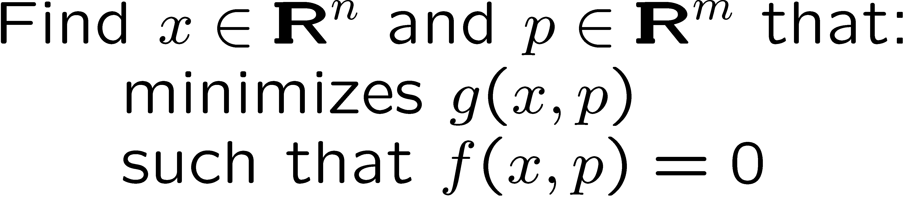
Trilinos Nonlinear Solver and Analysis Packages
Trilinos Packages
Nonlinear Problems:
  Nonlinear equations:
  Stability analysis:
NOX
LOCA
Transient Nonlinear Problems:
  DAEs/ODEs
  ODE/DAE Sensitivities …
Rythmos
Optimization Problems:
  Unconstrained:
  Constrained:
MOOCHO
Notes:
Here are some of the different types of abstract problems and the Trilinos packages implementing abstract numerical algorithms for solving these problems.

Slide 4
ModelEvaluator Overview

Slide 5
Nonlinear Algorithms and Applications : Everyone for Themselves?
Nonlinear ANA Solvers in Trilinos
NOX / LOCA
Rythmos
MOOCHO
…
Trilinos and non-Trilinos Preconditioner and Linear Solver Capability
Sandia Applications
Xyce
Charon
Tramonto
Aria
Aleph
…
Key Point
BAD

Slide 6
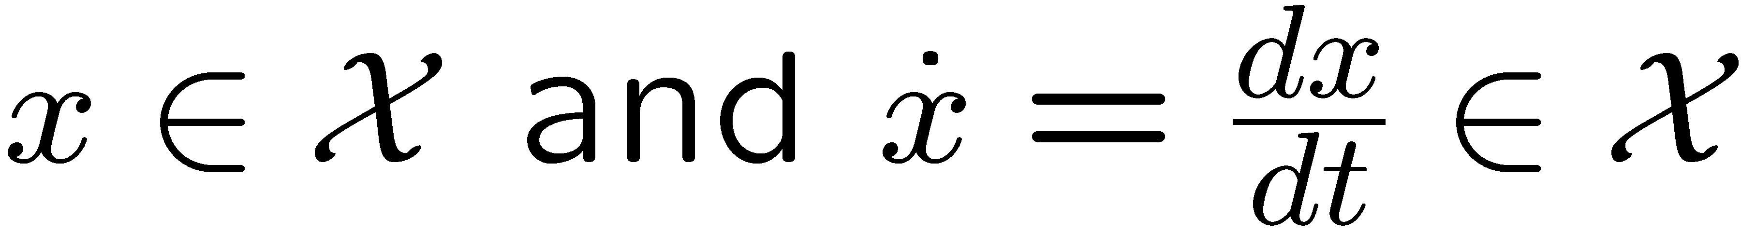

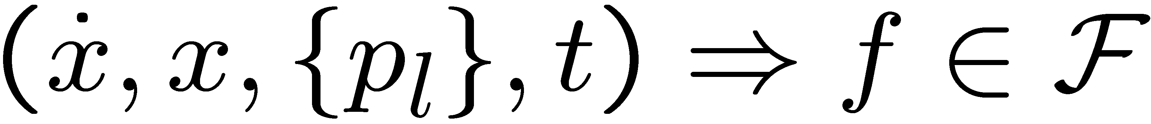
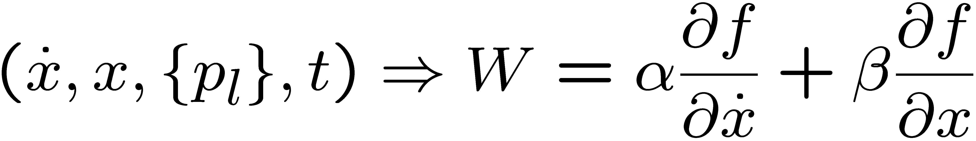
Overview of Nonlinear Model Evaluator Interface
Motivation: An interface for nonlinear problems is needed that will support a variety of different types of problems
Nonlinear equations (and senstitivities)
Stability analysis and continuation
Explicit ODEs (and sensitivities)
DAEs and implicit ODEs (and sensitivities)
Unconstrained optimization
Constrained optimization
Uncertainty quantification
…
as well as different combinations of problem types such as:
Uncertainty in transient simulations
Stability of an optimum under uncertainty of a transient problem
Key Point
The number of combinations of different problem types is large and trying to statically type all of the combinations is not realistic
Approach: Develop a single, scalable interface to address all of these problems
(Some) Input arguments:
  State and differential state:
  Parameter sub-vectors:
  Time (differential):
Key Point
All inputs and outputs are optional and the model evaluator object itself decides which ones are accepted.
(Some) Output functions:
  State function:
  Auxiliary response functions:
  State/state derivative operator (LinearOpWithSolve):

Slide 7
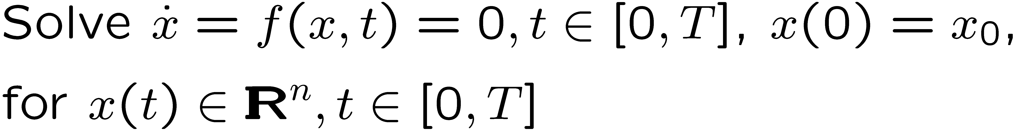
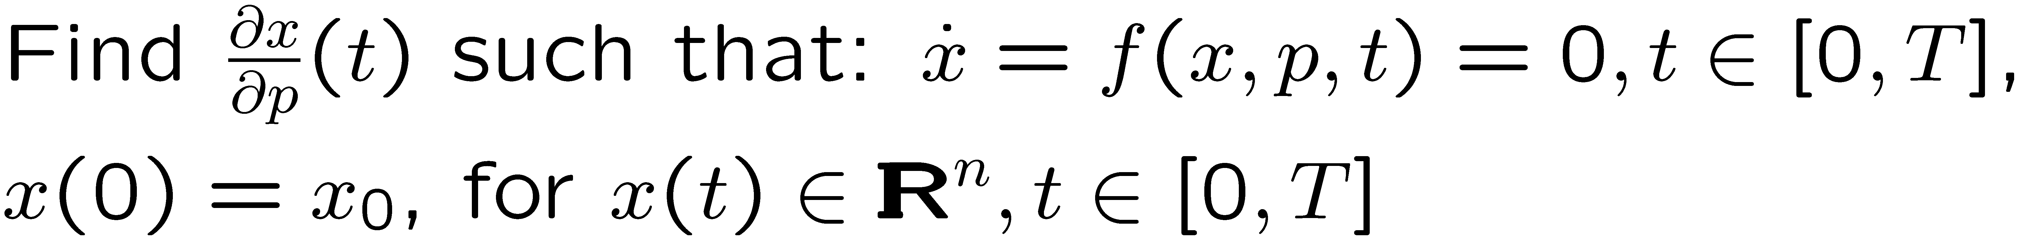
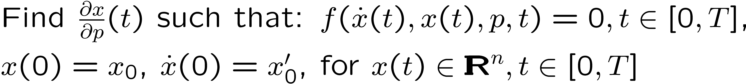
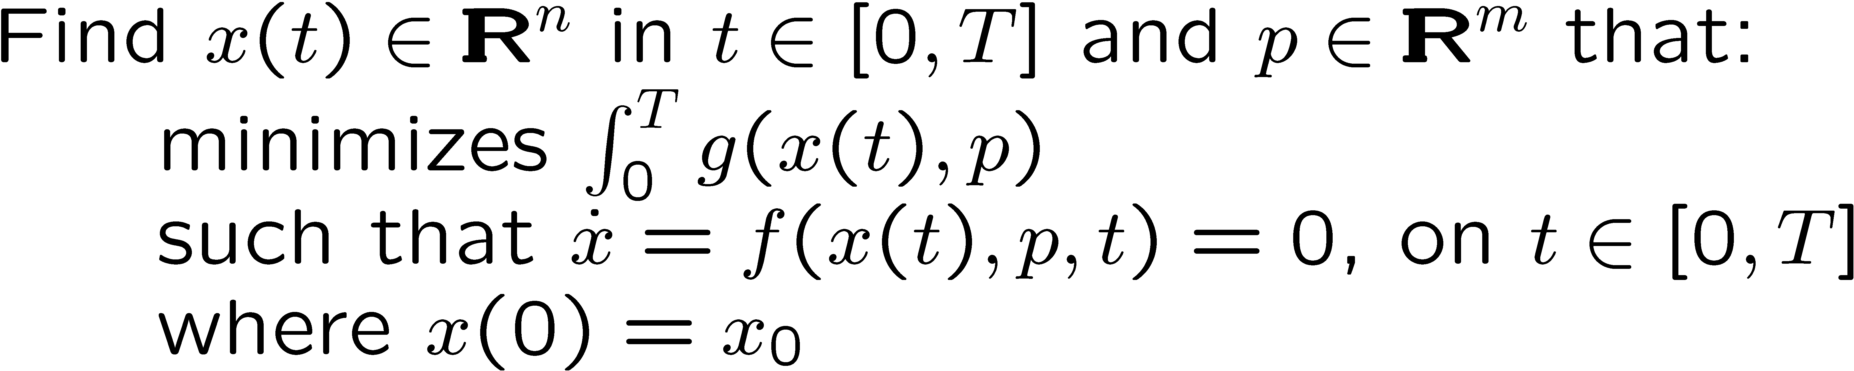
Some Nonlinear Problems Supported by the ModelEvaluator
Nonlinear equations:
Stability analysis:
Explicit ODEs:
DAEs/Implicit ODEs:
Explicit ODE Forward Sensitivities:
DAE/Implicit ODE Forward Sensitivities:
Unconstrained Optimization:
Constrained Optimization:
ODE Constrained Optimization:

Slide 8
Nonlinear Algorithms and Applications : Everyone for Themselves?
Nonlinear ANA Solvers in Trilinos
NOX / LOCA
Rythmos
MOOCHO
…
Trilinos and non-Trilinos Preconditioner and Linear Solver Capability
Sandia Applications
Xyce
Charon
Tramonto
Aria
Aleph
…
Key Point
BAD

Slide 9
Nonlinear Algorithms and Applications : Thyra & Model Evaluator!
Nonlinear ANA Solvers in Trilinos
NOX / LOCA
Rythmos
MOOCHO
…
Trilinos and non-Trilinos Preconditioner and Linear Solver Capability
Model Evaluator
Stratimikos!
Sandia Applications
Xyce
Charon
Tramonto
Aria
Aleph
…
Key Points
Provide single interface from nonlinear ANAs to applications
Provide single interface for applications to implement to access nonlinear ANAs
Provides shared, uniform access to linear solver capabilities
Once an application implements support for one ANA, support for other ANAs can quickly follow

Slide 10
Model Evaluator : Thyra and EpetraExt Versions
Thyra-based interoperability interface layer
Epetra-based application-friendly implementation support interface
Nonlinear ANA
Thyra::ModelEvaluator
EpetraExt::ModelEvaluator
create_W_op() : LinearOpBase create_W() : LinearOpWithSolveBase createInArgs() : InArgs
createOutArgs() : OutArgs
…
evalModel( in InArgs, out OutArgs )
createInArgs() : InArgs
createOutArgs() : OutArgs
create_W() : Epetra_Operator
…
evalModel( in InArgs, out OutArgs )
Thyra::EpetraModelEvaluator
createInArgs() : InArgs
createOutArgs() : OutArgs
create_W() : LinearOpWithSolveBase
…
evalModel( in InArgs, out OutArgs )
Concrete Application
Thyra::LinearOpWithSolveFactoryBase
Stratimikos!
Thyra::ModelEvaluator and EpetraExt::ModelEvaluator are near mirror copies of each other.
Thyra::EpetraModelEvaluator is fully general adapter class that can use any linear solver through a Thyra::LinearOpWithSolveFactoryBase object it is configured with
Stateless model that allows for efficient multiple shared calculations (e.g. automatic differentiation)
Adding input and output arguments involves
  Modifying only the Thyra::ModelEvaluator, EpetraExt::ModelEvaluator, Thyra::EpetraModelEvaluator, and a few other auxiliary classes and tools => O(1) overhead to add new arguments!
  Only recompilation of Nonlinear ANA and Concrete Application code

Slide 11
Simple Example EpetraExt::ModelEvaluator Subclass

Slide 12
Example EpetraExt::ModelEvaluator Application Implementation
/** \brief Simple example ModelEvaluator subclass for a 2x2 set of
* parameterized nonlinear equations.
*
* The equations modeled are:
\verbatim
f[0] = x[0] + x[1]*x[1] - p[0];
f[1] = d * ( x[0]*x[0] - x[1] - p[1] );
\endverbatim
*/
class EpetraModelEval2DSim : public EpetraExt::ModelEvaluator {
public:
EpetraModelEval2DSim(...);
/** \name Overridden from EpetraExt::ModelEvaluator . */
//@{
RCP<const Epetra_Map> get_x_map() const;
RCP<const Epetra_Map> get_f_map() const;
RCP<const Epetra_Vector> get_x_init() const;
RCP<Epetra_Operator> create_W() const;
InArgs createInArgs() const;
OutArgs createOutArgs() const;
void evalModel( const InArgs& inArgs, const OutArgs& outArgs ) const;
//@}
private:
...
};
Complete nonlinear equations example in:
  Trilinos/packages/epetraext/example/model_evaluator/2dsim/

Slide 13
Example EpetraExt::ModelEvaluator Application Implementation
EpetraExt::ModelEvaluator::InArgs EpetraModelEval2DSim::createInArgs() const
{
InArgsSetup inArgs;
inArgs.setModelEvalDescription(this->description());
inArgs.setSupports(IN_ARG_x,true);
return inArgs;
}
EpetraExt::ModelEvaluator::OutArgs EpetraModelEval2DSim::createOutArgs() const
{
OutArgsSetup outArgs;
outArgs.setModelEvalDescription(this->description());
outArgs.setSupports(OUT_ARG_f,true);
outArgs.setSupports(OUT_ARG_W,true);
outArgs.set_W_properties(
DerivativeProperties(DERIV_LINEARITY_NONCONST,DERIV_RANK_FULL,true)
);
return outArgs;
}
void EpetraModelEval2DSim::evalModel( const InArgs& inArgs, const OutArgs& outArgs ) const
{
const Epetra_Vector &x = *inArgs.get_x();
RCP<Epetra_Vector> f_out = outArgs.get_f();
RCP<Epetra_Operator> W_out = outArgs.get_W();
if (!is_null(f_out)) {
...
}
if (!is_null(W_out)) {
...
}
}
Key Point
From looking at example code, there is not even a hint that other input and output arguments exist!

Slide 14
Vertical Integration Milestone:
ModelEvaluator in Action!

Slide 15


Summary of Trilinos Vertical Integration Project (Milestone)
Goal: Vertically integrate Trilinos solver algorithms in Trilinos to build new predictive embedded analysis capabilities
  Impact: Vertically integrated 10+ Trilinos algorithm packages
Goal: Demonstrate on relevant production applications
  Impact: Solved steady-state parameter estimation problems and transient sensitivities on semiconductor devices in Charon
  Impact: Solved Eigen problems on MHD problem in Charon
Added Goal: Explore refined models of collaboration between production application developers and algorithm researchers.
  Impact: Closer collaboration between application and algorithm developers yielding better algo and app R&D
Bartlett, Roscoe, Scott Collis, Todd Coffey, David Day, Mike Heroux, Rob Hoekstra, Russell Hooper, Roger Pawlowski, Eric Phipps, Denis Ridzal, Andy Salinger, Heidi Thornquist, and Jim Willenbring. ASC Vertical Integration Milestone. SAND2007-5839, Sandia National Laboratories, 2007 [http://www.cs.sandia.gov/~rabartl/publications.html]

Slide 16


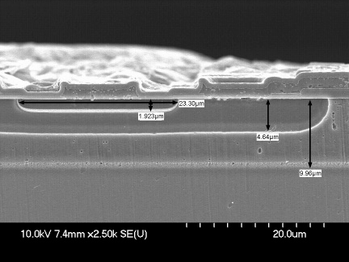
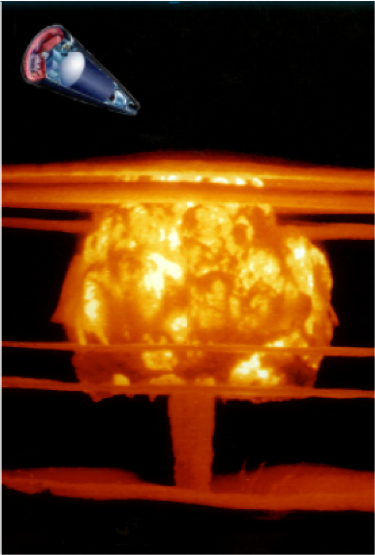
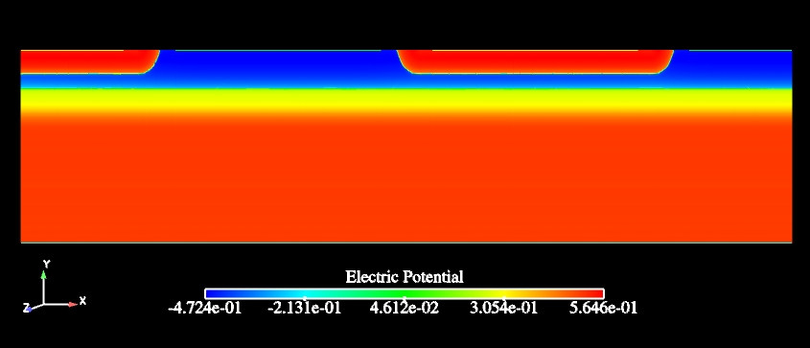

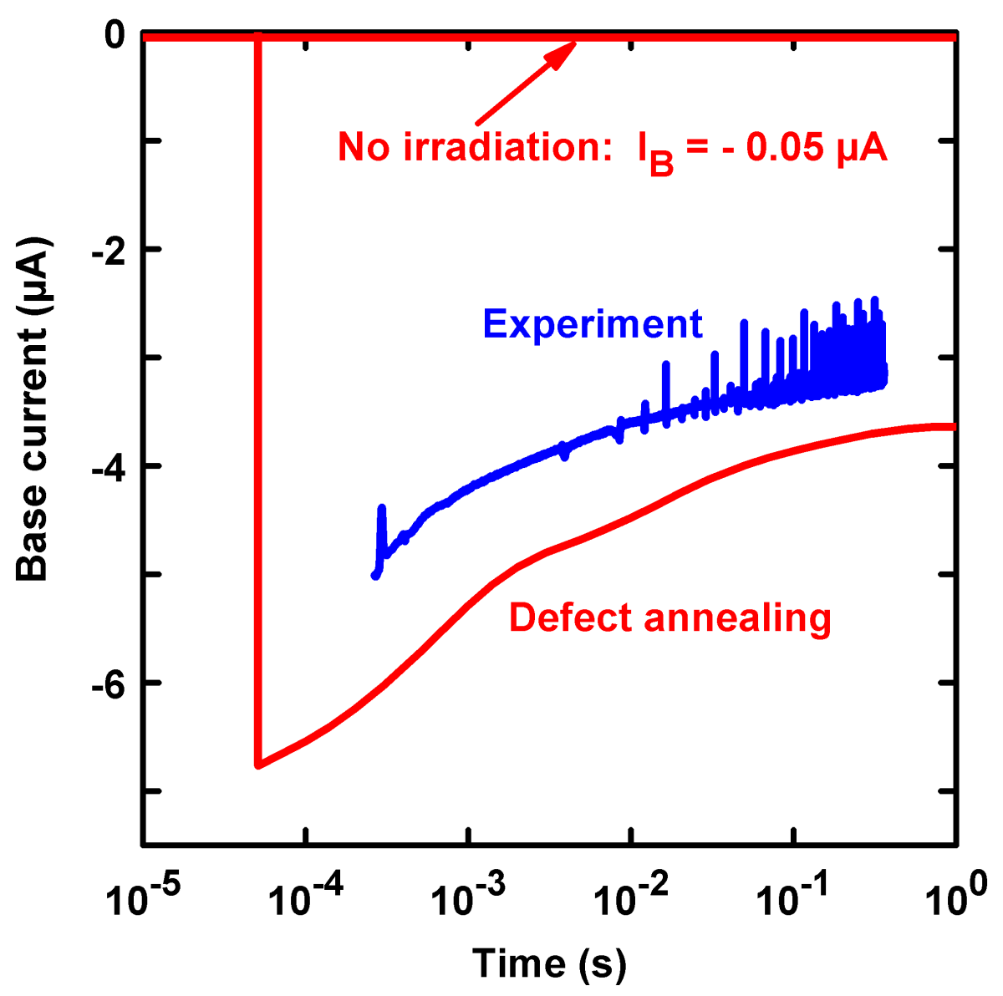

QASPR
Qualification of electronic devices in hostile environments
Stockpile BJT
PDE semiconductor device simulation
Defect reactions
B_{I}B (0,–)
B_{I} (+,0,–)
B_{I}O (+,0)
Si interstitial (I) (+2,+1,0,–1,–2)
B_{I}C
C_{I} (+,0,-)
Annihilation
VV (+1,0,–1,–2)
Annihilation
VB (+,0)
Vacancy (V) (+2,+1,0,–1,–2)
VP (0,–)
VO (0,–)

Slide 17
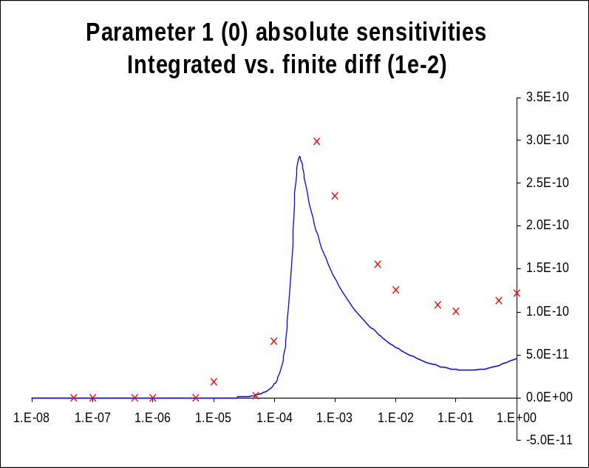
Vertical Integrations of Trilinos Capabilities: Example 1
Trilinos Capabilities
Analysis Tools
(embedded)
Nonlinear Solver
Time Integration
Continuation
Sensitivity Analysis
Stability Analysis
Constrained Solves
Optimization
Linear Algebra
Data Structures
Iterative Solvers
Direct Solvers
Eigen Solver
Transient sensitivity analysis of a 2n2222 BJT
in Charon w/AD+Rythmos: 14x faster than FD
Preconditioners
Matrix Partitioning
Derivative Tools
Derivatives
Sensitivities

Slide 18
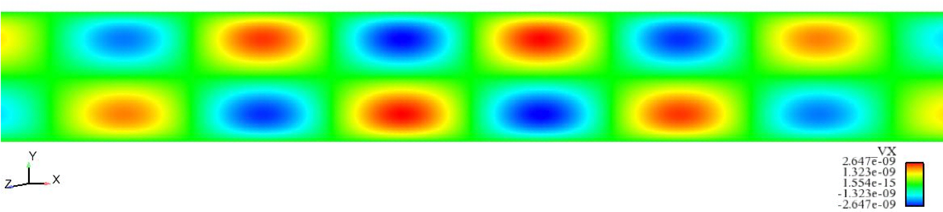
Vertical Integrations of Trilinos Capabilities: Example 2
Trilinos Capabilities
Analysis Tools
(embedded)
Nonlinear Solver
Time Integration
Continuation
Sensitivity Analysis
Stability Analysis
Constrained Solves
Optimization
Linear Algebra
Data Structures
Destabilizing eigen-vector for heated fluid in magnetic field
Iterative Solvers
Direct Solvers
Eigen Solver
Preconditioners
Matrix Partitioning
Derivative Tools
Derivatives
Sensitivities

Slide 19
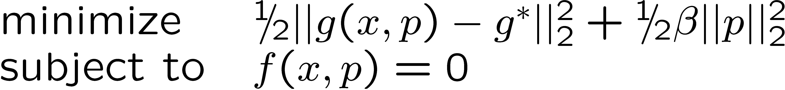
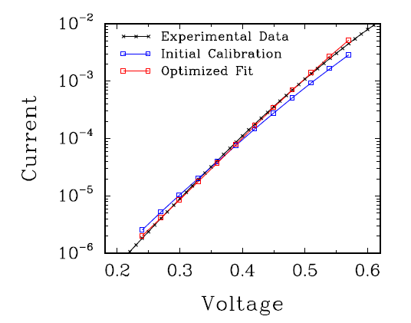
Vertical Integrations of Trilinos Capabilities: Example 3
Trilinos Capabilities
Analysis Tools
(embedded)
Nonlinear Solver
Time Integration
Continuation
Sensitivity Analysis
Stability Analysis
Constrained Solves
Optimization
Linear Algebra
Data Structures
Iterative Solvers
Direct Solvers
Eigen Solver
Preconditioners
Steady-Sate Parameter Estimation Problem
using 2n2222 BJT in Charon MOOCHO + AD
Matrix Partitioning
Derivative Tools
Derivatives
Sensitivities

Slide 20
Derivative Support and Sensitivity Analysis

Slide 21
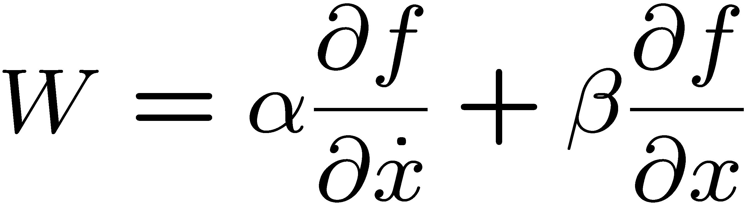
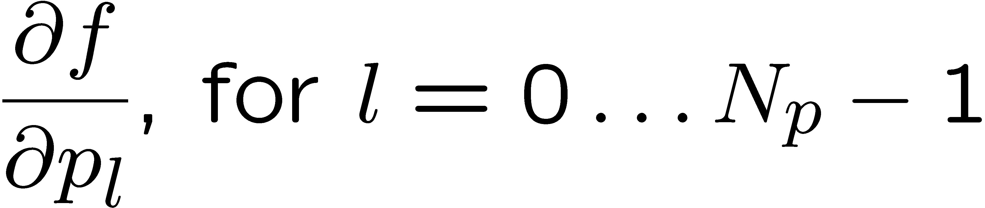
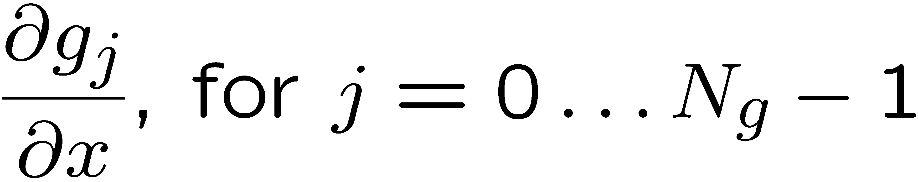
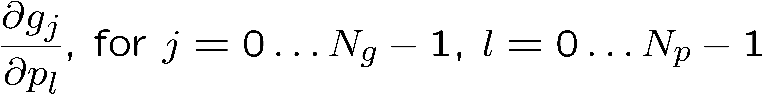
Model Derivatives
First Derivatives
State function state sensitivities:
[LinearOpWithSolveBase or LinearOpBase]
State function parameter sensitivities:
[LinearOpBase or MultiVectorBase]
Auxiliary function state sensitivities:
[LinearOpBase or MultiVectorBase²]
Auxiliary function parameter sensitivities:
[LinearOpBase or MultiVectorBase²]
Use Cases:
Steady-state and transient sensitivity computations
Optimization
Multi-physics coupling
…
Key Point
Derivative class used to store one of these three forms of a derivative

Slide 22
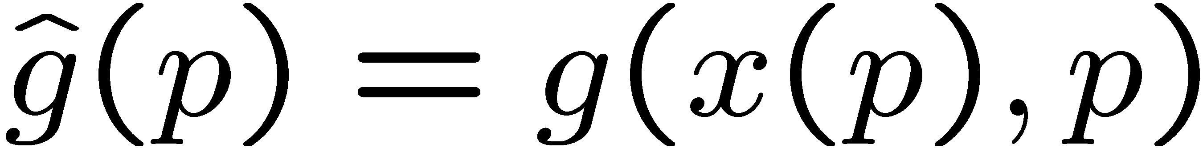
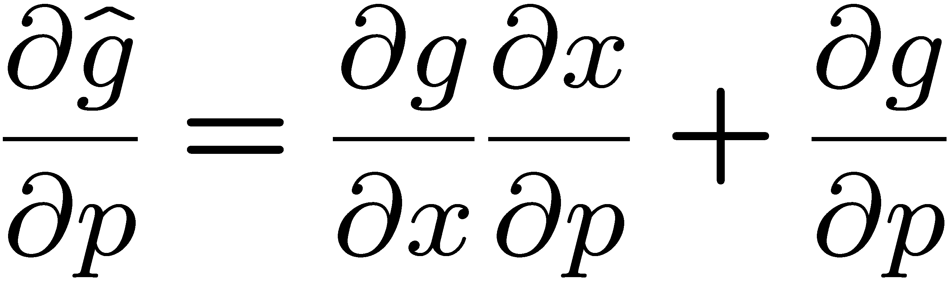
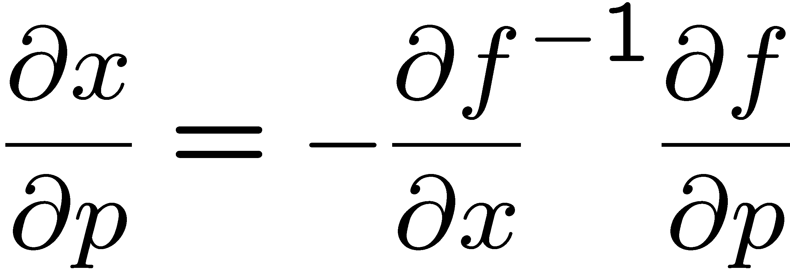
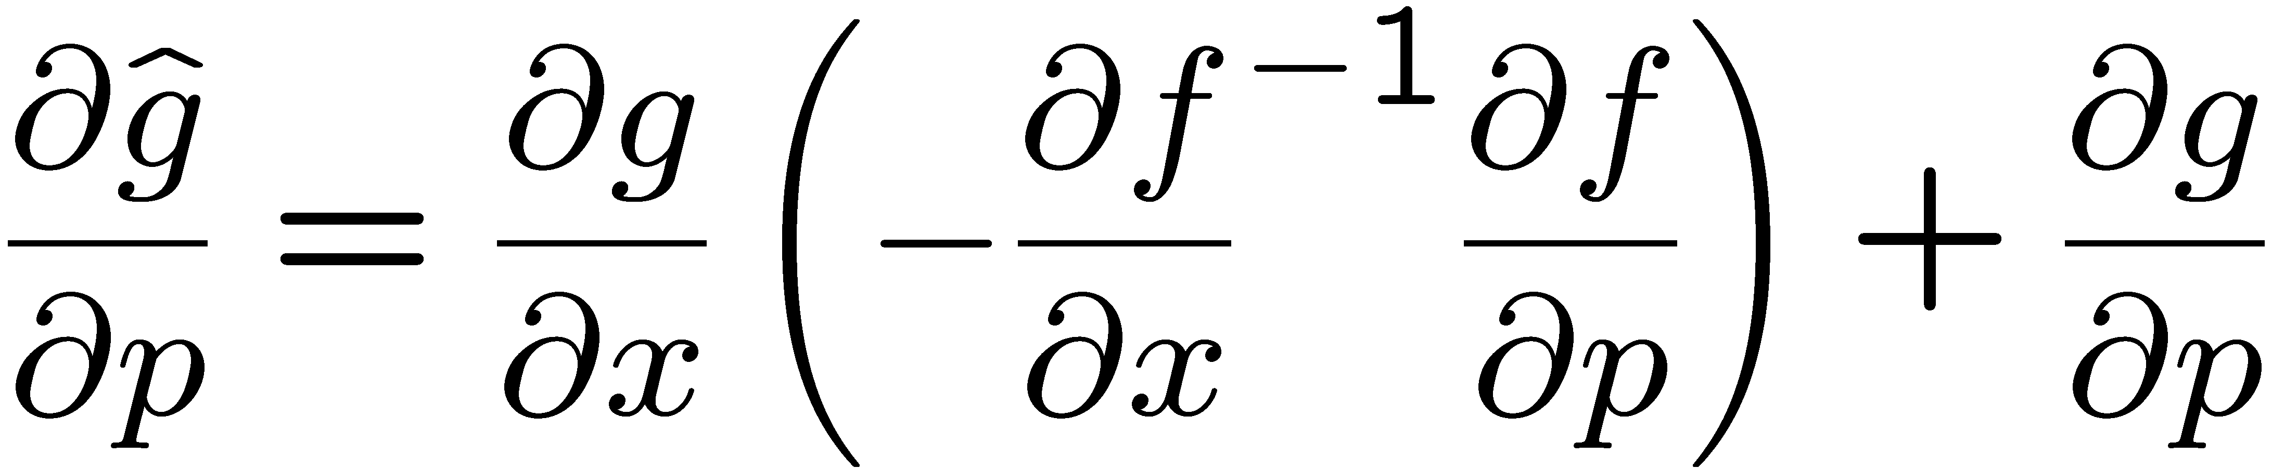
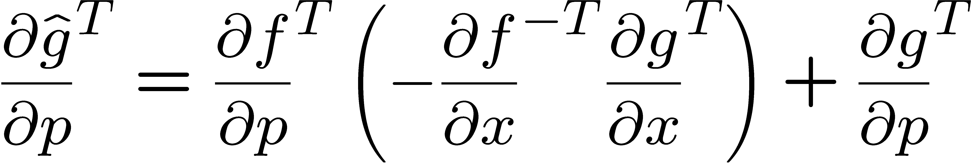
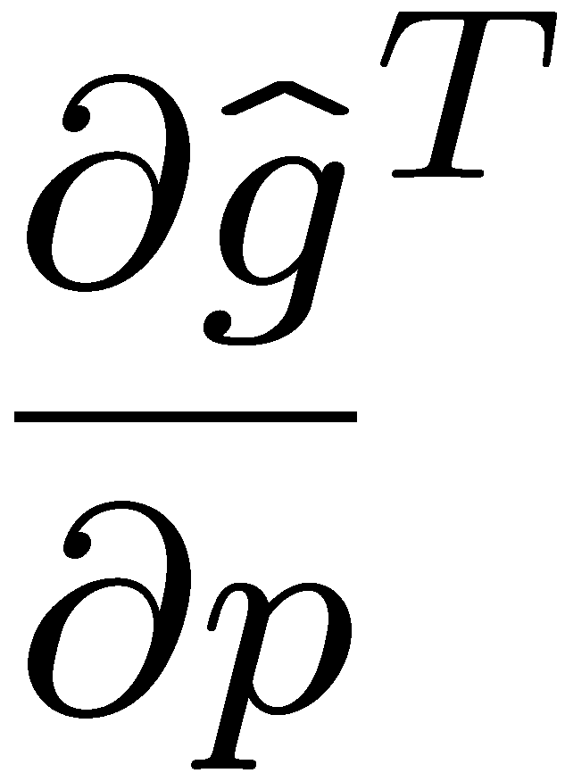
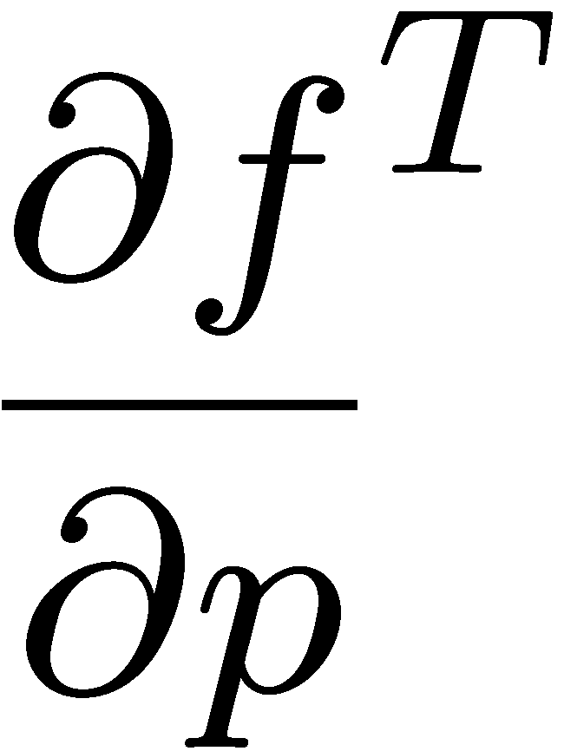
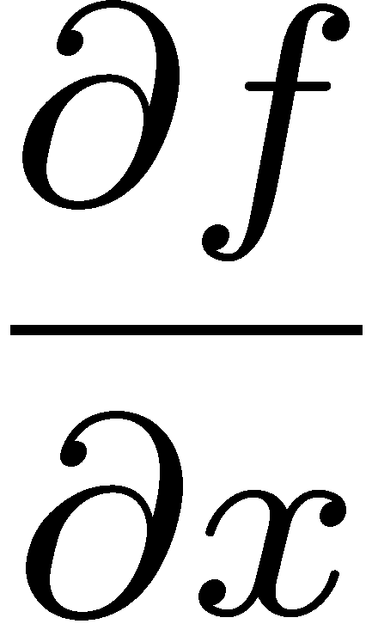
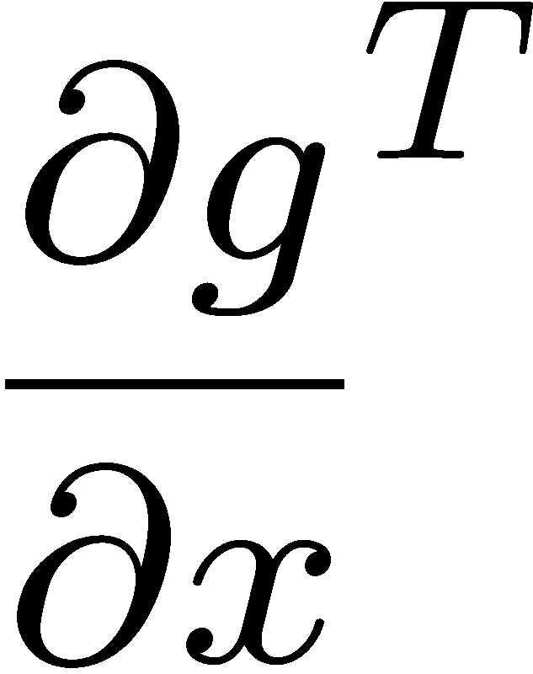
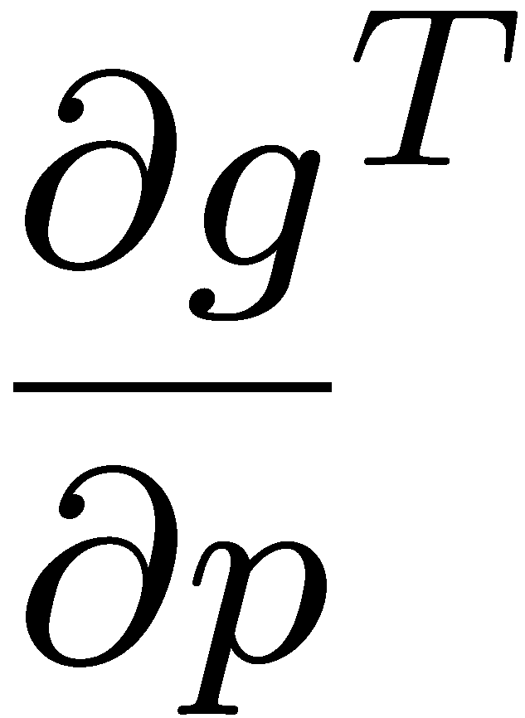
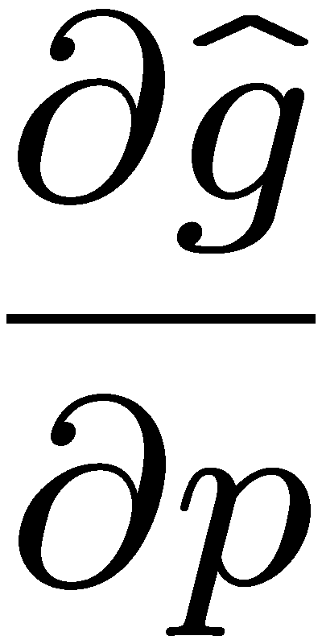
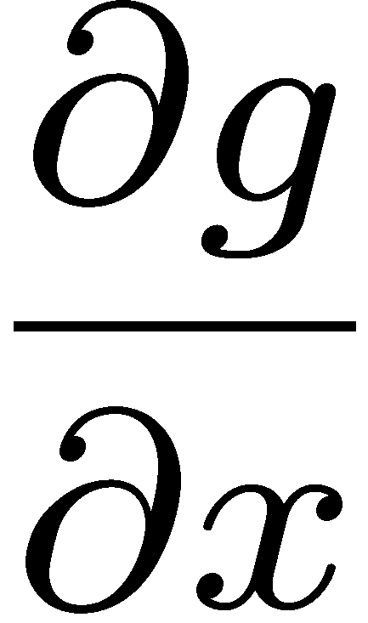
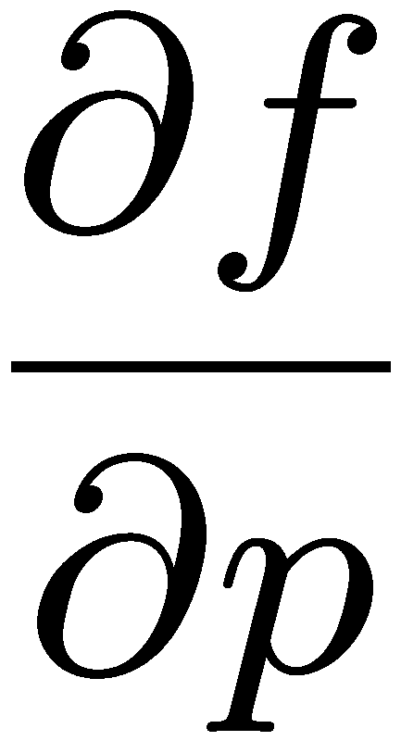
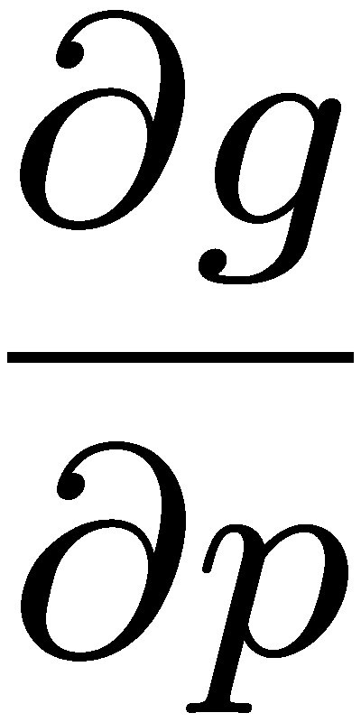
Forward/Direct and Adjoint Sensitivities
Steady-state constrained response:
Reduced response function:
Reduced Sensitivities:
Key Point
The form of the derivatives you need depends on whether you are doing direct or adjoint sensitivities
where:
Forward/Direct Sensititivies (n_{g} large, n_{p} small)
Adjoint Sensititivies (n_{g} small, n_{p} large)
-1
-T
n_{g}
=
-
+
n_{p}
=
-
+
n_{p}
n_{g}
MV
LO
LOWS
MV
MV
MV
LO
LOWS
MV
MV
MV
MV

Slide 23
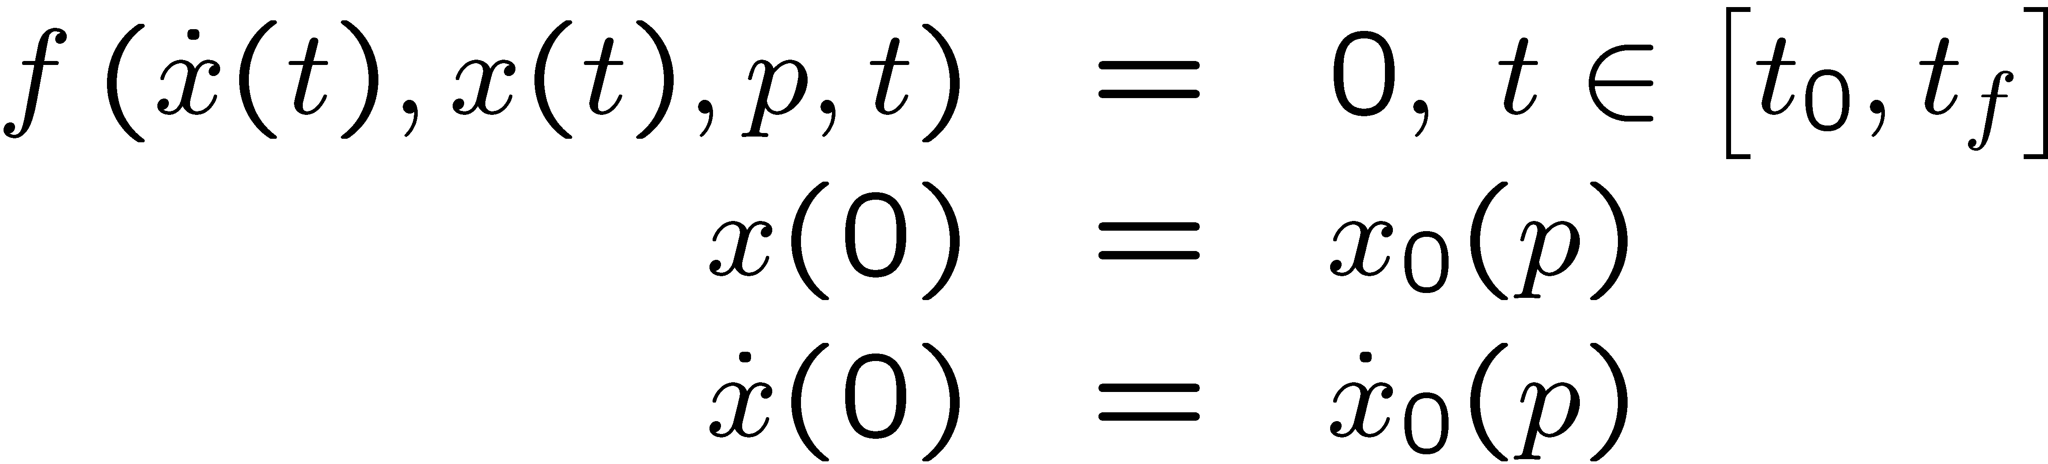
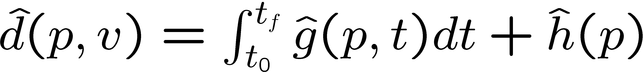
Transient Sensitivities: State Equations with Responses
Fully Implicit ODE/DAE State Equations
Composite Response Function
Reduced Composite Response Function
where:
http://www.cs.sandia.gov/~rabartl/TransientSensitivitiesDerivation2007.pdf

Slide 24
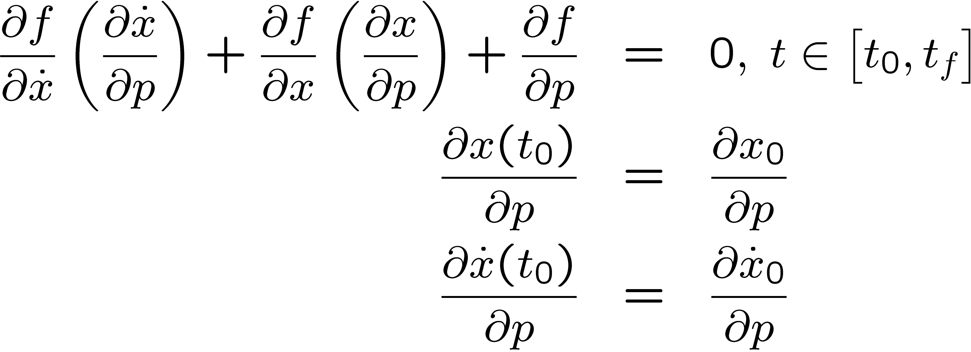
Transient Sensitivities: Forward Sensitivity Method
Forward Sensitivity Equations:
Forward Reduced Gradient
Forward Sensitivity Methods:
The forward sensitivities d(x)/d(p) are integrated right along with the forward state equation
Can be solved using explicit or implicti time integration mehtods
O(n_{p}) extra storage and computation per time step
Reuse of forward solver integrator infrastructure, Jacobian/preconditioner storage
http://www.cs.sandia.gov/~rabartl/TransientSensitivitiesDerivation2007.pdf

Slide 25
Forward Transient Sensitivities with Charon/Rythmos
QASPR transient current sensitivities w.r.t. reaction parameters for an irradiated semiconductor device modeled with Charon
  Embedded sensitivities with AD/Sacado (Phipps) & Rythmos
  Finite differences (steplen=1e-2) (optimal steplen=1e-1)
  Embedded sensitivities vs. finite diff.
    Much more accurate and robust!
    10x faster for 40 parameters!
Bartlett, Roscoe, Scott Collis, Todd Coffey, David Day, Mike Heroux, Rob Hoekstra, Russell Hooper, Roger Pawlowski, Eric Phipps, Denis Ridzal, Andy Salinger, Heidi Thornquist, and Jim Willenbring. ASC Vertical Integration Milestone. SAND2007-5839, Sandia National Laboratories, 2007 [http://www.cs.sandia.gov/~rabartl/publications.html]

Slide 26
ModelEvaluator Software Summary
Motivation for Unified ModelEvaluator Approach to Nonlinear Problems
  Large overlap in commonality between requirements for many nonlinear abstract numerical algorithms (ANAs).
  Incremental support for sensitivities, optimization, and UQ
  Mixed problem types will become more and more common and must be easy to support
Properties of ModelEvalutor Software
  Strong Typing of Input/Object Types but Weak Typing of Problem Formulation
  Designed for Augmentation
  Incremental Development of Model Types and Capabilities
  Self-Describing Models => Smart Algorithms
  Independence/Multiplicity of Input and Output Objects
ANAs already using or can use ModelEvaluator
  NOX (nonlinear equations)
  LOCA (stability analysis, continuation)
  Rythmos (explicit ODEs, implicit ODEs, DAEs)
  MOOCHO (constrained optimization, unconstrained optimization, nonlinear equations)
  Aristos (full space, trust-region optimization)

