Slide 1
MS17
A Case Study on the Vertical Integration of Trilinos Solver Algorithms with a Production Application Code
Organizer: Roscoe A. Bartlett
Sandia National Laboratories
10:00-10:25 Overview of the Vertical Integration of Trilinos Solver Algorithms in a Production Application Code
Roscoe A. Bartlett, Sandia National Laboratories
10:30-10:55 Analytic Sensitivities in Large-scale Production Applications via Automatic Differentiation with Sacado
Eric Phipps, Sandia National Laboratories
11:00-11:25 To PDE Components and Beyond
Andy Salinger, Sandia National Laboratories
11:30-11:55 Analysis Tools for Large-scale Simulation with Application to the Stationary Magnetohydrodynamics Equations
Roger Pawlowski, Eric Phipps, Heidi K. Thornquist, and Roscoe A. Bartlett, Sandia National Laboratories
Replacement

Slide 2
Overview of the Vertical Integration of Trilinos Solver Algorithms in a Production Application Code
Roscoe A. Bartlett
Department of Optimization & Uncertainty Estimation
http://www.cs.sandia.gov/~rabartl
Sandia National Laboratories
March 13th, 2008
Sandia is a multiprogram laboratory operated by Sandia Corporation, a Lockheed Martin Company,
for the United States Department of Energy under contract DE-AC04-94AL85000.

Slide 3


Overview of Trilinos Vertical Integration Project (Milestone)
Goal: Vertically integrate Trilinos solver algorithms in Trilinos to build new predictive embedded analysis capabilities
  Impact: Vertically integrated 10+ Trilinos algorithm packages
Goal: Demonstrate on relevant production applications
  Impact: Solved steady-state parameter estimation problems and transient sensitivities on semiconductor devices in Charon
  Impact: Solved Eigen problems on MHD problem in Charon
Added Goal: Explore refined models of collaboration between production application developers and algorithm researchers.
  Impact: Closer collaboration between application and algorithm developers yielding better algo and app R&D
Bartlett, Roscoe, Scott Collis, Todd Coffey, David Day, Mike Heroux, Rob Hoekstra, Russell Hooper, Roger Pawlowski, Eric Phipps, Denis Ridzal, Andy Salinger, Heidi Thornquist, and Jim Willenbring. ASC Vertical Integration Milestone. SAND2007-5839, Sandia National Laboratories, 2007 [http://www.cs.sandia.gov/~rabartl/publications.html]

Slide 4
Outline
Overview of Trilinos and Charon
Overview of vertical solver algorithm integration
Moving beyond the forward solve
  Challenges/barriers to embedded analysis methods
  Enabling methods
Examples of vertically integrated algorithms with Trilinos and Charon
Steady-state parameter estimation optimization with MOOCHO/Charon

Slide 5
Outline
Overview of Trilinos and Charon
Overview of vertical solver algorithm integration
Moving beyond the forward solve
  Challenges/barriers to embedded analysis methods
  Enabling methods
Examples of vertically integrated algorithms with Trilinos and Charon
Steady-state parameter estimation optimization with MOOCHO/Charon

Slide 6
Overview of Trilinos
Provides a suite of numerical solvers to support predictive simulation for Sandia’s customers
    => Scope has expended to include discretizations methods, …!
Provides a decoupled and scalable development environment to allow for algorithmic research and production capabilities => “Packages”
Provides support for growing SQA requirements
Mostly C++ with some C, Fortran, Python …
Advanced object-oriented and generic C++ …
Current Status
Current release: Trilinos 8.0.x (September 2007)
Next release Trilinos 9.0 (September 2008)
Trilinos website
http://trilinos.sandia.gov

Slide 7
Trilinos (8.0 & 9.0+) Package Summary
 | Objective | Package(s)
Discretizations | Meshing & Spatial Discretizations | phdMesh, Intrepid
Methods | Automatic Differentiation and UQ Prop. | Sacado, Stokos
 | Mortar Methods | Moertel
Core | Linear algebra objects | Epetra, Jpetra, Tpetra
 | Abstract interfaces | Thyra, Stratimikos, RTOp
 | Load Balancing | Zoltan, Isorropia
 | “Skins” | PyTrilinos, WebTrilinos, Star-P, ForTrilinos, CTrilinos
 | C++ utilities, (some) I/O | Teuchos, EpetraExt, Kokkos, Triutils
Solvers | Iterative (Krylov) linear solvers | AztecOO, Belos, Komplex
 | Direct sparse linear solvers | Amesos
 | Direct dense linear solvers | Epetra, Teuchos, Pliris
 | Iterative eigenvalue solvers | Anasazi
 | ILU-type preconditioners | AztecOO, IFPACK
 | Multilevel preconditioners | ML, CLAPS
 | Block preconditioners | Meros
 | Nonlinear system solvers | NOX, LOCA
 | Time Integration & Sensitivities | Rythmos
Analysis | Optimization (SAND) | MOOCHO, Aristos
Green: Packages used in Vertical Integration Milestone
Gray: New packages that will be included in Trilinos 9.0 (September 2008) or later

Slide 8
Trilinos Strategic Goals
Scalable Computations: As problem size and processor counts increase, the cost of the computation will remain nearly fixed.
Hardened Computations: Never fail unless problem essentially intractable, in which case we diagnose and inform the user why the problem fails and provide a reliable measure of error.
Full Vertical Coverage: Provide leading edge enabling technologies through the entire technical application software stack: from problem construction, solution, analysis and optimization.
Grand Universal Interoperability: All Trilinos packages will be interoperable, so that any combination of solver packages that
makes sense algorithmically will be possible within Trilinos.
Universal Accessibility: All Trilinos capabilities will be available to users of major computing environments: C++, Fortran, Python and the Web, and from the desktop to the latest scalable systems.
Universal Solver RAS: Trilinos will be:
  Reliable: Leading edge hardened, scalable solutions for each of these applications
  Available: Integrated into every major application at Sandia
  Serviceable: Easy to maintain and upgrade within the application environment.
Algorithmic
Goals
Software
Goals
Courtesy of Mike Heroux, Trilinos Project Leader

Slide 9
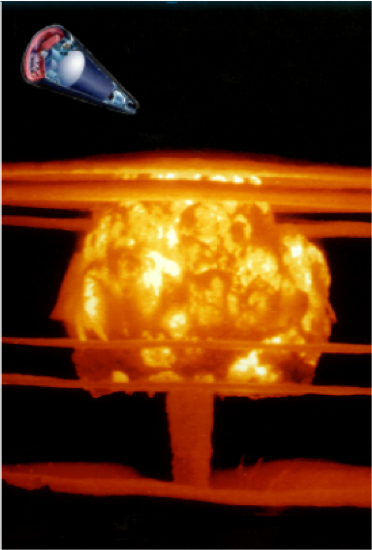
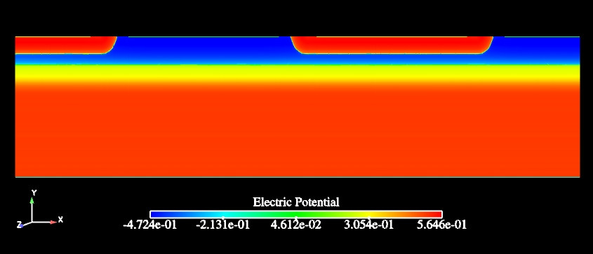
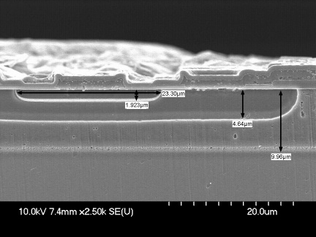
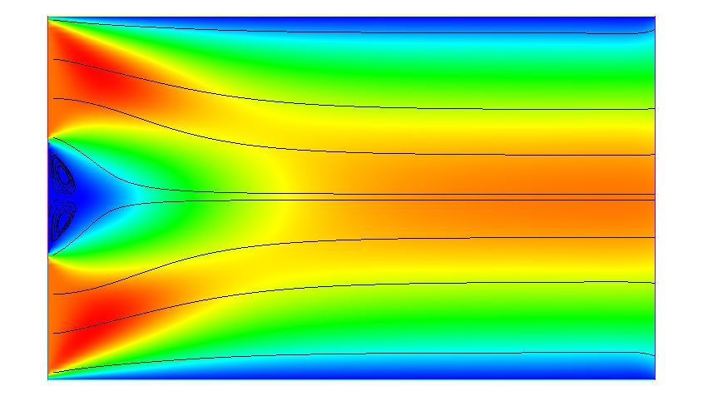
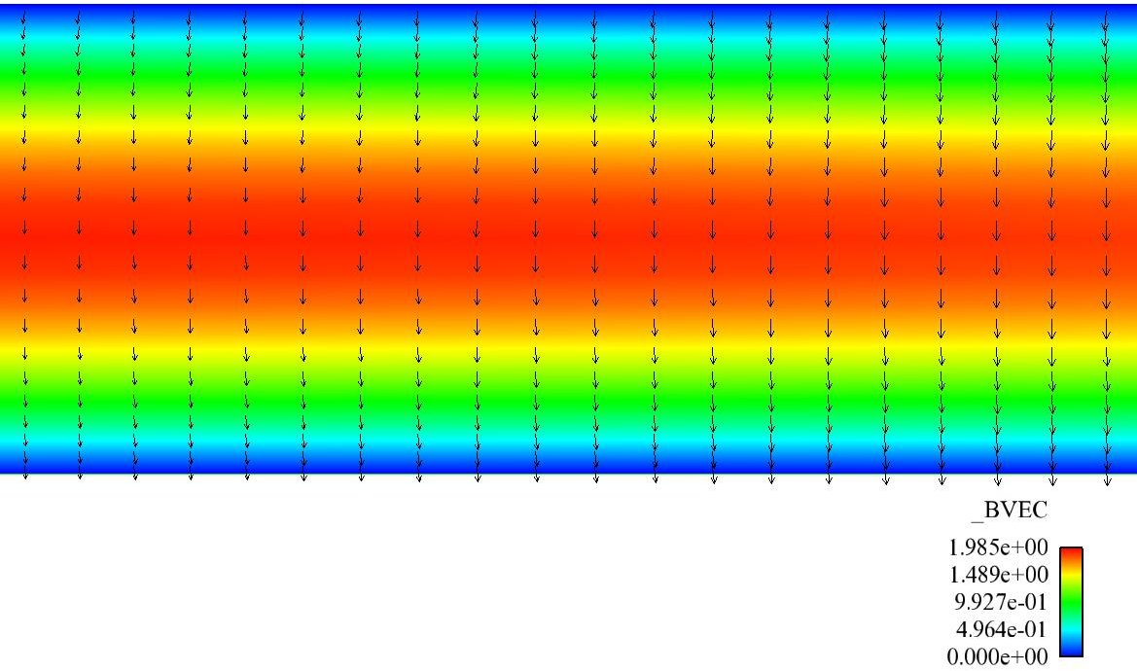
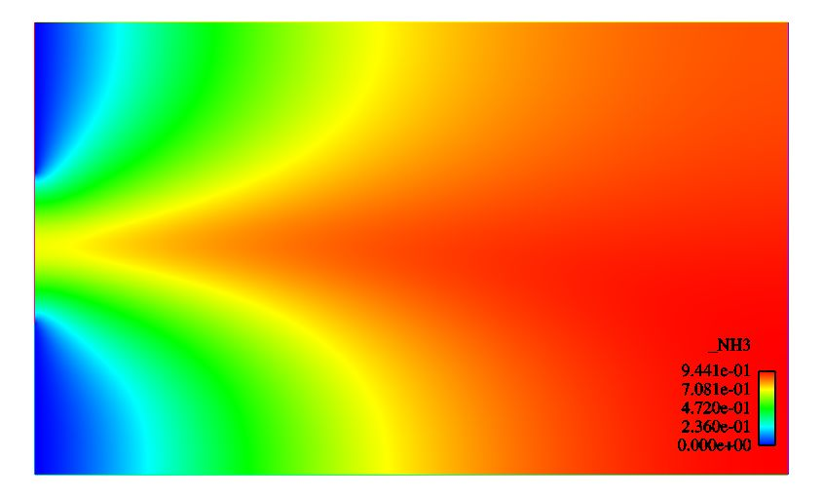
(Generalized PDE Solver)
Internal SNL Code for QASPR project
Large-scale parallel (MPI)
Unstructured grid finite elements
Automatic Differentiation
Adaptive Mesh Refinement
Generalized operators – fast addition of new operators/equations
Physics
  Semiconductor Device
  Multi-phase Aerosol
  Reacting flows/gas-phase Combustion
  MHD/Plasma
Algorithms testing ground
Semiconductor
MHD Pump
Reacting Flow

Slide 10
Outline
Overview of Trilinos and Charon
Overview of vertical solver algorithm integration
Moving beyond the forward solve
  Challenges/barriers to embedded analysis methods
  Enabling methods
Examples of vertically integrated algorithms with Trilinos and Charon
Steady-state parameter estimation optimization with MOOCHO/Charon

Slide 11
Trilinos Strategic Goals
Scalable Computations: As problem size and processor counts increase, the cost of the computation will remain nearly fixed.
Hardened Computations: Never fail unless problem essentially intractable, in which case we diagnose and inform the user why the problem fails and provide a reliable measure of error.
Full Vertical Coverage: Provide leading edge enabling technologies through the entire technical application software stack: from problem construction, solution, analysis and optimization.
Grand Universal Interoperability: All Trilinos packages will be interoperable, so that any combination of solver packages that
makes sense algorithmically will be possible within Trilinos.
Universal Accessibility: All Trilinos capabilities will be available to users of major computing environments: C++, Fortran, Python and the Web, and from the desktop to the latest scalable systems.
Universal Solver RAS: Trilinos will be:
  Reliable: Leading edge hardened, scalable solutions for each of these applications
  Available: Integrated into every major application at Sandia
  Serviceable: Easy to maintain and upgrade within the application environment.
Algorithmic
Goals
Thyra is being developed to address this issue
Software
Goals
Courtesy of Mike Heroux, Trilinos Project Leader

Slide 12
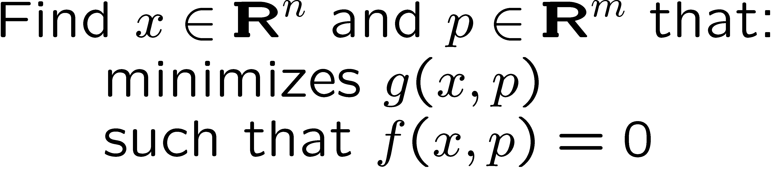
Packages/Algorithms Most Directly to Vertical Integration Project
Trilinos Packages
Linear Problems:
  Linear equations:
  Eigen problems:
Belos
Anasazi
Nonlinear Problems:
  Nonlinear equations:
  Stability analysis:
NOX
Transient Nonlinear Problems:
  DAEs/ODEs
  ODE/DAE Sensitivities …
LOCA
Embedded Analysis Algorithms
Rythmos
Optimization Problems:
  Unconstrained:
  Constrained:
MOOCHO
Notes:
Here are some of the different types of abstract problems and the Trilinos packages implementing abstract numerical algorithms for solving these problems.

Slide 13
Vertical Integration and Interoperability is Important
Example: Numerous interactions exist between layers of abstract numerical algorithms (ANAs) in a transient optimization problem
Nonlinear Optimizer
MOOCHO, ???
What is needed to solve problem?
Standard interfaces to break O(N²) 1-to-1 couplings
Transient Solver
Rythmos, SUNDIALS, ???
Iterative Linear Solver
AztecOO, Amesos, Belos, ???
Nonlinear Solver
NOX, PETSc, ???
Thyra is being developed to address interoperability of ANAs by defining interfaces for:
Linear operators/vectors
Preconditioners / Linear solvers
Nonlinear models
Nonlinear solvers
Transient solvers
Operators and Vectors
Epetra, Tpetra, PETSc, ???
Application
Charon, Aria, ???
Key Points
Higher level algorithms, like optimization, require a lot of interoperability
Interoperability and vertical integration must be “easy” or these configurations will not be achieved in practice

Slide 14
Outline
Overview of Trilinos and Charon
Overview of vertical solver algorithm integration
Moving beyond the forward solve
  Challenges/barriers to embedded analysis methods
  Enabling methods
Examples of vertically integrated algorithms with Trilinos and Charon
Steady-state parameter estimation optimization with MOOCHO/Charon

Slide 15
Embedded Analysis Algorithms and “The Cutting Edge”
Forward Simulator (linear solvers, preconditioners, …)
Sensitivities and Error-Estimation
Embedded R&D
Optimization (Opt)
Embedded R&D
UQ
Embedded R&D
Opt and UQ
Embedded R&D
0%
100%
Complexity/Fidelity of Simulation (% of “cutting edge”)
The “Cutting Edge” for the Forward Simulation Application
  Drives capability computing (e.g., Gordan Bell, etc.)
  Drives (i.e., “Pulls”) R&D for linear solvers, preconditioners, …
Advanced Analysis Methods
  Lag behind the “cutting edge” of the forward simulation
  R&D reduces the lag!
  Less direct impact on the forward simulation results => Leads to “Push” instead of “Pull”
  Requires a different approach w.r.t. working with APP developers and customers!

Slide 16
Challenges/Barriers to Embedded Analysis Algorithms
Version Control, Build, Test
(incompatible dev sources, environments, tools, lack of testing, …)
APP + Trilinos Dev (Bartlett et. al.)
Software Infrastructure
(narrow forward solvers, inflexible implementation approaches, …)
Thyra ModelEvaluator (Bartlett et. al.)
Derivatives
(smoothness, accuracy, parameter derivatives, … )
AD/Sacado (Phipps and Gay)
Fleeting effort #1
SNL
APP + Trilinos Dev (Bartlett et.al.)
Thyra ModelEvaluator (Bartlett et.al.)
AD/Sacado (Phipps et.al.)
…
Fleeting effort #2
Embedded Algorithms R&D with Production APPs
Better Algorithms R&D
Better Production APPs
We are now addressing these barriers in a fundamental way to provide the foundation for sustained embedded algorithms R&D

Slide 17
Nonlinear Algorithms and Applications : Thyra & Model Evaluator!
Nonlinear ANA Solvers in Trilinos
NOX / LOCA
Rythmos
MOOCHO
…
Trilinos and non-Trilinos Preconditioner and Linear Solver Capability
Model Evaluator
Stratimikos!
Sandia Applications
Xyce
Charon
Tramonto
Aria
Aleph
…
Key Points
Provide single interface from nonlinear ANAs to applications
Provides for shared, uniform access to linear solver capabilities
Once an application implements support for one ANA, support for other ANAs can be added incrementally

Slide 18
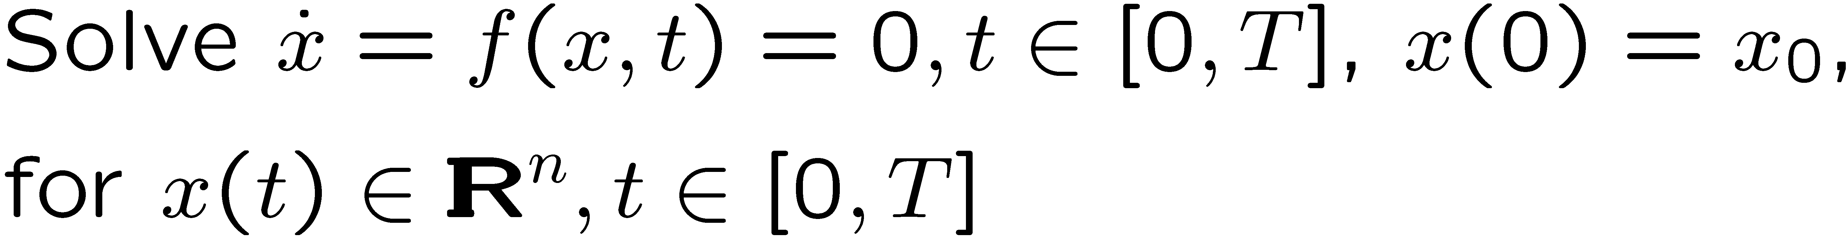
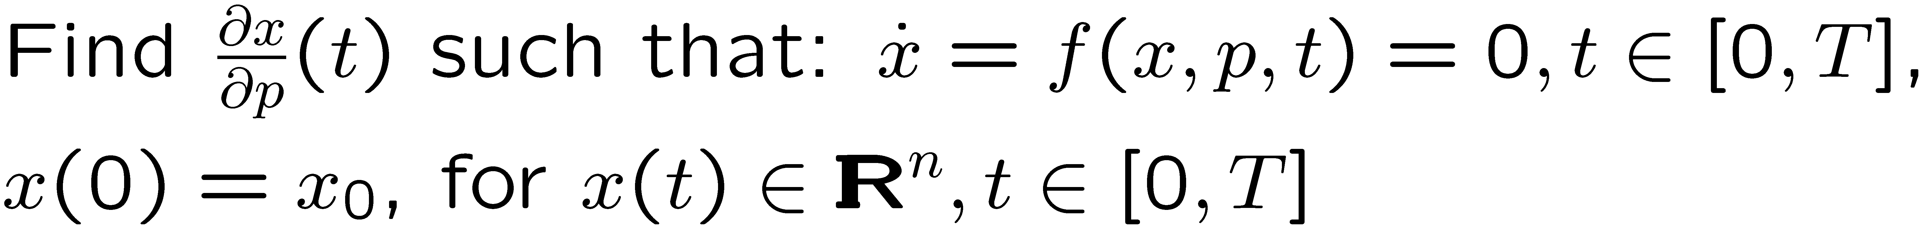
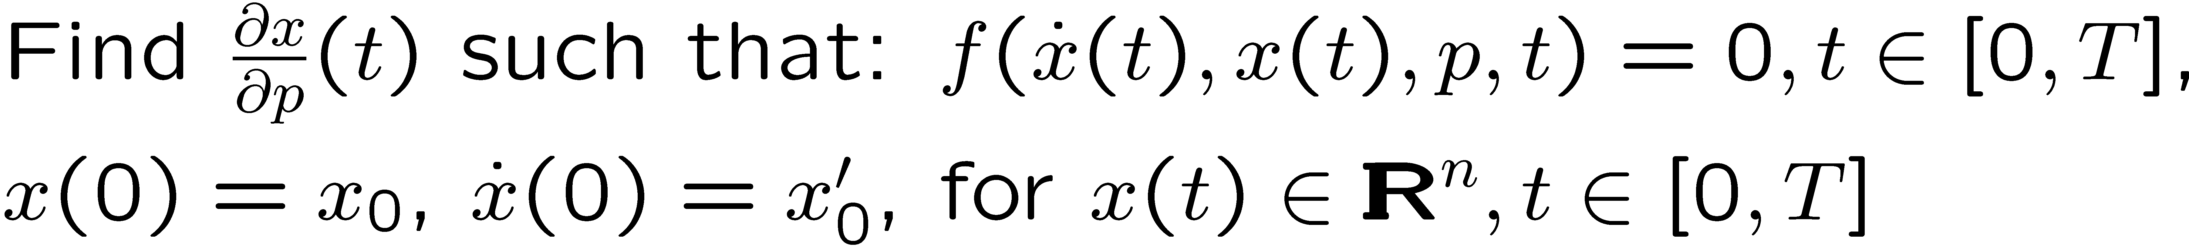
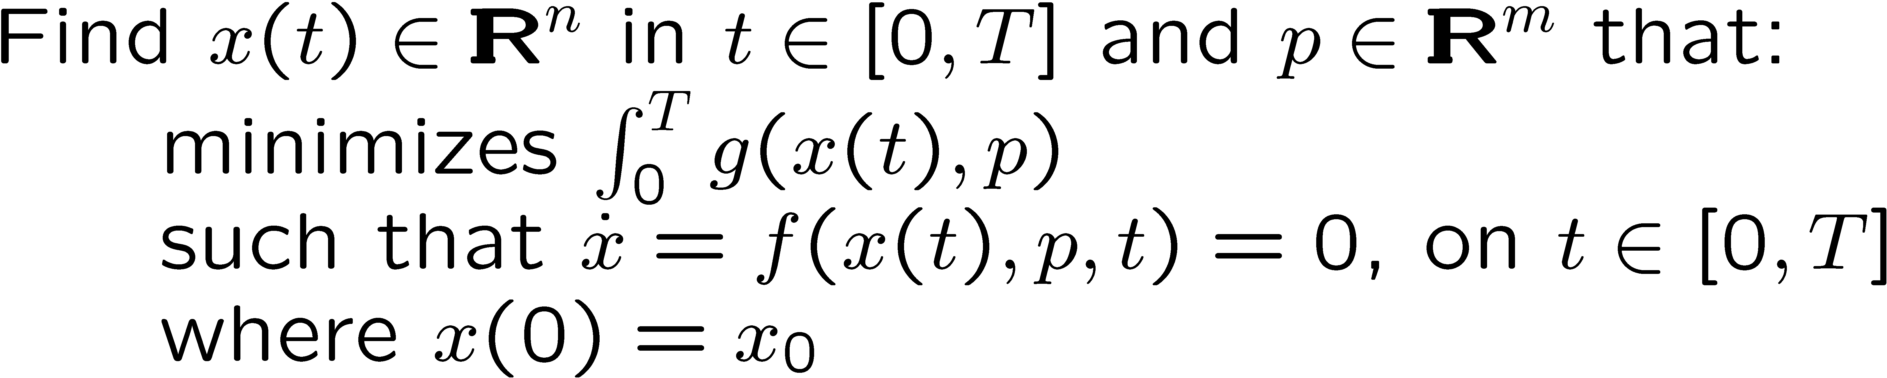
Some Nonlinear Problems Supported by the ModelEvaluator
Nonlinear equations:
Stability analysis:
Explicit ODEs:
DAEs/Implicit ODEs:
Explicit ODE Forward Sensitivities:
DAE/Implicit ODE Forward Sensitivities:
Unconstrained Optimization:
Constrained Optimization:
ODE Constrained Optimization:

Slide 19
APP + Trilinos Dev: Algorithms and Applications Integration
The Idea:
  Keep the development versions of APP and Trilinos code updated and tested daily
  Automated daily integrations tests
    =>Results in better production capabilities and better research
Charon + Trilinos Dev
  Development versions of Charon and Trilinos are kept up-to-date every day!
  New embedded optimization and sensitivity capabilities are run and tested every day!
Aria/SIERRA + Trilinos Dev
  We have automated configuration and daily integration testing of Aria/SIERRA VOTD against Trilinos Dev working!
  Now, we are addressing Aria/SIERRA software infrastructure issues and will start adding new embedded Trilinos analysis algorithms!
Bartlett, Roscoe. Daily Integration and Testing of the Development Versions of Applications and Trilinos: A stronger foundation for enhanced collaboration in application and algorithm research and development, SAND2007-7040, Sandia National Laboratories, October 2007 [http://www.cs.sandia.gov/~rabartl/publications.html]

Slide 20
Outline
Overview of Trilinos and Charon
Overview of vertical solver algorithm integration
Moving beyond the forward solve
  Challenges/barriers to embedded analysis methods
  Enabling methods
Examples of vertically integrated algorithms with Trilinos and Charon
Steady-state parameter estimation optimization with MOOCHO/Charon

Slide 21
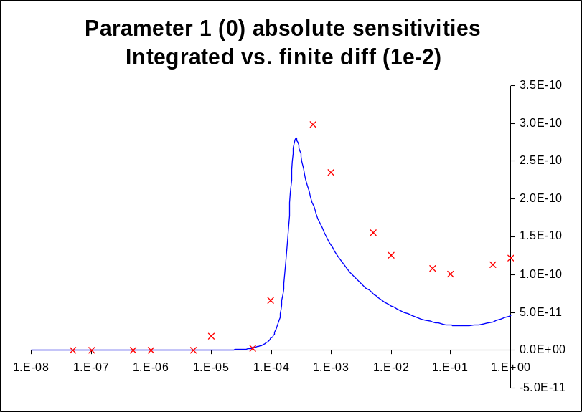
Vertical Integrations of Trilinos Capabilities: Example 1
See Andy Salinger’s Talk at 11:00 AM
Trilinos Capabilities
Analysis Tools
(embedded)
Nonlinear Solver
Time Integration
Continuation
Sensitivity Analysis
Stability Analysis
Constrained Solves
Optimization
Linear Algebra
Data Structures
Iterative Solvers
Direct Solvers
Eigen Solver
Transient sensitivity analysis of a 2n2222 BJT
in Charon w/AD+Rythmos: 14x faster than FD
Preconditioners
Matrix Partitioning
Derivative Tools
See Eric Phipp’s Talk at 10:30 AM
Derivatives
Sensitivities

Slide 22
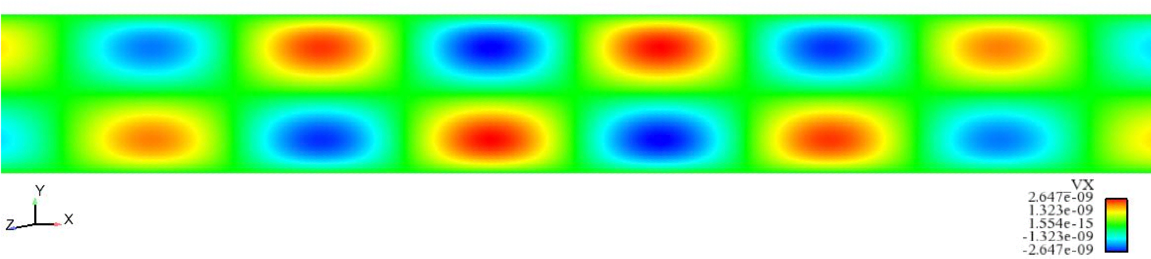
Vertical Integrations of Trilinos Capabilities: Example 2
Trilinos Capabilities
Analysis Tools
(embedded)
Nonlinear Solver
Time Integration
Continuation
Sensitivity Analysis
Stability Analysis
Constrained Solves
Optimization
Linear Algebra
Data Structures
Destabilizing eigen-vector for heated fluid in magnetic field
Iterative Solvers
Direct Solvers
Eigen Solver
Preconditioners
See Roger Pawlowski’s Talk at 11:30 AM
Matrix Partitioning
Derivative Tools
Derivatives
Sensitivities

Slide 23
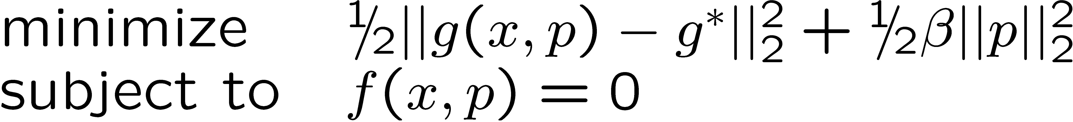
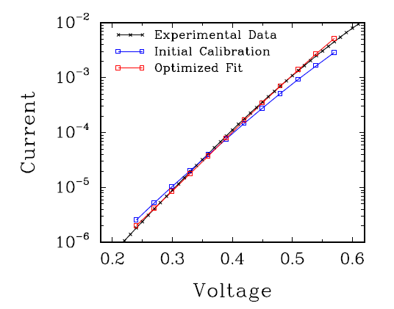
Vertical Integrations of Trilinos Capabilities: Example 3
Trilinos Capabilities
Analysis Tools
(embedded)
Nonlinear Solver
Time Integration
Continuation
Sensitivity Analysis
Stability Analysis
Constrained Solves
Optimization
Linear Algebra
Data Structures
Iterative Solvers
Direct Solvers
Eigen Solver
Preconditioners
Steady-Sate Parameter Estimation Problem
using 2n2222 BJT in Charon MOOCHO + AD
Matrix Partitioning
Derivative Tools
I am talking about this next
Derivatives
Sensitivities

Slide 24
Outline
Overview of Trilinos and Charon
Overview of vertical solver algorithm integration
Moving beyond the forward solve
  Challenges/barriers to embedded analysis methods
  Enabling methods
Examples of vertically integrated algorithms with Trilinos and Charon
Steady-state parameter estimation optimization with MOOCHO/Charon

Slide 25



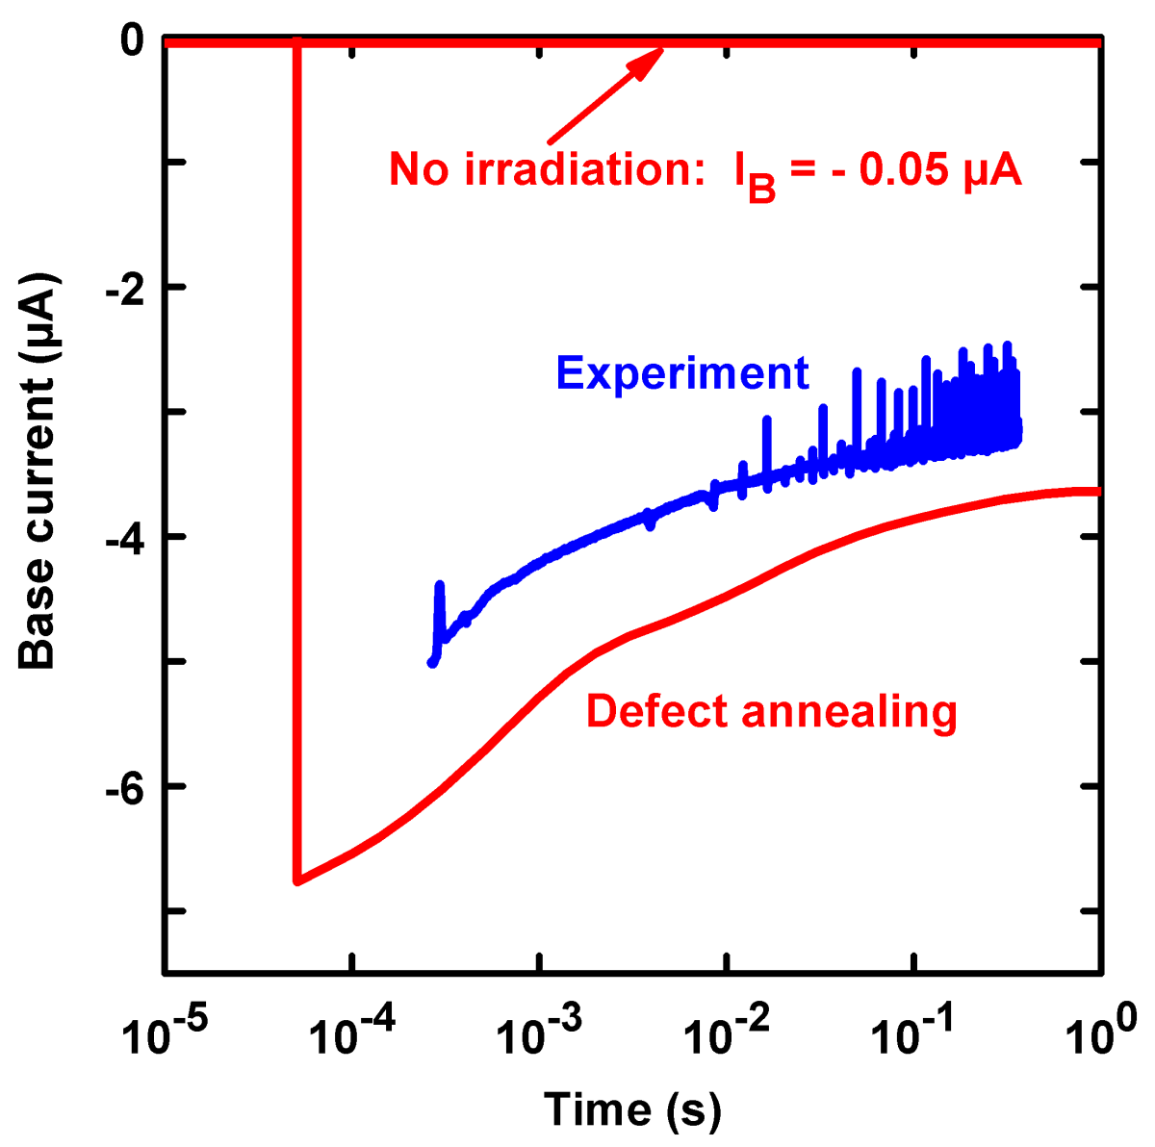

QASPR
Qualification of electronic devices in hostile environments
Stockpile BJT
PDE semiconductor device simulation
Defect reactions
B_{I}B (0,–)
B_{I} (+,0,–)
B_{I}O (+,0)
Si interstitial (I) (+2,+1,0,–1,–2)
B_{I}C
C_{I} (+,0,-)
Annihilation
VV (+1,0,–1,–2)
Annihilation
VB (+,0)
Vacancy (V) (+2,+1,0,–1,–2)
VP (0,–)
VO (0,–)

Slide 26
Steady-State Parameter Estimation with Charon/MOOCHO
Minimize Current model vs. target mismatch
Subject to: Steady-state semiconductor
defect physic FE model
Solved current matching optimization problems to calibrate model parameters against target currents
MOOCHO (Bartlett) optimization solver converges simulation model and optimality at same time
  Faster and more robust than black-box optimization methods
  More accurate solutions
Successes
  Very accurate inversion of currents and model parameters for contrived “inverse” problems
Challenges
  Extremely difficult nonlinear solver convergences on model convergence => Opportunities for algorithm research
  Inability to match experimental data => May indicate incomplete FE model

Slide 27
Summary of Trilinos Vertical Integration Project (Milestone)
Goal: Vertically integrate Trilinos solver algorithms in Trilinos to build new predictive embedded analysis capabilities
  Impact: Vertically integrated 10+ Trilinos algorithm packages
Goal: Demonstrate on relevant production applications
  Impact: Solved steady-state parameter estimation problems and transient sensitivities on semiconductor devices in Charon
  Impact: Solved Eigen problems on MHD problem in Charon
Added Goal: Explore refined models of collaboration between production application developers and algorithm researchers.
  Impact: Closer collaboration between application and algorithm developers yielding better algo and app R&D
Bartlett, Roscoe, Scott Collis, Todd Coffey, David Day, Mike Heroux, Rob Hoekstra, Russell Hooper, Roger Pawlowski, Eric Phipps, Denis Ridzal, Andy Salinger, Heidi Thornquist, and Jim Willenbring. ASC Vertical Integration Milestone. SAND2007-5839, Sandia National Laboratories, 2007 [http://www.cs.sandia.gov/~rabartl/publications.html]

Slide 28
MS17
A Case Study on the Vertical Integration of Trilinos Solver Algorithms with a Production Application Code
Organizer: Roscoe A. Bartlett
Sandia National Laboratories
10:00-10:25 Overview of the Vertical Integration of Trilinos Solver Algorithms in a Production Application Code
Roscoe A. Bartlett, Sandia National Laboratories
10:30-10:55 Analytic Sensitivities in Large-scale Production Applications via Automatic Differentiation with Sacado
Eric Phipps, Sandia National Laboratories
11:00-11:25 To PDE Components and Beyond
Andy Salinger, Sandia National Laboratories
11:30-11:55 Analysis Tools for Large-scale Simulation with Application to the Stationary Magnetohydrodynamics Equations
Roger Pawlowski, Eric Phipps, Heidi K. Thornquist, and Roscoe A. Bartlett, Sandia National Laboratories
Replacement

