Slide 1


New Teuchos Utility Classes for Safer Memory Management in C++
SAND2007-7237C
Roscoe A. Bartlett
Department of Optimization & Uncertainty Estimation
Sandia National Laboratories
Trilinos Users Group Meeting, November 7th, 2007
Sandia is a multiprogram laboratory operated by Sandia Corporation, a Lockheed Martin Company,
for the United States Department of Energy under contract DE-AC04-94AL85000.

Slide 2
Current State of Memory Management in Trilinos C++ Code
The Teuchos reference-counted pointer (RCP) class is being widely used
  Memory leaks are becoming less frequent (but are not completely gone => circular references!)
  Fewer segfaults from uninitailized pointers and accessing deleted objects …
However, we still have problems …
  Segfaults from improper usage of arrays of memory (e.g. off-by-one errors etc.)
  Improper use of other types of data structures
The core problem? => Ubiquitous high-level use of raw C++ pointers in our application (algorithm) code!
What I am going to address in this presentation:
  Adding new Teuchos utility classes similar to Teuchos::RCP to encapsulate usage of raw C++ pointers for:
    handling of single objects
    handling of contiguous arrays of objects
  New Teuchos utility classes without reference counting to eliminate all raw pointers

Slide 3
Outline
Background
High-level philosophy for memory management
Existing STL classes
Overview of Teuchos Memory Management Utility Classes
Challenges to using Teuchos memory management utility classes
Wrap up

Slide 4
Outline
Background
  Background on C++
  Problems with using raw C++ pointers at the application programming level
High-level philosophy for memory management
Existing STL classes
Overview of Teuchos Memory Management Utility Classes
Challenges to using Teuchos memory management utility classes
Wrap up

Slide 5
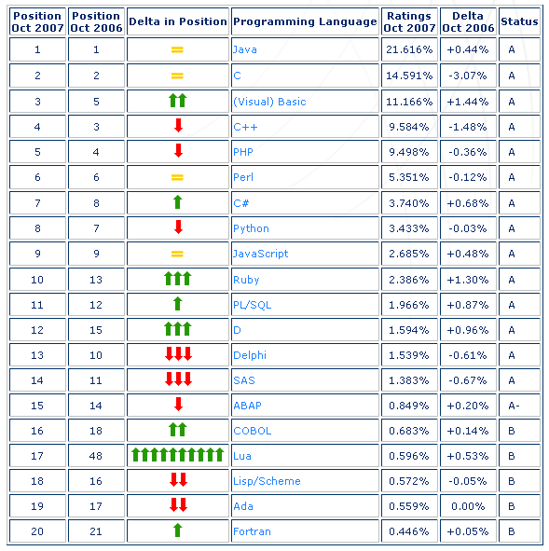
Popularity of Programming Languages
The ratings are based on:
world-wide availability of skilled engineers
available courses
third party vendors
only max of language dialects
C++ is only the 4th most popular language
C is almost twice as popular as C++ (so much for object-oriented programming)
Java and Visual Basic popularity together are at least 4 times more popular than C++
Fortran is hardly a blip
  C++ is 20 times more popular
  Java is 40 times more popular
Source: http://www.tiobe.com
Referenced in appendix of [Booch, 2007]

Slide 6
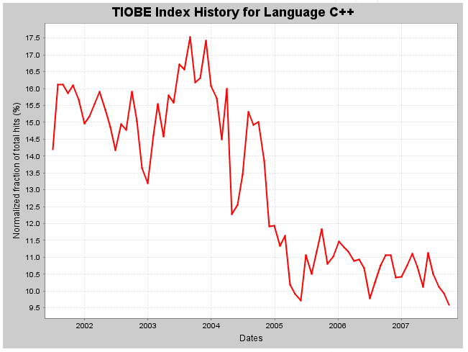
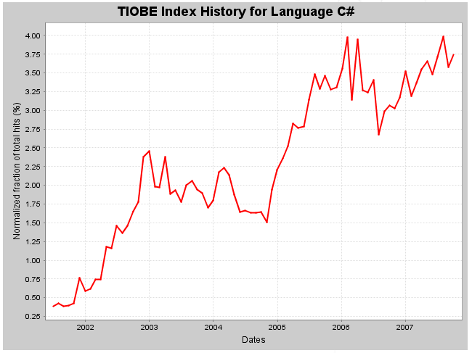
Declining Overall Popularity of C++
The C++ Programming Language
Highest Rating (since 2001): 17.531% (3rd position, August 2003)
Lowest Rating (since 2001): 9.584% (4th position, October 2007)
The C# Programming Language
Highest Rating (since 2001): 3.987% (7th position, August 2007)
Lowest Rating (since 2001): 0.384% (22nd position, August 2001)
C++ is about half as popular as it was 4 years ago!
  => Is C++ is on it’s way out? => Of course not, but it’s popularity is declining!
C# is more than twice as popular as it was 4 years ago
  => Will C# mostly replace C++? => Depends if C# expands past .NET!
Source: http://www.tiobe.com

Slide 7
Implications for the Decline in Popularity of C++
Fewer and lower-quality tools for C++ in the future for:
  Debugging?
  Automated refactoring?
  Memory usage error detection?
  Others?
Fewer new hirers will know C++ in the future
  Bad news since C++ is already very hard to learn in the first place!
    Who is going to take over the maintenance of our C++ codes?
  However, the extremely low and declining popularity of Fortran does not stop organizations from using it either …

Slide 8
The Good and the Bad for C++ for Scientific Computing
The good:
  Better ANSI/ISO C++ compilers now available for most of our important platforms
    GCC is very popular for academics, produces fast code on Linux
    Red Storm and the PGI C++ compiler (gone is Janus)
    etc …
  Easy interoperability with C, Fortran and other languages
  Very fast native C++ programs
  Precise control of memory (when, where, and how)
  Support for generics (i.e. templates), operator overloading etc.
    Example: Sacado! Try doing that in another language!
  If Fortran is so unpopular then why are all of our customers using it?
    => C++ will stay around for a long time if we are productive using it!
The bad:
  Language is complex and hard to learn
  Language has been cobbled together over many years constrained by C and backward compatibility => Incompatible features (e.g. new/delete and exception handling, see CPPCS, Item 13)
  Memory management is still difficult to get right

Slide 9
Preserving our Productivity in C++ in Modern Times
Support for modern software engineering methodologies
  Test Driven Development (easy)
  Other modern software engineering practices (code reviews supported by coding standards, etc.)
  Refactoring => No automated refactoring tools!
Safe memory management
  Avoiding memory leaks
  Avoiding segmentation faults from improper memory usage
Training and Mentoring?
  There is no silver bullet here!

Slide 10
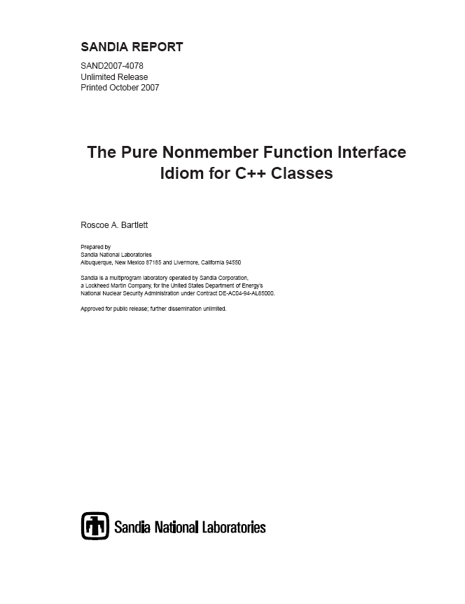
Refactoring Support: The Pure Nonmember Function Interface Idiom
SAND2007-4078
Unifies the two idoms:
  Non -Virtual Interface (NVI) idiom [Meyers, 2005], [Sutter & Alexandrescu, 2005]
  Non-member Non-friend Function idiom [Meyers, 2005], [Sutter & Alexandrescu, 2005]
Uses a uniform nonmember function interface for very “stable” classes (see [Martin, 2003] for this definition of “stable”)
Allows for refactorings to virtual functions without breaking client code
Doxygen \relates feature attaches link to nonmember functions to the classes they are used with.

Slide 11
Outline
Background
  Background on C++
  Problems with using raw C++ pointers at the application programming level
High-level philosophy for memory management
Existing STL classes
Overview of Teuchos Memory Management Utility Classes
Challenges to using Teuchos memory management utility classes
Wrap up

Slide 12
Problems with using Raw Pointers at the Application Level
The C/C++ Pointer:
  Type *ptr;
Problems with C/C++ Pointers
  No default initialization to null => Leads to segfaults
    int *ptr;
    ptr[20] = 5; // BANG!
  Using to handle memory of single objects
    int *ptr = new int;
    // No good can ever come of:
    ptr++, ptr--, ++ptr, --ptr, ptr+i, ptr-i, ptr[i]
  Using to handle arrays of memory:
    int *ptr = new int[n];
    // These are totally unchecked:
    *(ptr++), *(ptr--), ptr[i]
  Creates memory leaks when exceptions are thrown:
    int *ptr = new int;
    functionThatThrows(ptr);
    delete ptr; // Will never be called if above function throws!
How do we fix this?
  Memory leaks? => Reference-counted smart pointers (not a 100% guarantee)
  Segfaults? => Memory checkers like Valgrind and Purify? (far from a 100% guarantee)

Slide 13
Ineffectiveness of Memory Checking Utilities
Memory checkers like Valgrind and Purify only know about stack and heap memory requested from the system!
  => Memory managed by the library or the user program is totally unchecked
Examples:
  Library managed memory (e.g. GNU STL allocator)
valgrind “red zone”
library management regions
Writing into “management” regions is not caught by valgrind!
valgrind “red zone”
memory given to application
untouched memory
Allocated from the heap by library using new[]
  Program managed memory
Sub-array given to subrountine for processing
Read/writing outside of slice will never be caught by valgrind!
One big array allocated from the heap by user program using new[]
  Memory checkers can never sufficiently verify your program!

Slide 14
What is the Proper Role of Raw C++ Pointers?
AVOID USING RAW POINTERS AT THE APPLICATION PROGRAMMING LEVEL!
If we can’t use raw pointers at the application level, then how can we use them?
  Basic mechanism for communicating with the compiler
  Extremely well-encapsulated, low-level, high-performance algorithms
  Compatibility with other software (again, at a very low, well-encapsulated level)
For everything else, let’s use (existing and new) classes to more safely encapsulate our usage of memory!

Slide 15
Outline
Background
High-level philosophy for memory management
Existing STL classes
Overview of Teuchos Memory Management Utility Classes
Challenges to using Teuchos memory management utility classes
Wrap up

Slide 16
Memory Management: Safety vs. Cost, Flexibility, and Control
How important is a 100% guarantee that memory will not be misused?
  I will leave that as an open question for now
Two kinds of features (i.e. guarantees)
  Memory access checking (e.g. array bounds checking etc.)
  Memory cleanup (e.g. garbage collection)
Extreme approaches:
  C: All memory is handled by the programmer, few if any language tools for safety
  Python: All memory allocation and usage is controlled and/or checked by the runtime system
A 100% guarantee comes with a cost in:
  Speed: Checking all memory access at runtime can be expensive (e.g. Matlab, Python, etc.)
  Flexibility: Can’t place objects where ever we want to (e.g. no placement new)
  Control: Controlling exactly when memory is acquired and given back to the system (e.g. garbage collections running at bad times can kill parallel scalability)

Slide 17
Memory Management Philosophy: The Transportation Metaphor
Little regard for safely, just speed: Riding a motorcycle with no helmet, in heavy traffic, going 100 MPH, doing a wheelie
    => Coding in C/C++ with only raw pointers at the application programming level
An almost 100% guarantee: Driving a reinforced tank with a Styrofoam suit, racing helmet, Hans neck system, 10 MPH max speed
    => All coding in a fully checked language like Java, Python, or Matlab
Reasonable safety precautions (not 100%), and good speed: Driving a car, wearing a seat belt, driving speed limit, defensive driving, etc.
  How do we get there? => We can get there from either extreme …
  Sacrificing speed & efficiency for safely: Go from the motorcycle to the car:
    => Coding in C++ with memory safe utility classes
  Sacrificing some safely for speed & efficiency: Going from the tank to the to the car:
    => Python or Java for high-level code, C/C++ for time critical operations
Before we make a mad rush to Java/Python for the sake of safer memory usage lets take another look at making C++ safer

Slide 18
Outline
Background
High-level philosophy for memory management
Existing STL classes
  What about std::vector?
Overview of Teuchos Memory Management Utility Classes
Challenges to using Teuchos memory management utility classes
Wrap up

Slide 19
Semantics of STL Containers: std::vector
std::vector<T> for continuous data
Stored data type T must be a value type
  Default constructor: T::T()
  Copy constructor: T::T(const T&)
  Assignment operator: T& T::operator=(const T&)
Non-const std::vector<T>
  std::vector<T> v;
  Can change shape of the container (add elements, remove elements etc.)
  Can change element objects
Const std::vector<T>
  const std::vector<T> &cv = v;
  Can not change the shape of the container
  Can not change the elements
  Can only read elements (e.g. val = cv[i]);

Slide 20
General Problems with using std::vector at Application Level
Usage of std::vector is not checked
  std::vector<T> v;
  …
  a[i]; // Unchecked
  *(a.begin()+i); // Unchecked
  for ( … ; a1.begin() != a2.end() ; … ) { … } // Unchecked
What about std::vector::at(i)?
  // Are you going to write code like this?
  #ifdef DEBUG
  val = a.at(i); // Really bad error message if throws!
  #else
  val = a[i];
  #endif
What about checking iterator access? => There is no equivalent to at(i)
Specialized STL memory allocators disarm memory checking tools!
What about a checked implementation of the STL?
  “Use a checked STL implementation”: Item 83, C++ Coding Standards
  This has to be part of your everyday programming toolbox!
  Okay, there is a checked STL with g++ (see _GLIBCXX_DEBUG)

Slide 21
Problems with using std::vector as Function Arguments
Sub-array given to subrountine for processing
Using a raw pointer to pass in an array of objects to modify
  void foo ( T v[], const int n )
  Allows function to modify elements (good)
  Allows for views of larger data (good)
  Requires passing the dimension separately (bad)
  No possibility for memory usage checking (bad)
Using a std::vector to pass in an array of objects to modify
  void foo( std::vector<T> &v )
  This allows functions to modify elements (good)
  Keeps the dimension together with data (good)
  Allows function to also add and remove elements (usually bad)
  Requires copy of data for subviews (bad)
Using a std::vector to pass in an array of const objects
  void foo( const std::vector<T> &v )
  Requires copy of data for subviews (bad)
  You are throwing away 95% of the functionality of std::vector!
Yes there is an std::valarray class but that has lots of problems too!

Slide 22
Outline
Background
High-level philosophy for memory management
Existing STL classes
Overview of Teuchos Memory Management Utility Classes
  Introduction
  Management of single objects
  Management for arrays of objects
  Usage of Teuchos utility classes as data objects and as function arguments
Challenges to using Teuchos memory management utility classes
Wrap up

Slide 23
Basic Strategy for Safer “Pointer Free” Memory Usage
Encapsulate raw pointers in specialized utility classes
  In a debug build (--enable-teuchos-debug), all access to memory is checked at runtime … Maximize runtime checking and safety!
  In an optimized build (default), no checks are performed giving raw pointer performance … Minimize/eliminate overhead!
Define a different utility class for each major type of use case:
  Single objects (persisting and non-persisting associations)
  Views of arrays (persisting and non-persisting associations)
  Containers (arrays, maps, lists, etc.)
  etc …
Allocate all objects in a safe way (i.e. don’t call new directly at the application level!)
  Use non-member constructor functions that return safe wrapped objects (See SAND2007-4078)
Pass around encapsulated pointer(s) to memory using safe (checked) conversions between safe utility class objects
Definitions:
Non-persisting association: Association that only exists within a single function call
Persisting association: Association that exists beyond a single function call and where some “memory” of the object persists

Slide 24
Outline
Background
High-level philosophy for memory management
Existing STL classes
Overview of Teuchos Memory Management Utility Classes
  Introduction
  Management of single objects
  Management for arrays of objects
  Usage of Teuchos utility classes as data objects and as function arguments
Challenges to using Teuchos memory management utility classes
Wrap up

Slide 25
Utility Classes for Memory Management of Single Classes
Teuchos::RCP (Long existing class, first developed in 1997!)
  RCP<T> p;
  Smart pointer class (e.g. usage looks and feels like a raw pointer)
  Uses reference counting to decide when to delete object
  Used for persisting associations with single objects
  Allows for 100% flexibility for how object gets allocated and deallocated
  Used to be called Teuchos::RefCountPtr
    See the script teuchos/refactoring/change-RefCountPtr-to-RCP-20070619.sh
  Counterpart to boost::shared_ptr and std::tr1::shared_ptr
Teuchos::Ptr (New class)
  void foo( const Ptr<T> &p );
  Smart pointer class (e.g. operator->() and operator*())
  Light-weight replacement for raw pointer T* to a single object
  Default constructs to null
  No reference counting! Used only for non-persisting association function arguments
  In a debug build, throws on dereferences of null
  Integrated with other memory utility classes
  No counterpart to boost or C++0x

Slide 26
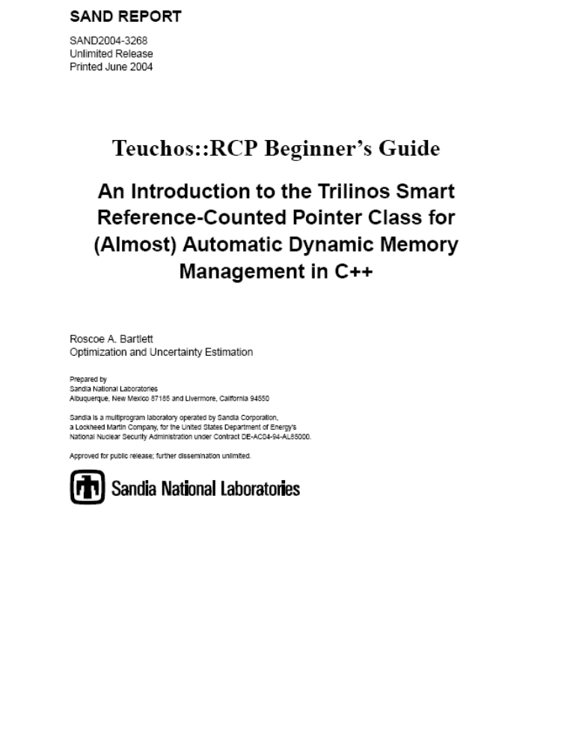
Teuchos::RCP Technical Report
SAND2007-4078
http://trilinos.sandia.gov/documentation.html

Slide 27
Conversions Between Single-Object Memory Management Types
getRawPtr() AVOID THIS!
<Derived> to <Base>
<T> to <const T>
RCP<T>
operator*
T&
ptr()
operator*
<Derived> to <Base>
<T> to <const T>
ptr()
Ptr<T>
T*
getRawPtr() AVOID THIS!
Legend
<<implicit conversion>>
<<explicit conversion>>

Slide 28
Outline
Background
High-level philosophy for memory management
Existing STL classes
Overview of Teuchos Memory Management Utility Classes
  Introduction
  Management of single objects
  Management for arrays of objects
  Usage of Teuchos utility classes as data objects and as function arguments
Challenges to using Teuchos memory management utility classes
Wrap up

Slide 29
Utility Classes for Memory Management of Arrays of Objects
Teuchos::ArrayView (New class) => No equivenent in boost or C++0x
  void foo( const ArrayView<T> &v );
  Used to replace raw pointers as function arguments to pass arrays
  Used for non-persisting associations only (i.e. only function arguments)
  Allows for 100% flexibility for how memory gets allocated and sliced up
  Minimal overhead in an optimized build, just a raw pointer and a size integer
Teuchos::ArrayRCP (Failry new class) => Counterpart to boost::array_ptr
  ArrayRCP<T> v;
  Used for persisting associations with fixed size arrays
  Allows for 100% flexibility for how memory gets allocated and sliced up
  Uses same reference-counting machinery as Teuchos::RCP
  Gives up (sub)views as Teuchos::ArrayView objects
Teuchos::Array (Existing class but majorly reworked)
  Array<T> v;
  A general purpose container class like std::vector (actually uses std::vector within)
  All usage is runtime checked in a debug build
  Gives up (sub)views as Teuchos::ArrayView objects
Teuchos::Tuple (New class) => Counterpart to boost::array
  Tuple<T,N> t;
  Statically sized array class (replacement for built-in T[N])
  Gives up (sub)views as Teuchos::ArrayView objects

Slide 30
Raw Pointers and [Array]RCP : const and non-const
Example:
A a;
A* a_ptr = &a;
Important Point: A pointer object a_ptr of type A* is an object just like any other object with value semantics and can be const or non-const
an address
A’s data
a_ptr
a
Raw C++ Pointers
RCP
Remember this equivalence!
typedef A* ptr_A;
equivalent to
RCP<A>
typedef const A* ptr_const_A;
equivalent to
RCP<const A>
an address
A’s data
non-const pointer to non-const object
ptr_A a_ptr;
equivalent to
RCP<A> a_ptr;
A * a_ptr;
an address
A’s data
const pointer to non-const object
const ptr_A a_ptr;
equivalent to
const RCP<A> a_ptr;
A * const a_ptr;
an address
A’s data
non-const pointer to const object
ptr_const_A a_ptr;
equivalent to
RCP<const A> a_ptr;
const A * a_ptr;
an address
A’s data
const pointer to const object
const ptr_const_A a_ptr;
equivalent to
const RCP<const A> a_ptr;
const A * const a_ptr;

Slide 31
Teuchos::ArrayRCP
template<class T>
class ArrayRCP {
private:
T *ptr_; // Non-debug implementation
Ordinal lowerOffset_;
Ordinal upperOffset_;
RCP_node *node_; // Reference counting machinery
General purpose replacement for raw C++ pointers to deal with contiguous arrays of data and uses reference counting
Supports all of the good pointer operations for arrays and more:
  ++ptr, --ptr, ptr++, ptr--, ptr+=i // Increments to the pointer
  *ptr, ptr[i] // Element access (debug checked)
  ptr.begin(), ptr.end() // Returns iterators (debug checked)
Support for const and non-const:
  ArrayRCP<T> // non-const pointer, non-const elements
  const ArrayRCP<T> // const pointer, const elements
  ArrayRCP<const T> // non-const pointer, const elements
  const ArrayRCP<const T> // const pointer, const elements
Does not support bad pointer array operations:
  ArrayRCP<Base> p2 = ArrayRCP<Derived>(rawPtr); // Doesn’t compile!
ArrayRCP is reused for all checked iterator implementations!

Slide 32
Teuchos::ArrayView
template<class T>
class ArrayView {
private:
T *ptr_; // Non-debug implementation
Ordinal size_;
Lightweight replacement for raw C++ pointers to deal with contiguous arrays passed into functions
Only support array indexing and iterators:
  ptr[i] // Indexing the pointer to access elements
  ptr.begin(), ptr.end() // Returns iterators (debug checked)
Uses ArrayRCP under the hood for debug-only checked implementation!
Support for const and non-const element access
  ArrayView<T> // non-const elements
  ArrayView<const T> // const elements

Slide 33
Teuchos::Array
template<class T>
class Array {
private:
std::vector<T> vec_; // Non-debug implementation
Thin, inline wrapper around std::vector
Debug checked element access:
  a[i] // Debug runtime checked
  a[-1] // Throws exception in debug build!
  a[a.size()] // Throws exception in debug build!
Debug checked iterators (uses ArrayRCP):
  *(ptr.begin()+i) // Debug runtime checked
  *(ptr.begin-1) // Throws exception in debug build!
  *(ptr.end()) // Throws exception in debug build!
Supports copy conversions to and from std::vector
Nonmember constructors
  Array<T> a = array(obj1,obj2,…);
Gives up views as ArrrayView objects
  Array<T> a; ...
  someFunc( a(1, n) );

Slide 34
Conversions Between Array Memory Management Types
RCP<std::vector<T> >
arcp(…)
RCP<Array<T> >
<T> to <const T>
arcp(…)
ArrayRCP<T>
getRawPtr()
getRawPtr()
T*
getRawPtr()
Array<T>
ArrayView<T>
<T> to
<const T>
createVector(a)
createVector(av)
Tuple<T,N>
std::vector<T>
<<implicit view conversion>>
<<explicit view conversion>>
<<implicit copy conversion>>
<<explicit copy conversion>>

Slide 35
Outline
Background
High-level philosophy for memory management
Existing STL classes
Overview of Teuchos Memory Management Utility Classes
  Introduction
  Management of single objects
  Management for arrays of objects
  Usage of Teuchos utility classes as data objects and as function arguments
Challenges to using Teuchos memory management utility classes
Wrap up

Slide 36
Class Data Member Conventions for Arrays
Uniquely owned array, expandable (and contractible)
    Array<T> a_;
Shared array, expandable (and contractible)
    RCP<Array<T> > a_;
Shared array, fixed size
    ArrayRCP<T> a_;
  Advantages:
    Your class object can allocate the array as arcp(size)
    Or, you class object can accept a pre-allocated array from client
      => Allows for efficient views of larger arrays
    The original array will be deleted when all references are removed!
Warning! Never use Teuchos::ArrayView<T> as a class data member!
  ArrayView is never to be used for a persisting relationship!
  Also, avoid using ArrayView for stack-based variables

Slide 37
Function Argument Conventions : Single Objects, Value or Reference
Non-changeable, non-persisting association, required
  const T &a
Non-changeable, non-persisting association, optional
  const Ptr<const T> &a
Non-changeable, persisting association, required or optional
  const RCP<T> &a
Changeable, non-persisting association, optional
  const Ptr<T> &a
Changeable, non-persisting association, required
  const Ptr<T> &a
or
  T &a
Changeable, persisting association, required or optional
  const RCP<const T> &a
Increases the vocabulary of you program! => Self Documenting Code!
Even if you don’t want to use these conventions you still have to document these assumptions in some way!

Slide 38
Function Argument Conventions : Arrays of Value Objects
Non-changeable elements, non-persisting association
  const ArrayView<const T> &a
Non-changeable elements, persisting association
  const ArrayRCP<const T> &a
Changeable elements, non-persisting association
  const ArrayView<T> &a
Changeable elements, persisting association
  const ArrayRCP<T> &a
Changeable elements and container, non-persisting association
  const Ptr<Array<T> > &a
or
  Array<T> &a
Changeable elements and container, persisting association
  const RCP<Array<T> > &a
Warning!
  Never use const Array<T>& => use ArrayView<const T>&
  Never use RCP<const Array<T> >& => use ArrayRCP<const T>&

Slide 39
Function Argument Conventions : Arrays of Reference Objects
Non-changeable objects, non-persisting association
  const ArrayView<const Ptr<const A> > &a
Non-changeable objects, persisting association
  const ArrayView<const RCP<const A> > &a
Non-changeable objects, changeable pointers, persisting association
  const ArrayView<RCP<const A> > &a
Changeable objects, non-persisting association
  const ArrayView<const Ptr<A> > &a
Changeable objects, persisting association
  const ArrayView<const RCP<A> > &a
Changeable objects and container, non-persisting association
  Array<Ptr<A> > &a or const Ptr<Array<Ptr<A> > > &a
Changeable objects and container, non-persisting container, persisting objects
  Array<RCP<A> > &a or const Ptr<Array<RCP<A> > > &a
Changeable objects and container, persisting assoc. container and objects
  const RCP<Array<RCP<A> > > &a
And there are other use cases!

Slide 40
Outline
Background
High-level philosophy for memory management
Existing STL classes
Overview of Teuchos Memory Management Utility Classes
Challenges to using Teuchos memory management utility classes
Wrap up

Slide 41
Challenges for Incorporating Teuchos Utility Classes
More classes to remember
  However, this increases the vocabulary of your programming environment!
    => More self documenting code!
Implicit conversions not supported as well as for raw C++ pointers
  Avoid overloaded functions involving these classes!
Refactoring existing code?
  Internal Trilinos code? => Not so hard but we need to be careful
  External Trilinos (user) code? => Harder to upgrade “published” interfaces but manageable [Folwer, 1999]
How can we smooth the impact of these and other refactorings?

Slide 42
Refactoring, Deprecated Functions, and User Support
How can we refactor existing code and smooth the transition for dependent code?
  => Keep deprecated functions but ifdef them (supported for one release cycle?)
Example: Existing Epetra function:
  class Epetra_MultiVector {
  public:
  ReplaceGlobalValues(int NumEntries, double *Values, int *Indices);
  };
Refactored function:
  class Epetra_MultiVector {
  public:
  // New function
  ReplaceGlobalValues(const ArrayView<const double> &Values,
  const ArrayView<const int> &Indices);
  #ifdef TRILINOS_ENABLE_DEPRICATED_FEATURES
  // Deprecated function
  ReplaceGlobalValues(int NumEntries, double *Values, int *Indices)
  { ReplaceGlobalValues(arrayView(Values,NumEntries),
  arrayView(Indices,NumEntries)); }
  #endif
  };
How does this help users?

Slide 43
Refactoring, Deprecated Functions, and User Support
Upgrade process for user code:
Add -DTRILINOS_ENABLE_DEPRICATED_FEATURES to build Trilinos and user code
Test user code (should compile right away)
Selectively turn off -DTRILINOS_ENABLE_DEPRICATED_FEATURES in user code and let compiler show code what needs to updated, Example:
  // userFunc.cpp
  #undef TRILINOS_ENABLE_DEPRICATED_FEATURES
  #include “Epetra_MultiVector.hpp”
  void userFunc( Epetra_MultiVector &V )
  {
  std::vector<double> values(n); …
  std::vector<double> indices(n); …
  V.ReplaceGlobalValues(n,&values[0],&indices[0]); // No compile
  }
Fix a few function calls, Example:
  V.ReplaceGlobalValues(values,indices); // Now this will compile!
Turn -DTRILINOS_ENABLE_DEPRICATED_FEATURES back on and rebuild
Run user tests and get all of them to pass before moving on [Fowler, 1999]
Repeat steps 3 through 6 for all user code until all deprecated calls are gone!
User code is safely and incrementally upgraded!

Slide 44
Outline
Background
High-level philosophy for memory management
Existing STL classes
Overview of Teuchos Memory Management Utility Classes
Challenges to using Teuchos memory management utility classes
Wrap up

Slide 45
Teuchos classes verses boost/C++0x classes
Teuchos provides complete system of low-level types to replace raw C++ pointers
  => Avoids all raw pointers at application level => safer code
  => Boost and C++0x do not
Teuchos classes throw exceptions in debug mode
  => Makes unit tests easier to write
  => Boost classes can be made to? Not sure about compatibility issues?
  => Not sure of g++ checked STL can?
Teuchos reference-counting classes have optional debug tracking mode to catch and diagnose circular references
  => Helps to diagnose tricking circular reference problem (e.g. NOX, Tpetra, AztecOO/Thyra adapters)
  => Nothing like this in boost (yet). => Might use sp_scalar_constructor_hook(...)?
Teuchos reference-counted classes are two-way compatible with Boost/C++0x reference-counted classes
  e.g. see teuchos/test/MemoryManagement/RCP_test.cpp
  You don’t have to pick on implementation of for all code!
We control Teuchos, we can’t control/change boost
  => Modifying our own version of boost classes would be incompatible with other code
  => Can’t assume other code has not also used the “hooks”
You can’t mix and match Teuchos view classes and boost/C++0x classes and have strong debug runtime checking => Internal details must be shared!

Slide 46
Next Steps
Finish development and testing of these Teuchos memory management utility classes => Done
Address circular reference problems with dual-mode Teuchos::[Array]RCP classes
  See Trilinos/doc/RefCountPtr/ideas/WeakPointersModeForTeuchosRCP.ppt
Incorporate them into a lot of Trilinos software
  Initially: teuchos, rtop, thyra, stratimikos, rythmos, moocho, …
  Get practical experience in the use of the classes and refine their design
Write a detailed technical report describing these memory management classes
Update Trilinos to work with checked STL (g++ _GLIBCXX_DEBUG)
Encourage the assimilation of these classes into more Trilinos and user software (much like was done for Teuchos::RCP)
  Prioritize what to refactor based on risk and other factors
Make memory leaks and segfaults a rare occurrence!

Slide 47
Conclusions
Using raw pointers at too high of a level is the source of nearly all memory management and usage issues in C++ (e.g. memory leaks and segfaults)
STL classes do not offer runtime flexibility in allocation and views of data
Memory checking tools like Valgrind and Purify will never be able to sufficiently verify our C++ programs
  Declining popularity of C++ means we will have less support for tools for refactoring, debugging, memory checking, etc.
Boost and C++0x libraries do not provide a sufficient integrated solution
Teuchos::RCP has been effective at reducing memory leaks of all kinds but we still have segfaults (e.g. array handling, off-by-one errors, etc.)
New Teuchos classes Array, ArrayRCP, ArrayView, and Tuple, allow for safe (debug runtime checked) use of contiguous arrays of memory but very high performance in an optimized build
Much Trilinos software will be updated to use these new classes
Deprecated features will be maintained along with a process for supporting smooth and safe user upgrades
A detailed technical report will be written to explain all of this

Slide 48
The End
THE END
References:
  [Martin, 2003] Robert C. Martin, Agile Software Development: Principles, Patterns, and Practices, Prentice Hall, 2003
  [Meyers, 2005] Scott Meyers, Effective C++: Third Edition, Addison-Wesley, 2005
  [Sutter & Alexandrescu, 2005], C++ Coding Standards, Addison-Wesley, 2005
  [Fowler, 199] Martin Fowler, Refactoring, Addison-Wesley, 1999

