Slide 1


Teuchos Utility Classes for
Safer Memory Management in C++
2008-7717P
Roscoe A. Bartlett
Department of Optimization & Uncertainty Estimation
Sandia National Laboratories
Trilinos Users Group Meeting, October 22, 2008
Sandia is a multiprogram laboratory operated by Sandia Corporation, a Lockheed Martin Company,
for the United States Department of Energy under contract DE-AC04-94AL85000.

Slide 2
Current State of Memory Management in Trilinos C++ Code
The Teuchos reference-counted pointer (RCP) class is being widely used
  Memory leaks are becoming less frequent (but are not completely gone => circular references!)
  Fewer segfaults from uninitailized pointers and accessing deleted objects …
However, we still have problems …
  Segfaults from improper usage of arrays of memory (e.g. off-by-one errors etc.)
  Improper use of other types of data structures
The core problem? => Ubiquitous high-level use of raw C++ pointers in our application (algorithm) code!
What I am going to address in this presentation:
  Adding new Teuchos utility classes similar to Teuchos::RCP to encapsulate usage of raw C++ pointers for:
    handling of single objects
    handling of contiguous arrays of objects
  New Teuchos utility classes without reference counting to eliminate all raw pointers

Slide 3
Outline
Background
Overview of Teuchos Memory Management Utility Classes
Challenges to using Teuchos memory management utility classes
Wrap up

Slide 4
Outline
Background
  Problems with using raw C++ pointers at the application programming level
Overview of Teuchos Memory Management Utility Classes
Challenges to using Teuchos memory management utility classes
Wrap up

Slide 5
Problems with using Raw Pointers at the Application Level
The C/C++ Pointer:
  Type *ptr;
Problems with C/C++ Pointers
  No default initialization to null => Leads to segfaults
    int *ptr;
    ptr[20] = 5; // BANG!
  Using to handle memory of single objects
    int *ptr = new int;
    // No good can ever come of:
    ptr++, ptr--, ++ptr, --ptr, ptr+i, ptr-i, ptr[i]
  Using to handle arrays of memory:
    int *ptr = new int[n];
    // These are totally unchecked:
    *(ptr++), *(ptr--), ptr[i]
  Creates memory leaks when exceptions are thrown:
    int *ptr = new int;
    functionThatThrows(ptr);
    delete ptr; // Will never be called if above function throws!
How do we fix this?
  Memory leaks? => Reference-counted smart pointers (not a 100% guarantee)
  Segfaults? => Memory checkers like Valgrind and Purify? (far from a 100% guarantee)

Slide 6
Ineffectiveness of Memory Checking Utilities
Memory checkers like Valgrind and Purify only know about stack and heap memory requested from the system!
  => Memory managed by the library or the user program is totally unchecked
Examples:
  Library managed memory (e.g. GNU STL allocator)
valgrind “red zone”
library management regions
Writing into “management” regions is not caught by valgrind!
valgrind “red zone”
memory given to application
untouched memory
Allocated from the heap by library using new[]
  Program managed memory
Sub-array given to subrountine for processing
Read/writing outside of slice will never be caught by valgrind!
One big array allocated from the heap by user program using new[]
  Memory checkers can never sufficiently verify your program!

Slide 7
What is the Proper Role of Raw C++ Pointers?
AVOID USING RAW POINTERS AT THE APPLICATION PROGRAMMING LEVEL!
If we can’t use raw pointers at the application level, then how can we use them?
  Basic mechanism for communicating with the compiler
  Extremely well-encapsulated, low-level, high-performance algorithms
  Compatibility with other software (again, at a very low, well-encapsulated level)
For everything else, let’s use (existing and new) classes to more safely encapsulate our usage of memory!

Slide 8
Outline
Background
Overview of Teuchos Memory Management Utility Classes
  Introduction
  Management of single objects
  Management for arrays of objects
  Handling of circular references
  Runtime checking of dangling references
  Usage of Teuchos utility classes as data objects and as function arguments
Challenges to using Teuchos memory management utility classes
Wrap up

Slide 9
Basic Strategy for Safer “Pointer Free” Memory Usage
Encapsulate raw pointers in specialized utility classes
  In a debug build (--enable-teuchos-debug), all access to memory is checked at runtime … Maximize runtime checking and safety!
  In an optimized build (default), no checks are performed giving raw pointer performance … Minimize/eliminate overhead!
Define a different utility class for each major type of use case:
  Single objects (persisting and non-persisting associations)
  Views of arrays (persisting and non-persisting associations)
  Containers (arrays, maps, lists, etc.)
  etc …
Allocate all objects in a safe way (i.e. don’t call new directly at the application level!)
  Use non-member constructor functions that return safe wrapped objects (See SAND2007-4078)
Pass around encapsulated pointer(s) to memory using safe (checked) conversions between safe utility class objects
Definitions:
Non-persisting association: Association that only exists within a single function call
Persisting association: Association that exists beyond a single function call and where some “memory” of the object persists

Slide 10
Outline
Background
Overview of Teuchos Memory Management Utility Classes
  Introduction
  Management of single objects
  Management for arrays of objects
  Handling of circular references
  Runtime checking of dangling references
  Usage of Teuchos utility classes as data objects and as function arguments
Challenges to using Teuchos memory management utility classes
Wrap up

Slide 11
Utility Classes for Memory Management of Single Classes
Teuchos::RCP (Long existing class, first developed in 1997!)
  RCP<T> p;
  Smart pointer class (e.g. usage looks and feels like a raw pointer)
  Uses reference counting to decide when to delete object
  Used for persisting associations with single objects
  Allows for 100% flexibility for how object gets allocated and deallocated
  [New] General approach for dealing with circular references
  In a debug build, throws on dereferences of null and dangling references
  Counterpart to boost::shared_ptr and std::tr1::shared_ptr
Teuchos::Ptr (New class)
  void foo( const Ptr<T> &p );
  Smart pointer class (e.g. operator->() and operator*())
  Light-weight replacement for raw pointer T* to a single object
  Default constructs to null
  No reference counting! Used only for non-persisting association function arguments
  In a debug build, throws on dereferences of null and dangling references
  Integrated with other memory utility classes
  No counterpart to boost or C++0x

Slide 12
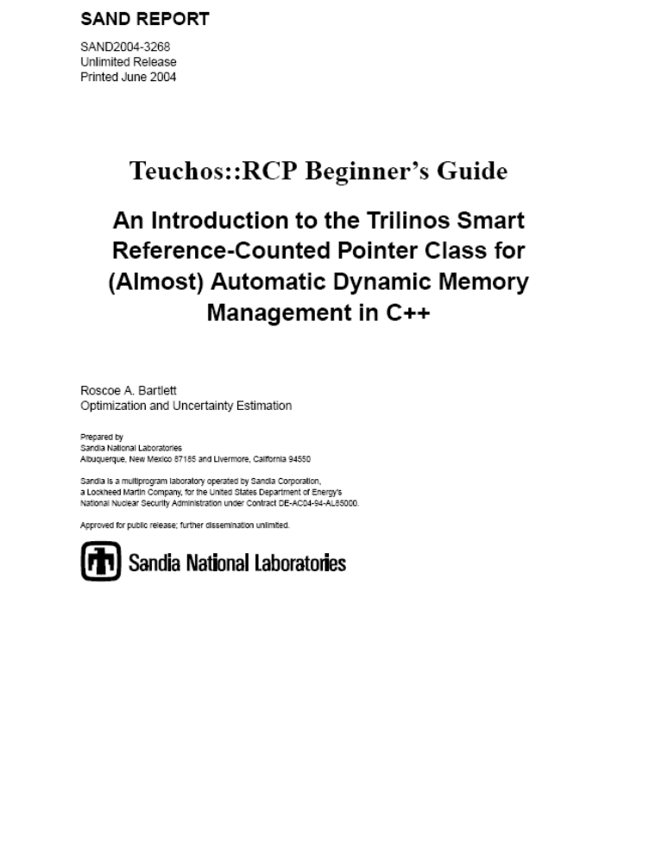
Teuchos::RCP Technical Report
SAND2007-4078
http://trilinos.sandia.gov/documentation.html

Slide 13
Conversions Between Single-Object Memory Management Types
.get() AVOID THIS!
<Derived> to <Base>
<T> to <const T>
RCP<T>
.operator*
T&
.ptr()
.operator*
<Derived> to <Base>
<T> to <const T>
ptr(rawPtr)
Ptr<T>
T*
.get() AVOID THIS!
Legend
<<implicit conversion>>
<<explicit conversion>>

Slide 14
Outline
Background
Overview of Teuchos Memory Management Utility Classes
  Introduction
  Management of single objects
  Management for arrays of objects
  Handling of circular references
  Runtime checking of dangling references
  Usage of Teuchos utility classes as data objects and as function arguments
Challenges to using Teuchos memory management utility classes
Wrap up

Slide 15
Utility Classes for Memory Management of Arrays of Objects
Teuchos::ArrayView (New class) => No equivenent in boost or C++0x
  void foo( const ArrayView<T> &v );
  Used to replace raw pointers as function arguments to pass arrays
  Used for non-persisting associations only (i.e. only function arguments)
  Allows for 100% flexibility for how memory gets allocated and sliced up
  Minimal overhead in an optimized build, just a raw pointer and an integer
Teuchos::ArrayRCP (Failry new class) => Counterpart to boost::array_ptr
  ArrayRCP<T> v;
  Used for persisting associations with fixed size arrays
  Allows for 100% flexibility for how memory gets allocated and sliced up
  Uses same reference-counting machinery as Teuchos::RCP
  Gives up (sub)views as Teuchos::ArrayView and Teuchos::ArrayRCP objects
Teuchos::Array (Existing class but majorly reworked)
  Array<T> v;
  A general purpose container class like std::vector (actually uses std::vector within)
  All usage is runtime checked in a debug build
  Gives up (sub)views as Teuchos::ArrayView objects
Teuchos::Tuple (New class) => Counterpart to boost::array
  Tuple<T,N> t;
  Statically sized array class (replacement for built-in T[N])
  Gives up (sub)views as Teuchos::ArrayView objects

Slide 16
Conversions Between Array Memory Management Types
RCP<std::vector<T> >
arcp(…)
RCP<Array<T> >
<T> to <const T>
arcp(…)
ArrayRCP<T>
Workspace<T>
.getRawPtr()
.getRawPtr()
T*
.getRawPtr()
Array<T>
ArrayView<T>
<T> to
<const T>
createVector(a)
createVector(av)
Tuple<T,N>
std::vector<T>
<<implicit view conversion>>
<<explicit view conversion>>
<<implicit copy conversion>>
<<explicit copy conversion>>

Slide 17
Outline
Background
Overview of Teuchos Memory Management Utility Classes
  Introduction
  Management of single objects
  Management for arrays of objects
  Handling of circular references
  Runtime checking of dangling references
  Usage of Teuchos utility classes as data objects and as function arguments
Challenges to using Teuchos memory management utility classes
Wrap up

Slide 18
Handling of Circular References
Without special handling, this will create memory leak of ‘A’ and ‘B’ objects
Debugging circular references:
  Teuchos::setTracingActiveRCPNodes(true);
A
B
Client of A
Client of B
***
*** Warning! The following Teuchos::RCPNode objects were created but have
*** not been destroyed yet. This may be an indication that these objects may
*** be involved in a circular dependency! A memory checking tool may complain
*** that these objects are not destroyed correctly.
***
RCPNode address = '0x890bb0', information = {T=‘C',Concrete T=‘C',p=0x890ee8,has_ownership=1}, call number = 1
RCPNode address = '0x890be0', information = {T=‘A',Concrete T=‘A',p=0x890b90,has_ownership=1}, call number = 0
See: Trilinos/packages/teuchos/test/MemoryManagement/RCP_test.cpp

Slide 19
Handling of Circular References
Strong
A
B
New Feature: Strong/Weak RCPs
Individual objects just store RCPs to shared objects
Higher-level objects (i.e. factories) assign “strength”
  Example: We know that ‘B’ will not access ‘A’ after ‘A’ gets deleted!
Weak
Strong
Strong
Client of A
Client of B
See:
Source: teuchos/test/MemoryManagement/RCP_UnitTests.cpp
Run:
Build: teuchos/test/MemoryManagement/MemoryManagement_UnitTests.exe

Slide 20
Circular References with Weak/Strong RCPs
a : A
b : B
rcpA1 : RCP
rcpB1 : RCP
WEAK
STRONG
nodeA: RCPNode
nodeB: RCPNode
strongCount=1
weakCount=1
strongCount=2
weakCount=0
rcpA2 : RCP
rcpB2 : RCP
STRONG
STRONG
clientA
clientB

Slide 21
Client A deleted first then Client B: #1
a : A
3: <<delete>>
b : B
2: <<delete>>
rcpA1 : RCP
rcpB1 : RCP
WEAK
STRONG
nodeA: RCPNode
4: deincrStrongCount
nodeB: RCPNode
strongCount=1 → 0
weakCount=1
strongCount=2 → 1
weakCount=0
1: deincrStrongCount, deleteObject
rcpA2 : RCP
rcpB2 : RCP
STRONG
STRONG
clientA
clientB

Slide 22
Client A deleted first then Client B: #2
a : A
3: <<delete>>
b : B
2: <<delete>>
rcpA1 : RCP
rcpB1 : RCP
WEAK
STRONG
4: deincWeakCount, <<delete>>
nodeA: RCPNode
nodeB: RCPNode
strongCount=0
weakCount=1 → 0
strongCount=1 → 0
weakCount=0
1: deincrStrongCount, <<delete>>
rcpA2 : RCP
rcpB2 : RCP
STRONG
STRONG
clientA
clientB

Slide 23
Client B deleted first then Client A: #1
a : A
b : B
rcpA1 : RCP
rcpB1 : RCP
WEAK
STRONG
nodeA: RCPNode
nodeB: RCPNode
strongCount=1
weakCount=1
strongCount=2 → 1
weakCount=0
rcpA2 : RCP
rcpB2 : RCP
STRONG
STRONG
clientA
clientB

Slide 24
Client B deleted first then Client A: #2
a : A
3: <<delete>>
b : B
2: <<delete>>
6: <<delete>>
rcpA1 : RCP
rcpB1 : RCP
5: <<delete>>
WEAK
STRONG
7: deincrWeakCount, <<delete>>
4: deincStrongCount, <<delete>>
nodeA: RCPNode
nodeB: RCPNode
strongCount=1 → 0
weakCount=1 → 0
strongCount=1 → 0
weakCount=0
1: deincrStrongCount, deleteObject
rcpA2 : RCP
rcpB2 : RCP
STRONG
STRONG
clientA
clientB

Slide 25
Outline
Background
Overview of Teuchos Memory Management Utility Classes
  Introduction
  Management of single objects
  Management for arrays of objects
  Handling of circular references
  Runtime checking of dangling references
  Usage of Teuchos utility classes as data objects and as function arguments
Challenges to using Teuchos memory management utility classes
Wrap up

Slide 26
Runtime Checking of Dangling References: Unit Test Code
TEUCHOS_UNIT_TEST_TEMPLATE_1_DECL( ArrayRCP, danglingArrayView, T )
{
ArrayView<T> av;
{
ArrayRCP<T> arcp1 = arcp<T>(n);
av = arcp1();
}
#ifdef TEUCHOS_DEBUG
...
TEST_THROW( av[0], DanglingReferenceError );
...
#endif
}
See: Trilinos/packages/teuchos/test/MemoryManagement/ArrayRCP_UnitTests.cpp

Slide 27
Runtime Checking of Dangling References: Error Output
Test that code {av[0];} throws Teuchos::DanglingReferenceError: passed
Exception message for expected exception:
/cygdrive/c/_mystuff/PROJECTS/Trilinos.base/Trilinos/packages/teuchos/src/Teuchos_RCPNode.hpp:340:
Throw number = 4
Throw test that evaluated to true: true
Error, an attempt has been made to dereference the underlying object
from a weak smart pointer object where the underly object has already
been deleted since the strong count has already gone to zero.
Context inforamtion:
RCP type: Teuchos::ArrayView<double>
RCP address: 0x22c5ac
RCPNode type: Teuchos::RCPNodeTmpl<double, Teuchos::DeallocArrayDelete<double> >
RCPNode address 0xc33af8
RCP ptr address: 0xc33aa0
Concrete ptr address: 0xc33aa0
Hint: Open your debugger and set conditional breakpoints in the various
routines involved where this node object is first created with this
concrete object and in all of the RCP objects of the type given above
use this node object. Debugging an error like this may take a little work
setting up your debugging session but at least you don't have to try to
track down a segfault that would occur otherwise!

Slide 28
Outline
Background
Overview of Teuchos Memory Management Utility Classes
  Introduction
  Management of single objects
  Management for arrays of objects
  Handling of circular references
  Runtime checking of dangling references
  Usage of Teuchos utility classes as data objects and as function arguments
Challenges to using Teuchos memory management utility classes
Wrap up

Slide 29
Class Data Member Conventions for Arrays
Uniquely owned array, expandable (and contractible)
    Array<T> a_;
Shared array, expandable (and contractible)
    RCP<Array<T> > a_;
Shared array, fixed size
    ArrayRCP<T> a_;
  Advantages:
    Your class object can allocate the array as arcp(size)
    Or, you class object can accept a pre-allocated array from client
      => Allows for efficient views of larger arrays
    The original array will be deleted when all references are removed!
Warning! Never use Teuchos::ArrayView<T> as a class data member!
  ArrayView is never to be used for a persisting relationship!
  Also, avoid using ArrayView for stack-based variables

Slide 30
Function Argument Conventions : Single Objects, Value or Reference
Non-changeable, non-persisting association, required
  const T &a
Non-changeable, non-persisting association, optional
  const Ptr<const T> &a
Non-changeable, persisting association, required or optional
  const RCP<T> &a
Changeable, non-persisting association, optional
  const Ptr<T> &a
Changeable, non-persisting association, required
  const Ptr<T> &a
or
  T &a
Changeable, persisting association, required or optional
  const RCP<const T> &a
Even if you don’t want to use these conventions you still have to document these assumptions in some way!
Increases the vocabulary of you program! => Self Documenting Code!

Slide 31
Function Argument Conventions : Arrays of Value Objects
Non-changeable elements, non-persisting association
  const ArrayView<const T> &a
Non-changeable elements, persisting association
  const ArrayRCP<const T> &a
Changeable elements, non-persisting association
  const ArrayView<T> &a
Changeable elements, persisting association
  const ArrayRCP<T> &a
Changeable elements and container, non-persisting association
  const Ptr<Array<T> > &a
or
  Array<T> &a
Changeable elements and container, persisting association
  const RCP<Array<T> > &a
Warning!
  Never use const Array<T>& => use ArrayView<const T>&
  Never use RCP<const Array<T> >& => use ArrayRCP<const T>&

Slide 32
Function Argument Conventions : Arrays of Reference Objects
Non-changeable objects, non-persisting association
  const ArrayView<const Ptr<const A> > &a
Non-changeable objects, persisting association
  const ArrayView<const RCP<const A> > &a
Non-changeable objects, changeable pointers, persisting association
  const ArrayView<RCP<const A> > &a
Changeable objects, non-persisting association
  const ArrayView<const Ptr<A> > &a
Changeable objects, persisting association
  const ArrayView<const RCP<A> > &a
Changeable objects and container, non-persisting association
  Array<Ptr<A> > &a or const Ptr<Array<Ptr<A> > > &a
Changeable objects and container, non-persisting container, persisting objects
  Array<RCP<A> > &a or const Ptr<Array<RCP<A> > > &a
Changeable objects and container, persisting assoc. container and objects
  const RCP<Array<RCP<A> > > &a
And there are other use cases!

Slide 33
Outline
Background
High-level philosophy for memory management
Existing STL classes
Overview of Teuchos Memory Management Utility Classes
Challenges to using Teuchos memory management utility classes
Wrap up

Slide 34
Challenges for Incorporating Teuchos Utility Classes
More classes to remember
  However, this increases the vocabulary of your programming environment!
    => More self documenting code!
Implicit conversions not supported as well as for raw C++ pointers
  Avoid overloaded functions involving these classes!
Refactoring existing code?
  First, we maintain backward compatibility!
  Internal Trilinos code? => Not so hard but we need to be careful
  External Trilinos (user) code? => Harder to upgrade “published” interfaces but manageable [Folwer, 1999]

Slide 35
Outline
Background
High-level philosophy for memory management
Existing STL classes
Overview of Teuchos Memory Management Utility Classes
Challenges to using Teuchos memory management utility classes
Wrap up

Slide 36
Teuchos classes verses boost/C++0x classes
Teuchos provides complete system of low-level types to replace all raw C++ pointers in high-level C++ code
  => Avoids all raw pointers at application level => safer code
  => Boost and C++0x do not
Teuchos classes throw exceptions in debug mode
  => Makes unit tests easier to write
  => Boost classes can be made to? Not sure about compatibility issues?
  => Not sure of g++ checked STL can?
Teuchos reference-counting classes have optional debug tracking mode to catch and diagnose circular references
  => Helps to diagnose tricking circular reference problem (e.g. NOX, Tpetra, AztecOO/Thyra adapters)
  => Nothing like this in boost (yet). => Might use sp_scalar_constructor_hook(...)?
Teuchos reference-counted classes are two-way compatible with Boost/C++0x reference-counted classes
  e.g. see teuchos/test/MemoryManagement/RCP_test.cpp
  You don’t have to pick on implementation of for all code!
We control Teuchos, we can’t control/change boost
  => Modifying our own version of boost classes would be incompatible with other code
  => Can’t assume other code has not also used the “hooks”
You can’t mix and match Teuchos view classes and boost/C++0x classes and have strong debug runtime checking => Internal details must be shared!

Slide 37
Next Steps
Do detailed performance study on different platforms/compilers
Write a detailed technical report describing these memory management classes
Encourage the assimilation of these classes into more Trilinos and user software (much like was done for Teuchos::RCP)
  Prioritize what to refactor based on risk and other factors
Make memory leaks and segfaults a rare occurrence!

Slide 38
Conclusions
Using raw pointers at too high of a level is the source of nearly all memory management and usage issues in C++ (e.g. memory leaks and segfaults)
Memory checking tools like Valgrind and Purify will never be able to sufficiently verify our C++ programs
Boost and C++0x libraries do not provide a sufficient integrated solution
Teuchos::RCP has been effective at reducing memory leaks of all kinds but we still have segfaults (e.g. array handling, off-by-one errors, etc.)
New Teuchos classes Array, ArrayRCP, ArrayView, and Tuple, allow for safe (debug runtime checked) use of contiguous arrays of memory but very high performance in an optimized build
Much Trilinos software will be updated to use these new classes
Deprecated features will be maintained along with a process for supporting smooth and safe user upgrades
A detailed technical report will be written to explain all of this

Slide 39
The End
THE END
References:
  [Martin, 2003] Robert C. Martin, Agile Software Development: Principles, Patterns, and Practices, Prentice Hall, 2003
  [Meyers, 2005] Scott Meyers, Effective C++: Third Edition, Addison-Wesley, 2005
  [Sutter & Alexandrescu, 2005], C++ Coding Standards, Addison-Wesley, 2005
  [Fowler, 199] Martin Fowler, Refactoring, Addison-Wesley, 1999

