Slide 1
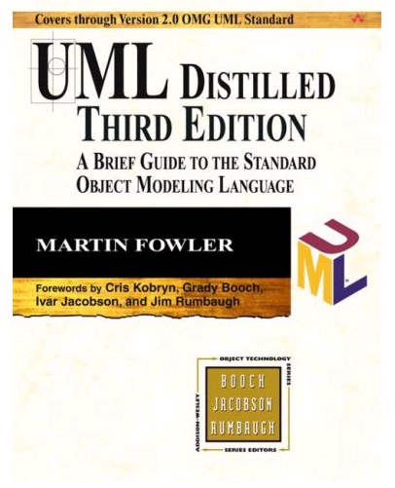
Unified Modeling Language (UML)
Unified Modeling Language
Graphical language for designing, documenting and communicating designs object-oriented software
Standardized by the Object Management Group (OMG) and backed by a large group of software companies
Allows the specification and description of object-oriented software at various levels of detail
Supported by many different CASE tools for
  Designing OO software
  Documenting OO software
  Reverse engineering OO software
  Creating skeleton code for OO software
  Refactoring OO software
Good tutorial on object-orientation development process and short (about 200 pages) introduction to the UML.

Slide 2
Overview of Basic UML Notation for Object Orientation (OO)
Simple UML Class Diagram
Compatible C++ declarations
class BaseA {
public:
virtual ~BaseA() {}
virtual int aFunc() const = 0;
virtual C& c() = 0;
…
};
class DerivedB : public BaseA {
public:
…
private:
std::vector<BaseD*> d_;
};
class C { … };
class BaseD { … };
class DerivedE : public BaseD {
public:
void eFunc( const C& c );
…
};
Abstract class
(italics)
Abstract member function (italics)
c
BaseA
C
aFunc(): int
Dependency
(relationship)
Association
(relationship)
Abstract class
and inheritance (italics)
Inheritance
(relationship)
Role name
d
BaseD
DerivedB
1…*
Concrete class
(non-italics)
Multiplicity
DerivedE
eFunc(in c: C)
Member function implementation
(non-italics)

