Slide 1

Embedded Sensitivities and Optimization
From Research to Applications
SAND2008-0769P
Roscoe A. Bartlett
Department of Optimization & Uncertainty Estimation
Sandia National Laboratories
Department Review, January 30, 2008
Sandia is a multiprogram laboratory operated by Sandia Corporation, a Lockheed Martin Company,
for the United States Department of Energy under contract DE-AC04-94AL85000.

Slide 2
Roscoe Bartlett in a Nut Shell
Came to Sandia in 2001 directly into 1411
Ph.D. background (CMU Chemical Engineering) is in large-scale embedded derivative-based optimization: rSQP++ => MOOCHO
Primary algorithms research area continues to be embedded derivative-based optimization (MOOCHO/Trilinos)
Talent and interests lie at the intersection of advanced numerical algorithms and modern software engineering methods (e.g. Thyra)
Object-Oriented Software Engineering and C++ Expert
Leading efforts to bridge transformational embedded analysis methods (sensitivities, optimization, …) and applications:
  Thyra/Trilinos: Interoperability of numerical algorithms
  Thyra ModelEvaluator: Infrastructure for support of embedded algorithms
  Rythmos/Trilinos (Coffey (1414)): Transient sensitivities for optimization, …
  Stratimikos/Trilinos: Unification of linear solvers and preconditioners
  APP + Trilinos Dev: Keep APPs and algorithms working together, driving R&D
    Charon + Trilinos Dev (ASC FY07 Level-2 Vertical Integration Milestone)
    Aria/SIERRA + Trilinos Dev (1400/1500 Collaboration)
Website: http://www.cs.sandia.gov/~rabartl

Slide 3
Notable Projects for Roscoe Bartlett
FY07 ASC Level-2 Vertical Integration Milestone (Lead):
  Charon + Trilinos Dev, vertical solver integration using Thyra
  Optimization and transient sensitivities for QASPR problems
  Involved members from:
    1411: Roscoe Bartlett, Eric Phipps, Denis Ridzal
    1414: Scott Collis, Todd Coffey, David Day, Russell Hooper, Roger Pawlowski, Andy Salinger
    1416: Mike Heroux, Jim Willenbring
    1437: Rob Hoeskstra, Heidi Thornquist
ASC Algorithms:
  Trilinos Framework: Addressing scalability and interoperability from build tools through advanced numerical algorithms (Teuchos, Thyra, Rythmos, MOOCHO, …)
  Optimization:
    R&D of embedded optimization methods (MOOCHO)
    Bridging embedded (Trilinos) and non-invasive (Dakota)
  Aria/SIERRA + Trilinos Dev Integration (Lead):
    Add embedded algorithms to Aria/SIERRA for sensitivities, error-estimation, optimization, …
    Bridge between SIERRA application developers and Trilinos algorithm researchers
    Joint 1400/1500 Collaboration:
      1411: Roscoe Bartlett, Eric Phipps
      1414: Todd Coffey, Russell Hooper, Bart vBW
      1541: Brian Carnes, Kevin Copps, Derek Gaston, Pat Notz
SCIDAC TOPS-2: Trilinos Fortran/C++ interoperability for Office of Science customers
CSRF Componentizing Effort (Salinger (1414)): Leading three working groups

Slide 4
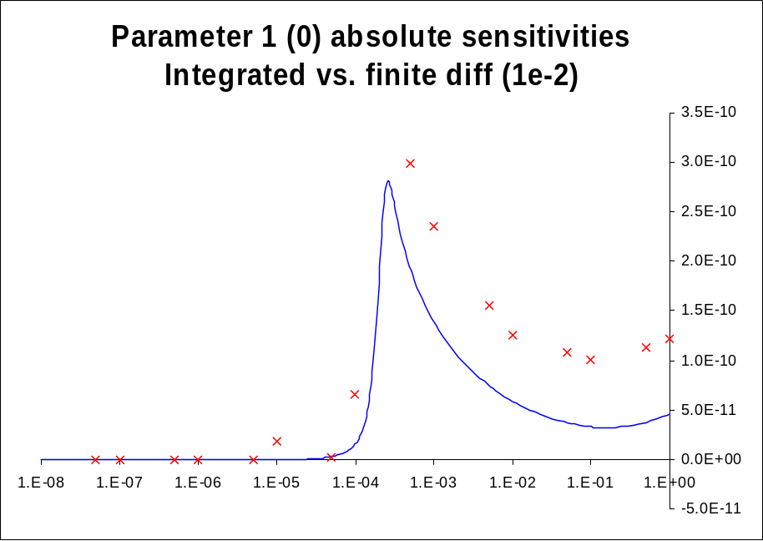
Potential of Embedded Analysis Algorithms
For appropriate problems, embedded derivative-based analysis methods (e.g., sensitivities, optimization, UQ, error estimation …) potentially provide large improvements in speed, accuracy, and/or capability over other approaches.
Example: QASPR transient current sensitivities w.r.t. reaction parameters for an irradiated semiconductor device modeled with Charon
  Embedded sensitivities with AD/Sacado (Phipps) & Rythmos
  Finite differences (steplen=1e-2) (optimal steplen=1e-1)
  Embedded sensitivities vs. finite diff.
    Much more accurate and robust!
    10x faster for 40 parameters!
Bartlett, Roscoe, Scott Collis, Todd Coffey, David Day, Mike Heroux, Rob Hoekstra, Russell Hooper, Roger Pawlowski, Eric Phipps, Denis Ridzal, Andy Salinger, Heidi Thornquist, and Jim Willenbring. ASC Vertical Integration Milestone. SAND2007-5839, Sandia National Laboratories, 2007 [http://www.cs.sandia.gov/~rabartl/publications.html]
Since coming to Sandia in August 2001 I have been involved a number of projects related to embedded sensitivities and optimization and have had mixed experiences => I have learned a lot about how to apply embedded methods!

Slide 5
Challenges/Barriers to Embedded Analysis Algorithms
Version Control, Build, Test
(incompatible dev sources, environments, tools, lack of testing, …)
APP + Trilinos Dev (Bartlett et. al.)
Software Infrastructure
(narrow forward solvers, inflexible implementation approaches, …)
Thyra ModelEvaluator (Bartlett et. al.)
Derivatives & UQ Support
(smoothness, accuracy, parameter derivatives, uncertainty proposition, … )
AD/Sacado (Phipps and Gay)
UQ/Stokhos (Phipps)
Fleeting effort #1
1400/1500
APP + Trilinos Dev (Bartlett et.al.)
Thyra ModelEvaluator (Bartlett et.al.)
AD/Sacado (Phipps et.al.)
UQ/Stokhos (Phipps)
…
Fleeting effort #2
Embedded Algorithms R&D with Production APPs
Better Algorithms R&D!
Better Production APPs!
We are now addressing these barriers in a fundamental way to provide the foundation for sustained embedded algorithms R&D

Slide 6
APP + Trilinos Dev: Algorithms and Applications Integration
The Idea:
  Keep the development versions of APP and Trilinos code updated and tested daily
  Also keep APP and Trilinos Release updated
  Automated daily integrations tests
  Results in better production capabilities and better research
Charon + Trilinos Dev
  Development versions of Charon and Trilinos are kept up-to-date every day!
  New embedded optimization and sensitivity capabilities are run and tested every day!
Aria/SIERRA + Trilinos Dev
  We have automated configuration and daily integration testing of Aria/SIERRA VOTD against Trilinos Dev working!
  Now, we are addressing Aria/SIERRA software infrastructure issues and will start adding new embedded Trilinos analysis algorithms!
Bartlett, Roscoe. Daily Integration and Testing of the Development Versions of Applications and Trilinos: A stronger foundation for enhanced collaboration in application and algorithm research and development, SAND2007-7040, Sandia National Laboratories, October 2007 [http://www.cs.sandia.gov/~rabartl/publications.html]

Slide 7
The End

