Slide 1
The application of TriBITS to the Software Development and Integration Processes of Larger Componentized Multi-Organization Scientific and Engineering Software Projects
SAND2018-11082 PE
Roscoe A. Bartlett
Multiphysics Applications (org. 1446), Sandia National Labs
CASL Physics Integration Infrastructure Lead
Trilinos Software Engineering Technologies and Integration Lead
ATDM Software Tools and Environment Lead
Sandia Computational Science Seminar Series
June 9, 2016
Sandia is a multiprogram laboratory operated by Sandia Corporation, a Lockheed Martin Company, for the United States Department of Energy under contract DE-AC04-94AL85000.

Slide 2
Overview of CASL VERA Development

Slide 3

Overview of CASL
CASL: Consortium for the Advanced Simulation of Lightwater reactors
DOE Innovation Hub including DOE labs, universities, and industry partners
Goals:
Advance modeling and simulation of lightwater nuclear reactors
Produce a set of simulation tools to model lightwater nuclear reactor cores to provide to the nuclear industry: VERA: Virtual Environment for Reactor Applications.
Phase 1: July 2010 – June 2015
Phase 2: July 2015 – June 2020
Organization and management:
ORNL is the hub of the Hub
Milestone driven (6 month plan-of-records (PoRs))
Focus areas: Physics Integration (PHI), Thermal Hydraulic Methods (THM), Radiation Transport Methods (RTM), Advanced Modeling Applications (AMA), Materials Performance and Optimization (MPO), Validation and Uncertainty Quantification (VUQ)

Slide 4
CASL VERA Development Overview
VERA development is complicated in almost every way ☹
VERA Currently Composed of:
21 different git repositories on casl-dev.ornl.gov (clones of other repos) most with a different access list (NDAs, Export Control, IP, etc.)
Integrating development efforts from many teams from 9+ institutions
Large single CMake build system using TriBITS CMake Framework:
Very large full source code base:
55K source and script files
12M lines of code (not comments)
2,700 CMakeLists.txt files
229 packages + subpackages enabled (out of 496 total) ≈ 46% of full code base
Most CMake developer reconfigures take place in less than 30 seconds!
VERA Software Development Process:
VERA integration maintained by continuous and nightly testing:
Pre-push CI testing: checkin-test-vera.sh, cloned VERA git repos
Post-push CI testing: CTest/CDash, all VERA git repos
Nightly testing: MPI and Serial builds, Debug and Release builds, …
Main 100% passing builds and tests most days!
Many internal and external repository integrations on daily basis
VERA releases are taken off of stable ‘master’ branches on casl-dev git repos.
Very low maintenance cost of the infrastructure

Slide 5
Dependencies Between Selected VERA Repositories
Trilinos (SNL)
TeuchosWrappersExt
(Multi Inst.)
DatraTransferKit
(ORNL)
VERAInExt
(Multi Inst.)
MOOSEExt
SCALE (ORNL)
MOOSE / Bison (INL)
MAMBA (LANL)
Exnihilo (ORNL)
COBRA-TF
(PennState)
MPACT (U.Mich.)
PSSDriversExt
(Multi Inst.)
Primary/originating institution shown in Blue
Most codes being contributed by multiple institutions as well
All direct dependencies not shown
Dependencies between repos are though TriBITS package dependencies
Local VERA git clones of all these repos kept compatible
DakotaExt
VUQDemos
(SNL)
Dakota (SNL)

Slide 6
Why CMake?
Why TriBITS?

Slide 7
Why CMake?
Open-source tools maintained and used by a large community and supported by a profession software development company (Kitware).
CMake:
Simplified build system, easier maintenance
Improved mechanism for extending capabilities (CMake language)
Support for all major C, C++, and Fortran compilers.
Automatic full dependency tracking (headers, src, mod, obj, libs, exec)
Good Fortran support (parallel builds with modules with src => mod => object tracking, C/Fortran interoperability, etc.)
Shared libraries on all platforms and compilers (support for RPATH)
Faster configure times (e.g. > 10x faster than autotools)
Generates different backend builds: Makefiles, Ninja, Visual Studio, Eclipse, XCode, …
Portable support for cross-compiling
CTest:
Parallel running and scheduling of tests and test time-outs
Memory testing (Valgrind)
Line coverage testing (GCC GCOV)
Better integration between the test system and the build system
CDash:
Web server for display and archive of build, test, memory, and coverage results
Flexible query and filtering of build and test results
Automated failure email notifications

Slide 8
Componentized CMake-based Projects Approaches
CMake, CTest, and CDash are great, but raw usage does not scale very well to large projects and multiple repositories and teams!
Multiple CMake projects:
Manual builds and linking through <Package>Config.cmake files (e.g. Albany & Trilinos)
CMake ExternalProject:
+ Provided as standard CMake module ExternalProject.cmake
+ Allows non-CMake subprojects
- Does not do full dependency tracking between component CMake projects
Google Catkin (used for the Google Robotics Operating System (ROS) project)
+ Automatic dependency handling logic (implemented in Python)
+ Parallel builds of CMake (sub)projects and posting to CDash
- Requires Python for basic usage
CMakeBasis
+ Standardize creation and usage of <Package>Config.cmake files
- Core functionality requires Python
Single CMake project:
Kitwawe VTK Modules:
- Does not support optional dependencies
- Slow due to need to sort submodules based on dependencies
TriBITS:
+ Support multiple repos
+ Core functionality depends only on CMake 2.8.11+

Slide 9
Why TriBITS?
TriBITS: Tribal (or Trilinos) Build, Integration, and Test System
Framework for large, distributed multi-repository CMake projects
Reduce boiler-plate CMake code and enforce consistency across large distributed projects
Subproject dependencies and namespacing architecture (packages)
Automatic package dependency handling (directed acyclic graph)
Additional functionality missing in raw CMake
Change default CMake behavior when necessary
Additional tools for agile software development processes (e.g. Continuous Integration (CI))
History of TriBITS:
2007: Initially developed as a CMake package architecture for Trilinos
2011: Generalized and extended for CASL VERA
2014: Source code hosted on GitHub

Slide 10
Raw CMake vs. TriBITS

Slide 11
Example Raw CMakeLists.txt File
# Build and install library
set(HEADERS hello_world_lib.hpp)
set(SOURCES hello_world_lib.cpp)
add_library(hello_world_lib ${SOURCES})
install(TARGETS hello_world_lib DESTINATION lib)
install(FILES ${HEADERS} DESTINATION include)
# Build and install user executable
add_executable(hello_world hello_world_main.cpp)
target_link_libraries(hello_world hello_world_lib)
install(TARGETS hello_world DESTINATION bin)
# Test the executable
add_test(hello_world ${CMAKE_CURRENT_BINARY_DIR}/hello_world)
set_tests_properties(hello_world PROPERTIES PASS_REGULAR_EXPRESSION "Hello World")
# Build and run some unit tests
add_executable(unit_tests hello_world_unit_tests.cpp)
target_link_libraries(unit_tests hello_world_lib)
add_test(unit_test ${CMAKE_CURRENT_BINARY_DIR}/unit_tests)
set_tests_properties(unit_test PROPERTIES PASS_REGULAR_EXPRESSION "All unit tests passed")
Executable and test names must be globally unique!

Slide 12
Example TriBITS Package CMakeList.txt File
tribits_package(HelloWorld)
tribits_add_library(hello_world_lib HEADERS hello_world_lib.hpp SOURCES hello_world_lib.cpp)
tribits_add_executable(hello_world NOEXEPREFIX SOURCES hello_world_main.cpp INSTALLABLE)
tribits_add_test(hello_world NOEXEPREFIX PASS_REGULAR_EXPRESSION "Hello World")
tribits_add_executable(_AND_TEST(unit_tests SOURCES hello_world_unit_tests.cpp
PASS_REGULAR_EXPRESSION "All unit tests passed")
tribits_package_postprocess()
Less duplication and boiler-plate code
Fewer commands
Build command wrappers:
Install by default (most common)
Optionally Install libraries and headers or just executables?
Optional global prefixing of libraries
And more …
CTest command wrappers:
Automatic namespacing of tests and test executables
Classification of tests (BASIC, CONTINUOUS, NIGHTLY, …)
Uniform handling of timeouts (and scaling of timeouts)
And more …
Maintain consistency and add/change behavior across different independent repositories and packages and 1000s of CMakeLists.txt files!

Slide 13
TriBITS Structural Units

Slide 14
TriBITS Structural Units
TriBITS Project:
Complete CMake “Project”
Overall projects settings
TriBITS Repository:
Collection of Packages and TPLs
Unit of distribution and integration
Typically a version control (git) repository
TriBITS Package:
Encapsulated collection of related software & tests
Unit of testing, namespacing, documentation, and reuse
Lists dependencies on SE Packages & TPLs
TriBITS Subpackage:
Optional partitioning of package software & tests
Primarily for dependency management (SE principles)
TriBITS TPLs (Third Party Libraries):
Specification of external dependencies (libs)
Required or optional dependency
Single definition across all packages
Can use native CMake Find<Package>.cmake modules
See: https://tribits.org/doc/TribitsDevelopersGuide.html
Packages
+ Subpackages
=
Software Engineering (SE) Packages

Slide 15
TriBITS and VC Repos for CASL VERA
Trilinos (SNL)
TeuchosWrappersExt
(Multi Inst.)
DatraTransferKit
(ORNL)
VERAInExt
(Multi Inst.)
MOOSEExt
SCALE (ORNL)
MOOSE / Bison (INL)
MAMBA (LANL)
Exnihilo (ORNL)
COBRA-TF
(PennState)
MPACT (U.Mich.)
PSSDriversExt
(Multi Inst.)
Outer boxes are all TriBITS and VC repos (all native git or snapshotted to git)
Inner boxes (e.g. Exnihilo, MOOSE/Bison, Dakota) are VC repos but not TriBITS repos
DakotaExt
VUQDemos
(SNL)
Dakota (SNL)

Slide 16
VERA/cmake/ExtraRepositoriesList.cmake
tribits_project_define_extra_repositories(
TriBITS "" GIT git@casl-dev:TriBITS "" ${TriBITS_REPO_TYPE}
Trilinos "" GIT git@casl-dev:Trilinos "" Continuous
TeuchosWrappersExt "" GIT git@casl-dev:TeuchosWrappersExt "" Continuous
MAMBA "" GIT git@casl-dev:MAMBA "" Continuous
Cicada "" GIT git@casl-dev:Cicada "" Continuous
COBRA-TF "" GIT git@casl-dev:COBRA-TF "" Continuous
VERAInExt "" GIT git@casl-dev:VERAInExt "" Continuous
VERAData "" GIT git@casl-dev:VERAData NOPACKAGES ${VERADATA_CAT}
DataTransferKit "" GIT git@casl-dev:DataTransferKit "" Continuous
MOOSEExt "" GIT git@casl-dev:MOOSEExt "" Continuous
MOOSE MOOSEExt/MOOSE GIT
git@casl-dev:MOOSE NOPACKAGES Continuous
SCALE "" GIT git@casl-dev:SCALE "" Continuous
Exnihilo SCALE/Exnihilo GIT
git@casl-dev:Exnihilo NOPACKAGES Continuous
XSTools "" GIT git@casl-dev:XSTools "" Nightly
MPACT "" GIT git@casl-dev:MPACT "" Continuous
PSSDriversExt "" GIT git@casl-dev:PSSDriversExt "" Continuous
DakotaExt "" GIT git@casl-dev:DakotaExt "" Continuous
Dakota DakotaExt/Dakota GIT git@casl-dev:Dakota NOPACKAGES Continuous
VUQDemos "" GIT git@casl-dev:VUQDemos "" Nightly
VERAView "" GIT git@casl-dev:VERAView "" Continuous
)
Official version of VERA in on master branch used for CI & Nightly testing
Partial set of repos can be cloned (protected by different groups)
Non-git repos are converted into git repos: Dakota (svn), SCALE (hg), MOOSE (git submodules)

Slide 17
VERA Meta-Project, Repositories, Packages & Subpackages
VERA
VERAInExt
MPACT
Trilinos
VERAIn
MPACT_libs
Teuchos
…
…
MPACT_exe
Core
Comm
SCALE/Exnihilo
…
ParameterList
…
Nemesis
Shift
Insilico
COBRA-TF
Epetra
NOX
…
Neutronics
…
COBRA_TF
…
VERA meta-project (1): Git repository and TriBITS meta-project (contains no packages)
TriBITS repos (17):: Trilinos, VERAInExt, COBRA-TF, MPACT, SCALE …
TriBITS packages (93 enabled out of 213 total): Teuchos, Epetra, VERAIn, Insilico, COBRA_TF, MPACT_exe, …
TriBITS subpackages: TeuchosCore, InsilicoNeutronics …
TriBITS SE packages (229 enabled out of 496 total): TeuchosCore , Teuchos, VERAIn, Insilico, InsilicNeutronics, …

Slide 18
Current Adoption and Usage of TriBITS in CASL
Repositories of independent projects using TriBITS primary build/test system:
Trilinos: SNL
SCALE: ORNL
Requires GCC 4.6.1+ and Intel 13.1+
Mixed Fortran, C, C++
Linux builds
Windows builds
Exnihilo: ORNL
Mostly C++ with some Fortran 90/77, Python, etc.
Contains Denovo, Shift, Insilico
MPACT: Univ. of Mich.
Requires GCC 4.6.1+ and Intel 13.1+
Mostly Fortran
Windows builds
COBRA-TF: Penn. State Univ.
Mostly Fortran 77 and 90
Native TriBITS repos providing packages: TeuchosWrappersExt, VERAInExt, DataTransferKit
VERA Repositories/packages not using TriBITS as native build system but have secondary native TriBITS support: MAMBA
VERA Repositories not providing a TriBITS build: MOOSE/Bison, DAKOTA

Slide 19
Flexibility in TriBITS Projects and Repositories
MPACT
Trilinos
Trilinos
VERAInExt
MPACT
Trilinos
COBRA-TF
SCALE
SCALE (Exnihilo)
Trilinos
SCALE
COBRA-TF
Exnihilo
COBRA-TF
VERAInExt
The same TriBITS repositories can be rearranged into multiple TriBITS CMake projects

Slide 20
TriBITS Automated Package and TPL Dependency Handling

Slide 21
Package Dependency Structure (Example: Trilinos)
Thyra
RTOp
Triutils
EpetraExt
Teuchos
Epetra
Required Dependence
Optional Dependence

Slide 22
Package Dependencies.cmake Files
Teuchos
Epetra
tribits_package_define_dependencies(
LIB_REQUIRED_TPLS BLAS LAPACK
LIB_OPTIONAL_TPLS Boost )
tribits_package_define_dependencies(
LIB_REQUIRED_TPLS BLAS LAPACK )
RTOp
Triutils
tribits_package_define_dependencies(
LIB_REQUIRED_PACKAGES Teuchos )
tribits_package_define_dependencies(
LIB_REQUIRED_PACKAGES Epetra )
EpetraExt
Thyra
tribits_package_define_dependencies(
LIB_REQUIRED_PACKAGES Epetra Teuchos
LIB_OPTIONAL_PACKAGES Triutils )
tribits_package_define_dependencies(
LIB_REQUIRED_PACKAGES RTOp Teuchos
LIB_OPTIONAL_PACKAGES EpetraExt Epera )

Slide 23
Enabling a Package its Tests
$ cmake \
-D Trilinos_ENABLE_Thyra=ON \
-D Trilinos_ENABLE_TESTS=ON \
…
Thyra
Libs & Tests
RTOp
Triutils
EpetraExt
Lib Only
Teuchos
Epetra

Slide 24
CI Testing: Change Epetra
$ cmake \
-D Trilinos_ENABLE_Epetra=ON \
-D Trilinos_ENABLE_ALL_FORWARD_DEP_PACKAGES=ON \
-D Trilinos_ENABLE_TESTS=ON \
…
Thyra
Libs & Tests
RTOp
Triutils
EpetraExt
Lib Only
Teuchos
Epetra

Slide 25
CI Testing: Change RTOp
$ cmake \
-D Trilinos_ENABLE_RTOp=ON \
-D Trilinos_ENABLE_ALL_FORWARD_DEP_PACKAGES=ON \
-D Trilinos_ENABLE_TESTS=ON \
…
Thyra
Libs & Tests
RTOp
Triutils
EpetraExt
Lib Only
Teuchos
Epetra

Slide 26
TriBITS Packages and Subpackages

Slide 27
Software Engineering Theory about Packaging
Package Cohesion OO Principles:
REP (Release-Reuse Equivalency Principle): The granule of reuse is the granule of release.
CCP (Common Closure Principle): The classes in a package should be closed together against the same kinds of changes. A change that affects a closed package affects all the classes in that package and no other packages.
CRP (Common Reuse Principle): The classes in a package are used together. If you reuse one of the classes in a package, you reuse them all.
Package Coupling OO Principles:
ADP (Acyclic Dependencies Principle): Allow no cycles in the package dependency graph.
SDP (Stable Dependencies Principle): Depend in the direction of stability.
SAP (Stable Abstractions Principle): A package should be as abstract as it is stable.
The TriBITS (e.g Trilinos) definition of a “Package” is not consistent with SE packaging principles most importantly the CRP
Source: Martin, Robert C. Agile Software Development (Principles, Patterns, and Practices). Prentice Hall, 2003

Slide 28
TriBITS Packages and Subpackages: Overview
A
A1
A2
C
B
C1
C2
TriBITS Parent Package:
Collection of related subpackages
Community of tightly integrated developers
Unit of documentation, package-by-package CTest driver (single email address)
Downstream (SE) packages should not list parent package as a dependency!
TriBITS Subpackage:
Lightweight encapsulated collection of tightly related libs and tests/examples
Lightweight use the options of the parent package
Lists dependencies on upstream SE Packages & TPLs
Primary unit for dependency management!

Slide 29
TriBITS Packages and Subpackages: Dependencies
A
A1
A2
C
B
C1
C2
This is how the TriBITS dependency management looks at packages and subpackages => Packages and Subpackages are just are all just SE packages!
The parent package is just an SE Package that depends (optional or required) on all of its subpackages
New TriBITS packages should only have optional subpackages, have no required subpackages!
Support for required subpackages is to maintain backward compatibility when packages are broken into subpackages (when optional packages are disabled).

Slide 30
TriBITS Multi-Repository Support and Handling

Slide 31
TriBITS and VC Repos for CASL VERA
Trilinos (SNL)
TeuchosWrappersExt
(Multi Inst.)
DatraTransferKit
(ORNL)
VERAInExt
(Multi Inst.)
MOOSEExt
SCALE (ORNL)
MOOSE / Bison (INL)
MAMBA (LANL)
Exnihilo (ORNL)
COBRA-TF
(PennState)
MPACT (U.Mich.)
PSSDriversExt
(Multi Inst.)
Outer boxes are all TriBITS and VC repos (all native git or snapshotted to git)
Inner boxes (e.g. Exnihilo, MOOSE, Dakota) are VC repos but not TriBITS repos
DakotaExt
VUQDemos
(SNL)
Dakota (SNL)

Slide 32
Managing Compatible Repos and Repo Versions
pull
and/or
push
pull
and/or
push
Project Internal Repos
pull
push
External
Repo1
Project Copy
Repo1
PkgA
PkgB
Repo1 Devs
Repo1 Integrator
PkgA
PkgB
pull
push
External
Repo2
pull
and/or
push
pull
and/or
push
Project Copy
Repo2
PkgC
PkgD
Repo2 Devs
PkgC
PkgD
Issues that need to be addressed:
Flexibility for development inside and outside of particular project.
Managing changes between different repos versions and projects.
Full tracking of changes and updates.
Reproducibility of prior versions.
Repos may be missing with optional package dependencies.
Making non-backward compatible changes across many repos.
How to manage compatible repos versions?
Repo2 Integrator
pull
and/or
push
Project Native
Repo3
PkgE
PkgF
Project Devs
pull
Project Releaser

Slide 33
Managing Multiple Compatible Git Repositories
Combine all repos into one big git repo (e.g. SIERRA/Trilinos style)
git subtree & snapshotting (e.g. TriBITS snapshot_dir.py):
Pro: One set of SHA1s, easy to do git bisect
Pro: One repo to pull and build final version
Pro: Can pull in non-git repos (e.g. Hg, svn)
Con: Harder to coordinate changes back and forth to native repos
Con: Does not allow for partitioning based on access control
Directly deal with set of separate git repos:
Manual: (e.g. SIERRA code, test, & doc repos; Albany & Trilinos)
Pro: No extra tool dependence
Cons: Does not scale, easy to make mistakes
git submodule:
Pro: Built-in git support and documentation
Pro: Individual repos stay independent (let git do its job).
Pro: Tracks compatible versions of repos, allows basic git bisect
Con: Extra commands to pull component repos
Con: Updating repos versions is complex for non-git savvy developers
Con: Does not support co-development well at all
Treat set of repos as one big repo (Google Repo, TriBITS gitdist)
Pro: Simple single-repo workflow
Con: Must track compatible versions as an add-on (e.g. to support git bisect)
CASL VERA => Uses gitdist for most git repos, uses snapshotting for non-native or more complex git repos.

Slide 34
gitdist: Treat collection of git repos as one
gitdist: Simple stand-alone Python tool for distributing git commands across multiple git repos.
Usage: gitdist [gitdist options] <raw-git-command> [git options]
.gitdist.default file committed to base git repo:
Trilinos
SCALE
SCALE/Exnihilo
…
Example:
$ gitdist status
*** Base Git Repo: VERA
On branch master
…
*** Git Repo: Trilinos
On branch master
…
*** Git Repo: SCALE
# On branch master
…
*** Git Repo: SCALE/Exnihilo
# On branch master
…
Same workflow as single git repo:
$ gitdist checkout master
$ gitdist pull
<create commits to repos>
$ gitdist status
$ gitdist push
No complexities of git submodules
Keeps full history of separate repos for easy merging, etc. (unlike snapshots)
Special commands for many repos:
Show compact status table:
$ gitdist-status
Show only changed repos:
$ gitdist-mod-status
$ gitdist-mod local-stat

Slide 35
gitdist: Show summary status table
$ gidist-status # alias ‘gitdist dist-repo-status’
------------------------------------------------------------------
| ID | Repo Dir | Branch | Tracking Branch | C | M | ? |
|----|--------------------|--------|-----------------|---|---|---|
| 0 | VERA (Base) | master | origin/master | 2 | 1 | |
| 1 | TriBITS | master | origin/master | | | |
| 2 | Trilinos | master | origin/master | | | |
| 3 | TeuchosWrappersExt | master | origin/master | | | 2 |
| 4 | MAMBA | master | origin/master | | | |
| 5 | COBRA-TF | master | origin/master | | | |
| 6 | VERAInExt | master | origin/master | | | 3 |
| 7 | DataTransferKit | master | origin/master | | | |
| 8 | MOOSEExt | master | origin/master | | | |
| 9 | MOOSEExt/MOOSE | master | origin/master | | | |
| 10 | SCALE | master | origin/master | | | |
| 11 | SCALE/Exnihilo | master | origin/master | | | |
| 12 | MPACT | master | origin/master | 2 | | |
| 13 | LIMEExt | master | origin/master | | | |
| 14 | hydrath | master | origin/master | | | |
| 15 | PSSDriversExt | master | origin/master | | 4 | |
| 16 | DakotaExt | master | origin/master | | | |
| 17 | DakotaExt/Dakota | master | origin/master | | | |
| 18 | VUQDemos | master | origin/master | | | |
------------------------------------------------------------------

Slide 36
gitdist: Show summary status table, modified only
$ gidist-mod-status # alias ‘gitdist dist-repo-status --dist-mod-only’
------------------------------------------------------------------
| ID | Repo Dir | Branch | Tracking Branch | C | M | ? |
|----|--------------------|--------|-----------------|---|---|---|
| 0 | VERA (Base) | master | origin/master | 2 | 1 | |
| 3 | TeuchosWrappersExt | master | origin/master | | | 2 |
| 6 | VERAInExt | master | origin/master | | | 3 |
| 12 | MPACT | master | origin/master | 2 | | |
| 15 | PSSDriversExt | master | origin/master | | 4 | |
------------------------------------------------------------------
Compress out repos with no changes
Manage changes on many repos at once even when there are 100s of repos!

Slide 37
gitdist: Run commands only on modified repos
$ gitdist-mod log --oneline --name-status HEAD ^@{u}
*** Base Git Repo: VERA
0ed6639 Minor comment update
M cmake/ctest/drivers/fissile4/load_dev_env_gcc-4.8.3.sh
*** Git Repo: TriBITS
db7152a Add better gitdist-mod-status command
M test/python_utils/gitdist_UnitTests.py
M tribits/devtools_install/load_dev_env.csh.in
M tribits/devtools_install/load_dev_env.sh.in
M tribits/python_utils/gitdist
See detailed changes only in changed repos
Manage changes on many repos at once even when there are 100s of repos!

Slide 38
TriBITS: clone_extra_repos.py
$./clone_extra_repos.py
…
-----------------------------------------------------------------------------------------------------
| ID | Repo Name | Repo Dir | VC | Repo URL | Category |
|----|--------------------|--------------------|-----|---------------------------------|------------|
| 1 | TriBITS | TriBITS | GIT | git@casl-dev:TriBITS | Continuous |
| 2 | Trilinos | Trilinos | GIT | git@casl-dev:Trilinos | Continuous |
| 3 | TeuchosWrappersExt | TeuchosWrappersExt | GIT | git@casl-dev:TeuchosWrappersExt | Continuous |
| 4 | MAMBA | MAMBA | GIT | git@casl-dev:MAMBA | Continuous |
| 5 | COBRA-TF | COBRA-TF | GIT | git@casl-dev:COBRA-TF | Continuous |
| 6 | VERAInExt | VERAInExt | GIT | git@casl-dev:VERAInExt | Continuous |
| 7 | VERAData | VERAData | GIT | git@casl-dev:VERAData | Nightly |
| 8 | DataTransferKit | DataTransferKit | GIT | git@casl-dev:DataTransferKit | Continuous |
| 9 | MOOSEExt | MOOSEExt | GIT | git@casl-dev:MOOSEExt | Continuous |
| 10 | MOOSE | MOOSEExt/MOOSE | GIT | git@casl-dev:MOOSE | Continuous |
| 11 | SCALE | SCALE | GIT | git@casl-dev:SCALE | Continuous |
| 12 | Exnihilo | SCALE/Exnihilo | GIT | git@casl-dev:Exnihilo | Continuous |
| 13 | XSTools | XSTools | GIT | git@casl-dev:XSTools | Nightly |
| 14 | MPACT | MPACT | GIT | git@casl-dev:MPACT | Continuous |
| 15 | PSSDriversExt | PSSDriversExt | GIT | git@casl-dev:PSSDriversExt | Continuous |
| 16 | DakotaExt | DakotaExt | GIT | git@casl-dev:DakotaExt | Continuous |
| 17 | Dakota | DakotaExt/Dakota | GIT | git@casl-dev:Dakota | Continuous |
| 18 | VUQDemos | VUQDemos | GIT | git@casl-dev:VUQDemos | Nightly |
| 19 | VERAView | VERAView | GIT | git@casl-dev:VERAView | Continuous |
-----------------------------------------------------------------------------------------------------
…
Running: git clone git@casl-dev:TriBITS TriBITS
Running: git clone git@casl-dev:Trilinos Trilinos
…
Reads from ExtraRepositoriesList.cmake
Only clones the repos that the user/developer has access to clone

Slide 39
TriBITS: Keeping track of compatible sets of repos
How to keep track of compatible sets of repos?
=> TriBITS support for <Project>RepoVersion.txt file:
*** Base Git Repo: SomeBaseRepo
e102e27 [Mon Sep 23 11:34:59 2013 -0400] <author1@someurl.com>
First summary message
*** Git Repo: ExtraRepo1
b894b9c [Fri Aug 30 09:55:07 2013 -0400] <author2@someurl.com>
Second summary message
*** Git Repo: ExtraRepo1/ExtraRepo2
97cf1ac [Thu Dec 1 23:34:06 2011 -0500] <author3@someurl.com>
Third summary message
...
Setting -D<PROJECT>_GENERATE_REPO_VERSION_FILE=ON results in <Project>RepoVersion.txt getting:
generated in the build base directory,
echoed in the configure output (therefore archived to CDash),
installed in the base install directory,
included in the source tarball (‘make package_source’),
installed in the base install directory from the untarred source.
Use with gitdist to access compatible versions:
$ gitdist --dist-version-file=<Project>RepoVersion.<somedate>.txt \
[git command and arguments]

Slide 40
Using <Project>RepoVersion.txt for Dev Distributions
Known “good” versions of the Project code are recorded as <Project>RepoVersion.txt files (e.g. archived on CDash, committed directly to base repo, etc.).
Example: If a given Nightly build of Project passed on all platforms then we can give the associated <Project>RepoVersion.txt file as the “version” for a client to use.
Send client file <Project>RepoVersion.<newdate>.txt for “good” version to install.
Client gets updated version:
$ cd VERA/
$ gitdist fetch
$ gitdist --dist-version-file=~/<Project>RepoVersion.<newdate>.txt \
checkout _VERSION_
Client can see changes since a previous installs of <Project>:
$ gitdist fetch
$ gitdist \
--dist-version-file=~/<Project>RepoVersion.<newdate>.txt \
--dist-version-file2=${INSTALL_BASE}/<olddate>/<Project>RepoVersion.txt \
log-short --name-status _VERSION_ ^_VERSION2_
NOTE: A variation of the <Project>RepoVersion.txt file could be committed to the base repo (at well-defined points) to allow using git bisect to search for introduction of defects and other changes.

Slide 41
Dealing with Missing Repos giving Missing Packages
What if Repo2 is missing? Can we still configure and build the remaining packages in Repo3?
# Repo3/PkgE/cmake/Dependencies.cmake
LIB_REQUIRED_PACKAGES PkgA
LIB_OPTIONAL_PACKAGES PkgC
…
TRIBITS_ALLOW_MISSING_EXTERNAL_PACKAGES(PkgC)
# Repo3/PkgF/cmake/Dependencies.cmake
LIB_REQUIRED_PACKAGES PkgD
LIB_OPTIONAL_PACKAGES PkgC
…
TRIBITS_ALLOW_MISSING_EXTERNAL_PACKAGES(PkgC PkgD)
Now when configuring the Project with Repo2 missing TriBITS automatically adjusts:
NOTE: PkgC is being ignored since its directory is missing and PkgC_ALLOW_MISSING_EXTERNAL_PACKAGE = TRUE!
…
NOTE: Setting <PROJECT>_ENABLE_PkgF=OFF because PkgD is a required missing package!
Repo1
PkgA
PkgB
Repo2
PkgC
PkgD
Repo3
PkgE
PkgF

Slide 42
Primary Meta-Project Packages (PMPP)
Some packages are “primary” to the project and are under development by the project. Other packages are just there to satisfy downstream dependencies.
Example: VERA
set(Trilinos_NO_PRIMARY_META_PROJECT_PACKAGES TRUE)
set(SCALE_NO_PRIMARY_META_PROJECT_PACKAGES TRUE)
set(SCALE_NO_PRIMARY_META_PROJECT_PACKAGES_EXCEPT Insilico)
-DVERA_ENABLE_ALL_PACKAGES=ON: Only explicitly enable the PMPPs for VERA and not packages in Trilinos, SCALE (except Insilico), etc.
-DVERA_ENABLE_ALL_TESTS=ON: Only enable tests for PMPPs that are explicitly enabled and not others that might be enabled in Trilinos, SCALE, etc.
Used in:
Automated CTest/CDash testing (only process PMPPs)
Pre-push CI testing with checkin-test.py (tests for only PMPPs)
Creating source tarball distributions (excludes packages not enabled)

Slide 43
Incorporating Externally Configured/Built Software
Motivation: For some software, it may not be practical or maintainable to create a (secondary) native TriBITS build for a piece of software.
Goal:
Use another configure/build tool for external software.
Put in CMake/TriBITS hooks to incorporate into TriBITS build with other packages.
Easy case: No upstream TriBITS packages => Repo1
Medium case: No downstream TriBITS packages => Repo3 (e.g. Dakota)
Hard case: Both upstream and downstream TriBITS packages => Repo2
Example: INL MOOSE/Bison developers not willing to support a native TriBITS build of libmesh and MOOSE/Bison for CASL VERA. Libmesh depends on DataTransferKit and therefore Trilinos ☹
Tpetra <= DataTransferKit <= libmesh <= MOOSE/Bison <= Tiamat
Technical challenges addressed in TriBITS:
Generate export makefile for upstream Trilinos packages
Create CMake rules to produce libs/executables
Add dependencies for changes to upstream code
Add dependencies for modified external project files
Repo1
PkgA
PkgB
Repo2
PkgC
PkgD
Repo3
PkgE
PkgF

Slide 44
Development Workflow for Projects with TriBITS

Slide 45
COBRA-TF: Clone, Configure, Build, Test
$ git clone git@github.com:CASL/COBRA-TF
$ cd COBRA-TF/
$ mkdir BUILD/
$ cd BUILD/
$ cmake \
-DCOBRA-TF_ENABLE_TESTS=ON \
[other standard cmake options] .. # Compilers and BLAS found in PATH
$ make –j16
$ ctest –j16
Key Points:
TriBITS is snapshotted in, no extra dependencies.
Just looks like a regular simple CMake project to most users and developers.

Slide 46
COBRA-TF: Pull, Change, Test, Commit, Push
Source Directory Terminal
$ cd COBRA-TF/
$ git pull
$ emacs <files-to-change>
$ git status
$ git commit –a
Build Directory Terminal
$ cd BUILD/
$ make –j16
$ ctest –j16 # Passed!
$ ../checkin-test.py --do-all --push
Key Points:
Just looks like a regular simple CMake project to most developers.

Slide 47
VERA: Clone, Configure, Build, Test
# Set up to find compilers, TPLs, etc.
$ source /projects/vera/gcc-4.8.3/load_dev_env.sh
# Get the source repos
$ git clone git@casl-dev:VERA
$ cd VERA/
$ ./clone_vera_repos.py # Calls ./clone_extra_repos.py
# Configure, build and test
$ export VERA_STD=$PWD/cmake/std/gcc-4.8.3 # Standard configurations
$ mkdir BUILD/
$ cd BUILD/
$ cmake \
–DVERA_CONFIGURE_OPTIONS_FILE=$VERA_STD/mpi-release-shared-options.cmake \
-DVERA_ENABLE_TESTS=ON \
-DVERA_ENABLE_Tiamat=ON \
[other standard cmake options] \
..
$ make -j16
$ ctest -j16
Key Points:
Looks like a regular CMake project for most users and developers (except for cloning extra repos).

Slide 48
VERA: Pull, Change, Test, Commit, Push
Source Directory Terminal
# Pull updates from remote repos
$ cd VERA/
$ gitdist pull # All 21 repos!
# Modify files in three git repos!
$ cd COBRA-TF/cobra-tf/
$ emacs \
preprocessor_src/ASCII_read.f90
$ cd ..
$ cd VERAInExt/verain/scripts/
$ emacs Templates/COBRA-TF.yml [more]
$ cd ..
$ cd ../../PSSDriversExt/Tiamat/
$ emacs src/Tiamat.cpp [more]
$ cd ..
# Check status and commit
$ gitdist-mod status
$ cd COBRA-TF/; git commit –a; ..
$ cd VERAInExt/; git commit –a; ..
$ cd PSSDriversExt/; git commit –a; ..
Key Points:
Just a single CMake project!
Same workflow as for a single git repo except for:
git pull => gitdist pull
git status => gitdist-mod status
Developers with very little git knowledge can do this!
Build Directory Terminal
# Local build and test
$ cd BUILD/PSSDrivers/tiamat/
$ make –j16 # Magic!
$ ctest –j16 # Passed!
$ ../checkin-test.py --do-all --push

Slide 49
Example Development Workflow For Project without TriBITS

Slide 50
Example Trilinos Configure for Downstream APP
cmake \
-D Teuchos_ENABLE_LONG_LONG_INT:BOOL=ON \
\
-D Trilinos_ENABLE_Teuchos:BOOL=ON \
-D Trilinos_ENABLE_Shards:BOOL=ON \
-D Trilinos_ENABLE_Sacado:BOOL=ON \
-D Trilinos_ENABLE_Epetra:BOOL=ON \
-D Trilinos_ENABLE_EpetraExt:BOOL=ON \
-D Trilinos_ENABLE_Ifpack:BOOL=ON \
-D Trilinos_ENABLE_AztecOO:BOOL=ON \
-D Trilinos_ENABLE_Amesos:BOOL=ON \
-D Trilinos_ENABLE_Anasazi:BOOL=ON \
-D Trilinos_ENABLE_Belos:BOOL=ON \
-D Trilinos_ENABLE_ML:BOOL=ON \
-D Trilinos_ENABLE_Phalanx:BOOL=ON \
-D Trilinos_ENABLE_Intrepid:BOOL=ON \
-D Trilinos_ENABLE_Intrepid2:BOOL=ON \
-D Trilinos_ENABLE_NOX:BOOL=ON \
-D Trilinos_ENABLE_Stratimikos:BOOL=ON \
-D Trilinos_ENABLE_Thyra:BOOL=ON \
-D Trilinos_ENABLE_Rythmos:BOOL=ON \
-D Trilinos_ENABLE_MOOCHO:BOOL=ON \
-D Trilinos_ENABLE_Stokhos:BOOL=ON \
-D Trilinos_ENABLE_Piro:BOOL=ON \
-D Trilinos_ENABLE_Teko:BOOL=ON \
\
-D Trilinos_ENABLE_STKIO:BOOL=ON \
-D Trilinos_ENABLE_STKMesh:BOOL=ON \
-D TPL_ENABLE_Boost:BOOL=ON \
-D Boost_INCLUDE_DIRS:FILEPATH="$BOOSTDIR/include" \
-D Boost_LIBRARY_DIRS:FILEPATH="$BOOSTDIR/lib" \
-D TPL_ENABLE_BoostLib:BOOL=ON \
-D BoostLib_INCLUDE_DIRS:FILEPATH="$BOOSTDIR/include" \
-D BoostLib_LIBRARY_DIRS:FILEPATH="$BOOSTDIR/lib" \
\
… [Continued] …
-D Trilinos_ENABLE_SEACASIoss:BOOL=ON \
-D Trilinos_ENABLE_SEACASExodus:BOOL=ON \
-D TPL_ENABLE_Netcdf:BOOL=ON \
-D Netcdf_INCLUDE_DIRS:PATH="$NETCDFDIR/include" \
-D Netcdf_LIBRARY_DIRS:PATH="$NETCDFDIR/lib" \
-D TPL_ENABLE_HDF5:BOOL=ON \
-D HDF5_INCLUDE_DIRS:PATH="$HDF5DIR/include" \
-D HDF5_LIBRARY_DIRS:PATH="$HDF5DIR/lib" \
\
-D Trilinos_ENABLE_Tpetra:BOOL=ON \
-D Trilinos_ENABLE_Kokkos:BOOL=ON \
-D Trilinos_ENABLE_Ifpack2:BOOL=ON \
-D Trilinos_ENABLE_Amesos2:BOOL=ON \
-D Trilinos_ENABLE_Zoltan2:BOOL=ON \
-D Trilinos_ENABLE_MueLu:BOOL=ON \
-D Amesos2_ENABLE_KLU2:BOOL=ON \
\
-D Trilinos_ENABLE_EXPLICIT_INSTANTIATION:BOOL=ON \
-D Tpetra_INST_INT_LONG_LONG:BOOL=ON \
-D Tpetra_INST_INT_INT:BOOL=ON \
-D Tpetra_INST_DOUBLE:BOOL=ON \
-D Tpetra_INST_FLOAT:BOOL=OFF \
-D Tpetra_INST_COMPLEX_FLOAT:BOOL=OFF \
-D Tpetra_INST_COMPLEX_DOUBLE:BOOL=OFF \
-D Tpetra_INST_INT_LONG:BOOL=OFF \
-D Tpetra_INST_INT_UNSIGNED:BOOL=OFF \
\
-D Trilinos_ENABLE_Kokkos:BOOL=ON \
-D Trilinos_ENABLE_KokkosCore:BOOL=ON \
-D Phalanx_KOKKOS_DEVICE_TYPE:STRING="SERIAL" \
-D Phalanx_INDEX_SIZE_TYPE:STRING="INT" \
-D Phalanx_SHOW_DEPRECATED_WARNINGS:BOOL=OFF \
-D Kokkos_ENABLE_Serial:BOOL=ON \
-D Kokkos_ENABLE_OpenMP:BOOL=OFF \
-D Kokkos_ENABLE_Pthread:BOOL=OFF \
[more options] ..
55 separate enables and disables!

Slide 51
APP + Trilinos: Clone, Configure, Build, Test
# Set up to find compilers, TPLs, etc.
$ source <some-env-script>
# Clone the repos
$ git clone git@github.com:trilinos/Trilinos.git
$ git clone <some-url>:<app>
# Set up build dirs
$ mkdir BUILD/ ; cd BUILD/ ; mkdir Trilinos ; cd .. ; mkdir <app> ; ..
# Configure, build and install Trilinos
$ export TRIINOS_INSTALL_DIR=$PWD/trilinos-install
$ cd Trilinos/
$ cd ../BUILD/Trilinos/
$ cmake [55 enables/disables] [other options] \
-DCMAKE_INSTALL_PREFIX=$TRIINOS_INSTALL_DIR \
../../Trilinos
$ make –j16 install
# Configure, build, and test APP
$ cd ../../BUILD/<app>/
$ cmake \ # Pulls in TrilinosConfig.cmake for most info!
-D<APP>_TRILINOS_DIR=$TRIINOS_INSTALL_DIR \
../../<app>
$ make –j16
$ ctest –j16

Slide 52
APP+Triilnos: Pull, Change, Commit, Test, Push
Source Directory Terminal
# Pull updates from remote repos
$ cd Trilinos/ ; git pull ; cd ..
$ cd <app>/ ; git pull ; cd ..
# Modify files in Trilinos and APP
$ cd Trilinos/packages/sacado/
$ emacs src/Sacado_Fad_DFad.hp
$ cd ../../..
$ cd <app>/
$ emacs <some-app-files>
$ cd ..
# Check status and commit
$ Trilinos/ ; git local-stat
$ git commit –a
$ cd ../<app>/ ; git local-stat
$ git commit –a
$ git pull --rebase; git push
Key Points:
This is just 2 git repos and CMake projects but other examples at SNL involve 3, 4, 5+ repos!
How well does this scale?
=> CMake ExternalProject?
Build Directory Terminal
$ cd BUILD/Trilinos/
$ make –j16 install
$ cd ../<app>/
$ make –j16
$ ctest –j16 # Passed!
$ cd ../Trilinos_CHECKIN/
$ ./checkin-test-<machine>.sh \
--do-all --push
$ cd ../<app>/
$ make –j16 ; ctest –j16 # Pass

Slide 53
TriBITS Testing Support
&
CTest, CDash

Slide 54
TriBITS Standardized CTest Handling
tribits_add_test( <exeRootName> [NOEXEPREFIX] [NOEXESUFFIX]
[NAME <testName> | NAME_POSTFIX <testNamePostfix>]
[COMM [serial] [mpi]]
[NUM_MPI_PROCS <numMpiProcs>]
[NUM_TOTAL_CORES_USED <numTotalCoresUsed>]
[CATEGORIES <category0> <category1> ...]
[HOST <host0> <host1> ...] [XHOST <host0> <host1> ...]
[HOSTTYPE <hosttype0> <hosttype1> ...] [XHOSTTYPE <hosttype0> <hosttype1> ...]
[TIMEOUT <maxSeconds>]
…
)
Automatic namespacing of tests
Automatic running of parallel tests with MPI
Include/exclude tests based on number of MPI processes, number of cores, MPI/serial, host type (Linux, Windows, OSX, …),, specific hosts machines, …
Standard classification of tests (BASIC, CONTINUOUS, NIGHTLY, HEAVY, …) for inclusion/exclusion of tests
Uniform handling of timeouts (and scaling of timeouts)
And more …

Slide 55
TriBITS CTest Extensions
tribits_add_advanced_test( <testNameBase>
TEST_0 (EXEC <execTarget0> | CMND <cmndExec0>)
[ARGS <arg1> <arg2> ... <argn>] [MESSAGE "<message>"] [WORKING_DIRECTORY <workingDir>]
[NUM_MPI_PROCS <numProcs>] [NUM_TOTAL_CORES_USED <numTotalCoresUsed>]
[OUTPUT_FILE <outputFile>] [NO_ECHO_OUTPUT]]
[PASS_ANY | PASS_REGULAR_EXPRESSION "<regex>“
| PASS_REGULAR_EXPRESSION_ALL "<regex1>" "<regex2>" ... "<regexn>“
| FAIL_REGULAR_EXPRESSION "<regex>“ | STANDARD_PASS_OUTPUT ] …
[TEST_1 (EXEC <execTarget1> | CMND <cmndExec1>) ...]
...
[TEST_N (EXEC <execTargetN> | CMND <cmndExecN>) ...]
[OVERALL_NUM_MPI_PROCS <overallNumProcs>]
[OVERALL_NUM_TOTAL_CORES_USED <overallNumTotalCoresUsed>]
[CATEGORIES <category0> <category1> ...]
[HOST <host0> <host1> ...] [XHOST <host0> <host1> ...] …
[TIMEOUT <maxSeconds>]
…
)
Run tests defined by multiple steps, .e.g. preprocessing, post-processing, etc.
All the same behaviors/features as tribits_add_test() plus …
Timing of individual test steps
Creates `cmake -P` script that is added with add_test()
And more …

Slide 56
Standard TriBITS Test Categories and Layers
Heavy Testing
CATEGORIES [BASIC CONTINUOUS NIGHTLY HEAVY]
(more expensive tests)
Nightly Testing
CATEGORIES [BASIC CONTINUOUS NIGHTLY]
(MPI/Serial(non-MPI), Shared/Static, Debug/Release)
Correctness Testing
Post-Push CI Testing
CATEGORIES [BASIC CONTINUOUS]
(post-push CTest/CDash, Linux/GCC)
Pre-Push CI Testing
CATEGORIES [BASIC]
(checkin-test.py)
Coverage Testing
Memory (Valgrind) Testing

Slide 57
Pre-Push CI Testing: checkin-test.py
$ checkin-test.py --do-all –push
Checks that git repos are “clean”
Checks that all git repos on are tracking branches
Integrates (i.e. pulls) latest version in remote git repositories
Figures out modified packages
Modified file: 'packages/teuchos/CMakeLists.txt'
=> Enabling 'Teuchos'!
Enables all forward/downstream packages & tests
Configures, builds, and runs tests
Does the push (if all builds/tests pass)
Sends notification emails
Fully customizable (enabled packages, build cases, etc.)
Documentation: checkin-test.py --help

Slide 58
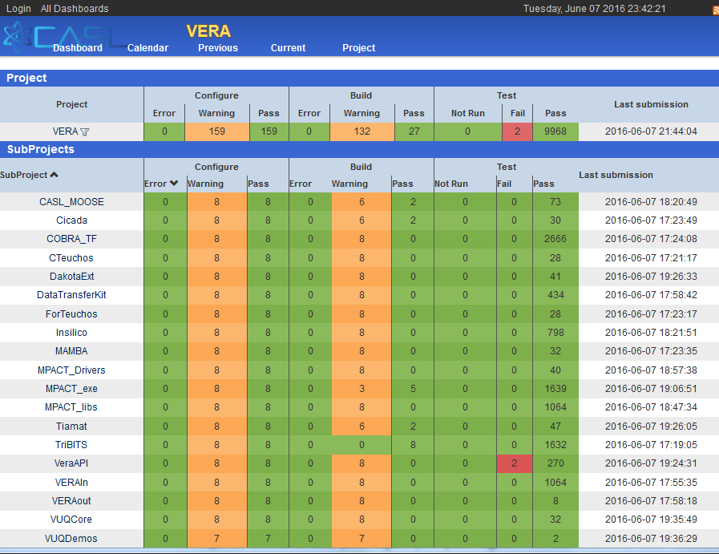
CDash: VERA Packages

Slide 59
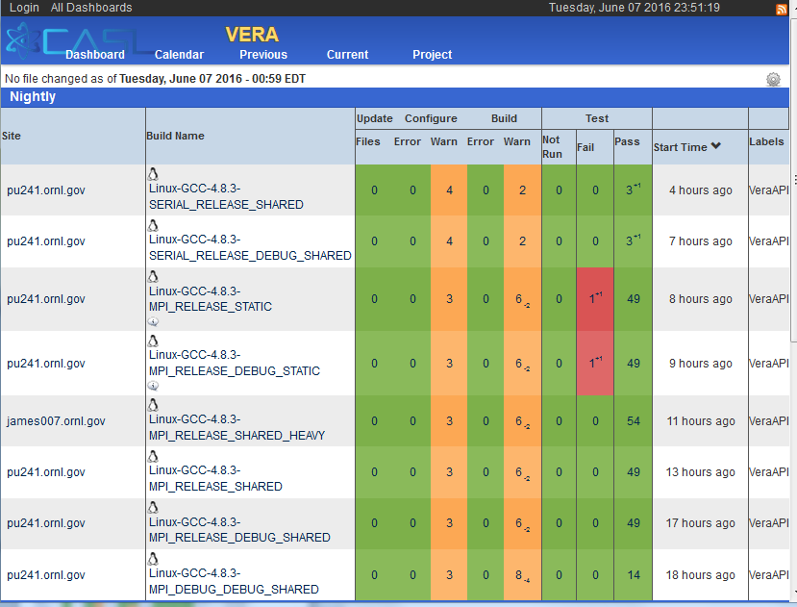
CDash: VERA Package Builds (VeraAPI)

Slide 60
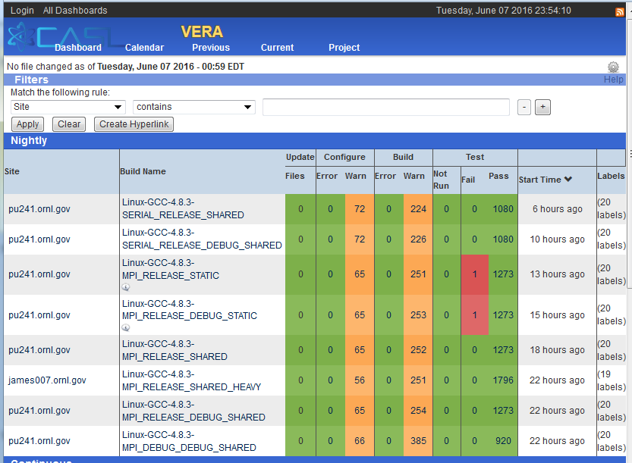
CDash: VERA (Collapsed) Builds

Slide 61
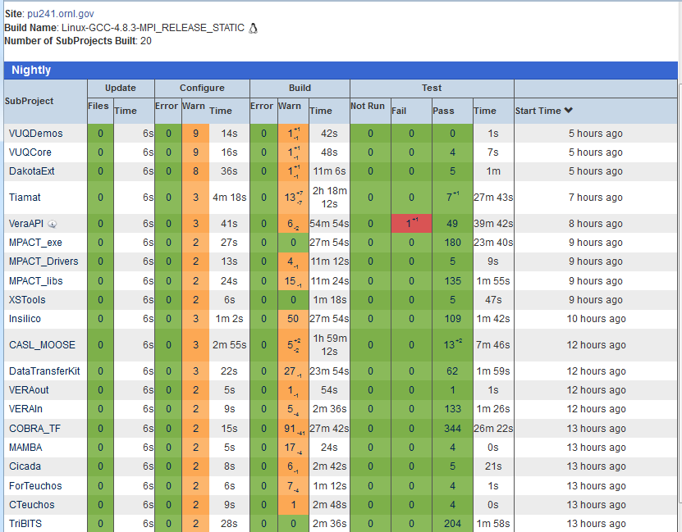
Package-by-Package Build/Test Results

Slide 62
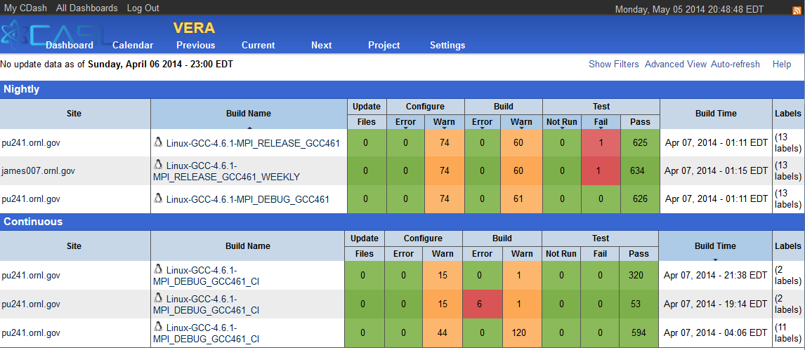
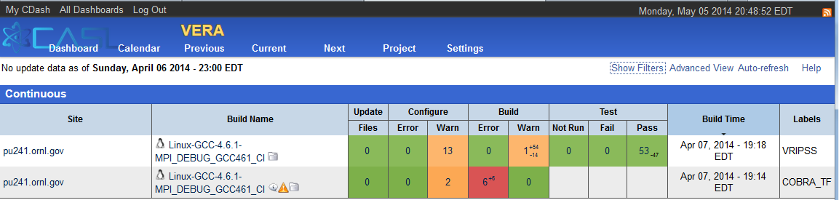
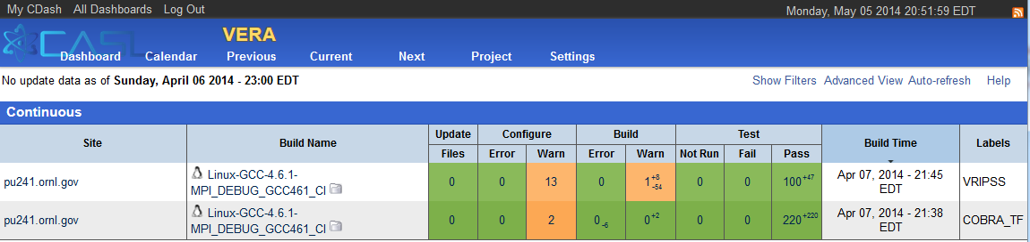
Post-Push Testing: TRIBITS_CTEST_DRIVER()
VERA CDash Dashboard for 4/6/2014
Collapsed summaries for each build case
Nightly, CI, Experimental build cases
VERA CDash CI Iterations
Individual packages built in sequence
Targeted emails for failed package build & tests
Failed packages disabled in downstream packages
=> Don’t propagate failures!

Slide 63
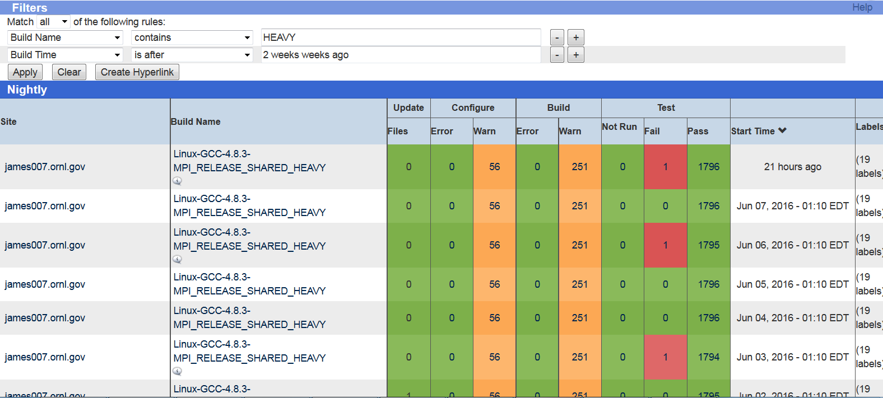
CDash Queries: Killer Feature
Show the HEAVY builds for the last two weeks:

Slide 64
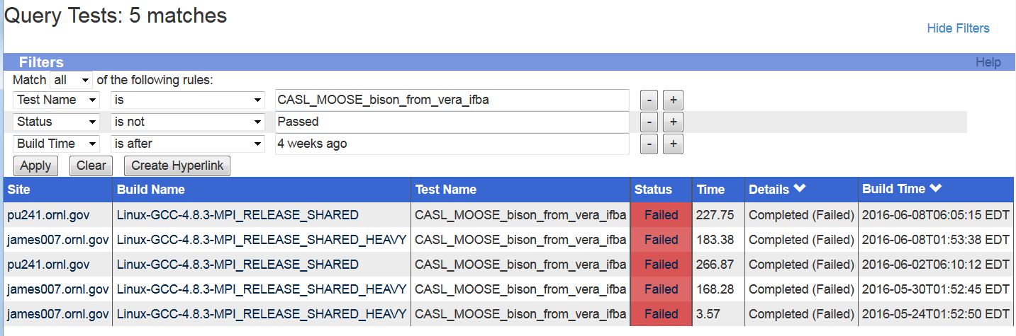
CDash Queries: Killer Feature
Show failures for test CASL_MOOSE_bison_from_vera_ifba in last 4 weeks:
This test is failing randomly ☹

Slide 65
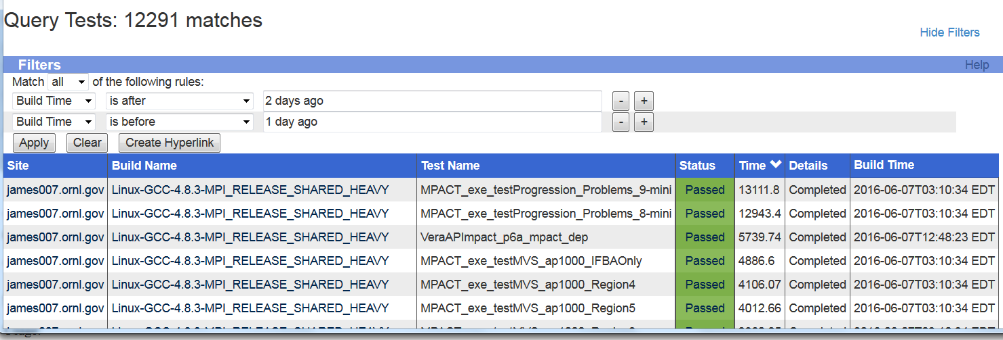
CDash Queries: Killer Feature
Show most expensive tests yesterday:

Slide 66
TriBITS Specialized CDash Support
TriBITS Core:
Provides ready-made partitioning into CTest/CDash Subprojects (i.e. TriBITS Packages)
Gives CDash regression emails for each Package (i.e. CDash Subproject)
Exports XML file with all TriBITS Package dependencies
TriBITS CTest Driver Support:
Generates CDashSubproject.xml file and automatically submitts to CDash
Determines set of changed packages for fast CI rebuilds and tests
Posts updated commits from git pull as CDash build notes files

Slide 67
Multi-Repo Git Updates Shown on CDash
Displays pulled commits as “Notes” file for Subproject (Package) build
…
***
*** VERAInExt updates:
***
c23eff9: Add training slides
Author: Scott Palmtag <pmy@ornl.gov>
Date: Tue Jun 7 08:59:00 2016 -0400
A verain/docs/VERA-Input-Training-2012.pdf
A verain/docs/VERA-Input-Training-May2016.pdf
***
*** VERAData updates:
***
…

Slide 68
TriBITS Summary

Slide 69
Recent CMake/TriBITS Progress
Speed of configuring with CMake 3.3+
CMake 3.3+ eliminates the cost of TriBITS dependency handling:
Example: The cost for building CASL VERA dependency graph of 467 SE packages and then processing enables/disables dropped from 2 minutes with CMake 2.8.11 to less than 2.5 seconds for CMake 3.3
CMake 3.6 (soon to be released) to be even faster!
TriBITS with CMake 3.3+:
Reconfigure time for large CASL VERA coupled code Tiamat < 30 sec
CDash:
Addressed numerous issues/defects with ORNL CASL Kitware contract

Slide 70
In Progress and Upcoming work
In-Progress Work:
Transition to use Ninja instead of Makefiles
Ninja Advantages:
Faster dependency analysis: E.g. Drekar dependency check dropped from 2+ minutes to 2 seconds)
More parallelization of builds vs. recursive Makefiles
Ninja support for Fortran (fork exists, waiting for Google to accept)
Dummy Makefiles to make Ninja easy to use (same usage)
Address issues with Ninja and NVCC/CUDA
Configure, build, and test all packages at once and submit to CDash
Upcoming Work:
Combining concepts of packages and TPLs for large meta-projects (TriBITS #63)
High-level and tutorial documentation
Enable usage of `git bisect` with gitdist (automate with checkin-test.py)
A few of the backlog issues (see TriBITS Issues and TriBITS Backlog)
Once these are done => TriBITS will be a good candidate for a universal meta-build and installation system for a very large amount of CSE software

Slide 71
TriBITS Partitioning and Dependencies
TriBITS
python 2.4+
CMake 2.8.11+
Core
PythonUtils
git
Com. TPLs
CI Support
CTest Driver
TriBITS Core (tribits/core/): Core TriBITS package-based architecture for CMake projects includes configure, build, test, install, deploy (tarballs) for multi-repo projects. (1M size)
TriBITS Python Utils (tribits/python_utils/): Some basic Python utilities that are not specific to TriBITS (e.g. gitdist, snapshot_dir.py).
TriBITS CI Support (tribits/ci_support/): Support code for pre-push continuous integration testing (e.g. checkin-test.py).
TriBITS CTest Driver (tribits/ctest_driver/): Support for package-by-package testing driven by CTest submitting to CDash (e.g. TribitsCTestDriverCore.cmake).
TriBITS Common TPLs (tribits/common_tpls/): Used by many independent TriBITS projects (e.g. FindTPLBLAS.cmake, FindTPLLAPACK.cmake, FindTPLHDF5.cmake, …)
…

Slide 72
TriBITS Summary
TriBITS System Partitioning and Dependencies:
TriBITS Core: Basic configure, build, test, install, and creating distributions
=> Only requires raw CMake 2.8.11+
=> 10K lines of CMake code (1M of disk space)
TriBITS CI Support (checkin-test.py, clone_extra_repos.py,…)
=> Requires Git (1.7.0.4+) and Python 2.4
See TriBITS Developers Guide for more details (http://tribits.org )
Usage of TriBITS:
Trilinos (SNL, originating project)
ORNL: SCALE, Exnihilo, DataTransferKit
Non-ORNL: MPACT (Univ. of Misc.), COBRA-TF (Penn. State)
CASL-Related: VERA
TriBITS Development & Distribution:
3-clause BSD-like license, Copyright SNL
Main source hosted on GitHub (https://github.com/TriBITSPub/TriBITS )
Documentation hosted on http://tribits.org
Near-term Future Work:
Support for Ninja with Fortran, NVCC, etc.
More flexibility on pre-building packages and linking in as TPLs
Define a standard installation of TriBITS
Put out a TriBITS release (release with CMake in the future?)
Finish overview document and tutorials
More error checking to catch user mistakes

Slide 73
Multi-Repository Integration Models and Processes

Slide 74
Integrating Repos into Project: External and Internal
pull
and/or
push
pull
and/or
push
Project Internal Repos
pull
push
External
Repo1
Project Copy
Repo1
PkgA
PkgB
PkgA
PkgB
Repo1 Devs
Repo1 Integrator
pull
push
External
Repo2
pull
and/or
push
pull
and/or
push
Project Copy
Repo2
PkgC
PkgD
PkgC
PkgD
Repo2 Devs
Repo2 Integrator
Project must contain consistent clones of all the repos in the master branches of each!
Processes enforce that code pulled from the master branch of the project’s interval repo’s is working code!
Core developers for Repo1 and Repo2 may be in different organizations/regions.
pull
and/or
push
Project Native
Repo3
PkgE
PkgF
Project Devs
pull
Project Releaser

Slide 75
Multi-Repository Integration Models
Range of development and sync models (external dev to internal dev):
External repo is manually synced into project/master as needed.
External repo is synced automatically using sync server into project/master.
Both external and internal repos pushed to by different development groups with sync servers running one way or both ways.
Internally managed repo is synced to an external repo on some schedule to make available to other developers and users and changes from external repo may or may not be synced back into internal repo.
Internally managed repo not shared externally
A given repo may shift between different integration models at different periods of time (e.g. Trilinos, COBRA-TF, VERAIn)
Integration of different repos should be done independently if possible (e.g. errors trying to integrate new MPACT version should not stop integration of new versions of SCALE/Exnihilo and visa versa).
Non-backward compatible changes for multiple repos repos require coordinated development and combined pushing to project/master

Slide 76
External Repo is manually synced
Project Internal Repos
pull
push
External
Repo2
Project Copy
Repo1
pull
Repo2 Devs
PkgC
PkgD
push
PkgA
PkgB
Repo2 Integrator
A person (Repo2 Integrator) as needed:
Clones all repos from “Project Internal Repos”
Merges in changes from “External Repo2” (fast-forward or no-fast-forward)
Tests against all downstream packages and pushes to “Project Copy Repo2”
Notes:
No-one else pushes changes to “Project Copy Repo2”
Good when changes are not urgent for Project or when “External Repo2” is not stable
Project Copy
Repo2
PkgC
PkgD
pull
Project Native
Repo3
PkgE
PkgF
Project Devs
VERA Repos: Trilinos, DataTransferKit, MAMBA

Slide 77
External repo is synced automatically using sync server
Project Internal Repos
pull
push
External
Repo2
Project Copy
Repo1
pull
Repo2 Devs
PkgC
PkgD
push
PkgA
PkgB
Cron job
Repo2 Integrator
A cron job running a script (Repo2 Integrator) on a hourly/daily/weekly basis:
Clones all repos from “Project Internal Repos”
Merges in changes from “External Repo2” (fast-forward or no-fast-forward)
Tests against all downstream packages and pushes to “Project Copy Repo2”
Notes:
No-one else pushes changes to “Project Copy Repo2”.
Good when changes are important or urgent to Project and “External Repo2” is fairly stable.
Project Copy
Repo2
PkgC
PkgD
pull
Project Native
Repo3
PkgE
PkgF
Project Devs
VERA Repos: SCALE/Exnihilo, MPACT, MOOSE/Bison

Slide 78
Both external and internal repos pushed to
Project Internal Repos
pull
push
push
External
Repo2
Project Copy
Repo1
[Cron job?] Internal to External Integrator
pull
Repo2 Devs
PkgC
PkgD
PkgA
PkgB
pull
Different sets of developers make changes and push to the different Repo2 clones.
Sync servers (or people when manual) pull/push changes both ways (fast-forward or no-fast-forward).
Notes:
Good when subsets of developers can not push to each other’s repos
Good when changes are important or urgent to Project.
Good when changes tend to be independent made to Internal and External repos.
Most complex and danger of merge conflicts that someone has to resolve!
Project Copy
Repo2
[Cron job?]
External to Internal Integrator
push
PkgC
PkgD
Project Native
Repo3
pull
push
PkgE
PkgF
Project Devs
VERA Repos: TriBITS
(sometimes COBRA-TF, MPACT, Trilinos, …)

Slide 79
Internally managed repo is synced to an external repo
Project Internal Repos
pull
External
Repo2
Project Copy
Repo1
push
External Repo2 User
PkgC
PkgD
pull
PkgA
PkgB
[Cron job?]
Repo2 Integrator
A cron job running a script (Repo2 Integrator) on a hourly/daily/weekly basis (or a person when manual):
Clones “External Repo2”
Merges in changes from “Project Copy Repo2” (fast-forward or non-fast-forward)
Tests against just Repo2 tests and push to “External Repo2”
Notes:
No-one else directly pushes changes to “External Repo2”
Good when you just want to make changes available to external users on a continuous/frequent basis.
Project Copy
Repo2
PkgC
PkgD
pull
push
Project Native
Repo3
PkgE
PkgF
Project Devs
VERA Repos: COBRA-TF, TeuchosWrappersExt, VERAIn

Slide 80
Internally managed repo
Project Internal Repos
Project Copy
Repo1
PkgA
PkgB
Simple single-repo development model
Notes:
Good when you don’t need to coordinate with developers outside of the Project
Project Copy
Repo2
PkgC
PkgD
pull
push
Project Native
Repo3
PkgE
PkgF
Project Devs
VERA Repos: MOOSEExt, PSSDriversExt , DakotaExt, VUQDemos

Slide 81
TriBITS Multi-Repository Integration Processes Support
Project Internal Repos
pull
push
push
External
Repo2
Project Copy
Repo1
[Cron job]
checkin-test.py
Internal to External Integration Owner
pull
Repo2 Devs
PkgC
PkgD
PkgA
PkgB
pull
Project Copy
Repo2
Initial local repo clones and remote setup:
$ git clone <url>:<base-repo>
$ ./clone_extra_repos.py
… Set up git remotes …
Single script call to perform integration:
$ checkin-test.py \
--extra-pull-from=<repo>:<remote>:<branch> \
[other options] --do-all --push
Setting up an external-to-internal or internal-to-external integration process takes hours, not days or weeks!
Integration Owners for the integration processes watch over the process, triage issues, and make sure they are addressed.
[Cron job]
checkin-test.py
External to Internal Integration Owner
push
PkgC
PkgD
Project Native
Repo3
pull
push
PkgE
PkgF
Project Devs

Slide 82
THE END

