Slide 1
Mapping Irrigation consumptive water use in the Lower Yakima Basin
Precipitation, and in particular its effective portion, provides part of the water crops need to satisfy their transpiration requirements. The soil, acting as a buffer, stores part of the precipitation water and returns it to the crops in times of deficit.
In humid climates, this mechanism is sufficient to ensure satisfactory growth in rainfed agriculture. In arid climates or during extended dry seasons, irrigation is necessary to compensate for the evapotranspiration (crop transpiration and soil evaporation) deficit due to insufficient or erratic precipitation.
Irrigation consumptive water use is defined as the volume of water needed to compensate for the deficit between potential evapotranspiration on the one side and effective precipitation over the crop growing period and change in soil moisture content on the other side. It varies considerably with climatic conditions, seasons, crops and soil types.
http://www.fao.org/aquastat/en/data-analysis/irrig-water-use/irrig-water-requirement/

Slide 2
Mapping Irrigation consumptive water use
in the Lower Yakima Basin
ICU = ETc - P – DS
Where:
ICU = irrigation consumptive water use needed to satisfy crop water demand (mm)
ETc = potential crop evapotranspiration (mm)
P = effective precipitation (mm)
DS = change in soil moisture (mm)
http://www.fao.org/aquastat/en/data-analysis/irrig-water-use/irrig-water-requirement/

Slide 3
Potential crop evapotranspiration
Available here: http://www.fao.org/3/X0490E/X0490E00.htm
Alternatively, we could use ET values

Slide 4
Precipitation
Available from DayMet (see Emilio ’s Tuesday tutorial)

Slide 5
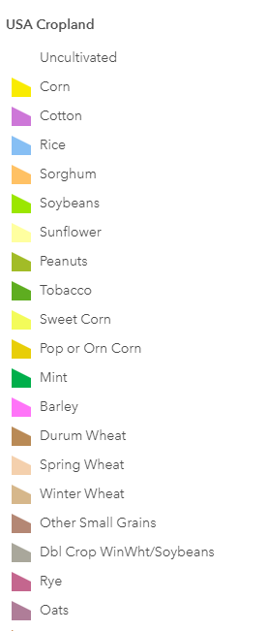
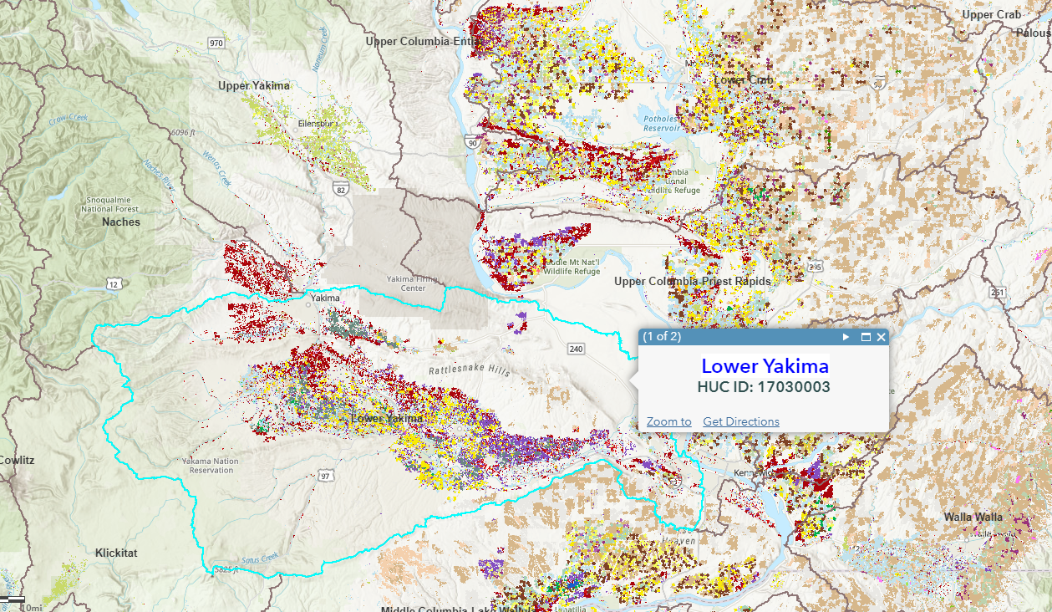
Crop data (annual 2008-present; 30-meter resolution)
Source: https://nassgeodata.gmu.edu/CropScape/
REST service: https://landscape11.arcgis.com/arcgis/rest/services/USA_Cropland/ImageServer

Slide 6
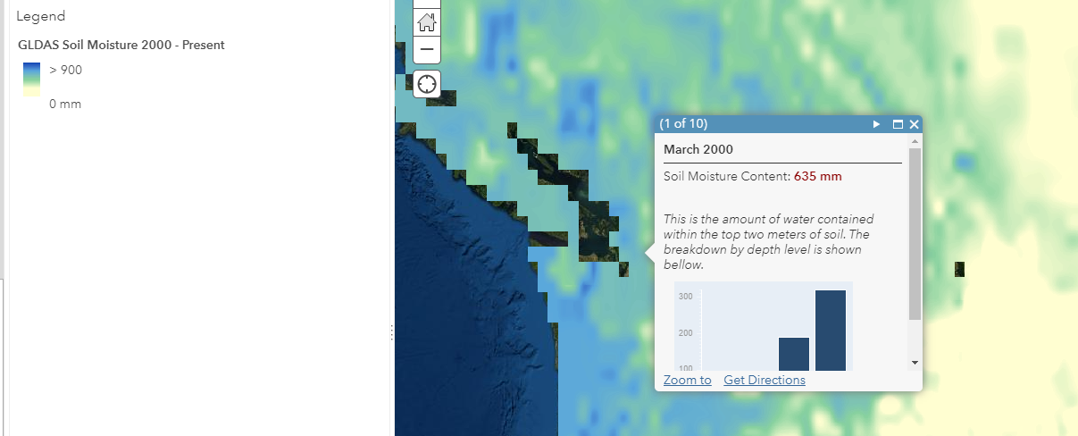
Change in soil moisture (monthly 2000-present; 0.25-degree resolution)
Source: https://hydro1.gesdisc.eosdis.nasa.gov/data/GLDAS/GLDAS_NOAH025_M.2.1/
REST service: https://earthobs2.arcgis.com/arcgis/rest/services/GLDAS_SoilMoisture/ImageServer

