Slide 1
King County House Prices

Slide 2

Hi there! I’m a software engineer based in NY and working for the UN, and an aspiring data scientist at Flatiron Academy
Barto Molina, Flatiron DS, April 2019 cohort

Slide 3
the project
House Prices King County Sept ‘14 – Oct ‘15
21,597 rows of data
3% of the total number of houses in KC
predict house prices

Slide 4

the process
Scrub
Explore
Model
Interpret

Slide 5
our target
House Price

Slide 6
feature selection
zipcode
latitude
longitude
waterfront
sq ft nearest neighbors
location
year built
year renovated
grade
condition
condition
bedrooms
bathrooms
floors
sq feet (living, above, basement)
sq feet lot
features

Slide 7
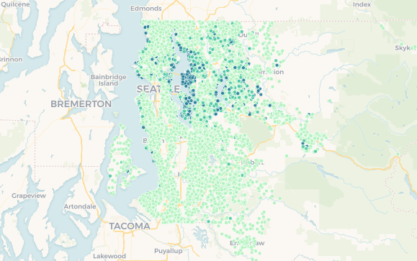
waterfront
properties
01
waterfront houses 75% more expensive
moving 32 miles north increases price 1.5%

Slide 8
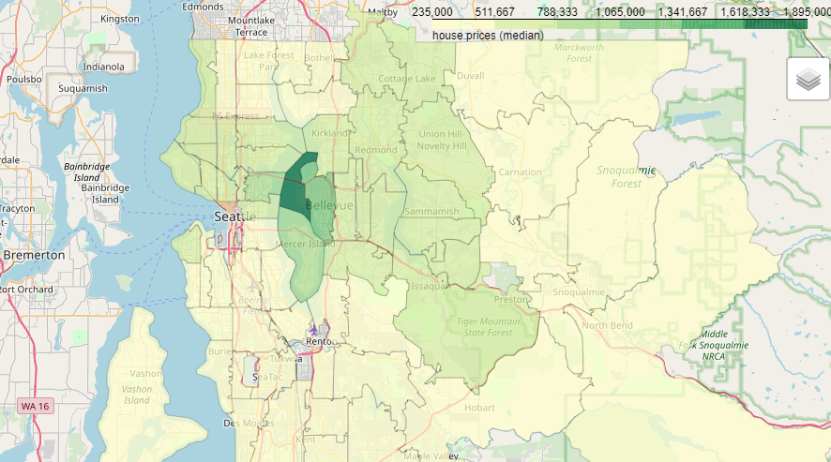
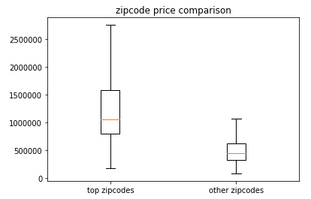
prime
location
54% price increase
Bellevue
Medina
Clyde Hill
Mercer Island
East Seattle
02

Slide 9
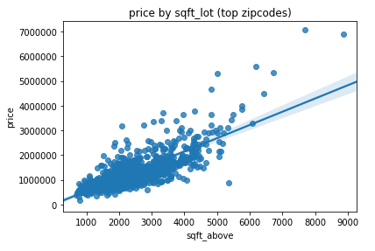
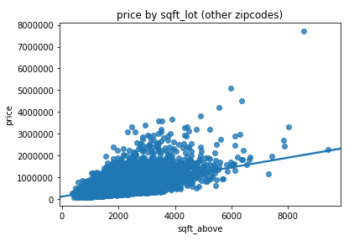
03
square
footage
1,000 sqft to 1,100 sqft:
15% price increase
However…

Slide 10
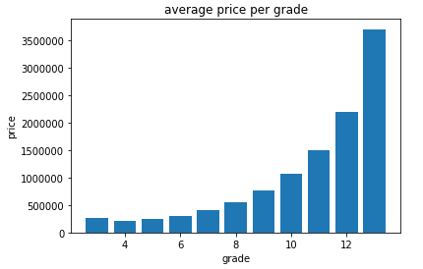
04
grade
condition
Grade can increase price up to 180%
1. Falls short of minimum building standards. Normally cabin or inferior structure.
...
13. Generally custom designed and built. Mansion level. Large amount of highest quality cabinet work, wood trim, marble, entry ways etc.
Condition can increase price up to 12%

Slide 11
thank you.

