Slide 1


Slide 2

Hi there! I’m a software engineer based in NY and working for the UN, and an aspiring data scientist at Flatiron Academy
Barto Molina, Flatiron DS, April 2019 cohort

Slide 3
the problem methodology
Predict customer satisfaction
Dataset preparation
Machine learning algorithms

Slide 4
features types
numerical features
Related to user account. i.e. balance.
categorical features
Like the different products associated to the users.
other features
Country, Age, value of the Mortgage.

Slide 5
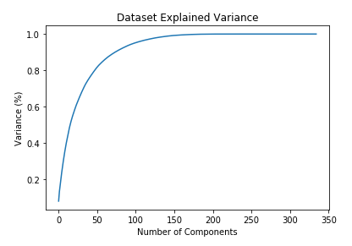
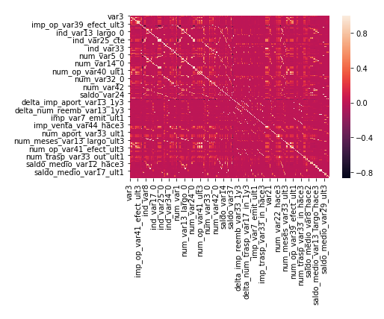
features PCA

Slide 6
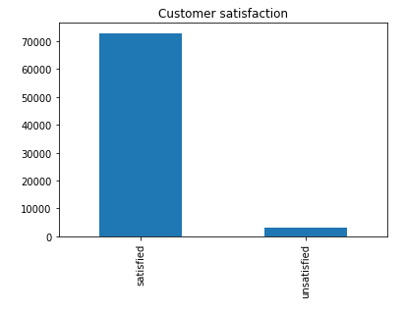
target unbalanced
4% unsatisfied customers

Slide 7
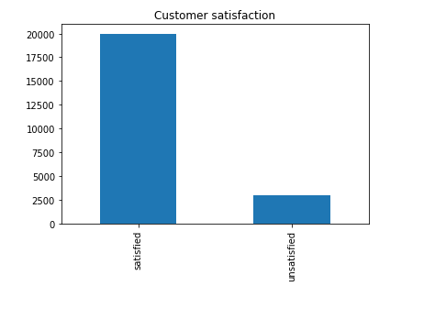
target resampling
Random undersampling
undersampling
Tomek links
Cluster centroids
oversampling
SMOTE

Slide 8
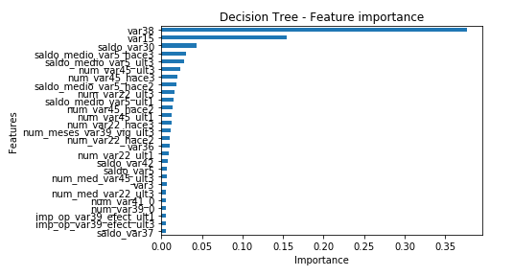
random forest feature importance
mortgage
age
account balance

Slide 9
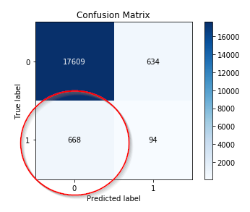
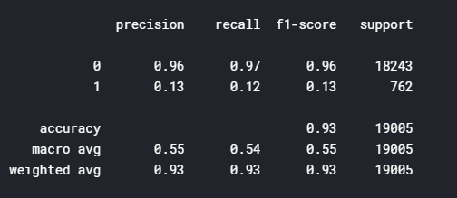
random forest unbalanced dataset

Slide 10
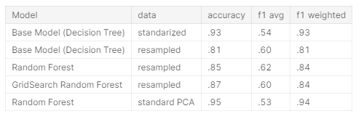
random forest comparison

Slide 11
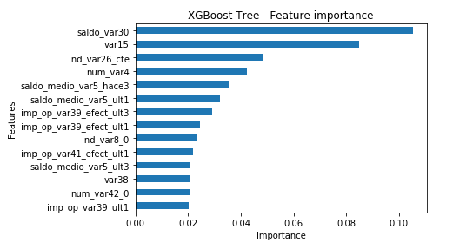
XGBoost feature importance
account balance
age
ind_var26_cte

Slide 12
conclusions lessons learned
missing / incomplete data
difficult to interpret.
high dimensional data
computational power required.
Unbalanced datasets
sampling, hyperparameter tuning.

Slide 13
conclusions future work
unbalanced data
Further work on the sampling / hyperparameter tuning.
additional ML algorithms
SVM, AdaBoost.
pipelines
Streamline the machine learning process.

Slide 14
thank you.

