Slide 1

Thinking About
Clusters in the Cloud

Slide 2
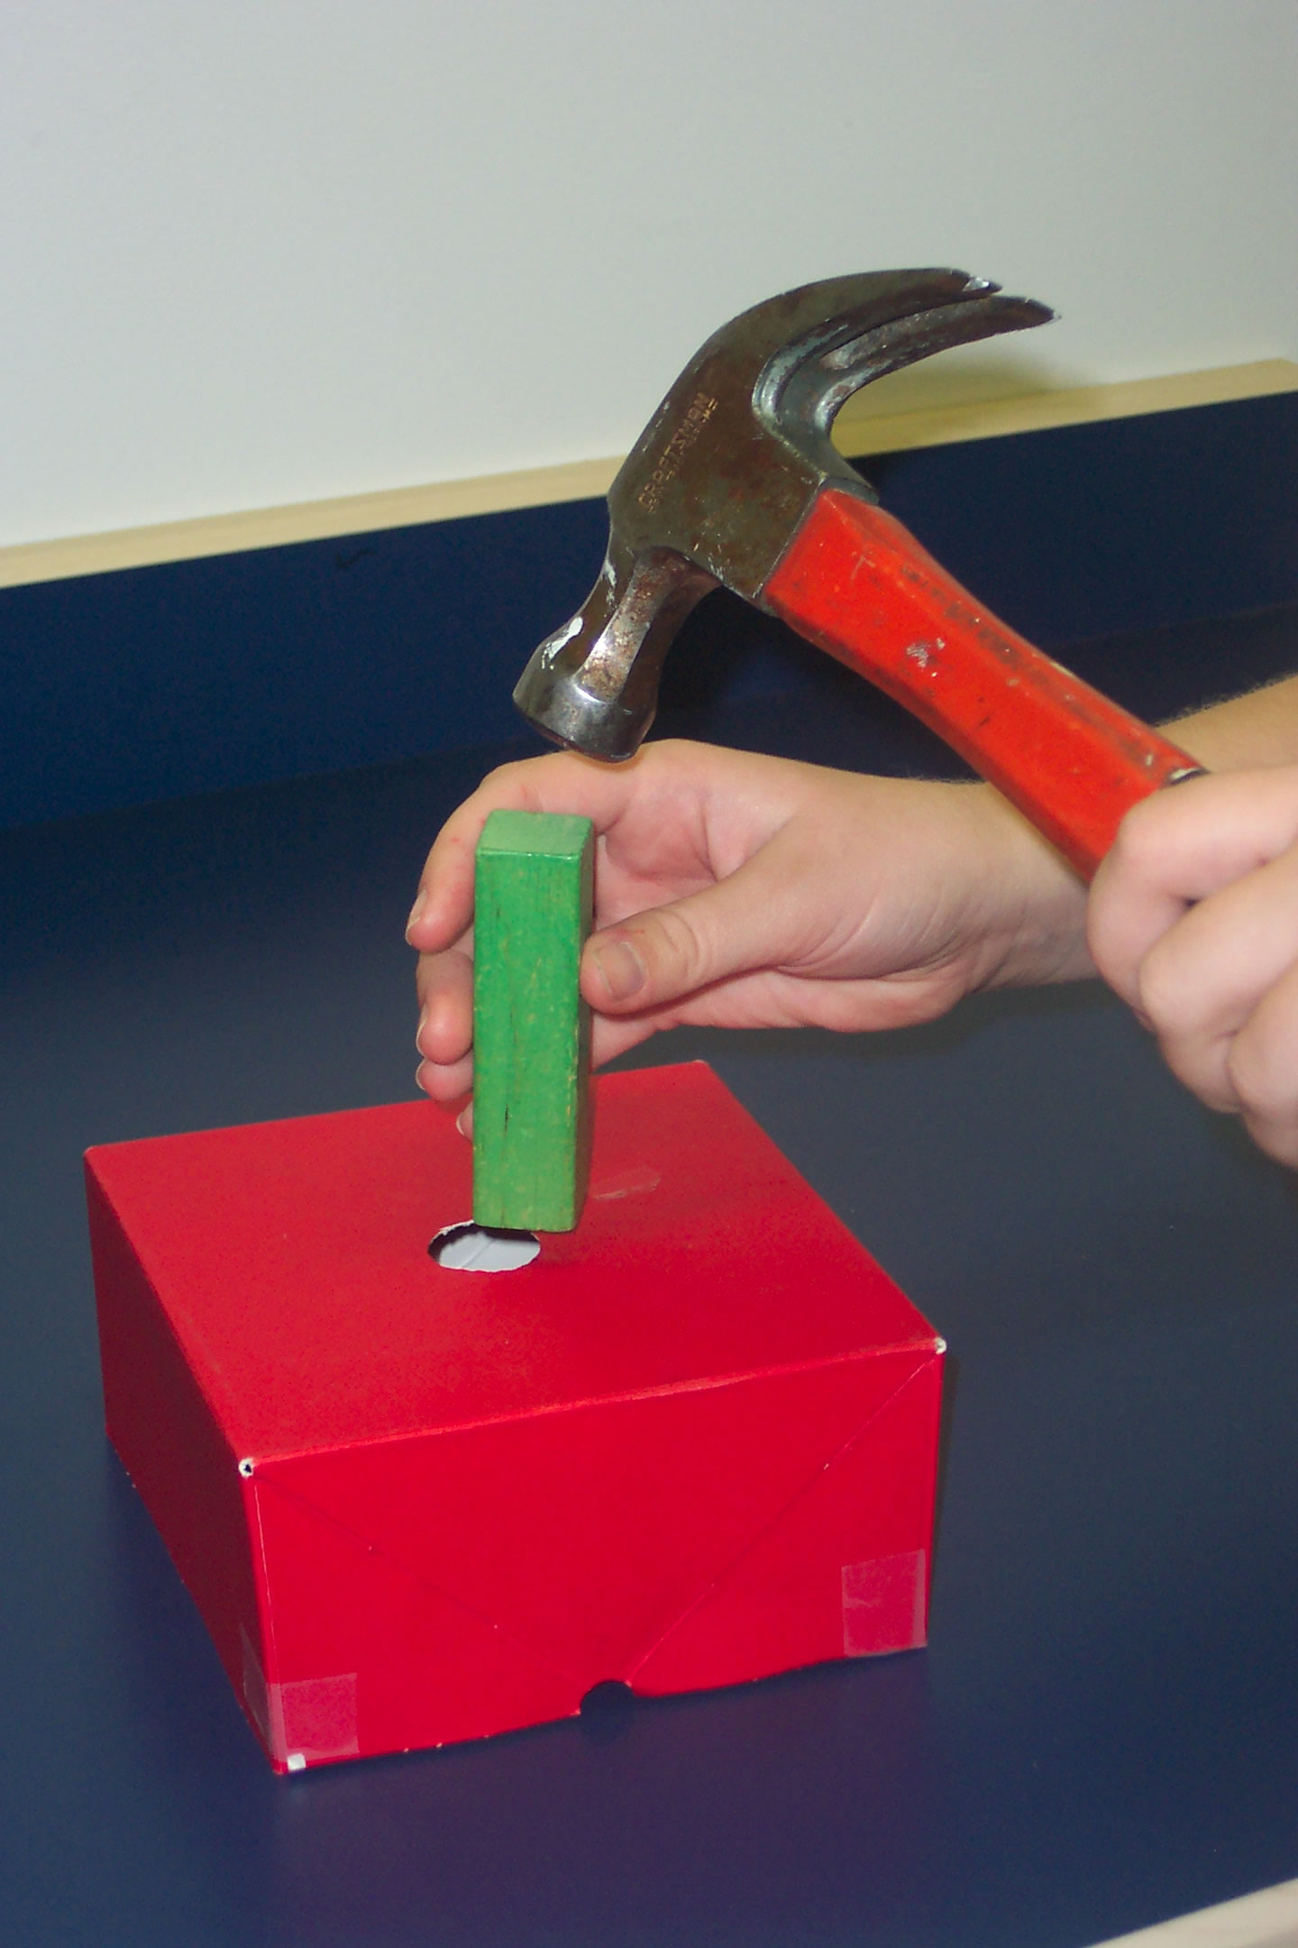

Slide 3
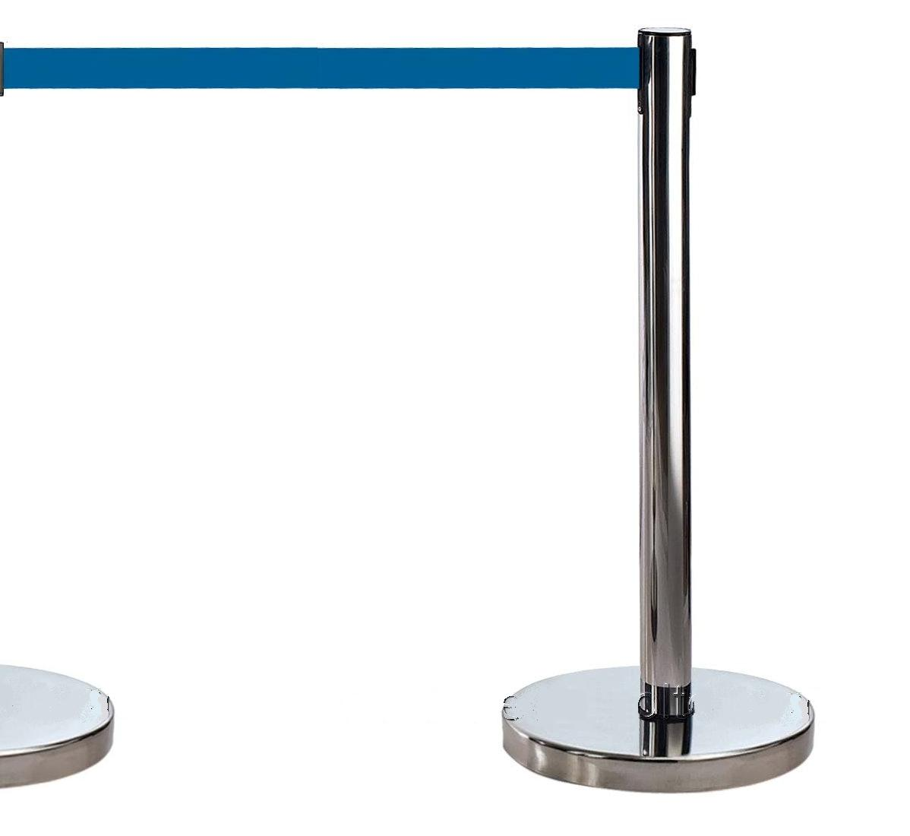

Slide 4

Grid Computing
Cloud Computing

Slide 5
Grid Computing
Cloud Computing
  High Performance

Slide 6
Grid Computing
Cloud Computing
  High Performance
  Batch Interface

Slide 7
Grid Computing
Cloud Computing
  High Performance
  Batch Interface
  Terminal Access

Slide 8
Grid Computing
Cloud Computing
  High Performance
  Batch Interface
  Terminal Access
  Asynchronous

Slide 9
Grid Computing
Cloud Computing
  High Performance
  Batch Interface
  Terminal Access
  Asynchronous
  Shared

Slide 10
Grid Computing
Cloud Computing
  High Performance
  Batch Interface
  Terminal Access
  Asynchronous
  Shared
  High Throughput

Slide 11
Grid Computing
Cloud Computing
  High Performance
  Batch Interface
  Terminal Access
  Asynchronous
  Shared
  High Throughput
  On demand

Slide 12
Grid Computing
Cloud Computing
  High Performance
  Batch Interface
  Terminal Access
  Asynchronous
  Shared
  High Throughput
  On demand
  Interactive

Slide 13
Grid Computing
Cloud Computing
  High Performance
  Batch Interface
  Terminal Access
  Asynchronous
  Shared
  High Throughput
  On demand
  Interactive
  Synchronous

Slide 14
Grid Computing
Cloud Computing
  High Performance
  Batch Interface
  Terminal Access
  Asynchronous
  Shared
  High Throughput
  On demand
  Interactive
  Synchronous
  No humans

Slide 15
Grid Computing
Cloud Computing
  High Performance
  Batch Interface
  Terminal Access
  Asynchronous
  Shared
  High Throughput
  On demand
  Interactive
  Synchronous
  No humans
  Owned by the user

Slide 16


Slide 17
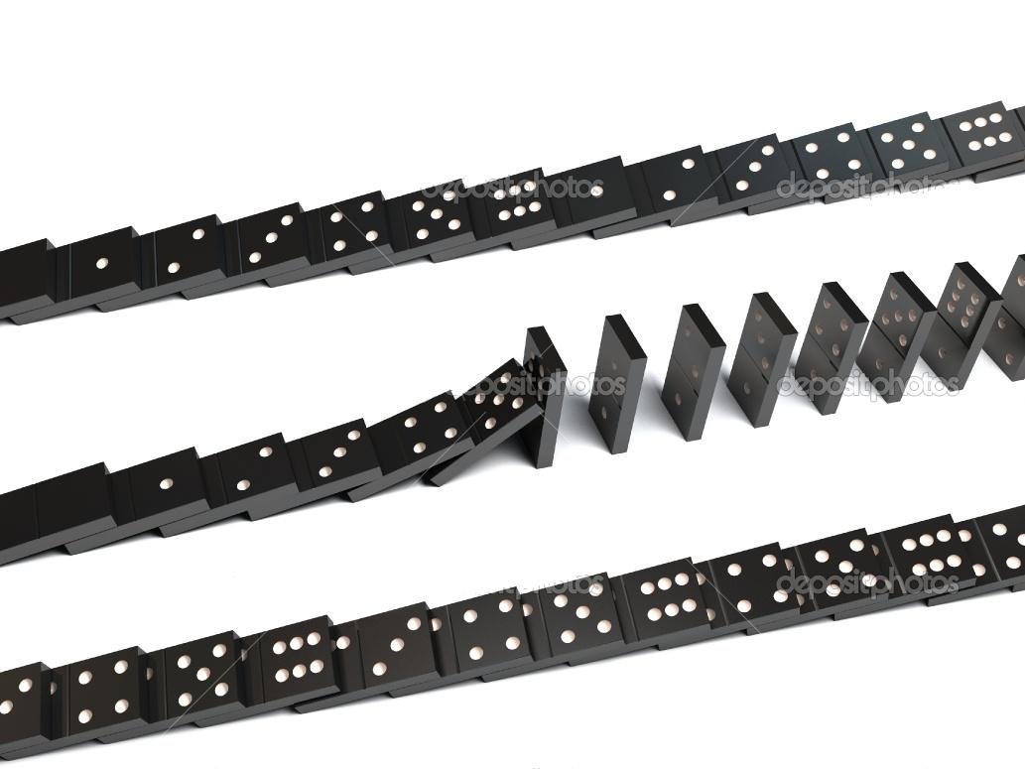

Slide 18
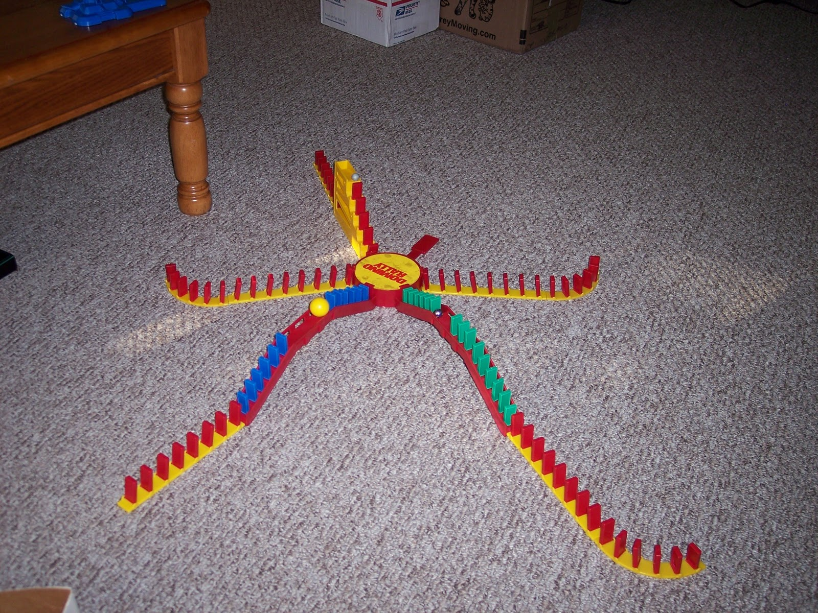

Slide 19
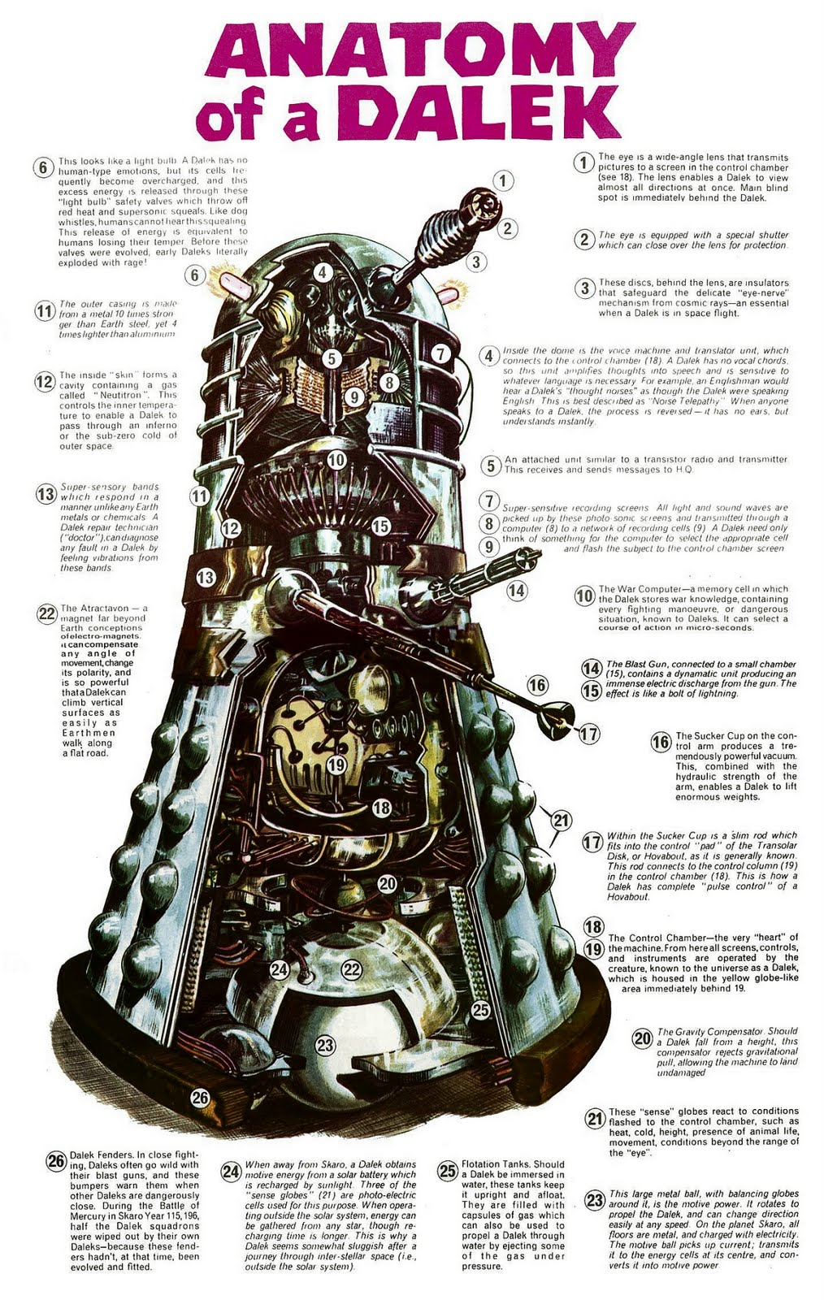

Slide 20


Slide 21


Slide 22
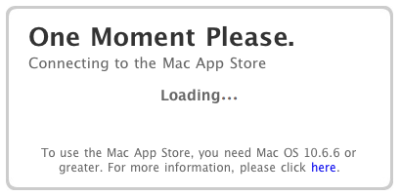

Slide 23


Slide 24
Grid Computing
Cloud Computing
  High Performance
  Batch Interface
  Terminal Access
  Asynchronous
  Shared
  High Throughput
  On demand
  Interactive
  Synchronous
  No humans
  Owned by the user

Slide 25

Grid Computing
Cloud Computing
  High Performance
  Batch Interface
  Terminal Access
  Asynchronous
  Shared
  High Throughput
  On demand
  Interactive
  Synchronous
  No humans
  Owned by the user

Slide 26
Grid Computing
Cloud Computing
  High Performance
  Batch Interface
  Terminal Access
  Asynchronous
  Shared
  High Throughput
  On demand
  Interactive
  Synchronous
  No humans
  Owned by the user

Slide 27
Grid Computing
Cloud Computing
  High Performance
  Batch Interface
  Terminal Access
  Asynchronous
  Shared
  High Throughput
  On demand
  Interactive
  Synchronous
  No humans
  Owned by the user

Slide 28
Grid Computing
Cloud Computing
  High Performance
  Batch Interface
  Terminal Access
  Asynchronous
  Shared
  High Throughput
  On demand
  Interactive
  Synchronous
  No humans
  Owned by the user

Slide 29
Grid Computing
Cloud Computing
  High Performance
  Batch Interface
  Terminal Access
  Asynchronous
  Shared
  High Throughput
  On demand
  Interactive
  Synchronous
  No humans
  Owned by the user

Slide 30
Grid Computing
Cloud Computing
  High Performance
  Batch Interface
  Terminal Access
  Asynchronous
  Shared
  High Throughput
  On demand
  Interactive
  Synchronous
  No humans
  Owned by the user

Slide 32
Grid Computing
Cloud Computing
  High Performance
  Batch Interface
  Terminal Access
  Asynchronous
  Shared
  High Throughput
  On demand
  Interactive
  Synchronous
  No humans
  Owned by the user

Slide 33
Grid Computing
Cloud Computing
  High Performance
  Batch Interface
  Terminal Access
  Asynchronous
  Shared
  High Throughput
  On demand
  Interactive
  Synchronous
  No humans
  Owned by the user

Slide 34
Grid Computing
Cloud Computing
  High Performance
  Batch Interface
  Terminal Access
  Asynchronous
  Shared
  High Throughput
  On demand
  Interactive
  Synchronous
  No humans
  Owned by the user

Slide 35
Grid Computing
Cloud Computing
  High Performance
  Batch Interface
  Terminal Access
  Asynchronous
  Shared
  High Throughput
  On demand
  Interactive
  Synchronous
  No humans
  Owned by the user

Slide 36


