Slide 1

Automate All The Things!
Notes:
About 18 months ago, we were wondering what to do next. We had been exploring clouds and infrastructure as a service, and recognised that without developing tools and techniques for working in the cloud, it's potential couldn't be realised. We knew that there's a lot more to figuring out a new technology than just standing it up in a lab, so we were looking for an opportunity to actually try these new tools in a serious production environment.At the same time, the university was also wondering about these things, and how they could be used.

Slide 2

The Learning Management Cloud
Partnership between Alberta post-secondary institutions
3-year pilot to
Explore cloud-based shared computing resources,
Build a collaborative community and,
Create stable, flexible systems that grow with each institution,
Reduce costs
Notes:
So the University of Alberta, together with NAIT and Athabasca Unversity formed a club with the intention of migrating their learning management systems into the cloud, and to use cloud infrastructure to it's fullest advantage. And they invited us to help them do it.This project turned out to be everything we hoped it would be --which is to say that it uncovered a lot of problems and forced us to deal with them. Problems with technology, problems with culture, problems adapting to this new environment.

Slide 3
Who Are We?
Cybera is a not-for-profit organization that works to spur and support innovation, for the economic benefit of Alberta, through the use of cyberinfrastructure.
We run your Research and Education network!
Notes:
I'm with a company called 'Cybera'. Our mission statement makes us sound like a bunch of boy scouts, but it's the real deal. In a nutshell, we play around with new technology, and try to figure out what it's good for. We’ve enjoyed a good relationship with the universities over the years, and they are a big part of our mandate.We also run the high-speed research network in Alberta, connecting the university to other institutions around the globe. So you and I probably work together every day!

Slide 4
The Ingredients
OpenStack infrastructure-as-a-service cloud
Chef infrastructure automation tools
DevOps culture
Collaboration with institutions
Humility
Lots of discussion
Notes:
I mentioned before that we used an IaaS cloud. I should be careful to distinguish between 'cloud' and mere virtualisation. Cloud means that I can get my resources on demand, with no intermediation.
We used 'Chef' as an automation tool. Chef turns hardware into software. It allows you to write code that manages your hardware --physical or virtual. It also contains all the metadata about the servers it manages, and you can use this metadata in your automation.All of the tools in this project are open source, by the way. We can't really afford licensed, propieatary systems, and neither can you. We started to adopt a devops culture a couple of years ago. We were kinda forced into it, we're a very small organisation, and if we wanted to get anything done we pretty much had to cover all the bases ourselves. But we like it this way, and think it's a healthy way to work.
We worked very closely with each institution. We had to get to a point where we understood the system well enough to automate it. Not just the software, but also how it was used and how it fit into the process at each institution. None of the institutions were alike, they were all very different.So, this put us into a position where we were not the experts, we didn't really understand the problems. This is a humbling position to be in, and it took a bit of work for us to get used to it.

Slide 5
A Word On DevOps
Developers + Operators
A mixing of cultures and expertise
Dissolving silos
Thinking about the entire stack is good for you!
Notes:
I should say a bit more about 'devops'. Devops is all about breaking down the barriers between software development and operations, combining the best practices from both worlds. Personally, I'm coming at this with a developers background, and I've learned more in the last 3 years than I have in my entire career, and I like it. It has made me a better developer, and it has made what I build better.
Part of being a devop is I'm part of the 24-hour support team, I get those 3:00am phone calls. Way back, as part of another system, I got one of those phone calls. I was trying to figure out the problem in some weird state of being half-asleep and on the verge of panic, and found myself staring at one of those terrible, terrible error message that are utterly usless! Some cryptic garbage that is no help at all in diagnosing the problem or correcting it. And I recognised the message! I had written it! It was useless, I changed it the next day.
And this is probably the way things are going to be, from now on. It's not okay anymore for developers to not understand the operational environment, or to just throw code over the wall. It's not okay for operators to cling to inefficent practices, or to treat servers like pets. Things are changing, and you can either change with them, or die in the tar pit.

Slide 6
Infrastructure Automation
A revolution
Turning hardware into software
Infrastructure under version control
Platform for iterative improvement
Platform for consistency and auditability
Platform for documentation and discoverability
Notes:
So let's talk about these flash new tools. The zealots call it a 'revolution', but perhaps that's a bit overblown.

Slide 7
Infrastructure Automation
A revolution an evolution
Turning hardware into software
Infrastructure under version control
Platform for iterative improvement
Platform for consistency and auditability
Platform for documentation and discoverability
Notes:
Let's call it an 'evolution'. This is the culmination of 30 years of experience and learning about managing infrasturcture.
This is infrastructure as code. It brings to hardware(!) all the benefits that digitisation has given to everything else in our lives: flexibility, portability, fluidity,...Once your hardware becomes software, you can bring all the tools and techniques used in application development to your infrastructue. It gives you a platform for iterative improvment of your infrastructure, a platform for consistency, for auditabiltiy, and for documentation. I don't want to skip over 'discoverability'. Once you've turned your hardware into software, you can do things like diff two servers. Or grep through every server you've got. Can't remember how some obscure service is configured? Search your source code, it's all right there.

Slide 8
Take The Red Pill
Notes:
So, let's see this in action. I want a new installation of our learning management system. I need a robust, highly-available configuration, and data is prescious so I need full backup and snapshoting.So, I'll sit down at my laptop, and press the go button. Immediately, the automation tool starts creating virtual machines in our cloud...

Slide 9

Notes:
first, we start up an application server...

Slide 10
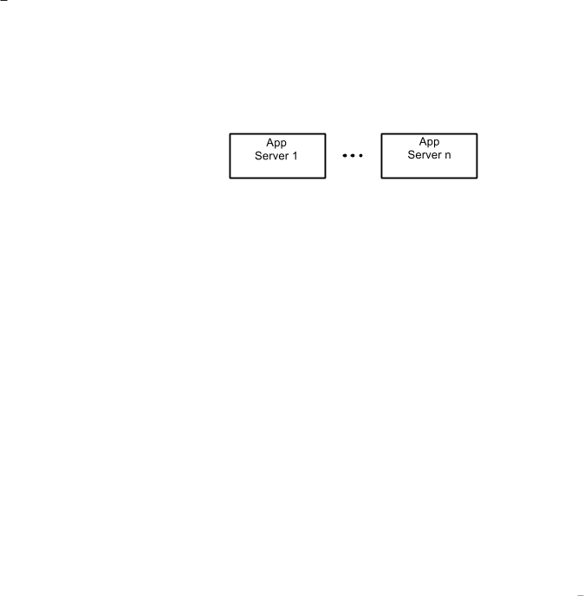
Notes:
...actually, we start a whole bunch of them...

Slide 11
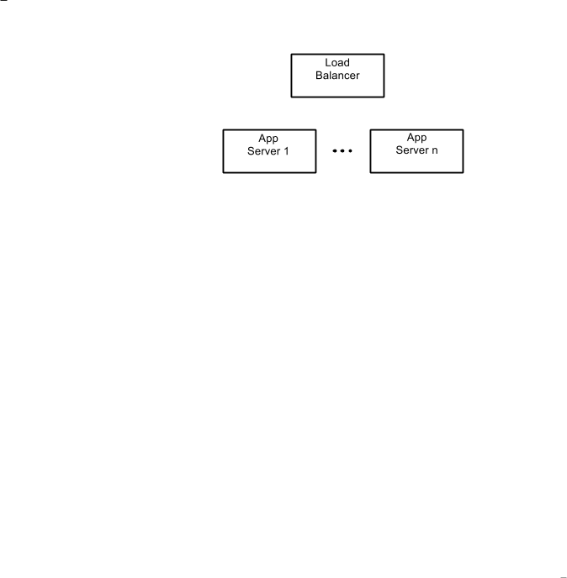
Notes:
...and put a load balancer in front of them.

Slide 12
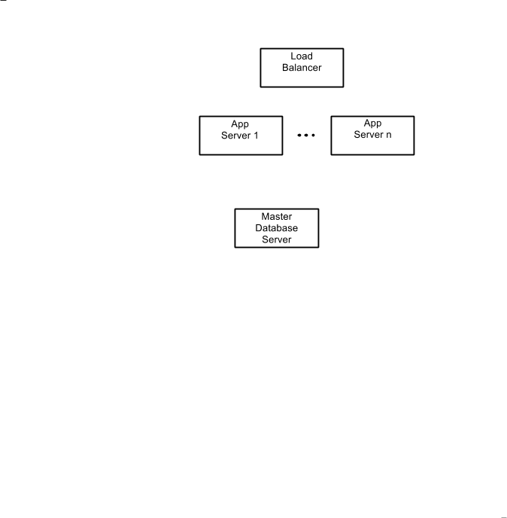
Notes:
We need a database...

Slide 13
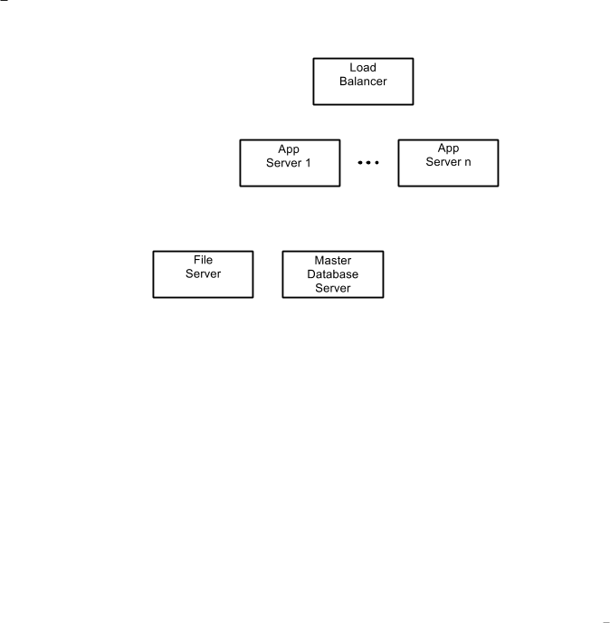
Notes:
...and a file server...

Slide 14
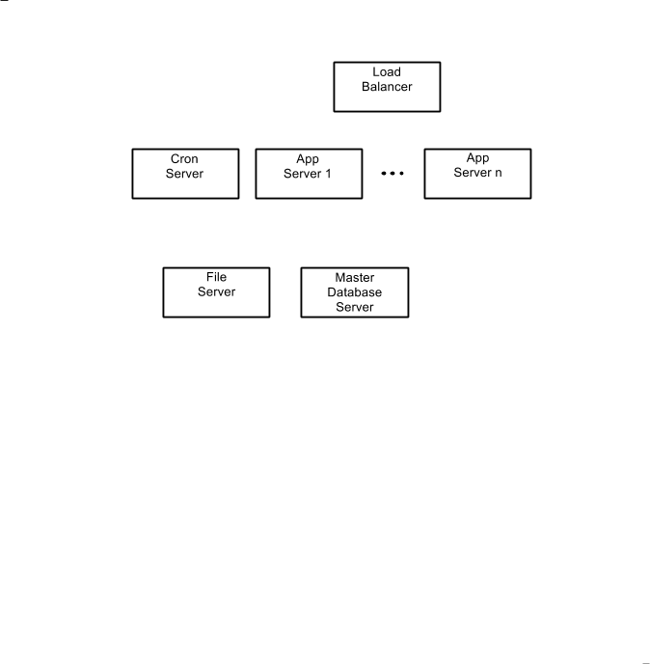
Notes:
...and the moodle cron service runs on it’s own server (those of you who know moodle are nodding, grimly)...

Slide 15
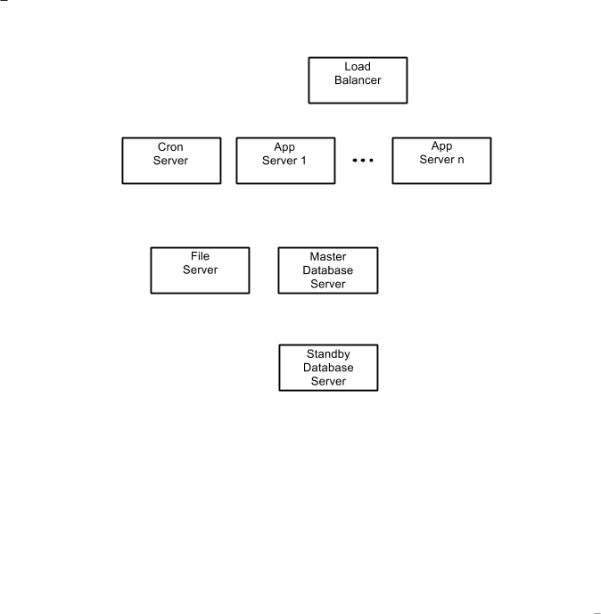
Notes:
...we should have a local standby database...

Slide 16
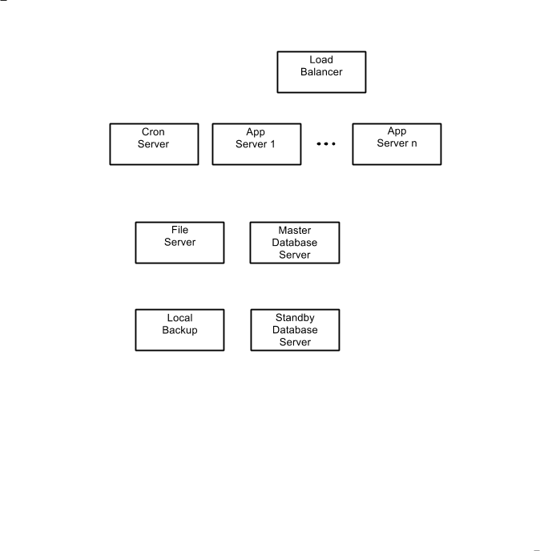
Notes:
...and something to backup the file server.

Slide 17
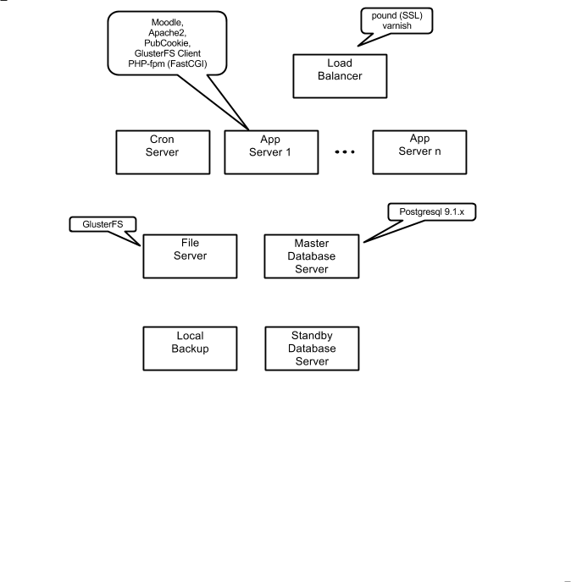
Notes:
We install and configure all the software automatically.

Slide 18
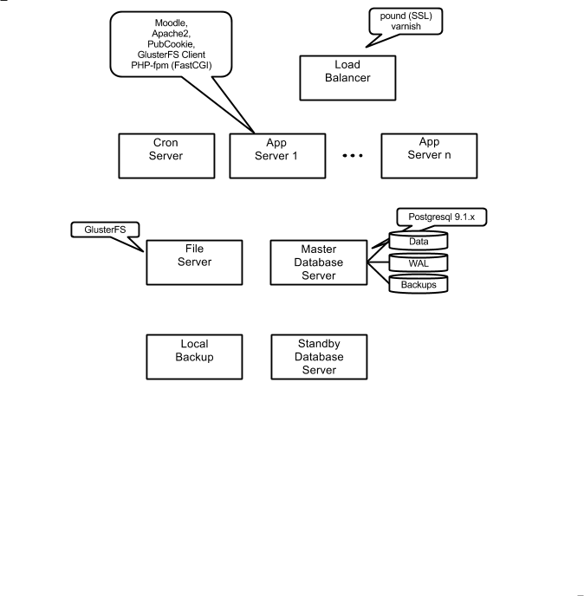
Notes:
virtual disks are created and attached...

Slide 19
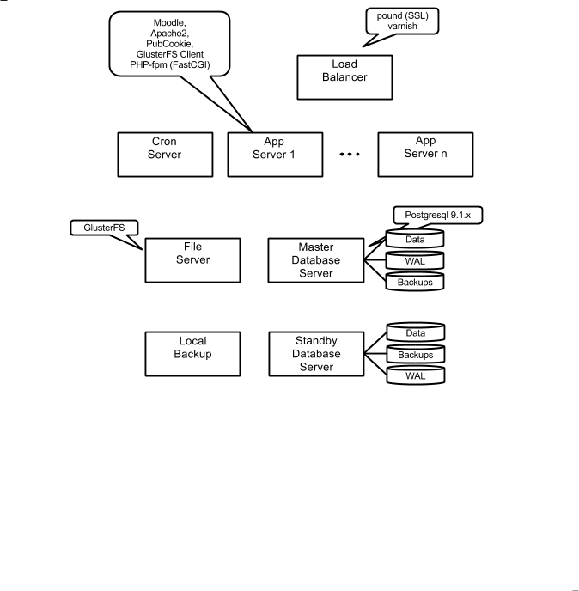

Slide 20
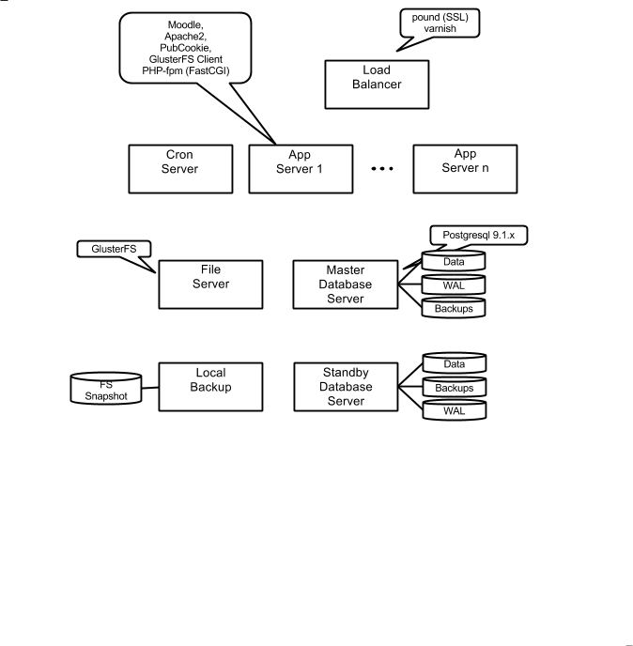

Slide 21
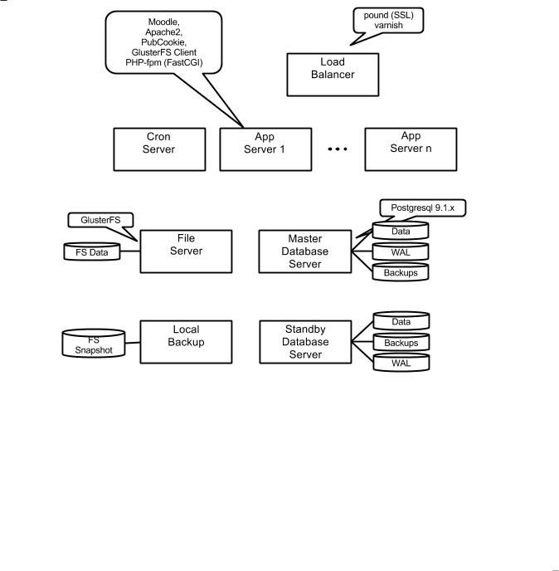

Slide 22

Notes:
And finally, all of the servers are wired together. The automation system contains metadata describing the cluster, and we take advantage of that.

Slide 23


Slide 24


Slide 25
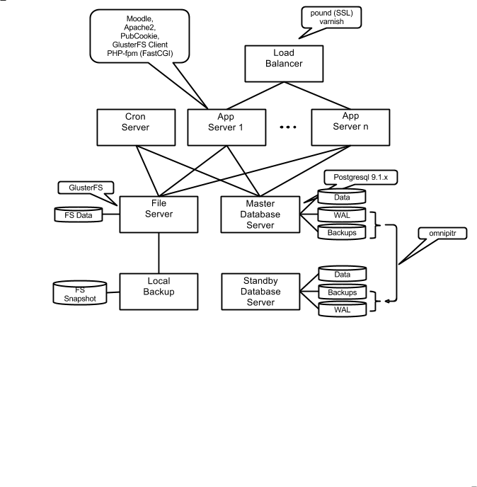

Slide 26
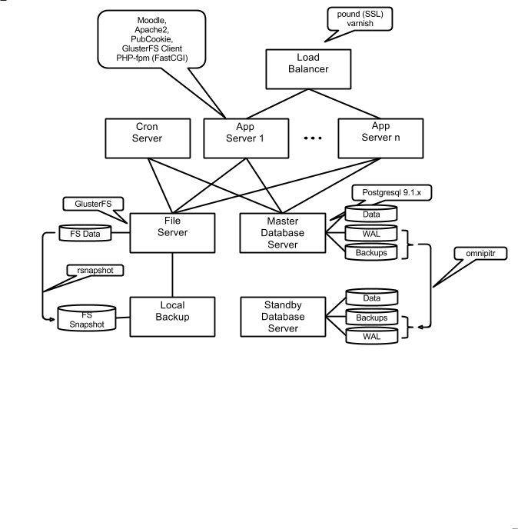

Slide 27
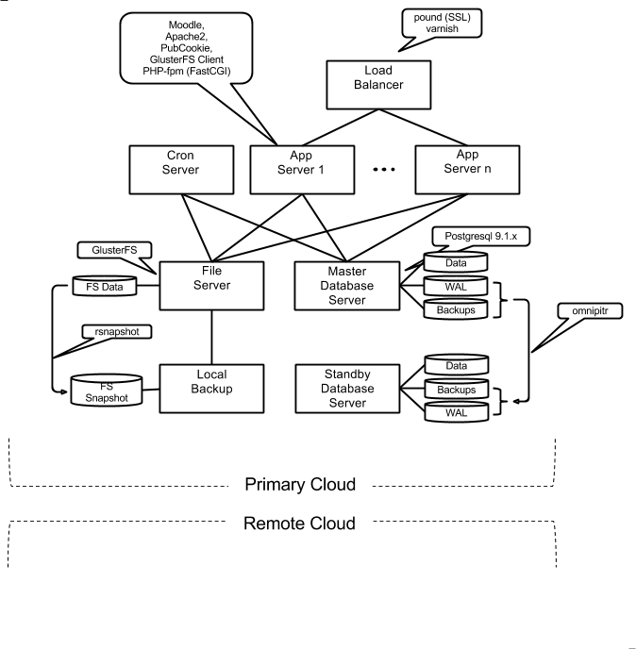
Notes:
We have a separate, redundant cloud that we use for disaster recovery.

Slide 28
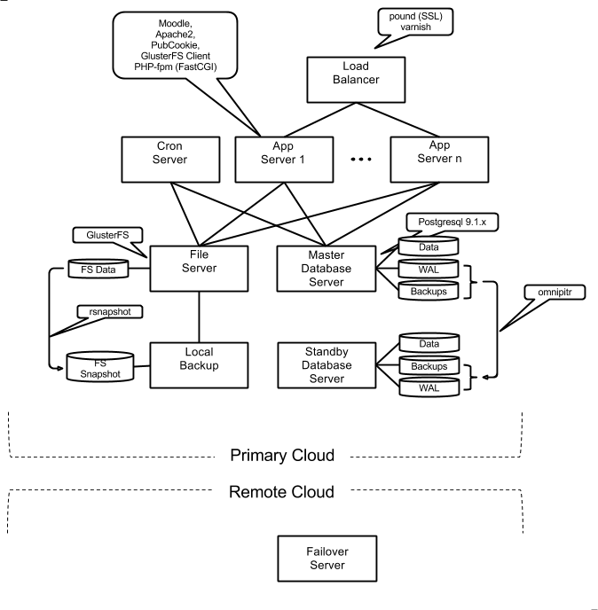
Notes:
so, we automatically build a server there to host a set of backup data volumes

Slide 29
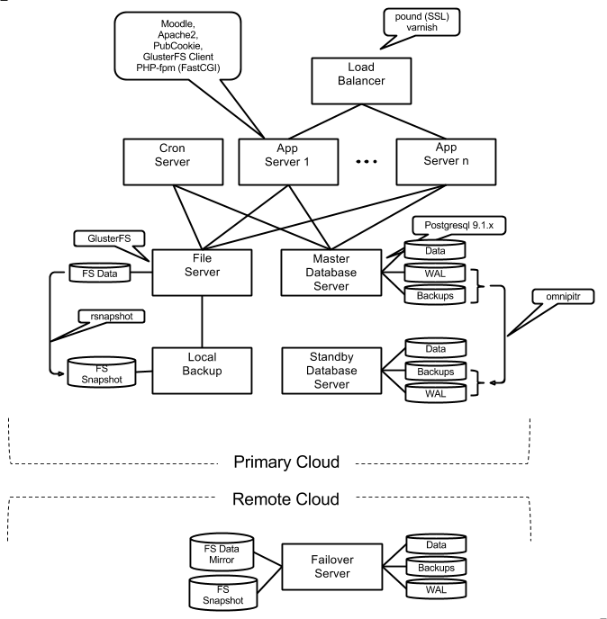

Slide 30

Notes:
the same reliable tools that are used in the main cluster are also used to build the failover data

Slide 31
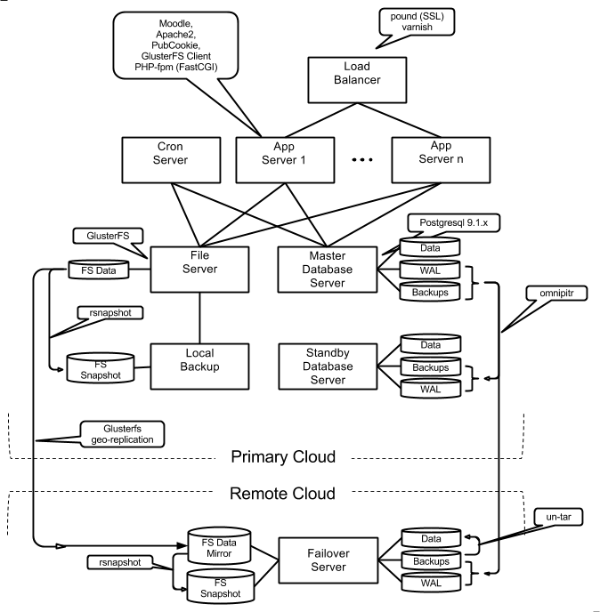
Notes:
And there it is: a fully configured production-scale cluster, and I haven’t even finished my coffee!

Slide 32
Where Are We Now?
In production since November - nobody noticed!
99.97% uptime
Better performance than bare-metal system
3 institutions, 2 more later this summer
170 servers in 14 environments
2 devops support, 2 devops extending they system
Open source. Fork us!
Notes:
We went live in November. It went so smoothly nobody even noticed.
The point about the support is worth commenting on: because we're interested in the tools and technology, it was important for us to be able to continue to develop the system even after we went live. We have things set up so that 2 of us handle the day-to-day support issues that come up, leaving the other 2 free to concentrate on extending the system. We all take turns with this, and that way we all remain competent with all aspects of the system. We don't want specialists.

Slide 33
What Did We Learn?
How to migrate to cloud
How to automate legacy systems
How systems evolve in the cloud
Challenges traditional procedures and cultures
It’s hard work
But it works!
Notes:
And what did we learn in this project? Most importantly, we learned how to take an important leagacy system, automate it, migrate it to a cloud, and operate it. This is a *big* step forward, and --in drastic cases-- can rescue a system from a dead-end path and give it new life.Now, we're learning now how to evolve the system in order to take better advantage of it's new environment --I'll say a bit more about that later.And finally, we learned that this stuff actually works. There was a lot of skepticism at the start of the project --not just about the technology, but about the techniques as well. Even we thought there would be some parts that wouldn't work. But we were wrong. It works great.

Slide 34
Tension
Traditional audit and compliance systems assume unchanging systems
Difficult to reconcile with dynamic systems
Tension is healthy and keeps things in balance
Compromise and trust is necessary
Trust is earned
Notes:
We also learned that many of the practices that come with infrastructure automation do not fit well with established procedures and cultures. This surprised us a little bit, we had already drunk the kool-aid, and had forgotten how reckless some of this stuff sounds.
You should have seen the look on the project managers face when I told her the infrastructure would be constantly changing throughtout the acceptance tests! Or that we wanted to thow away a server and replace it with a new one! "oh, it'll be identical, I promise!" These are alarming suggestions to most people with any sense, and we had to find ways to demonstrate that a system can be dynamic and stable at the same time.These are not a small problems! These were the biggest challenge we faced in the entire project, and they're the only ones that nearly sunk us. It took a lot of trust, and a lot of mutual respect to find a balance to things. And trust has to be earned.
I just want to step out of the presentation for a moment, and say something about the team we worked with here at the university. They were impossibly demanding and held us to ridiculously high standards. And they were right to do so! They had an uptime and a service record that anyone would be jealous of, and they got it by being really good, and really careful. It would have been negligent of them to lower their standards one jot just because we came along.

Slide 35
You Are Not The Expert
You can’t automate what you don’t understand
Knowledge of legacy systems distributed across different silos
no single group fully understands system
Need to bring in experts from many areas
Notes:
You can't automate what you don't understand!
The application team knows how to connect to an authentication system, but doesn’t know how to build the SSL certificates. The network team knows how to build SSL certificates, but not how to deploy them. No-one knows how to build the authentication client.
We had to do a lot of running around hunting people down, we had to do a lot of reading, a lot of discovery.
This comes back around to yet another benefit of infrastructure automation: the ENTIRE configuration is in one place. There are no missing pieces, nothing gets lost or forgotten.

Slide 36
Aggressively Automate
Generate customised management scripts
Generate tools for common operations
Create consistency on top of diversity
Reduce cognitive load
Notes:
The best of both worlds: the efficiency of code reuse with the reliability of custom tailored scripts

Slide 37
Automation Style
Use just-in-time complexity
Think about discoverability
Use prescriptive error messages
Take a more mature attitude toward errors
MTTR over MTBF
Notes:
We didn't think of this at the start, but we gradually recognised that some 'styles' of automation worked better in the field than others.
We sometimes found that we had built an automation tool that worked great, and hid a lot of the complexity, but got in the way if we needed to do something that the tool didn't handle. We discovered it was better to build tools in such a way that you could easily open them up and work with in a 'manual override' sort of fashion. For example, I might want to execute only part of the tool, do a few manual things, then execute some other parts. Most of the time, I want the tool to protect me from complexity, but sometimes I need to see all the details. We call it 'just in time complexity'
We've also adopted a style of prescriptive error messages. "Don't just tell me that you can't connect to your foobar service, tell me what to do about it! Tell me where your configuration file is, tell me what parameter doesn't seem right, how to re-start your service, how to restart the foobar service!"
Don’t bother trying to prevent every possible error, you can’t even think of them all. Instead, try building systems that tollerate errors and let you fix problems quickly. Value mean time to recovery more than mean time between failures.

Slide 38
Finding a Balance
Security updates
Package updates
Latest packages and bug-fixes vs. stability
Frequent releases with small change sets safer

Slide 39
The Future

Slide 40
Notes:
I've shown you what our automation system can build, and we are justifiably proud of it, but...

Slide 41
This is your
Grandfather’s Architecture
Notes:
...it's yesterday's system. The problem is that it's just a port of an architecture designed to run on bare metal. It doesn't really take any advantage of features made possible by the cloud. So let's see where we want to go next

Slide 42
We Want Cloud Architecture
No single point of failure
Service redundancy instead of fail-over
Elastic compute, elastic storage
Distribution and replication are properties of infrastructure
Notes:
We want a cloud architecture. We want an architecture that expects failure, but doesn't allow the failure to disturb the service. We want an architecture that assumes storage resources are elastic and can grow or shrink according to the needs of the moment.
And we don't want to have to build our own data backup systems, features like data replication and distribution should simply be properties of the cloud.

Slide 43
Database
We need High-Availability
Database-as-a-Service?

Slide 44
Monitoring
Until recently, stodgy and unchanging
Now evolving very quickly
Explosion of new tools and capabilities
Explosion of new expectations
Notes:
Monitoring deserves it's own hour-long presentation, but I can't pass it by without saying that monitoring is changing as rapidly as all the other technologies. It used to be okay to graph some network statistics, or generate an uptime report, but no more. Monitoring has become a front-line service, and is expected to reflect the total health of the total system. There's no aspect of a system that cannot be monitored, and there is a growing expectation that it *will* be monitored. In additon to getting richer, monitoring is also getting smarter. Instead of waiting until something actually goes wrong to raise the alarm, monitoring is becoming predictive, it should take note of deteriorating conditions, and let you know how long you have to react to the problem. This is a long road, we've only gotten started.

Slide 45
Our Monitoring Currently Tells Us:
Is the server up?
Is the service up?
Alert! Something’s not right!
Despite automation, some manual work still necessary
Separate monitoring stacks for network and server/application

Slide 46
But We Need to go Deeper
Fully automated deployment and configuration
More granular metrics
Disk I/O
Trends
Predictive
Notes:
Not just Postgres up, but how many TPS
slow growth in volume size is different from a sudden spike, and warrants a different response

Slide 47
Find a Way to Combine
Network, server, and application monitoring
Same with graphing
Benefit is an accurate, current, whole body health diagnosis

Slide 48
Object Storage
Object storage systems handle replication
Better suited for archives and backups

Slide 49
Modern File System
Copy-on-write
Self-healing
Synthetic devices built out of resource pools
Snapshots and time machine
Caching
Deduplication
Transparent to the operating system

Slide 50
~ Fin ~
cybera.ca

Slide 51
~ Commencement ~
cybera.ca

Slide 52
Questions

Slide 53
Additional Material
cybera.ca
github.com/cybera
opscode.com/chef/
openstack.org/

