Slide 1
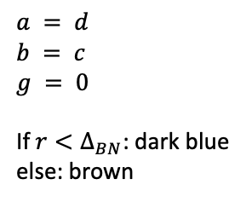
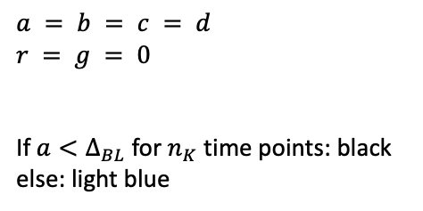
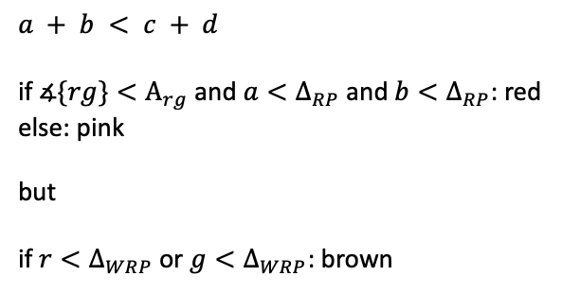
r
r
a
a
b
a
d
b
c
g
$$a = b = c = d$$
$$r = g = 0$$
If $a<Δ_{BL}$ for $n_{K}$ time points: black else: light blue
$$a = d$$
$$b = c$$
$$g = 0$$
If $r<Δ_{BN}$: dark blue else: brown
$$a + b < c + d$$
if $∡\{rg\}<Α_{rg}$ and $a<Δ_{RP}$and $b<Δ_{RP}$: red
else: pink
but
if $r<Δ_{WRP}$or $g<Δ_{WRP}$: brown

