Slide 1
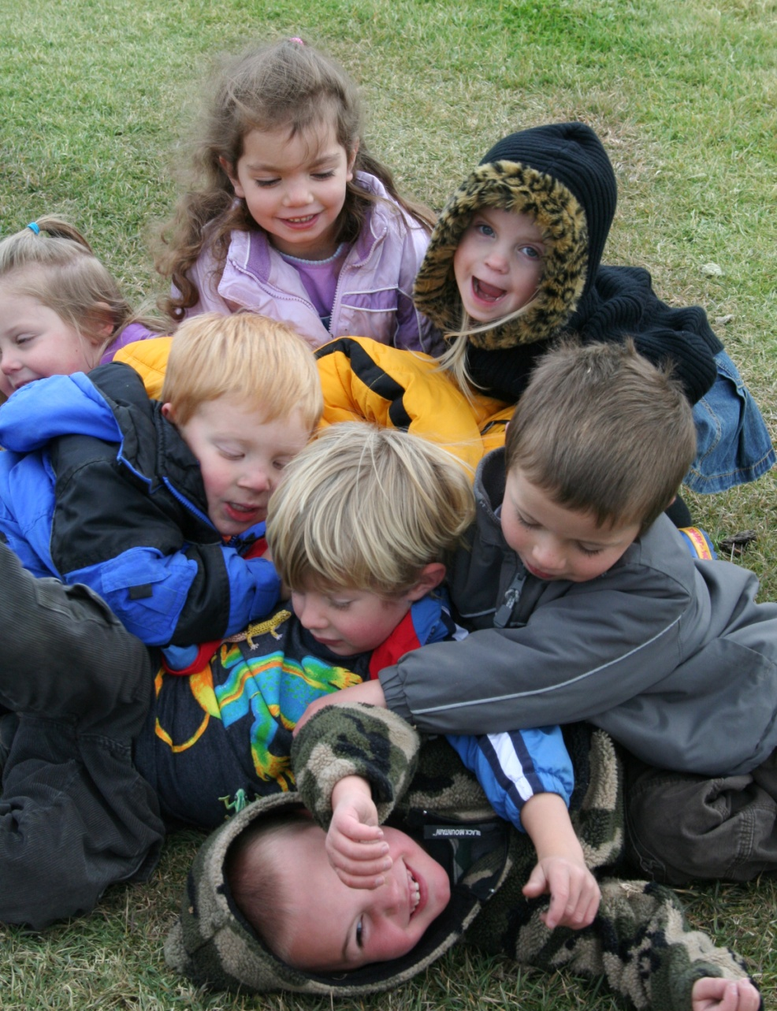
Early Childhood Colorado
In Grand County
Granby Rotary
October 14, 2009
<date/time>10/14/09
Notes:
<date/time>10/14/09
<header>Grand Beginning' Presentation to Granby Rotary

Slide 2
Early Care and Education in GC
* based on NACCRAWARE Report of CC as of September 2009
Area | ECE Centers | ECE Professionals | Children Served
WP/ Fraser | 6 | 32 | 170
Granby/ GL/HSS | 8 | 17 | 125
Kremmling | 5 | 9 | 50
345 children out of 821 children from kids count
<date/time>10/14/09
Notes:
<date/time>10/14/09
<header>Grand Beginning' Presentation to Granby Rotary

Slide 3
Grand Beginnings’ Funding
* as budgeted for 09/10 fiscal year
<date/time>10/14/09
Notes:
HOW
Cde, lions club, town of wp, town of gl, town of fraser, bocc, qualistar, grand foundation
Rate of return on investement
<date/time>10/14/09
<header>Grand Beginning' Presentation to Granby Rotary

Slide 4
Grand Beginning’s Contributions to Quality
Early Care and Education Fall 2009
Facilitated 1 Colorado Mountain College ECE courses in Grand County with over 12 participants
Awarded in full or subsidized in part 17 college classes for teachers working directly with young children totaling over $3000
Funded 3 classrooms to participate in the Qualistar Rating System
Hosted Community Forum with over 20 participants
Provided 2 continuing education trainings to ec professionals with a combined total of over 30 participants
Awarded over $5,000 in childcare tuition assistance to families in hardship
<date/time>10/14/09
Notes:
<date/time>10/14/09
<header>Grand Beginning' Presentation to Granby Rotary

Slide 5
Promotion and Prevention
Nurturing and Responsive Relationships
Intentional Interactions/Teaching
Effective Workforce
High Quality Supportive Environments
Intervention
<date/time>10/14/09
Notes:
<header>Grand Beginning' Presentation to Granby Rotary
<date/time>10/14/09

Slide 6
Early Childhood Grand County
Early Learning
Children
Family Support and Parent
Education
Health
Child and Family
Social Emotional and Mental Health
School and Community
<date/time>10/14/09
Notes:
<date/time>10/14/09
<header>Grand Beginning' Presentation to Granby Rotary

Slide 7
“ What the best and wisest parent wants for his own child, that must the community want for all of its children.”
-John Dewey
<date/time>10/14/09
Notes:
<date/time>10/14/09
<header>Grand Beginning' Presentation to Granby Rotary

