Slide 1
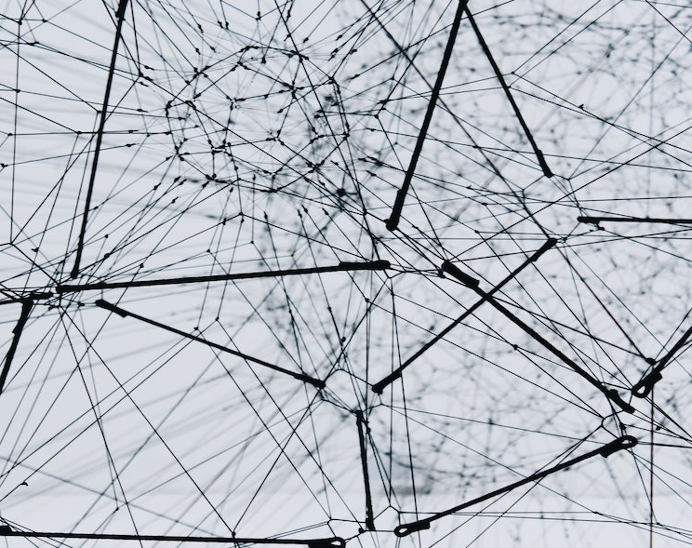
Data loading methods
Cross-chain diagram
Transaction Network
Vertex attribute name + vertex attribute value
Author: Bartosz Bryg

Slide 2
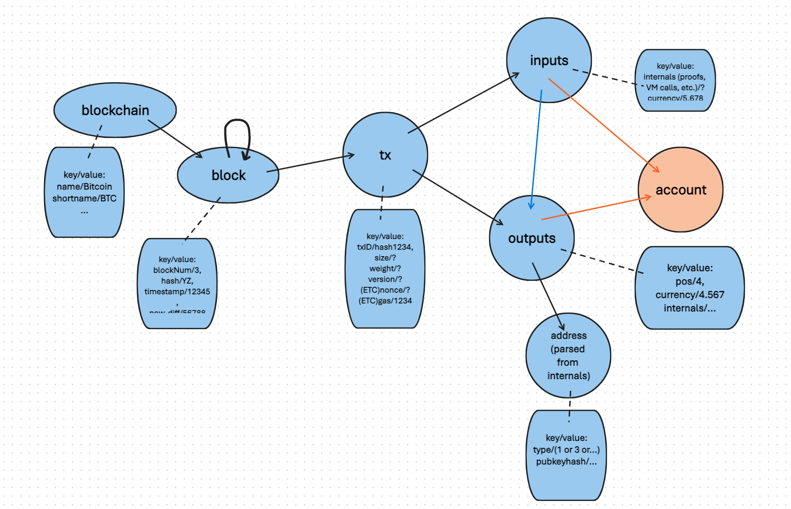
Cross-chain Diagram
Each vertex has all the attributes/columns that are included in the whole diagram
Every vertex of a specific node attribute name present values from columns included in file assigned to this vertex
Each edge includes ‘type’ column that specifies the types of the source and destination vertices
Attributes which do not belong to the current vertex are empty
Cross-chain Diagram

Slide 3
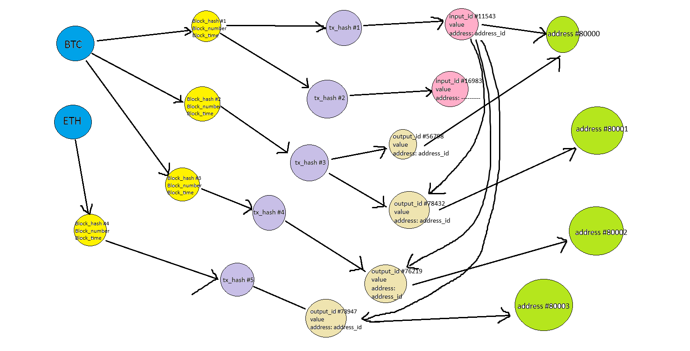
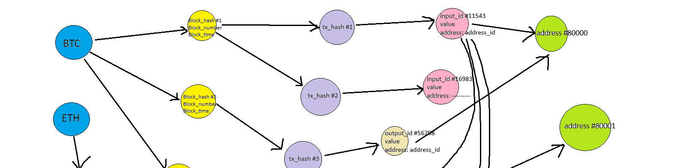
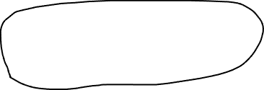
Cross-chain Diagram
Pros:
Contain all the information of the dataset
By applying specific conditions, it can quickly filter the vertices or edges that meet the criteria
Cons:
Due to many empty values, it occupies a lot of space
Vertices have different types, making it difficult to analyze the graph using graph algorithms
Part of the cross-chain graph for our dataset

Slide 4
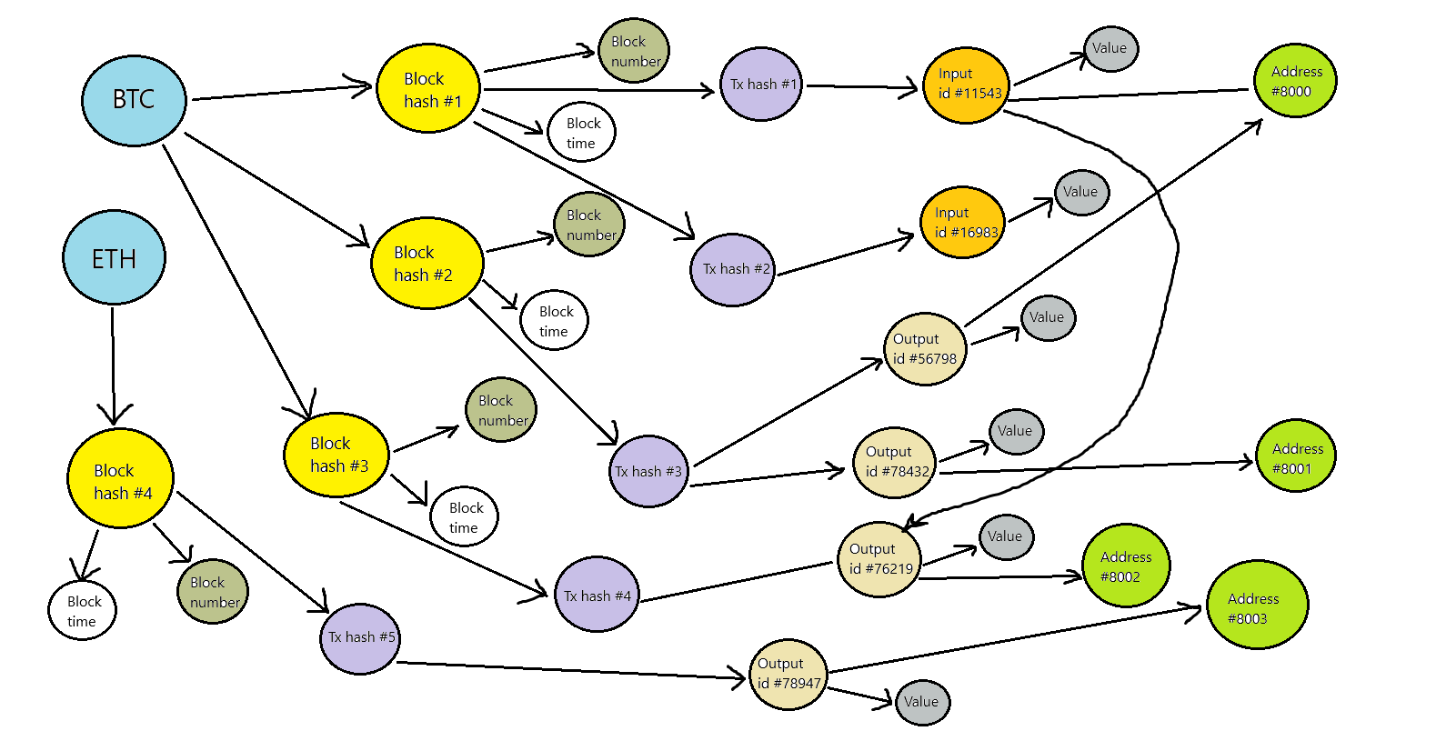
Node attribute name + node attribute value
No edge attributes
Only two vertex attributes: attribute name + attribute value
The largest number of vertices
While performing analysis, the attribute name must be considered (for example, after running PageRank, we need to sort vertices according to their name to draw useful conclusions)
Part of the “node attribute name + node attribute value” graph for our cross-chain dataset

Slide 5
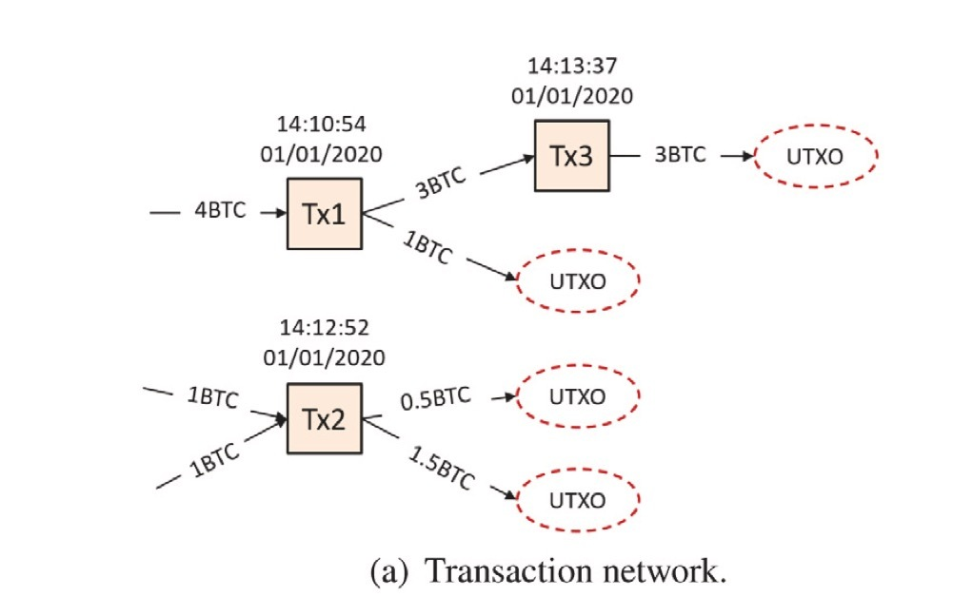
Transaction Network
Commonly used in the Bitcoin transaction UTXO model. Each vertex represent a transaction
Loads the whole dataset without duplicates and empty values
Most efficient graph data loading

Slide 6
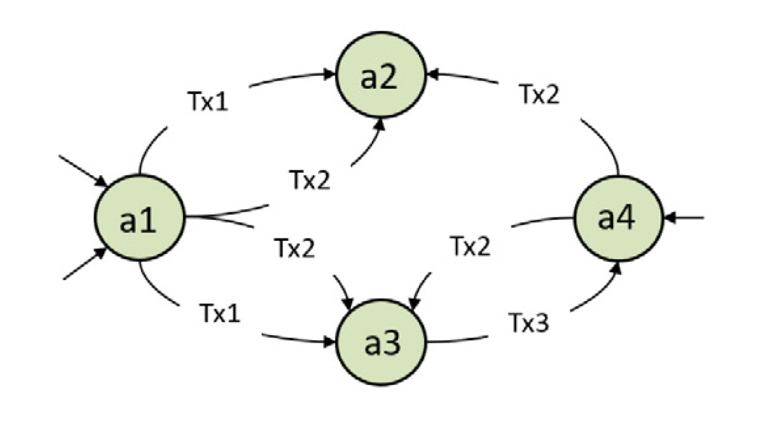
Account Network
Each vertex represents an account, and edge exists if there are transactions between two accounts
Commonly used in the graph construction of Etherum transactions.
Most adapted to perform data analytics by graph algorithms

Slide 7
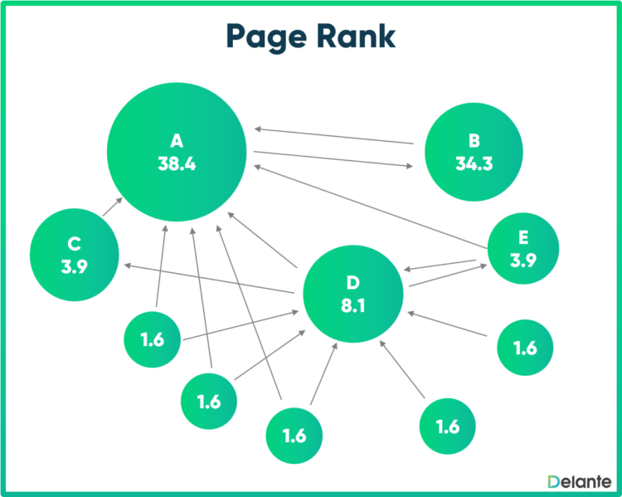
Graph algorithms testing
Graph algorithms which revealed potential fraud in our cross-chain dataset:
PageRank
BFS
PageRank representation
(source: https://delante.co/definitions/pagerank/)

Slide 8

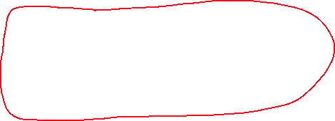

Source code
Output
Suspicious vertex – transaction
[…]

Slide 9
Summary of algorithms testing
One transaction vertex stands out with a significantly higher PageRank value compared to the others—the top-ranked node has a PageRank that is more than twice as high as the second-ranked node (0.00028... vs. 0.000117...)
This transaction is a first-degree transaction (no input addresses) – 85 inputs and 564 outputs
BFS analysis reveals that there is only one child transaction is derived from this transaction (other outputs are UTXOs)
Modified PageRank needed to consider transaction values
We implemented the Arachne version of PageRank for future use

Slide 10
Louvain Algorithm Implementation in Arachne
Each iteration, the move phase is processed on the server backend, returning the label for each vertex
Send the label back to the front end, then the graph coarsening phase is completed using Arkouda’s existing Groupby and broadcast methods.
Process continues on the new graph until the graph no longer changes
Performance results on modest laptop
Name | Vertices | Edges | Time(sec)
karate | 34 | 78 | 0.3566
Com-amazon | 334,863 | 925,872 | 3.363
com-Youtube | 1,134,890 | 2,987,624 | 9.6177
com-LiveJournal | 3,997,962 | 34,681,189 | 130.91
Future Work: Oliver is migrating some of the Arkouda methods we frequently use to Arachne, so we can call the corresponding methods directly without transferring data to the front end. This will save a lot of time

Slide 11
PageRank performance Result in Arachne
Name | Vertices | Edges | Time(sec)
wiki-Vote | 7115 | 103689 | 2.153
Amazon-0302 | 262,111 | 1,234,877 | 1.0956
Amazon-0312 | 400,727 | 3,200,440 | 1.897

