Slide 1

Battle of Cards
Bartosz Maleta,
Szymon Niemiec,
Przemysław Buszek

Slide 2







Technologies and tools

Slide 3
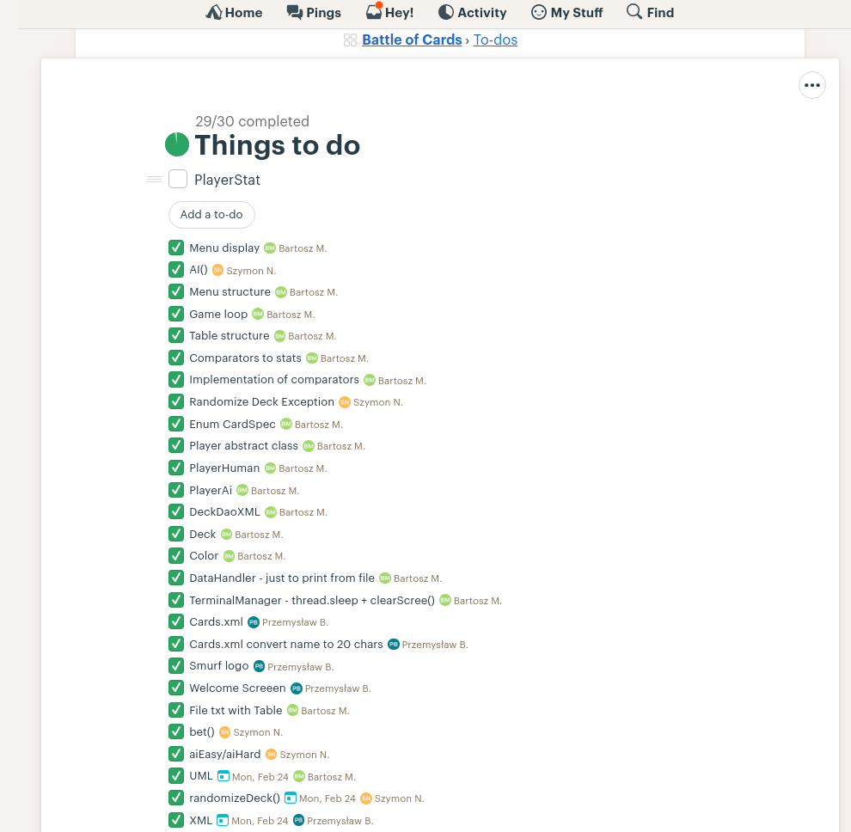
TODO list on
Basecamp

Slide 4
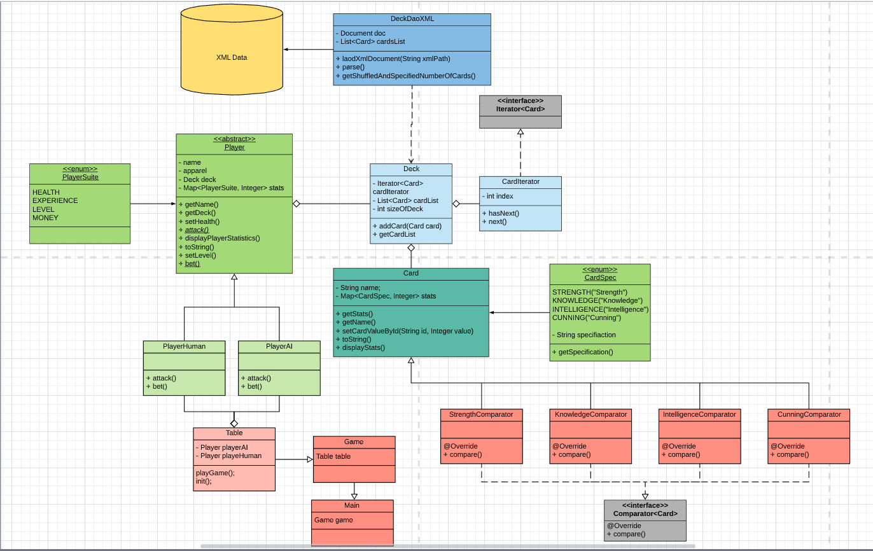
UML

Slide 5
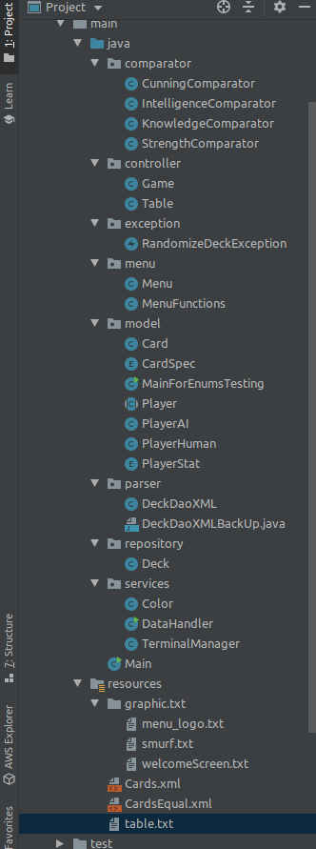
Project structure

Slide 6
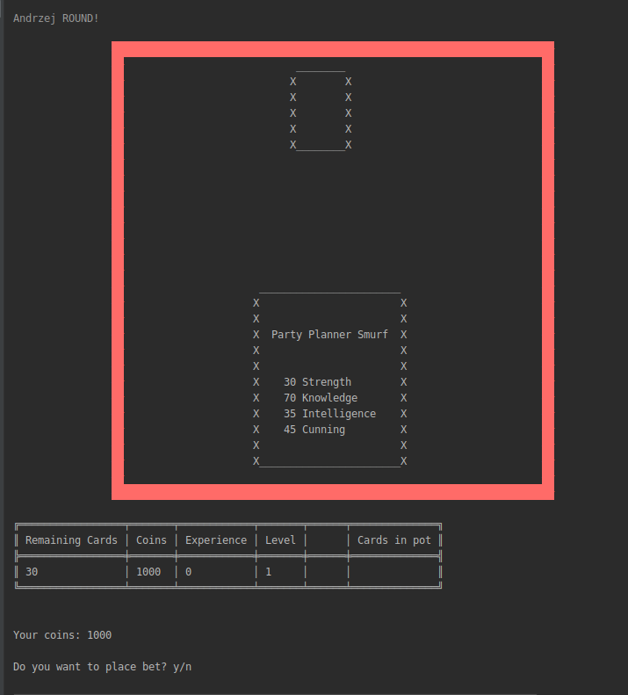
Gameplay

Slide 7
Let’s play!

Slide 8
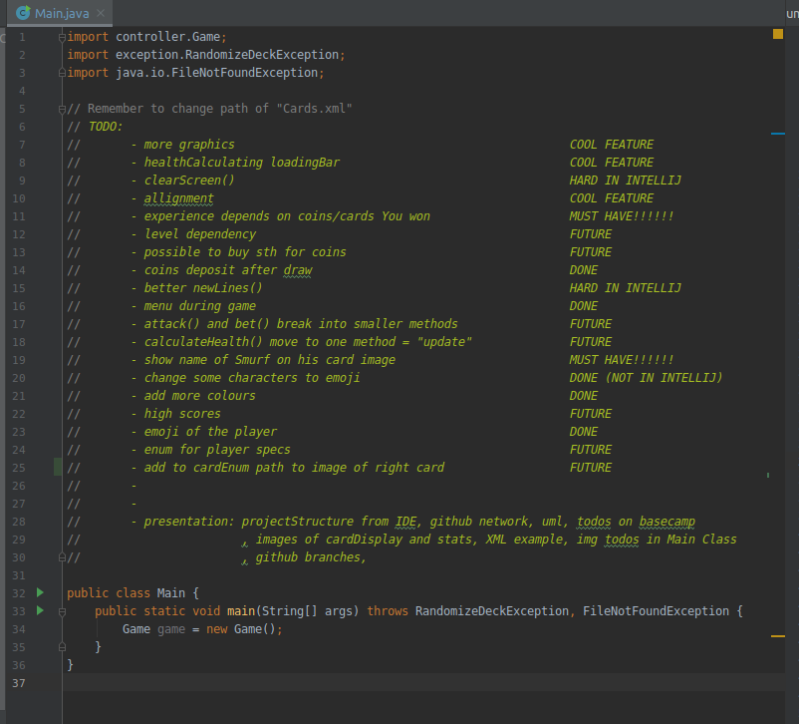
>>>>> Big goal <<<<<
Enigma
Battleships
Roguelike
Battle of Cards

Slide 9


