Slide 1
Enterprise size database
Szymon Niemiec
Bartosz Maleta

Slide 2










Tools and technologies

Slide 3
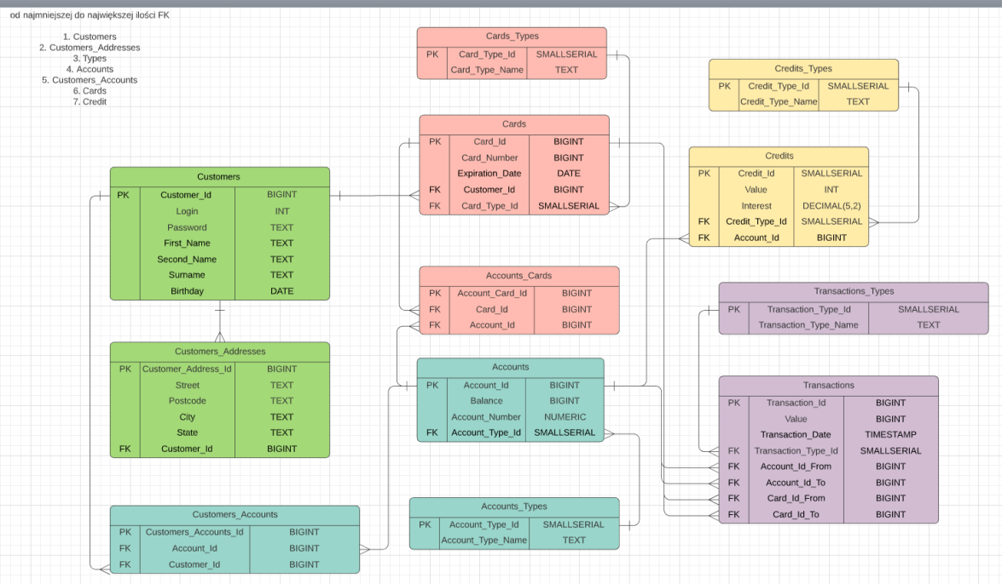
ERD

Slide 4
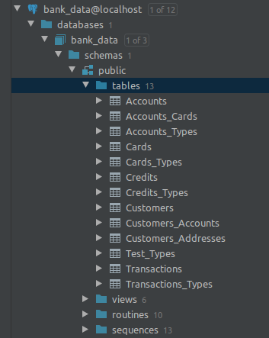
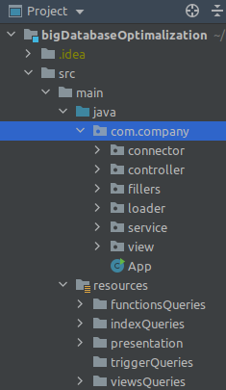
Db

Slide 5
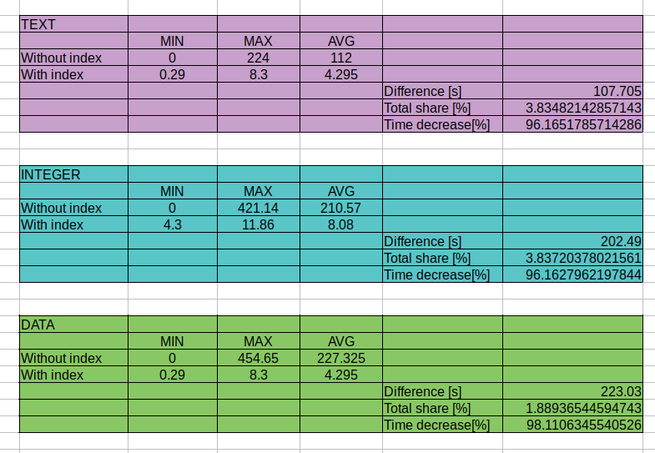
Index performance

