Slide 1
Testing Quest Store
Aleksandra Kasaraba
Bartosz Maleta

Slide 2










Tools and technologies

Slide 3
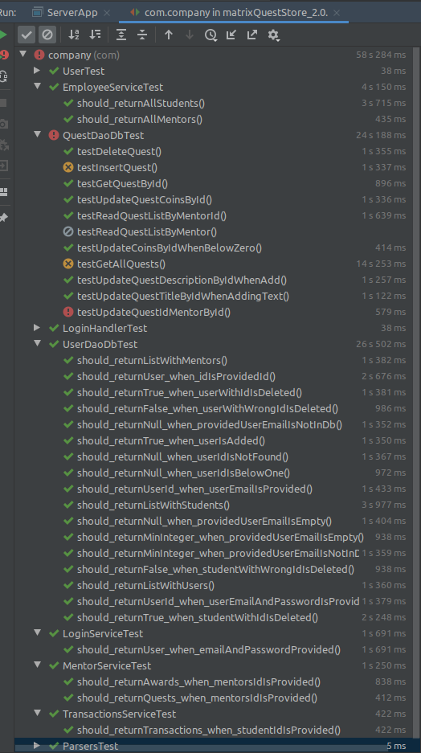
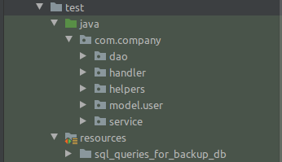

Tests in project

