Slide 1
Quest Store - Database
Aleksandra Kasaraba
Bartosz Maleta
Michał Zieliński

Slide 2
















Tools and technologies

Slide 3
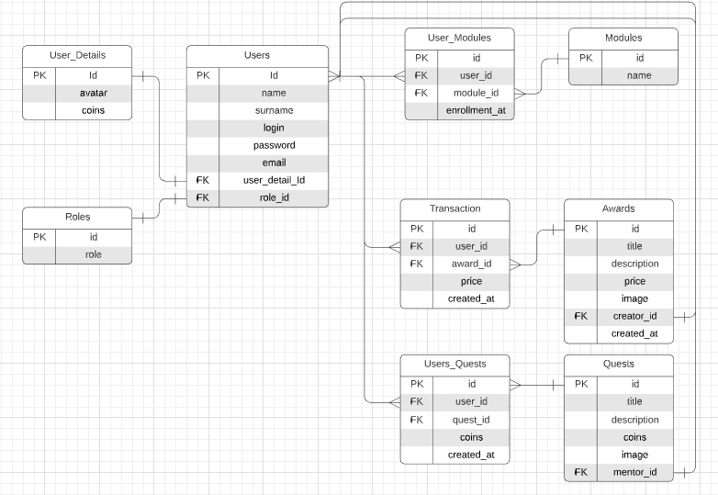
ERD

Slide 4
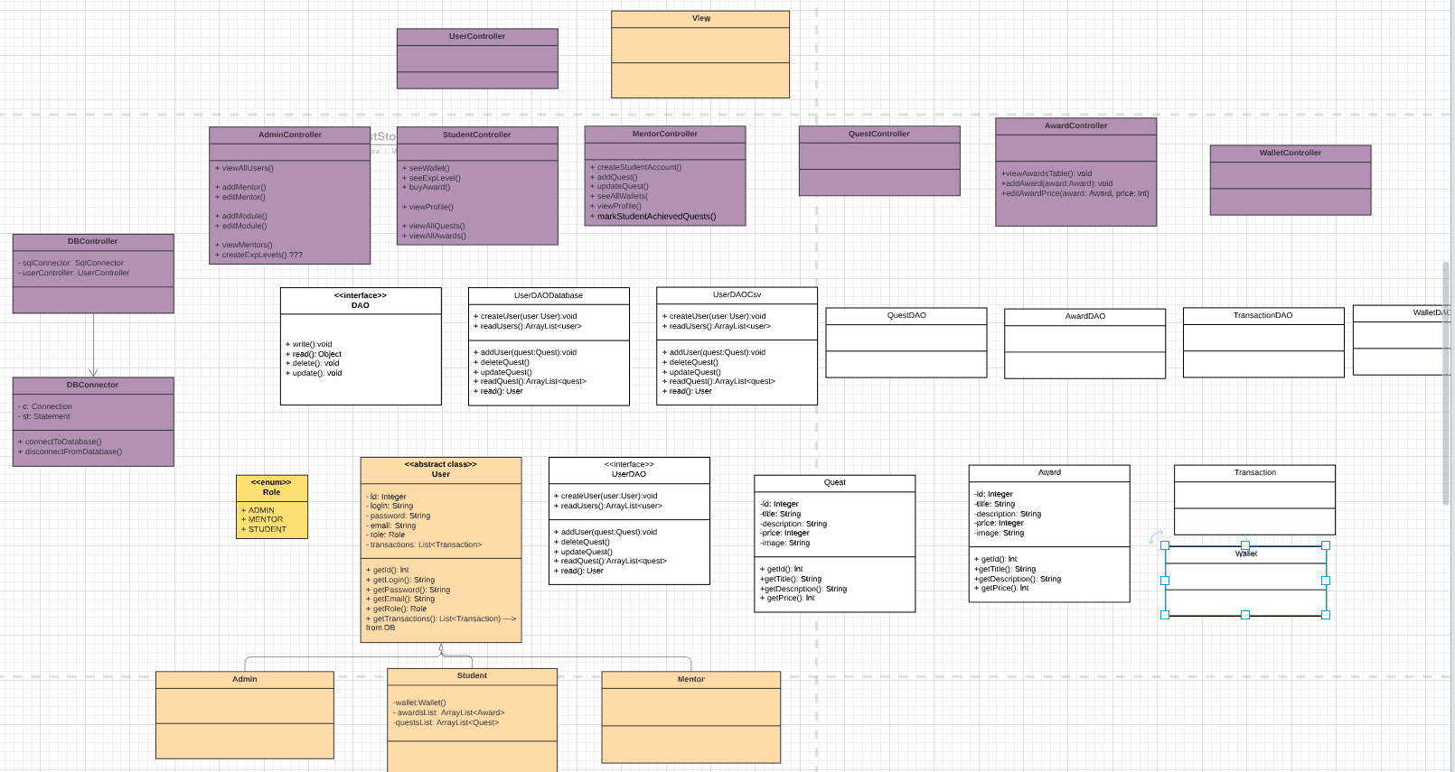
UML

Slide 5
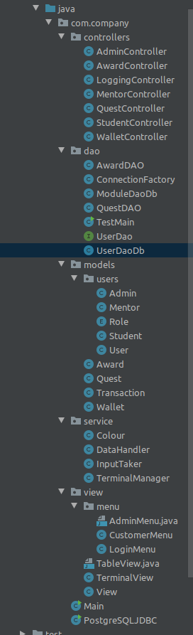
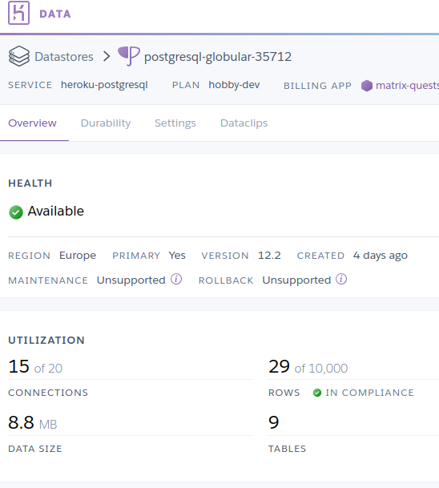
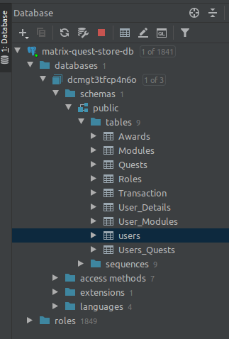
Project structure, db and server

