Slide 1
TicTacToe project
Natalia Rajska
Stanisław Chynek
Bartosz Maleta

Slide 2








We used:

Slide 3
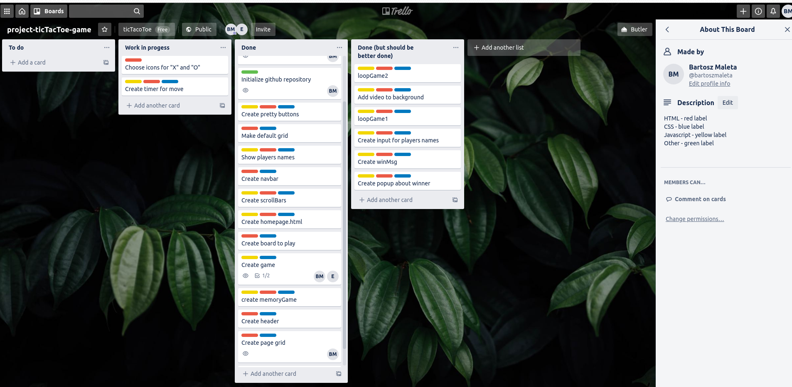
Planning

Slide 4
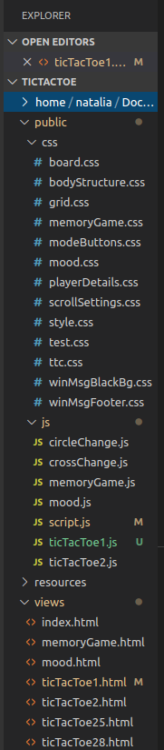
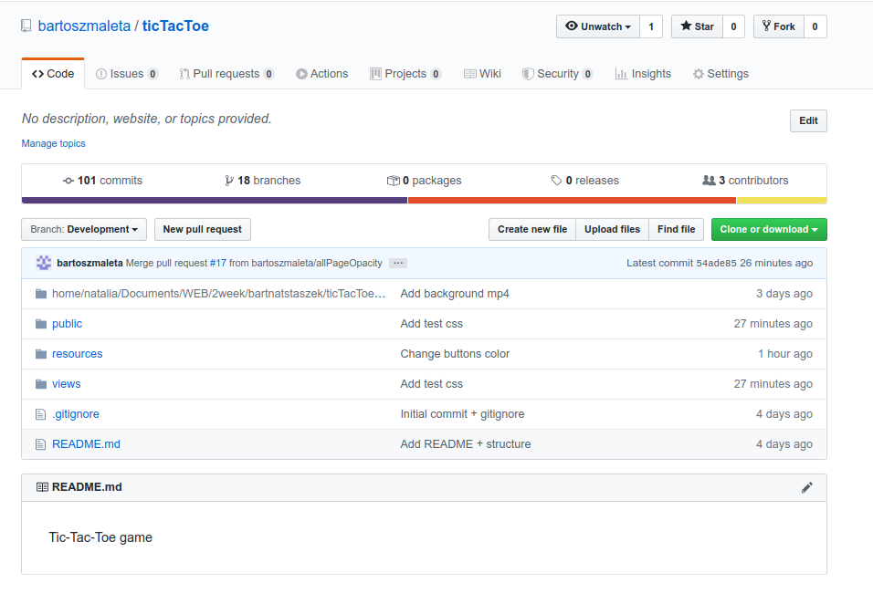
Execution

Slide 5
