Slide 1
Workshop about DATA STRUCTURES

Slide 2
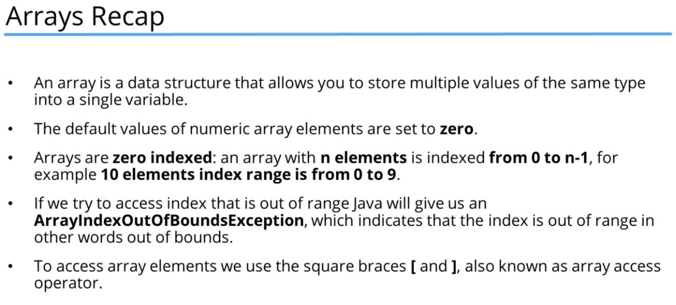

Slide 3
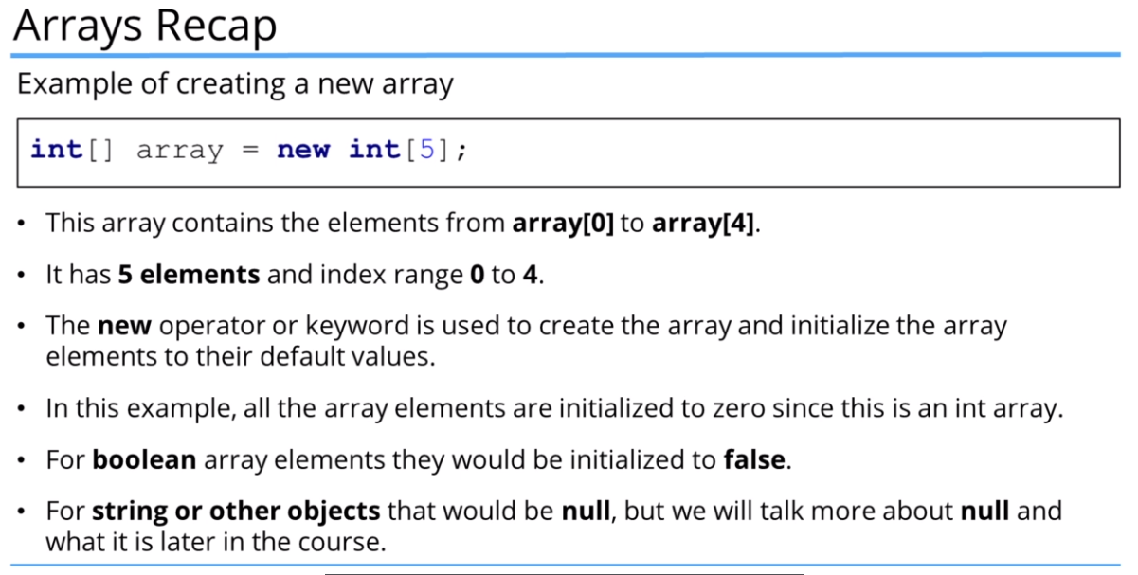

Slide 4
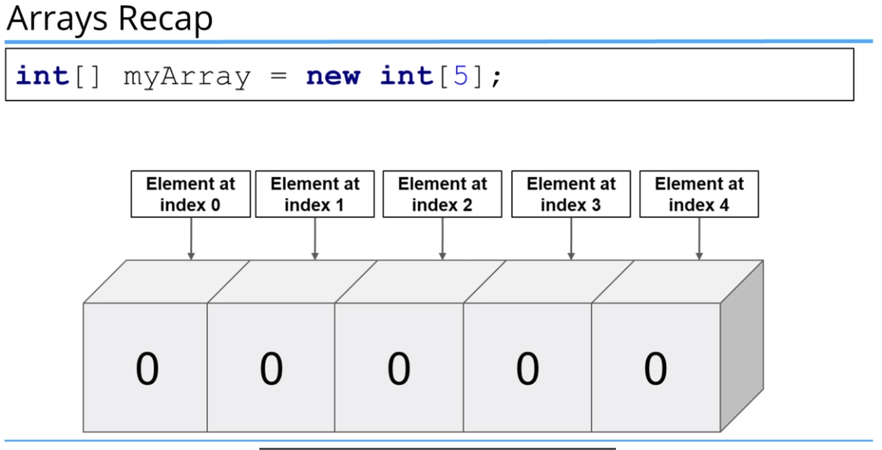

Slide 5
Links
Repository of workshop about ARRAY
https://github.com/bartoszmaleta/workshopAboutDataStructuresInJava/tree/master/src/arrayExample
More about:
https://www.w3schools.com/java/java_arrays.asp

Slide 6
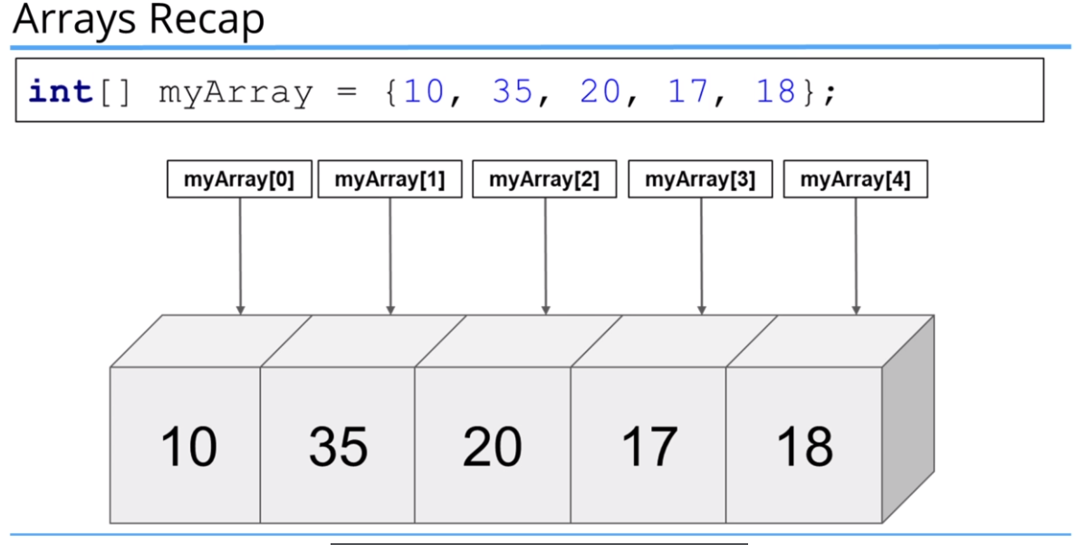

Slide 7
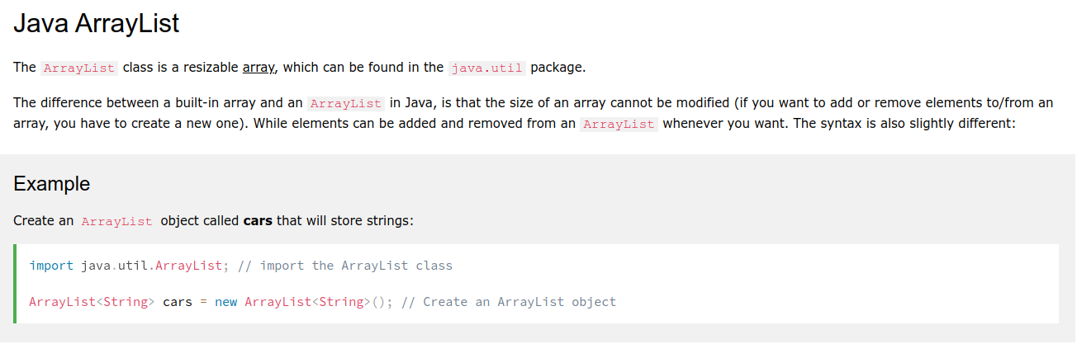
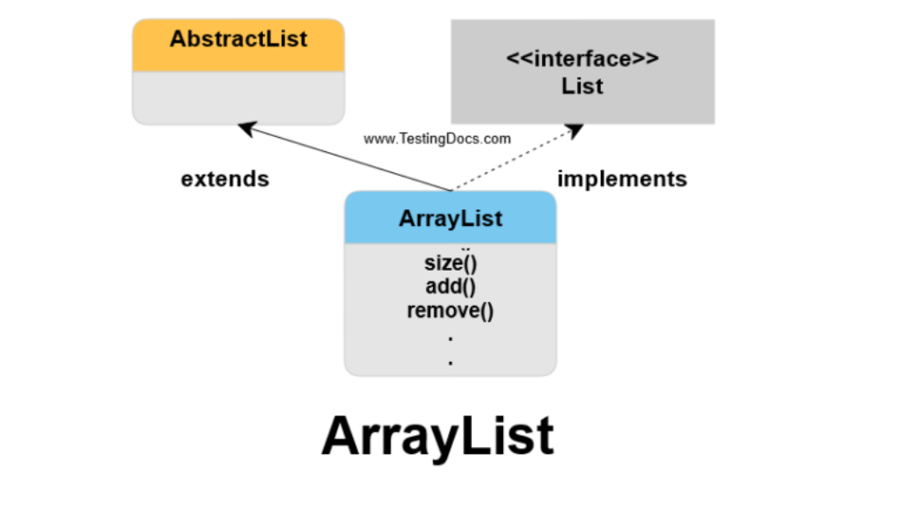
ArrayList

Slide 8
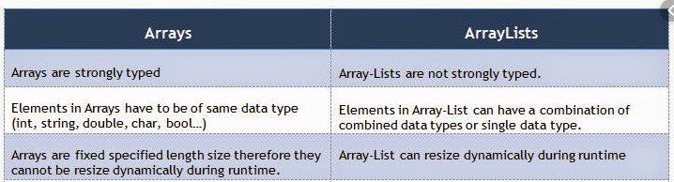
Array vs. ArrayList
Shortly:
1) Array is a fixed length data structure. We cannot change length of array once created.
ArrayList has variable length and can be changed by adding removing items.
2) Array can contain both primitives and objects.
ArrayList cannot store primitives, it can only store objects.
*Since Java 5, primitives are automatically converted in objects which is known as auto-boxing.
3) Array strongly typed
Array dynamically typed

Slide 9
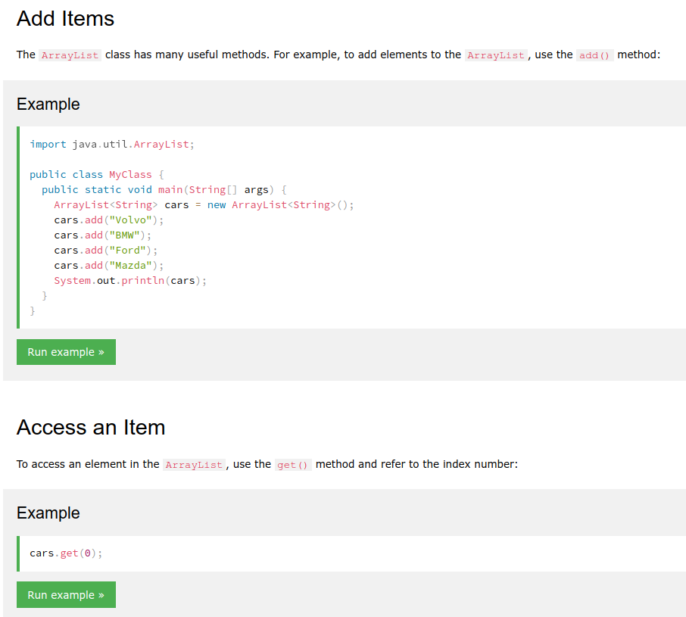
ArrayList

Slide 10
Link for ArrayList
Repository of workshop about ARRAYLIST
https://github.com/bartoszmaleta/workshopAboutDataStructuresInJava/tree/master/src/arrayListExample
More about:
https://www.w3schools.com/java/java_arraylist.asp

Slide 11
LinkedList
LinkedList is fast for adding and deleting elements, but slow to access a specific element.
ArrayList is fast for accessing a specific element but can be slow to add to either end, and especially slow to delete in the middle.

Slide 12
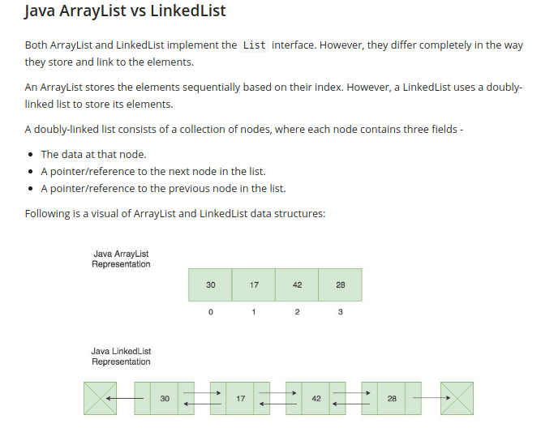
ArrayList vs. LinkedList

Slide 13
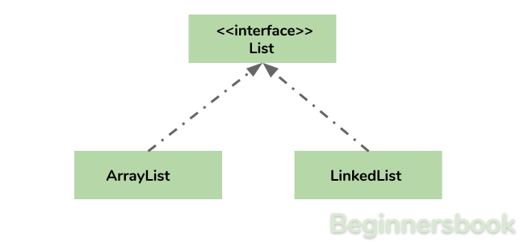
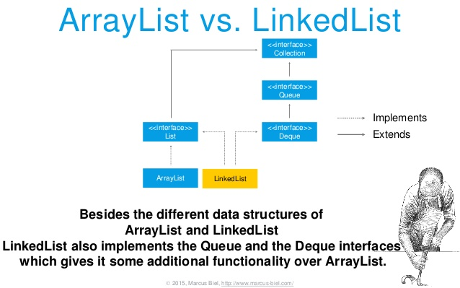
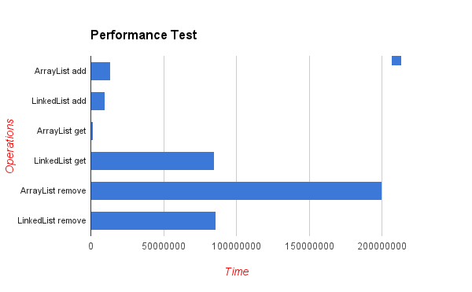
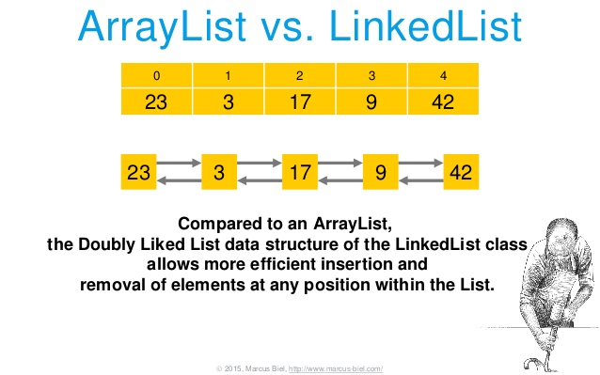
ArrayList vs. LinkedList

Slide 14
Links for LinkedList
Repository of workshop about LINKEDLIST:
https://github.com/bartoszmaleta/workshopAboutDataStructuresInJava/tree/master/src/linkedListExample
More about:
1) https://www.geeksforgeeks.org/linked-list-in-java/
2) https://www.callicoder.com/java-linkedlist/

