Slide 1
2D Graphics / SVG

Slide 2

Representation

Slide 3

Tools for Computer Graphics
Vector Analysis
Transformations

Slide 4
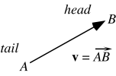
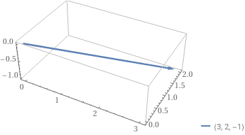
Vector Basics: Length of a Vector
Our Vector is (3,2,-1)
Length of a vector is
||v||=sqrt(x*x+y*y+z*z)
length(v)= sqrt(9+4+1)
length(v)=sqrt(14)=3.74166
Normalized Vector
(3/3.74166, 2/3.74166, -1/3.74166)

Slide 5
Line Segment
x=3t
y=2t
z=-t
P(x,y,z) any point on the line
for 0<=t<=1

Slide 6
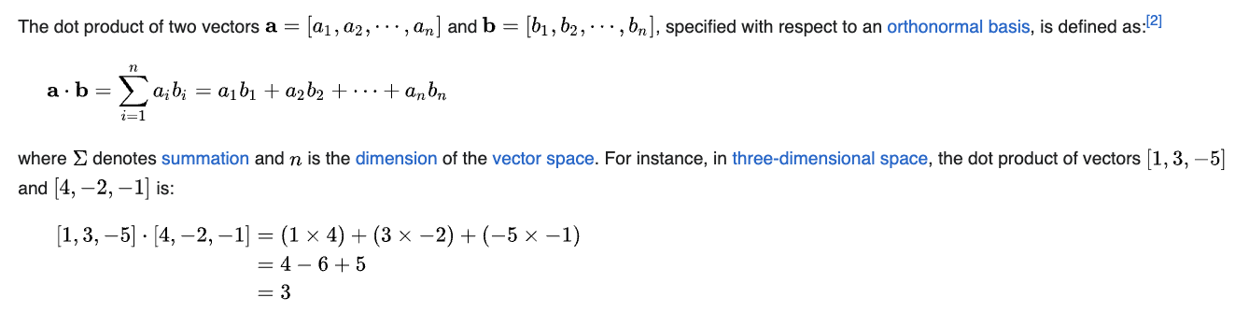
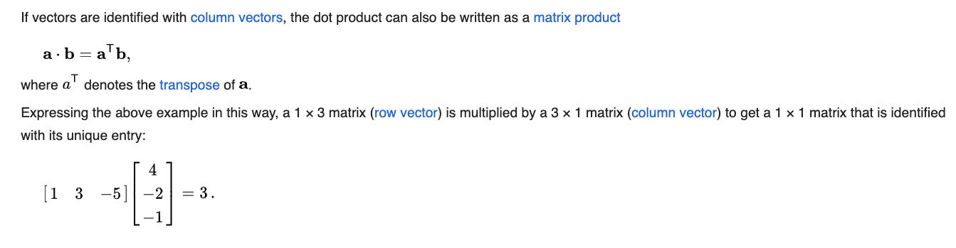
Vector Basics: Dot or Scalar Product

Slide 7
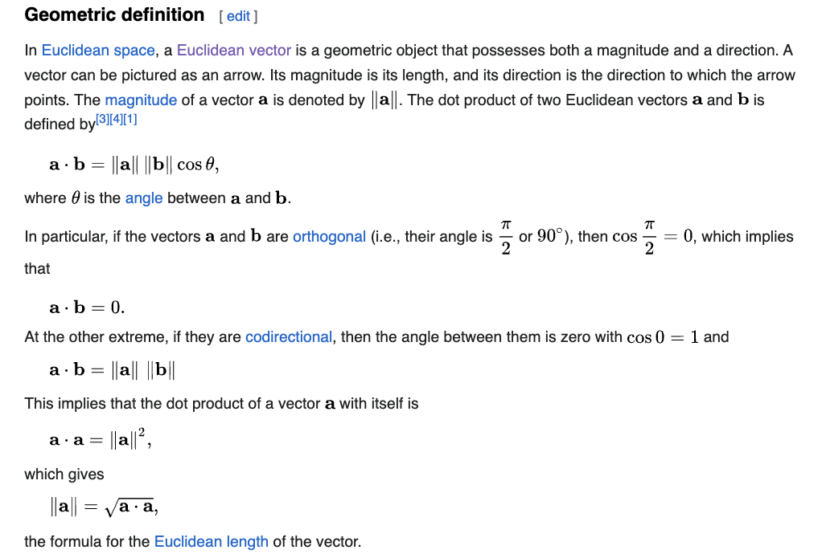
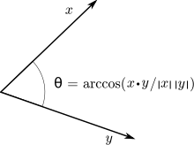
Vector Basics: Dot Product

Slide 8
Practical Notes
Collision Detection
Clipping

Slide 9
Affinity and Euler Geometry
Affine combination: A linear combination is an affine combination when the coefficients a1, a2,... add up to 1
Convex combination: each coefficient of the linear combination sum to one and each one must be nonnegative.
Note that this representation is with respect to a particular basis
For example, in OpenGL we start by representing vectors using the world basis but later the system needs a representation in terms of the camera or eye basis

Slide 10
Representaion
Until now we have been able to work with geometric entities without using any frame of reference, such a coordinate system
Need a frame of reference to relate points and objects to our physical world.
For example, where is a point?
Can’t answer without a reference system
World coordinates
Camera coordinates

Slide 11
Coordinate Systems
Consider a basis v₁, v₂,…., v_{n}
A vector is written v=α₁v₁+ α₂v₂ +….+α_{n}v_{n}
The list of scalars {α₁, α₂, …. α_{n}}is the representation of v with respect to the given basis
We can write the representation as a row or column array of scalars
a=[α₁ α₂ …. α_{n}]^{T}=

Slide 12
Coordinate Systems
Which is correct?
v
v
Both are because vectors have no fixed location

Slide 13
Frames
Coordinate System is insufficient to present points
If we work in an affine space we can add a single point, the origin, to the basis vectors to form a frame
v₂
v₁
P₀
v₃

Slide 14
Frame determined by (P₀, v₁, v₂, v₃)
Within this frame, every vector can be written as
v=α₁v₁+ α₂v₂ +….+α_{n}v_{n}
Every point can be written as
P = P₀ + β₁v₁+ β₂v₂ +….+β_{n}v_{n}

Slide 15
Confusing Points and Vectors
Consider the point and the vector
P = P₀ + β₁v₁+ β₂v₂ +….+β_{n}v_{n}
v=α₁v₁+ α₂v₂ +….+α_{n}v_{n}
They appear to have the similar representations
p=[β₁ β₂ β₃] v=[α₁ α₂ α₃]
which confuse the point with the vector
A vector has no position
v
p
v
can place anywhere
fixed

Slide 16
A Single Representation
If we define 0 • P = 0 and 1 • P = P then we can write
v=α₁v₁+ α₂v₂ +α₃v₃ = [α₁ α₂ α₃ 0 ] [v₁ v₂ v₃ P₀] ^{T}
P = P₀ + β₁v₁+ β₂v₂ +β₃v₃= [β₁ β₂ β₃ 1 ] [v₁ v₂ v₃ P₀] ^{T}
Thus we obtain the four-dimensional homogeneous coordinate representation
v = [α₁ α₂ α₃ 0 ] ^{T}
p = [β₁ β₂ β₃ 1 ] ^{T}

Slide 17
Homogeneous Coordinates
The general form of four dimensional homogeneous coordinates is
p=[x y x w] ^{T}
We return to a three dimensional point (for w≠0) by
x←x/w
y←y/w
z←z/w
If w=0, the representation is that of a vector
Note that homogeneous coordinates replaces points in three dimensions by lines through the origin in four dimensions

Slide 18
Homogeneous Coordinates and Computer Graphics
Homogeneous coordinates are key to all computer graphics systems
OpenGL uses 4D homogeneous coordinates for all its vertices.
If you send it a triple of the form (x,y,z), it converts it
immediately to (x,y,z,1).
If you send it a 2D point (x,y), it first appends a 0 for the z
component and then a 1, to form (x,y,0,1).

Slide 19
Homogeneous Coordinates and Computer Graphics
Homogeneous coordinates are key to all computer graphics systems
All standard transformations (rotation, translation, scaling) can be implemented by matrix multiplications with 4 x 4 matrices
Hardware pipeline works with 4 dimensional representations
For orthographic viewing, we can maintain w=0 for vectors and w=1 for points
For perspective we need a perspective division

Slide 20
The difference of two points (x,y,z,1) and (u,v,w,1) is (x-u, y-v, z-w, 0), which is a vector
The sum of a point (x, y, z, 1) and a vector (d, e, f, 0) is (x + d, y + e, z + f, 1), another point

Slide 21
Affine combination of points
Consider forming a linear combination of two points, P = (P₁, P₂, P₃, 1)
and R = (R₁, R₂, R₃, 1), using the scalars f and g:
fP + gR = (fP₁ + gR₁, fP₂ + gR₂, fP₃ + gR₃, f + g)
This is a valid vector if f + g = 0
It is not a valid point, unless f + g = 1
The only linear combination of points that is valid is an affine
combination.

Slide 22
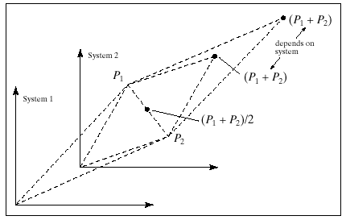
P₁ + P₂ depends on the choice of coordinate system.
The affine combination 0.5 (P₁ + P₂) does not depend on this choice.

Slide 23
A point plus a vector is an affine combination of points
P = A + t (B - A)
P = t B + (1 – t) A !!!!!!!!!Why?

Slide 24
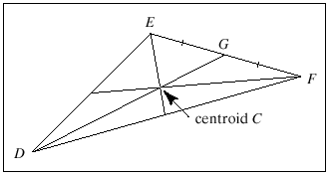
The Centroid of a triangle
Show that the three medians of T meet at a point that lies 2/3 of the
way along each median.
G = (E + F) / 2
The point that is two-thirds of the way from D to G is
D + (2/3)(G – D)
= (D + E + F) /3

Slide 25
Linear Interpolation of Two Points
The affine combination of points
P = A (1 – t) + B t
performs a linear interpolation between the points A and B.
lerp(a,b,t) provides a number that is the fraction t of the way from
a to b.
a+ (b-a)*t;
tween (A,B,t) computes the point P(t) that is the fraction t of the way
Along the straight line from point A to point B.

Slide 26
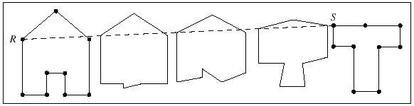
Tweening
P = (1 – t) A_{i} + t B_{i}
This polyline begins with the shape of A and ends with the shape of B,
but in between it is a blend of the two shapes.

Slide 27
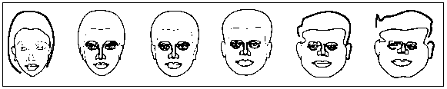
Keyframe Animation

Slide 28
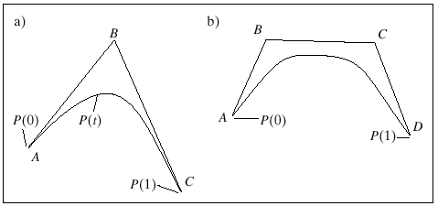
Quadratic and Cubic Tweening
1 = ((1-t) + t) ²
P = (1 – t)² A + 2t (1 – t) B + t² C
This is the Bezier curve for the points A, B, and C.
1 = ((1-t) + t) ³

Slide 29
Representing Lines and Planes

Slide 30
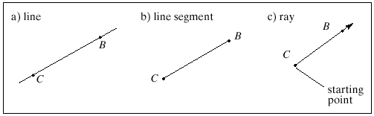
Lines

Slide 31
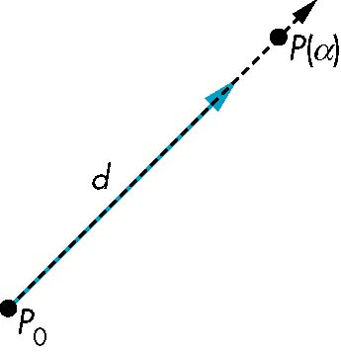
Parametric Representation
Consider all points of the form
P(α)=P₀ + α d
Set of all points that pass through P₀ in the direction of the vector d
for the segment, 0 ≤ α ≤ 1;
for the ray, 0 ≤ α < ∞;
for the line, -∞ < α < ∞;

Slide 32
This form is known as the parametric form of the line
More robust and general than other forms
Extends to curves and surfaces

Slide 33
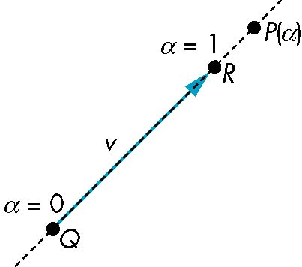
Rays and Line Segments
If α ≥ 0, then P(α) is the ray leaving P₀ in the direction d
If we use two points to define v, then
P( α) = Q + α (R-Q)=Q+αv
=αR + (1-α)Q
For 0 ≤ α ≤ 1 we get all the
points on the line segment
joining R and Q

Slide 34
Point normal form for the Equation of a Line (Implicit form)
f x + g y = 1 (2D)
(f, g) . (x, y) = 1 (What is this ?)
Every point (x,y) that satisfies this equation lies on the line so the equation provides a condition for a point to be on the line.
(This form is very useful in such tasks as clipping, eliminating hidden
lines, and tracing rays.)

Slide 35
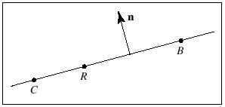
Point normal form (Implicit form)
The line passes through the points C and B. What is the point normal
form of L?
n . (R-C) = 0
For any R(x,y).
A certain dot product must turn out to be zero for every point R on the line.

Slide 36
Example: L passes through C=(3,4) and B=(5,-2)
Find the point normal form of L.
Find the parametric form of L.

Slide 37
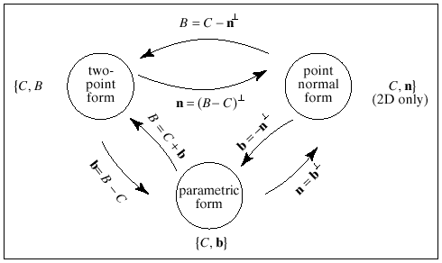

Slide 38
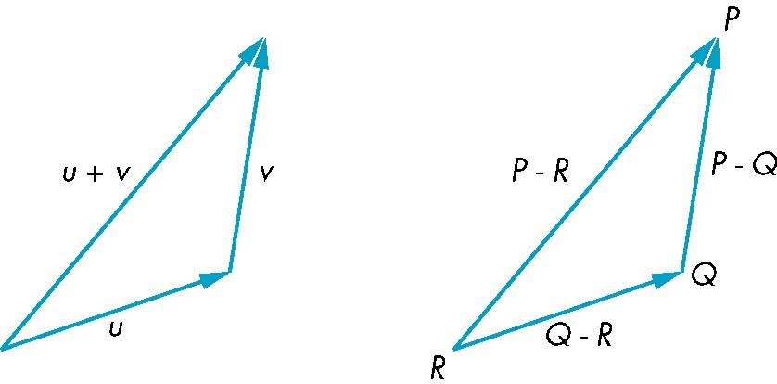
Planes
A plane can be determined by a point and two vectors or by three points
P(α,β)=R+αu+βv
P(α,β)=R+α(Q-R)+β(P-Q)

Slide 39
The line segment that joins A and C is the set of points of the form
S (α) = αC + (1-α)A
0 ≤ α ≤ 1
Suppose that we take an arbitrary point on this line segment and form
the line segment from this point to B
T (β) = βS + (1-β)B
0 ≤ β ≤ 1
Such points are determined by both α and β, and form the plane
determined by A,B, and C.
T (α,β) =β[αC + (1-α)A] + (1-β)B
T (α,β) = C + β(1−α)(A – C) + (1-β)(B-C)

Slide 40
T (α,β) = C + β(1−α)(A – C) + (1-β)(B-C)
Noting that A-C and B-C are arbitrary vectors, a plane can be
determined as:
T (s,t) = C + su + tv
We can rearrange terms to obtain the affine combination of points:
T (s,t) = sA + tB + (1-s-t)C
In mathematics, an affine combination of vectors x1, ..., xn is a linear combination in which the sum of the coefficients is 1

Slide 41
Example: Plane passing through A=(3,3,3), B=(5,5,7) and C=(1,2,4)
Find the parametric form of the plane.
Find the point normal form of the plane.

Slide 42
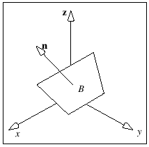
The point normal form for a plane
A plane is completely specified by giving a single point B that lies
within it and the direction n of the normal to the plane.
n . (R – B) = 0

Slide 43
Example: Plane passing through A=(1,2,3) with normal vector
N=(2, -1, -2)
Write the Point Normal Form

Slide 44
Example: Find a parametric form for the plane 2x – y + 3z = 8

Slide 45
Normal n (2,-1,3)
A point on the plane C (4,0,0)
Two vectors on the plane:
Condition n.a=0
a(1,5,1) b(0,3,1)
Parametric form
P(s,t) = (4,0,0) + (1,5,1)s + (0,3,1)t

Slide 46
Given the normal n to a plane, can you find two points on the plane.

Slide 47
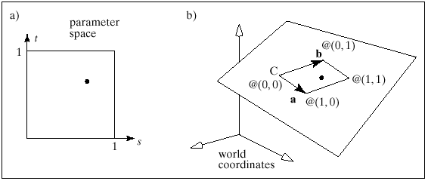
Planar patches
To each point (s,t) in parameter space, one 3D
point in the patch corrresponds P(s,t) = C +as + bt.
P(0,0) = C
P(1,0) = C + a
P(0,1) = C + b
P(1,1) = C + a + b

Slide 48
Example: Let C = (1,3,2), a = (1,1,0), b = (1,4,2)
Find the corners of the planar patch.

Slide 49
Example: Find the values of a, b and C that create a square patch of
length 4 on a side, centered at the origin and parallel to the x,z-plane.

Slide 50
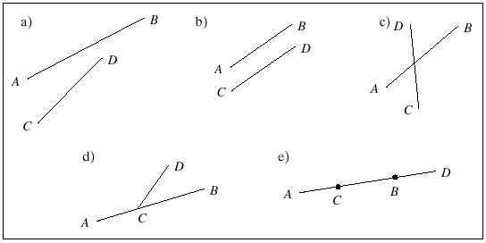
Finding the Intersection of two line segments
AB (t) = A + bt b = B - A
CD (u) = C + du d = D - C
A + bt = C + du

Slide 51
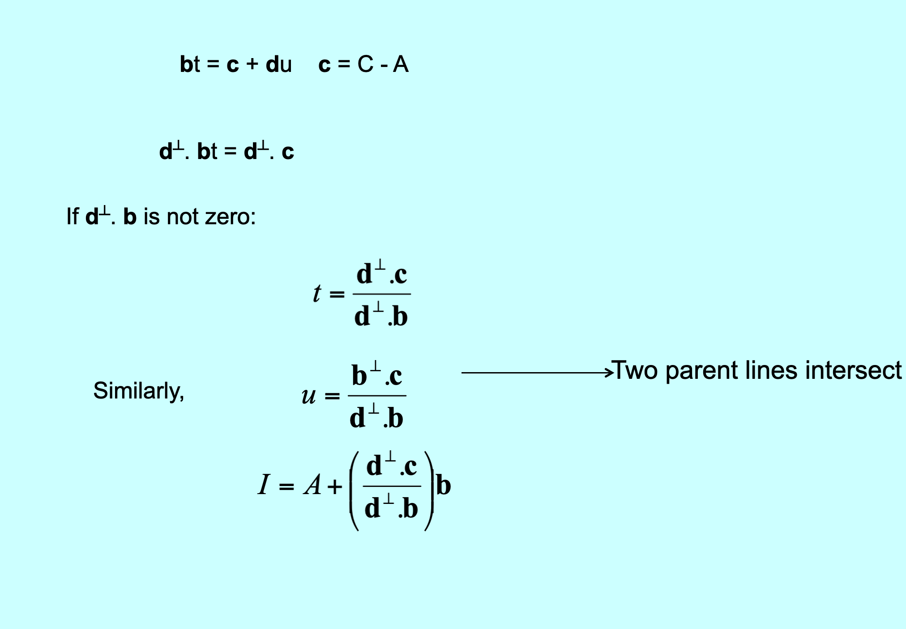

bt = c + du c = C - A
d┴. bt = d┴. c
If d┴. b is not zero:
Two parent lines intersect
Similarly,

Slide 52
Example: Given the endpoints A = (0,6), B = (6,1), C = (1,3), and
D = (5,5), find the intersection of the lines AB and CD if it exists.

Slide 53
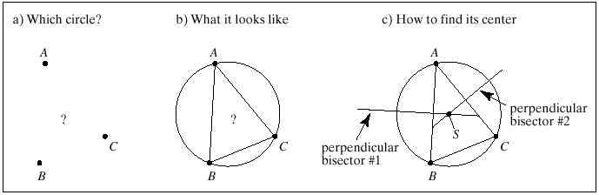
The Circle Through 3 points
The center S of the desired circle must be equidistant from all three
vertices, so it must lie on the perpendicular bisector of each side of
triangle ABC.

Slide 54
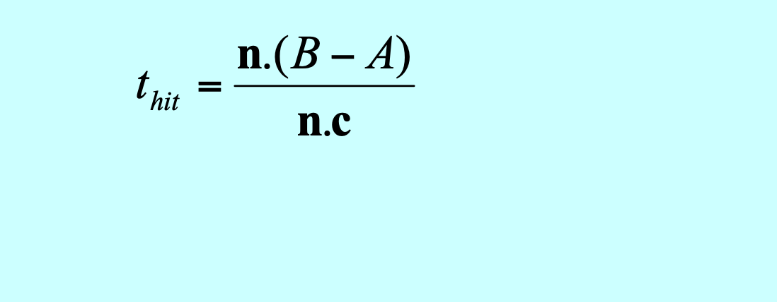
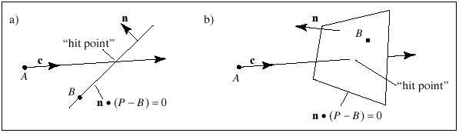
Intersection of lines with planes; clipping
n . (P – B) = 0
n . (A + ct_{hit} – B) = 0
n . (A – B) + (n . ct_{hit}) = 0

Slide 55
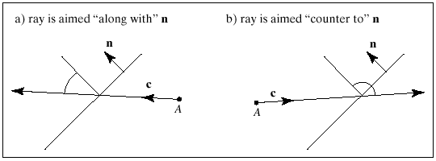
if n . c > 0 the ray is aimed “along with” the normal
if n . c = 0 the ray is parallel to the line
if n . c < 0 the ray is aimed “counter to” the normal

Slide 56
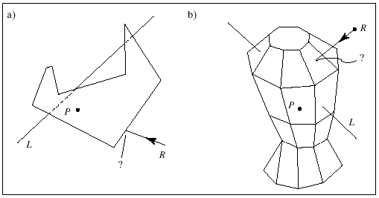
Polygons are fundamental objects that are used in 2D and 3D graphics.
In 3D, an object is often modeled as a polygonal “mesh”; a collection
of polygons.
If the skin forms a closed surface that encloses some space, the mesh
is called a polyhedron.

Slide 57
Polygon Intersection Problems
Is a given point P inside or outside the object?
Where does a given ray R first intersect the object?
Which part of a given line L lies inside the object, and which part
lies outside

Slide 58
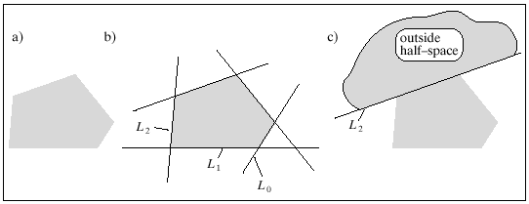
Convex Polygons and Polyhedra
Convex polygon is completely described by a set of “bounding lines”
In 3D, a convex polyhedron is completely described by a set of
“bounding planes”

Slide 59
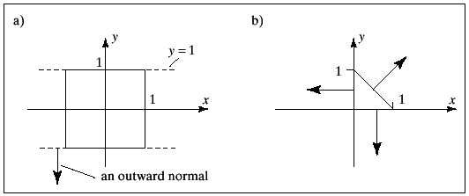
Finding the bounding lines
(-1, 0) . (P – (0,0) = 0
(0, -1) . (P – (0,0) = 0
(1, 1) . (P – (1,0) = 0
Note that in each case the outward normal is used

Slide 60
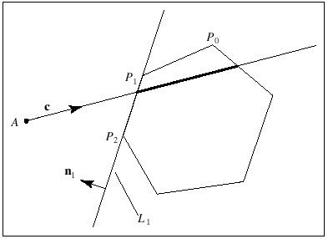
Ray Intersections and Clipping for convex polygons
Since P is convex, the ray hits P exactly twice.
Entering hit point = A + c t_{in}
Exiting hit point = A + c t_{out}
The ray is inside P for all t in the interval [t_{in}, t_{out}]

Slide 61
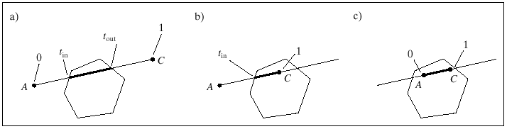
The Clipping problem
To find the clipped segment, compute t_{in} and t_{out}
A’ = A + c max(0,t_{in})
C’ = A + c min(1,t_{out})

Slide 62
How are t_{in} and t_{out} computed?
Consider each of the bounding lines of P in turn and find where the
ray A + ct intersects that line.
Assume that each bounding line of P is stored in point normal form as the
pair {B, n}
If n . c > 0 the ray is exiting from P
If n . c = 0 the ray is parallel to the line
If n . c < 0 the ray is entering P

Slide 63
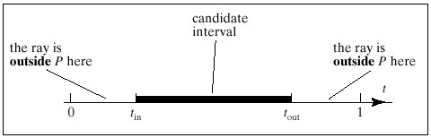
[t_{in} , t_{out} ] is the candidate interval of t, the interval inside of which
the ray might lie inside the object.

Slide 64
Initialize the candidate interval to [0,1]
For each bounding line, find the hit time t_{hit} and determine whether
it is an entering or exiting hit
If entering hit, set t_{in} = max (t_{in}, t_{hit})
If exiting hit, set t_{out} = min (t_{out}, t_{hit})
If the candidate interval is not empty, then, the segment from A + c t_{in} to A + c t_{out} lies inside P. (For clipping, the endpoints of the clipped line, for ray tracing, entering and exiting points of the ray)
Stop if the candidate interval vanishes

Slide 65
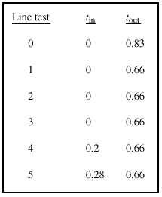
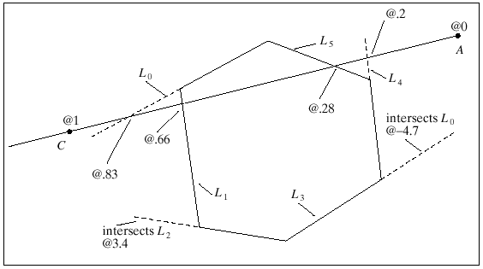

Slide 66
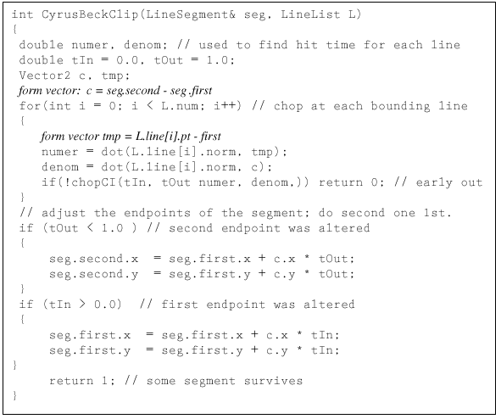
The Cyrus-Beck clipping algorithm
(Clipping of a line segment against any convex polygon)

Slide 67
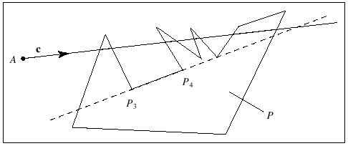
Clipping against arbitrary polygons
Find where the ray A + ct lies inside the polygon P given the list
of vertices P₀, P₁, ..., P_{N-1}

Slide 68
The ray can enter and exit from P multiple times and the result of
clipping a segment against P may result in a list of segments rather
than a single one.
P is no longer described by a collection of infinite bounding lines in
point normal form; we must work with the N finite segments such as
P₃P₄ that form its edges.

Slide 69
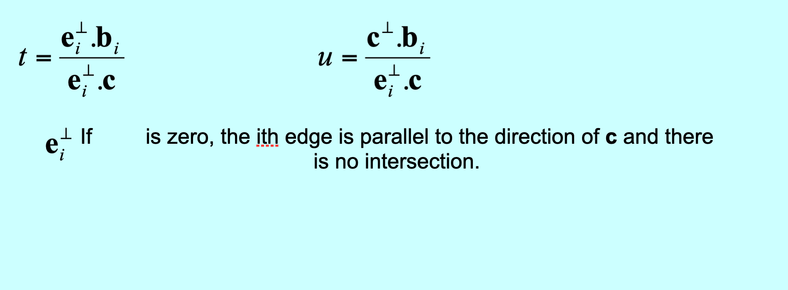
Represent each edge of P parametrically.
The ith edge is given by P_{i} + e_{i}u, for u in [0,1] e_{i} = P_{i+1} – P_{i} P_{N} = P₀
The ray A + ct hits the ith edge when t and u have the proper values to
Make A + ct = P_{i} + e_{i}u
ct = b_{i} + e_{i}u
If is zero, the ith edge is parallel to the direction of c and there
is no intersection.

Slide 70
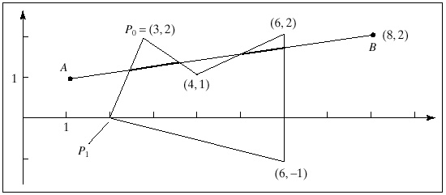
Example:
Edge u t
0 0.3846 0.2308
1 -0.727 -0.2727
2 0.9048 0.7142
3 0.4 0.6
4 0.375 0.375

