Slide 1
Raster Images
What is a pixel?
We will come back to this again and again...
Pixel Depth and Quantization
  2 bits/pixel 4 gray levels
  4 bits/pixel 16...
  8 bits/pixel 256...

Slide 2
Polylines
A polyline is a connected sequence of straight lines.
  Start PolyLine
  drawLine (x1, y1, x2, y2)
  drawLine (x2, y2, x3, y3)
  End PolyLine
  Attributes of Polylines:
  - color, thickness, stroke, joins, ends

Slide 3
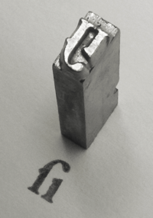
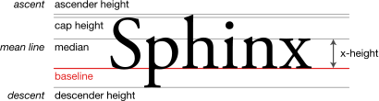
Text
Text is critical in Graphics
Attributes:
  Typeface, color, size, spacing, orientation

Slide 4
Filled Regions
Fill algorithms
Convex objects
Objects with one or more holes
Filling with shade of gray/color

Slide 5
Basic 2D Shape Rendering and SVG

Slide 6
Raster Imaging vs Vector Graphics
Raster Imaging – collection of pixels
(JPEG, PNG, GIF, …)
  The pixel at column 1 on row 1 is white.
  The pixel at column 2 on row 1 is green.
  The pixel at column 3 on row 1 is yellow.
  . . .
Vector Graphics - collection of shapes
(PDF, Flash, PS, Adobe Illustrator, Corel Draw, ...)
  There is a yellow circle at (2, 4) with radius of 6
  There is a black rectangle at (3, 5) with width of 3,height 2.
  There is a red rectangle at (7, 11) with width of 1,height 3.

Slide 7
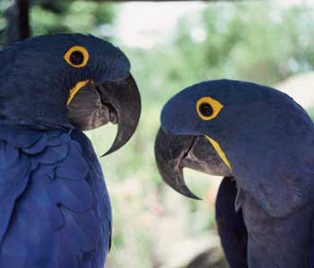
Vector Graphics
A vector image is a collection of shapes
Shapes are defined using geometrical descriptions
  Lines, rectangles, circles, polygons, Bezier curves, etc.
  Example: A circle is defined by its center and radius
  Shapes are scalable and independent of resolution
Shapes may be filled with various color effects or raster images
  Vector graphics usually means mixed vector / raster graphics
Shapes can be positioned using geometrical transformations
  Translation, rotation, scaling, etc.

Slide 8



Advantages of Vector Graphics
Vector graphics has many advantages over raster technology:
  Device independent: Same content renders the same quality on any device, independent of display size.
  Zoomable: You can zoom a vector graphics image without any loss of quality.
  Efficient: Smaller file sizes, more convenient to use
  Interactive: Easy to create interactive content
  Searchable: Text is represented as text, not pixels. Required feature for maps!
Raster
Vector

Slide 9
Why SVG ?
SVG: Scalable Vector Graphics
  Open vector graphics standard
W3C’s 2D Vector Graphics Recommendation based on XML
  W3C Working Group was created in 1998
  W3C Recommendation: v1.0 - 09/2001 v1.1 - 01/2003
  Get SVG Viewer from Adobe www.adobe.com
Compatible with other Web technologies
  SMIL: Uses SMIL 1.0 for animation
  XML: XML-based
  XHTML: Maximum compatibility with XHTML
  DOM: SVG DOM based on DOM Level 2
  Compatible with XML namespaces, XLink, XPointer
  CSS: Allows styling with CSS properties

Slide 10
SVG Features
XML-based representation of vector graphics images
Structured representation of graphical shapes
  Shapes can be grouped to define higher-level shapes
  Supports multiple XML namespaces
  Document Object Model (DOM)
  Scripting
A large set of graphical primitives, advanced manipulation
Animated Content with SMIL animation
Advanced vector representation of text, and user-defined fonts
Styling with both CSS and XML attributes

Slide 11
SVG Feature Overview
SVG images consist of hierarchically organized sets of graphical shapes
  <?xml version="1.0" standalone="no"?>
  <!DOCTYPE svg PUBLIC "-//W3C//DTD SVG 20030114//EN"
  "http://www.w3.org/TR/2003/REC-SVG-030114/DTD/svg11.dtd">
  <svg width=“220" height=“120"
  xmlns="http://www.w3.org/2000/svg">
  <g id="group1" fill="red" stroke=“black”>
  <rect x=“10" y="10" width=“80" height=“40" />
  <rect x=“20" y=“20" width=“80" height=“60" />
  </g>
  <g id="group2" fill="blue" >
  <rect x="110" y=“10" width=“80" height=“40" />
  <rect x=“120" y=“20" width=“80" height=“60" />
  </g>
  </svg>
Group 1
Group 2

Slide 12
SVG Features – Shapes
Lines
Curves
Circles
Abc
Ellipses
Paths
Text

Slide 13
SVG Features – Basic Shapes
<rect> element
  <rect x="400" y="100" width="400" height="200"
  fill="yellow" stroke="navy" stroke-width="10"/>
<circle> element
<circle cx="600" cy="200" r="100”
fill="red" stroke="blue" stroke-width="10"/>
<ellipse> element
<ellipse rx="250" ry="100“ fill="red“/>
<line> element
<line x1="100" y1="300" x2="300" y2="100“ stroke-width="5"/>
<polyline> element
<polyline points="50,375 150,375 150,325”
fill="none" stroke="blue" stroke-width="10" />
<polygon> element
<polygon points="350,75 379,161 469,161“
fill="red" stroke="blue" stroke-width="10" />

Slide 14
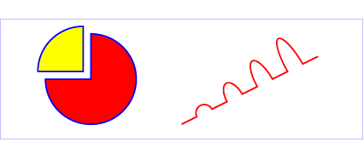
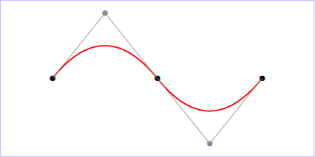
SVG Features – General Paths
<path> element
<path d="M 100 100 L 300 100 L 200 300 z"
  fill="yellow" stroke="navy" stroke-width="10"/>
Path mimics the movement of a pen to draw a shape:
  Move To 100 100
  Draw Line To 300 100
  Draw Line To 200 300
  Close Path
Possible commands:
  Move To
  Draw Line To
  Draw Quadratic Bezier Curve To
  Draw Cubic Bezier Curve To
  Draw Elliptic Arc To
  Close Path

Slide 15
Path Data
Cubic Bezier Curve: C (x1 y1 x2 y2 x y)
  Starting point, end point and two control points
Quadratic Bezier Curve: Q (x1 y1 x y)
  Starting point, end point and one control point
Elliptical Arc: A ( rx ry x-axis-rotation large-arc-flag sweep flag x y)
  Use current point as starting point, size and orientation of the ellipse (rx ry x-axis-rotation), end point
Relative and Absolute Coordinates Notation :L,l

Slide 16
2D Coordinate Systems
Canvas: the space where the content is rendered.
Viewport: the rectangular part of the canvas visible to user.
Outmost <svg> element defines the viewport for SVG Documents
A new coordinate system can be established by ‘transform’ attribute on group element or by ‘viewport’ attribute on svg element
Example

Slide 17






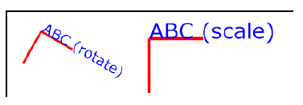
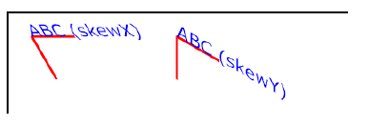
2D Transformations
Translation
Rotation
Scale
Skew
Rotation about the origin

Slide 18

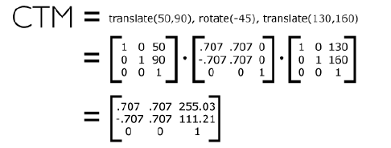
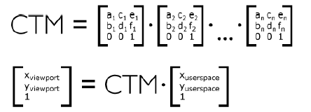
2D Transformations
Nested Transformations
Current Transformation Matrix

Slide 19
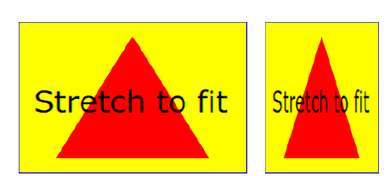
Viewing
Viewbox: stretch a set of graphics to fit a particular area
<svg width=“300px” height=“200px” viewBox=“0 0 1500 1000”/>.
…
<svg width=“150px” height=“200px” viewBox=“0 0 1500 1000”/>.

Slide 20
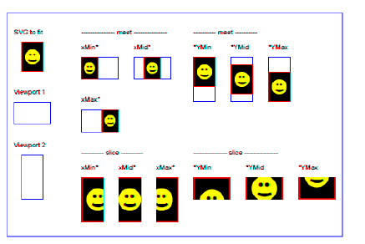
Aspect Ratio

Slide 21




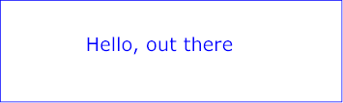
SVG Features – Text
Text is represented as text
  <text x="250" y="150" font-family="Verdana" font-size="55” fill="blue"> Hello, out there </text>
Supports Unicode: www.unicode.org
Supports vertical text, bi-directional text

Slide 22
SVG Features – Fonts
Different ways of defining fonts:
  System fonts
  Content-defined fonts
Hello, out there
  <font id=“myfont" horiz-adv-x="1000">
  <glyph unicode=“A" horiz-adv-x="300">
  <!-- Outline of ‘A’ glyph -->
  </glyph>
  <glyph unicode=“B">
  <!-- Outline of ‘B’ glyph -->
  </glyph>
  …
  </font>
Hello, out there
Hello, out there

Slide 23
SVG Features – Styling
Shapes and text can be associated with styling properties
Styling can be done using XML attributes, CSS, or XSLT.
XML style attributes:
  <rect x="400" y="100" width="400" height="200"
  fill="yellow" stroke=”blue”/>
CSS styling:
  <rect x="400" y="100" width="400" height="200"
  style=”fill:yellow stroke:blue”/>

Slide 24
SVG Features – Painting
Painting Options
  Single color
  Gradient (linear or radial)
  Pattern (vector or image, possibly tiled)
  Custom paints
A large set of properties to control painting

Slide 25
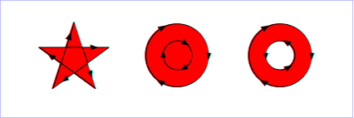
SVG Features – Painting
Fill rules:
  Nonzero: This rule determines ‘insideness’ of a point on the canvas by drawing a ray from that point to infinity in any direction and then examining the places where the segment of the shape crosses the ray. Starting with a count of zero, add one each time a path segment crosses the ray from left to right and subtract one each time a path segment crosses the ray from right to left. After counting the crossings, if the result is zero then the point is outside the path. Otherwise , it is inside.

Slide 26
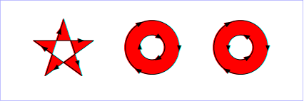
SVG Features – Painting
Fill rules:
  Even-odd: This rule determines the ‘insideness’ of a point on the canvas by drawing a ray from that point to infinity in any direction and counting the number of path segments from the given shape that the ray crosses. If this number is odd’ the point is inside; if even, the point is outside.

Slide 27
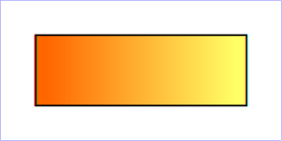
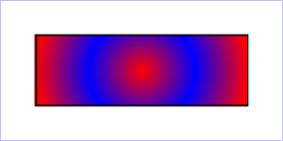
SVG Features – Gradients and Patterns
Linear Gradients
  <linearGradient id="MyGradient">
  <stop offset="5%" stop-color="#F60" />
  <stop offset="95%" stop-color="#FF6" />
  </linearGradient>
Radial Gradients
  <radialGradient id="MyGradient"
  gradientUnits="userSpaceOnUse"
  cx="400" cy="200" r="300“
  fx="400" fy="200">
  <stop offset="0%" stop-color="red" />
  <stop offset="50%" stop-color="blue" />
  <stop offset="100%" stop-color="red" />
  </radialGradient>

Slide 28



SVG Features – Filter Effects
Filter effects allow client-side generation of special effects
14 different filters that can be combined with each other
Diffuse lighting, specular lighting, turbulence, image, Gaussian blur

Slide 29
SVG Features – Interactivity
Different modes of interactivity
User-initiated actions
  Such as button presses can cause animations or scripts to execute
Hyperlinks
  Links to URLs
  Actions such as mouse clicks over particular shapes
Zoom and pan
  Ability to change view of SVG content
Changes to the cursor
  User movements of the pointing device

Slide 30
SVG Features – Animation
SVG uses SMIL animation to animate SVG content
  <animate>
  <set>
  <animateColor>
  <animateMotion> EXAMPLES
SVG defines extensions to SMIL animation
  <animateTransform>
  ‘path’ attribute
  <mpath> element
  ‘keyPoints’ attribute
  ‘rotate’ attribute

Slide 31




SVG Features – Animation
  <text id="TextElement" x="0" y="0" font-family="Verdana“
  font-size="35.27" visibility="hidden">
  It's alive!
  <set attributeName="visibility" attributeType="CSS"
  to="visible" begin="3s" dur="6s" fill="freeze" />
  <animateMotion path="M 0 0 L 100 100" begin="3s" dur="6s"
  fill="freeze" />
  <animateColor attributeName="fill"
  attributeType="CSS" from="rgb(0,0,255)“
  to="rgb(128,0,0)" begin="3s" dur="6s" fill="freeze" />
  <animateTransform attributeName="transform"
  attributeType="XML" type="rotate" from="-30" to="0"
  begin="3s" dur="6s" fill="freeze" />
  <animateTransform attributeName="transform"
  attributeType="XML" type="scale" from="1" to="3"
  additive="sum" begin="3s" dur="6s" fill="freeze" />
  </text>

Slide 32
Homework
Design a data visualization with the data from
https://data.tuik.gov.tr/Bulten/Index?p=Death-and-Causes-of-Death-Statistics-2022-49679

