Slide 1
Transformations
Basic Transforms
Matrix Transforms and Operations
Quaternions
Vertex Blending
Projections

Slide 2
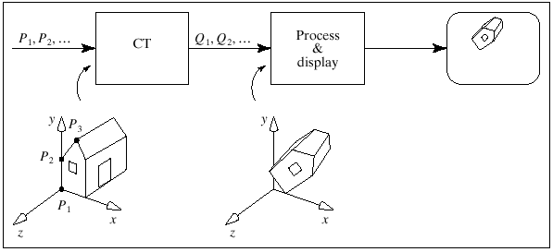
Graphics pipeline
Current transformation
Points

Slide 3
Object Transformations versus Coordinate Transformation
An object transformation alters the coordinates of each point on the
object according to some rule, leaving the underlying coordinate
system fixed.
A coordinate transformation defines a new coordinate system in terms
of the old one and then represents all of the object’s points in this
new system.

Slide 4
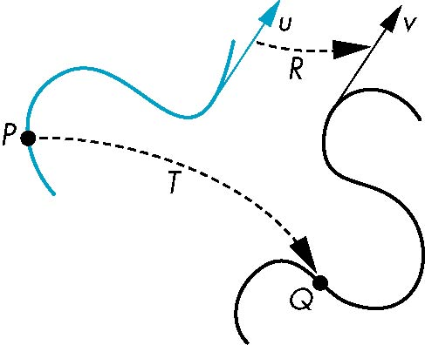
General Transformations
A transformation maps points to other points and/or vectors to other vectors
v=T(u)
Q=T(P)

Slide 5
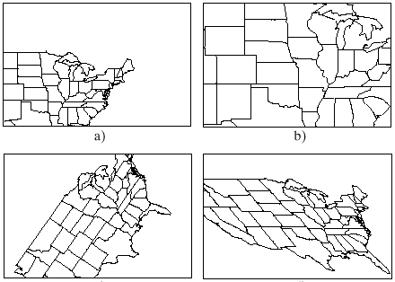
Affine transformations produce combinations of translations, scaling,
rotation and shear.
translation
scale
rotation
shear

Slide 6
Affine Transformations
Every linear transformation is equivalent to a change in frames
Every affine transformation preserves lines
However, an affine transformation has only 12 degrees of freedom because 4 of the elements in the matrix are fixed and are a subset of all possible 4 x 4 linear transformations

Slide 7
Affine Transformations
Line preserving
Characteristic of many physically important transformations
  Rigid body transformations: rotation, translation
  Scaling, shear
Importance in graphics is that we need only transform endpoints of line segments and let implementation draw line segment between the transformed endpoints

Slide 8
Pipeline Implementation
T
(from application program)
frame
buffer
u
transformation
T(u)
rasterizer
v
T(v)
T(v)
T(v)
v
T(u)
u
T(u)
vertices
vertices
pixels

Slide 9
Translation
Move (translate, displace) a point to a new location
Displacement determined by a vector d
  Three degrees of freedom
  P’=P+d
P’
d
P

Slide 10
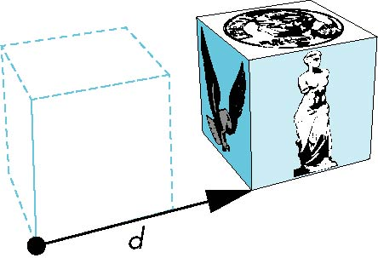

How many ways?
Although we can move a point to a new location in infinite ways, when we move many points there is usually only one way
object
translation: every point displaced
by same vector

Slide 11
Basic Transforms
Homogenous notation
Unit of operations: 4x4 Matrices
Vector: (Vx, Vy, Vz, 0)
Point: (Vx, Vy, Vz, 1)

Slide 12
Translation Using Representations
Using the homogeneous coordinate representation in some frame
p=[ x y z 1]^{T}
p’=[x’ y’ z’ 1]^{T}
d=[dx dy dz 0]^{T}
Hence p’ = p + d or
x’=x+d_{x}
y’=y+d_{y}
z’=z+d_{z}
note that this expression is in
four dimensions and expresses
that point = vector + point

Slide 13
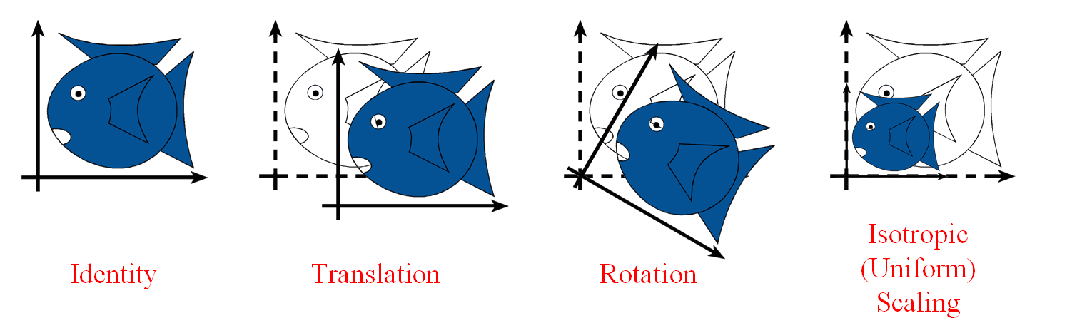
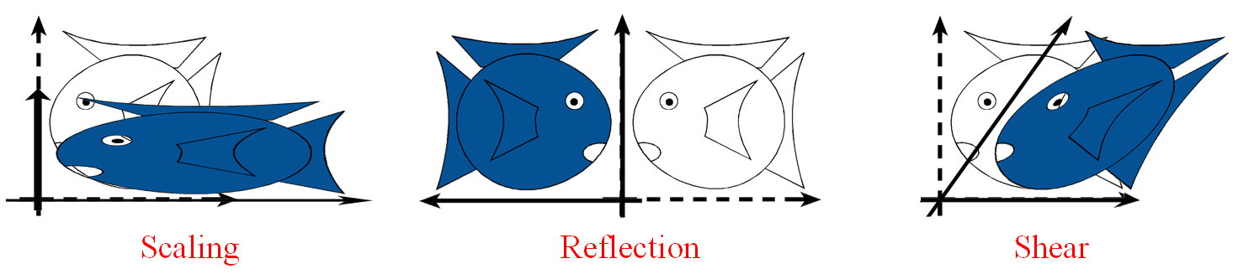
Basic Transforms

Slide 14
Basic Transforms
Add an extra dimension
    in 2D, we use 3 x 3 matrices
    In 3D, we use 4 x 4 matrices
Each point has an extra value, w
x'
y'
z'
w'
a
e
i
m
b
f
j
n
c
g
k
o
d
h
l
p
x
y
z
w
=
p' = M p

Slide 15
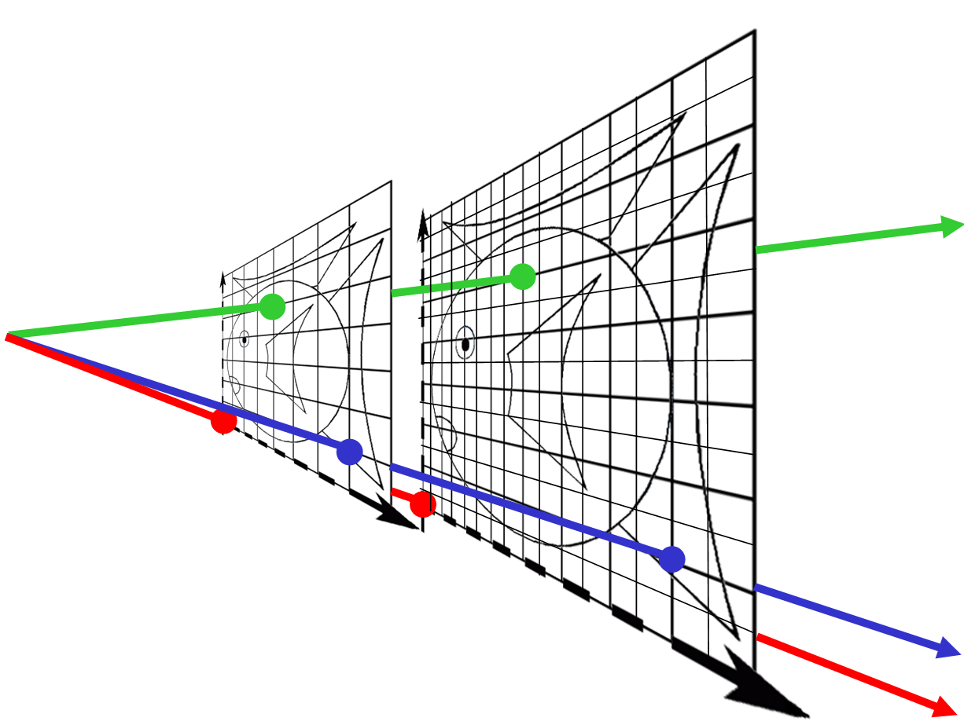
Basic Transforms
Divide by w to normalize (homogenize)
W = 0?
Point at infinity (direction)
w = 1
(0, 0, 1) = (0, 0, 2) = …
(7, 1, 1) = (14, 2, 2) = …
w = 2
(4, 5, 1) = (8, 10, 2) = …

Slide 16
Basic Transforms
1
0
0
0
0
1
0
0
0
0
1
0
tx
ty
tz
1
Translation

Slide 17
Basic Transforms
Scale
sx
0
0
0
0
sy
0
0
0
0
sz
0
0
0
0
1

Slide 18
Basic Transforms
ZRotate(θ)
Rotation about z axis
y
cos θ
sin θ
0
0
-sin θ
cos θ
0
0
0
0
1
0
0
0
0
1
p'
θ
p
x
z

Slide 19
Basic Transforms
1
0
0
0
0
cos θ
sin θ
0
0
-sin θ
cos θ
0
0
0
0
1
About x axis
cos θ
0
-sin θ
0
0
1
0
0
sin θ
0
cos θ
0
0
0
0
1
About y axis

Slide 20
Basic Transforms
Concatenation of Transforms
  Due to the noncommutativity of the matrix multiplication, the order in which the matrices occur matters.
  The major reason to concatenate the transformations into single one is to gain efficiency

Slide 21
Basic Transforms
Scale then Translate: p' = T ( S p ) = TS p
(5,3)
Scale(2,2)
(2,2)
Translate(3,1)
(1,1)
(3,1)
(0,0)
(0,0)
Translate then Scale: p' = S ( T p ) = ST p
Translate(3,1)
(4,2)
Scale(2,2)
(6,2)
(1,1)
(3,1)
(0,0)

Slide 22
Inverses
Although we could compute inverse matrices by general formulas, we can use simple geometric observations
  Translation: T⁻¹(d_{x}, d_{y}, d_{z}) = T(-d_{x}, -d_{y}, -d_{z})
  Rotation: R ⁻¹(θ) = R(-θ)
    Holds for any rotation matrix
    Note that since cos(-θ) = cos(θ) and sin(-θ)=-sin(θ)
    R ⁻¹(θ) = R ^{T}(θ)
  Scaling: S⁻¹(s_{x}, s_{y}, s_{z}) = S(1/s_{x}, 1/s_{y}, 1/s_{z})

Slide 23
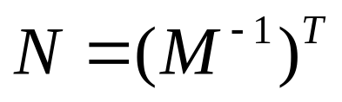
Basic Transforms
Normal Transform
  Normals must be transformed by the transpose of the inverse of the matrix used to transform geometry.
  Computing the inverse ? (expensive)
    If the matrix is orthogonal (only rotations); no need to compute the inverse
    Matrix itself can be used to transform normals, since the inverse of an orthogonal matrix is its transpose
    Translations do not affect vector direction, ok to use.
    Uniform scaling matrixes are ok to use they only affect the length of the transformed normal (don’t forget to renormalize)

Slide 24
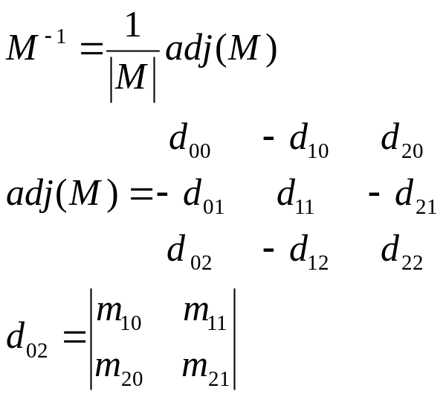
Basic Transforms
And if you still need to compute the inverse to transform vectors:
  You only need the transpose of the adjoint of the matrix’s upper left 3x3. (it is faster to compute the adjoint)
  We don’t need to divide by the derminant, since we know we will have to normalize the transformed normal anyway.
Normal transform is not an issue in systems where after transformation the surface normal is derived from the triangle (cross product). But often the vertices contain information for lighting and normal transformations must be addressed.

Slide 25
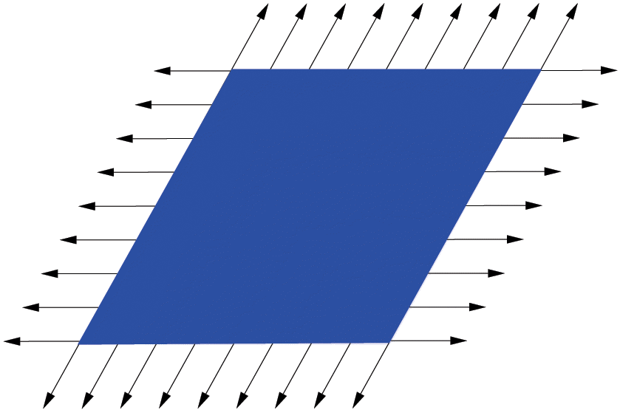
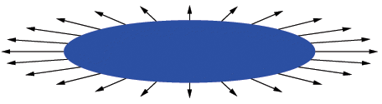
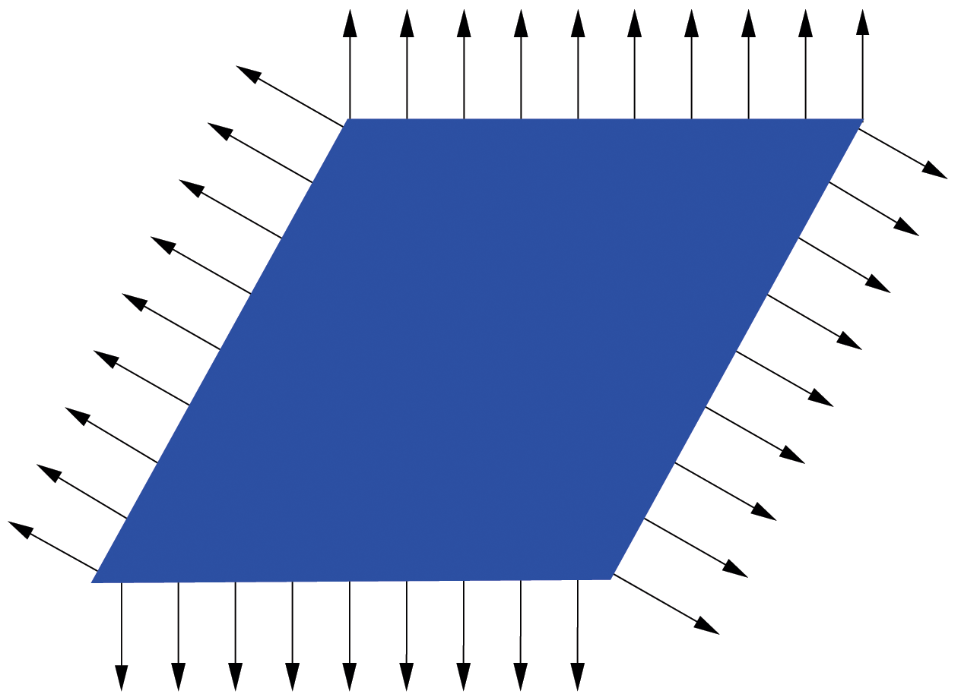
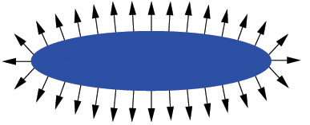
Basic Transforms
Incorrect
Normal
Transformation
Correct
Normal
Transformation

Slide 26


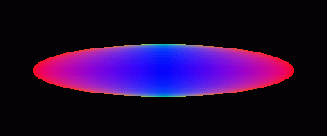
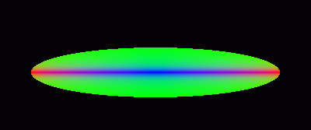
Basic Transforms
Incorrect Normal Transformation
Correct Normal Transformation

Slide 27
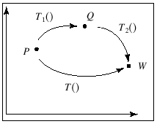
Concatenation
We can form arbitrary affine transformation matrices by multiplying together rotation, translation, and scaling matrices
Because the same transformation is applied to many vertices, the cost of forming a matrix M=ABCD is not significant compared to the cost of computing Mp for many vertices p
The difficult part is how to form a desired transformation from the specifications in the application

Slide 28
Order of Transformations
Note that matrix on the right is the first applied
Mathematically, the following are equivalent
p’ = ABCp = A(B(Cp))
Note many references use column matrices to present points. In terms of column matrices
p^{T}’ = p^{T}C^{T}B^{T}A^{T}

Slide 29
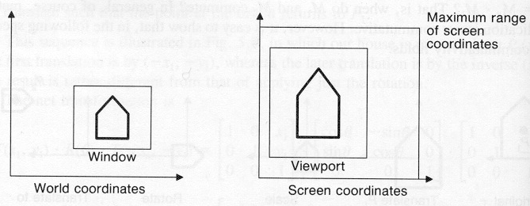
The Window to Viewport Transformation

Slide 30
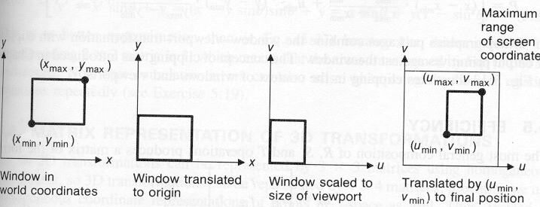

Slide 31
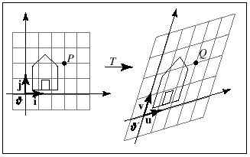
Useful Properties of Affine Transformations
Parallelism of lines and planes is preserved

Slide 32
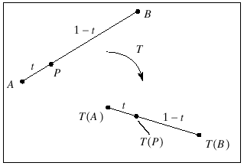
Useful Properties of Affine Transformations
Relative ratios are preserved

Slide 33
Every affine transformations is composed of elementary operations
M = (translation)(shear)(scaling)(rotation)

Slide 34
Special Transforms
The Euler Transform
  An intuitive way to construct a matrix to orient yourself in a certain direction
Orientation matrix given by the Euler angles head (yaw), pitch, roll.
E(h, p, r) = R_{z}(r)R_{x}(p)R_{y}(h)
Since E is orthogonal, its inverse is
E⁻¹ = E^{T} = (R_{z}R_{x}R_{y})^{T} = R_{y}^{T}R_{x}^{T}R_{z}^{T}

Slide 35
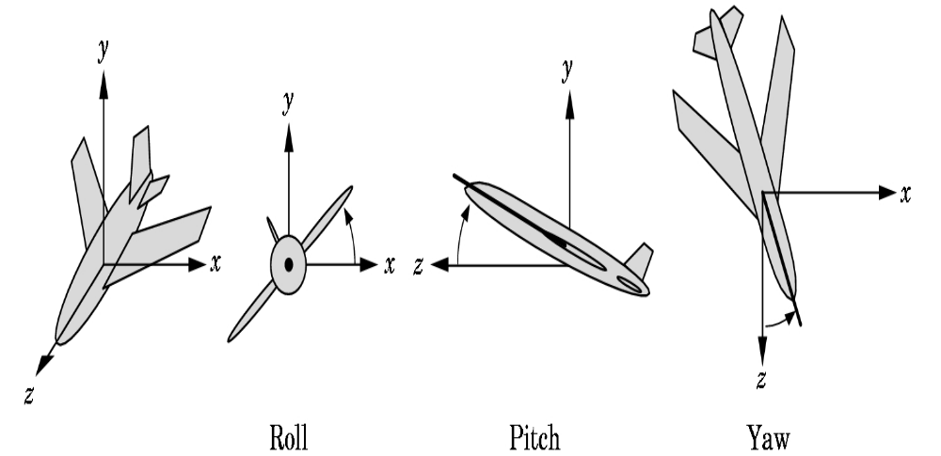

Slide 36
Special Transforms
Gimbal lock happens when rotations are made so that 1 d.o.f is lost
Example:
  for h=0 (no rotation around y axis), 90 deg around x axis.
  Now we want to rotate around z axis.
  But due to our previous rotation, our rotation matrix around the z axis at this point would actually be a rotation around y axis.
  So we have lost one degree of freedom.

Slide 37
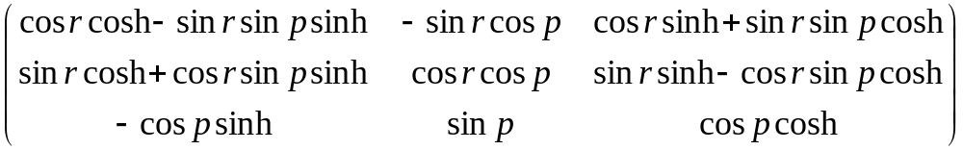
Special Transforms
Extracting Parameters from Euler Transform
F = R_{z}(r)R_{x}(p)R_{y}(h) = E(h, p, r)
F =

Slide 38
Special Transforms
Matrix Decomposition
  The task of retrieving various transforms from a concatenated matrix
    Scale factor
    Tranform needed by a particular system. VRML uses a transform node no use of arbitrary 4x4 matrix
    Interpolating between keyframes in an animation where only the matrix for the object is available

Slide 39
Special Transforms
Rotation about an Arbitrary Axis
  Find an orthonormal basis formed by k, s, t
  Align this basis with the standard basis so that k is aligned with the x-axis
  The rotation around the x-axis is performed
  Transform back

Slide 40
Special Transforms
y
r
M
s
s
x
t
r
R(a)
t
z
M^{T}

Slide 41
Special Transforms
Rotate(k, θ)
y
θ
k
About (kx, ky, kz), a unit
vector on an arbitrary axis
(Rodrigues Formula)
x
z
x'
y'
z'
1
kxkx(1-c)+c
kykx(1-c)+kzs
kzkx(1-c)-kys
0
kzkx(1-c)-kzs
kzkx(1-c)+c
kzkx(1-c)-kxs
0
kxkz(1-c)+kys
kykz(1-c)-kxs
kzkz(1-c)+c
0
0
0
0
1
x
y
z
1
=
where c = cos θ & s = sin θ

Slide 42
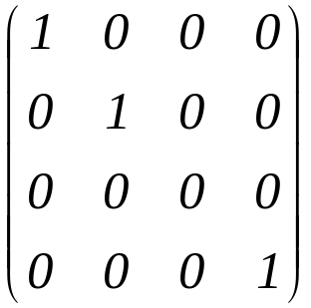
Orthographic Projections
P₀ =
Projects to plane z=0 leaves x and y unchanged
Positive and negative z values fall into the same z plane !
Define (l,r,b,t,n,f)
glOrtho

Slide 43
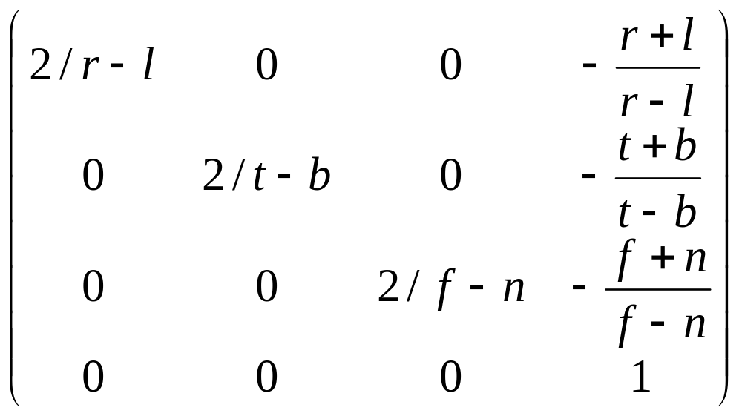
Orthographic Projections
Po=

Slide 44
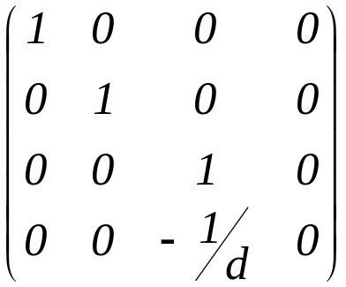
Perspective Projections
P_{p} =
Projects onto a plane z = -d, d > 0
Define (l,r,b,t,n,f)
Horizontal field of view: angle between l and r
Vertical field of view: angle between t and b
Asymmetric frustums: r not equal to l or t not equal to b
  Used for stereo viewing and CAVEs

Slide 45
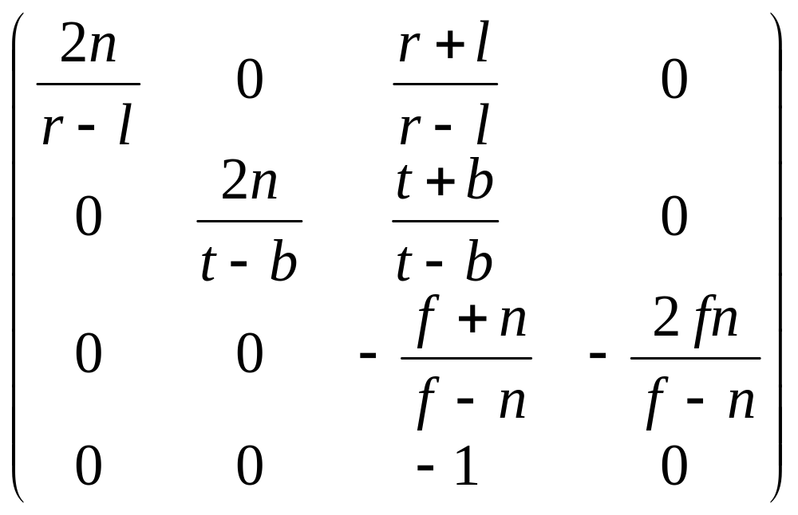
Perspective Projections
Pogl=
Note: The f and n values are modified to map near plane z=-1 and far plane z=1

Slide 46
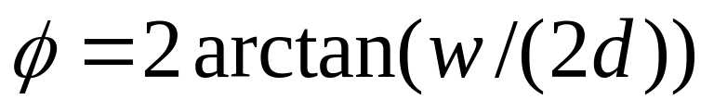

Field of View
Human field of view
field of view
w width of the object perpendicular to the line of the sight
d distance to the object

Slide 47

Field of View
Example
  21 inch monitor, 16 inches wide and 25 inches is the minimum view distance
  FOV is 35 degrees
  At 12 inches away FOV is 67 degrees
  At 30 inches away 30 degrees
  50mm lens for a 35 mm camera (36mm wide frame size) gives

Slide 48
Field of View
Smaller FOV less perspective effect, as you will be zooming into the scene.
Computer depth value does not vary linearly with the input Pz value.
Example: n=10, f=110, Pz=60, the normalized device coordinate depth value is 0.855 not 0.
Placement of near and far planes affects the precision of the Z-buffer.

Slide 49
Implementing Transformation Sequences
Calculate the matrices and cumulatively multiply them into a global Current Transformation Matrix
Postmultiplication is more convenient in hierarchies – multiplication is computed in the opposite order of function application
The calculation of the transformation matrix, M,
  initialize M to the identity
  in reverse order compute a basic transformation matrix, T
  post-multiply T into the global matrix M, M <- MT
Example - to rotate by T around [x,y]:
glLoadIdentity() /* initialize M to identity mat.*/
glTranslatef(x, y, 0) /* LAST: undo translation */
glRotatef(theta,0,0,1) /* rotate about z axis */
glTranslatef(-x, -y, 0) /* FIRST: move [x,y] to origin. */
Remember the last T calculated is the first applied to the points
  calculate the matrices in reverse order

Slide 50
