Slide 1
Viewing in 3D
In 2D, we specify
a window on the 2D world and
a viewport on the 2D view surface.
Objects in the world are clipped against the window and are then transformed into the viewport for display.
In 3D, we specify
a view volume in the world,
a projection onto a projection plane, and
a viewport on the view surface.
Objects in the 3D world are clipped against the 3D view volume and are then projected. The contents of the projection of the view volume onto the projection plan, called the window, are then transformed into the viewport for display.

Slide 2
Viewing in 3D
Viewing requires three basic elements
One or more objects
A viewer with a projection surface
Projectors that go from the object(s) to the projection surface
Classical views are based on the relationship among these elements
The viewer picks up the object and orients it how she would like to see it
Each object is assumed to constructed from flat principal faces
Buildings, polyhedra, manufactured objects

Slide 3
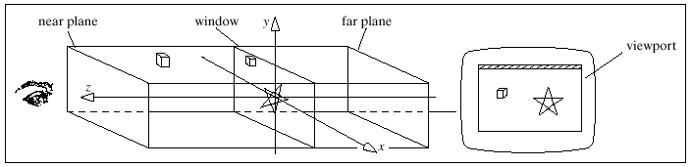
Clipped
world
coordinates
2D device
coordinates
3D world-coordinate
output primitives
Clip against
view volume
Project onto
projection
plane
Transform into
viewport in 2D
device coordinates
for display

Slide 4
Planar Geometric Projections
Standard projections project onto a plane
Projectors are lines that either
converge at a center of projection
are parallel
Such projections preserve lines
but not necessarily angles
Nonplanar projections are needed for applications such as map construction

Slide 5
Perspective vs Parallel
Computer graphics treats all projections the same and implements them with a single pipeline
Classical viewing developed different techniques for drawing each type of projection
Fundamental distinction is between parallel and perspective viewing even though mathematically parallel viewing is the limit of perspective viewing

Slide 6
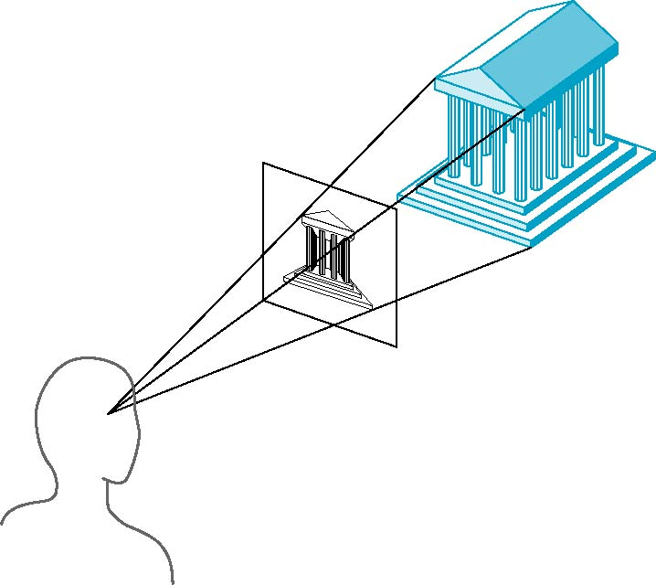
Perspective Projection
Projectors coverage at center of projection

Slide 7
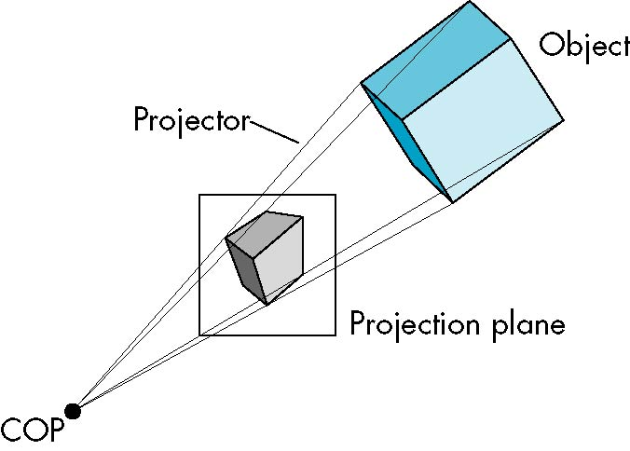
Perspective Projection

Slide 8
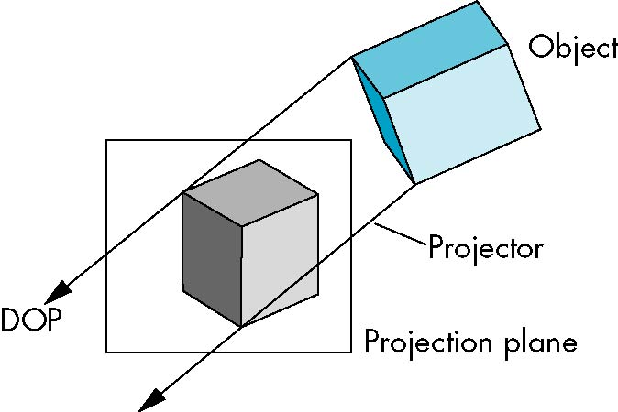
Parallel Projection

Slide 9
Computer Viewing
There are three aspects of the viewing process, all of which are implemented in the pipeline,
Positioning the camera
Setting the model-view matrix
Selecting a lens
Setting the projection matrix
Clipping
Setting the view volume

Slide 10
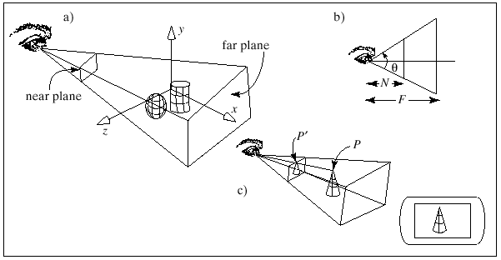
Computer Viewing
3D viewing involves not just a projection, but also a view volume against which the 3D world is clipped.
The projection and view volume together provide all the information needed to clip and project into 2D space.
view angle

Slide 11
The windows have a certain aspect ratio
OpenGL clips off any parts of the scene that lie outside the view
volume.
Points lying inside the view volume are projected onto the viewplane.
view angle

Slide 12
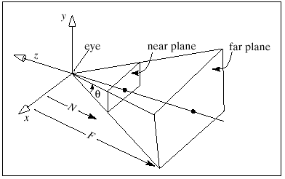
Setting the view volume
The shape of the camera’s view volume is encoded in the projection matrix.
glMatrixMode(GL_PROJECTION);//make the projection matrix current
glLoadIdentity(); // start with a unit matrix
gluPerspective(viewAngle, aspectRatio, N,F); //load the appropriate value

Slide 13
The OpenGL Camera
In OpenGL, initially the world and camera frames are the same
Default model-view matrix is an identity
The camera is located at origin and points in the negative z direction
OpenGL also specifies a default view volume that is a cube with sides of length 2 centered at the origin
Default projection matrix is an identity

Slide 14
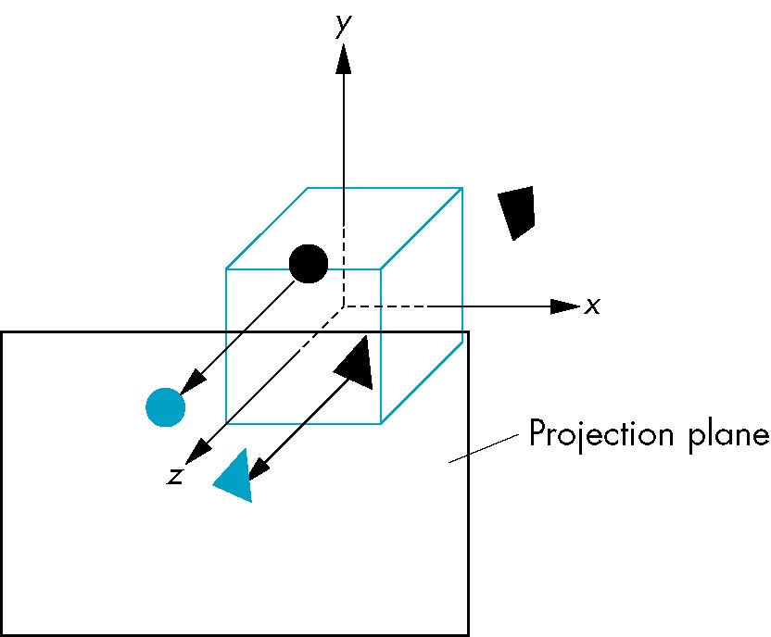
Default Projection
Default projection is orthogonal
clipped out
2
z=0

Slide 15
Moving the Camera Frame
If we want to visualize object with both positive and negative z values we can either
Move the camera in the positive z direction
Translate the camera frame
Move the objects in the negative z direction
Translate the world frame
Both of these views are equivalent and are determined by the model-view matrix
Want a translation (glTranslatef(0.0,0.0,-d);)
d > 0

Slide 16
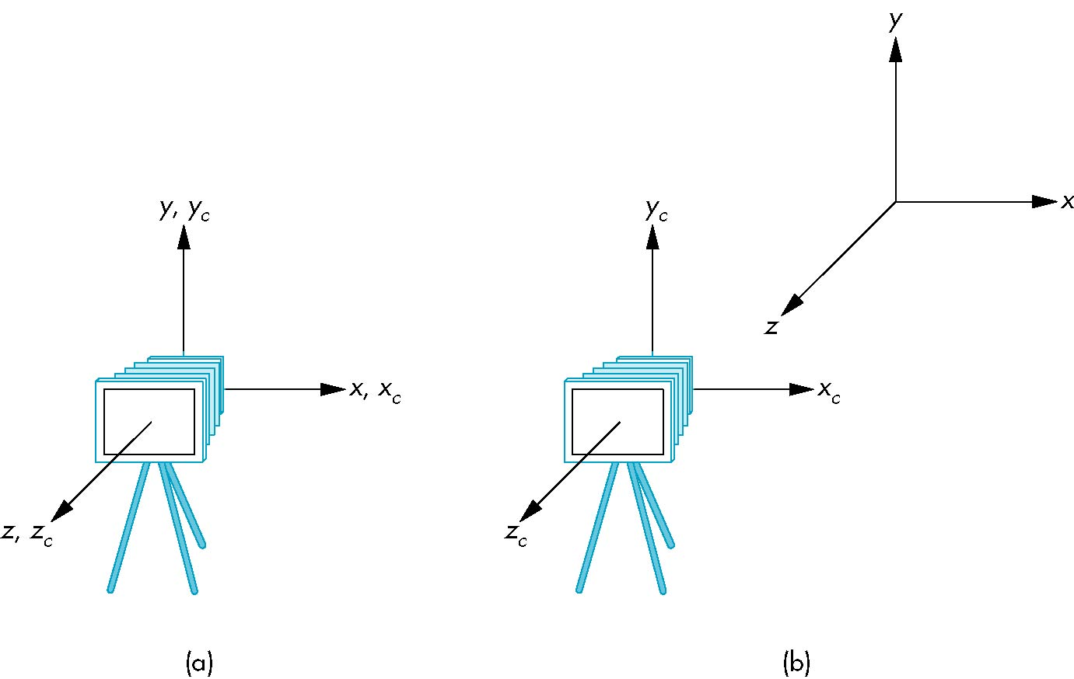
Moving Camera back from Origin
frames after translation by –d
d > 0
default frames

Slide 17
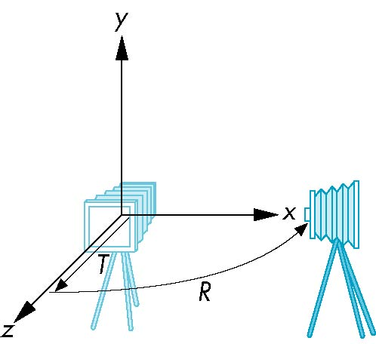
Moving the Camera
We can move the camera to any desired position by a sequence of rotations and translations
Example: side view
Rotate the camera
Move it away from origin
Model-view matrix C = TR

Slide 18
OpenGL code
glMatrixMode(GL_MODELVIEW)
glLoadIdentity();
glTranslatef(0.0, 0.0, -d);
glRotatef(90.0, 0.0, 1.0, 0.0);

Slide 19
The LookAt Function
The GLU library contains the function glLookAt to from the required modelview matrix through a simple interface
Note the need for setting an up direction
Still need to initialize
Can concatenate with modeling transformations
Example: isometric view of cube aligned with axes
glMatrixMode(GL_MODELVIEW):
glLoadIdentity();
gluLookAt(1.0, 1.0, 1.0, 0.0, 0.0, 0.0, 0., 1.0. 0.0);

Slide 20
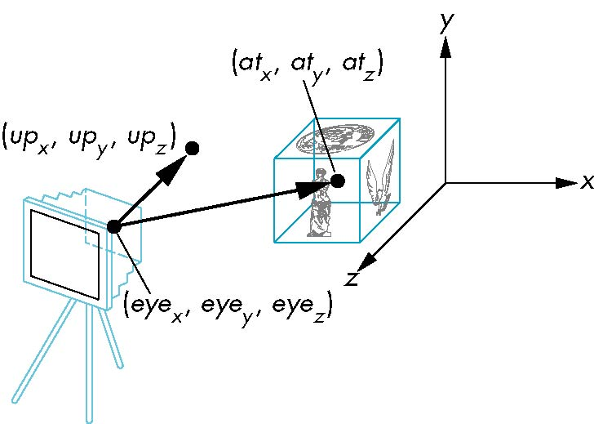
gluLookAt(eye.x, eye.y, eye.z, look.x, look.y, look.z, up.x, up.y, up.z)

Slide 21
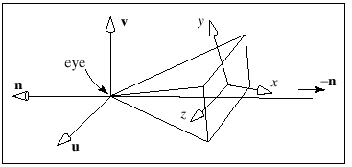
It is useful to attach a coordinate system to the camera.
This coordinate system has its origin at the eye, and has three axes, u,
v, and n

Slide 22
Other Viewing APIs
The LookAt function is only one possible API for positioning the camera
Others include
View reference point, view plane normal, view up (PHIGS, GKS-3D)
Yaw, pitch, roll
Elevation, azimuth, twist
Direction angles

Slide 23
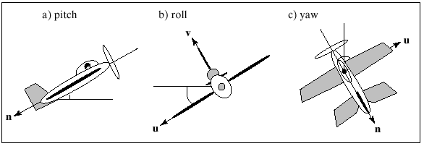

Slide 24
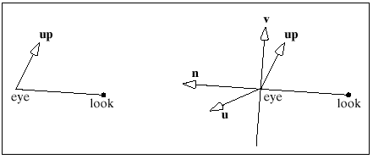
What are the directions of u,v, and n when we execute gluLookAt()?
n = eye – look
u = up x n
v = n x u

Slide 25
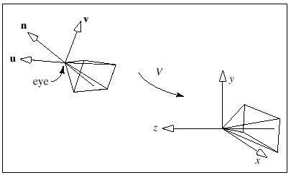
The transformation that gluLookAt() sets up
The gluLookAt() sets up the transformation matrix V that converts
world coordinates to camera coordinates and the matrix M that
embodies all of the modeling all of the modeling transformations
applied to points.

Slide 26
Projections and Normalization
The default projection in the eye (camera) frame is orthogonal
For points within the default view volume
Most graphics systems use view normalization
All other views are converted to the default view by transformations that determine the projection matrix
Allows use of the same pipeline for all views
x_{p} = x
y_{p} = y
z_{p} = 0

Slide 27
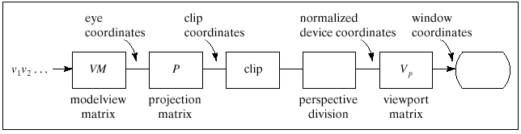
Perspective Projections of 3D objects

Slide 28
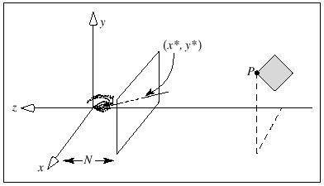
Perspective projection of a point
Note that the denominator term is larger for more remote points .
This introduces perspective forshortening and makes remote parts of an object appear smaller than nearer parts.

Slide 29
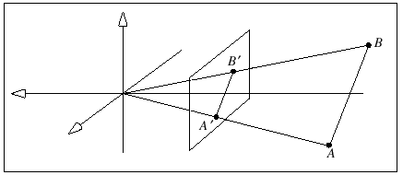
Straight lines project to straight lines.

Slide 30
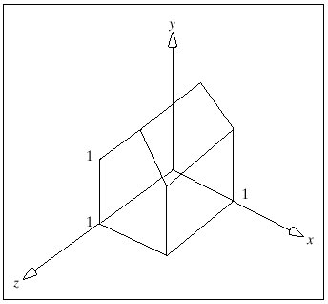
Example:

Slide 31
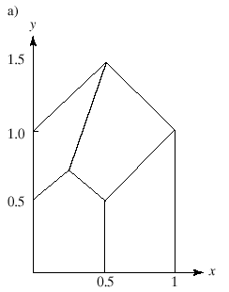
View 1: Set the camera’s eye at (0,0,2) and have it look down the
negative z-axis, with u = (1,0,0), n = (-1,0,0)
Set the near plane at a distance of unity from the eye.
All points on the front wall have P_{z} = -1
All points on the back wall have P_{z} = -2
Any point (P_{x},P_{y},P_{z}) on the front wall projects to P’= (P_{x},P_{y})
Any point on the back wall projects to P’= (P_{x}/2,P_{y} /2)

Slide 32
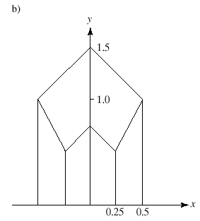
View 2: Set the camera’s eye at (0.5,0,2) , u and n are the same.
Set the near plane at a distance of unity from the eye.

Slide 33
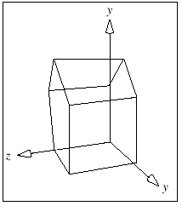
View 3: Set the camera’s eye at (2,5,2) , look = (0,0,0).

Slide 34
Perspective Projection of a line
Suppose a line in 3D passes through the point A = (A_{x}, A_{y}, A_{z}) and
the direction vector c = (c_{x},c_{y},c_{z}).
P(t) = A + ct.
Suppose the line A + ct is parallel to the viewplane. Then c_{z} = 0
This is the parametric form of a line with slope c_{y}/c_{x}

Slide 35
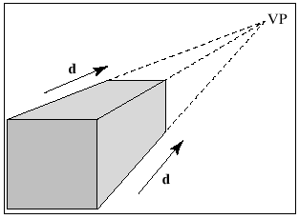
If two lines in 3D are parallel to each other and to the viewplane, they
project to two parallel lines.
All parallel lines share the same vanishing point. In particular, they
project to lines that are not parallel.

Slide 36
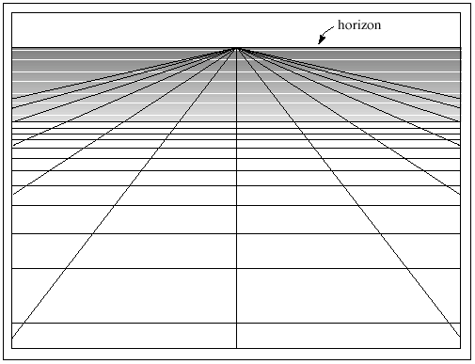
A grid of lines

Slide 37
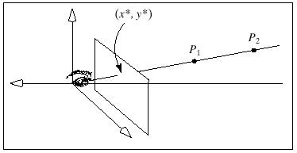
Adding Pseudodepth
Taking a projection discards information on depth; we lose information
about how far a point is from the eye.

Slide 38
Adding Pseudodepth
The actual distance of a point P from the eye, is
Cumbersome and slow to compute

Slide 39
What is a good choice for the pseudodepth function?
We will choose a and b s.t. the pseudodepth varies between -1 and 1.

Slide 40
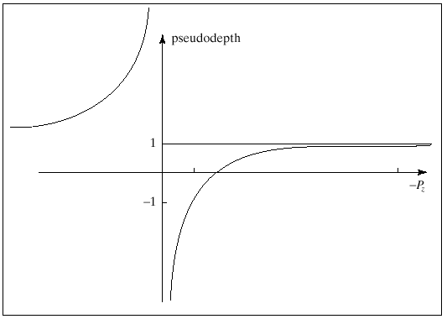

Slide 41
Homogeneous Coordinate Form
Recall that a point P=(P_{x},P_{y},P_{z}) has the representation
(P_{x},P_{y},P_{z},1) in homogeneous coordinates and
a vector v=(v_{x},v_{y},v_{z}) has the representation (v_{x},v_{y},v_{z},0)
Now we extend the idea and say that a point P=(P_{x},P_{y},P_{z}) has a whole family of homogeneous representations
(wP_{x},wP_{y},wP_{z},w) for any value of w except 0.
e.g. the point (1,2,3) has representations (1,2,3,1), (2,4,6,2), (.3,.6,.9,.3)

Slide 42
Homogeneous Coordinate Form
Consider and affine transform
q = Mp where
M =

Slide 43
What if we deviate from a fourth row of (0,0,0,1)?
consider

Slide 44
Which point is this?
Dividing through the fourth component
Perspective division!!
Perspective transformation!!

Slide 45
Perspective projection
Perspective projection = perspective transformation + orthographic
projection

Slide 46
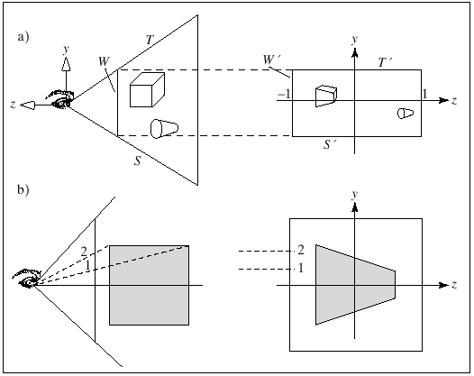
Transforming the view volume
The perspective transformation “warps” objects so that, when viewed with an orthographic projection, they appear the same as the original objects do when viewed with a perspective projection

Slide 47
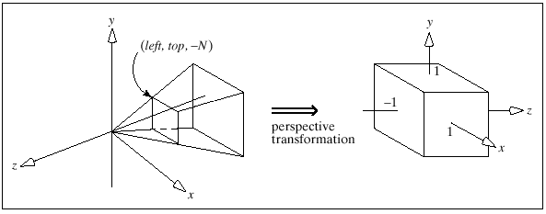
Transforming the view volume

Slide 48
OpenGL composes the perspective transformation with another
mapping that scales and shifts this parallelepiped into the canonical
view volume, a cube that extends from -1 to 1 in each dimension.

Slide 49
Two steps
Move center to origin
T(-(left+right)/2, -(bottom+top)/2)
Scale to have sides of length 2
S(2/(left-right),2/(top-bottom),2/(near-far))
R =
This is the projection matrix, and it performs the perspective
transformation plus scaling and shifting to transform the camera’s view
volume into the canonical view volume.

Slide 50
R =
This is the matrix, that OpenGL creates (and by which it multiplies the
current matrix) when glFrustum(left,right,bott,top,N,F)
is executed.

Slide 51
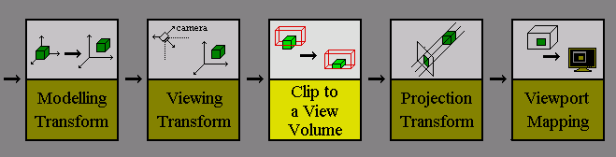
The view volume bounds the portion of the scene that is to be clipped
out and projected onto the view plane. However, the view volume
depends on the type of projection.

Slide 52
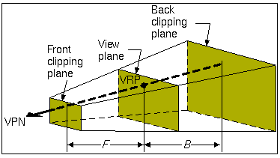
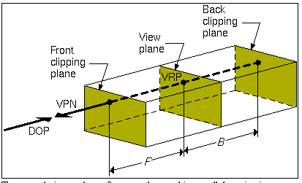

Slide 53
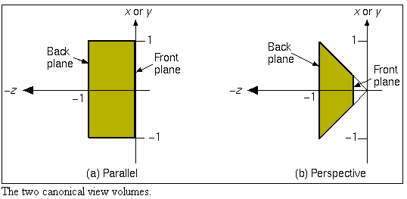
Canonical View Volume
The canonical view volumes are a prism for parallel projections
and the truncated right regular pyramid for perspective projections.
It is much easier to clip to these volumes than to an arbitrary view
volume, so view volumes are often transformed to one of these before
clipping.

Slide 54
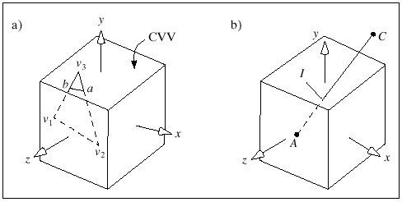
Clipping Faces against View Volume
A point lies inside the camera’s view volume if its transformed version
lies inside the canonical view volume.

Slide 55
Back-face culling can be performed to eliminate the polygons which
are facing away from the viewer.
Culling is a process where any polygon facing away from the view
direction is labeled as 'invisible' and ignored through the rest of the
pipeline.

Slide 56
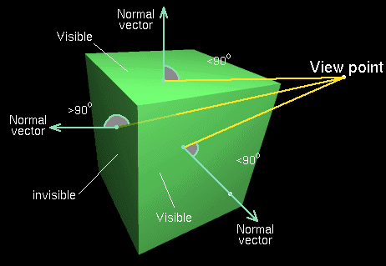

Slide 57
The test for visibility is quite straightforward and is best carried out in
view space.
We calculate the outward normal for a polygon and apply it to the
following equation:
If N_{p} . N > 0 then the polygon is visible, otherwise invisible where:
N_{p} is the polygon normal N is the vector from the polygon to the
viewpoint ('line of sight' vector)

Slide 58
The Cohen-Sutherland algorithm (3D Version)
The Cohen-Sutherland algorithm extends to 3D very simply.
The outcode for 3D clipping is a 6-bit code. For a parallel canonical
view volume the bits represent:
bit 1 - point above view volume (Y>1)
bit 2 - point below view volume (Y<-1)
bit 3 - point to the right of view volume (X>1)
bit 4 - point to the left of view volume (X<-1)
bit 5 - point behind view volume (Z<-1)
bit 6 - point in front of view volume (Z>0)

Slide 59
As in the 2D case, the line may be trivially accepted
(both outcodes=000000), or trivially rejected
((code 1 AND code 2) not 000000).
Otherwise line subdivision is used again. The points of intersection
with the clipping edges are found using a parametric representation of
the line being clipped.

Slide 60
Suppose we want to clip the line segment AC against the CVV.
View the CVV as six infinite planes and consider where the given
edge lies relative to each plane in turn.

Slide 61
A +(C-A)t
If A and C lie on the same side of a wall, no need to compute the
intersection of the edge with the wall.
If A and C lie on opposite sides, locate the intersection point and clip
off the part of the edge that lies outside the wall.

Slide 62
We need to test whether a point is on the “outside” or “inside” of a plane.
Consider the plane x = -1. The point A lies to the right of it
(on the “inside) if

Slide 63
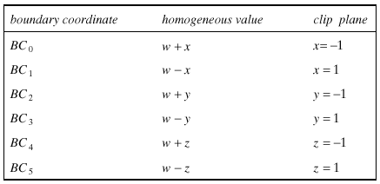

Slide 64
Following the clipping operation, perspective division is finally done.

Slide 65
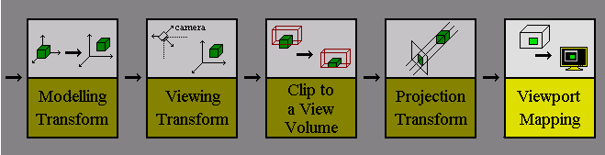
Pipeline View

Slide 66
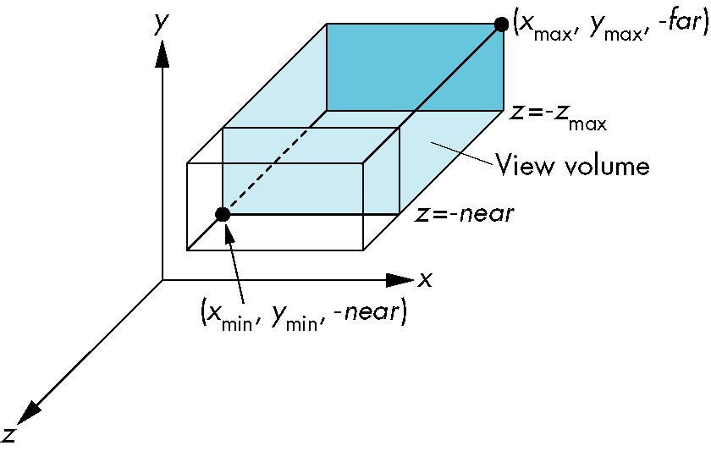
OpenGL Orthogonal Viewing
glOrtho(xmin,xmax,ymin,ymax,near,far)
glOrtho(left,right,bottom,top,near,far)
near and far measured from camera

Slide 67
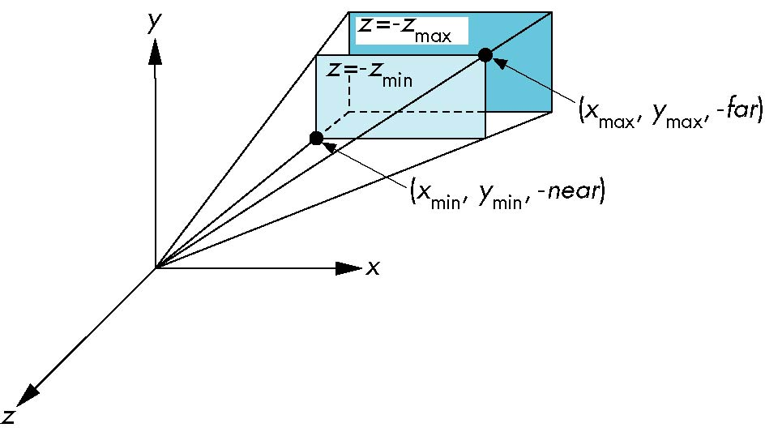
OpenGL Perspective
glFrustum(xmin,xmax,ymin,ymax,near,far)

Slide 68
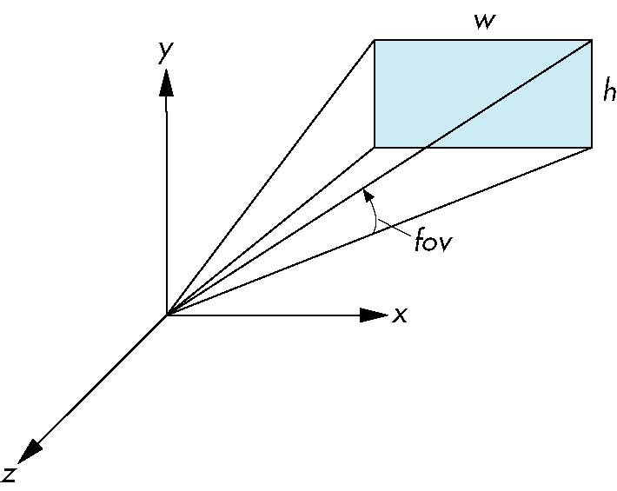
Using Field of View
With glFrustum it is often difficult to get the desired view
gluPerpective(fovy, aspect, near, far) often provides a better interface
front plane
aspect = w/h

Slide 69
Notes
We stay in four-dimensional homogeneous coordinates through both the modelview and projection transformations
Both these transformations are nonsingular
Default to identity matrices (orthogonal view)
Normalization lets us clip against simple cube regardless of type of projection
Delay final projection until end
Important for hidden-surface removal to retain depth information as long as possible

Slide 70
Final Projection
Set z =0
Equivalent to the homogeneous coordinate transformation
Hence, general orthogonal projection in 4D is
M_{orth} =
P = M_{orth}ST

Slide 71
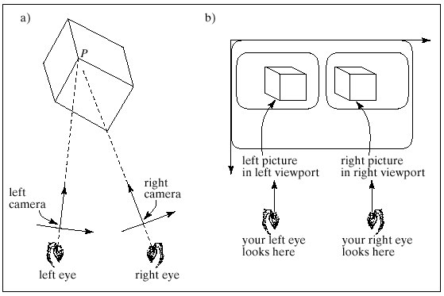
Producing Stereo Views
To make a stereo view, two pictures – a “left eye” and a “right eye” picture – are made using slightly different cameras.
The cameras have the same LookAt point, but different eye positions.

Slide 72
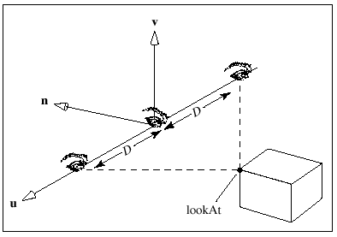
Where do we put the left and right eye?

Slide 73
Taxonomy of Planar Geometric Projections
planar geometric projections
parallel
perspective
1 point
2 point
3 point
multiview
orthographic
axonometric
oblique
isometric
dimetric
trimetric

Slide 74
Vanishing Points
Parallel lines (not parallel to the projection plan) on the object converge at a single point in the projection (the vanishing point)
Drawing simple perspectives by hand uses these vanishing point(s)
vanishing point

Slide 75
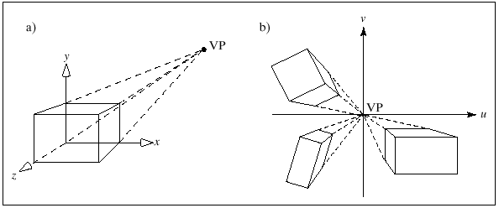
Perspective projections are categorized by their number of principal vanishing points and therefore by the number of axes the projection plane cuts.
One point perspective views

Slide 76
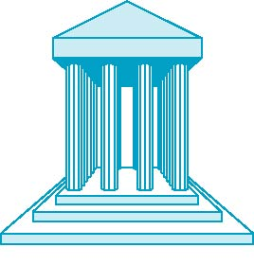
One-Point Perspective
One principal face parallel to projection plane
One vanishing point for cube

Slide 77
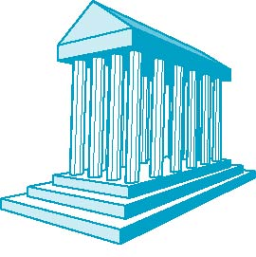
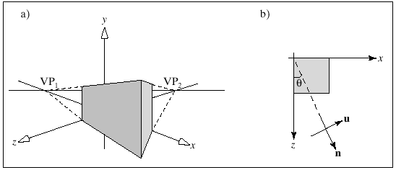
Two-Point Perspective
On principal direction parallel to projection plane
Two vanishing points for cube

Slide 78
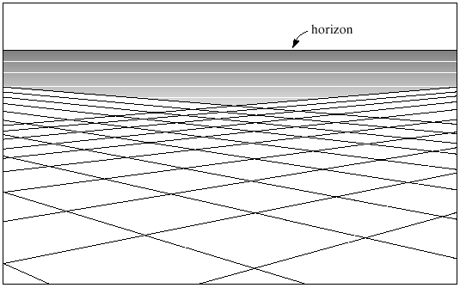
The infinite grid in two-point perspective

Slide 79
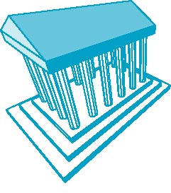
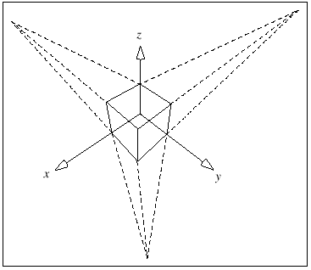
Three-Point Perspective
No principal face parallel to projection plane
Three vanishing points for cube

Slide 80
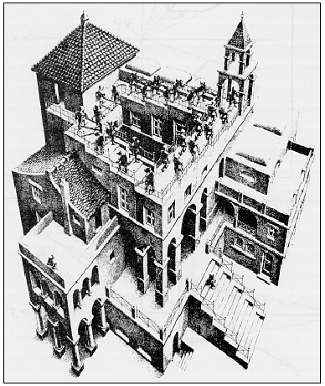
Escher’s Ascending and Descending: a three-point perspective.

Slide 81
Advantages and Disadvantages
Objects further from viewer are projected smaller than the same sized objects closer to the viewer (diminuition)
Looks realistic
Equal distances along a line are not projected into equal distances (non-uniform foreshortening)
Angles preserved only in planes parallel to the projection plane
More difficult to construct by hand than parallel projections (but not more difficult by computer)

Slide 82
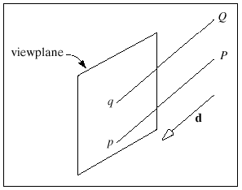
Parallel Projections
To what point p does P project?

Slide 83
Using n=(0,0,1), and project onto the xy plane for which B=(0,0,0)

Slide 84
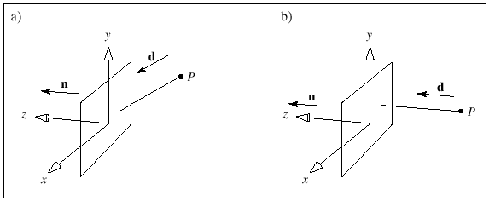
Parallel Projections
Oblique Orthographic
Oblique = the projection direction d is not parallel to n
Orthographic = the projection direction d is parallel to n

Slide 85

Orthographic Projection
Projectors are orthogonal to projection surface
In orthographic projections, d_{x} and d_{y} are zero.

Slide 86

Orthogonal Normalization
glOrtho(left,right,bottom,top,near,far)
normalization ⇒ find transformation to convert
specified clipping volume to default

Slide 87
Orthogonal Matrix
Two steps
Move center to origin
T(-(left+right)/2, -(bottom+top)/2,(near+far)/2))
Scale to have sides of length 2
S(2/(left-right),2/(top-bottom),2/(near-far))
P = ST =

Slide 88

Multiview Orthographic Projection
Projection plane parallel to principal face
Usually form front, top, side views
isometric (not multiview
orthographic view)
front
in CAD and architecture,
we often display three
multiviews plus isometric
top
side

Slide 89


Slide 90
Advantages and Disadvantages
Preserves both distances and angles
Shapes preserved
Can be used for measurements
Building plans
Manuals
Cannot see what object really looks like because many surfaces hidden from view
Often we add the isometric

Slide 91

Axonometric Orthographic Projections
Allow projection planes that are not normal to a principle axis and therefore show several faces of an object at once.
classify by how many angles of
a corner of a projected cube are
the same
none: trimetric
two: dimetric
three: isometric
θ ₁
θ ₂
θ ₃

Slide 92

Axonometric Orthographic Projections
foreshortening

Slide 93

Types of Axonometric Projections
2 principle axes foreshortened equally.
All 3 principle axes foreshortened unequally.
All 3 principle axes foreshortened equally.

Slide 94
Advantages and Disadvantages
Lines are scaled (foreshortened) but can find scaling factors (all three principal axes are equally foreshortened
Lines preserved but angles are not
Projection of a circle in a plane not parallel to the projection plane is an ellipse
Can see three principal faces of a box-like object
Some optical illusions possible
Parallel lines appear to diverge
Does not look real because far objects are scaled the same as near objects
Used in CAD applications

Slide 95
Oblique Projection
Orthographic projections preserve the exact shape of one face of an object, but do not reveal its 3D nature very well.
Axonometric projections show a 3D quality, but do not yield the
exact shape of any of the faces of the object.
Oblique projections are an attempt to combine the uesful properties of
both orthographic and axonometric projections.
They usually present the exact shape of one face of an object (the most
important face), while simultaneously revealing the general 3D
appearance of the object.

Slide 96
Oblique Projections
Oblique Projection = Shear + Orthogonal Projection

Slide 97

Oblique Projection
Arbitrary relationship between projectors and projection plane

Slide 98



Slide 99
Advantages and Disadvantages
Can pick the angles to emphasize a particular face
Architecture: plan oblique, elevation oblique
Angles in faces parallel to projection plane are preserved while we can still see “around” side
In physical world, cannot create with simple camera; possible with bellows camera or special lens (architectural)

Slide 100

Classical Projections

Slide 101

OpenGL Perspective
glFrustum allows for an unsymmetric viewing frustum (although gluPerspective does not)

Slide 102
OpenGL Perspective Matrix
The normalization in glFrustum requires an initial shear to form a right viewing pyramid, followed by a scaling to get the normalized perspective volume. Finally, the perspective matrix results in needing only a final orthogonal transformation
P = NSH
our previously defined
perspective matrix
shear and scale

Slide 103
Why do we do it this way?
Normalization allows for a single pipeline for both perspective and orthogonal viewing
We keep in four dimensional homogeneous coordinates as long as possible to retain three-dimensional information needed for hidden-surface removal and shading
We simplify clipping

