Slide 1
Rendering Pipeline

Slide 2
Pipeline
Main function is to render a 2D image
Application
Geometry
Rasterizer

Slide 3
Pipeline
Most of the pipeline stages are implemented in hardware, impossible to
  Optimize
  Improve
As in a real pipeline the speed of the pipeline is determined by its slowest pipeline stage, no matter how fast the other stages may be
Remember you cannot update the display faster than your output device

Slide 4
Example
Output device maximum update frequency: 60 Hz
Rendering pipeline bottleneck: 62.5ms
First compute the maximum rendering speed:
  1/0.0625 = 16 Hz.
Second adjust the value of to the frequency of the output device:
  60Hz, 30Hz, 20Hz, 15Hz, 12Hz..
  We can expect the rendering speed to be 15Hz

Slide 5
Application Stage
Fully software implemented
Room of improvement
  Decreasing the number of triangles
Can be executed in parallel on several CPU’s
  superscalar construction: execute several things at the same time in the same stage

Slide 6
Application Stage
GPU
Vertex Processing
CPU
AGP Bus
Application
Triangle Setup
API
Large Cache
Fragment Shading
Conceptually, 5 processors
  CPU
  Vertex-processor(s)
  Setup processor(s)
  Fragment processor(s)
  Blending processor(s)
Framebuffer Access

Slide 7
Application Stage
Collision detection
Input from sensors, devices
Running the VE simulation
Animations
View frustum culling

Slide 8
Geometry Stage
Most of the per-polygon and per-vertex operations
Model & View
Transform
Lighting
Projection
Clipping
Screen Mapping

Slide 9
Model and View Transform
Model & View
Transform
Lighting
Projection
Clipping
Screen Mapping
Transformation of the vertices and normals of a model
Model Transform: model to world coordinates
  A unique space with all the models
View Transform: to place the camera at the origin and aim it, to make it look in the direction of negative z-axis.
  Facilitate projection and clipping

Slide 10
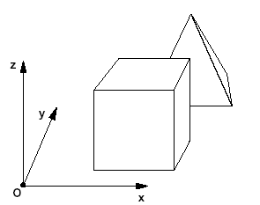
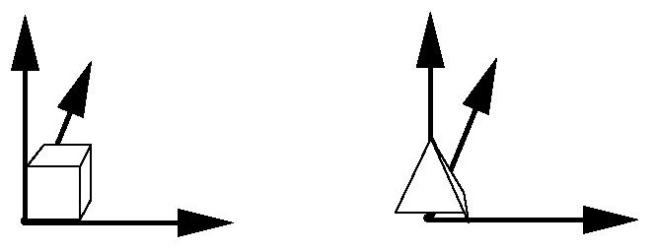
Model and View Transform
Model & View
Transform
Lighting
Projection
Clipping
Screen Mapping
Object space
World space

Slide 11
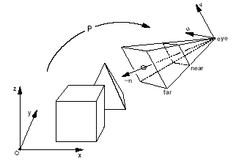
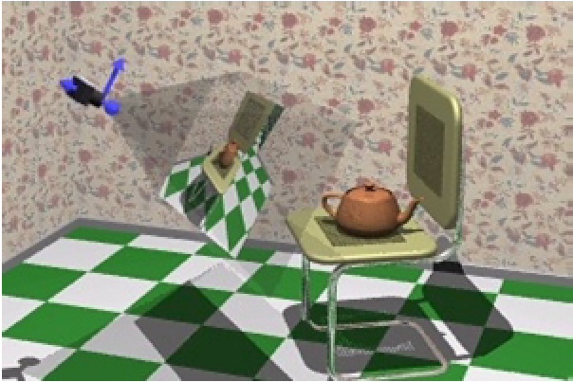
Model and View Transform
Model & View
Transform
Lighting
Projection
Clipping
Screen Mapping
Eye space
World space

Slide 12
Model and View Transforms
Model & View
Transform
Lighting
Projection
Clipping
Screen Mapping
More advanced operations at this stage
  Vertex Blending: to smoothly join rigid parts
  Vertex Shader transforms can modify the geometry of the surface

Slide 13
Lighting
Model & View
Transform
Lighting
Projection
Clipping
Screen Mapping
Effect of light sources in the scene
Compute a color at each vertex of the model with lighting equations
It approximates the real world interaction between photons and surfaces
No true reflections, shadows

Slide 14
Lighting
Model & View
Transform
Lighting
Projection
Clipping
Screen Mapping
The color of each vertex of the surface is computed using
  Location of the light sources and their properties
  The position and normal of the vertex
  The properties of the material belonging to the vertex
Afterwards the colors at the vertices of a triangle are interpolated over the triangle when rendering to the screen (Gouraud shading)
Pixel shading in the rasterization

Slide 15
Projection
Model & View
Transform
Lighting
Projection
Clipping
Screen Mapping
Transform the view volume into a unit cube
between (-1, -1, -1) and (1,1,1)
There are two projection methods
  Orthographic
    Parallel lines remain parallel.
    Translation + Scaling
  Perspective
    The farther away an object lines from the camera, the smaller it appears
    Parallel lines may converge at the horizon
    View volume is a frustum

Slide 16
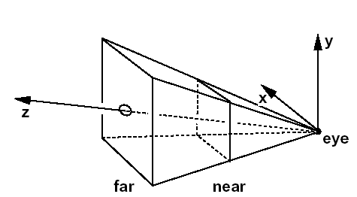
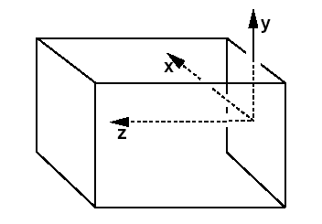
Projection
Model & View
Transform
Lighting
Projection
Clipping
Screen Mapping
Eye space
NDC
After projection transform the models are in normalized device coordinates (NDC)

Slide 17
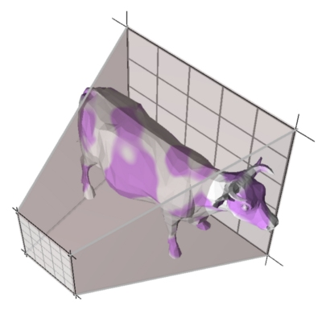
Clipping
Model & View
Transform
Lighting
Projection
Clipping
Screen Mapping
Only the primitives wholly or partially inside the view volume need to be rendered
It is the primitives that are partially inside the view volume require clipping

Slide 18
Screen Mapping
Model & View
Transform
Lighting
Projection
Clipping
Screen Mapping
The x,y coordinates of each primitive are transformed to form screen coordinates. With z coordinates (unchanged) they form window coordinates.
(x,y) are between the max and min of the window coordinates.
Translation + scaling

Slide 19
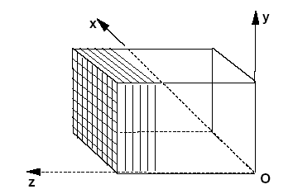
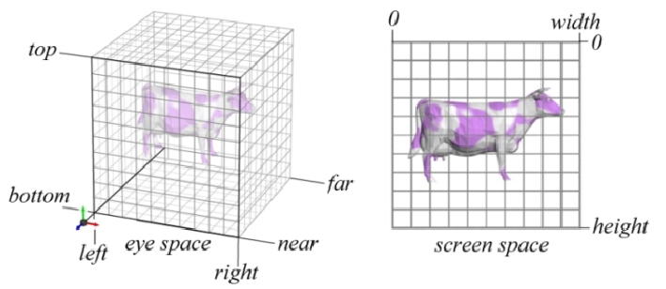
Screen Mapping
NDC
Screen Space

Slide 20
Rasterizer / Scan Conversion
Task: Assign correct colors to the pixels to render an image correctly.
Each Vertices has
  2D screen coordinates with z value
  One or two colors
  One or more sets of texture coordinates

Slide 21
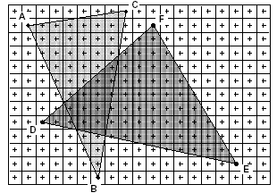
Rasterizer

Slide 22
Rasterizer
Double Buffering
Visibility (Z-Buffer)
  When a primitive is being rendered to a certain pixel, the z-value on that primitive at that pixel is being computed and compared to the contents of the Z-buffer at the same pixel.
  If the new z-value is smaller than the z-value in the Z-Buffer, then the primitive that being rendered is closer to the camera than the primitive that was previously closest to the camera at that pixel.
  This algorithm allows the primitives to be rendered at any order. (What are the drawbacks ??)

Slide 23
Rasterizer
Alpha Channel
  Opacity value for each pixel
Stencil Buffer
  Controlling color and z buffer with a mask
Frame Buffer
  Color and Z buffer
Accumulation Buffer
  Images can be accumulated using a set of operations. (motion blurring, depth of field, antialiasing, soft shadows)

Slide 24
OpenGL Resources
https://www.khronos.org/
http://www.opengl-tutorial.org/
https://www.realtimerendering.com/

