Slide 1


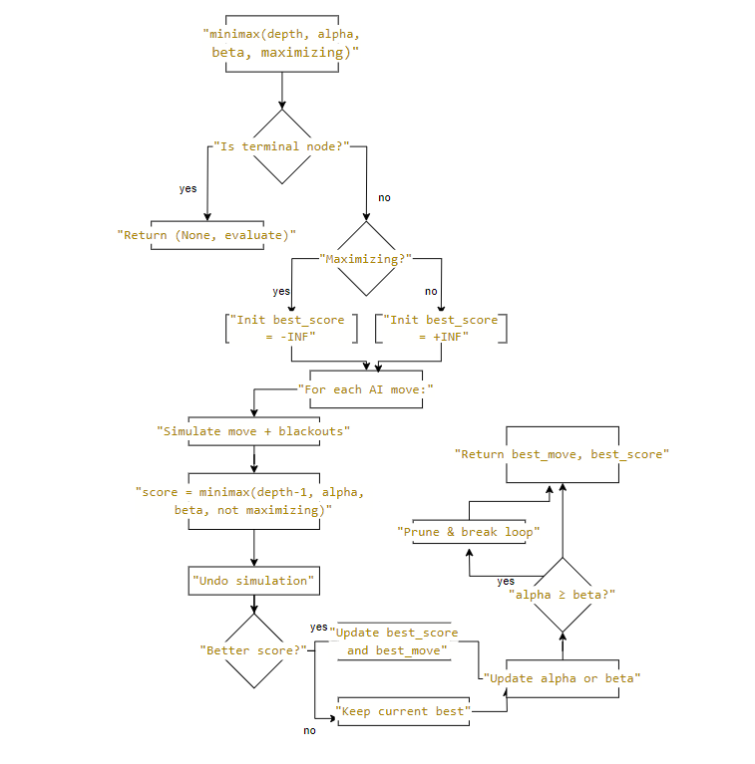
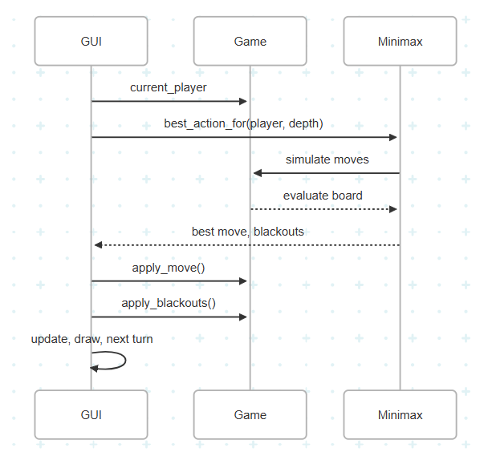

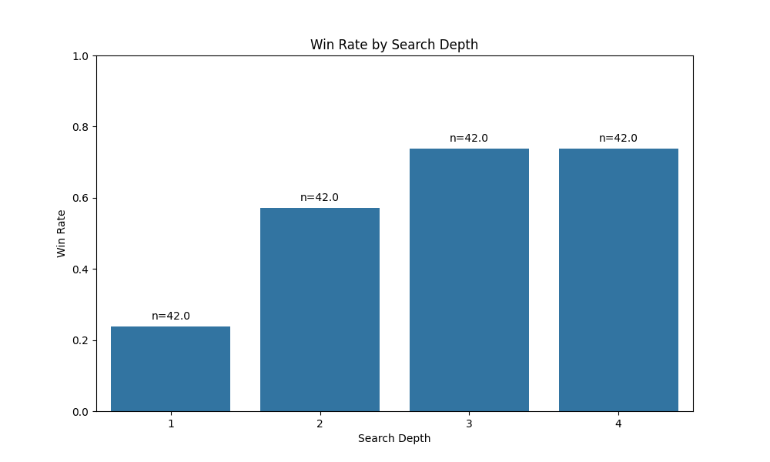
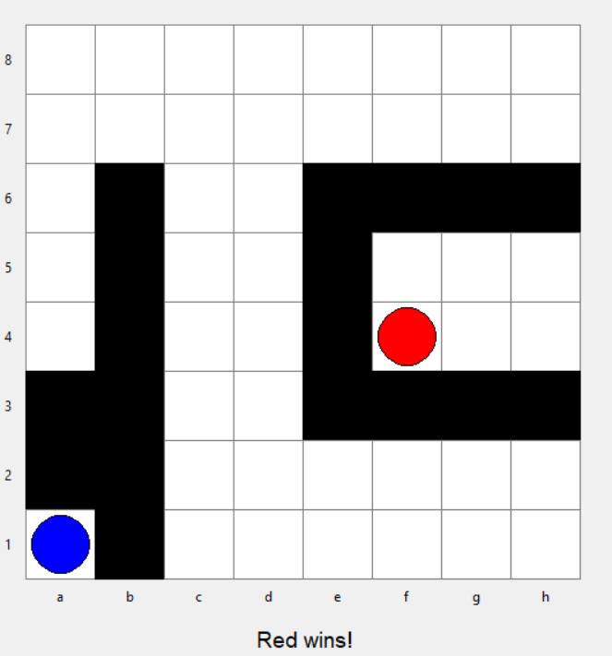
GAME AI WITH MINIMAX
AND ALPHA-BETA TECHNIQUES
Bartu Uyar Mustafa Bülent Mutluoğlu
Department of Computer Engineering, Yeditepe University
Abstract
The development of game-playing agents is a well-established and important area within both computer science and game design. Beyond entertainment, game AI finds significant applications in educational contexts within games, and advancements in fields like reinforcement learning have profound impacts on real-world applications such as self-driving cars. A key challenge in this domain lies in creating game artificial intelligence that not only plays strategically and optimally but also operates within computationally feasible timeframes. This project specifically addresses this challenge by implementing and analyzing the Minimax algorithm with Alpha-Beta pruning for the Isolation Game, a two-player strategy game. The core methodology focuses on efficient decision-making under the combinatorial explosion of possible moves and blackout options, demonstrating the critical role of Alpha-Beta pruning.
Implementation
The project was implemented in Python using the Tkinter library for the GUI and a modular class structure for game logic and AI. The AI component supports variable depth search. The GUI allows users to play against another human, against the AI, or watch two AIs play. It includes real-time board updates, visual indicators for legal moves and blackouts, and a timer system in hard mode.
Minimax Flowchart
Isolation Game
Isolation Game is a two-player strategy game played on an 8x8 board. Each player takes turns moving their token to an adjacent square and then blacking out two tiles to limit the opponent's movement. A player loses when they can no longer make a legal move. This rule set creates a shrinking, dynamic environment that rewards spatial reasoning and planning. The game has perfect information and no chance elements, making it ideal for search-based AI methods. Figure below shows an example board during gameplay, with red and blue tokens and blacked-out tiles.
AI Methodology
The AI developed for this project uses classical game tree search techniques to choose optimal actions. Specifically, it employs the Minimax algorithm with Alpha-Beta pruning to simulate future game states. In each state, the AI evaluates possible moves, simulates the opponent’s best responses, and selects the move that maximizes its advantage while minimizing the opponent’s. This is guided by a utility function based on mobility: the difference in number of legal moves between players..
Results
The AI demonstrates strong performance at search depths of 3 and 4, consistently outperforming human players and lower-depth AIs. Across multiple test scenarios, it was shown to effectively limit the opponent’s mobility and avoid self-traps, validating the effectiveness of the minimax-based approach with Alpha-Beta pruning.
User feedback collected through a Likert-scale survey indicated that the majority of players found the game to be enjoyable, challenging, and visually clear. The interface was rated as responsive and intuitive, supporting an overall positive user experience.
Experimental modes, such as Hard Mode, featuring randomized starting positions and time-limited moves significantly increased game tension and strategic variation. These features were well-received and contributed to higher engagement levels during testing. The results support the AI's competence in adversarial planning as well as the project's usability and entertainment value.
References
[1] P. N. Stuart Russell, Artificial Intelligence: A Modern Approach, Global Edition. Pear
son Higher Ed: Pearson Higher Ed, Jul. 2016, ISBN: 9781292153971, 1292153970.
[2] C. E. S. and, “Xxii. programming a computer for playing chess,” The London, Edin
burgh, and Dublin Philosophical Magazine and Journal of Science
[3] Stockfish (chess), en, Page Version ID: 1296970334, Jun. 2025. [Online]. Available:
https://en.wikipedia.org/w/index.php?title=Stockfish_(chess)&oldid=
1296970334
[4] P. Sweetser and P. Wyeth, “GameFlow: A model for evaluating player enjoyment in
games,” en, Computers in Entertainment, vol. 3, no. 3
Future Work
We may explore more advanced methods like Monte Carlo Tree Search or reinforcement learning, and features like networked play or adaptive difficulty. The project also serves as a modular foundation for experimenting with AI in other turn-based board games.
GUI Design
Contact
mustafa.mutluoglu@yeditepe.edu.tr
uyarbartu@gmail.com

