Slide 1
Monitoring environment-parameters
for research towards
energy-efficient buildings

Slide 3
Speaker's Intro
Speaker
  Bart Voet
Day Job
  Practice Lead Java Development at AXA
Evening and weekend
  Family
  Programming and hacking
  Learning electronics
  Skateboarding and snowboarding
  ...

Slide 4
Intro
What is the content of this thesis?

Slide 5
Stakeholders
Primary stakeholder
  Division of Building Physics KUL
  (Department Civil Engineering)
    System capturing data from digital sensors
    Scalable to different scenario's
      Research facility
      Educational environment
      External research

Slide 6
Stakeholders
Stakeholder
  Groep T
  Evolution
      Smart sensors
      Digital interfaces
      Sensor networking
    New devices (and open source)
      Rapsberry Pi, BeagleBoard, Cubieboard
      AVR, Arduino, ...
      ...

Slide 7
Stakeholders
Stakeholder
  Author (and other hobbyist)
  Learning platform
      Experienced Java Developer
      Learning embedded development
    Open source platform
      Scalable to different devices
      Focused on monitoring
      Integrable in different scenario's

Slide 8
Requirements and scope
What is expected?

Slide 9
Startup requirements
Context
  Department of Building Physics KUL
  performing
  research on energy efficient buildings

Slide 10
Startup requirements
Demand
  System(s) for continuous measurement
  that is
    Reliable
    Inexpensive system(s)
    Continuous measurement

Slide 11
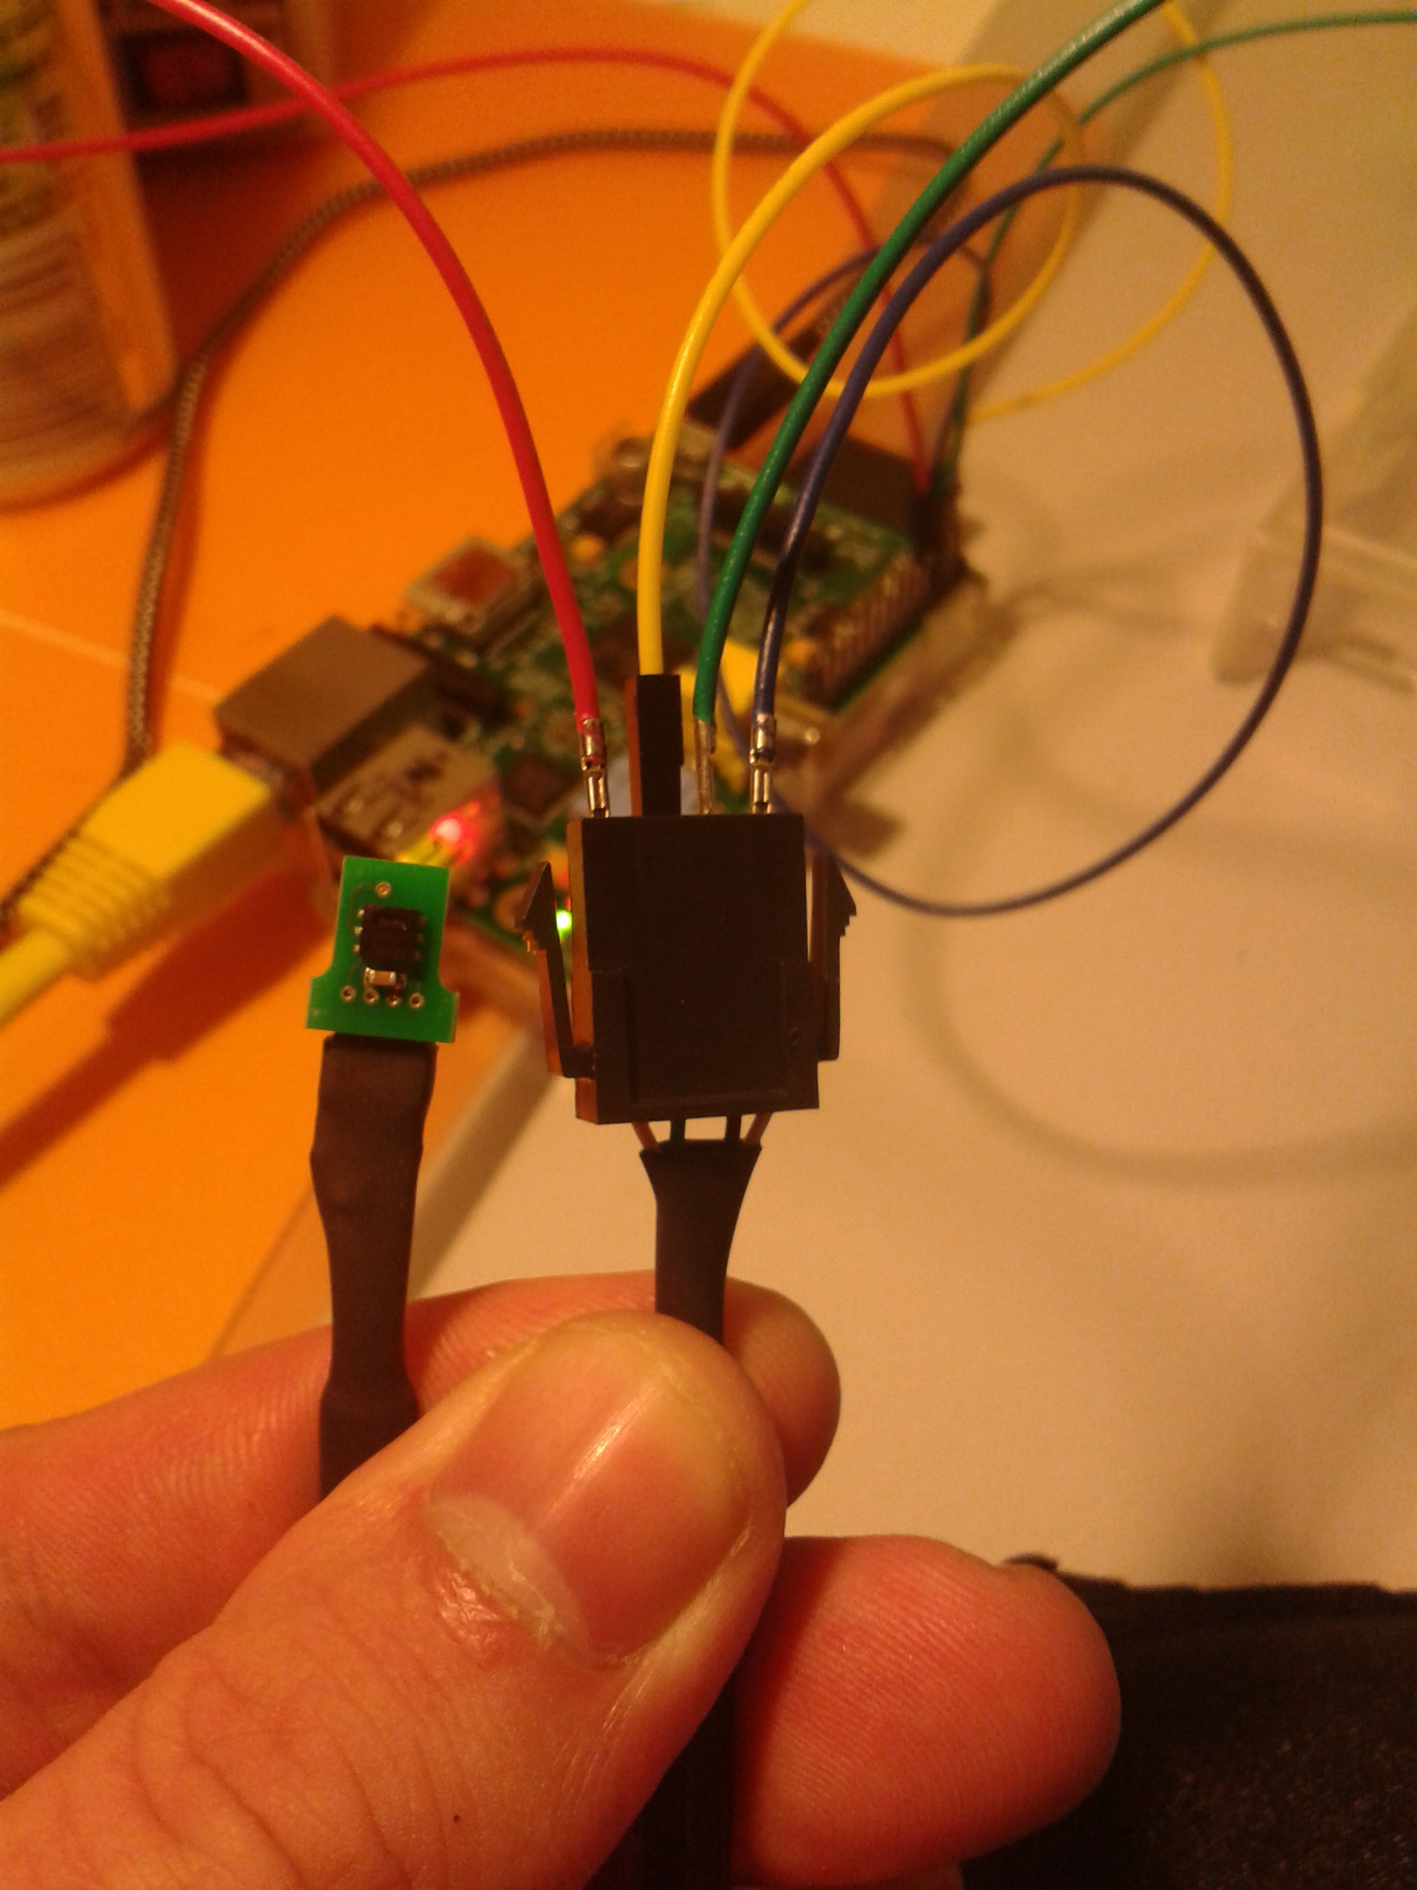
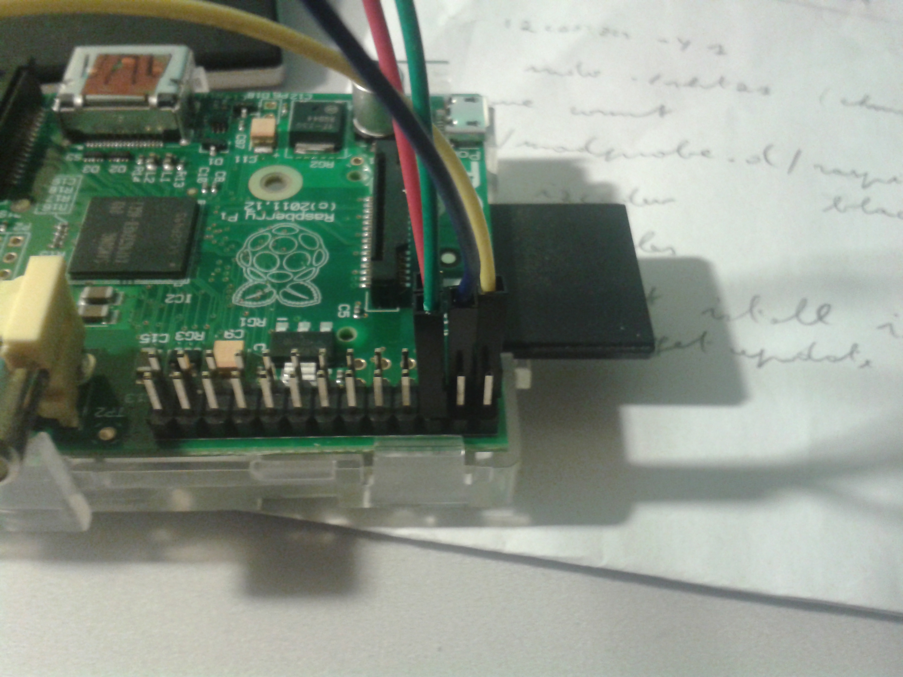
Startup requirements
Use Raspberry Pi as a device for sensing

Slide 12
Startup requirements
Use Raspberry Pi as a device for sensing
environment parameters
  Important for
    Indoor climate
    Energy consumption
  Example given
    Relative humidity
    Temperature
    Differential pressure
  … and other measurements in the future

Slide 13
Startup requirements
More specifically, use Raspberry Pi as a device to
  Control and configure sensors
  Collect data
  Store sensor measurements
    (for later evaluation and analysis)
  Correlate stored measurements
    configuration
    timing

Slide 14
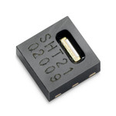
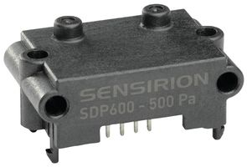
Startup requirements
Using sensors (Sensirion)
  SHT21 (STS21-SHT25)
    temperature
    relative humidity
  SDP600 (later phase)
    differential pressure

Slide 15
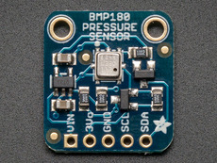
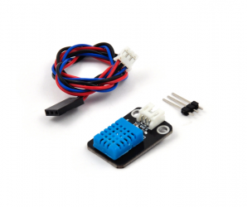
Startup requirements
(Not requested by stakeholder)
  BMP180 (Bosh)
    Barometric pressure
  DHT11
    Temperature

Slide 16
User profile
Taking into account profile of the users
  Students
  Researchers
Assuming only basic knowledge of
  Electronics
  Command line
  High level programming construct
(but not advanced)

Slide 17
Scope and focus
Scope limited to digital (smart) sensors
  Digital interface (i2c, spi or custom)
  Integrated MCU performing
      Calibration
      Linearization
No focus on classic sensors
  Manual calibration
  Precision resistors
  ...
  (although not excluded)

Slide 18
Scope and focus
Consequence
Focus on system design
(not hardware design)
    Integration
    Extensibility
    Ease of use
    Reliability
    Documentation
    …

Slide 19
Scope and position
Consequence
Focus on a pluggability and portability
Different hardware
    Different systems (OS or not)
    Different network-integration
    …
  Open for extension
  Closed for modification

Slide 20
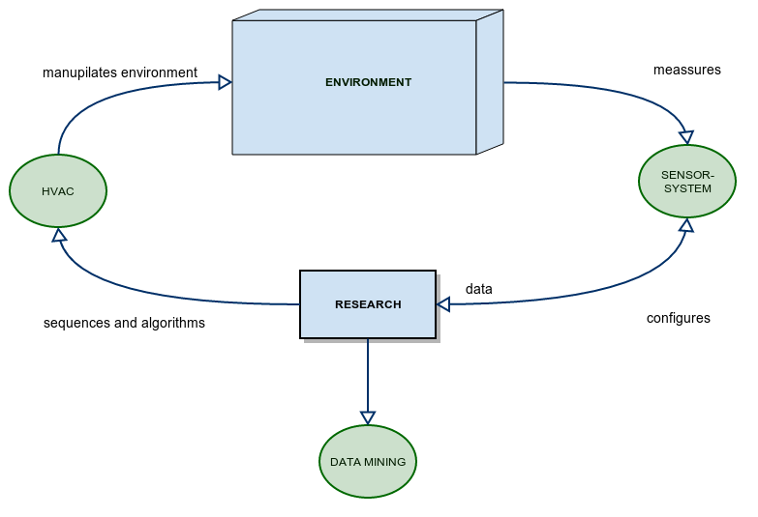
Environment
Research-process and its components

Slide 21
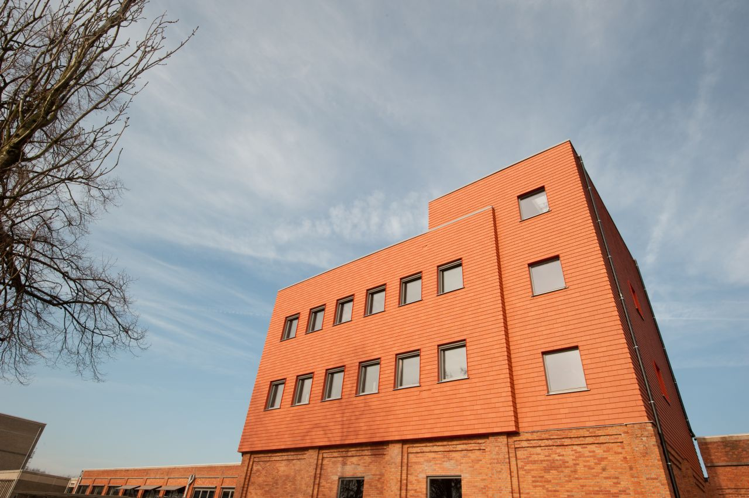
Scenario's
Primary scenario: Research-facility in Gent
  HVAC-infrastructure deployed
  Electricity and ethernet
  Deploy, install and configure sensors
  Aggregate data
  Long time

Slide 22
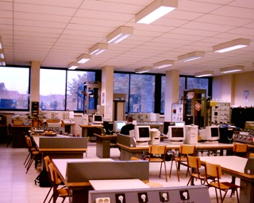
Scenario's
Scenario: Educational environment (students)
  Class-room environment
  Labo
  Experiment and learn
  Explore sensors

Slide 23

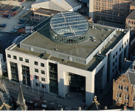
Scenario's
Scenario: Large buildings
  Mobile scenario
  No HVAC
  No assumptions on
    Electricity
    Network
  Similar to primary scenario
  More constrained environment

Slide 24
System Challenges
TOP Challenges
  Multiple sensors
    Concurrent access
        e.g. Sensirion-sensors having
        same i2c-adress (40)
    Large area's
        i2c and spi not developed
        for long distance
        (even if you lower the clock)

Slide 25
System Challenges
TOP Challenges
  Reliability, durability and resilience
    Ability to recover from
      Power interruption
      Network incidents ...
    Alerting-capability
      Sensor goes down
      Errors coming from sensors
      Processing device not working
      Heating ...

Slide 26
System Challenges
TOP Challenges
  Usability
    Scalable to different scenario's
    Users are no software- or hardware- engineers
    Need an interface that's
      Easy to integrate with other systems
      Easy to integrate in personal computing
      (structured txt-files)

Slide 27
System Challenges
TOP Challenges
  Extensibility
    Adding new sensors and configure
    Adding new sensor-type without changing the system (open-closed-system)
  Configurability
    Changing sensor-parameters
    Changing scheduling

Slide 28
System Challenges
TOP Challenges
  Correlation and timing
    Measurements need to be correlated to
      Time
      Configuration of sensors

Slide 29
Approach
Process of development?
Building blocks?

Slide 30
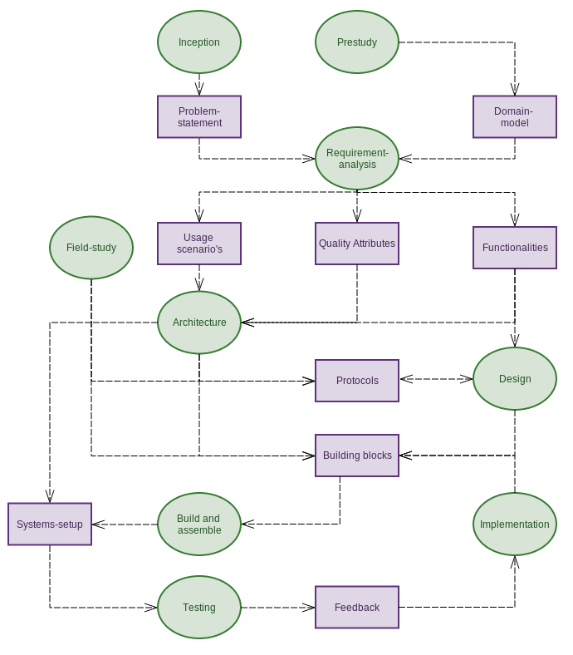
Approach

Slide 31
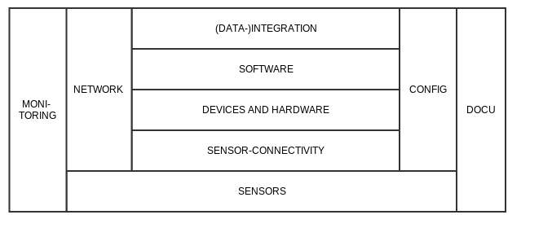
Approach
Category of building blocks (solutions)
Hardware, software, documentation
Serve as annotation in thesis

Slide 32
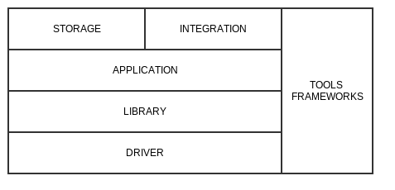
Approach
Category of solutions
Hardware, software, documentation
Serve as annotation in thesis

Slide 33
Design and architecture
Concept?
Principles?
Design?
Building blocks?

Slide 34
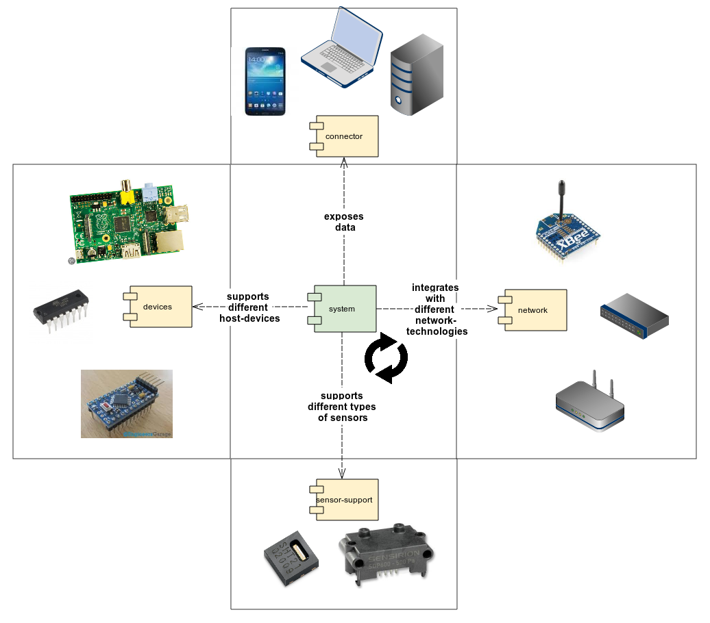
System Concept
System-concept: runtime and dependencies

Slide 35
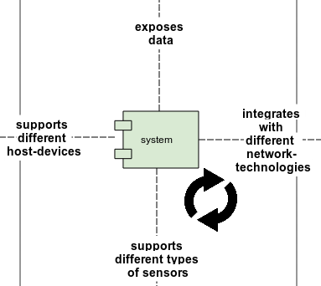
System Concept
System-concept Runtime
  Scheduling measurements
  Relying on system abstractions
    Integration
    Storage
    Device-abstractions
    More sensors
    Of different types

Slide 36
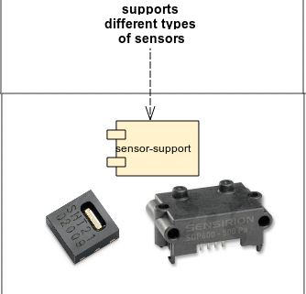
System Concept
System-concept: Support different sensors
  System supports
    Extracting data from
    multiple Sensors
    Multiple types via
    Sensor-abstraction

Slide 37
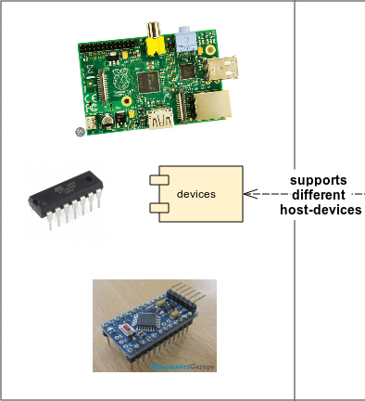
System Concept
System-concept: Support different devices
  Isolate system-dependencies
    Scheduling
    Digital interfaces
    ...
  Support for
    Low level (c-api)
    High level (java)

Slide 38
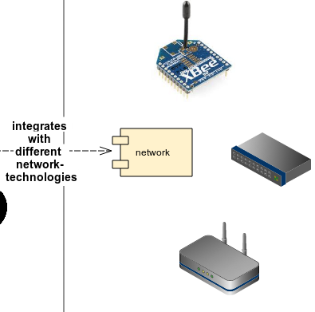
System Concept
System-concept: Network independence
  Integration-capability isolated
    Local integration
    Zigbee
    WIFI
    MQTT
    ...
  !! System provides abstraction and pluggability to adapt, not all implementations exists !!

Slide 39
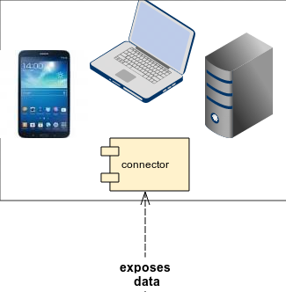
System Concept
System-concept: Data exposure
  Connectors for clients
    Open protocols to integrate
    with various kind of devices
  Current provided protocol
    REST exposing
      JSON
      CSV (under construction)

Slide 40
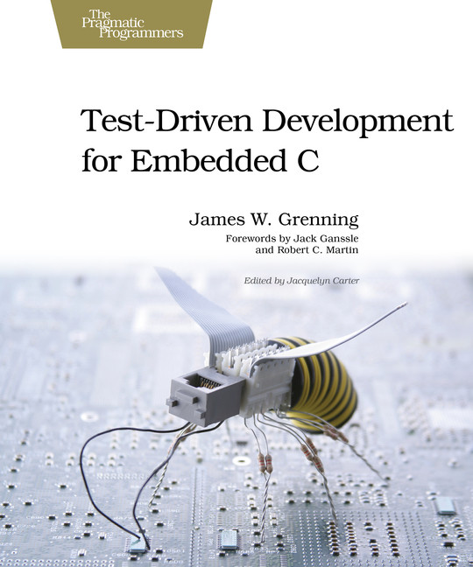

Development principles
S
Single Responsibility Principle
O
Open Closed Principle
L
Liskov Substitution Principle
I
Interface Segregation Principle
D
Dependency Inversion Principle

Slide 41
Development principles
SOLID
Introduced by Robert C-Martin
  Principles for improving
    Flexibility
    Extensibility
    Modularity
    Testability
  Introduced in OO but applicable
  to all programming-paradigms

Slide 42
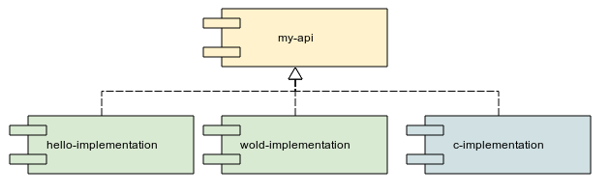
Development principles
Modularity
Package code and classes
into reusable and composable
package
    Provide
      api-components
      (interfaces and types)
      concrete
      implementations
    Code needs to be SOLID

Slide 43
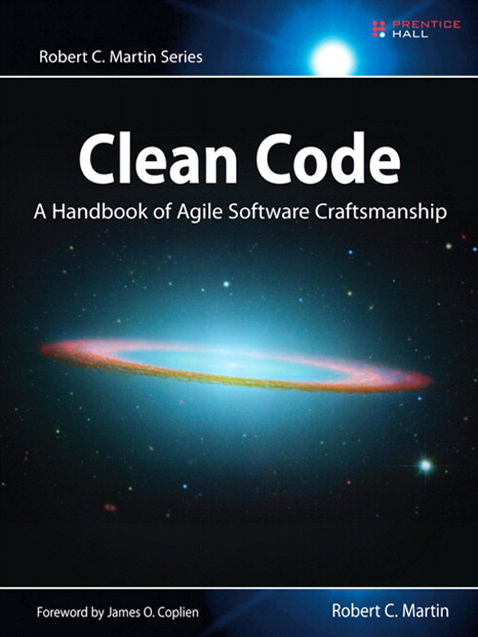
Development principles
Test Driven Development (TDD)
  Drive your code trough tests
  Just enough code
  Isolate dependencies
(Discovered/invented by Kent Beck)

Slide 44
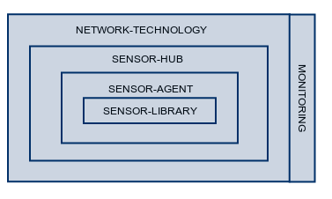
System Architecture
Design-concept: Layering
Different building blocks
  Built on top
  Inner layers can be used independently
  Segregation by interface

Slide 45
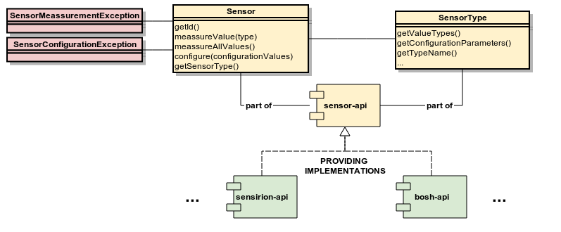
System Architecture
Layer: Sensor-API
Sensor- and SensorType-abstraction
  Interfaces key-value pair based
  Modules containing concrete implementations
  Standardized exceptions
Goal
  Provide a repository for reuse (Github-project)
  Isolate the processing logic
  Provide an abstraction layer for Sensor-agent
  Translate the datasheet behind an abstraction

Slide 46
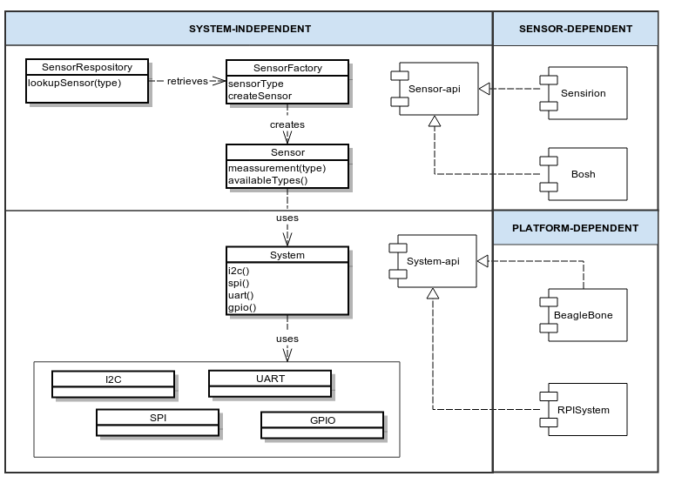
System Architecture
Layer: Sensor-API
System-abstraction of
  Digital interfaces
  (i2c, spi, uart)
  Pin-access
  Timing
Goal
  Portability (vs scenario's)
  Choice of libraries (e.g. RPi can work JME or Pi4j)

Slide 47
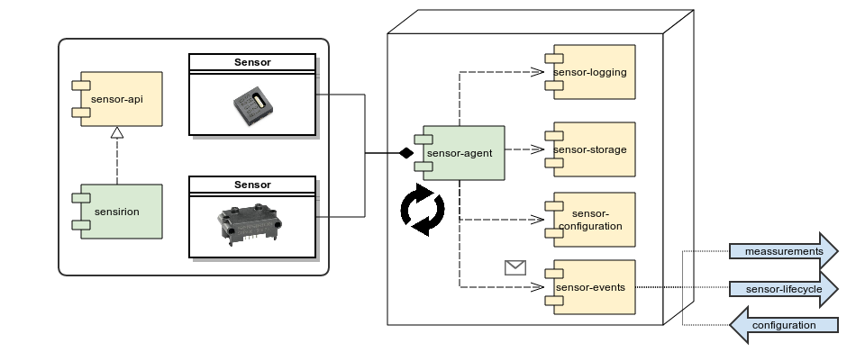
System Architecture
Layer: Sensor-Agent
Runtime or application
  Captures data at interval
  Manages sensors via sensor-api-abstraction
  Notifies and communicates via sensor-events
Goal
  Use the sensor-api without low-level coding
  Set up a measurement system based on configuration
  Plug-in architecture for cross-cutting-concerns

Slide 48
System Architecture
Layer: Sensor-Agent
Depends on abstractions
  Logging
  Storing the sensor-measurement (locally)
  Storing the sensor-configuration
  (might be another storage-medium than measurement)
  Integrates with the outside-world via sensor-events
    New measurement (out)
    Sensor activated or reconfigured (out)
    Instructions for reconfiguration (in)

Slide 49
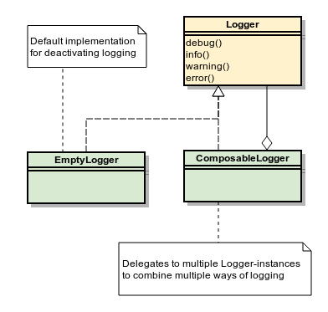
System Architecture
Layer: Sensor-Agent
Abstractions
  are interchangeable
    interface segregation
    dependency injection
  can be combined (or composed)
  are deactivated by default
    by default empty implementations

Slide 50
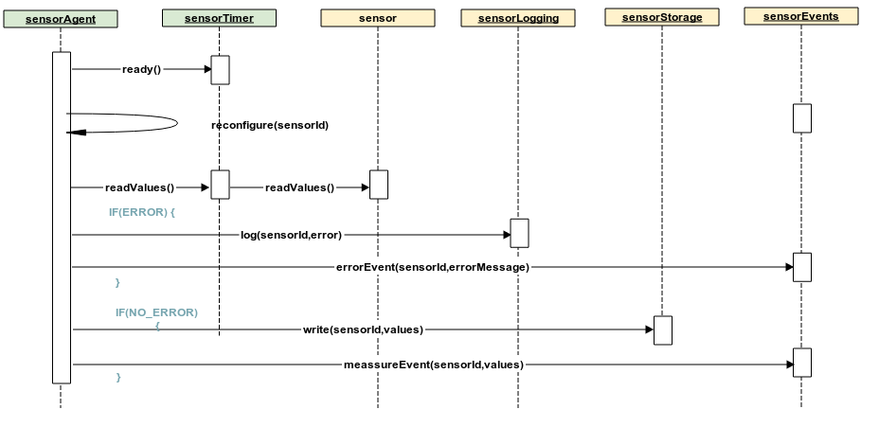
System Architecture
Layer: Sensor-Agent
Runtime sequence

Slide 51
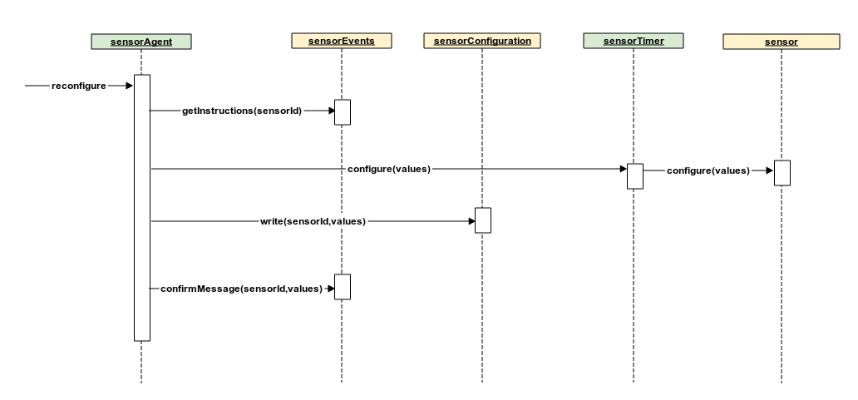
System Architecture
Layer: Sensor-Agent
Configuration sequence

Slide 52
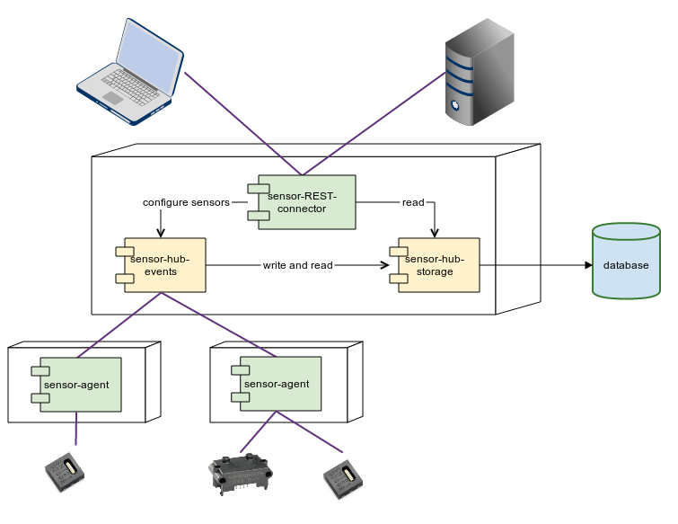
System Architecture
Layer: Sensor-Hub
Runtime or (web-)application
  Communicating with agents
  Centralizing data-storage
  Exposing data to users (and other devices/servers)
Goal
  Collecting and storing data from different sensors
  Enable user to query the data
  Interface for configuring remotely the sensors

Slide 53
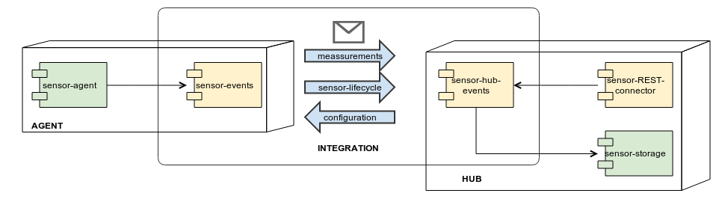
System Architecture
Layer: Sensor-Hub
Link between agent and hub
  Measurements are pushed
  Instructions are forwarded to
  Events
    Confirmation of configuration
    Errors
Sensor-hub-events and sensor-events
  Should integrate with same protocol
  Code is message based

Slide 54
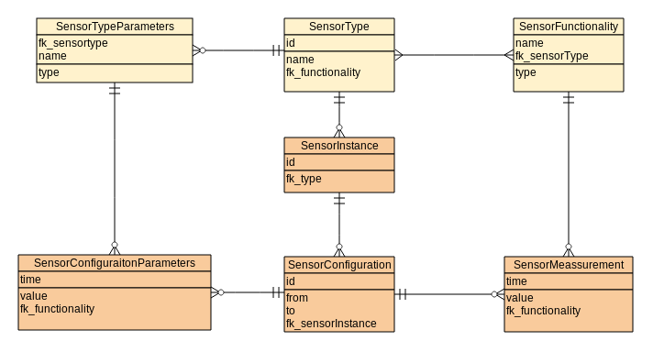
System Architecture
Layer: Sensor-Hub
  Datamodel

Slide 55
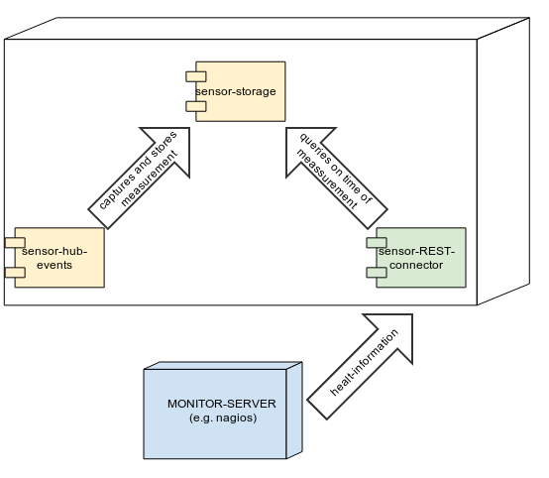
System Architecture
Layer: Monitoring
Monitor tool can query for
  Error events
  Deactivated agents
  or sensors
  (activity-monitoring)
REST-interface

Slide 56
In practice
Today?
Status?
Future?

Slide 57
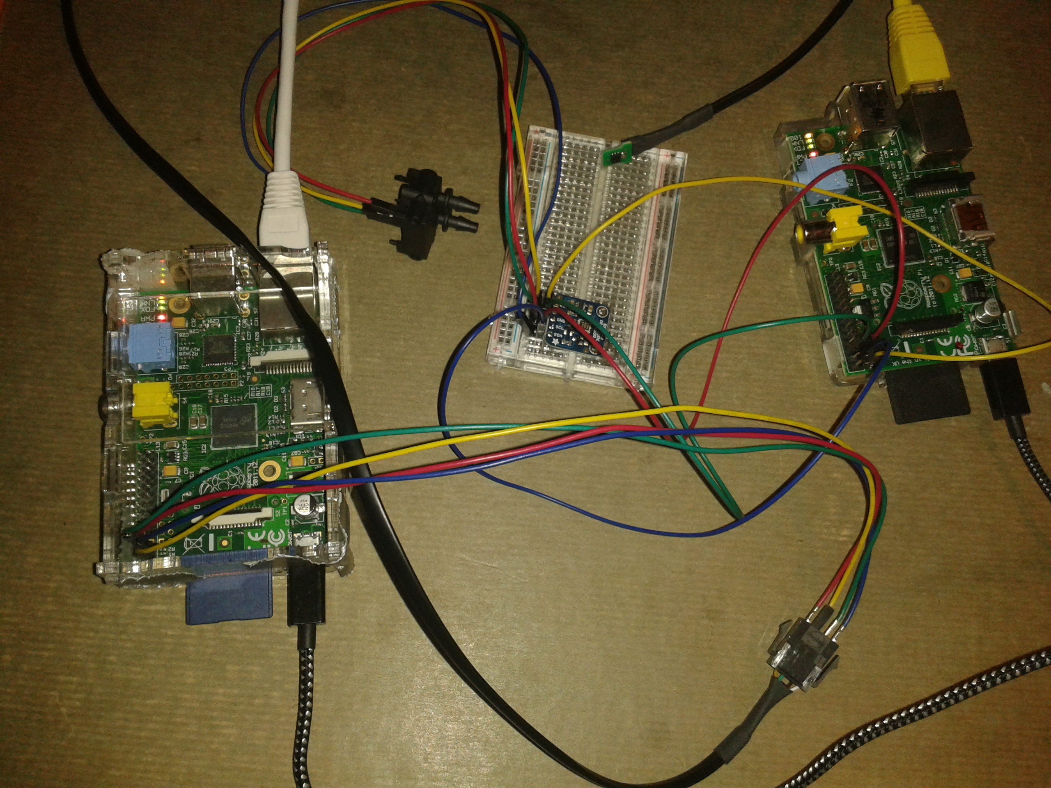
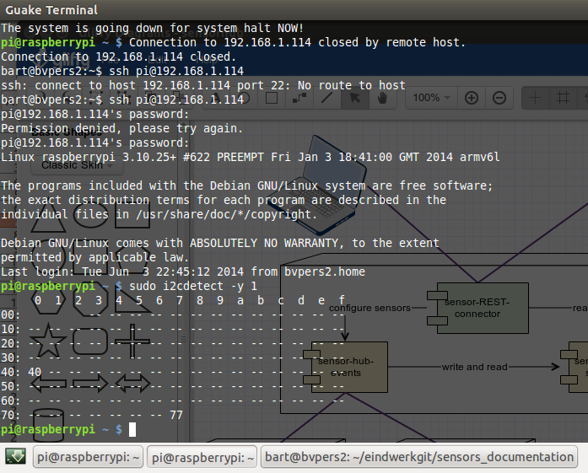
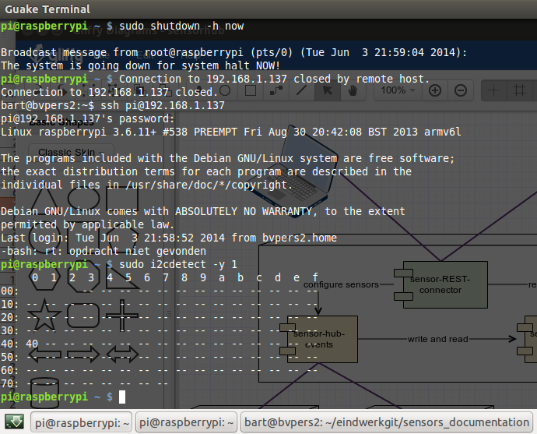
Today
SDP600
SHT21
BMP180
Both
BMP180 (77)
and
SDP600 (40)
on same bus

Slide 58
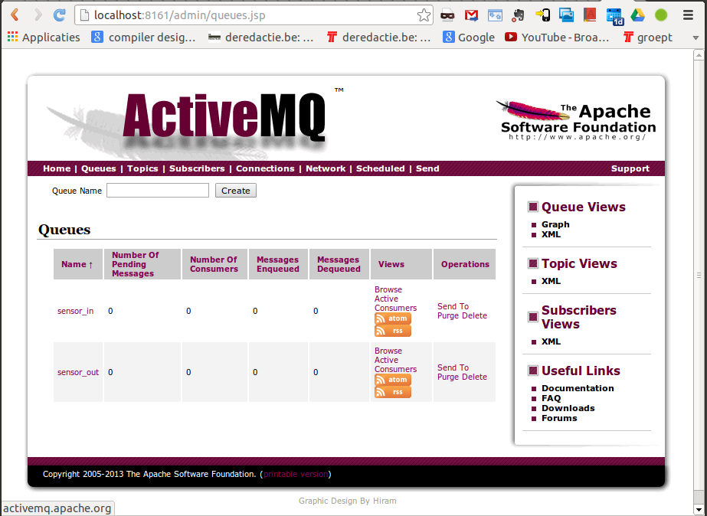
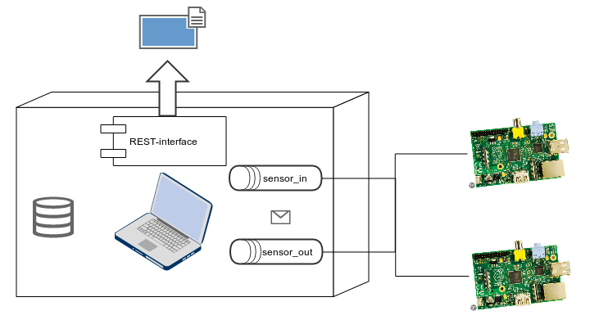
Today

Slide 59
Recap of top challenges
Multiple sensors
  Support for “heterogeneous sensor networks”

Slide 60
Recap of top challenges
Reliability
  Data Loss
      Local and centralized storage
      Scalability of sensor-hub and centralized storage
  Support for different devices
      For different non-functional requirements
  Monitoring
      Sensor-Hub can propagate errors
      Sensor-Hub can non-activity of Sensor-agents

Slide 61
Recap of top challenges
Correlation and timing
  Data-model integrates configuration-id's
  Timing is kept centralized
  Few seconds difference can be tolerated
  Sensor-Hub can be programmed to check differences (if required)

Slide 62
Recap of top challenges
Usability and Configurability
  System requires no low-level programming
  to set up sensors
  Sensor-configuration and -timing
  can be configured via hub

Slide 63
Recap of top challenges
Extensibility
  Sensor-implementation are abstracted behind generic interface
  New sensors can be added by implementing an interface

Slide 64
Status
Java-implementations
  Sensor-API
    SHT21 and SDP600 done
    STS21, BMP118 ongoing
  Sensor-Agent (activemq)
    READY TO BE TESTED !!!
  Sensor-HUB (Activemq and Tomcat)
    READY TO BE TESTED !!!
    DEPLOYMENT-refinements (configuration and discovery)

Slide 65
Status
C-implementations
  Sensor-API
    SHT21 done
    SDP600, STS21, BMP118 ongoing
    System-support limited to RPI
  Sensor-Agent
    Raspberry Pi ongoing
    AVR ongoing

Slide 66
Status
Documentation
  Deployment-guide
  Mini-training on Raspberry Pi
  Structured documentation on supported sensors ongoing

Slide 67
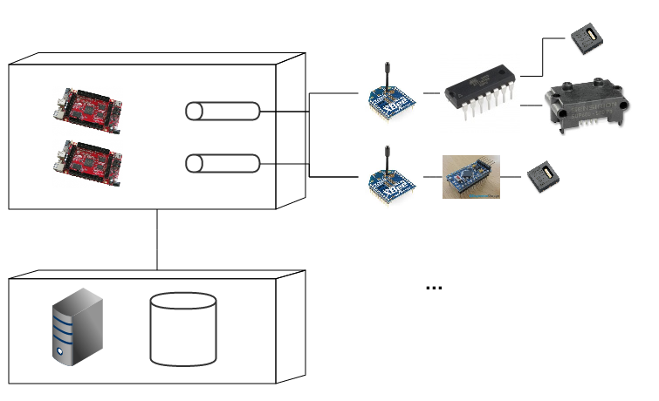
Future scenarios

Slide 68
Future scenarios
Adding sensors
    Sensor-abstraction
    Adding new implementation to sensor-agent
Keep attention
    C and Java-implementation should remain in sync

Slide 69
Future scenarios
Elaborating/Finishing the C-agents
    (currently only on Raspberry Pi)
    Support for AVR
    Allowing low-level devices
    Larger scenario's (networks)
    Constrained environments

Slide 70
Future scenarios
New integration-mechanisms
    Data-Link, Network,Transport
      Meshing networks
      Zigbee - IEEE 802.15.4 – Bluetooth light – RF
    Middleware
      MQTT (Message Queuing Telemetry Transport)
      MQTT-SN (MQTT for Sensor Networks)

Slide 71
Future scenarios
Scaling
    Adding more sensor-hubs
      (load balancing ActiveMq)
    Storage and backup on server
Monitoring
    Monitor rest-interface with Nagios

Slide 72
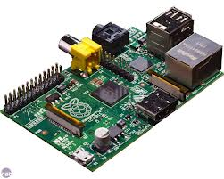
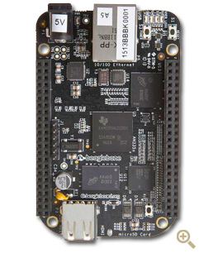
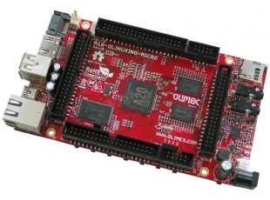
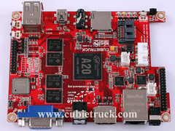

Future scenarios
SensorHub: Raspberry Pi best option?
 | Raspberry Pi | BeagleBone Black | pcDuino | Olinuxino Micro | Cubietruck
Memory | 4 / 32 GB DDR-1600 | 4 / 32 GB DDR-1600 ECC | 2 / 16 GB DDR-1600 | 2 / 16 GB DDR-1600 | 2 / 16 GB DDR-1600
Clockspeed | 700 MHz | 1 GHz | 1 GHz | 1 GHz | 1 GHz
CPU-core(s) | ARM-11 | ARM-Cortex-A8 | ARM-Cortex-A8 | Dual ARM-Cortex-A7 | Dual ARM-Cortex-A7
GPU-core | Videocore IV | SGX530 | Mali-400 | Dual Mali-400 | Dual Mali-400
Hardware Codecs | H264, MPEG-4 AVC (MPEG-2, VC-1 optioneel) | - | MPEG-1/2/4 AVC, JPEG, H.263, H.264, AVS, VC1, WMV7/8, VP-6 | MPEG-1/2/4 AVC, JPEG, H.263, H.264, AVS, VC1, WMV7/8, VP-6 | MPEG-1/2/4 AVC, JPEG, H.263, H.264, AVS, VC1, WMV7/8, VP-6
RAM | 512 MB | 512 MB | 1 GB | 1 GB | 2 GB
Flash | - | 2 GB | 2 GB | 4 GB | 2 GB

Slide 73
Future scenarios
SensorHub: Raspberry Pi best option?
 | Raspberry Pi | BeagleBone Black | pcDuino | Olinuxino Micro | Cubietruck
Lithium-battery | - | - | - | Supported | Supported
Video | HDMI, Composer | Micro-HDMI | HDMI | HDMI, VGA ( adapter) | HDMI, VGA
Connections | 2 * USB 2.0 | USB 2.0 | 2 * USB 2.0 | 3 * USB 2.0 | 3 * USB 2.0, Bluetooth
Audio | Audio-jack | - | - | Audio-jack, Micro | Audio-jack, SPDIF
Network | Fast Ethernet | Fast Ethernet | Fast Ethernet | Fast Ethernet | Gigabit, WIFI
Storage | SD | micro-SD | micro-SD | SD, micro-SD, SATA | SD, micro-SD, SATA
Usage | Media Center ++ PC + Home automation + | Home automation ++ | PC + | Media Center + Router + NAS ++ SERVER ++ Home automation + Mobile ++ | Media Center + Router ++ NAS +++ SERVER ++ Home automation + Mobile +
Price | 35 € | 45 € | 60 € | 65 € | 95 €

Slide 74
Future scenarios
SensorHub: Raspberry Pi best option?
    Depends on scenario
        + Accessible
        + Well documented and supported by community
        - Stability and industry compliance
        - Performance (strength is GPU not CPU)
    Recommended for educational scenario's
Depending on storage-setup and power required
    BeagleBone Olinuxino Cubieboard

Slide 75
Future scenarios
SensorHub: Raspberry Pi best option?
    Sensor-hub and -agent
        Portable
        Java is supported on most (all) high-level devices
        C is supported on all low-level devices
        System-dependencies isolated
    Recommended for educational scenario's
Depending on storage-setup and power required
    BeagleBone Olinuxino Cubieboard

Slide 76
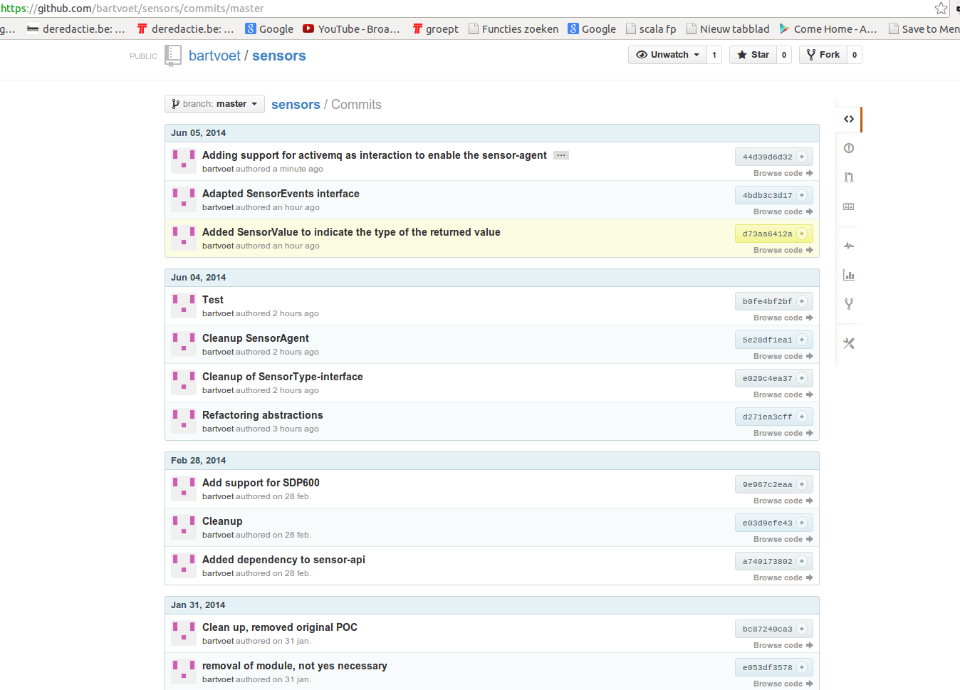
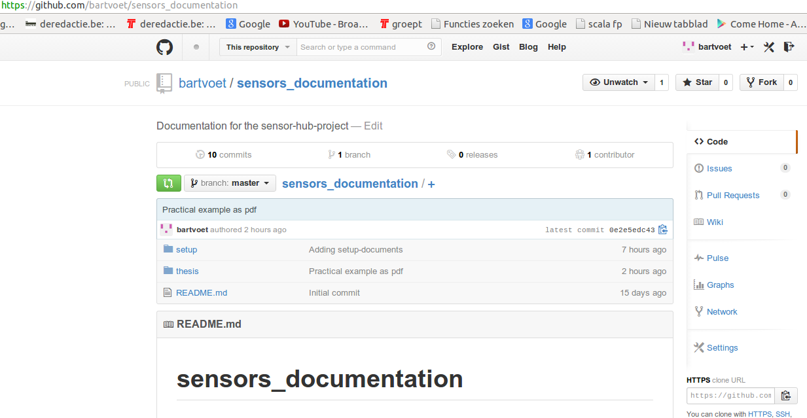
More information
Code and documentation on https://github.com/bartvoet/

Slide 77
Thank you for the attention!
Ready for Questions.

