Slide 1
Raspberry Pi & Co
Practice and theory
Speaker's introduction
Goal of this presentation
Notes:
Opbouw
Werking (mechaniek)
Karakteristiek
Frequentie bereik
Impedantie
Rendement
Behuizing
Voordelen
Nadelen
Typisch gebruik

Slide 2
Speaker's Intro
Speaker
  Bart Voet
Day Job
  Practice Lead Java Development at AXA
Evening and weekend
  Family
  Programming and hacking
  Learning electronics
  Skateboarding and snowboarding
  ...

Slide 3
Goal
Overall goal of presentation
  Share my experiences as a RPi-user
  I'm a programmer not a hardware- nor an os-expert
  (trying to become one)
  What is the RPi, what else is there?
  Give some practical advice
  Whan you do with it?
  ...

Slide 4

Goal
What is the Raspberry Pi?
Some theory:
  History
  Overview
  Hardware
  Software
  ...

Slide 5

Goal
Finding your way around...
Getting started:
  Setting up the board
  Resources
  Attributes
  Advice
  Documentation
  ...

Slide 6





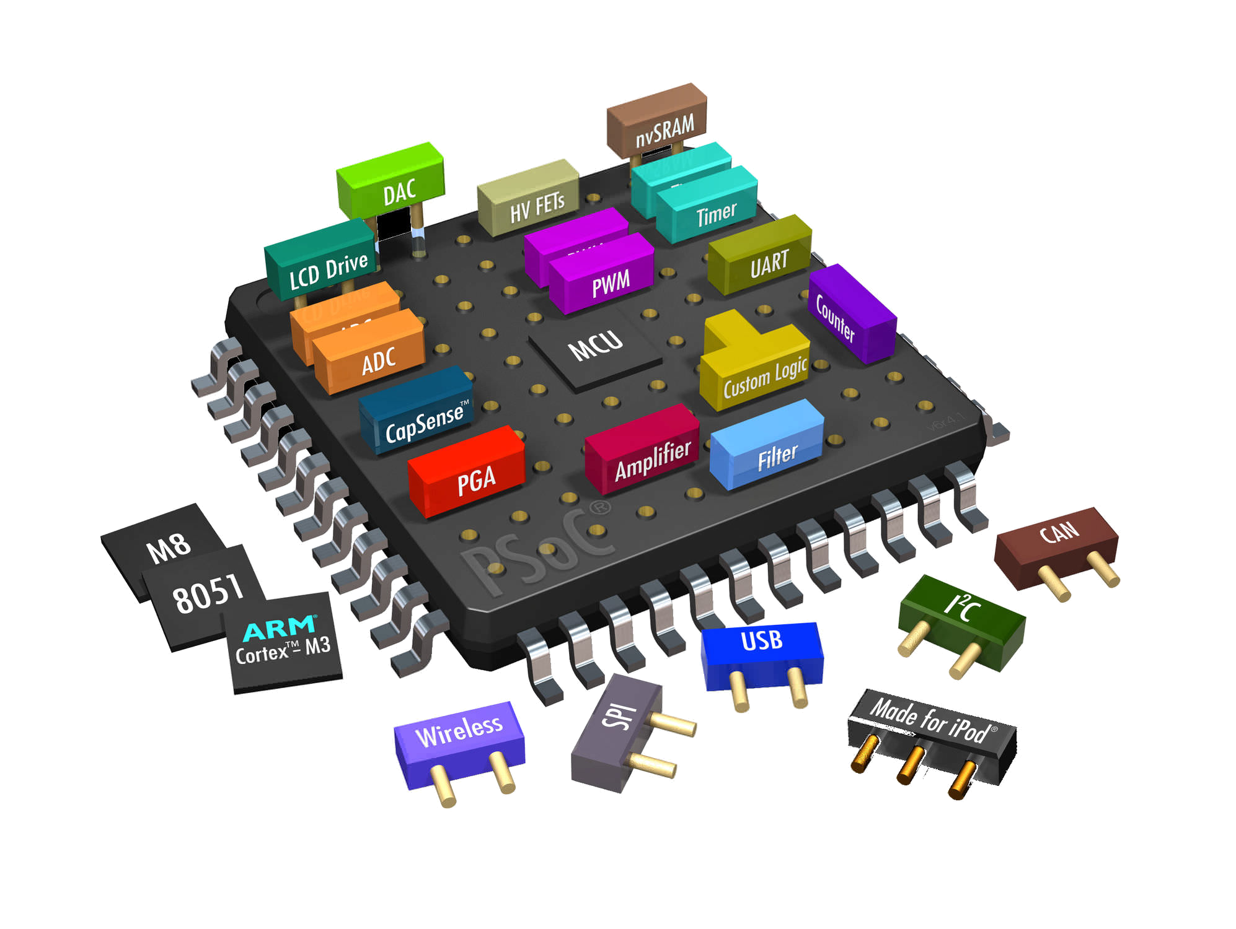






Goal
What is about the Raspberry Pi?
Some theory again:
  Context and background
  Hype or not?
  Buzzwords?
  ...

Slide 7

Goal
Why using a Raspberry Pi?
Some advice:
  What's in it for you?
    Cheap PC?
    Microcontroller?
    Media Center?
    ...
  Added value?

Slide 8
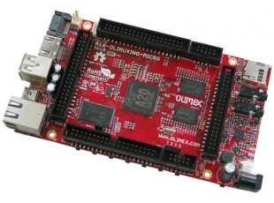
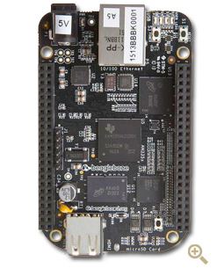
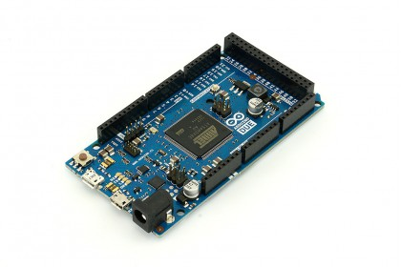
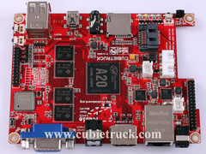
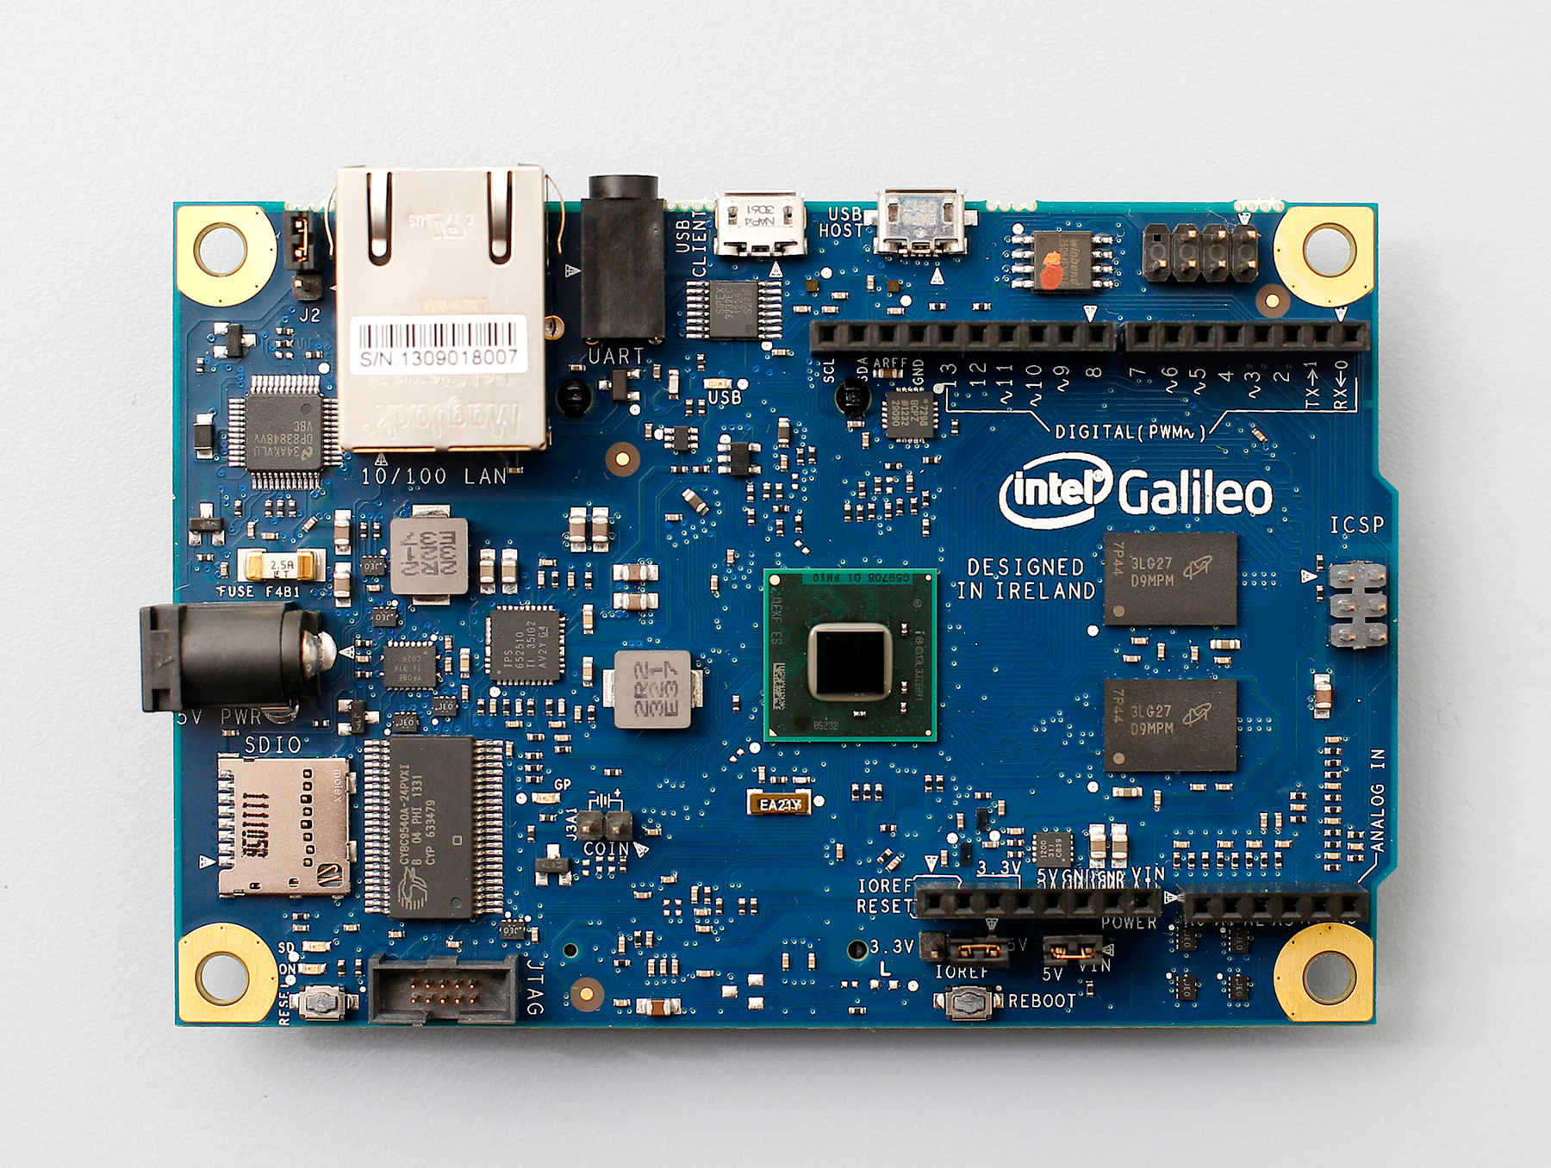

Goal
Really, is it the only board out there?
Comparing:
  Alternatives?
  < 100 €
  <> microcontroller?
  ...

Slide 9
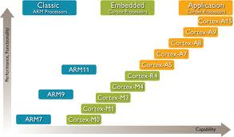

Goal
Something about ARM?

Slide 10

Goal
Enough theory!!!
Some hands on:
  Tools
  Linux
  Some projects
    Radio
    Overclocking
    Sensors
    … ?

