Slide 1
Raspberry Pi & Co
Practice and theory
Raspberry Pi in a nutschell
History of RPi
Notes:
Opbouw
Werking (mechaniek)
Karakteristiek
Frequentie bereik
Impedantie
Rendement
Behuizing
Voordelen
Nadelen
Typisch gebruik

Slide 2
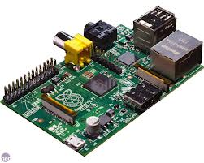
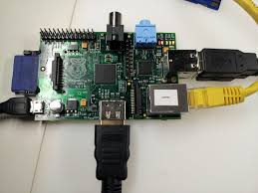
RPi in a nutshell
Raspberry Pi is a desktop-computer
  Light-weight credit-card-sized
  USB 2.0, Ethernet, Audio Jack
  Powerful graphic capabilities and HDMI
  GPIO and support for low-level-protocols like
    i2c, spi, uart ...

Slide 3

History of RPi
Original Idea behind Raspberry Pi originates
  from Cambridge University
  Computer Laboratory
    Eben Upton
    Rob Mullins
    Jack Lang
    Alan Mycroft
2006

Slide 4
History of RPi
Original inspiration Raspberry Pi
General observation in Computer Science:
  < 2000
  Students in many cases
  experienced hobbyist
  programmers and/or hardware hackers
  > 2000
  Student decline in both numbers and skillset
2006

Slide 5
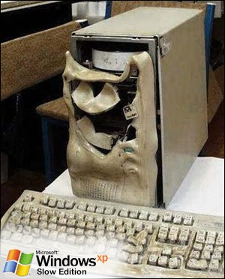
History of RPi
Original inspiration Raspberry Pi
Interaction of kids with computer changed:
  ICT curriculum-colonisation
    Office, Web-technologies, 4GL, …
  Rise of PC-consoles
  (replacing Amigas, BBC Micros, Commodore 64, …)
  Price of PC and devices to hack
  Closed and arcane operating systems
  Lock down hardware
  …
  (Note:
  Smartphones, IPhones,
  IPads aren't much of an improvement)
2006
2006

Slide 6
History of RPi
Original Concept behind Raspberry Pi
Development of a Platform that
  Like those old home computers, could boot into a programming environment.
  Was inspired from the BBC Micro project (1981)
  Was based on open source soft- and hardware
  Community-driven
2006

Slide 7
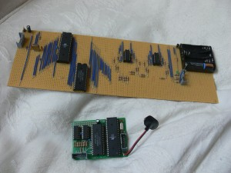
History of RPi
First (early) proof of concepts
  Atmel ATmega644 microcontroller
  Clocked at 22.1MHz
  512K SRAM
  (data and framebuffer storage)
  320×240 component video signal
https://www.youtube.com/watch?feature=player_embedded&v=ZHfRhqMo8ns
2006

Slide 8
History of RPi
In 2008 the project accelerated
  Mobile (r)evolution
    Mobile processors became affordable
    Graphical rich environments
  Linux-destop evolved
    Debian
    Ubuntu
    Fedora
    … Android
  Eben Uptom (founding member)
    New role as SOC-architect at Broadcom
    (SOC = System on a chip)
2008

Slide 9
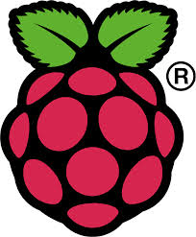
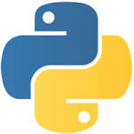
History of RPi
Raspberry Pi Foundation
registered in 2009
  Charitable organization
  Promote study of computer science in schools
  Put the fun back in to learning computing
  Responsible for developing and governing Raspberry Pi
  Name
    Tradition giving computers name fruit
    (Tangerine, Abricot, ...)
    Pi referring to Python
2009

Slide 10
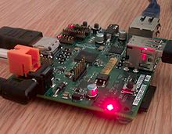
History of RPi
Pre-launch
  August 2011, 50 alpha boards
  (eq Model B)
  Debian with LXDE-desktop running Quake
  December 2011, 25 alpha boards
  (eq Model A – lighter version)
2011

Slide 11

History of RPi
Officially launched on Febuary 29 th 2012
  Manufacture deals element 14 and RS Electronics,
  First production run was 10,000 boards
  Both RS and Farnell’s servers were stalled on the day of launch.
  RS reported over 100,000 pre-orders in one day
  Within a year it had sold over one 1000,000 units.
  Current production is about 4,000 boards per day
2012
...

