Slide 1
Raspberry Pi & Co
Practice and theory
Raspberry Pi in a nutshell
Raspberry Pi hardware
Raspberry Pi Alternatives
Raspberry Pi Advice
Notes:
Opbouw
Werking (mechaniek)
Karakteristiek
Frequentie bereik
Impedantie
Rendement
Behuizing
Voordelen
Nadelen
Typisch gebruik

Slide 2
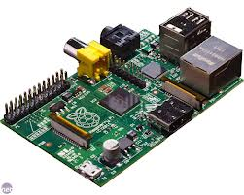
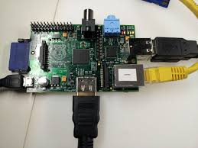
RPi in a nutshell
Raspberry Pi is a desktop-computer
  Light-weight credit-card-sized
  USB 2.0, Ethernet, Audio Jack
  Powerful graphic capabilities and HDMI
  GPIO and support for low-level-protocols like
    i2c, spi, uart ...

Slide 3
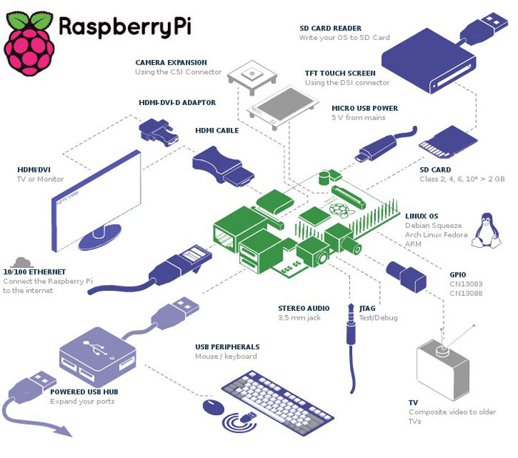
Hardware RPi

Slide 4
Hardware RPI
Raspberry Pi hardware
  SOC - Broadcom BCM2835
    ARM V11 => 700 mHz
    (overclockeable to 1 gHz within guarantee)
    GPU on SOC
    I2c,spi,uart, GPIO controlled
    Hardware-codecs

Slide 5
Hardware RPI
Raspberry Pi hardware
  Disk-less
    No diskcontroller
    No SATA connector
  SD-card
    OS booted from SD-card
    Data stored on SD
  No NAND Flash-memory

Slide 6
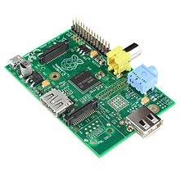
Hardware RPi
MODEL A
-
Less memory (RAM)
One USB (need a dongle)
No Ethernet (WIFI via usb)
+
Less power-consuming
Cheaper
MODEL B
-
More memory (RAM)
Two USB
Ethernet (WIFI via usb)
+
More power-consuming
10 $ more

Slide 7
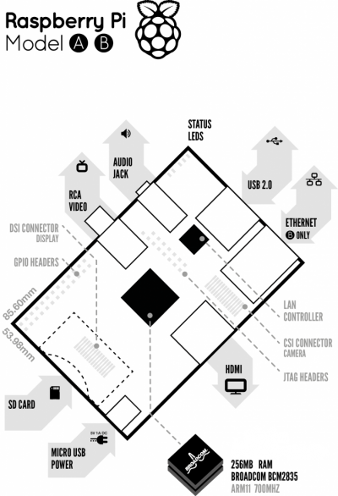
Hardware RPi
 | Model A | Model B
Target price | US$25 Ext tax | US$35 Ext tax
SoC | Broadcom BCM2835 (CPU + GPU. SDRAM is a separate chip stacked on top)
CPU | 700 MHz ARM11 ARM1176JZF-S core
Memory (SDRAM) | 256 MiB (planned with 128 MiB, Upgraded to 256 MiB on 29 Feb 2012) | 256 MiB (until 15 Oct 2012); 512 MiB (since 15 Oct 2012)
GPU | Broadcom VideoCore IV,OpenGL ES 2.0,OpenVG 1080p30 H.264 high-profile encode/decode
USB 2.0 ports | 1 (provided by the BCM2835) | 2 (via integrated USB hub)
Video outputs | Composite video | Composite RCA, HDMI (not at the same time)
Audio outputs | TRS connector | 3.5 mm jack, HDMI

Slide 8
Hardware RPi
 | Model A | Model B
Audio inputs | none, but a USB mic or sound-card could be added
Onboard Storage | Secure Digital|SD / MMC / SDIO card slot
Onboard Network | None | 10/100 wired Ethernet RJ45
Low-level peripherals | General Purpose Input/Output (GPIO) pins, Serial Peripheral Interface Bus (SPI), I²C, I²S, Universal asynchronous receiver/transmitter (UART)
Real-time clock | None
Power ratings | 300 mA, (1.5 W) | 700 mA, (3.5 W)
Power source | 5 V (DC) via Micro USB type B or GPIO header
Size | 85.0 x 56.0 mm x 15mm | 85.0 x 56.0 mm x 17mm
Weight | 31g | 40g

Slide 9
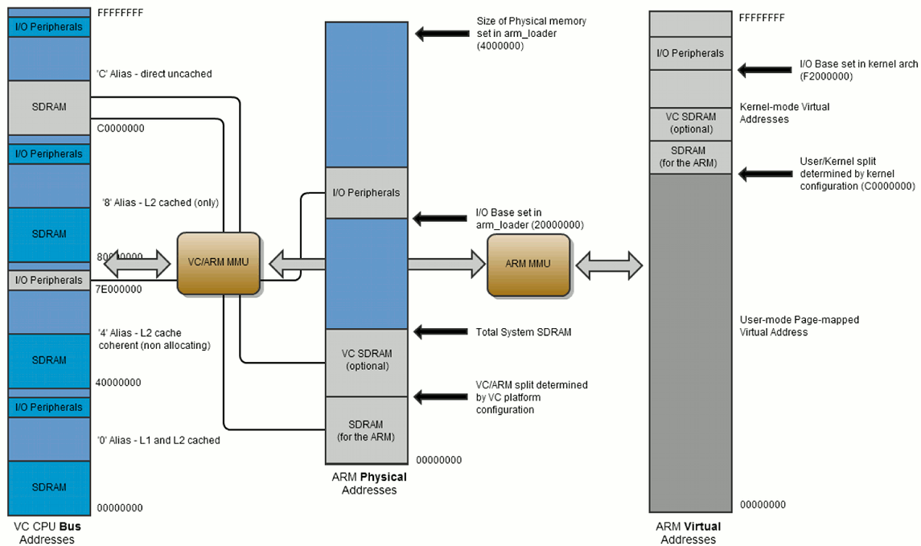
Hardware RPi
Broadcom BCM2835
  Heart of the Rpi => System on a Chip
    Timers
    Interrupt controller
    GPIO
    USB-controller
    PCM / I2S
    DMA controller
    I2C master
    I2C / SPI slave
    SPI0, SPI1, SPI2
    PWM
    UART0, UART1
  More detail on SOC and RTL-logic see:
  http://www.raspberrypi.org/wp-content/uploads/2012/02/BCM2835-ARM-Peripherals.pdf

Slide 10
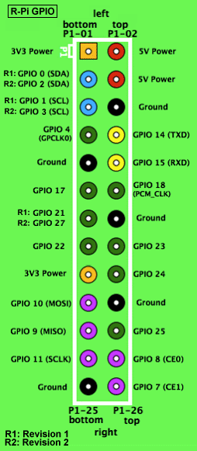
Hardware RPi
GPIO
  26 pins
    8 GPIO pins
    I²C, SPI, UART
    +3.3 V, +5 V and GND supply lines
  GPIO voltage levels are 3.3 V
  Not 5 V tolerant, no over-voltage protection
  (use logic level translator for 5 v-logic)
  All the GPIO pins can be reconfigured
  to provide alternate functions
  i2c pull-up resistor is built in
  Do not draw more than 3mA per output
  Higher might harm the RPi

Slide 11
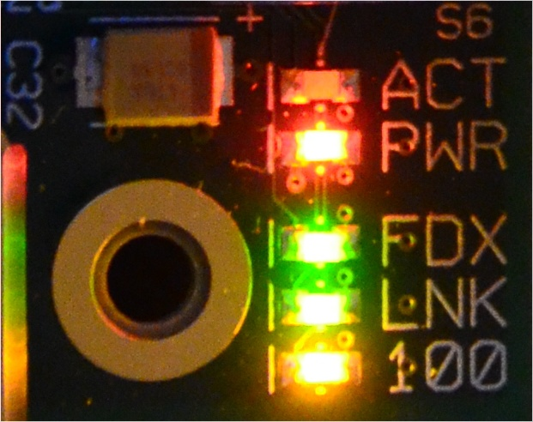
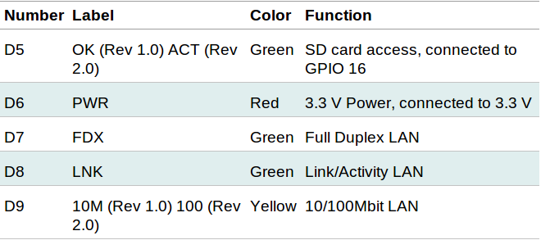
Hardware RPi
LEDS

Slide 12
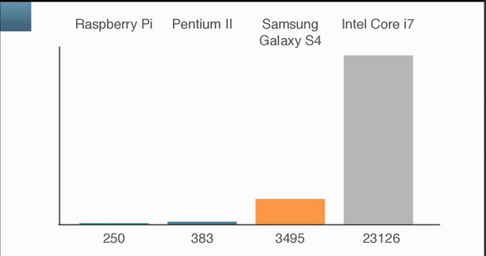
Benchmarking RPi
CPU-benchmark-result is not that good …
But it's not the only the CPU that counts …

Slide 13



Benchmarking RPi
And it's not intended to be fast
GPU
  Can play HD-resolution
  Hardware-decoding in the GPU
  (activating codecs for low price)
  Media Center, Indie games like minecraft,
Daily computing tasks (mail, web, office, ...)
Low consumption
  Between 300mA and 1 A (depending on) at 5 v
SOFTWARE
  Optimized Linux kernel

Slide 14
Comparing RPi
And there more
It's it the only board in it's category!!!
  Small Single-Board
  SOC-based
  ARM-based
  Open Source (hard and software)
  GPIO-pins
  Low level periphals-support
  Community-driven
  <= 100 €

Slide 15
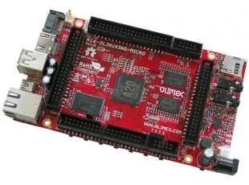

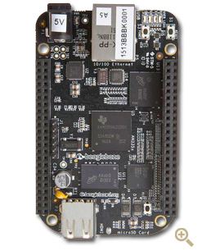
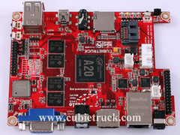
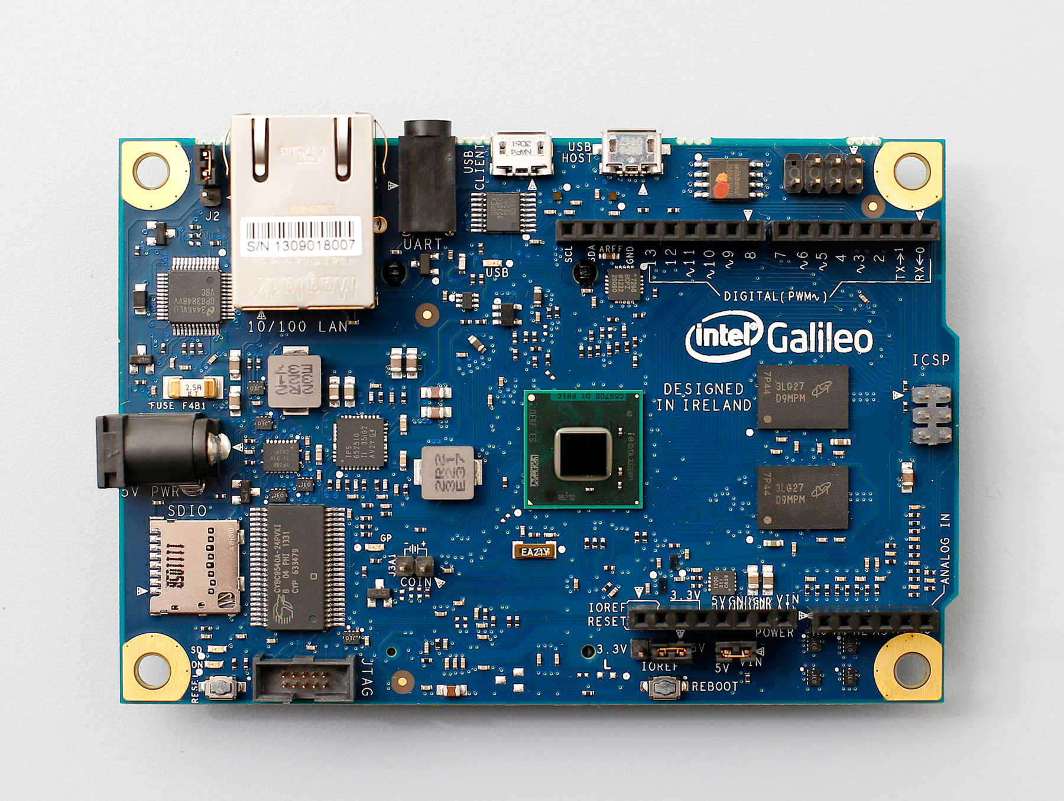
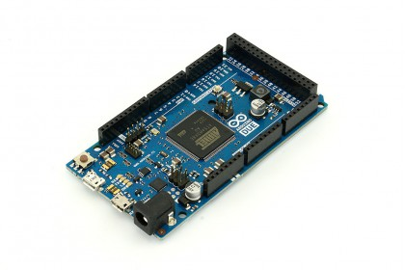
Comparing RPi
No, there's more of it
  with lot of variation in their characteristics...

Slide 16
Comparing RPi
 | Raspberry Pi | BeagleBone Black | pcDuino | Olinuxino Micro | Cubietruck
Memory | 4 / 32 GB DDR-1600 | 4 / 32 GB DDR-1600 ECC | 2 / 16 GB DDR-1600 | 2 / 16 GB DDR-1600 | 2 / 16 GB DDR-1600
Clockspeed | 700 MHz | 1 GHz | 1 GHz | 1 GHz | 1 GHz
CPU-core(s) | ARM-11 | ARM-Cortex-A8 | ARM-Cortex-A8 | Dual ARM-Cortex-A7 | Dual ARM-Cortex-A7
GPU-core | Videocore IV | SGX530 | Mali-400 | Dual Mali-400 | Dual Mali-400
Hardware Codecs | H264, MPEG-4 AVC (MPEG-2, VC-1 optioneel) | - | MPEG-1/2/4 AVC, JPEG, H.263, H.264, AVS, VC1, WMV7/8, VP-6 | MPEG-1/2/4 AVC, JPEG, H.263, H.264, AVS, VC1, WMV7/8, VP-6 | MPEG-1/2/4 AVC, JPEG, H.263, H.264, AVS, VC1, WMV7/8, VP-6
RAM | 512 MB | 512 MB | 1 GB | 1 GB | 2 GB
Flash | - | 2 GB | 2 GB | 4 GB | 2 GB

Slide 17
Comparing RPi
 | Raspberry Pi | BeagleBone Black | pcDuino | Olinuxino Micro | Cubietruck
Lithium-battery | - | - | - | Supported | Supported
Video | HDMI, Composer | Micro-HDMI | HDMI | HDMI, VGA ( adapter) | HDMI, VGA
Connections | 2 * USB 2.0 | USB 2.0 | 2 * USB 2.0 | 3 * USB 2.0 | 3 * USB 2.0, Bluetooth
Audio | Audio-jack | - | - | Audio-jack, Micro | Audio-jack, SPDIF
Network | Fast Ethernet | Fast Ethernet | Fast Ethernet | Fast Ethernet | Gigabit, WIFI
Storage | SD | micro-SD | micro-SD | SD, micro-SD, SATA | SD, micro-SD, SATA
Usage | Media Center ++ PC + Home automation + | Home automation ++ | PC + | Media Center + Router + NAS ++ SERVER ++ Home automation + Mobile ++ | Media Center + Router ++ NAS +++ SERVER ++ Home automation + Mobile +
Price | 35 € | 45 € | 60 € | 65 € | 95 €

Slide 18
ARM
Acorn RISC Machine
Intel refusal to give license for 80286
ARM1 started in BBC Micro (predecessor RPi) early 1985
Today maintained and developed by ARM Holdings
RISC-based, efficient, default in mobile development
Starting to get some grip on desktop and server
(especially 64-bit)
Recent Evolution | 1997 | 1998 | 2002 | 2005 | 2007 | 2009 | 2011 |  | 2013
Core-name | ARM9 | ARM10 | ARM11 | Cortex-A8 | Cortex-A9 | Cortex-A5 | Cortex-A15 | Cortex-A7 | Cortex-A12 | Cortex A53 | Cortex-A57
Optimization |  |  |  |  | Performing | Economic | Performing | Economic | Efficient | Efficient | Performing
Architecture | ARMv5 |  | ARMv6 | ARMv7 |  |  |  |  |  | ARMv8 (64 bit)
 | SINGLE-CORE |  |  |  | MULTI-CORE

Slide 19
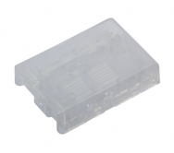

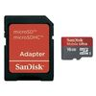
Advice RPi
Starters Advice
Buy a case
  SD-card-holder very fragile
  Solder-joints at the bottom
Availibility of an HDMI-screen
  Adapter will cost more then the RPi
Selection of SD-card
  Defines performance
  Not all SD-cards are performed (http://elinux.org/RPi_SD_cards)
What do you need?
  Compare...

Slide 20
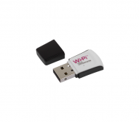
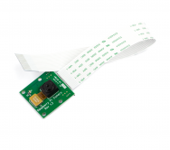
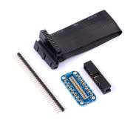
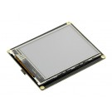
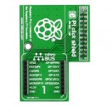
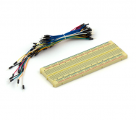
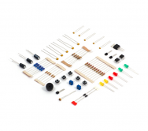
Advice RPi
Typical attributes
  WiFi Dongle
  Camera Module
  (connector foreseen)
  Cobbler
  LED-screens
  Shields
  Jumpwires, resistors,
  capacitors, ...

